Slide 2
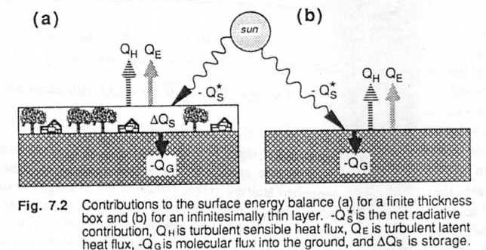
Heat Budget at the Surface

Slide 3
The energy budget for this layer, where upward fluxes are positive, is:
(7.2a)
or
(7.2b)
= net upward radiation at the surface
= represents the upward sensible hear flux out of the top
= represents the upward latent heat flux out of the top
= represents the upward molecular heat flux into the bottom
= denotes the storage or intake of internal energy (positive for warming and for chemical storage by photosynthesis).

Slide 4
The external forcing is , all the other terms are response terms.
Equation (7.2a) is in energy flux units such as or , while (7.2b) is in kinematic units such as .
Thus, the second equation is just the first equation divided by .
From section 2.6, we recall that and .

Slide 5
Very complex processes can occur within our imaginary layer, such as :
- Radiation between leaves, plants, buildings, and animals
- Turbulent circulations different from those higher in the boundary layer
- Vertical variations of the sensible and latent heat flux associated with evaporation and condensation
- Transpiration.
Because of this complexity, we have employed the simplification of a layer into which the net effect of all of the these processes can be lumped together as .

Slide 6
Sometimes, we prefer to conceptually employ an infinitesimally thin layer, as sketched in Fig. 7.2b. This is not a really layer, but a plane. The resulting surface heat budget is:

Slide 8
There can be no storage because there is no mass contained within a zero thickness layer.
The neglect of the storage layer works well for quasi-steady-state situation where there is no appreciable change in the mean temperature of that layer.
It also works well for flat barren land surfaces, and for waveless sea surfaces.

Slide 9
Day Over Land
During a late morning sunny day over land, is negative because there is more downward radiation entering the layer than leaving upward.
and are positive because of heat and moisture transport away upward from the surface.
is negative when heat is conducted downward into the ground from the warm surface ( see fig 7.3a).

Slide 10
Night Over Land
At night over land, is often positive because of the net upward longwave radiative cooling to space.
is negative because of downward heat flux from the air.
Dew or frost formation makes negative.
Conduction of heat from the warm ground up to the cooler surface makes positive .
The release of stored heat from the layer makes negative (see Fig 7.3b)

Slide 11
Surface Energy Balance Formulae
For the sensible and latent heat components in (1), general, closed-form solutions cannot be obtained. In lieu of such expressions the semiempirical relations (3) and (4) given below are commonly used.
These relations are based on simple, first-order solutions to the conversation equations for mass, momentum, and energy for the case when vertical transports is large in comparison with horizontal transport.
To be valid, these solutions require, among other thins, that the surface and the boundary layer be horizontally homogeneous; thus turbulent transport of heat and mass is one dimensional (vertical). Under such conditions:

Slide 12
Where :
H - sensible heat flux, W m;
Ρ - density of air, kg m;
Cp - specific heat of air, J kgºC;
Taero - reference height air temperature, ºC;
Ta - canopy temperature, ºC;
ra - aerodynamic resistance for heat and water vapor, s m-1.

Slide 13
In this formulation the aerodynamic resistance, ra , relates the vertical gradient in temperature, Taero – Ta, to the sensible heat flux.
The ra value is semiempirical and is intended to characterize the efficiency of the very complex transfer of heat by turbulent air movement through the canopy into the air above; ra is normally derived using empirical arguments to adjust the surface shear stress.
A number of such empirical formations are available for ra; we adopt one used successfully by Choudhury et al. [1986] for wheat, substituting parameters determined for prairie grass. This yields an expression for ra, see hall et al. [1991], given by

Slide 14
Where U is wide spread, m s-1; z is reference height for measurement of Ta and U, m; his height of canopy, m; and g is gravitational acceleration, m s-2.
Where,
e a - vapor pressure at reference height, mbar;
T a - air temperature at reference height, ºK;
e*( Taero) - saturated vapor pressure in the canopy air space, mbar;
- Psychometric constant, mbar ºK;
ρCp - as defined in (2);
g c - bulk stomatal conductance of canopy, m s;
g a - bulk aerodynamic conductance of canopy (1/ r), m s.

Slide 15
It is these first-order solutions to the turbulent transport equations which served as the primary model for investigation relationship between the properties of land surface vegetation, energy-mass balance, and remote sensing of these interactions in FIFE

Slide 16
References
Choudhury, B.J.,RJ.,R.J. Reginato, and S. B. Idso, An analysis of infrared temperature observation of wheat and calculation of latent heat flux, Agric. For. Meteorol., 37, 75-88, 1986.
Hall, F. G., K. F. Strebel, J. E. Nickeson, and S.J. Goetz, Radiometric Rectification: Toward a common radiometric response among multidate, multisensor images, Remote Sens. Environ., 35, 11 – 17, 1991a

Slide 17
Bowen ratio methods
The Bowen ratio, β, is defined as the ration of sensible to latent heat fluxes at the surface:
Where γ = Cp/ Lv 0.0004 ( g water/g air) ; K-1 is the psychometric constant. As one might expect, β is smaller over moist surfaces where most of the energy goes into evaporation, and layer over dry surfaces where most of the energy goes into sensible heating, typical values range from 5 over semi –arid regions, 0.5 over grasslands and forests, 0.2 over irrigated orchards or grass, 0.1 over the sea, to some negative values over oases.

Slide 18
It was once suggested that the Bowen ratio for surface were known, then the top ratio could be coupled with the bottom to give
Attempts to use this approach have mostly failed, because the Bowen ration usually varies with time and weather over site. Furthermore, the Evapotranspiration component of latent heat fluxes from plants. The pores, or stomates, of the plant open and close to regulate the life processes of the plant. Thus, the Stomatel resistance to water flux, or transportation, also varies.

Slide 19
Priestly – Taylor Method
The next level of sophistication ( Priestley and Taylor, 1972) comes by recognizing that to first order, we can use K-theory to approximate the fluxes by gradients of temperature and humidity in the Bowen ratio, assuming that K = K:
Where is the dry adiabatic lapse rate of 9.8 K/km. if the air is saturated (i.e., if q = q), then the change of specific humidity with temperature is given by the Clausius- Clapeyron equation:
Where ε = 0.622 (g water/g air) is the ration of gas constants for sir and water vapor.
We can use a variation of Teten’s formula (Bolton, 1980) to find q as a function of temperature.

Slide 20
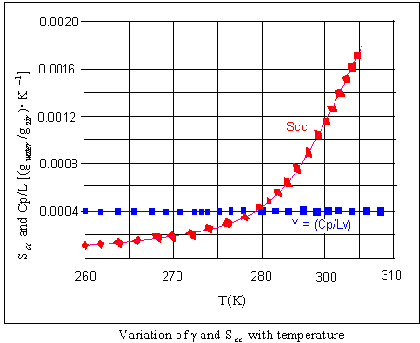

Slide 21
where:
for T in degrees Kelvin.
Both scc ) and γ = Cp/Lv are plotted in Fiq. 7.14 for easy reference. If we replace by ,then:

Slide 22
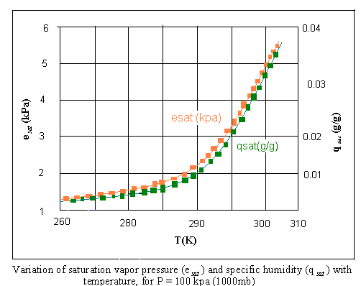

Slide 23
Remembering that is like a conductance for moisture, we see that surfaces with greater water conductive surfaces.
Alternately, we can view the parameterization via the concept of resistance to transfer. Physically, we would expect that surface/plant systems with less resistance to moisture transport would have greater evaporation, with the resulting reduction in sensible heat flux.
For example, the air resistance, ra to transfer of water vapor away from a plant stomata into the air is just the inverse of the conductance introduced earlier:

Slide 24
The total resistance of the plant, rp, is governed by the movement of water from the ground through the roots up into the plant to the cavity of the stomata where it is finally transpired into the air. We can combine that air and plant resistance to rewrite the correction term as:
This expression for Fw is equivalent to the one written earlier.
The topic of fluxes across vegetation systems is a complex one that we have barely parameterized above. A more detailed analysis should include factors such as canopy height, vegetation coverage, displacement heights, roughness lengths, plant reflectivity, plant architecture, root zone depth, ground water depth, heat conductivity, soil moisture, and stomatel resistance.
These topics are beyond the scope of the is book (see Verna, et all., 1986; Brutsert, 1978; Geiger, 1965).

Slide 25
If one neglects the last term in (7.5.2f), then substitution of (7.5.2f) back into (7.5.1b & c) yields the Priestly – Taylor parameterization:
where the parameter αpt is introduced to make up for neglecting the last term in (7.5.2f), and to allow the equation to be used for unsaturated conditions (DeBruin an Keijamn, 1970; DeBruin, 1983). For well-watered surfaces, α1.25.
The Priestley- Taylor method can yield incorrect fluxes when advection is happening. Although one possible fix is to increase the magnitude of α, many investigators (McNaughton, 1976 & b; Singh and Taillefer, 1986) prefer to add an additional advection term, A, to the moisture flux equation to yield:
QE = [ scc/( scc+ γ)] . (-Q*s + Q) + A. This same advection term must be subtracted from the equation for heat flux.

Slide 26
Penman-Monteith method
One way to include the evaporative cool effects such as occurs during advection is via a correction term, Fw, added to the priestly-Taylor parameterization for Q and subtracted from hat for QH, to yield the Penman-Monteith (Penman, 1948; Monteith, 1965; DeBruin and Holtslag, 1982)form:
Where XG is like a relative humidity of the earth or plant surface. Fw is like a specific humidity flux, and is approximated by a bulk transfer law of the form:
Fw = C(X - X). , ,where Xs is the relative humidity of the air near the surface.

Slide 28
Surface fluxes— Drag and Bulk Transfer Methods
In 1916, it was suggested that a velocity squared law might be used to describe the drag of the atmosphere against the earth’s surface.
Using as a measure of surface stress associated with drag, we find that

Slide 29
is called the drag coefficient for momentum transfer.
it is still a bulk transfer coefficient, and sometimes is written as in the literature.
The individual components of surface stress are correspondingly given by the drag laws:

Slide 30
.
The three factors , , and should all correspond to the same height above the surface.
10 m is assumed as the standard height.

Slide 31
Similar expressions can be used to parameterize surface heat and moisture fluxes:
subscript denotes “on the ground or sea surface”.

Slide 32
The parameters and are the bulk transfer coefficients for heat and moisture,
Sometimes, is called the Stanton number.
For statically neutral conditions (subscript N), it is often assumed that
Typical values range from to (dimensions).

Slide 33
The subscript represents values in the air near the surface.
The subscript means the value in the top 1 mm of the soil or sea surface, or just the top few molecules of the soil or sea.

Slide 34
Over the sea, it is assumed that air in the micro layer is saturated.
Over the land, the soil surface temperature and moisture depend on many factors, and are not easily approximated.
One approach is to include forecast equations for the temperature and moisture for a thin layer soil.
Another approach, for temperature, is to radiometrically measure the surface skin temperature

Slide 36
One measure of roughness is the spacing density of individual obstacles or roughness elements.
If we imagine that a large box could be placed over one whole plant or tree that would just touch the top and sides of the plant, then the volume of this box represents the space taken by the plant. The total surface area of the plant, including the area of both sides of each leaf can theoretically be measured or estimated.

Slide 37
The area density of roughness elements, , is the plant surface-area divided by the space volume. A dimensionless canopy density, , can be defined by:
is the drag coefficient associated with an individual roughness element
is the average height of the canopy

Slide 38
The value of the transfer coefficients increase as the canopy density increases
For dimensionless canopy densities greater than about 0.4 to 1.0, however, the bulk transfer coefficients decrease.
This happens when the roughness elements are so close together that they begin to appear to the wind as a solid smooth surface displaced above the ground.

Slide 39
Another measure of the surface roughness is the aerodynamic roughness length,
It is on the order of centimeters over grass and crops, and on the order of meters over sparse forests and towns.
This roughness measure is based on the observed wind shear in the surface layer

Slide 41
Over oceans, the drag laws are a bit easier to parameterize, because the roughness length associated with ocean wave height is a known function of surface stress or wind speed: (known as Charnock’s relation(1955))
(7.4.1h)

Slide 42
Stronger wind stress makes higher waves, which results in a greater roughness length.
The application of roughness length to bulk transfer is tied to the topic of measurement heights.

Slide 43
The relationship between drag coefficients, measurement height, and surface roughness under statically neutral conditions in the surface layer over either land or oceans is given by:

Slide 44
For oceans, (7.4.1i) can be combined with Charnock’s relationship to give
which yields a surface stress of:

Slide 45
Occasionally, numerical modelers use constant drag values for simplicity, such as the value of based on 10 m winds

Slide 48
Dependence on Stability.
Statically unstable flows cause a greater transport rate across an interface than statically neutral flows, which in turn transport more than stable flows.
Sometimes Richardson numbers are used as a measure of stability, while at other times is used.

Slide 49
The dimensionless wind shear, , and lapse rate, , can be used with surface-layer similarity theory to give stability correction terms and . This yields:

Slide 50
Surface Fluxes— Geostrophic Drag
Deacon (1973), Clarke and Hesse (1974), Melgargejo and Deardorff (1974), Arya (1975), Nicholls (1982), and Grant and Whiteford (1987) parameterized surface fluxes in terms of geostrophic wind, using

Slide 51
is the magnitude of the geostrophic wind, and
is called the geostrophic drag coefficient.
This parameterization is not as accurate as the one using surface wind, and should be avoided unless you have no choice.

Slide 52
Although we are defining geostrophic drag based on , some investigators use instead.
Be careful to check which definition is used for when comparing values reported in the literature.
One parameterization for the neutral geostrophic drag coefficient is

Slide 53
is the surface Rossby number.
Over oceans, Charnock’s relationship gives (for geostrophic winds in m/s):
(at 45ºN)

Slide 55
Entertainment into the Top of the Mixed Layer
The top of the mixed layer sometimes behaves like a boundary, where the fluxes across it are controlled by entertainment mechanism.
When (7.4a) and (7.4c) are combined with the definition that , then:

Slide 56
Using the mixing ratio example (where denotes the value just: above )

Slide 57
The left hand side can be rewritten as
, where
represents an average within the mixed layer.
Combining the first term from this expansion with the last term on the right hand side, and dividing by z, gives:

Slide 58
Using (in the absence of subsidence or clouds) and .
we know that the change in moisture in the mixed layer is caused by various sources and sinks,
Hence:

Slide 59
We could conclude that
Remember that this interfacial flux occurs only when there is turbulent entertainment of air across the capping interface.

Slide 61
Energy Balance at the Earth Surface
The main part of the energy absorbed at the surface is used to evaporate water, another part is lost to the atmosphere as sensible heat, and a smaller part is lost to the underlying layers or used to melt snow and ice. Thus, there are essentially four types of energy fluxes at the earth’s surface. They are the net radiation flux F_{rad}, the (direct) sensible heat flux F_{SH}↑, the (indirect) latent heat flux F_{LH}↑, and the heat flux into the subsurface layers F_{G}↓. Under steady conditions the balance equation for the energy is given by
F^{sfc}_{rad} - F_{SH}↑ - F_{LH}↑ - F_{G}↓ - F_{M} = 0

Slide 62
These surface fluxes are associated with land processes and depend on:
vertical stability; roughness
surface temperature
subsurface heat conduction
vegetation
surface hydrological balance
potential evapotranspiration
radiative flux

Slide 63
Theoretical aspects of satellite remote sensing of energy balance
Thermal equilibrium at the surface is maintained by a combination of thermodynamic and physiological processes.
The net energy absorbed by the surface through radiative processes, net radiation R_{n}, must be balanced by that transported to the atmosphere and ground (sensible, latent, and ground heat flux):
R_{n} = H + LE + G.
(1)
R_{n} is simply the difference between the incident and reflected shortwave radiation and the incident and emitted long wave radiation at the surface, that is:
R_{n} = S{1 - α} + L_{wd} - L_{wu},
(2)
where S is downwelling shortwave radiation energy flux (Wm⁻²).

Slide 64
Surface energy balance formulae
For the sensible and latent heat components in eq. 1, closed-form solutions cannot be obtained. Commonly used semi-empirical relations are:
For Sensible heat:
H = ρC_{p} (T_{aero} - T_{a})/r_{a}
(3)
where H sensible heat flux, W m⁻²; ρ density of air, kg m⁻³;
C_{p} specific heat of air, J kg^{-1 o}C⁻¹;
T_{a} reference height air temperature, ºC;
T_{aero} canopy temperature, ºC;
r_{a} aerodynamic resistance for heat and water vapor, s m⁻¹.

Slide 65
In this formulation the aerodynamic resistance, r_{a}, relates the vertical gradient in temperature, T_{aero} - T_{a,} to the sensible heat flux.
The r_{a} value is semi-empirical and is intended to characterize the efficiency of the very complex transfer of heat by turbulent air movement through the canopy into the air above; r_{a} is normally derived using empirical arguments to adjust the surface momentum transfer coefficient, a term that relates the vertical gradient in boundary layer wind speed to surface shear stress.
A number of such empirical formulations are available for r_{a} ( see Hall et al,. 1991), such as:

Slide 66
ln(z − 0.56h) ln[(z − 0.56h) / (0.0189h)]
,
where U is windspeed, m s⁻¹; z is reference height for measurement of T_{a} and U ; h is height of canopy (m); and g is gravitational acceleration, m s⁻².
For more details and additional formulation for Aerodynamic Resistance see the provided paper:
Measurement and estimation of the aerodynamic resistance
S. Liu, D. Mao, and L. Lu
^{ra =} 0.16U {1 + [5g(z − 0.56h)(T
− T ) / T U ² ]}^{3/4}
a a
aero

Slide 67
For latent heat:
LE = ρC_{p}[e*(T_{aero})- e_{a})](g_{c}g_{a})/γ(g_{c} + g_{a}),
(5)
•
where e_{a}
T_{a}
e*(T_{aero}) mbar;
psychometric constant, mbar ºk⁻¹; as defined in (2);
bulk stomatal conductance of canopy, m s⁻¹; bulk aerodynamic conductance of canopy (1/ r_{a}), m
vapor pressure at reference height, mbar; air temperature at reference height, ºk;
saturated vapor pressure in the canopy air space,
•
•
•
g_{a s}-1.
γ
ρC_{p}
g_{c}
•
These first-order solutions to the turbulent transport equations served as the primary model for investigating relationship between the properties of land surface vegetation, energy- mass balance, and remote sensing of these interactions in FIFE.

Slide 68
Sensible heat
For H in (3), remote sensing measures of surface radiometric temperature have been evaluated as a surrogate for T_{aero}.
•
However, T_{aero} is not explicitly T_{rad} but, as discussed above, a theoretical construct that parameterizes a “convective” temperature. Vining and Blad (1991) investigated the relationship between T_{aero} and T_{rad}.

Slide 69
Latent heat
For latent heat estimation (eq. 5) the main focus of remote sensing techniques is the conductance term g_{c} and the T_{aero} term in estimating canopy air-space vapor pressure.
The canopy conductance term g_{c} can be
modeled after Jarvis (1976) as a product of functions with range (0, 1) where each function characterizes the dependence of g_{c} on APAR (absorbed PAR), δe, T, and leaf water potential
ψ.

Slide 70
That is:
g = g (APAR)g(δe)g(T
)g(ψ)
(6)
*
c c aero
where g* (APAR) is “unstressed” canopy
c
conductance and g (δe), g (T_{aero}), g (ψ) are
functions with ranges (0, 1) describing the fraction of stomatal closure by vapor pressure deficit, leaf temperature, and leaf water
potential.
The most accurate method to estimate turbulent fluxes is the “Eddy Correlation Method “to be explained in what follows:

Slide 71
What is Flux
Flux – how much of something moves through a unit area per unit time
Flux is dependent on: (1) number of things crossing the area; (2) size of the area being crossed, and (3) the time it takes to cross this area

Slide 72
Flux Measurements
Flux measurements are widely used to estimate heat, water, and CO₂ exchange, as well as methane and other trace gases
Eddy Covariance is one of the most direct and defensible ways to measure such fluxes
The method is mathematically complex, and requires a lot of care setting up and processing data .

Slide 73
“A Brief Practical Guide to Eddy Covariance Flux Measurements: Principles and Workflow Examples for Scientific and Industrial Applications”
G. Burba and D. Anderson of LI-COR Biosciences
To help a non-expert gain a basic understanding of the Eddy Covariance method and to point out valuable references
To provide explanations in a simplified manner first, and then elaborate with specific details

Slide 74
Introduction
The Eddy Covariance method is one of the most accurate, direct and defensible approaches available to date for measurements of gas fluxes
and monitoring of gas emissions from areas with sizes ranging from a few hundred to millions of square
meters
The method relies on direct and very fast measurements of actual gas transport by a 3-D wind speed in real time in situ, resulting in calculations
of turbulent fluxes within the atmospheric boundary layer

Slide 75
Modern instruments and software make this
method easily available and potentially widely-used in studies beyond micrometeorology, such as in ecology, hydrology, environmental and industrial monitoring, etc.
Main challenge of the method for a non- expert is the shear complexity of system design, implementation and processing the large volume of data

Slide 76
The Eddy Covariance method provides measurements
of gas emission and also allows measurements of fluxes of sensible heat, latent
heat and momentum, integrated over an area.
This method was widely used in micrometeorology for over 30 years, but now, with firmer
methodology and more advanced instrumentation, it can be available to any discipline, including science, industry, environmental monitoring and inventory.

Slide 78
AOSC624 Class 23: May 3, 2012
Surface albedo
NDVI
Remotely sensed information on surface albedo and NDVI is used in climate modeling and research.
Above parameters and surface temperature and radiative fluxes needed for surface energy balance.

Slide 79
First, some augmentation of last lecture on: Surface Fluxes Must account for transfer of latent heat, which depends on rate of evapotranspiration. Model must know if vegetation is transpiring fully or if under water stress.
Moisture moves through the canopy and also from canopy level to the atmosphere. Since these are two processes and need to be combined, it is easier to introduce the concept of “resistence” to the flow of moisture than deal with transfer coefficient (can combine them in parallel like in Ohm’s Law)

Slide 81
Typical representation of wind and temperature profiles in the surface layer

Slide 84
Info from Remote Sensing

Slide 88
Aerodynamic Resistance
The aerodynamic resistance controls the rate of water vapor
transfer away from the surface and is intuitively inversely
proportional to the wind speed. It can be expressed for
conditions of neutral stability as:

Slide 92
SURFACE ALBEDO
Albedo=radiation reflected from a surface/radiation incident on the surface
Surface albedo generally refers to the total solar spectrum integrated over all angles. Albedo is used in climate to form surface energy budgets. For this purpose, the integrated albedo is needed.
TWO options for measuring albedo measure in broadband
1a) do atmospheric correction; gives you surface broadband reflectance
APPROACH 1 = assume isotropy to get albedo
APPROACH 2 = use surface bi-directional models
APPROACH 3 - borrow top of atmosphere bi-directional models

Slide 93
1b) (same thing, different order)
take broadband reflectance at top of atmosphere,
apply bi-directional model of top of
atmosphere,
get top of atmosphere broadband albedo,
do atmospheric correction applied to total flux to get surface albedo.
measure narrowband-spectral reflectance (more complicated because we have to integrate over spectral intervals and account for angular variability)

Slide 94
2a) apply atmospheric correction to get surface spectral reflectance; do APPROACH 1, 2, or 3, but also must do spectral integration; need a model of spectral characteristics of surface type to do spectral integration.
Albedo of snow, clouds, ice, water:
Fresh snow 75 to 95
Clouds (thick) 60 to 90
Clouds (thin) 30 to 50
Ice 30 to 40
Water 10
Earth and atmosphere 30

Slide 95
Incident radiation includes beam and/or diffuse radiation. Reflected radiation however, depends on surface properties.
The two limiting characteristics of a surface reflectivity are Diffuse and Specular.
Isotropic Diffuse Reflection has equal magnitude in all directions. After reflection from a diffuse surface, all signs of the incident radiation are completely obliterated.
Anisotropic Diffuse Reflection has greater magnitude away from the incident angle of radiation.
Specular surfaces are very smooth with respect to the wavelength of the incident radiation.
Perfectly Specular has equal angles of incidence and reflectance.
Bidirectionally Spectral has unequal angles of incidence and reflectance.
Each method of finding surface albedo has some faults.
An inverted pyranometer is capable of obtaining upwelling radiation.
To design satellite instruments requires knowledge of surface spectral and angular properties.

Slide 96
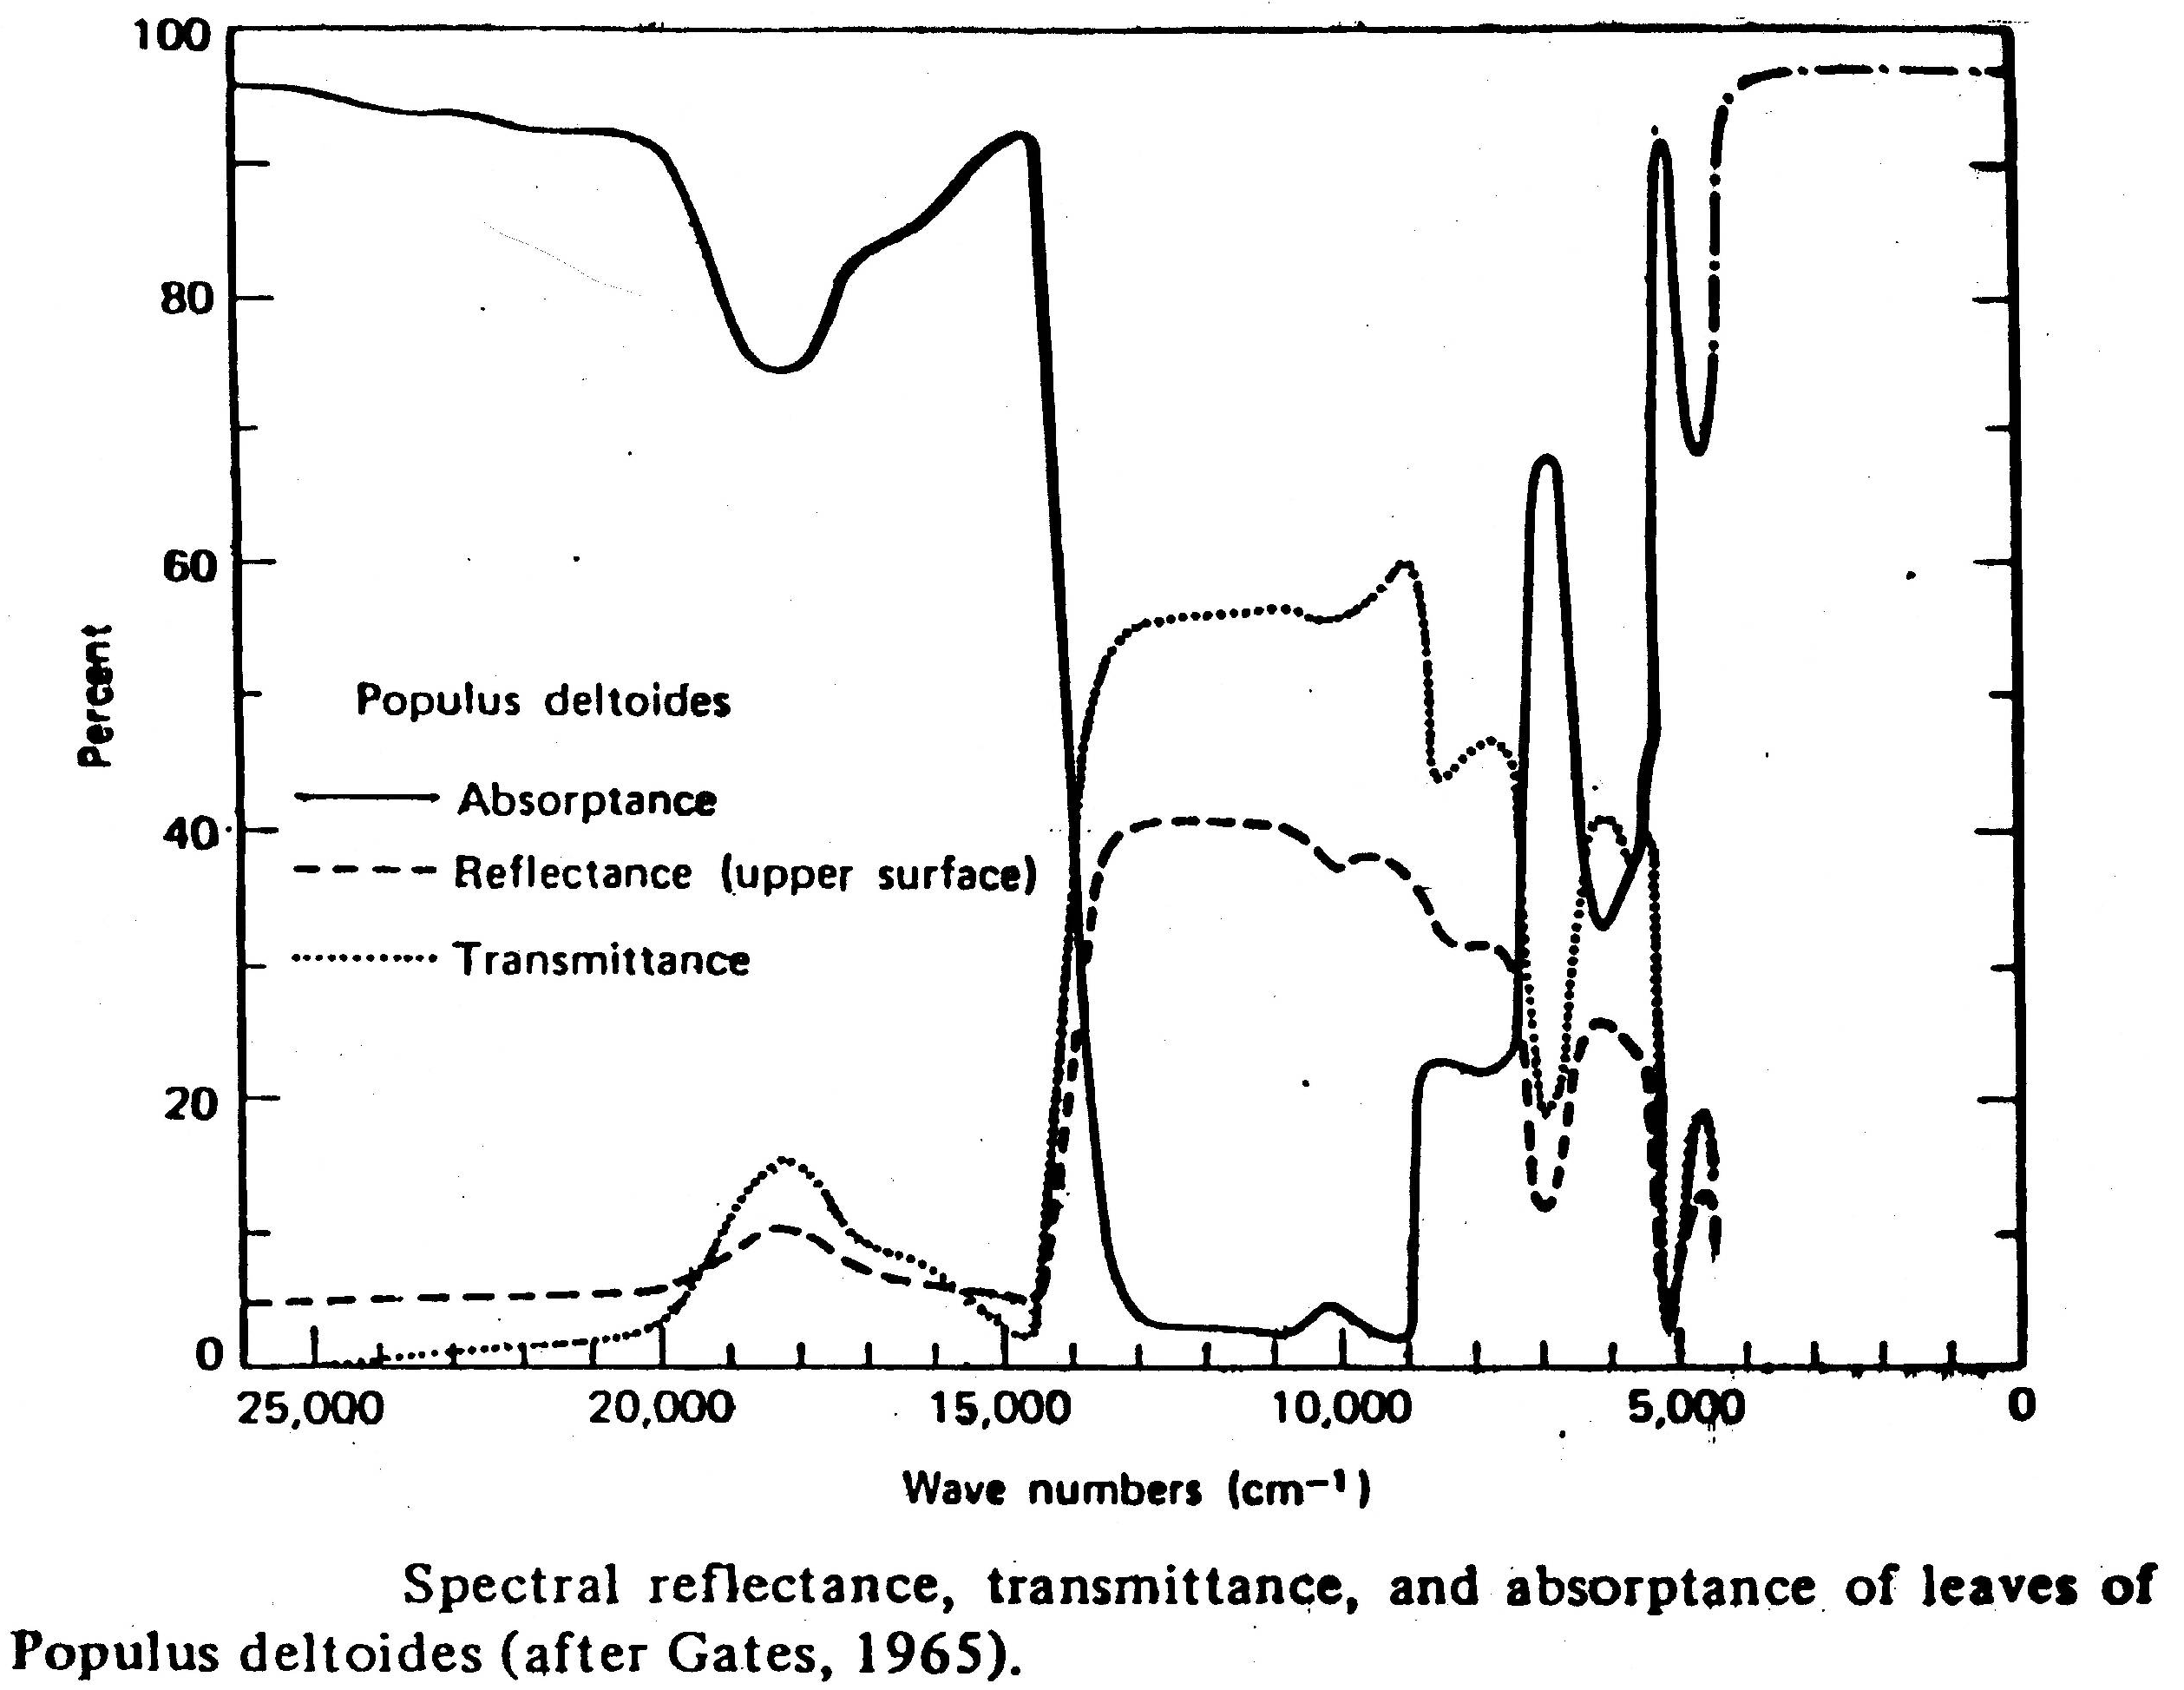

Slide 97
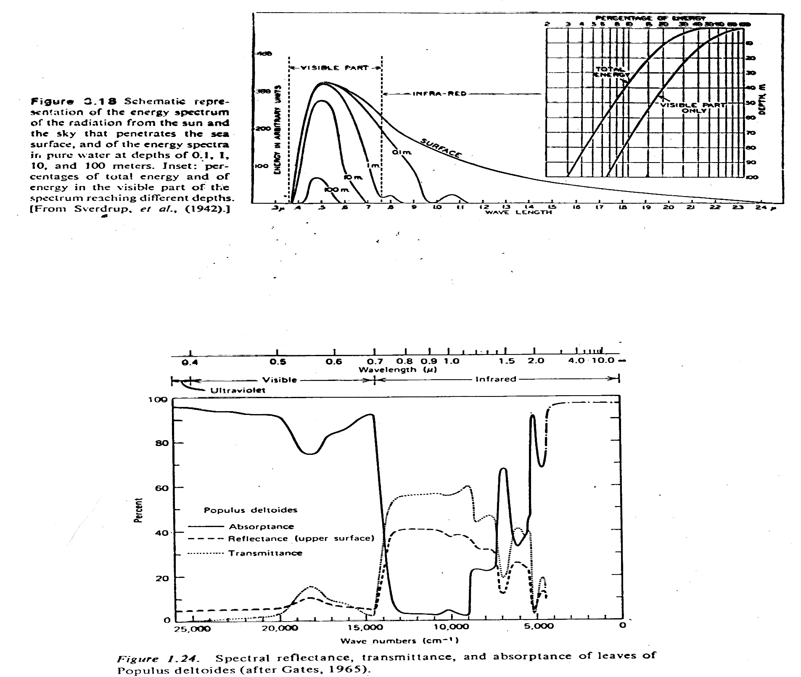

Slide 98
Example how NDVI is used in operations:
ENCEP Eta Model:
Regional mesoscale model used by NOAA for forecasting. Has 40 km resolution.
If NDVI is used as average index for a grid box large errors are obtained in Eta model output. If NDVI is used in conjunction with area distribution within that box, a better output results from Eta model.

Slide 99
Leaf Area Index (LAI)
Provides information for inside of canopy; amount of green leaf per unit area of the surface
Beer's Law I = I_{o} * e^{(-LAI * t)}
where t = transmission
LAI acts as an extinction coefficient for radiation going through canopy to surface.
Photosynthesis depends on photosynthetically active radiation (PAR) (0.4 - 0.7μm)
Absorbed PAR ~ NDVI
APAR = absorbed photosynthetically active radiation

Slide 100
Soil moisture
Attempts have been made to derive soil moisture from:
Visible
IR
Microwave
Physical principles for visible:
Surface albedo changes with soil moisture content. Many satellites look at surface albedo with the goal of getting soil moisture.
wet soil = lower albedo
dry soil = higher albedo
A profile of abedo depends on time and shows a "U" shape, noon occurring at the bottom of the "U" .
Idso, S. B. et al., 1975. The dependence of bare soil albedo on soil water content. J. Applied Meteor., 14, 109-113

Slide 101
Physical principles for IR:
Thermal Inertia
P=(ρcλ)^{1/2}
Where ρ=density of soil (gm-cm⁻³)
C=heat capacity (cal-gm⁻¹-⁰ C⁻¹
λ=thermal conductivity (cal-cm-1-sec⁻¹-⁰ C⁻¹)
The Heat Capacity Mapping Mission (HCMM) was designed to sense the magnitude of the diurnal temperature cycle by obtaining thermal data at the peak of the cycle and near the early morning minimum. The amplitude depends on soil moisture. HCMM was the first of planned series of Application Explorer Missions (AEM), which involved the placement of a small spacecraft in a special orbit.

Slide 102
Diurnal variation of surface temperature as a function of thermal inertia

Slide 103
After T. Schmugge

Slide 104
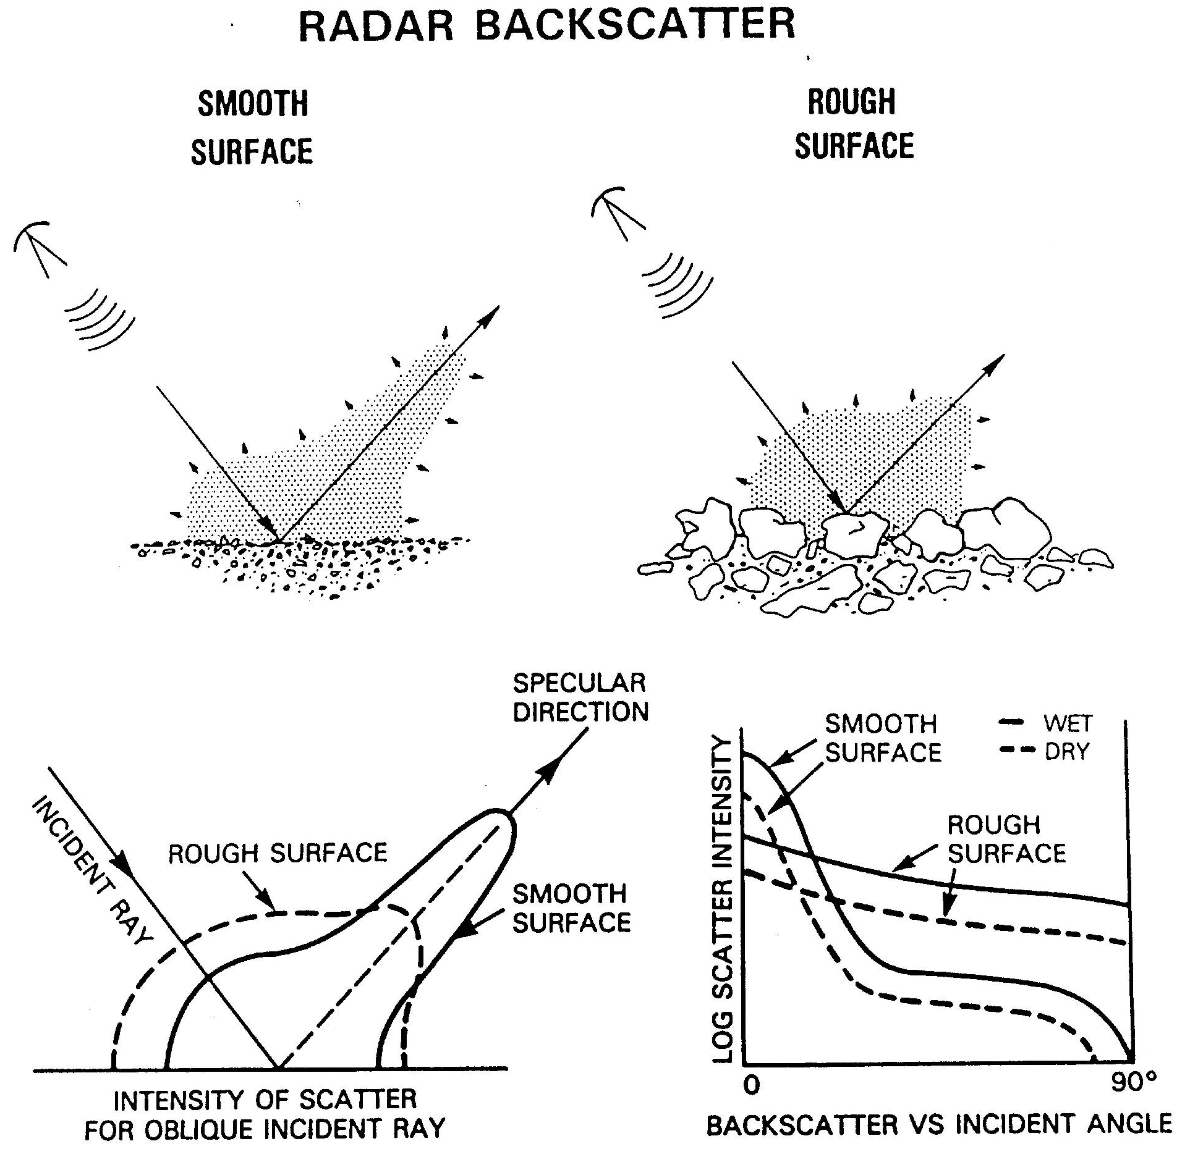

Slide 107
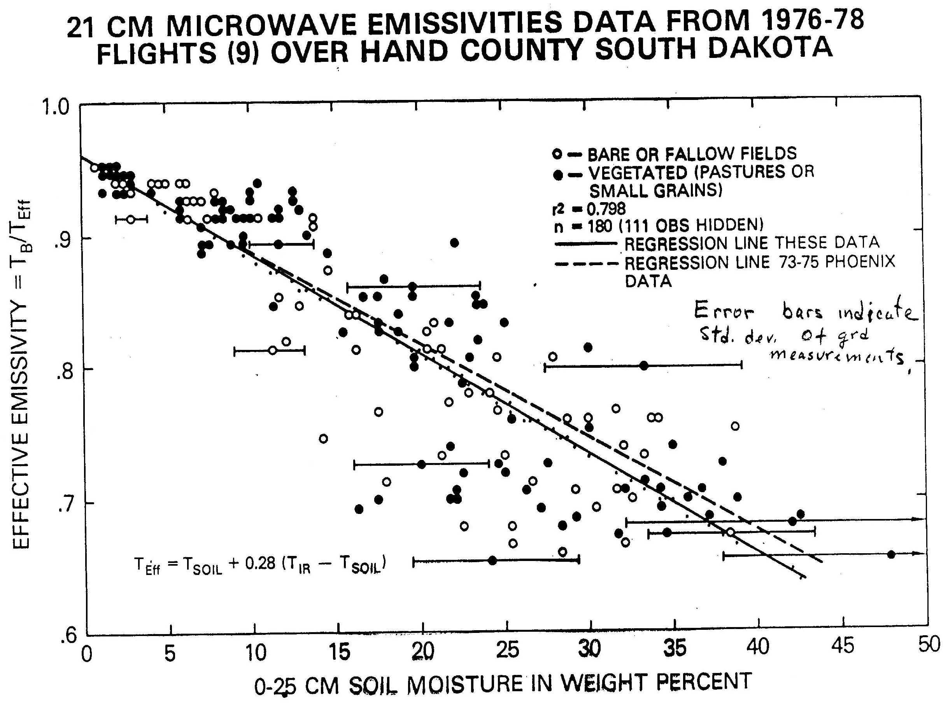

Slide 108
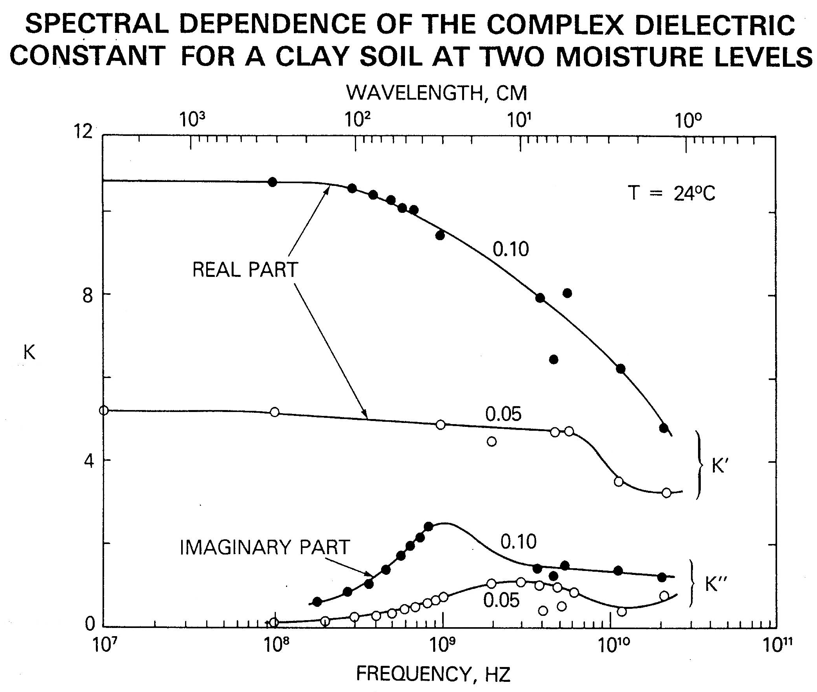

Slide 110
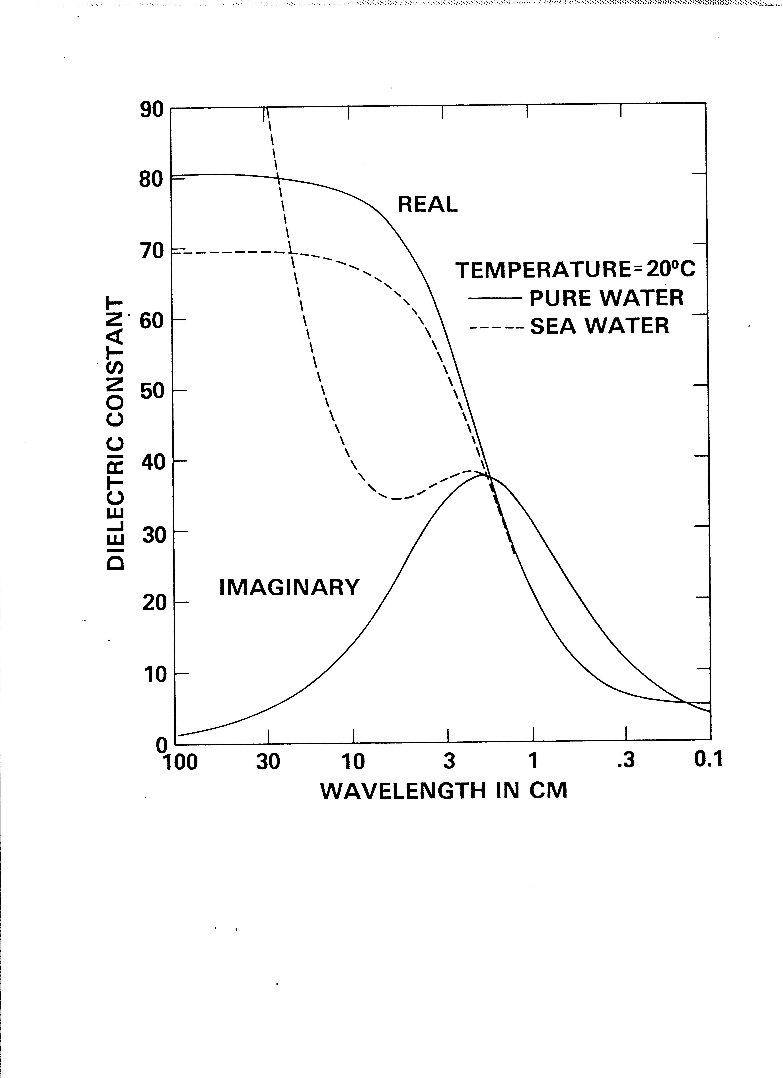

Slide 111
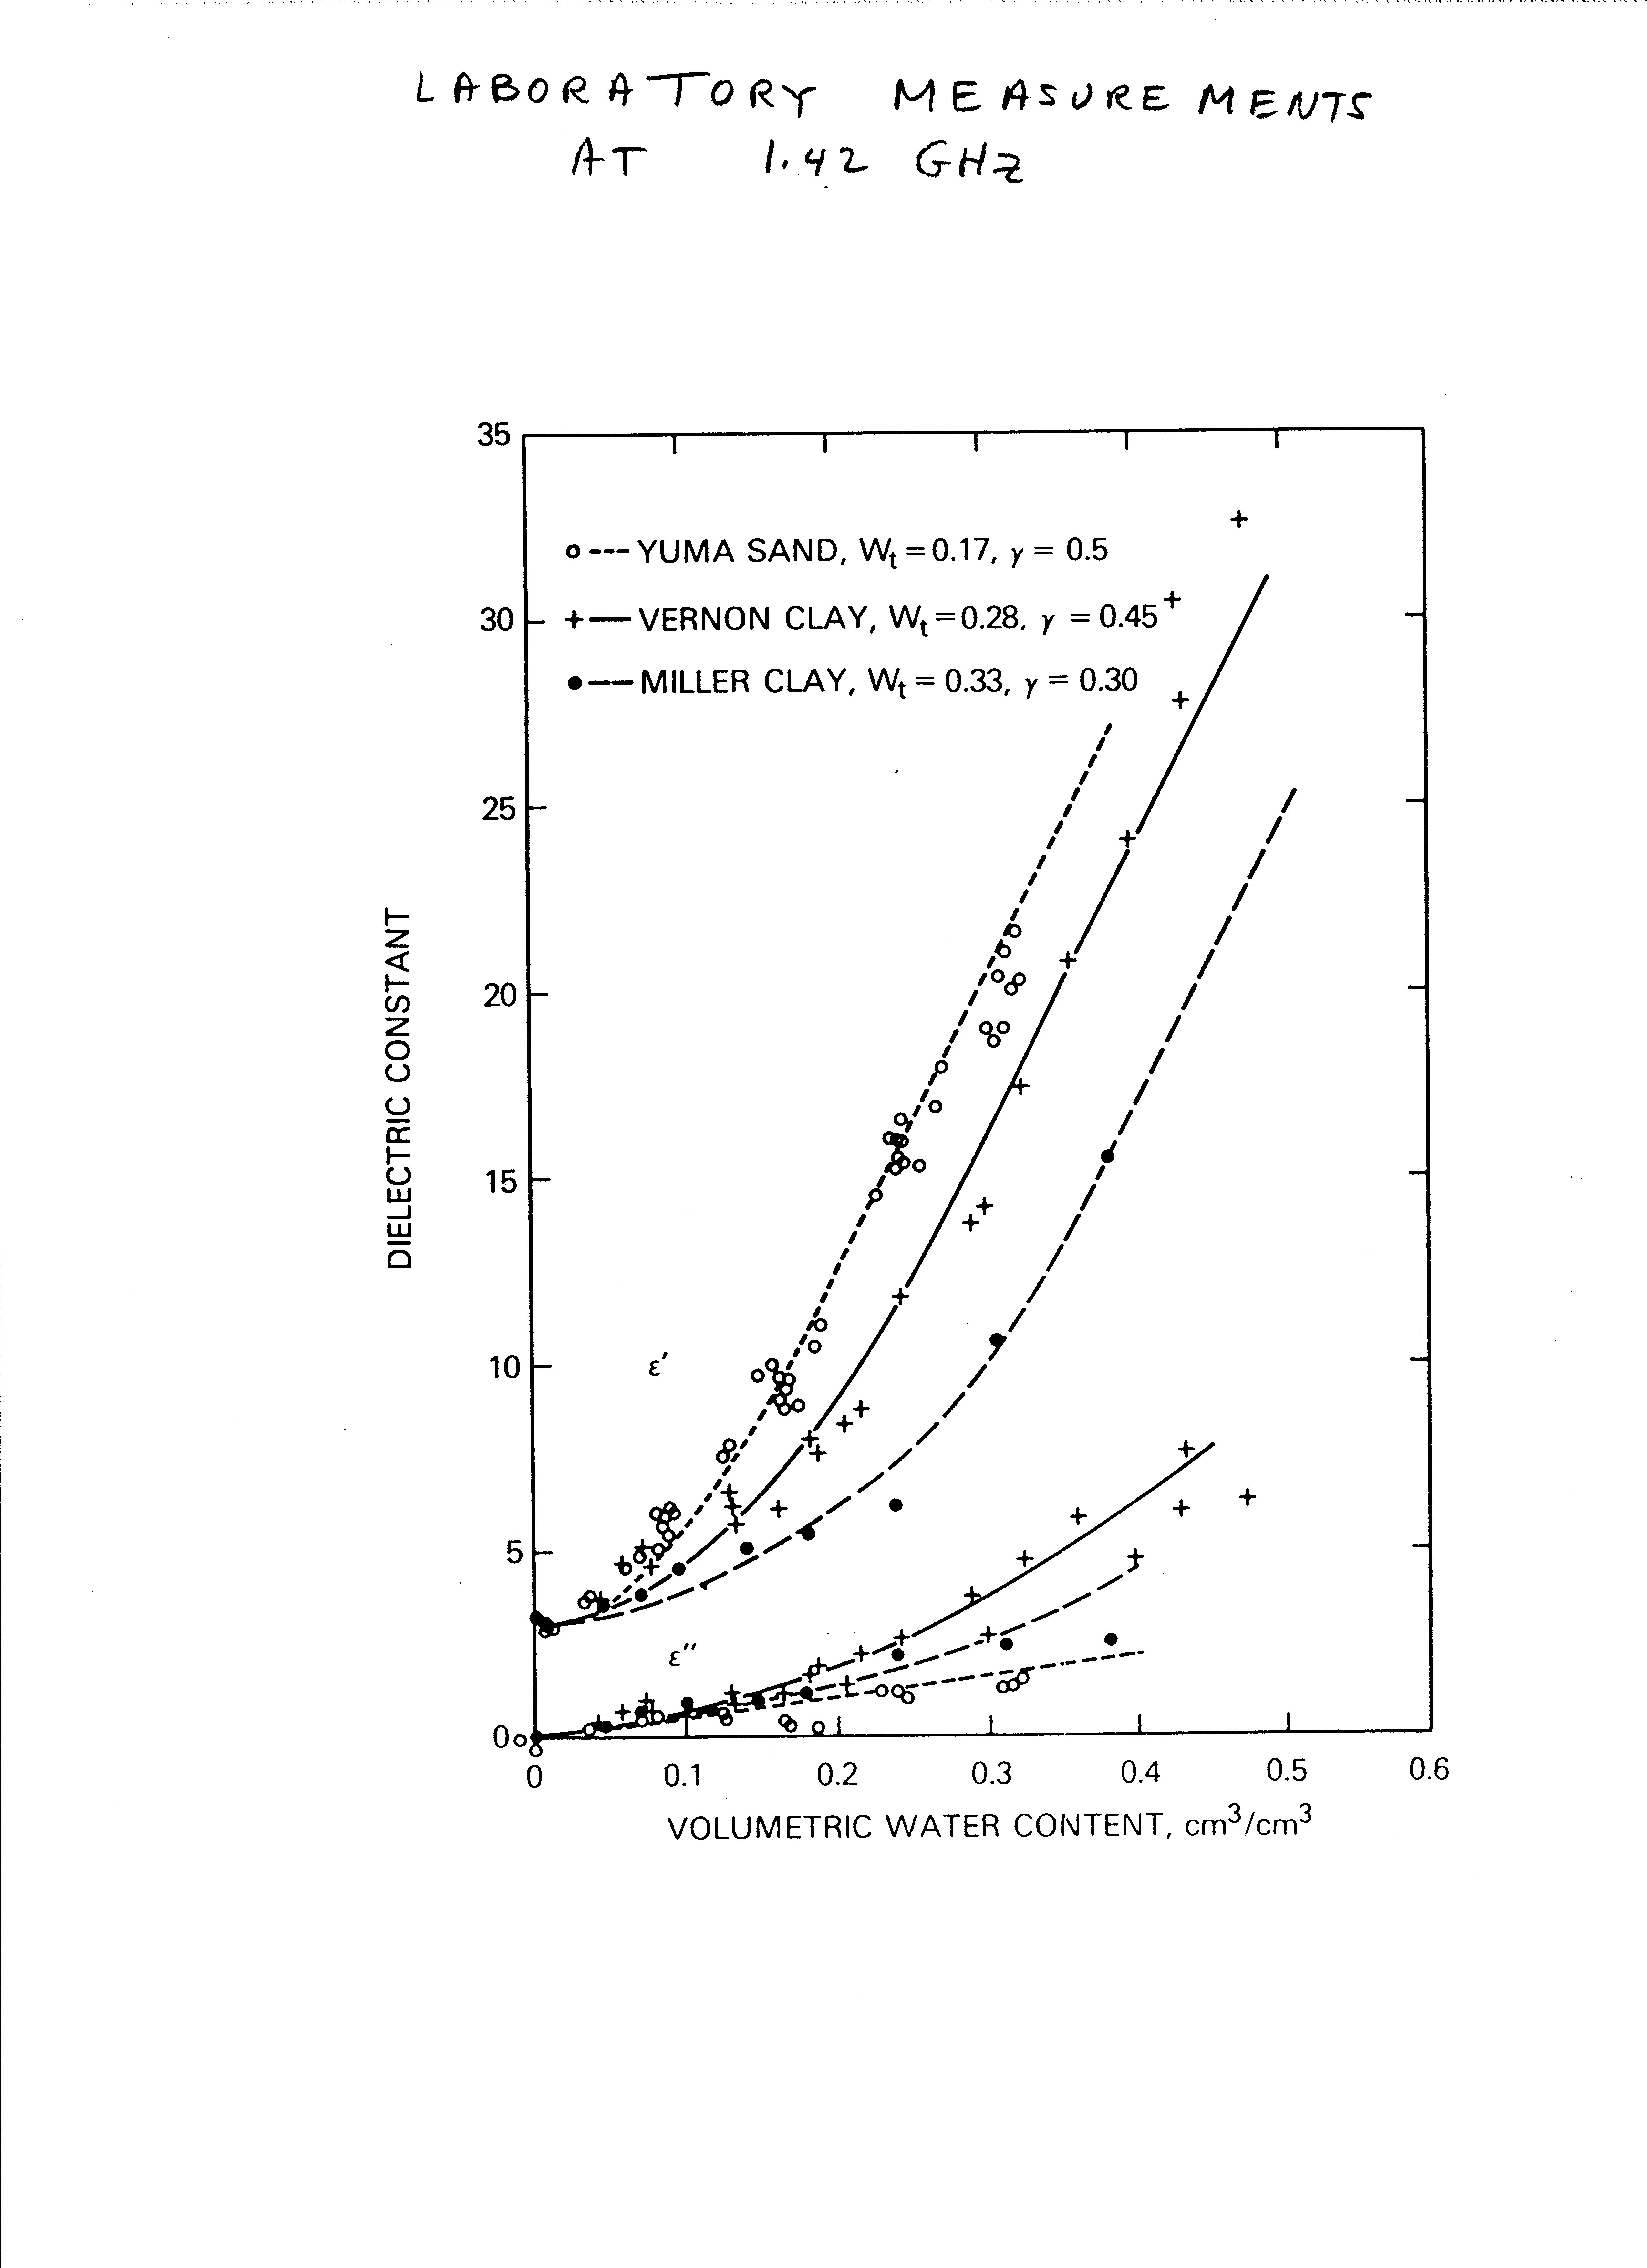

Slide 112
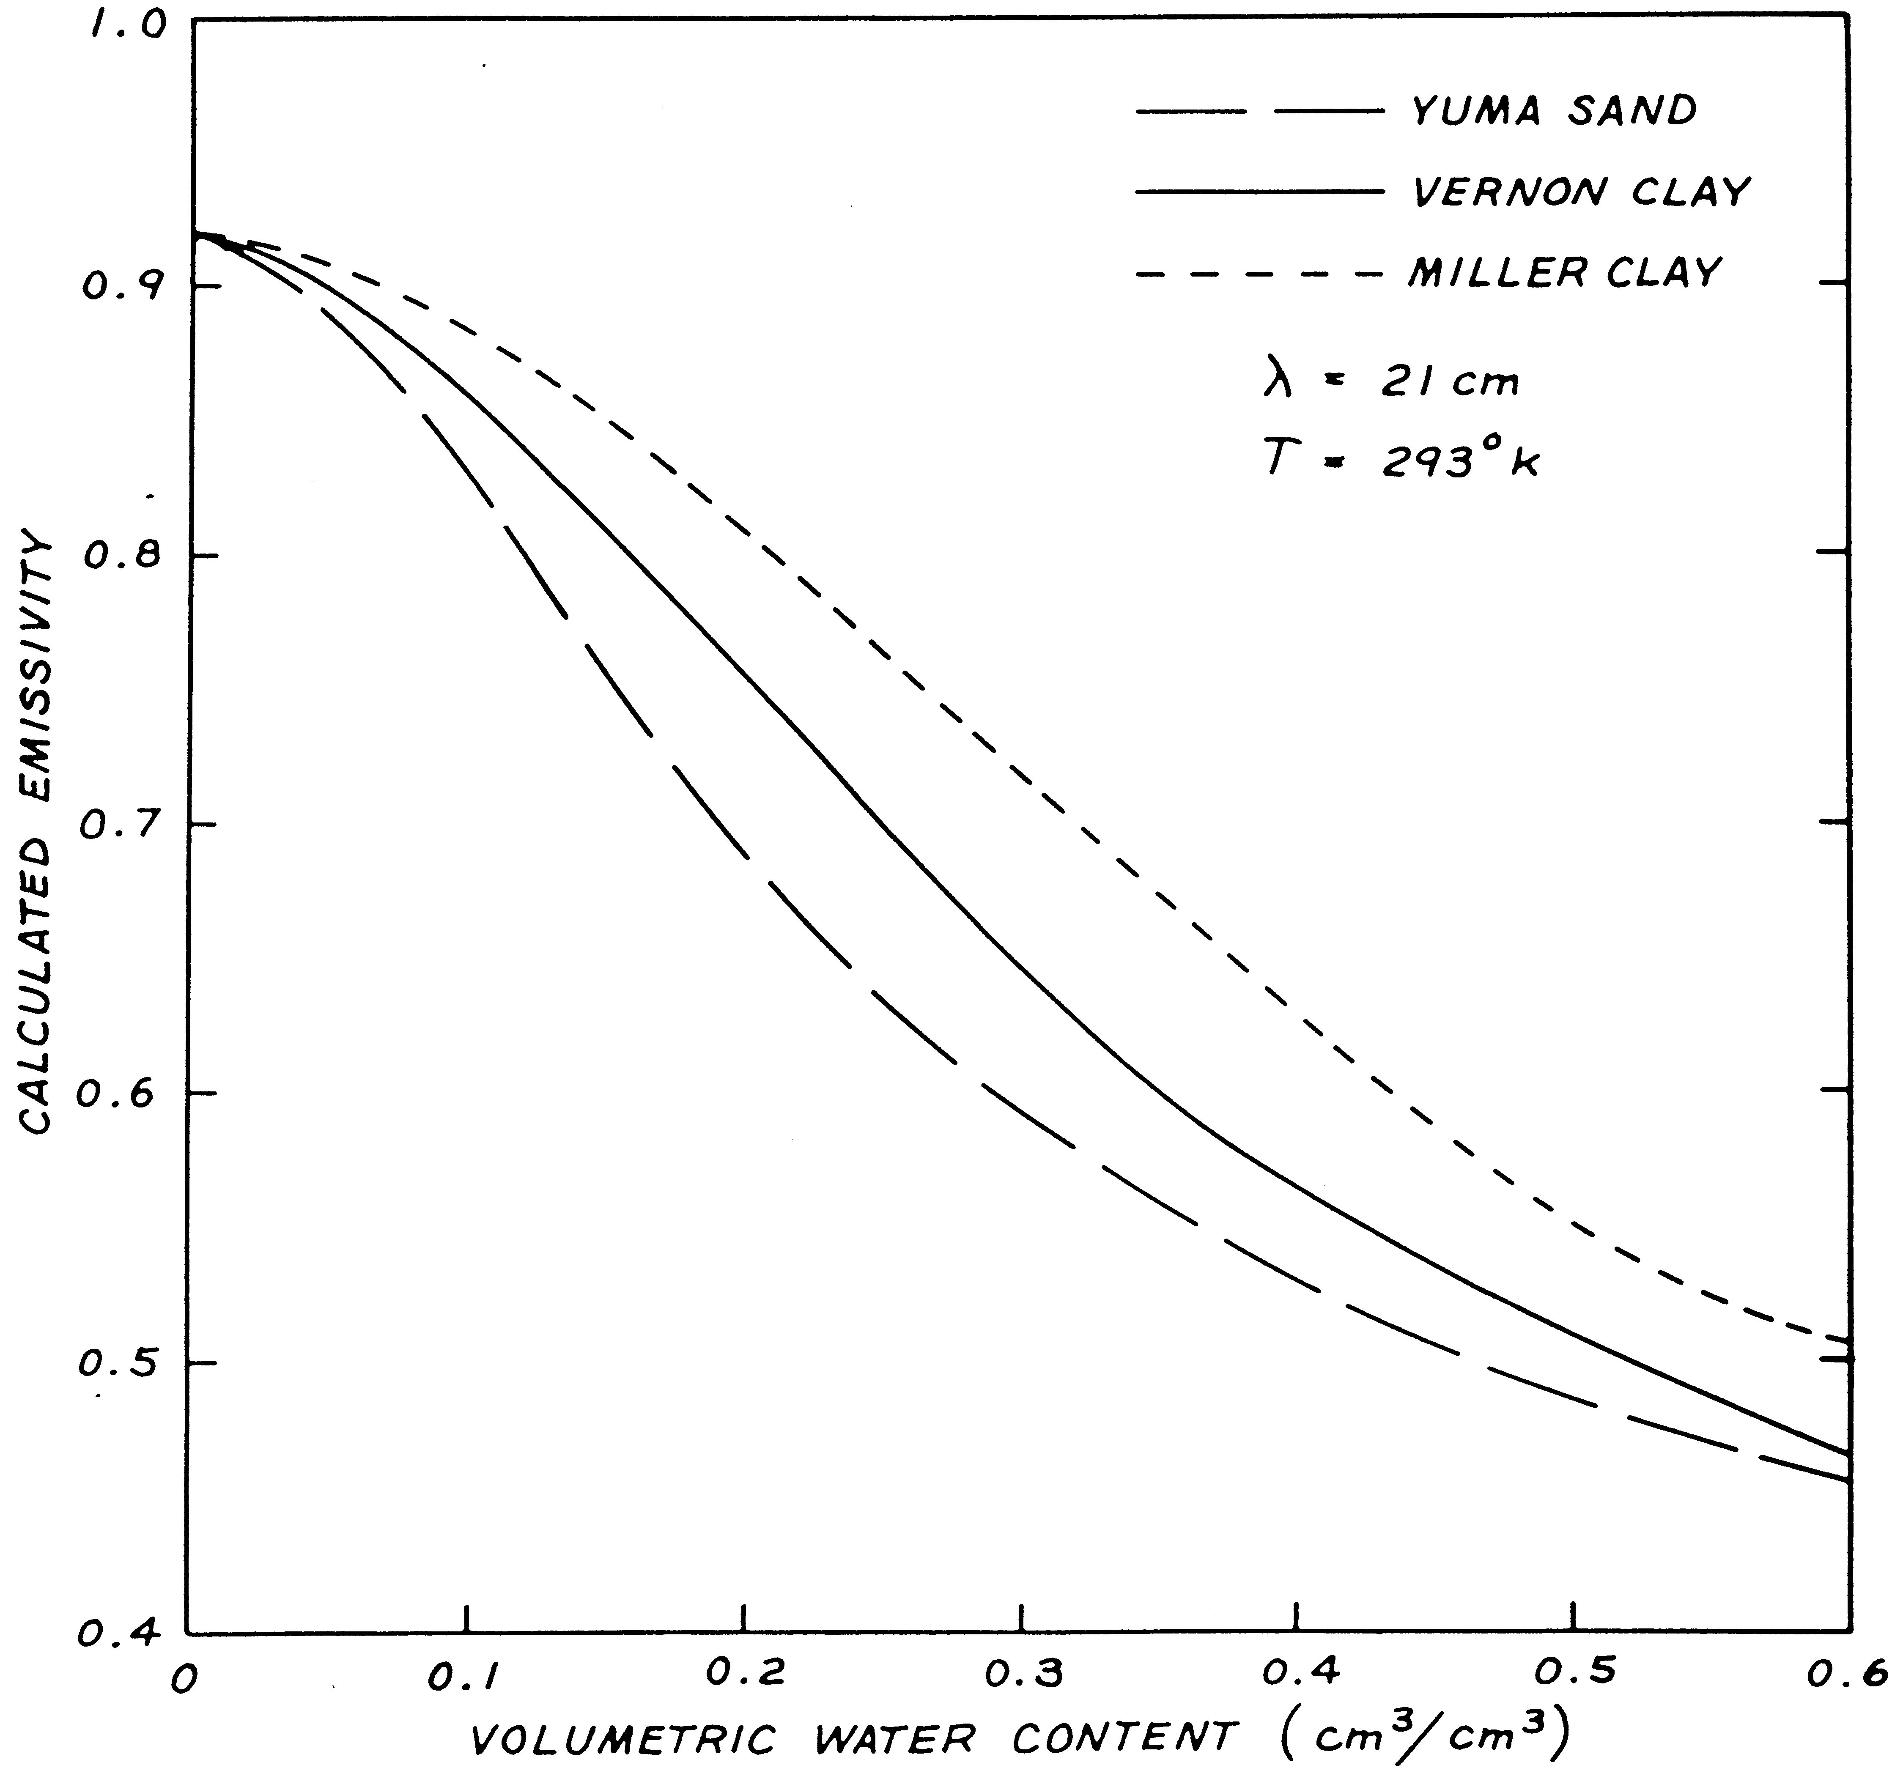

Slide 113
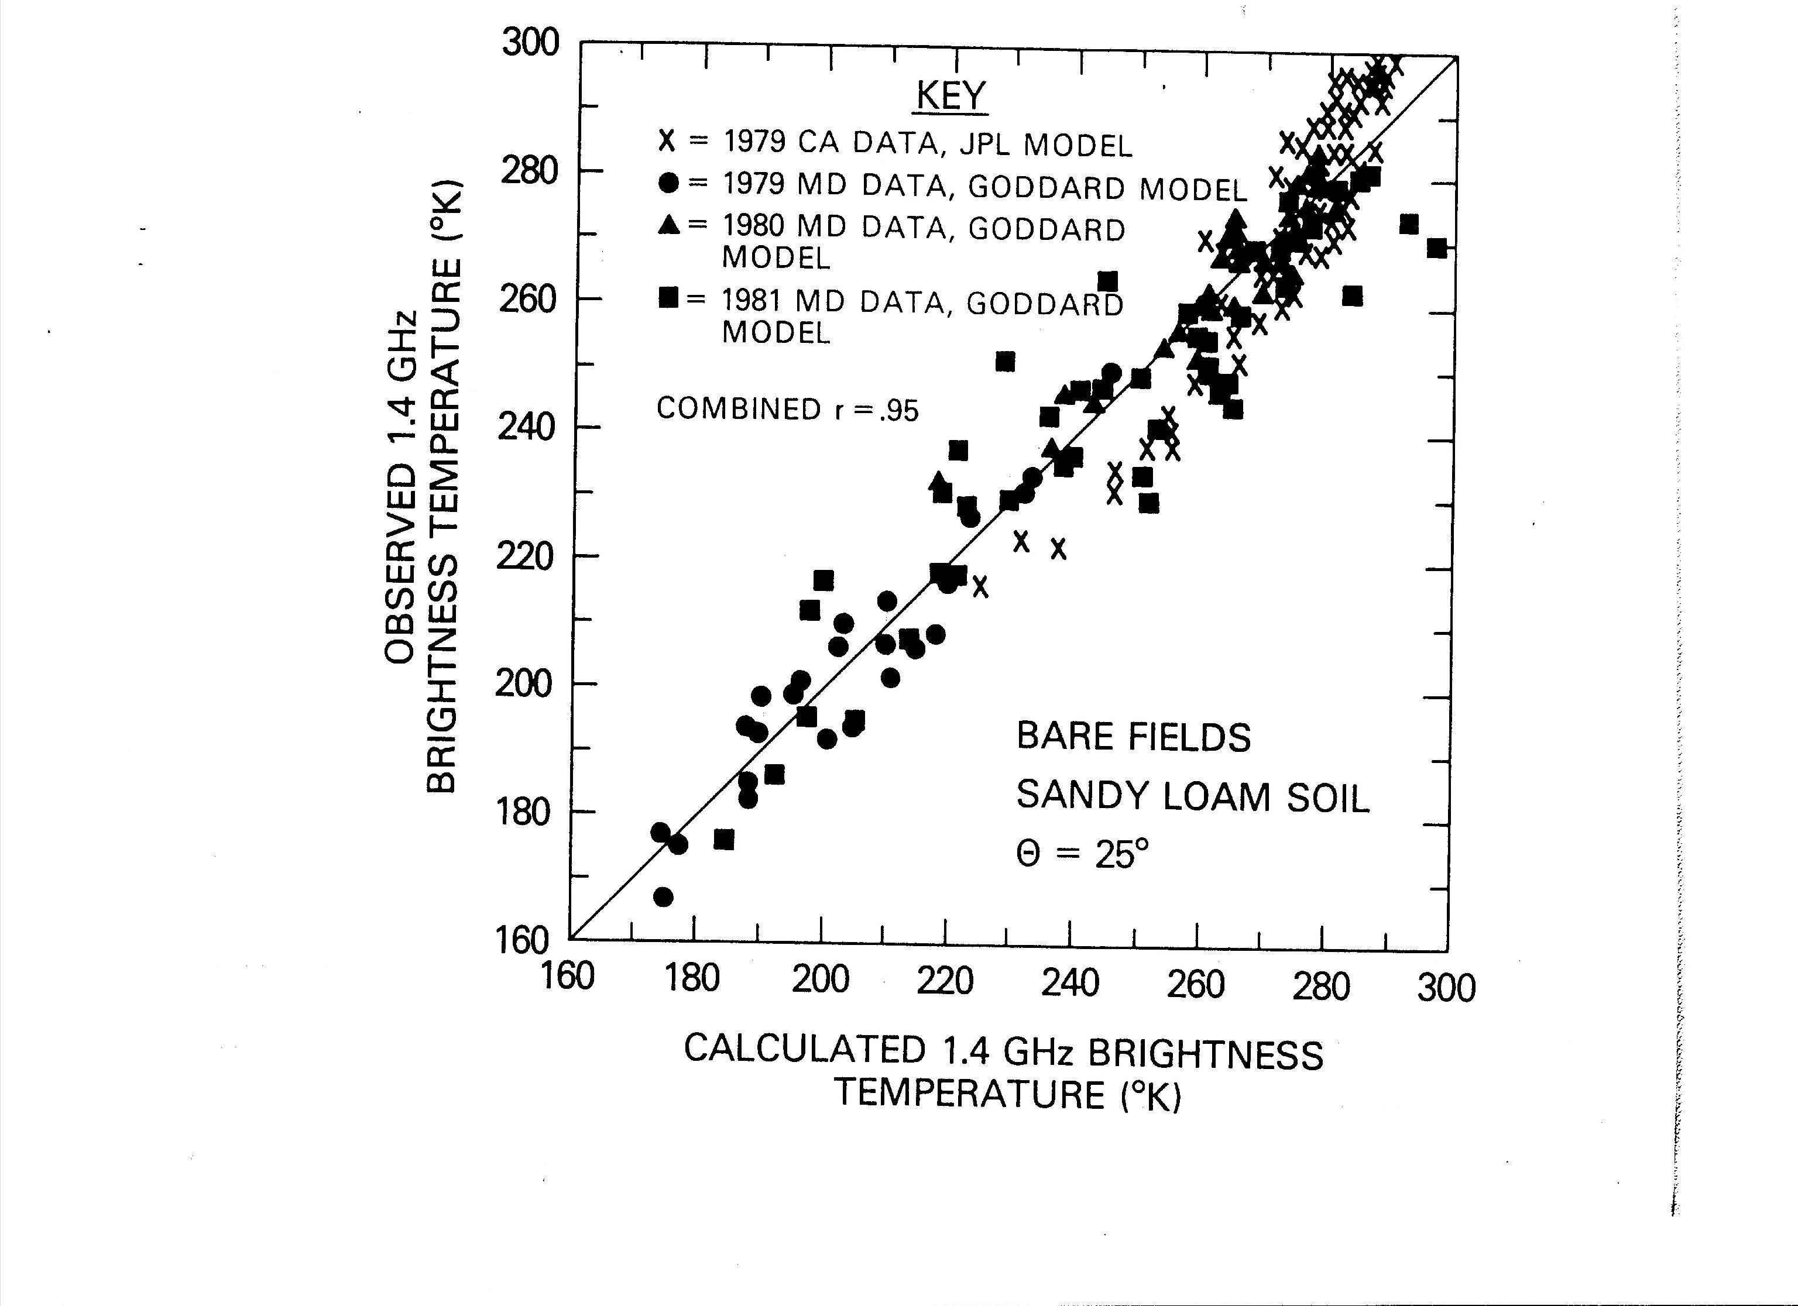

Slide 115
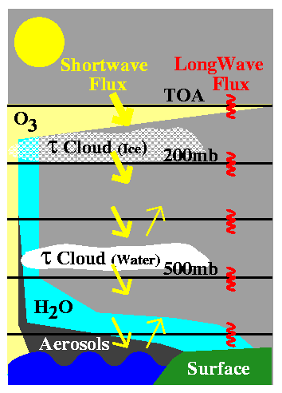
Surface and Atmospheric Radiation Budget
Calculations of Radiative Flux Profiles
Collect Inputs
Water vapor profiles
Temperature profiles
Ozone profiles
Cloud properties
Aerosol properties
Surface properties
Compute Fluxes
with radiative transfer code

Slide 116
What are TOA and Surface Fluxes?
As the radiation from Sun reaches Earth it first interacts with top of the atmosphere (TOA) layers, then with various atmospheric layers containing gases, clouds, aerosols, and/or other constituents
before reaching the surface. In each of these material layers solar radiation is being scattered and/or absorbed. Moreover, these atmospheric and surface constituents emit their own share of radiation. Due to the specifics of this complex interaction, one can separate its energetics it in two primary spectral parts:
the shortwave (SW) and the longwave (LW).
Depending on the specifics of the physical processes under investigation, this broad spectra can be further divided into finer and finer spectral intervals.

Slide 118
CERES Calculations of Radiative Fluxes
Compare With CERES TOA Fluxes
Adjust Appropriate Inputs

