Slide 1
AOSC400-2015: Lectures # 18 and # 19 -Review
Chapter 9:
Connection between Chapter 4 and Chapter 9
Components of the Surface Energy Budget (SEB)-in addition to radiation also fluxes of heat and moisture.
Fluxes of heat and moisture are transported by turbulence in the PLB
What is Planetary Boundary Layer (PBL)? Concept of Capping Inversion
What is turbulence? How do we represent it? Reynold’s Averaging.
Supplementary background material for understanding Chapter 9
Adiabatic Lapse Rate
Environmental Lapse Rate
Concept of stability
Hydrostatic balance
Potential temperature - will be covered in Lecture # 20
Copyright@2015 University of Maryland
This material may not be reproduced or redistributed, in whole or in part, without written permission of Rachel T. Pinker
*Sources of information used for this lecture are listed in updated Syllabus.

Slide 2

Potential temperature
The potential temperature θ of an air parcel is defined as the temperature which the parcel of air would have if it were expanded or compressed adiabatically from its existing pressure and temperature to a standard pressure p₀ (generally taken as 1000 mb).
Potential temperature is denoted as θ and, for air is given by
where T is the absolute temperature (in K) of the parcel, R is the gas constant of air, and c_{p} is the specific heat capacity at a constant pressure. This equation is often known as Poisson's equation.
Potential temperature is conserved for all dry adiabatic processes.
Above equation assumes an adiabatic process and :
Hydrostatic balance
Ideal gas: ρ = p/RT,

Slide 3
Can explain with the help of figure in slide # 4:
If we extract an air parcel out of the environment at level z and push it down adiabatically to the reference level where pressure is p_{S}, then the temperature Ts of the parcel when it reaches the reference level (denoted as ϑ) is the potential temperature. Potential temperature is a useful measure of the static stability of the unsaturated atmosphere.

Slide 4
If we let the apparatus fall back (adiabatically) to the level of p = p_{S}, the temperature in the chamber will be restored to T_{S} = ϑ(s)

Slide 5
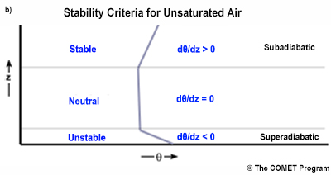
Common to use stability criteria for unsaturated air based on the vertical gradient of the potential temperature, θ.

Slide 6
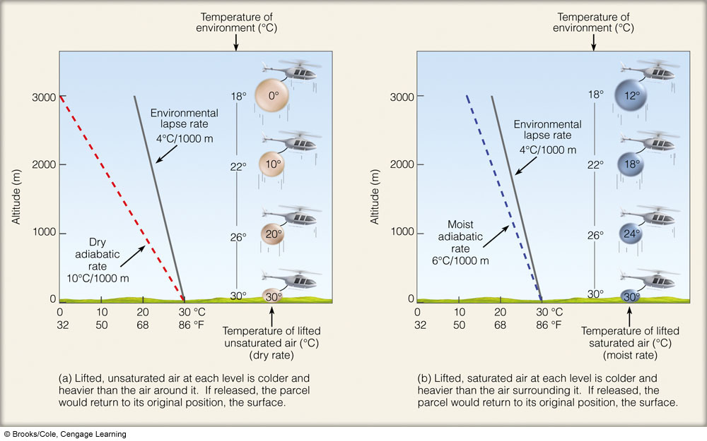
Discussed stability before as shown here: Ability of the parcel to rise depends on: Relationship between environmental lapse rate and dry adiabatic lapse rate or moist adiabatic lapse rate.

Slide 7
AOSC400-2015
November 24, Lecture # 20
Planetary Boundary Layer (PBL) or Atmospheric Boundary Layer (ABL)
Turbulent and Laminar Flow
Concept of stability and Richardson Number
Eddy Covariance Flux Measurements
Turbulent Kinetic Energy
Copyright@2015 University of Maryland
This material may not be reproduced or redistributed, in whole or in part, without written permission of Rachel T. Pinker
*Sources of information used for this lecture are listed in updated Syllabus.

Slide 8
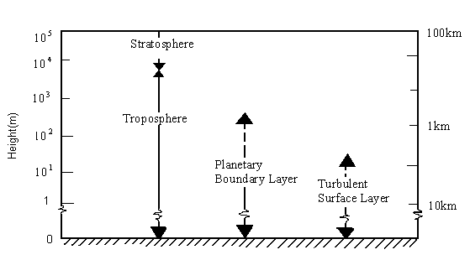

The troposphere can be subdivided as follows:

Slide 9
The portion of the atmosphere most affected by Earth's surface is called the Atmospheric Boundary Layer (ABL)
ABL, also known as the Planetary Boundary Layer (PBL), is the lowest layer of the troposphere.
The ABL is in contact with the surface and experiences frictional effects.
Heat, moisture, momentum, aerosols, and gases are exchanged between the free atmosphere and the surface through the ABL. The boundary layer depth varies from 10s of meters over tropical oceans to several km over hot, dry continents but the typical height is about 1 km.

Slide 10
Vertical Transport
Heat energy drives the physical cycles of the earth system.
Solar radiation is absorbed by the surface then energy is transferred from the surface to the troposphere by latent heat, longwave radiation, and sensible heat.
Latent heat energy stored in water vapor and released into the atmosphere with condensation, is the primary means of surface-to-atmosphere energy transport.
Sensible heat flux from the surface, which directly warms the atmosphere, while small in the annual global heat budget, is a significant energy source during the daytime over land.

Slide 11
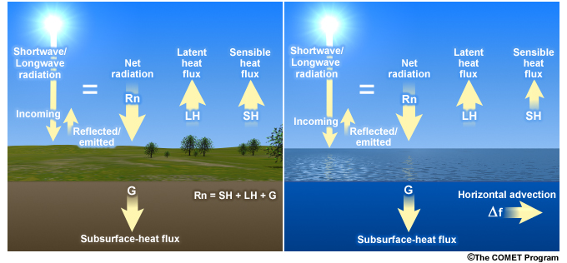
Surface energy budget for land and ocean surfaces during the daytime.

Slide 12
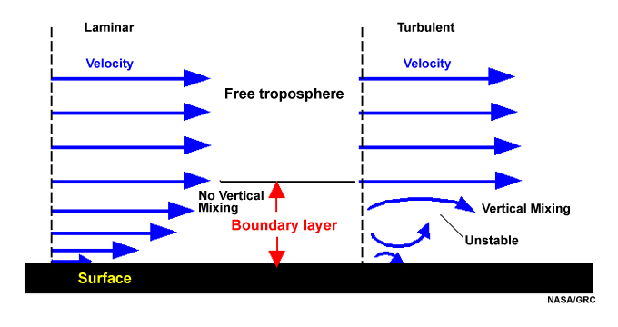
Turbulent and Laminar Flow
Schematic of laminar and turbulent flow in the boundary layer; velocity is zero at the surface.
Introduction to Tropical Meteorology 2nd Edition, Produced by The COMET Program

Slide 13
With turbulent flow, there is vertical mixing, while with laminar flow mixing between layers is non-existent or negligible.
For the atmosphere, the Richardson number, Ri, used to evaluate whether an atmospheric layer is predominantly turbulent or laminar; it is the ratio between the static stability and shear stability.
Here u is horizontal velocity, z is the height, g is the acceleration due to gravity, ρ is the density as a function of height. In general:
Laminar flow becomes turbulent when Ri < 0.25
Turbulent flow becomes laminar when Ri > 1.0
(1)

Slide 14

Sounding data and a finite difference estimate of equation (1) is used to calculate the Richardson number in practice. This form, known as the bulk Richardson number, is:
Eq. (2)
where Δz is the depth of the layer of interest.

Slide 15
Now we will explain how heat is transferred by turbulence in the atmosphere.
As seen before (when we discussed Reynolds averaging) an average over a time period T ( say half an hour) is :
In the atmosphere, this mean value can change from one half-hour period to the next, resulting in a slow variation of the mean-wind components with time.
Subtracting the mean from the instantaneous com­ponent u gives just the fluctuating (gust) portion of the flow (indicated with a prime)

Slide 16
The intensity of tur­bulence in the u direction is then defined by the variance:
In the atmosphere, fluctuations in velocity are often accompanied by fluctuations in scalar values such as temperature, humidity, or pollutant concentration.
For example, in a field of thermals there are regions where warm air is rising (positive potential temperature ϑ' accompanies positive vertical velocity w'), surrounded by regions where cold air is sinking (negative ϑ' accompanies negative w'). One measure of the amount that ϑ and w vary together is the covariance (cov).

Slide 18
What is Flux?
Flux – how much of something moves through a unit area per unit time
Flux is dependent on: (1) number of things crossing the area; (2) size of the area being crossed, and (3) the time it takes to cross this area

Slide 19
Flux Measurements
Flux measurements are widely used to estimate heat, water, and CO₂ exchange, as well as methane and other trace gases
Eddy Covariance is one of the most direct and defensible ways to measure such fluxes
The method is mathematically complex, and requires a lot of care setting up and processing data .

Slide 20
“A Brief Practical Guide to Eddy Covariance Flux Measurements: Principles and Workflow Examples for Scientific and Industrial Applications”
G. Burba and D. Anderson of LI-COR Biosciences
Objective:
To help a non-expert gain a basic understanding of the Eddy Covariance method and to point out valuable references
To provide explanations in a simplified manner first, and then elaborate with specific details

Slide 21
Mathematical foundation
In mathematical terms, "eddy flux" is computed as a covariance between instantaneous deviation in vertical wind speed (w') from the mean value (w-overbar) and instantaneous deviation in gas concentration, mixing ratio (s'), from its mean value (s-overbar), multiplied by mean air density (ρa). Several mathematical operations and assumptions, including Reynolds decomposition, are involved in getting from physically complete equations of the turbulent flow to practical equations for computing "eddy flux", as shown below.

Slide 22
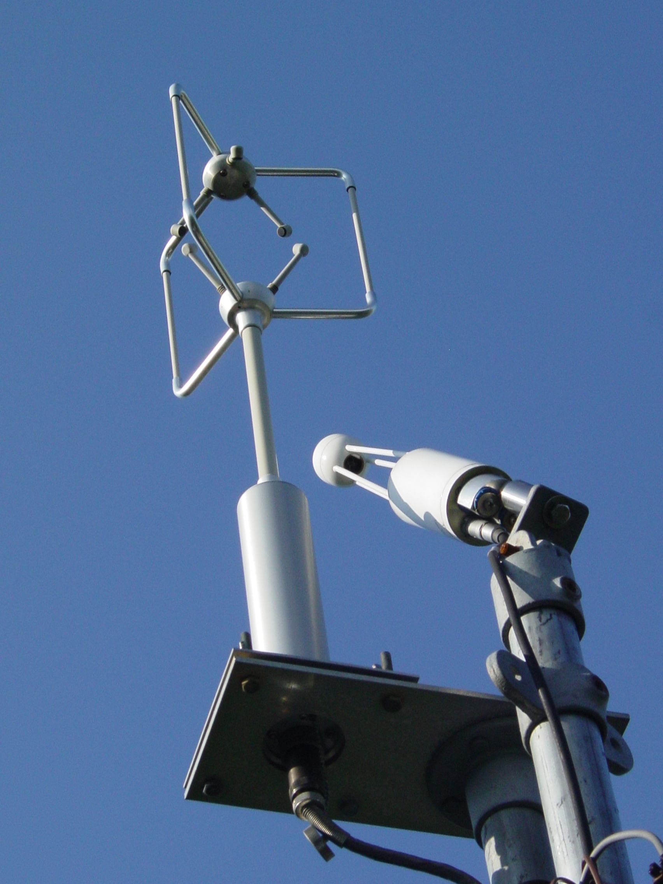
Eddy covariance system consisting of an ultrasonic anemometer and infrared gas analyser (IRGA).

Slide 23
The Eddy Covariance method is one of the most accurate, direct and defensible approaches available to date for measurements of gas fluxes and monitoring of gas emissions from areas with sizes ranging from a few hundred to millions of square meters
The method relies on direct and very fast measurements of actual gas transport by a 3-D wind speed in real time in situ, resulting in calculations of turbulent fluxes within the atmospheric boundary layer

Slide 24
Several networks have been established over the globe to measure turbulent fluxes.
Existing Flux Networks:
Fluxnet, Fluxnet-Canada, AsiaFlux, CarboEurope and AmeriFlux networks
They collect Eddy Covariance information.
http://gcmd.nasa.gov/records/GCMD_AMERIFLUX_SHIDLER-CDIAC.html
http://terraweb.forestry.oregonstate.edu/chair2. htm

Slide 25
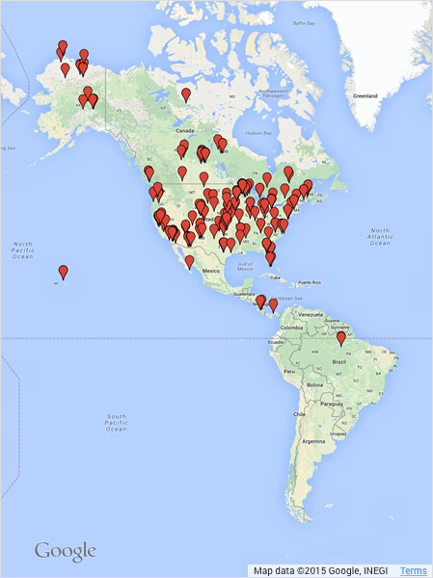
About the AmeriFlux Network
AmeriFlux is a network of PI-managed sites measuring ecosystem CO₂, water, and energy fluxes in North and South America. It was established to connect research on field sites representing major climate and ecological biomes, including tundra, grasslands, savanna, crops, and conifer, deciduous, and tropical forests. As a grassroots, investigator-driven network, the AmeriFlux community has tailored instrumentation to suit each unique ecosystem. This “coalition of the willing” is diverse in its interests, use of technologies and collaborative approaches.

Slide 26
The eddy covariance (also known as eddy correlation and eddy flux) technique is a key atmospheric measurement technique to measure and calculate vertical turbulent fluxes within atmospheric boundary layers.
The method analyzes high-frequency wind and scalar atmospheric data series, and yields values of fluxes of these properties.
It is a statistical method used in meteorology and other applications (micrometeorology, oceanography, hydrology, agricultural sciences, industrial and regulatory applications, etc.) to determine exchange rates of trace gases over natural ecosystems, agricultural fields, and to quantify gas emissions rates from other land and water areas. It is particularly frequently used to estimate momentum, heat, water vapour, carbon dioxide and methane fluxes

Slide 27
The technique is also used extensively for verification and tuning of global climate models, mesoscale and weather models, complex biogeochemical and ecological models, and remote sensing estimates from satellites and aircraft. The technique is mathematically complex, and requires significant care in setting up and processing data. To date, there is no uniform terminology or a single methodology for the Eddy Covariance technique, but much effort is being made by flux measurement networks (e.g., Fluxnet, Ameriflux, ICOS, CarboEurope, Fluxnet Canada, OzFlux, NEON, and iLEAPS) to unify the various approaches.

Slide 28
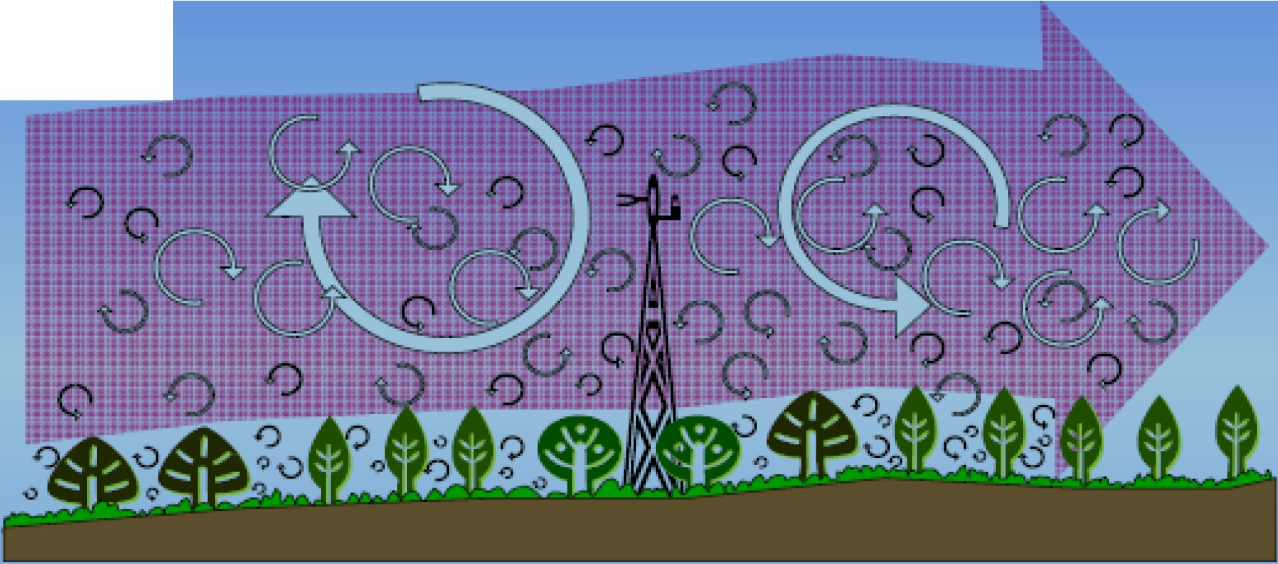
WIND
Airflow can be imagined as a horizontal flow of numerous rotating eddies
Each eddy has 3-D components, including a vertical wind component
• The diagram looks chaotic but components can be measured from tower

Slide 29
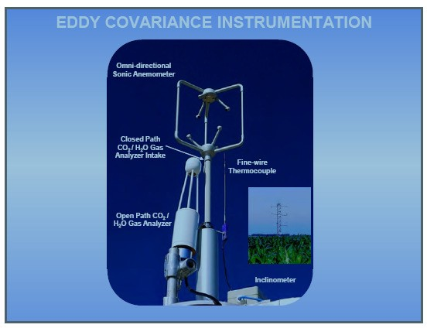

Slide 30
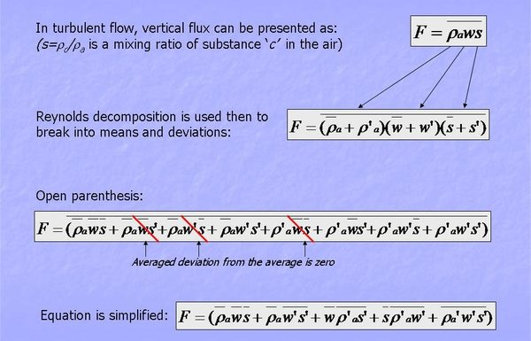

Slide 31
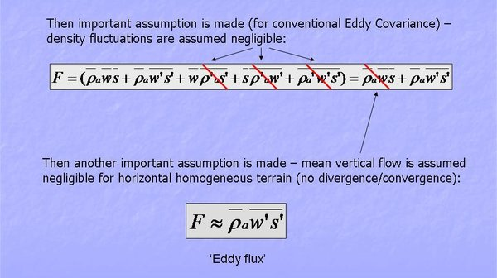

Slide 32

Summary of Eddy Covariance Theory
Measures fluxes transported by eddies
Requires turbulent flow
Requires state-of-the-art instruments
Calculated as covariance of w' and c'
Many assumptions to satisfy
Complex calculations
Most direct way to measure flux
Continuous new developments

Slide 33
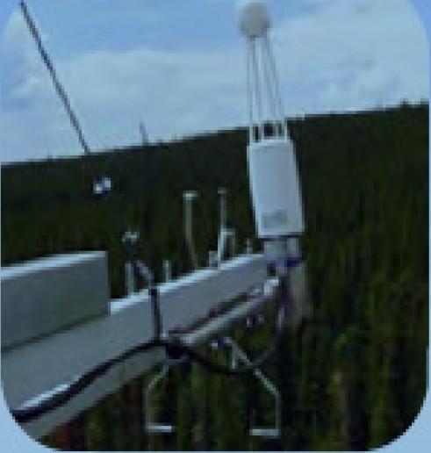

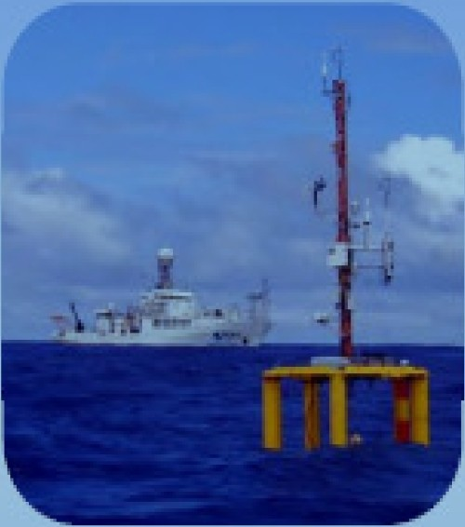
TERRESTRIAL
AIRBORNE
OCEANOGRAPHIC
98% of applications
<1%of applications
<1%of applications

Slide 34
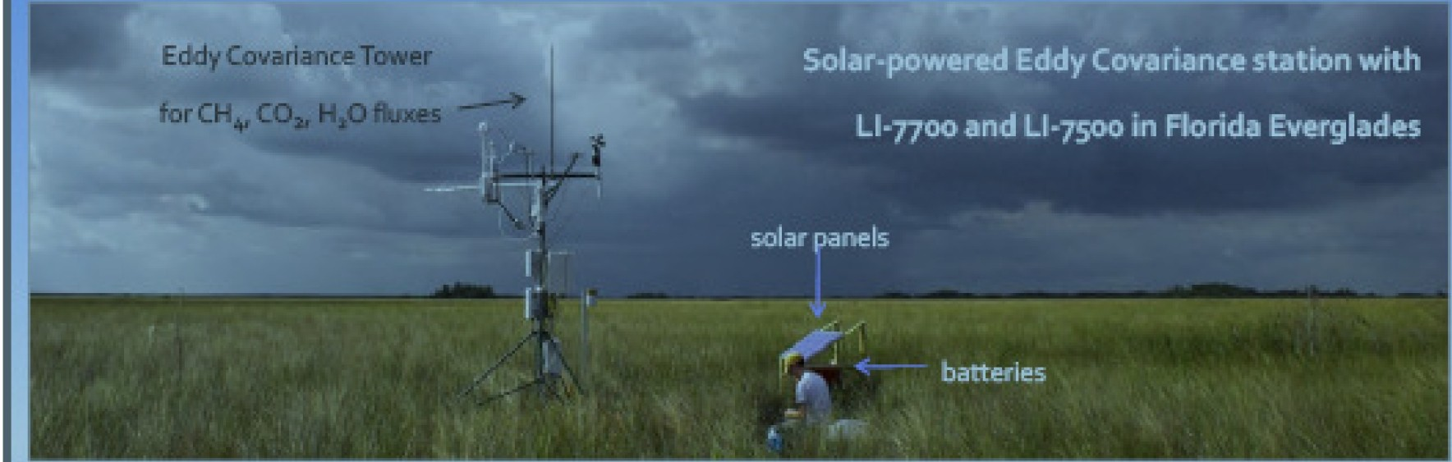

Slide 35
Turbulence kinetic Energy and Turbulence Intensity
Kinetic energy is defined as:
where m is mass and V is velocity. In meteorology we often use specific kinetic energy, namely KE/m, or the kinetic energy per unit mass. Similarly, we can define specific kinetic energy associated with turbulent fluctuations :
where TKE is turbulence kinetic energy. For laminar flow, which contains no micro-scale motions, TKE = 0, even though u, v, w are not necessarily zero. Larger values of TKE indicate a greater intensity of the microscale turbulence. We see now that the three components of velocity variance represent three con­tributions to the scalar TKE.

Slide 36
Intensity of Turbulence
The intensity of turbulence is measured in terms of the turbulent kinetic energy (TKE), ē,
Eqn (3)
where u, v, and w are the zonal, meridional, and vertical wind components, respectively. The overbar represents the time average and the prime is the perturbation or eddy contribution. TKE is zero for laminar flow, even though the mean wind components are not necessarily zero.

Slide 37
Using what we already know about mechanical and thermal generation of turbulence, and of viscous dissipation, we can write in descriptive form an Eulerian (i.e., fixed relative to the ground) forecast equation for turbulence kinetic energy:
the advection of TKE by the mean wind, M is mechanical generation of turbulence, B is buoyant generation or consumption of turbulence, Tr is trans­port of turbulence energy by turbulence itself, and ε is the viscous dissipation rate.

