Slide 1
Instructions
Supervised by Ni Dai (ndai@umd.edu)
Th-Nov. 12, 2015
Meet in class and create circles for each group according to Term Paper topic.
Discuss among group members organization of topic, delegate tasks of writing and start web search at Web of Science (link was provided) and try to select papers you want to use.

Slide 2
Tuesday- Nov.17, 2015
Homework Review and augmentation
Bring your Homework # 2 to class. Bring the table with information on declination and equation of time
Part II, HW # 2
Problem # 1: Joseph Zagami
Joseph, show how to do it the long way (using the equations) and also by using the table.
Problem # 2: Justin Hicks
Justin, show only one case. Also, show both ways, using equations and using the table.
Problem # 5: Christine Clements
Christine, derive the equation and solve for the temperature of the earth.

Slide 3
Problems 6 and 7: Yicheng He
Yicheng will explain the program he wrote and the results he obtained. He will also send you the programs via ELMS.
The numbers he got for the temperatures of the various planets are without accounting for their atmosphere. Use the Web of Science as a resource (or any other source) to find out what is the actual temperature of the planets. You can get organized as a group (based on the Term Paper grouping, and submit one report on your findings. If unable to complete in class, you can send it electronically within a week.

Slide 4
Marcel Caron will explain first the concept of hydrostatic balance.

Slide 5
Th-Nov. 19, 2015
Meet in class and create circles for each group according to Term Paper topic.
By now, you should have read some of the papers you have selected for review and have a good idea what you want to do. After reading the paper, fine-tune your outlines as a group and start working on the Term Paper.
Start preparing the Power Point presentation that each group will give at the end of the semester. Each student will get about 3 min to present his/hers section.

Slide 6
AOSC400-2015: Lectures # 18 and # 19
Chapter 9:
Connection between Chapter 4 and Chapter 9
Components of the Surface Energy Budget (SEB)-in addition to radiation also fluxes of heat and moisture.
Fluxes of heat and moisture are transported by turbulence
What is Planetary Boundary Layer (PBL)?
Concept of Capping Inversion
What is turbulence? How do we represent it? Reynold’s Averaging.
Supplementary background material for Chapter 9
Adiabatic Lapse Rate
Environmental Lapse Rate
Concept of stability
Hydrostatic balance
Potential temperature
Copyright@2015 University of Maryland
This material may not be reproduced or redistributed, in whole or in part, without written permission of Rachel T. Pinker
*Sources of information used for this lecture are listed in updated Syllabus.

Slide 7

Potential temperature
The potential temperature θ of an air parcel is defined as the temperature which the parcel of air would have if it were expanded or compressed adiabatically from its existing pressure and temperature to a standard pressure p₀ (generally taken as 1000 mb).
Potential temperature is denoted as θ and, for air is given by
where T is the absolute temperature (in K) of the parcel, R is the gas constant of air, and c_{p} is the specific heat capacity at a constant pressure. This equation is often known as Poisson's equation.
Potential temperature is conserved for all dry adiabatic processes.

Slide 8

Potential Temperature
The atmosphere stratified in the vertical; T(z), p(z), ρ(z).
As an air parcel is adiabatically lifted to a new height, all (ρ, p, T) of the parcel change .
Assuming:
Hydrostatic balance
Ideal gas: ρ = p/RT,

Slide 9
This can be understood in the following sense:
If we carve an air parcel out of the environment at level z and push it down (or lift it up) adiabatically to the reference level, p_{S}, ϑ(z) is the temperature of the parcel when it reaches the reference level.
Potential temperature is a useful measure of the static stability of the unsaturated atmosphere.

Slide 10
If we let the apparatus fall back (adiabatically) to the level of p = p_{S}, the temperature in the chamber will be restored to T_{S} = ϑ(s)

Slide 11
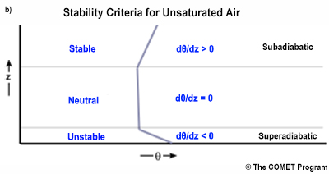
Stability criteria for unsaturated air based on the vertical gradient of the potential temperature, θ.

Slide 12
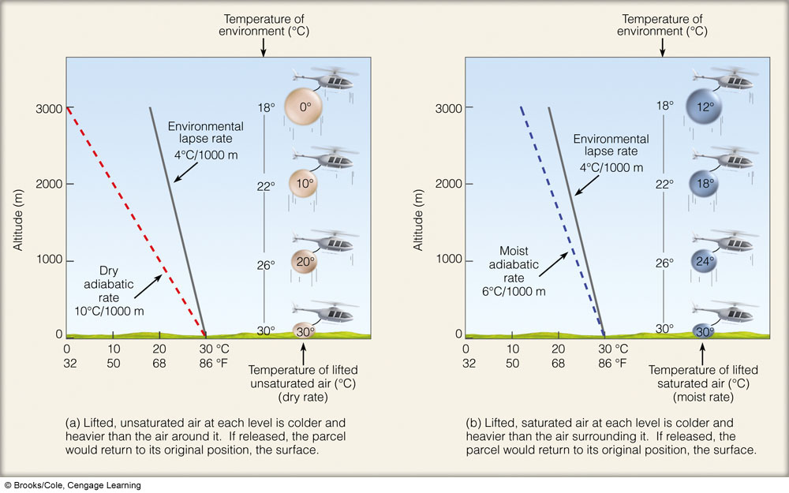
Ability of the parcel to rise depends on: Relationship between environmental lapse rate and dry adiabatic lapse rate or moist adiabatic lapse rate.

Slide 13
AOSC400-2015
November 24, Lecture # 20
Planetary Boundary Layer (PBL) or Atmospheric Boundary Layer (ABL)
Turbulent and Laminar Flow
Concept of stability and Richardson Number
Eddy Covariance Flux Measurements
Turbulent Kinetic Energy
Copyright@2015 University of Maryland
This material may not be reproduced or redistributed, in whole or in part, without written permission of Rachel T. Pinker
*Sources of information used for this lecture are listed in updated Syllabus.

Slide 14
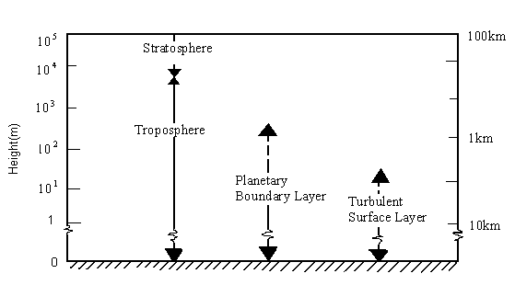

The troposphere can be subdivided as follows:

Slide 15
The Earth's surface is the bottom boundary of the atmosphere.
The portion of the atmosphere most affected by Earth's surface is called the Atmospheric Boundary Layer (ABL)
ABL, also known as the Planetary Boundary Layer (PBL), is the lowest layer of the troposphere.
The ABL is in contact with the surface and experiences frictional effects.
Heat, moisture, momentum, aerosols, and gases are exchanged between the free atmosphere and the surface through the ABL. The boundary layer depth varies from 10s of meters over tropical oceans to several km over hot, dry continents but the typical height is about 1 km.

Slide 16
Vertical Transport
Heat energy drives the physical cycles of the earth system.
Solar radiation is absorbed by the surface then energy is transferred from the surface to the troposphere by latent heat, longwave radiation, and sensible heat.
In a very basic sense, vertical transport occurs because surface energy warms the troposphere while the outgoing longwave radiation cools.
Latent heat energy stored in water vapor and released into the atmosphere with condensation, is the primary means of surface-to-atmosphere energy transport.
Sensible heat flux from the surface, which directly warms the atmosphere, while small in the annual global heat budget, is a significant energy source during the daytime over land.

Slide 17
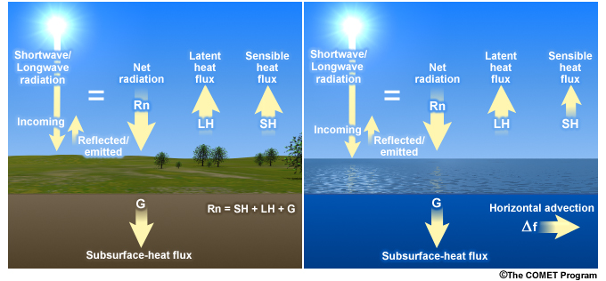
Surface energy budget for land surface and ocean surface during the daytime.

Slide 18
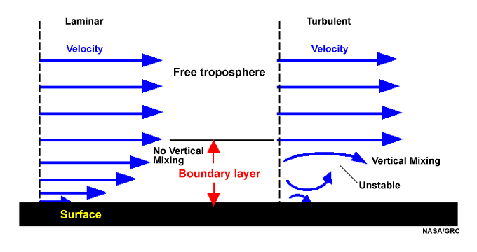
Turbulent and Laminar Flow
Schematic of laminar and turbulent flow in the boundary layer; velocity is zero at the surface.
Introduction to Tropical Meteorology 2nd Edition, Produced by The COMET Program

Slide 19
With turbulent flow, there is vertical mixing, while with laminar flow mixing between layers is non-existent or negligible.
For the atmosphere, the Richardson number, Ri, used to evaluate whether an atmospheric layer is predominantly turbulent or laminar; it is the ratio between the static stability and shear stability. Eq. (1)
Here u is horizontal velocity, z is the height, g is the acceleration due to gravity, ρ is the density as a function of height. In general:
Laminar flow becomes turbulent when Ri < 0.25
Turbulent flow becomes laminar when Ri > 1.0

Slide 20

Sounding data and a finite difference estimate of equation (1) is used to calculate the Richardson number in practice. This form, known as the bulk Richardson number, is:
Eq. (2)
where Δz is the depth of the layer of interest.

Slide 21
Refresh:
As seen before (when we discussed Reynolds averaging)
An average over a time period T ( say half an hour):
In the atmosphere, this mean value can change from one half-hour period to the next, resulting in a slow variation of the mean-wind components with time.
Subtracting the mean from the instantaneous com­ponent u gives just the fluctuating (gust) portion of the flow (indicated with a prime)

Slide 22
The intensity of tur­bulence in the u direction is then defined by the variance:
In the atmosphere, fluctuations in velocity are often accompanied by fluctuations in scalar values such as temperature, humidity, or pollutant concentration.
For example, in a field of thermals there are regions where warm air is rising (positive potential temperature ϑ' accompanies positive vertical velocity w'), surrounded by regions where cold air is sinking (negative ϑ' accompanies negative w'). One measure of the amount that ϑ and w vary together is the covariance (cov).

Slide 24
What is Flux?
Flux – how much of something moves through a unit area per unit time
Flux is dependent on: (1) number of things crossing the area; (2) size of the area being crossed, and (3) the time it takes to cross this area

Slide 25
Flux Measurements
Flux measurements are widely used to estimate heat, water, and CO₂ exchange, as well as methane and other trace gases
Eddy Covariance is one of the most direct and defensible ways to measure such fluxes
The method is mathematically complex, and requires a lot of care setting up and processing data .

Slide 26
“A Brief Practical Guide to Eddy Covariance Flux Measurements: Principles and Workflow Examples for Scientific and Industrial Applications”
G. Burba and D. Anderson of LI-COR Biosciences
To help a non-expert gain a basic understanding of the Eddy Covariance method and to point out valuable references
To provide explanations in a simplified manner first, and then elaborate with specific details

Slide 27
Mathematical foundation
In mathematical terms, "eddy flux" is computed as a covariance between instantaneous deviation in vertical wind speed (w') from the mean value (w-overbar) and instantaneous deviation in gas concentration, mixing ratio (s'), from its mean value (s-overbar), multiplied by mean air density (ρa). Several mathematical operations and assumptions, including Reynolds decomposition, are involved in getting from physically complete equations of the turbulent flow to practical equations for computing "eddy flux", as shown below.

Slide 28
Introduction
The Eddy Covariance method is one of the most accurate, direct and defensible approaches available to date for measurements of gas fluxes and monitoring of gas emissions from areas with sizes ranging from a few hundred to millions of square meters
The method relies on direct and very fast measurements of actual gas transport by a 3-D wind speed in real time in situ, resulting in calculations of turbulent fluxes within the atmospheric boundary layer

Slide 29
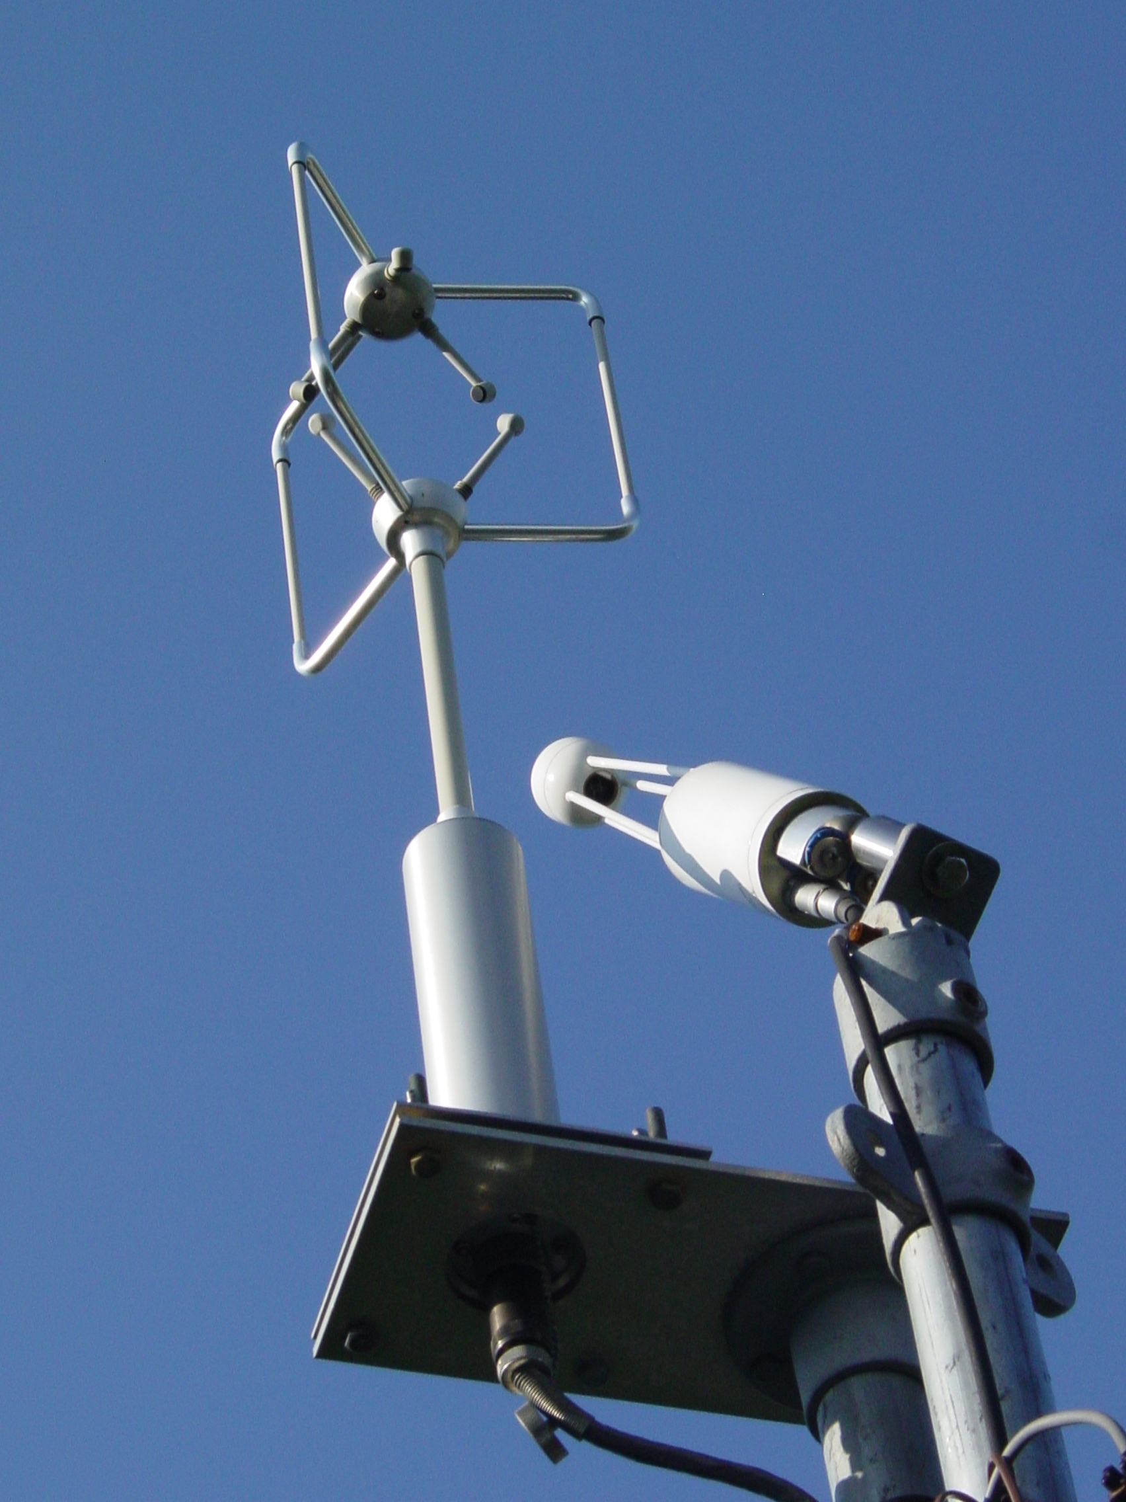
Eddy covariance system consisting of an ultrasonic anemometer and infrared gas analyser (IRGA).

Slide 30
Several networks have been established over the globe to measure turbulent fluxes Existing Flux Networks:
Fluxnet, Fluxnet-Canada, AsiaFlux, CarboEurope and AmeriFlux networks
They collect Eddy Covariance information.
http://gcmd.nasa.gov/records/GCMD_AMERIFLUX_SHIDLER-CDIAC.html
http://terraweb.forestry.oregonstate.edu/chair2. htm

Slide 31
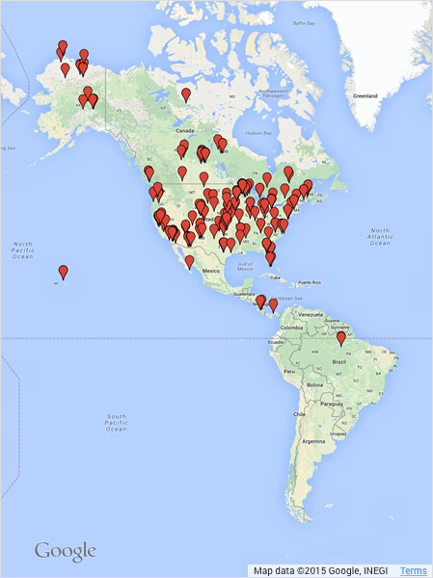
About the AmeriFlux Network
AmeriFlux is a network of PI-managed sites measuring ecosystem CO₂, water, and energy fluxes in North and South America. It was established to connect research on field sites representing major climate and ecological biomes, including tundra, grasslands, savanna, crops, and conifer, deciduous, and tropical forests. As a grassroots, investigator-driven network, the AmeriFlux community has tailored instrumentation to suit each unique ecosystem. This “coalition of the willing” is diverse in its interests, use of technologies and collaborative approaches.

Slide 32
The eddy covariance (also known as eddy correlation and eddy flux) technique is a key atmospheric measurement technique to measure and calculate vertical turbulent fluxes within atmospheric boundary layers.
The method analyzes high-frequency wind and scalar atmospheric data series, and yields values of fluxes of these properties.
It is a statistical method used in meteorology and other applications (micrometeorology, oceanography, hydrology, agricultural sciences, industrial and regulatory applications, etc.) to determine exchange rates of trace gases over natural ecosystems, agricultural fields, and to quantify gas emissions rates from other land and water areas. It is particularly frequently used to estimate momentum, heat, water vapour, carbon dioxide and methane fluxes

Slide 33
The technique is also used extensively for verification and tuning of global climate models, mesoscale and weather models, complex biogeochemical and ecological models, and remote sensing estimates from satellites and aircraft. The technique is mathematically complex, and requires significant care in setting up and processing data. To date, there is no uniform terminology or a single methodology for the Eddy Covariance technique, but much effort is being made by flux measurement networks (e.g., Fluxnet, Ameriflux, ICOS, CarboEurope, Fluxnet Canada, OzFlux, NEON, and iLEAPS) to unify the various approaches.

Slide 34
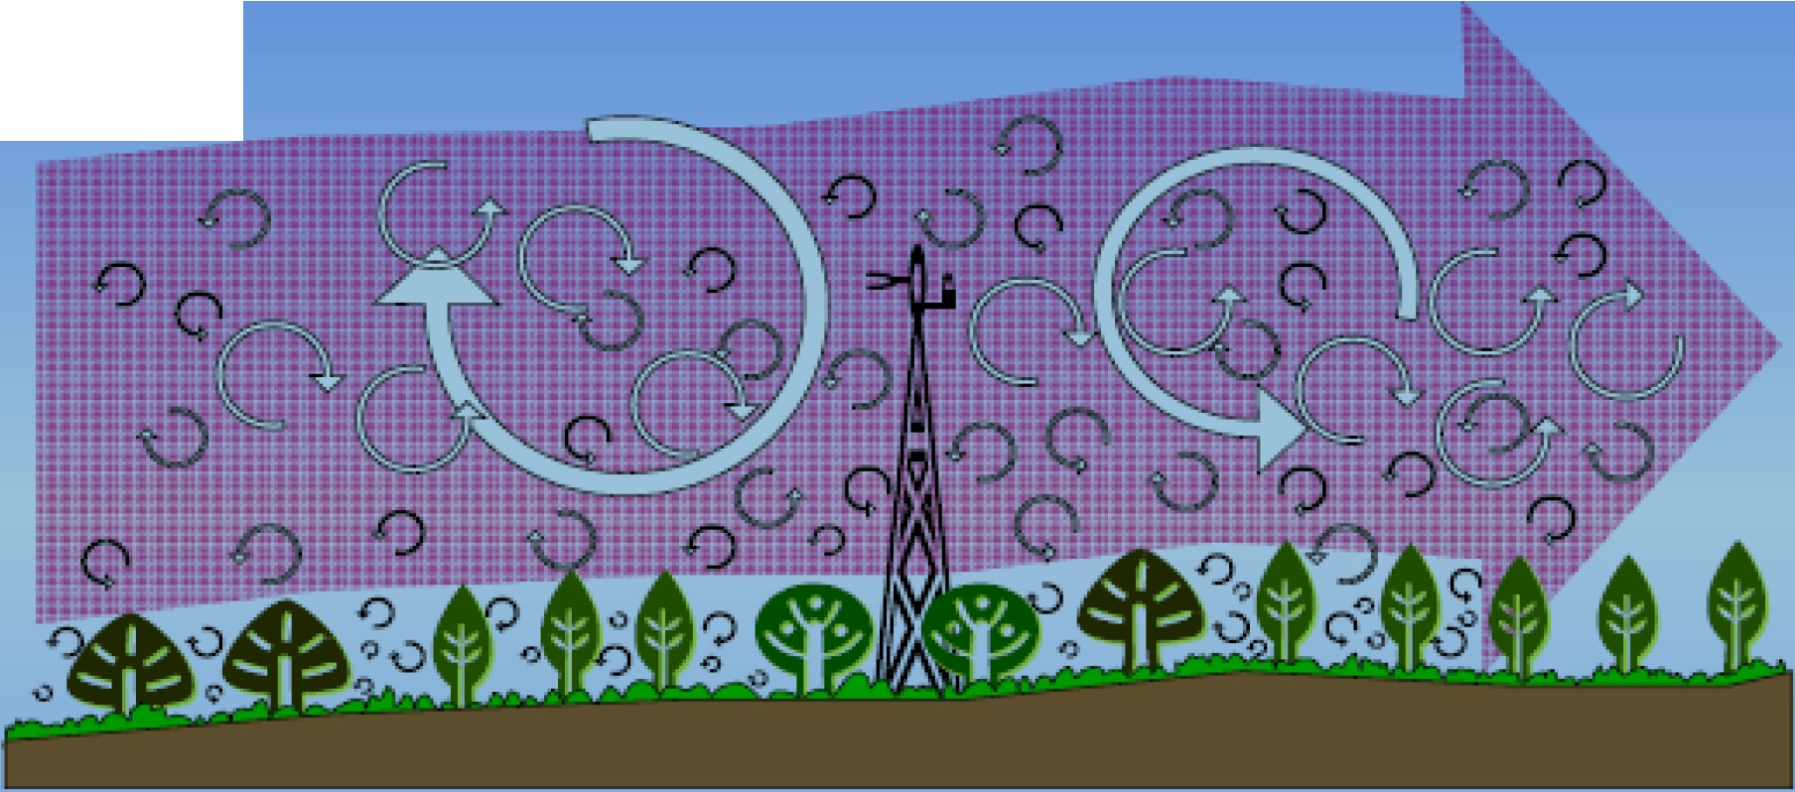
WIND
Airflow can be imagined as a horizontal flow of numerous rotating eddies
Each eddy has 3-D components, including a vertical wind component
• The diagram looks chaotic but components can be measured from tower

Slide 35
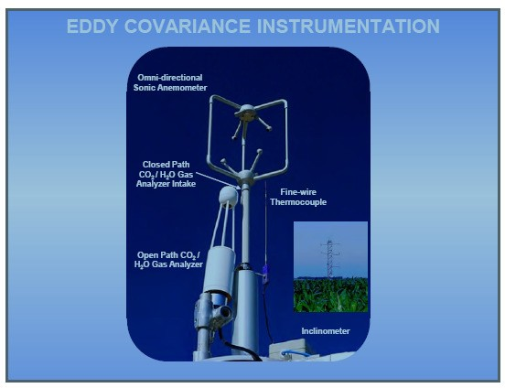

Slide 36
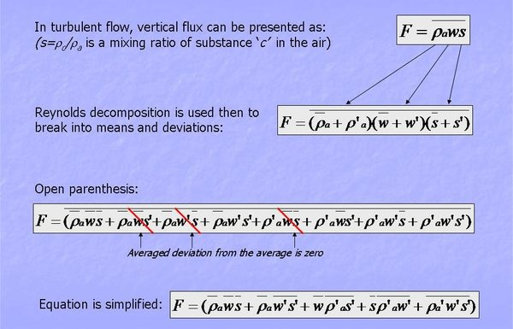

Slide 37
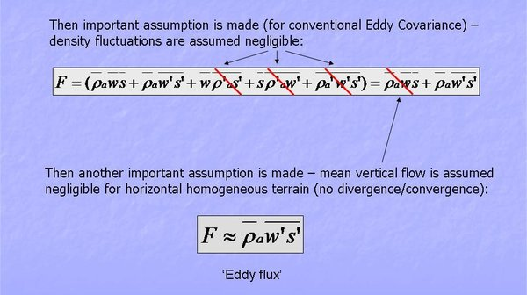

Slide 38

Summary of Eddy Covariance Theory
Measures fluxes transported by eddies
Requires turbulent flow
Requires state-of-the-art instruments
Calculated as covariance of w' and c'
Many assumptions to satisfy
Complex calculations
Most direct way to measure flux
Continuous new developments

Slide 39


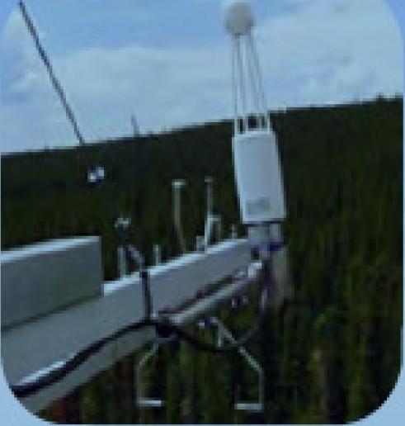

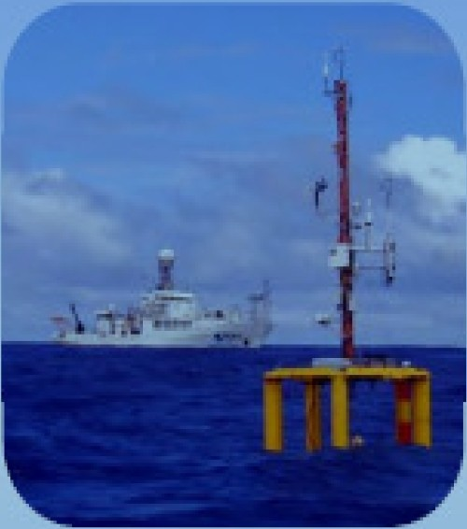
TERRESTRIAL
OCEANOGRAPHIC
98% of applications
<1%of applications
May need customized
reinforcement
May be affected by extreme temperatures and vibrations
<1%of apphcabOns May need customized
coating, LPS3
May be affected by precipitation,dew,& gyroscopic effects
Designed for stafonary use
Limited by precipitation,
fog,& dew

Slide 40
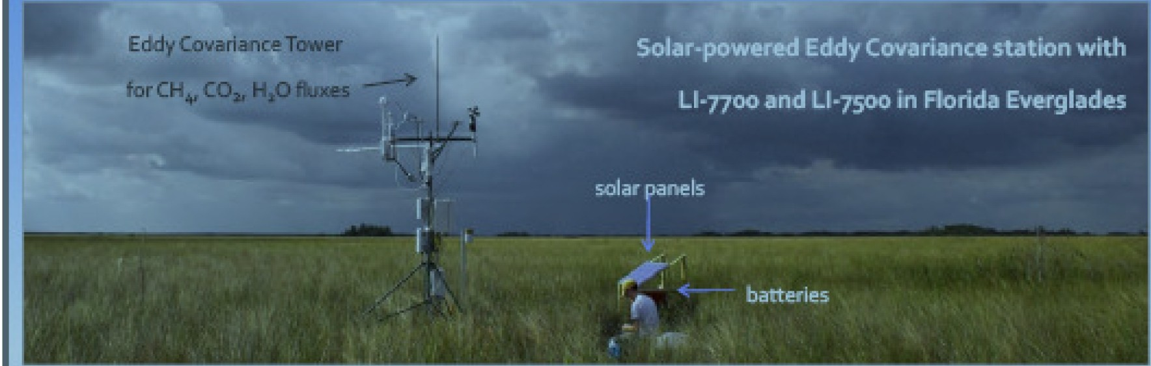
The power consumption by the entire Eddy Covariance station inthe Florida Everglades
,Ll-7500 for C0:1/H₂ 0,some anemometer,and air temperature/relative humidity sensors and barometer
was <30Watts,including Ll-noo for CH₄
The 12 lb.(5.5 kg) open path methane anatyzer was carried Into the wetland by
one person inthe backpack, along with tools,other sensors,and a laptop
•Insuch remote places occasionalcalibrationchecks can be done using small
hand-earned gastanks with known CH₄ concentration and CH₄-free air

Slide 41
Turbulence kinetic Energy and Turbulence Intensity
Kinetic energy is defined as:
where m is mass and V is velocity. In meteorology we often use specific kinetic energy, namely KE/m, or the kinetic energy per unit mass. Similarly, we can define specific kinetic energy associated with turbulent fluctuations :
where TKE is turbulence kinetic energy. For laminar flow, which contains no micro-scale motions, TKE = 0, even though u, v, w are not necessarily zero. Larger values of TKE indicate a greater intensity of the microscale turbulence. We see now that the three components of velocity variance represent three con­tributions to the scalar TKE.

Slide 42
Intensity of Turbulence
The intensity of turbulence is measured in terms of the turbulent kinetic energy (TKE), ē,
Eqn (3)
where u, v, and w are the zonal, meridional, and vertical wind components, respectively. The overbar represents the time average and the prime is the perturbation or eddy contribution. TKE is zero for laminar flow, even though the mean wind components are not necessarily zero.

Slide 43
Using what we already know about mechanical and thermal generation of turbulence, and of viscous dissipation, we can write in descriptive form an Eulerian (i.e., fixed relative to the ground) forecast equation for turbulence kinetic energy:
the advection of TKE by the mean wind, M is mechanical generation of turbulence, B is buoyant generation or consumption of turbulence, Tr is trans­port of turbulence energy by turbulence itself, and ε is the viscous dissipation rate.

Slide 45
The terms Ad and Tr neither create nor destroy TKE, they just redistribute it by moving it from one location to another. M is usually positive ( or zero if there is no shear) and
therefore generates turbulence, while B can be posi­tive or negative. Dissipation is always negative and can be approximated by
Where L_{ε} is the dissipation length scale.

Slide 46
In the absence of the terms Ad, M, B, and Tr, we see that as long as TKE is nonzero, the last term will always cause TKE to decrease toward zero. For this reason, turbulence is said to be dissipative.
In statically stable environments the buoyancy term can reduce TKE by converting it to potential energy by moving cold air up and warm air down. In such situations, the existence of turbulence depends on the relative strengths of mechanical generation (M) by wind shear versus buoyant consumption (B) by static stability.

Slide 47
Turbulence kinetic energy (TKE) is not conserved. It is continually dissipated into internal energy by molecular viscosity. This dissipation usually happens at only the smallest size (1 mm diameter) eddies, but affects all turbulent scales because of the turbulent cascade of energy from larger to smaller scales. For turbulence to exist, there must be continual genera­tion of turbulence from shear or buoyancy (usually into the larger scale eddies) to offset the transfer of kinetic energy down the spectrum of ever-smaller eddy sizes toward eventual dissipation. But why does nature produce turbulence?

Slide 48
Turbulence is a natural response to instabilities in the flow-a response that tends to reduce the insta­bility.
For example, on a sunny day the warm ground heats the bottom layers of air, mak­ing the air statically unstable. The flow reacts to this instability by creating thermal circulations, which move warm air up and cold air down until a new equilibrium is reached. Once this convective adjust­ment has occurred, the flow is statically neutral and turbulence ceases. The reason why turbulence can persist on sunny days is because of continual destabi­lization by external forcings (i.e., heating of the ground by the sun), which offsets continual stabiliza­tion by turbulence.

Slide 49
Similar responses are observed for forced turbu­lence. Vertical shear in the horizontal wind is a dynamic instability that generates turbulence. This turbulence mixes the faster and slower moving air, making the winds more uniform in speed and direc­tion. Once turbulent mixing has reduced the shear, then turbulence ceases. As in the case of convection, persistent mechanical turbulence is possible in the atmosphere only if there is continual destabilization by external forcings, such as by the larger scale weather patterns.

Slide 50
Although the human eye and brain can identify eddies via pattern recognition, the short life span of individual eddies renders them difficult to describe quantitatively. The equations of thermodynamics and dynamics can be brought to bear on this problem, but the result is an ability to deterministically simu­late and predict the behavior of each eddy for only exceptionally short durations. The larger diam­eter thermals can be predicted out to about 15 min to half an hour, but beyond that the predictive skill approaches zero. For smaller eddies of order 100 m, the forecast skill diminishes after only a minute or so. The smallest eddies of order 1 cm to 1 mm can be predicted out to only a few seconds. This inability to deterministically forecast turbu­lence out to useful periods of days is a result of the highly non-linear nature of turbulent fluid dynamics.

Slide 51
Despite the difficulties of deterministic descrip­tions of turbulence, scientists have been able to cre­ate a statistical description of turbulence.
The goal of this approach is to describe the net effect of many eddies, rather than the exact behavior of any individual eddy.

Slide 54
Kolmogorov turbulence
Turbulence is a very complex phenomenon. However, certain statistical properties of turbulence can be derived and understood without much computational eﬀort.
The basic idea is that we start from some large scale stirring, inducing solenoidal motions of wave number k0 =2π/L0 where L0 is the spatial scale of these large scale motions. Now, as we know from stirring milk in a cup of coﬀee: the large motions tend to break up in ever smaller-scale motions. In fact, it is this property of turbulence that leads to the quick dissolution of sugar in a cup of tea. This down-scaling of the turbulence is called a turbulent cascade. Energy is transferred from large-scale motions to ever smaller scale
motions, until one reaches a spatial scale Lν 􀀁 L0 which is the viscous dissipation scale: the spatial scale where the viscosity of the gas/ﬂuid starts to prohibit further cascading.
At this scale the kinetic energy of the gas motions is converted into heat. An important dimensionless number characterizing the turbulence is the Reynolds number:

Slide 55
where V0 is the typical turbulent velocity at the largest scale and ν (in units of cm2/s for CGS units) is the kinematic viscosity of the gas or ﬂuid. For air at 0 degrees Celsius this is ν =0.132cm2/s, and at -40 degrees Celcius it is ν =0.104cm2/s. We can deﬁne a turbulent viscosity

Slide 56
so that νturb = Re ν. For Re􀀂 1 the ratio L0/Lν 􀀂 1, though Re and L0/Lν are not linearly related.
If we assume that there is a constant random stirring at the scale L0, then this input energy cascades down to Lν where it is dissipated. The turbulent cascade is thus char-acterized by an energy input rate per gram of gas ε in units of erg gram−1 sec−1 which in this stationary state is the same as the energy dissipation rate. In k-space this is the energy ﬂow rate from small k to large k. Let us now try to characterize the energy stored in each mode k per gram of gas, written as E(k). The quantity E(k)dk has the dimension erg gram−1. Since k has the dimension cm−1, E(k) has the dimension erg cm gram−1.
Using these dimensions we can start a dimensional analysis. If we write erg = gram cm2 sec−2 then we get the following dimensions:

Slide 57
If kν 􀀂 k0 then there is a large region in k-space, k0 􀀁 k 􀀁 kν where the function E(k) must be independent on what is happening at k0 or kν. The only “information” that it
has in this intermediate-k region is k itself and the energy ﬂow ε. Somehow we must be
able to write E(k) ∝ εαkβ . Using the above dimensionalities you can see that this only
makes dimensional sense if α =2/3 and β = −5/3, i.e.

Slide 63

6.2 The Surface-atmosphere Interface
The surface interface or contact layer or molecular boundary layer is the boundary between the atmosphere and the ocean or the land. This point of contact is the start of energy exchange between the surface and the atmosphere. In the molecular layer, vertical transfer of
heat is by conduction,
moisture is by evaporation/transpiration or condensation, and
momentum is by viscous processes.
The molecular flux is a product of the diffusivity and the vertical gradient, e.g., the conduction of heat is described by:
Eqn (4)
where v is the molecular thermal diffusivity (˜ 2 × 10-5 m2 s-1 for air).
The air-to-surface temperature and moisture differences determine the direction of net transfer. For example, when cold air moves over a warm surface, heat is conducted from the surface to the air, resulting in warmer air and cooler surface.

Slide 64
6.3.1.1 Surface Energy Balance and Impact on Vertical Transport
The surface energy budget balances the net radiation against the sensible heat, latent heat, storage, and advection:
Eqn (5)
where Rn is the net radiation at the surface; SH is sensible heat, LH is latent heat, Δf is the horizontal flux or advection; and G is the heat transferred in and out of storage in subsurface layers. The budget does not include negligible contributors such as the conversion of kinetic energy in wind and waves to thermal energy or heat transfer by precipitation.

Slide 65
Surface energy budget for land surface and ocean surface during the daytime.

Slide 66
Under steady state conditions, such as for the annual averages or for a day over land, vertical transport of heat at the surface is mainly by radiation, latent heat, and sensible heat (Fig. 6.12). Horizontal transport is significant in the ocean but negligible for land. So the steady-state surface budget for the mostly oceanic tropics can be approximated by:
Eqn (6)
Latent heat transfer is the primary energy input from the surface to the atmosphere. Annually, the net surface radiation is balanced mostly by the average latent heat, which peaks near 20° latitude (Fig. 1.11). The average sensible heat is relatively small and varies little by latitude except near the poles where it reverses sign as the atmosphere heats the surface.

Slide 67
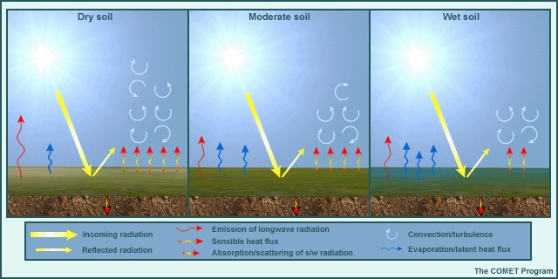
Fig. 6.13. Variations in the surface energy budget components and surface-to-air interactions as soil moisture changes from dry to wet conditions.

Slide 68
hanges in the surface energy budget directly affect the vertical transport and the ABL structure. For example, Fig. 6.13 shows how changes in the soil moisture alter the partitioning of the surface energy budget components (sensible heat, latent heat, and radiation), and the vertical transport by convective turbulence. Similar changes are observed between urban and rural surfaces where additional heating in the urban environment¹⁶ generate a higher BL over urban areas.
The amount of vertical transport is dependent on the fluxes at the surface interface, which are sensitive to the profiles of temperature, moisture, and wind speed in the air and subsurface. During the day, heat, moisture, and momentum are transported by convection; during the night by conduction at the surface interface. Rooted in the surface layer are thermals or buoyant eddies that drive the circulation in the mixed layer during the day (Fig. 6.10). The surface layer above the interface is a buffer between the interface and the rest of the ABL during the transition from the nighttime SBL to the daytime mixed layer; turbulence in the surface layer allows quasi-constant transport between the interface and the mixed layer. The transport from night to day is more complex, with an initial merging of the surface interface, layer, and shallow SBL surface layer at sunset.

Slide 69
Based on an average over a time period T ( say half an hour):
In the atmosphere, this mean value can change from one half-hour period to the next, resulting in a slow variation of the mean-wind components with time.
Subtracting the mean from the instantaneous com­ponent u gives just the fluctuating (gust) portion of the flow (indicated with a prime)

Slide 70
The intensity of tur­bulence in the u direction is then defined by the variance:
In the atmosphere, fluctuations in velocity are often accompanied by fluctuations in scalar values such as temperature, humidity, or pollutant concentration.
For example, in a field of thermals there are regions where warm air is rising (positive potential temperature ϑ' accompanies positive vertical velocity w'), surrounded by regions where cold air is sinking (negative ϑ' accom-arries negative w'). One measure of the amount that ϑ and w vary together is the covariance (cov)

Slide 72
Reynolds Averaging
http://twister.caps.ou.edu/MM2002/Chapter2.2.pdf

Slide 73
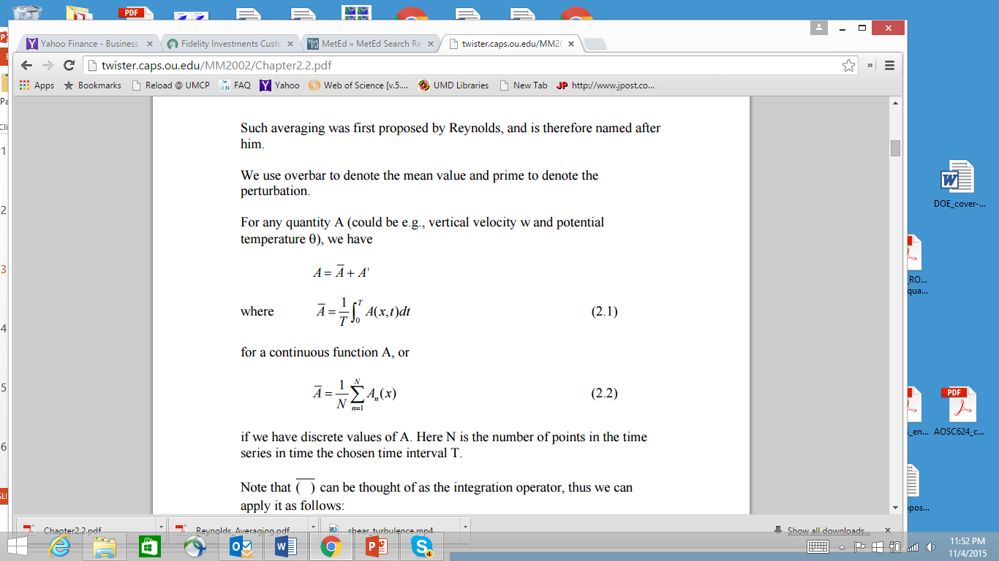

Slide 74
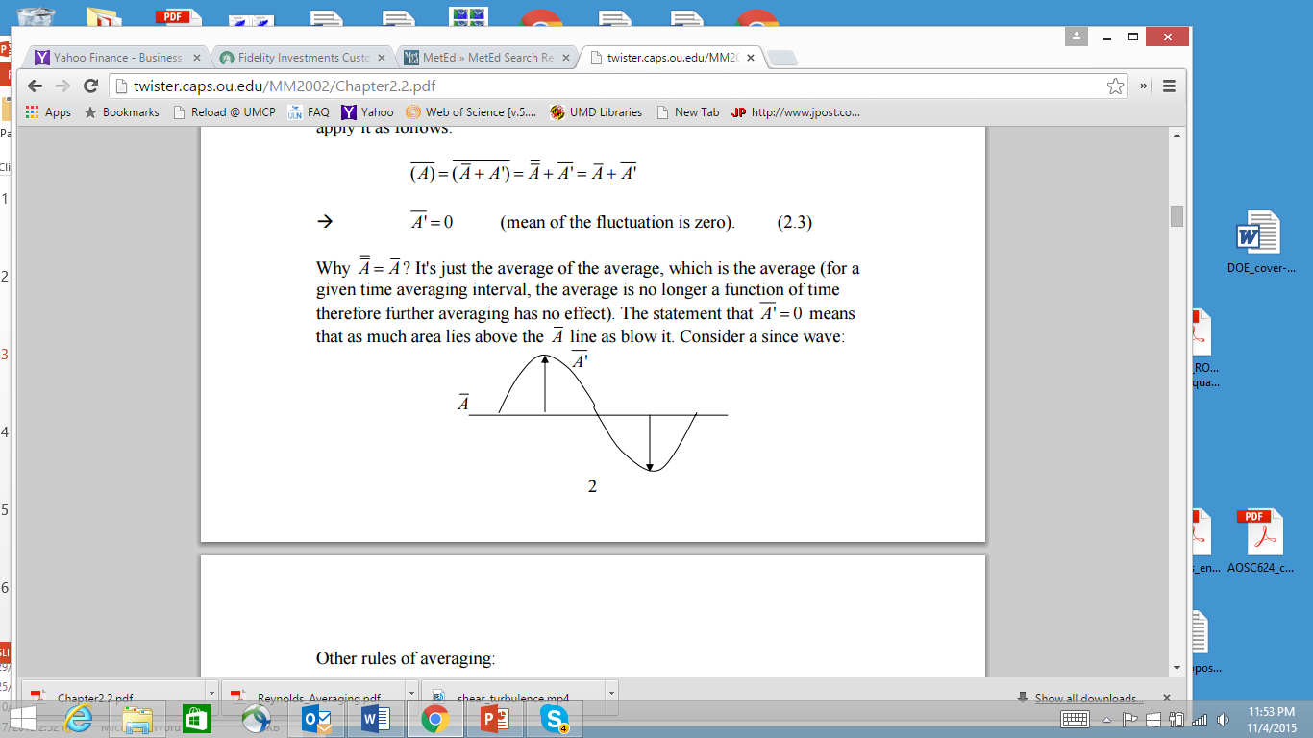

Slide 75
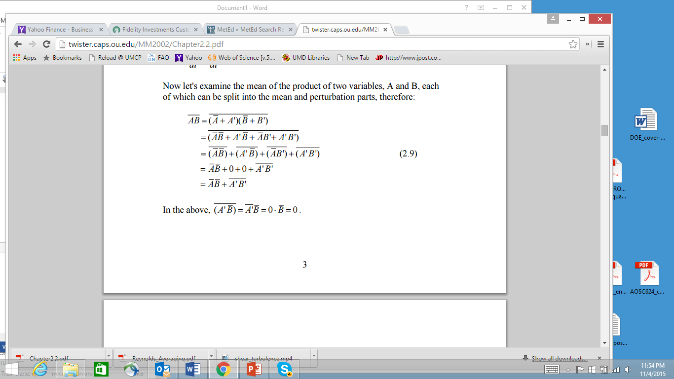

Slide 76
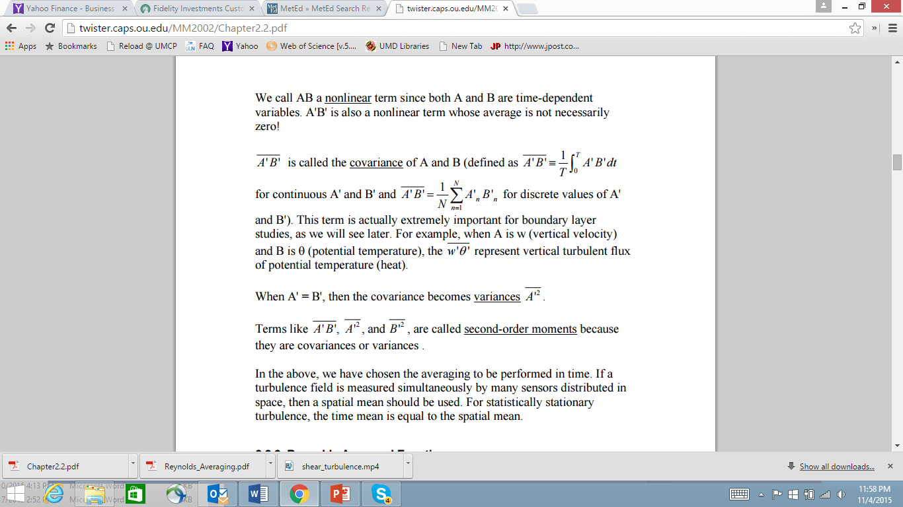

Slide 77
If warm air parcels are rising and cold parcels are sinking, as in a thermally direct circulation, then w' ϑ' > 0. Covariances can also be negative or zero for different situations in the atmosphere.
The power of the statistical approach is that the velocity variance is more than just a statistic-it represents the kinetic energy associated with the motions on the scale of the turbulence.

Slide 79
Turbulence kinetic Energy and Turbulence Intensity
Kinetic energy is defined as:
where m is mass and V is velocity. In meteorology we often use specific kinetic energy, namely KE/m, or the kinetic energy per unit mass. Similarly, we can define specific kinetic energy associated with turbulent fluctuations :
where TKE is turbulence kinetic energy. For laminar flow, which contains no rnicro-scale motions, TKE = 0, even though u, v, w are not necessarily zero. Larger values of TKE indicate a greater intensity of the microscale turbulence. We see now that the three components of velocity variance represent three con­tributions to the scalar TKE.

Slide 80
Using what we already know about mechanical and thermal generation of turbulence, aud of viscous dissipation, we can write in descriptive form an Eulerian (i.e., fixed relative to the ground) forecast equation for turbulence kinetic energy:

Slide 82
Or using eq. 9.4
where TKE is turbulence kinetic energy. For laminar flow, which contains no rnicro-scale motions, TKE = 0, even though
are not necessarily zero. Larger values of TKE indicate a greater intensity of the microscale turbulence. We see now that the three components of velocity variance represent three con­tributions to the scalar TKE.

Slide 83
Using what we already know about mechanical and thermal generation of turbulence, and of viscous dissipation, we can write in descriptive form an Eulerian (i.e., fixed relative to the ground) forecast equation for turbulence kinetic energy:
the advection of TKE by the mean wind, M is mechanical generation of turbulence, B is buoyant generation or consumption of turbulence, Tr is trans­port of turbulence energy by turbulence itself, and ε is the viscous dissipation rate.

Slide 84
The terms Ad and Tr neither create nor destroy TKE, they just redistribute it by moving it from one location to another. M is usually positive ( or zero if there is no shear) and
therefore generates turbulence, while B can be posi­tive or negative. Dissipation is always negative and can be approximated by
Where L_{ε} is the dissipation length scale.

Slide 86
In the absence of the terms Ad, M, B, and Tr, we see that as long as TKE is nonzero, the last term will always cause TKE to decrease toward zero. For this reason, turbulence is said to be dissipative.
In statically stable environments the buoyancy term can reduce TKE by converting it to potential energy by moving cold air up and warm air down. In such situations, the existence of turbulence depends on the relative strengths of mechanical generation (M) by wind shear versus buoyant consumption (B) by static stability.

Slide 88
The ratio of these two terms defines the dimensionless Richardson number, Ri, which can be approximated by the vertical gradients of wind and potential temperature
Laminar flow becomes turbulent when Ri drops below the critical value Ric = 0.25. Turbulent flow often stays turbulent, even for Richardson numbers
as large as 1.0, but becomes laminar at larger values of Ri. The presence or absence of turbulence for 0.25 < Ri < 1.0 depends on the history of the
flow: a behavior analogous to hysteresis. Flows for which Ric < 0.25 are said to be dynamically unstable.

Slide 92
statically stable environments the buoyancy term can reduce TKE by converting it to potential energy by moving cold air up and warm air down. In such situations, the existence of turbulence depends on the relative strengths of mechanical generation (M) by wind shear versus buoyant consumption (B) by static stability. The ratio of these two terms
defines the dimensionless Richardson number, Ri, which can be approximated by the vertical gradients of wind and potential temperature
where the term in the numerator is equivalent to the square of the Brunt Vaisala frequency, as defined in

Slide 93
(3.75). Laminar flow becomes turbulent when Ri drops below the critical value Ric = 0.25. Turbulent flow often stays turbulent, even for Richardson num­bers as large as 1.0, but becomes laminar at larger values of Ri. The presence or absence of turbulence for 0.25 < Ri < 1.0 depends on the history of the flow: a behavior analogous to hysteresis. Flows for
which Ric < 0.25 are said to be dynamically unstable. When the shear in laminar flow across a density interface ( e.g., between cold air below and warm air above) increases to the point at which the flow becomes dynamically unstable, the turbulence onset
grows as a Kelvin-Helmholtz (KH) instability on the interface.

Slide 94
First, small waves appear that grow in ampli­tude and curl over on themselves. If sufficient mois­ture is present in the atmosphere, a cloud can form in the rising portions of each curl, giving rise to a pattern that looks like breaking waves at the beach when viewed from the side (Fig. 9.7a). When viewed from above or below, these features appear as closely spaced para.lie! bands of clouds, called KH billows or billow clouds (Fig. 9.7b), which are perpendicular to the vertical shear vector av/ az. The overturning ofthe billows introduces static instabilities (i.e., locally unstable lapse rates) that further accelerate the transi­tion to turbulence within the shear layer.

Slide 95
2.1 The theory of turbulence in the Earth’s atm
The turbulence in the Earth’s atmosphere is always subsonic. To a very good degree one can regard the velocity ﬁelds to be divergence-free. That means that the turbulence in the Earth’s atmosphere is entirely carried by solenoidal motions: i.e. vorticity. It is caused by many diﬀerent phenomena:
•

Slide 96
Convection: If the lower parts of the atmosphere heat up, the atmosphere can be-come convectively unstable, leading to convective bubbles of gas rising to higher altitudes. Often these bubbles produce cumulus clouds, the strongest of which, the cumulonimbus clouds, cause lightning storms. But not all convection leads to clouds, and convection happens on all scales. For instance, if an asphalt road gets heated up by intense sunlight, the few centimeter thick layers of air above it convectively rise, while cooler air sinks. This leads to “seeing” eﬀects one can often observe in those conditions.
• Wind shear: Diﬀerent layers of the atmosphere may have diﬀerent horizontal ve-locities. If the vertical gradient of this horizontal velocity dvx/dz is strong enough, the Kelvin-Helmholtz instability can set in, leading to a turbulent layer. For this to happen, the Richardson number Ri≡ g/[∆h (dvx/dz)2], where g is the gravitational acceleration and ∆h is the altitude diﬀerence between the adjacent layers, must obey Ri􀀁 1.
• Wind over objects: If a wind ﬂows over objects, such as a mountain or the telescope dome, then turbulence can also be induc

Slide 97
2.2 Kolmogorov turbulence
Turbulence is a very complex phenomenon. A precise simulation of turbulence still often exceeds the capacities of modern supercomputers, although much progress has been made over the last decades. However, certain statistical properties of turbulence can be derived and understood without much computational eﬀort.
The basic idea is that we start from some large scale stirring, inducing solenoidal motions of wave number k0 =2π/L0 where L0 is the spatial scale of these large scale motions. Now, as we know from stirring milk in a cup of coﬀee: the large motions tend to break up in ever smaller-scale motions. In fact, it is this property of turbulence that leads to the quick dissolution of sugar in a cup of tea. This down-scaling of the turbulence is called a turbulent cascade. Energy is transferred from large-scale motions to ever smaller scale
motions, until one reaches a spatial scale Lν 􀀁 L0 which is the viscous dissipation scale: the spatial scale where the viscosity of the gas/ﬂuid starts to prohibit further cascading.
At this scale the kinetic energy of the gas motions is converted into heat. An important dimensionless number characterizing the turbulence is the Reynolds number:

Slide 98
where V0 is the typical turbulent velocity at the largest scale and ν (in units of cm2/s for CGS units) is the kinematic viscosity of the gas or ﬂuid. For air at 0 degrees Celsius this is ν =0.132cm2/s, and at -40 degrees Celcius it is ν =0.104cm2/s. We can deﬁne a turbulent viscosity

Slide 99
so that νturb = Re ν. For Re􀀂 1 the ratio L0/Lν 􀀂 1, though Re and L0/Lν are not linearly related.
If we assume that there is a constant random stirring at the scale L0, then this input energy cascades down to Lν where it is dissipated. The turbulent cascade is thus char-acterized by an energy input rate per gram of gas ε in units of erg gram−1 sec−1 which in this stationary state is the same as the energy dissipation rate. In k-space this is the energy ﬂow rate from small k to large k. Let us now try to characterize the energy stored in each mode k per gram of gas, written as E(k). The quantity E(k)dk has the dimension erg gram−1. Since k has the dimension cm−1, E(k) has the dimension erg cm gram−1.
Using these dimensions we can start a dimensional analysis. If we write erg = gram cm2 sec−2 then we get the following dimensions:

Slide 100
If kν 􀀂 k0 then there is a large region in k-space, k0 􀀁 k 􀀁 kν where the function E(k) must be independent on what is happening at k0 or kν. The only “information” that it
has in this intermediate-k region is k itself and the energy ﬂow ε. Somehow we must be
able to write E(k) ∝ εαkβ . Using the above dimensionalities you can see that this only
makes dimensional sense if α =2/3 and β = −5/3, i.e.

Slide 106
2.2.3. Reynolds fluxes and their physical interpretation
Equation set (2.25) is the Reynolds averaged equations for the mean state variables.
The various covariances in the square brackets in the equations represent turbulent fluxes (a flux is always a quantity multiplied by a velocity).
For example, wu'' is the vertical flux of momentum in the x direction or the
flux of vertical velocity w in x direction. w θ'' is the vertical turbulent flux (flux due to turbulent motion) of heat.

Slide 107
The heat flux is positive when w' and θ' are positively correlated, i.e., when w' and θ' tend to have the same sign. The end result is that warmer air gets transported by the turbulent velocity upward, and cold air gets transported downward, resulting in net positive (upward) heat flux.

Slide 108
The net (turbulent) heat flux into a unit volume of air causes the temperature of this volume to change. This net flux is the difference between the flux going into a, for example, cubed volume on one side and that going out of the volume on the other side, it is therefore the flux divergence that causes the change in the quantity being transported (by turbulence), which is θ in (2.25e) and q in (2.25f).
For momentum, the flux of the momentum parallel to a volume face (e.g., the flux of u through lower boundary of a cubed volume by w) causes the parallel momentum (u in this case) to change at that face. Therefore the momentum flux is the stress (force /unit area) applied at this face. We therefore also call the momentum fluxes in the above momentum equations the Reynolds stresses. We often symbol τ is used to denote the stress.
Let's look at the physical meaning of the fluxes in some more details. Let's look at the heat flux for example.

Slide 109
Suppose we have an idealized turbulent eddies near the ground on a hot summer day. If we start with a particular profile of θ , how will it change with time? Due to the surface heating, typically θ is super-adiabatic near the ground ( θddz</0), as shown in the following figure.
ssume that we have two parcels, A and B. The A moves downward, and B upward. When A moves downward, it becomes colder than its environment,

Slide 111
it therefore carries a negative θ'. For parcel B, it's the opposite, it carries a positive θ', therefore
For parcel A, w' < 0 and θ'< 0 􀀁 w θ'' > 0 therefore the heat flux is positive.
For parcel B, w'>0 and θ' > 0 􀀁 w θ'' > 0 therefore the heat flux is also positive.
Even though both fluxes are positive, the physical process is different – positive heat flux can be caused by either transporting (by turbulent eddies) colder air downward or transporting warmer air upward.

Slide 113
Eddy correlation, gradient-flux, and bulk transfer methods
According to Fick’s law the net vertical flux of water vapor across the earth’s surface is proportional to the specific humidity (concentration) gradient, a similar manner as for momentum and heat.
The proportionality coefficient for the vapor flux is the molecular diffusivity for water vapor:

Slide 114
This expression is only valid in the laminar viscous sublayer.
This mechanism operates at the air-water, air-soil, and air-vegetation interfaces.
The lower region of the surface boundary layer is almost always turbulent so that in this layer the water is transferred away from the molecular sublayer by turbulence.

Slide 115
The vertical flux is the given by
The transport in this mixed layer depends on surface roughness, wind shear, and thermal stratification.
The rate of transfer of water vapor (evaporation) depends on all these factors as well as on the gradient of specific humidity.

Slide 116
We can than accept a gradient-flux relation
Where by analogy the eddy diffusivity for water vapor replaces the molecular diffusivity .

Slide 117
In a similar way as in the bulk transfer approach for determining the heat flux, we can also write and equivalent expression for the evaporation as

Slide 118
Where
is the bulk transfer coefficient for water vapor.
The value of is not well established particularly at high wind speeds, such as for .

Slide 119
Sometimes and are used although they have a somewhat different behavior depending on the stability and wind shear or on the two factors combined in terms of the Richardson number.
The main difficulty in applying this last method is that the specific humidity at the surface q(0) is not easy to measure or estimate over land.

Slide 120
Energy balance method
The energy equation at the surface (6.40) can be written as
Solving for E we find
where B is the Bowen ratio.
Knowing the Bowen ratio and the other fluxes, this can be used to compute the evapotranspiration.

Slide 121
The Bowen ratio can be computed from the gradient-flux relationship for heat (10.33) and water vapor (10.37), assuming that :
or

Slide 122
Thus, to evaluate B one needs to measure the temperature difference and the specific humidity difference between two levels in the surface mixed layer.
,we can express B in terms on the vapor pressure e instead of q, so that

Slide 123
where
is the Bowen constant, the well-known psychomotor constant with a mean value of mb º for p=1000 mb.

Slide 124


Eddy correlation, gradient-flux, and bulk transfer methods
According to Fick’s law the net vertical flux of water vapor across the earth’s surface is proportional to the specific humidity (concentration) gradient, in a similar manner as for momentum and heat. The proportionality coefficient for the vapor flux is the molecular diffusivity for water vapor:
This expression is only valid in the laminar viscous sublayer, where the molecular exchange is the prevalent transfer mechanism. This mechanism operates at the air-water, air-soil, and air-vegetation interfaces.
The lower region of the surface boundary layer is almost always turbulent so that in this layer the water is transferred away from the molecular sublayer by turbulence. The vertical flux is the given by
The transport in this mixed layer depends on surface roughness, wind shear, and thermal stratification. Therefore, the rate of transfer of water vapor (evaporation) depends on all these factors as well as on the gradient of specific humidity. We can than accept a gradient-flux relation
Where by analogy the eddy diffusivity for water vapor replaces the molecular diffusivity .

Slide 125
Where by analogy the eddy diffusivity for water vapor replaces the molecular diffusivity .
In a similar way as in the bulk transfer approach for determining the heat flux, (10.34), we can also write and equivalent expression for the evaporation as
Where is the bulk transfer coefficient for water vapor. Over land, Eq. (10.38) gives only a measure of the potential not necessarily the actual evaporation. The value of is not well established particularly at high wind speeds, such as for , for which there are as yet no direct estimates. Sometimes for convenience and are used although they have a somewhat different behavior depending on the stability and wind shear or on the two factors combined in terms of the Richardson number (10.22). The main difficulty in applying this last method is that the specific humidity at the surface q(0) is not easy to measure or estimate over land.

Slide 126
Evaporative processes play a critical role in the climate
system, coupling the surface and the atmosphere and
linking the water, energy, and carbon cycles.

Slide 127
2.2. Reynolds averaging and Reynolds averaged equations We will study several aspects of the PBL. Before that, we need to develop a set of equations that are suitable for studying turbulent flows. 2.2.1. Reynolds Averaging
To obtain a wind speed measurement representative of the large-scale flow, we obtain take an average over a time period long enough to smooth over the fluctuations but still short enough for keep the trend. The trend can be early identified in the above

Slide 128
http://twister.caps.ou.edu/MM2002/Chapter2.2.pdf

Slide 130
Typically, wind shear creates the turbulence and horizontal roll vortices that loft dust up and away

Slide 131
0:02
0:01
0:09
Turbulence acts to disperse dust plumes and keep the dust particles in suspension. Without turbulence, dust generally settles at a rate of 305 meters (1,000 feet) per hour. However, this is highly dependent on environmental conditions. Any turbulence will slow the settlement rate.

Slide 132
A) Forced – flow across rough surface
B) Free – caused by density or buoyancy differences within a moving fluid
C) Natural – occurs over a heated surface when there is no wind.

Slide 133
Air masses1 are boundary layers that form over different surfaces. Temperature differences between neighboring air masses cause baroclinicity that drives extratropical cyclones. Heat and humidity trapped in the boundary layer are important fuels for convec­tive clouds. The capping inversion inhibits thunder­storm formation, allowing the buildup of convective available potential energy ( CAPE) in the free atmos­phere. Wind shear in the boundary layer, caused by drag near the ground, generates horizontal vorticity that can be tilted by the updrafts in convective clouds to form tornadoes. Dissipation of kinetic energy within the boundary layer serves as a brake on large­scale wind system

Slide 134
Bowen ratio
The nature of the ABL is determined by the balance between H and E, which depends on surface moisture availability.
A convenient parameter is the Bowen ratio, defined as
B= H / E
It is not suitable for parameterisation schemes in numerical models but it is conceptually helpful. Typical values at midday over different surfaces are:

Slide 143
How if heat transported?
Conduction – principal method of heat transfer in ground.
Air temperature – determined principally by –
a) Radiative flux divergence
b) Advection
c) Convection
d) Latent heat exchanges by evaporation and condensation
Advection import – if earth surface not uniform (motion of warm air across a cooler lake). Advection term doesn’t appear in energy balance because wind flow is horizontal.

Slide 144
Air masses1 are boundary layers that form over different surfaces. Temperature differences between neighboring air masses cause baroclinicity that drives extratropical cyclones. Heat and humidity trapped in the boundary layer are important fuels for convec­tive clouds. The capping inversion inhibits thunder­storm formation, allowing the buildup of convective available potential energy ( CAPE) in the free atmos­phere. Wind shear in the boundary layer, caused by drag near the ground, generates horizontal vorticity that can be tilted by the updrafts in convective clouds to form tornadoes. Dissipation of kinetic energy within the boundary layer serves as a brake on large­scale wind system

Slide 145
The Earth's surface is the bottom boundary of the atmosphere.
The portion of the atmosphere most affected by that boundary is called the atmospheric boundary layer (ABL) layer for
The thickness of the boundary layer is quite vari­able in space and time. Normally -1 or 2 km thick (i.e., occupying the bottom 10 to 20% of the troposphere), it can range from tens of meters to 4 km or more.
Turbulence and static stability conspire to sand­wich a strong stable layer ( called a capping inversion) between the boundary layer below and the rest of the troposphere above ( called the free atmosphere).
This stable layer traps turbulence, pol­lutants, and moisture below it and prevents most of the surface friction from being felt by the free atmosphere.

Slide 146
Turbulence is responsible for efficiently dispersing the pollutants
However, the capping inversion traps these pollutants within the boundary layer,
Turbulent communication between the sur­face and the air is quite rapid, allowing the air to quickly take 'on characteristics of the underlying sur­face.
In fact, one definition of the boundary layer is that portion of the lower troposphere that feels the effects of the underlying surface within about 30 min or less.

Slide 147
The Earth's surface is the bottom boundary of the atmosphere.
The portion of the atmosphere most affected by that boundary is called the atmospheric boundary layer (ABL) layer for
The thickness of the boundary layer is quite vari­able in space and time. Normally -1 or 2 km thick (i.e., occupying the bottom 10 to 20% of the troposphere), it can range from tens of meters to 4 km or more.
Turbulence and static stability conspire to sand­wich a strong stable layer ( called a capping inversion) between the boundary layer below and the rest of the troposphere above ( called the free atmosphere).
This stable layer traps turbulence, pol­lutants, and moisture below it and prevents most of the surface friction from being felt by the free atmosphere.

Slide 148
Turbulence is responsible for efficiently dispersing the pollutants
However, the capping inversion traps these pollutants within the boundary layer,
Turbulent communication between the sur­face and the air is quite rapid, allowing the air to quickly take 'on characteristics of the underlying sur­face.
In fact, one definition of the boundary layer is that portion of the lower troposphere that feels the effects of the underlying surface within about 30 min or less.

Slide 149
Fluxes are defined by:
QH = ρCp w'θ '
QLE = ρ Lv w'q'
• w’: turbulent fluctuations of upward wind velocity
• q’: turbulent fluctuations of humidity
θ
Turbulent fluctuations of temperature

Slide 150
9.1 Turbulence
Atmospheric flow is a complex superposition of many different horizontal scales of motion (Table 9.1), where the "scale" of a phenomenon describes its typi­cal or average size. The largest are planetary-scale circulations that have sizes comparable to the circum­ference of the Earth. Slightly smaller than planetary scale are synoptic scale cyclones, anticyclones, and waves in the jet stream. Medium-size features are called mesoscale and include frontal zones, rain bands, the larger thunderstorm and cloud complexes, and various terrain-modulated flows.
Smaller yet are the microscales, which contain boundary-layer scales of about 2 km, and the smaller turbulence scales contained within it and within clouds. The mesoscale and microscale are further subdivided, as indicated in Table 9.1. This chapter focuses on the microscales, starting with the smaller ones.

Slide 151
When flows contain irregul'ar swirls of many sizes that are superimposed, the flow is said to be turbu­lent. The swirls are often called eddies, but each individual eddy is evanescent and quickly disap­pears to be replaced by a succession of different eddies. When the flow is smooth, it is said to be laminar. Both laminar and turbulent flows can exist at different times and locations in the boundary layer.
Turbulence can be generated mechanically, ther­mally,, and inertially. iWechanical turbulence, also known as forced convection, can form if there is shear in the mean wind. Such shear can be caused by frictional drag, which causes slower winds near the ground than aloft; by wake turbulence, as the wind swirls behind obstacles such as trees, buildings, and islands (Fig. 9.2); and by free shear in regions away from any solid surface (Fig. 9.3).

Slide 153
Thermal or convective turbulence, also known as free convection, consists of plumes or thermals of warm air that rises and cold air that sinks due to buoyancy forces. Near the ground, the rising air is often in the form of intersecting curtains or sheets of updrafts, the intersections of which we can identify as plumes with diameters about 100 m. Higher in the boundary layer, many such plumes and updraft curtains merge to form larger diameter (-1 km) thermals. For air containing sufficient moisture, the tops of these thermals contain cumu­lus clouds (Fig. 9.4).

Slide 154
Small eddies can also be generated along the edges of larger eddies, a process called the turbulent cascade, where some of the inertial energy of the larger eddies is lost to the smaller eddies, as elo­quently described by Richardson's poem (see Chapter 1 ). Inertial turbulence is just a special form of shear turbulence, where the shear is generated by larger eddies. The superposition of all scales of eddy motion can be quantified via an energy spectrum (Fig. 9.5), which indicates how much of the total tur­bulence kinetic energy is associated with each eddy scale.
t affects all turbulent scales because of the turbulent cascade of energy from larger to smaller scales. For turbulence to exist, there must be continual genera­tion of turbulence from shear or buoy ancy (usually into the larger scale eddies) to offset the transfer of kinetic energy down the spectrum of ever-smaller eddy sizes toward eventual dissipation. But why does nature produce turbulence?

Slide 155
The intensity of tur­bulence in the u direction is then defined by the variance:
Again, this is the variance averaged over a half-hour period so this variance value can vary slowly with time over subsequent averaging periods. Similar equations can be defined for the other velocity components.
For situations in which u,7 is relatively constant with time (e.g., the same now as an hour ago), the turbulent nature of the flow is said to be stationary. When ua is relatively uniform in space ( e.g., the same value in one town as in a neighboriug town), the flow is said to be homogeneous. For situations in which the turbulence intensity at any one point is the same in all directions (u,7 = u3 = u,i), the flow is said to be isotropic.
In the atmosphere, fluctuations in velocity are often accompanied by fluctuations in scalar values such as temperature, humidity, or pollutant concentration. For example, in a field of thermals there are regions where warm air is rising (positive potential temperature O' accompanies positive vertical velocity w'), surrounded by regions where cold air is sinking (negative O' accom-arries negative w'). One measure of the amount that O and w vary together is the covariance (cov)

Slide 156
table: With warmer environment after an initial upward displacement, the parcel will sink
Unstable: With cooler environment after an initial upward displacement, the parcel will rise
Neutral: With the same temperature, the parcel will remain neutrally buoyant
Conditionally unstable: Stable except for rising or sinking parcels that are saturated with water vapor
The temperature profiles associated with stable, neutral, and unstable conditions are illustrated in Fig. 6.4a. Stability is also assessed from the vertical gradient of potential temperature, θ, where δθ/δz > 0 is stable; δθ/δz = 0 is neutral; and δθ/δz < 0 is unstable (Fig. 6.4b). Stability for moist convection is determined from the vertical gradient of the equivalent potential temperature, δθ_{e}/δz > 0 is stable; δθ_{e}/δz = 0 is neutral; and δθ_{e}/δz < 0. The local value of the lapse rate determines local stability; so the atmosphere may have stable and unstable layers. Instability promotes rapid vertical mixing because buoyancy accelerates an initial push on an air parcel.

Slide 157
Turbulence and static stability conspire to sand­wich a strong stable layer (capping inversion) between the boundary layer below and the rest of the troposphere above ( called the free atmosphere).
This stable layer traps pol­lutants, moisture and prevents the surface friction from being felt by the free atmosphere.

Slide 158
Mean Vertical Structure
“What goes up must come down” aptly describes the troposphere, which is a deep layer where upward motion is capped by the tropopause and the stable stratosphere. These basic layers characterize the mean sounding: the atmospheric boundary layer (ABL), the free atmosphere, and the tropopause (at 15-18 km, the highest global mean).
The ABL, also known as the planetary boundary layer (PBL), is the lowest layer of the troposphere. The ABL is in contact with the surface and experiences frictional effects. Heat, moisture, momentum, aerosols, and gases are exchanged between the free atmosphere and the surface through the ABL. The boundary layer is marked by small-scale turbulent motion and a rapid response to changes in the surface conditions. The boundary layer depth varies from 10s of meters over tropical oceans to several km over hot, dry continents but the typical height is about 1 km. Note that a well-defined boundary layer is not always present. A gradient level is defined for synoptic analysis as the level where friction effects are negligible; around 1 km—a typical ABL height.
The free atmosphere is unaffected by surface friction. It occupies most of the tropical troposphere and is marked by mostly large-scale subsidence, with upward motion in intermittent deep cumulus and cumulonimbus. Its motions and associated processes have a broad range of time and spatial scales in this layer (Fig. 3.1.4).

Slide 159
With turbulent flow, there is vertical mixing, while with laminar flow mixing between layers is non-existent or negligible.
For the atmosphere, the Richardson number, Ri, used to evaluate whether an atmospheric layer is predominantly turbulent or laminar, is the ratio between the static stability and shear stability. Vertical wind shear can lead to vertical mixing even in a statically stable environment. Using the Brunt-Väisälä or buoyancy frequency, N, as a measure of static stability in a stably-stratified environment, Ri can be expressed as,
Eqn (1)
Here u is horizontal velocity, z is the height, g is the acceleration due to gravity, ρ is the density as a function of height. For small Ri, the shear is enough to overcome the stable stratification; then a shear instability develops. In general,
Laminar flow becomes turbulent when Ri < 0.25
Turbulent flow becomes laminar when Ri > 1.0

Slide 160
In experiments with flow in pipes, Reynolds (1894) found that the transition from laminar to turbulent flow depends on the ratio of momentum advection effect to molecular viscosity. Turbulence occurs at a critical Reynolds number, Re, when the flow can no longer sustain the shear.

Slide 161
Using what we already know about mechanical and thermal generation of turbulence, aud of viscous dissipation, we can write in descriptive form an Eulerian (i.e., fixed relative to the ground) forecast equation for turbulence kinetic energy:

Slide 163
Or using eq. 9.4
where TKE is turbulence kinetic energy. For laminar flow, which contains no rnicro-scale motions, TKE = 0, even though
are not necessarily zero. Larger values of TKE indicate a greater intensity of the microscale turbulence. We see now that the three components of velocity variance represent three con­tributions to the scalar TKE.

Slide 164
The ratio of these two terms defines the dimensionless Richardson number, Ri, which can be approximated by the vertical gradients of wind and potential temperature
Laminar flow becomes turbulent when Ri drops below the critical value Ric = 0.25. Turbulent flow often stays turbulent, even for Richardson numbers
as large as 1.0, but becomes laminar at larger values of Ri. The presence or absence of turbulence for 0.25 < Ri < 1.0 depends on the history of the
flow: a behavior analogous to hysteresis. Flows for which Ric < 0.25 are said to be dynamically unstable.

Slide 165
Vertical motions due to horizontal divergence and convergence in the general circulation are on the order of 0.01 m s-1 while vertical motions due to local buoyancy in deep convection and turbulent processes are more rapid, on the order of 1-10 m s-1.
The latter indicates the importance of buoyancy and turbulence in the determination of vertical transport.

Slide 166





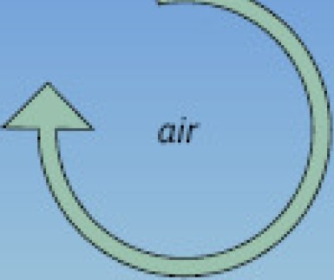
time:i. eddy:i.
time 2
eddy 2
[;J
lW
GJ
GJ
air
,_
t
2
_{W}2
GJ
At a single point on the tower:
Eddy 1moves parcel of air c down with the speed w
1 1
then Ed dy 2 moves parcel c₂ up with the speed w₂
Each pa cel has concentration,temperature, hum idity;
if we know these and the speed -we know the flux

Slide 167


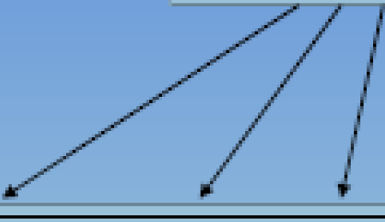

In turbulent flow, vertical flux can be presented as:
(s-p/pa is the mixing ratio of substance 'cin air)
F = JliliS
lF= (pa + p 'Q)(,..,+ lt·'')(s +s' )
Reynolds decomposition is used then to break i nto means and deviations:
"
Opening the parentheses:
--- -
-
F =(pa11.1s+ pa
' pa 1 · pa 1v's'+p al
p 'a11 '+p 'a1i"s + p 'a11-¹ )
1
Averoged deviationfrom theavemge is zem
--- ---
Equation is simplified: F = (pali¹s+ pa ,i,'s' +11- p'a.S' + sp 'a11¹ + pi ' ,i,'s')

Slide 168


General equation: IF ::::::: Pa W ^{I}S ^{I}I
H == p C ,1,' T '
Sensible heat flux:
a p
LE = .11,
'l .1\. .1.,.. / J\f.a --, ,
Latent heat flux:
"'_{p} p lt..' e
/J
Ca11bondioxide flux: F
l{ p C '
C
NOTE: Instruments usually do not measure mixing ratio s,so there is yet another assumptioninthe practicalformulas (such as: p,,w's'= w''P'c

Slide 169


Measurements at a pointcan represent an upwind area
Measurements are done inside the boundary layer of interest
Fetch/footprint is adequate -fluxes are measured only at the area of interest
Flux is fully turbulent -most of the net vertical transfer is done by eddies Terrain is horizontal and unitorm: average of fluctuations is zero;
air density fluctuations ,flow convergence & divergence are negligible
Instruments can detect very small changes at very high frequency
r -· I

Slide 170




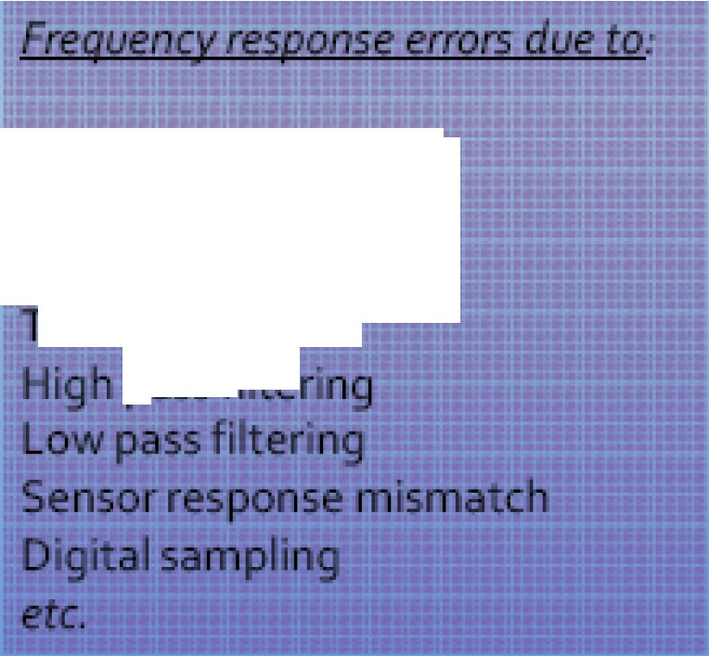
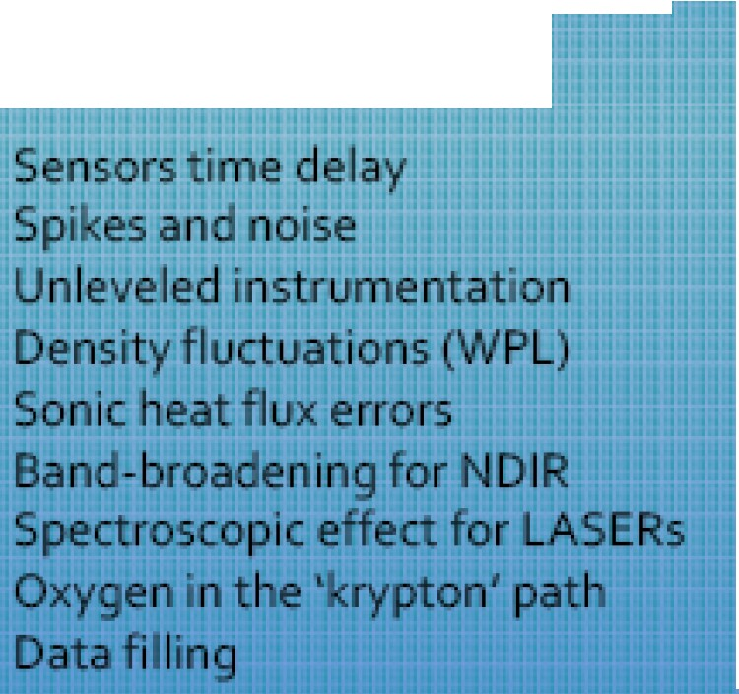
Measurements are not perfect:due to assumptions,physical phenomena,instrument problems,and specificities of terrain and setup
There could be a number of flux errors introduced if not corrected:
Other key error sources:
System time response
Sensor separation
Sc arpa h aver-,ing ube lon
11KllD R.,.,..._cr

Slide 171

These errors are not trivial- they may combine toover 10o% of the flux
To minimize or avoid such errors a number of procedures could be performed
Errors due to Affected fluxes Approximate Range
Frequency response | all | 5-30%
T me deray | all | 5-15%
Spikes,no se | all | 0-15%
Unleveled mstrument/flow | all | 0-25%
Density fluctuatton | H20,co>' CH.. | 0-50%
Sonic heat error | sensible heat | 0..10%
Band Broadening for NDtR | mostly C0₃ | 0..5%
Spectroscop..:effect for LASER | any gas | 0•3o96
Oxygen ln the path | some H30 | 0 1096
Messing data fill Ing | all | O·

Slide 172


Errors Remedy
Fruency respo se | frequency respo se corrections
Time lay | adjust• g for delay
Spikes,noise | spike removal
Unleveled inst1ument/ ow | coord ate rotatio
Density f luctuation | Webb..Pearman Leun ng correction
Son c heat error | son c temperature correction
Ba d Broaden g for NDIR | nd..broadening correctton
SpKtroscopic effect for LASER | no uniform W1dely used correcnon
Oxyge int e path | oxygen correct•on
Miss• g data fill•ng | Methodology/tests: Monte-Carlo etc-

Slide 173
The Eddy Covariance method provides measurements of gas emission and also allows measurements of fluxes of sensible heat, latent
heat and momentum, integrated over an area.
This method was widely used in micrometeorology for over 30 years, but now, with firmer methodology and more advanced instrumentation, it can be available to any discipline, including science, industry, environmental monitoring and inventory.

Slide 174
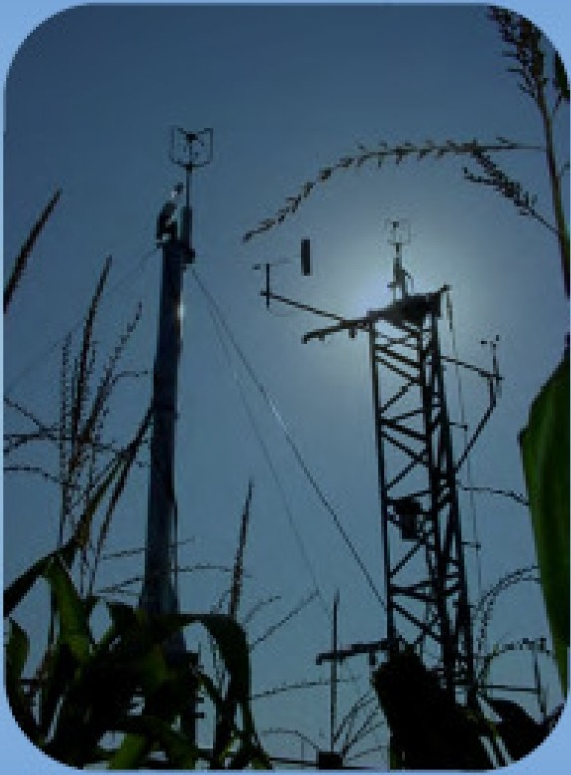
State of Methodology
There is currently no uniform technology
or a single methodo logy for EC method
A lot of effort is being placed by networ ks (e.g.,Fluxnet) to unify various approaches
Here we present one of the conventional ways of implement ing the Eddy Covariance method

Slide 175
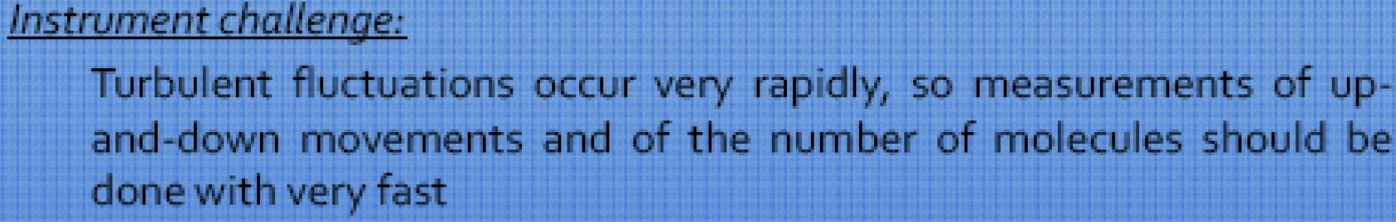
The general principle:
If we know how many molecules went up with eddies at time 1, and how many molecules went down with eddies at time 2 at the same point - we can calculate vertical flux at that point and over that time period
How to measure flux
Essenceof method: Vertical flux can be represented as a covariance of the vertical velocity and concentration of the entity of interest

Slide 176
Modern instruments and software make this
method easily available and potentially widely-used in studies beyond micrometeorology, such as in ecology, hydrology, environmental and industrial monitoring, etc.
Main challenge of the method for a non- expert is the shear complexity of system design, implementation and processing the large volume of data

Slide 177
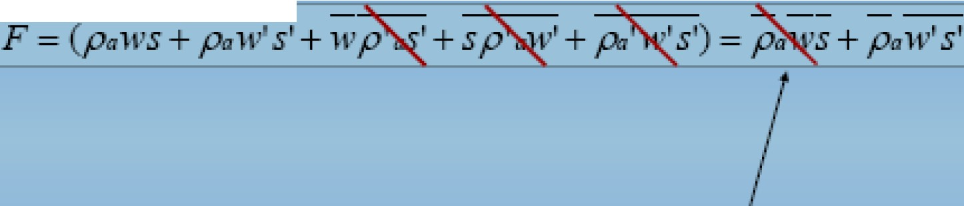
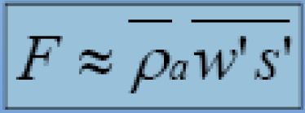
Now an important assumption is made (forconventional Eddy
Covariance)- air density fluctuations areassumed negligible:
--- ---
Then another important assumption is made - mean vertical flow is assumed negligible for horizontal homogeneous terrain (no divergence/convergence):
Eddy flux'

