Slide 1
AOSC400-2015
November 10, Lecture # 19
Supplementary background material for Chapter 9
Adiabatic Lapse Rate
Environmental Lapse Rate
Concept of stability
Hydrostatic balance
Copyright@2015 University of Maryland
This material may not be reproduced or redistributed, in whole or in part, without written permission of Rachel T. Pinker
*Sources of information used for this lecture are listed in updated Syllabus.

Slide 2
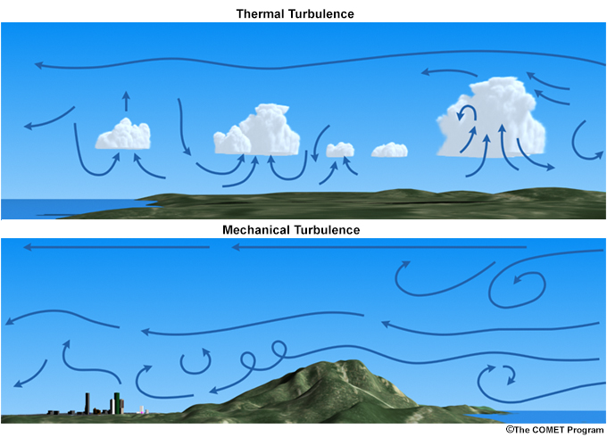
Schematic of turbulence generated convectively or thermally (upper) and mechanically (lower).

Slide 3
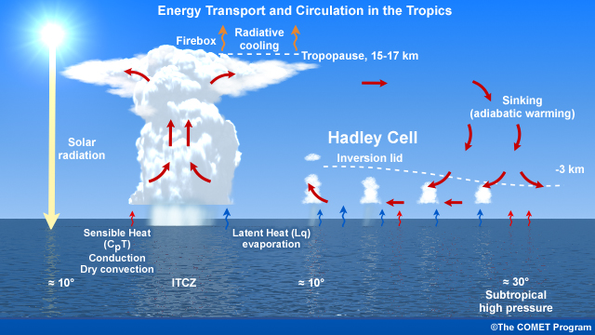
Circulation and energy in the Hadley Cells over the ocean

Slide 4
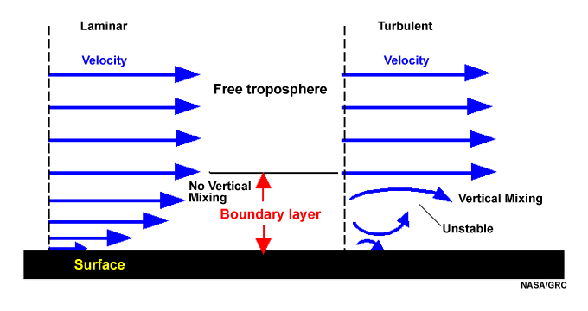
Turbulent and Laminar Flow
Schematic of laminar and turbulent flow in the boundary layer; velocity is zero at the surface.

Slide 5

Heat capacity (C) or thermal capacity is the ratio of the heat (Q) added to (or removed from) an object to the resulting temperature change ΔT.
Specific heat is the amount of heat needed to raise the temperature of a certain mass 1 degree Celsius.
In the International System of Units, heat capacity has the unit joules per kelvin.

Slide 6
To measure heat capacity is to add a known amount of heat to an object, and measure the change in temperature.
This works reasonably well for many solids.
For gasses, other aspects of measurement become critical and there are several slightly different measurements of heat capacity.
The most commonly used methods for measurement are to hold the object either at constant pressure (C_{P}) or at constant volume (C_{V}).

Slide 7
Measurements under constant pressure produce larger values than those at constant volume because the constant pressure values also include heat energy that is used to do work to expand the substance against the constant pressure as its temperature increases.
This difference is particularly notable in gases where values under constant pressure are typically 30% to 66.7% greater than those at constant volume.

Slide 8


These are defined as:
All gases follow approximately the same equation of state over large range of conditions:
pV ~ mT
pV = mRT
R is known as the gas constant
using the equation of state one can show that:

Slide 9
Next, concept of stability

Slide 10
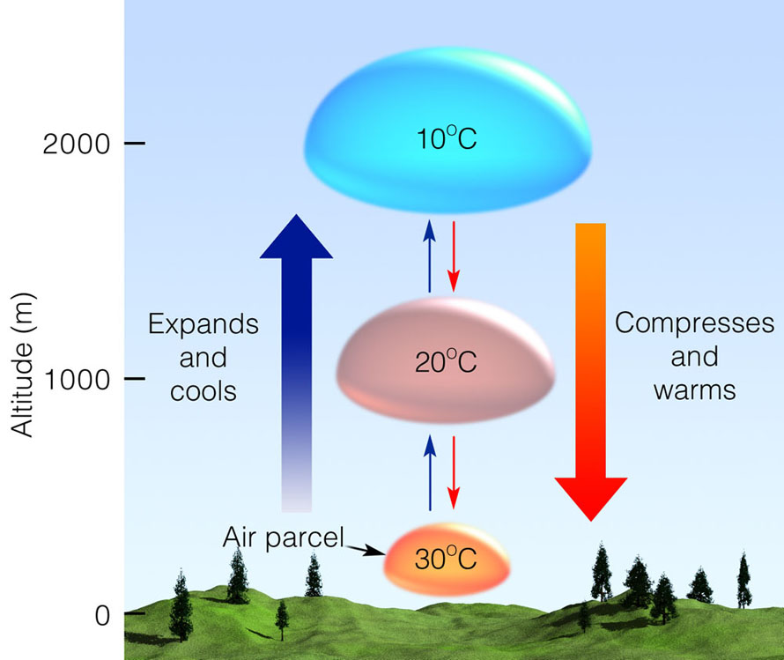
Usually, air parcels that move up –cool; when they descent, they warm.

Slide 11
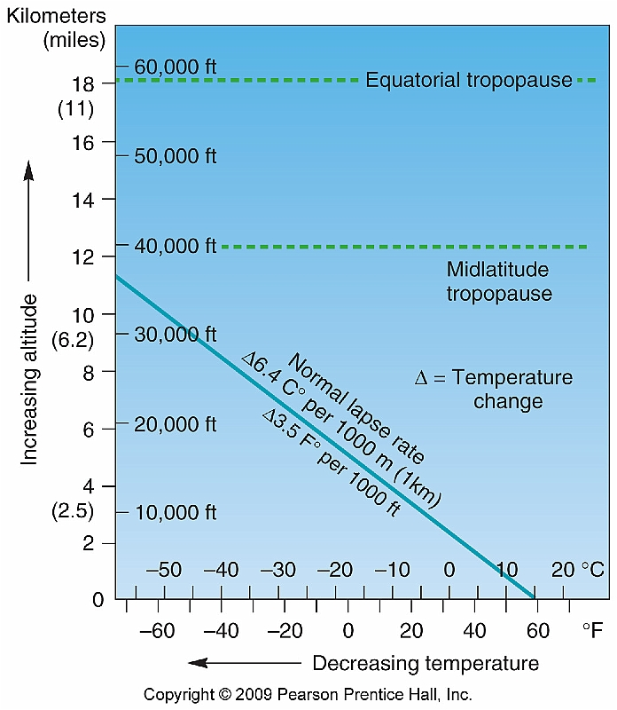
Earlier we have noted that on the average, the atmosphere cools by about 6.5 ⁰ C per each 1 km ascent . That is not always the case. Change with height is called “lapse rate”)

Slide 12
Adiabatic Process
If a material changes its physical state –(pressure, volume, or temperature change) without any heat being added or withdrawn - change is said to be adiabatic.
In the atmosphere, well-defined air parcels do the vertical mixing.
Assume that the air parcel is:
Thermally insulated from environment so that the temperature changes adiabatically as it rises or sinks
Is at same pressure as environment at the same level, which is assumed in hydrostatic equilibrium

Slide 13

The adiabatic lapse rate
The rate of change of temperature with height of parcel of dry air which moves about in the earth’s atmosphere while always satisfying the conditions of no exchange of heat with environment.
Since the air parcel undergoes only adiabatic transformations
and the atmosphere is in hydrostatic equilibrium, for a unit mass of air in the parcel we have, from
For derivation, see last slide (not mandatory, only for students that had thermodynamics).

Slide 14
where Ґ is called the dry adiabatic lapse rate.
Since an air parcel expands as it rises in the atmosphere, its temperature will decrease. Substituting g = 9.81 m s⁻² and c = 1004j kg deg into gives
Ґ = 0.0098 deg m or 9.8 deg km

Slide 15
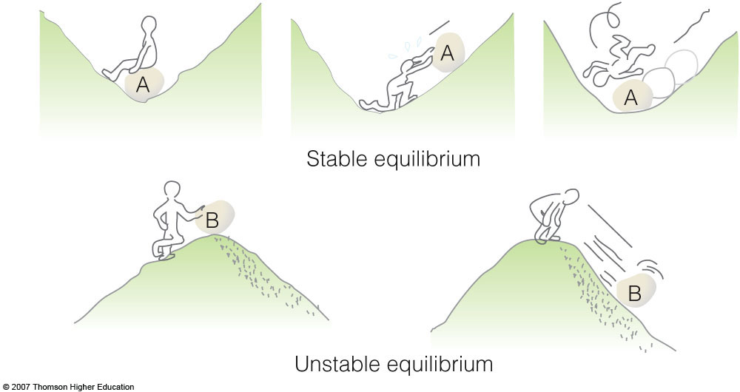
Stability
When rock A is disturbed, it will return to its original position; rock B, however, will accelerate away from its original position.

Slide 16
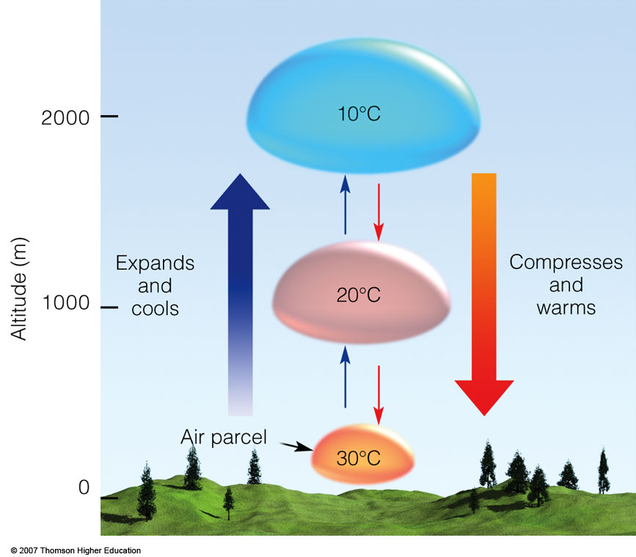
The dry
adiabatic rate
. As long as the air parcel remains unsaturated, it expands and cools by 10°C per 1000 m; the sinking parcel compresses and warms by 10°C per 1000 m.

Slide 17
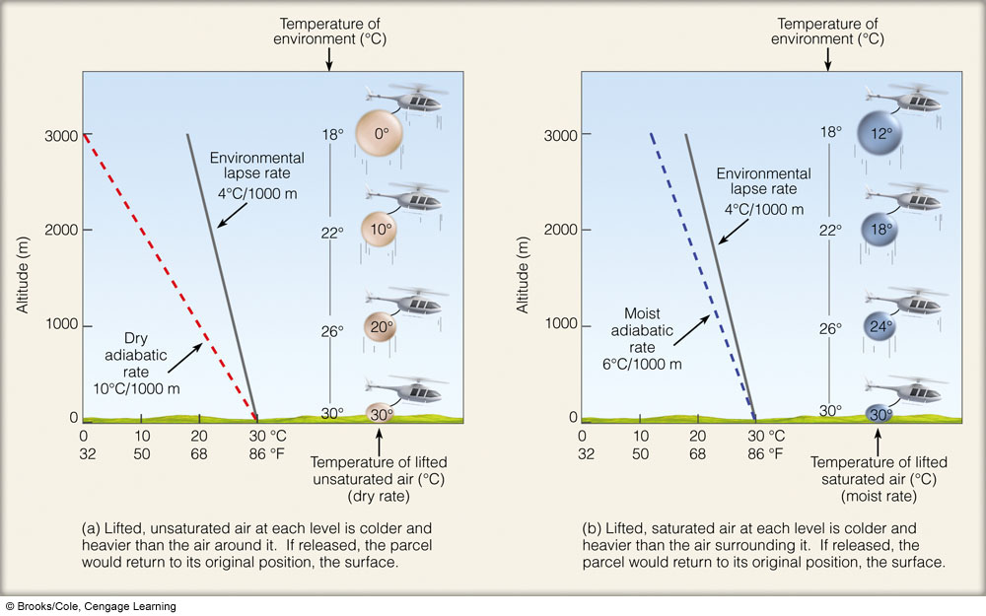

Slide 19
Ability of the parcel to rise depends on: Relationship between environmental lapse rate and dry adiabatic lapse rate or moist adiabatic lapse rate.

Slide 20
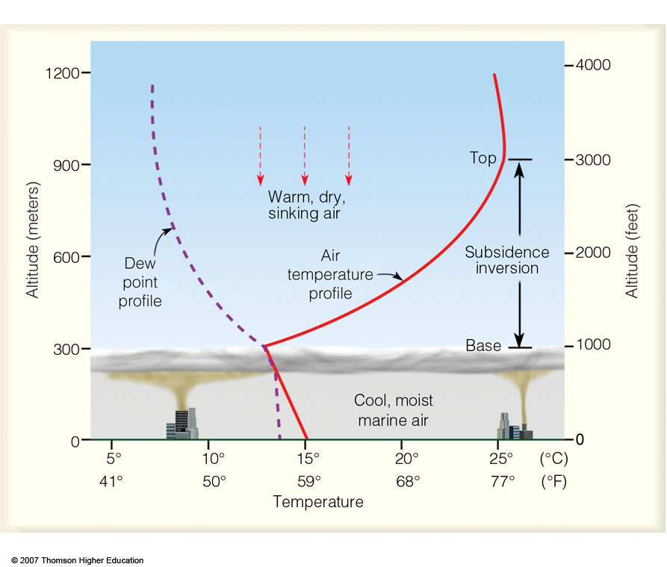
A strong subsidence inversion along the coast of California. The base of the stable inversion acts as a cap or lid on the cool, marine air below. An air parcel rising into the inversion layer would sink back to its original level because the rising parcel would be colder and more dense than the air surrounding it.

Slide 21
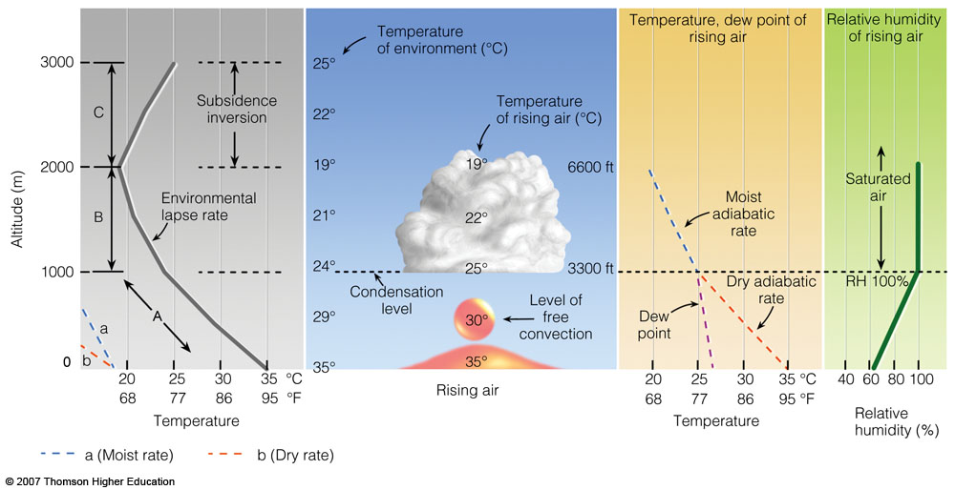
The development of a cumulus cloud.

Slide 22
Next, the concept of hydrostatic balance.
In Lecture # 14, defined heating rate of the atmosphere, namely, it is given by the radiative flux divergence at each level.
If the total net flux at a given height is given by:
F(z) = F (Z) - F (z)
Denoting the net flux F(z + Δ z) at the level z + Δz, the net flux divergence for the layer Δz is:
ΔF = F (z+ Δ z) - F(z)

Slide 23
Objective
In Lecture # 14, defined heating rate of the atmosphere, namely, it is given by the radiative flux divergence at each level.
If the total net flux at a given height is given by:
F(z) = F (Z) - F (z)
Denoting the net flux F(z + Δ z) at the level z + Δz, the net flux divergence for the layer Δz is:
ΔF = F (z+ Δ z) - F(z)

Slide 24
Heating Rates (namely, radiative flux divergence)
is the net flux and ρ is the total density of air.

Slide 25
The radiative heating or cooling rate is defined as the rate of temperature change of the layer dz due to radiative energy gain or loss, given as:
(3)
c_{p} is the specific heat at constant pressure
(c_{p} = 1004.67 J/kg/K and ρ is the air density in a given layer.
In order to understand how the last term was obtained from the previous one, we need to use the hydrostatic equation.
First, what is hydrostatic balance?

Slide 26
The Hydrostatic Equation
Air is in hydrostatic equilibrium when the upward-directed pressure gradient force is exactly balanced by the downward force of gravity.
Next figure shows air in hydrostatic equilibrium. Since there is no net vertical force acting on the air, there is no net vertical acceleration, and the sum of the forces is equal to zero.

Slide 27

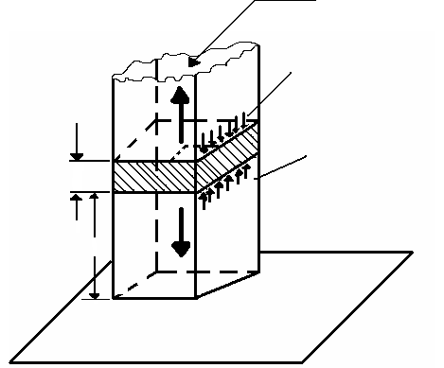


Slide 28


Since we know that pressure decreases with height, dp must be a negative quantity, and the upward pressure on the lower face of the shaded block must be slightly greater than the downward pressure on the upper face of the block.
Thus the net vertical force on the block due to the vertical gradient of pressure is upward and given by – dp as indicated in the figure. The balance of forces in the vertical requires that
or
The second equation is termed the hydrostatic equation. It should be noted that the negative sign in equation 2 ensures that the pressure decreases with increasing height.
Since ρ = 1/α, equation 2 can be rearranged to give

Slide 29


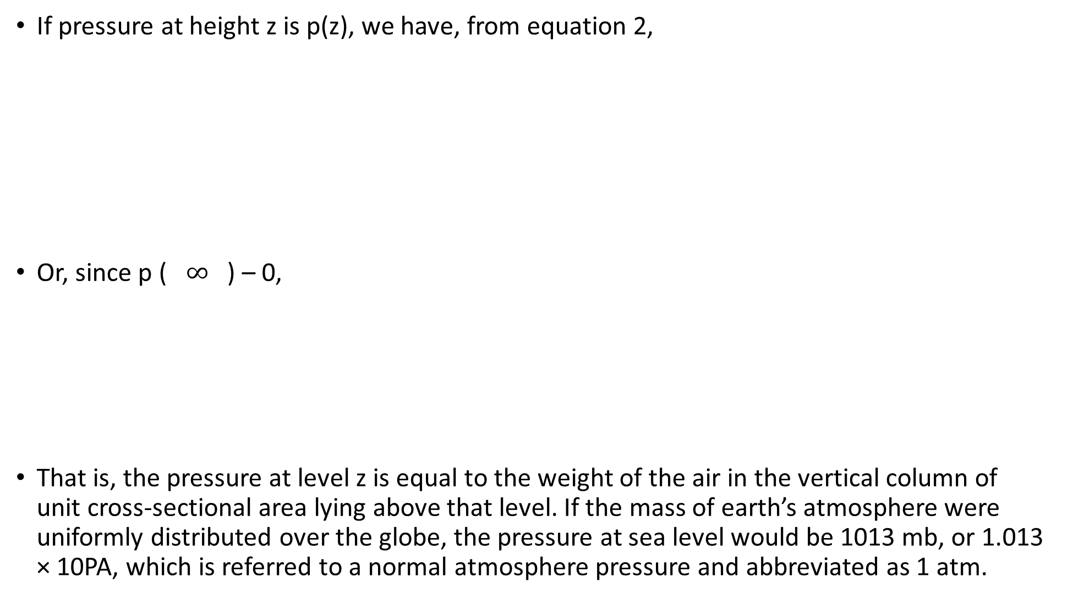
If pressure at height z is p(z), we have, from equation 2,
Or, since p ( $∞$ ) – 0,
That is, the pressure at level z is equal to the weight of the air in the vertical column of unit cross-sectional area lying above that level. If the mass of earth’s atmosphere were uniformly distributed over the globe, the pressure at sea level would be 1013 mb, or 1.013 × 10PA, which is referred to a normal atmosphere pressure and abbreviated as 1 atm.

Slide 30

Hydrostatic equation
The upward pressure gradient force acting on a thin slice of air (p decreases with z) is generally very closely in balance with the downward force due to gravitational force. Or:
If there is no vertical motion, the difference in presuure (dp) between two levels (dZ) is caused by the weight of the layer of the air –
mass * acceleration due to gravity.

Slide 31
If pressure at height z is p(z), we have, from equation 2,
Or since p ( ) – 0,
That is, the pressure at level z is equal to the weight of the air in the vertical column of unit cross-sectional area lying above that level. If the mass of earth’s atmosphere were uniformly distributed over the globe, the pressure at sea level would be 1013 mb, or 1.013 × 10PA, which is referred to a normal atmosphere pressure and abbreviated as 1 atm.

Slide 32
Why is it of interest in the following expression to change from dependence in z to dependence on p?
To evaluate the heating rate in equation one needs profile of IR upwelling and downwelling fluxes
To compute the IR downward and upward fluxes, one needs the vertical structure of various parameters describing the atmosphere. For various reasons, it is more convenient to work in pressure coordinates than in height coordinates.

Slide 33
Extra material (not required)

Slide 34
Adiabatic lapse rate
If process adiabatic dq = 0 and in hydrostatic equilibrium, in following eq.
dq = c_{p}dT – αdp
we can simplify:
0=c_{p}dT – αdp
Divide by dz: 0=c_{p}dT/dz – αdp/dz
and use: gdz = -αdp
Separate dT/dz in : 0= c_{p}dT/dz +gdz/dz
We get: -c_{p}dT/dz = gdz/dz
-(dT/dz) _{dry parcel} = g/c_{p} =Γd
Γd - the dry adiabatic lapse rate
g=9.81 ms⁻²; c_{p}=1004Jkg⁻¹deg⁻¹; therefore: Γd =9.8 deg km⁻¹

