Slide 1
AOSC400-2015
November 10, Lecture # 19
Supplementary background material for Chapter 9 :
Adiabatic Lapse Rate
Environmental Lapse Rate
Concept of stability
Potential temperature
Copyright@2015 University of Maryland
This material may not be reproduced or redistributed, in whole or in part, without written permission of Rachel T. Pinker
*Sources of information used for this lecture are listed in updated Syllabus.

Slide 2
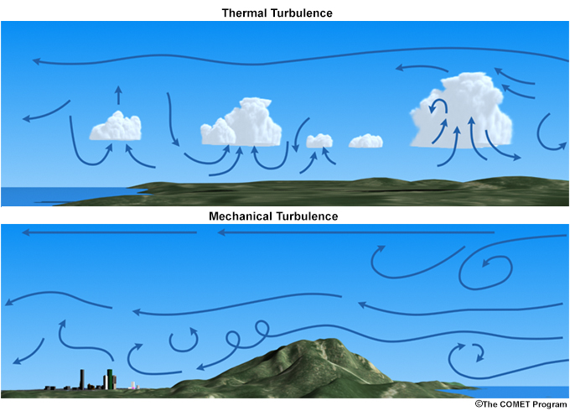
Schematic of turbulence generated convectively or thermally (upper) and mechanically (lower).

Slide 3
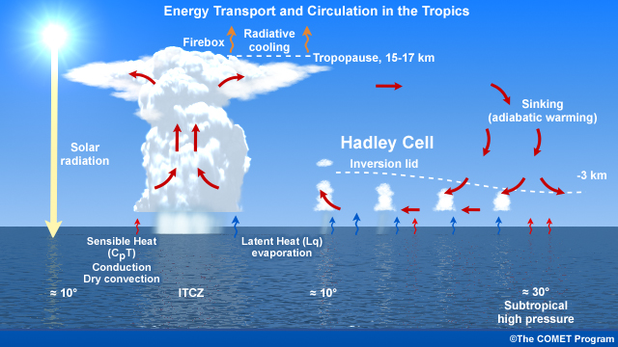
Circulation and energy in the Hadley Cells over the ocean

Slide 4
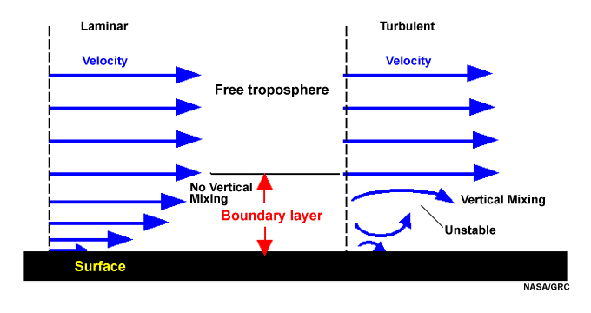
Turbulent and Laminar Flow
Schematic of laminar and turbulent flow in the boundary layer; velocity is zero at the surface.

Slide 5

Heat capacity (C) or thermal capacity is the ratio of the heat (Q) added to (or removed from) an object to the resulting temperature change ΔT.
Specific heat is the amount of heat needed to raise the temperature of a certain mass 1 degree Celsius.
In the International System of Units, heat capacity has the unit joules per kelvin.

Slide 6
To measure heat capacity is to add a known amount of heat to an object, and measure the change in temperature.
This works reasonably well for many solids.
For gasses, other aspects of measurement become critical and there are several slightly different measurements of heat capacity.
The most commonly used methods for measurement are to hold the object either at constant pressure (C_{P}) or at constant volume (C_{V}).

Slide 7
Measurements under constant pressure produce larger values than those at constant volume because the constant pressure values also include heat energy that is used to do work to expand the substance against the constant pressure as its temperature increases.
This difference is particularly notable in gases where values under constant pressure are typically 30% to 66.7% greater than those at constant volume.

Slide 8


These are defined as:
All gases follow approximately the same equation of state over large range of conditions:
pV ~ mT
pV = mRT
R is known as the gas constant
using the equation of state one can show that:

Slide 9
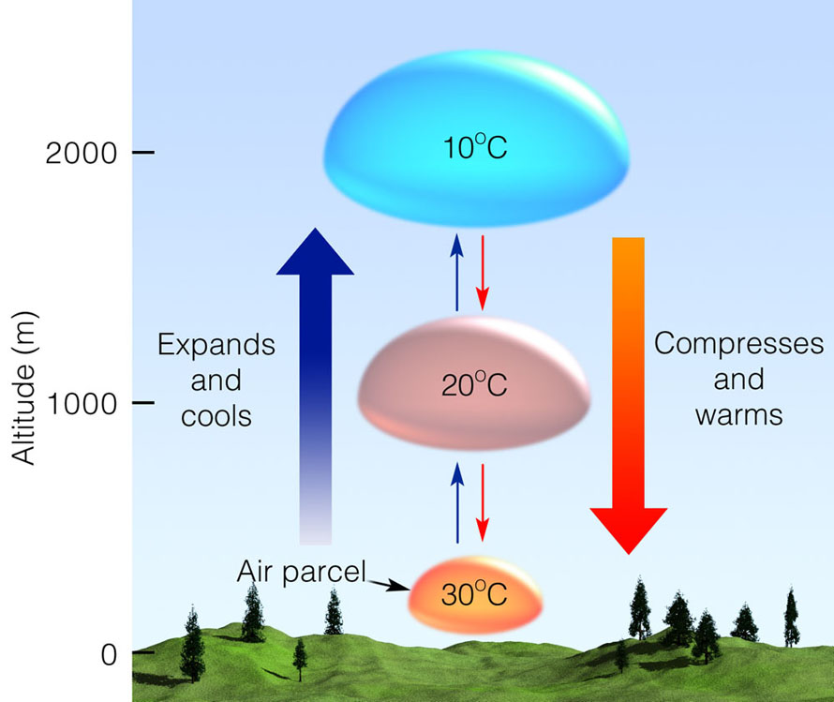
Usually, air parcels that move up –cool; when they descent, they warm.

Slide 10
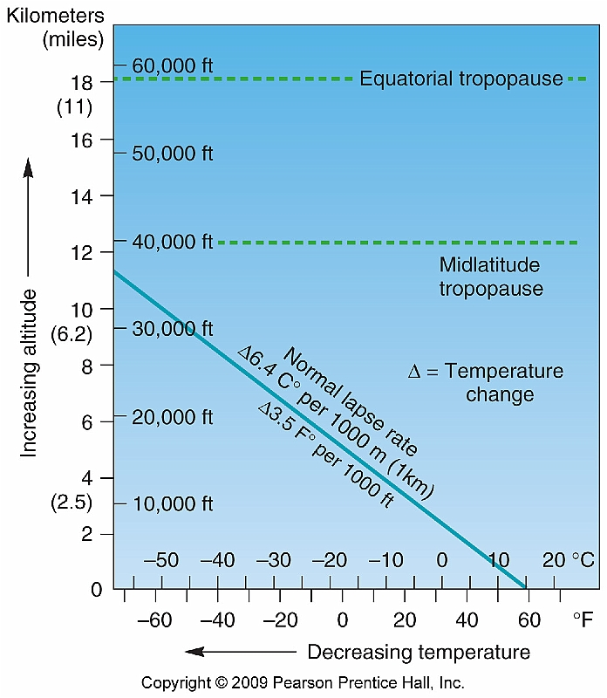
Earlier we have noted that on the average, the atmosphere cools by about 6.5 ⁰ C per each 1 km ascent . That is not always the case. Change with height is called “lapse rate”)

Slide 11
Adiabatic Process
If a material changes its physical state –(pressure, volume, or temperature change) without any heat being added or withdrawn - change is said to be adiabatic.
In the atmosphere, well-defined air parcels do the vertical mixing.
Assume that the air parcel is:
Thermally insulated from environment so that the temperature changes adiabatically as it rises or sinks
Is at same pressure as environment at the same level, which is assumed in hydrostatic equilibrium

Slide 12
Adiabatic lapse rate
If process adiabatic dq = 0 and in hydrostatic equilibrium, in following eq.
dq = c_{p}dT – αdp
we can simplify:
0=c_{p}dT – αdp
Divide by dz: 0=c_{p}dT/dz – αdp/dz
and use: gdz = -αdp
Separate dT/dz in : 0= c_{p}dT/dz +gdz/dz
We get: -c_{p}dT/dz = gdz/dz
-(dT/dz) _{dry parcel} = g/c_{p} =Γd
Γd - the dry adiabatic lapse rate
g=9.81 ms⁻²; c_{p}=1004Jkg⁻¹deg⁻¹; therefore: Γd =9.8 deg km⁻¹

Slide 13

The adiabatic lapse rate
The rate of change of temperature with height of parcel of dry air which moves about in the earth’s atmosphere while always satisfying the conditions of no exchange of heat with environment.
Since the air parcel undergoes only adiabatic transformations
and the atmosphere is in hydrostatic equilibrium, for a unit mass of air in the parcel we have, from

Slide 14
where Ґ is called the dry adiabatic lapse rate.
Since an air parcel expands as it rises in the atmosphere, its temperature will decrease. Substituting g = 9.81 m s⁻² and c = 1004j kg deg into gives
Ґ = 0.0098 deg m or 9.8 deg km

Slide 15
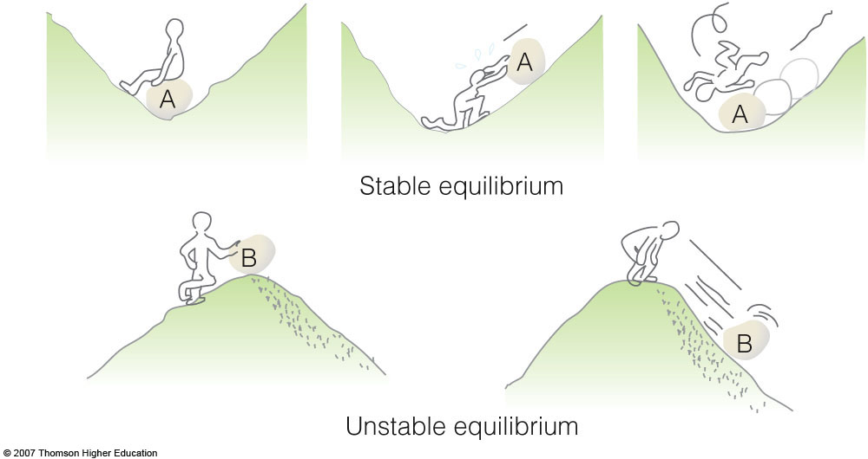
Stability
When rock A is disturbed, it will return to its original position; rock B, however, will accelerate away from its original position.

Slide 16
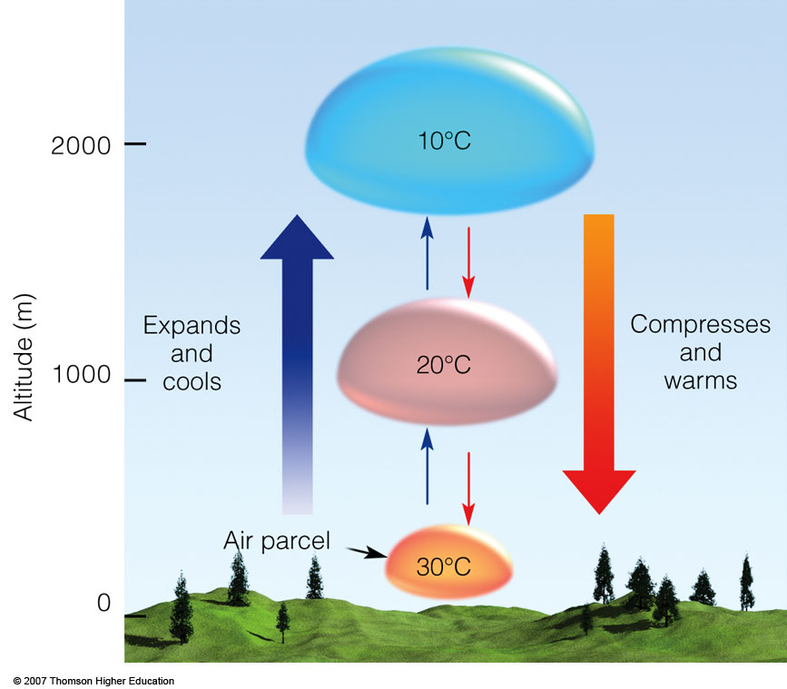
The dry
adiabatic rate
. As long as the air parcel remains unsaturated, it expands and cools by 10°C per 1000 m; the sinking parcel compresses and warms by 10°C per 1000 m.

Slide 17
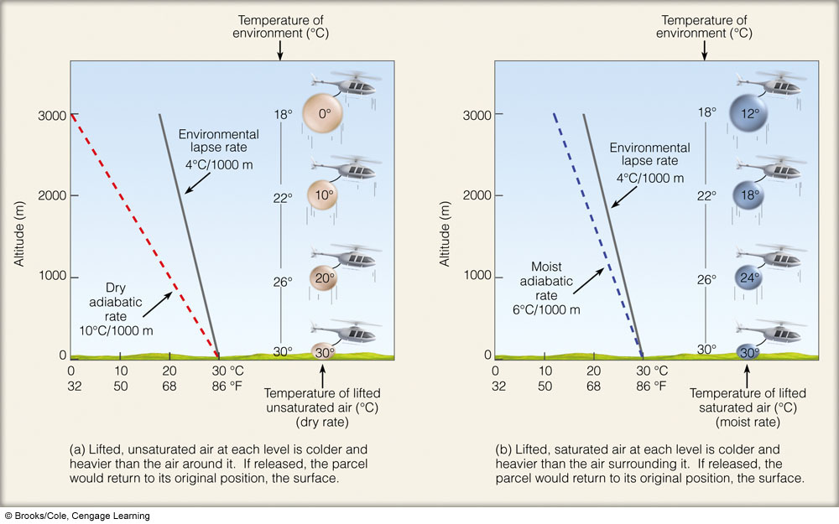

Slide 19
Ability of the parcel to rise depends on: Relationship between environmental lapse rate and dry adiabatic lapse rate or moist adiabatic lapse rate.

Slide 20
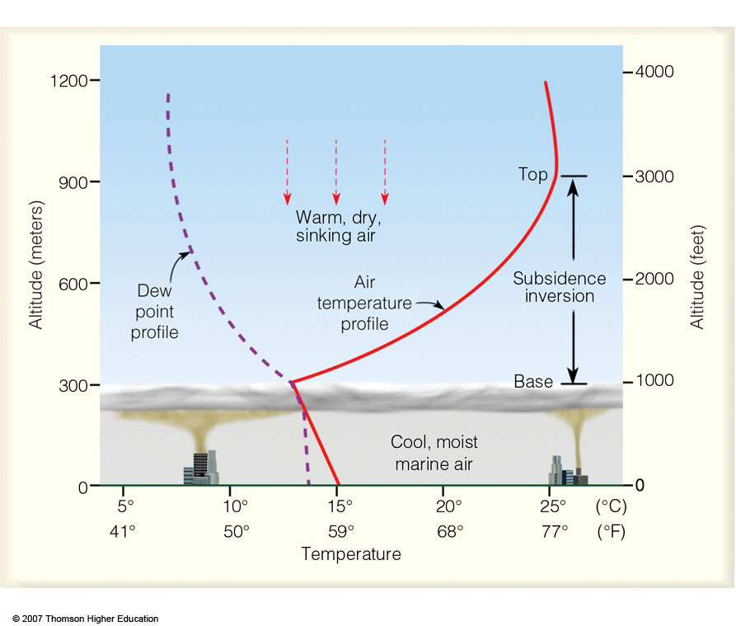
A strong subsidence inversion along the coast of California. The base of the stable inversion acts as a cap or lid on the cool, marine air below. An air parcel rising into the inversion layer would sink back to its original level because the rising parcel would be colder and more dense than the air surrounding it.

Slide 21
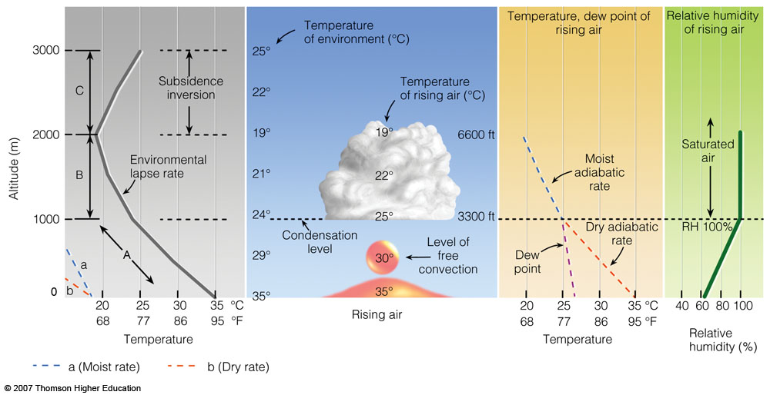
The development of a cumulus cloud.

Slide 22
Next, the concept of hydrostatic balance.
In Lecture # 14, defined heating rate of the atmosphere, namely, it is given by the radiative flux divergence at each level.
If the total net flux at a given height is given by:
F(z) = F (Z) - F (z)
Denoting the net flux F(z + Δ z) at the level z + Δz, the net flux divergence for the layer Δz is:
ΔF = F (z+ Δ z) - F(z)

Slide 23
Heating Rates (namely, radiative flux divergence)
is the net flux and ρ is the total density of air.

Slide 24
The radiative heating or cooling rate is defined as the rate of temperature change of the layer dz due to radiative energy gain or loss, given as:
(3)
c_{p} is the specific heat at constant pressure
(c_{p} = 1004.67 J/kg/K and ρ is the air density in a given layer.
In order to understand how the last term was obtained from the previous one, we need to use the hydrostatic equation.
First, what is hydrostatic balance?

Slide 25
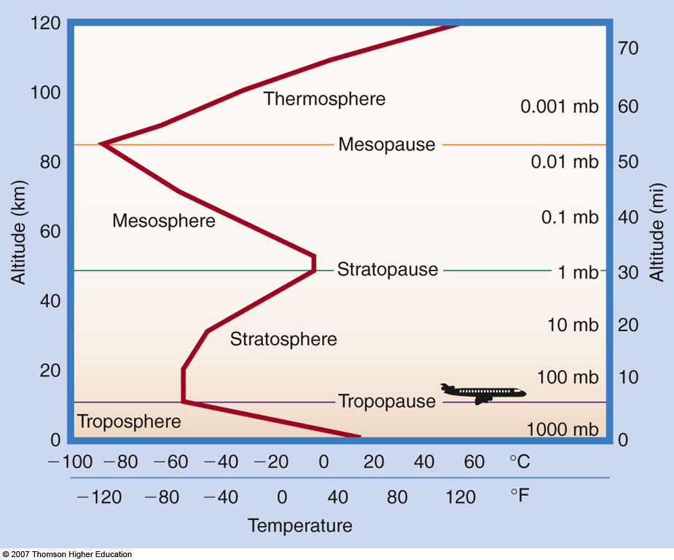
Main layers of the atmosphere
Troposphere, Stratosphere, Mesosphere, Thermosphere, Separated by conceptual partitions-called pauses (tropopause)

Slide 26
Moist adiabatic rate (review):
Ldw_{s} = c_{p}dT + gdz
The saturated adiabatic lapse rate is:
Γ_{s} = -dT/dz = Γ_{d}/ (1 + (L/ c_{p})(dw_{s} /dT))
Γ_{d} is the dry adiabatic lapse rate.
The magnitude of Γs is not constant but depends on the pressure and temperature. Since dw_{s}/dT is always positive, therefore Γs < Γd

Slide 27
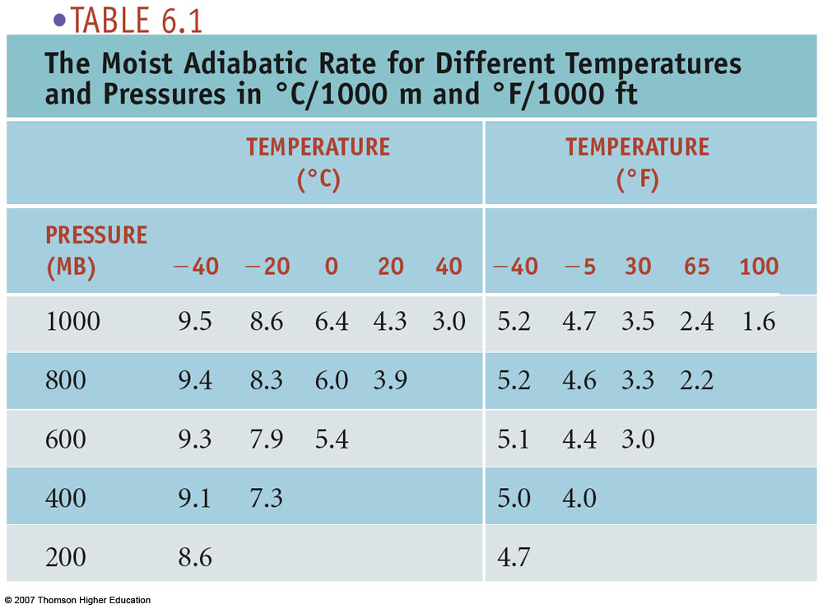
The theoretical basis for table provided in equation that gives the moist adiabatic lapse rate.

Slide 28
Ability of the parcel to rise depends on: Relationship between environmental lapse rate; dry adiabatic lapse rate; moist adiabatic lapse rate

Slide 29
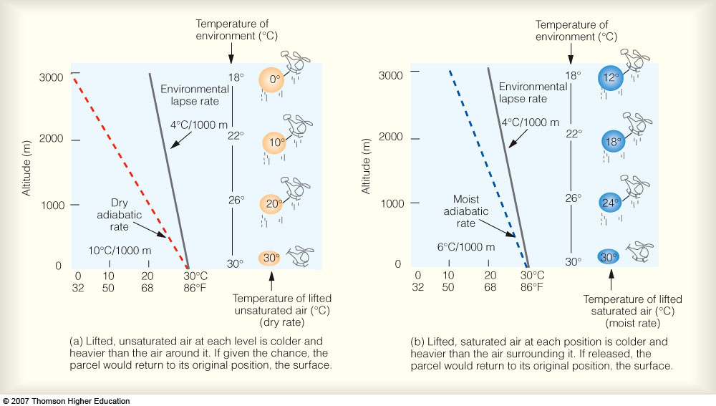
An absolutely stable atmosphere
When the environmental lapse rate is less than the moist adiabatic rate. In a stable atmosphere, a rising air parcel is colder and more dense than the air surrounding it; if given the chance, it will return to its original position.

Slide 30
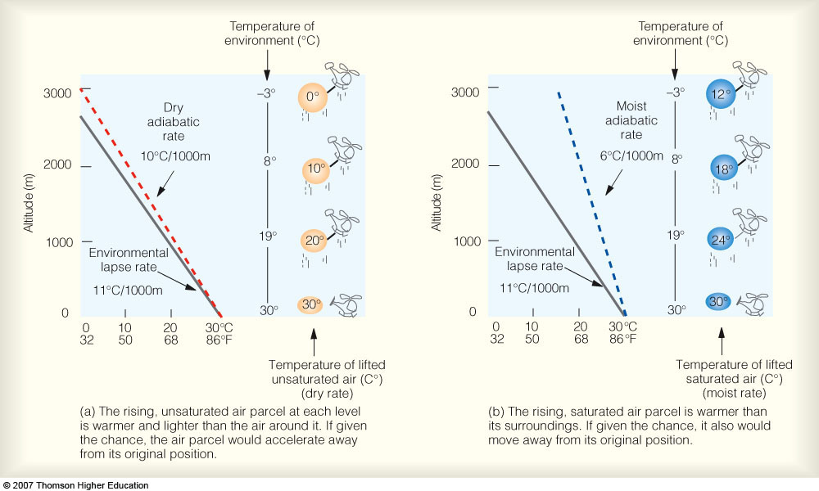
An absolutely unstable atmosphere
Occurs when the environmental lapse rate is greater than the dry adiabatic rate. In an unstable atmosphere, a rising air parcel will continue to rise because it is warmer and less dense than the air surrounding it.

Slide 31
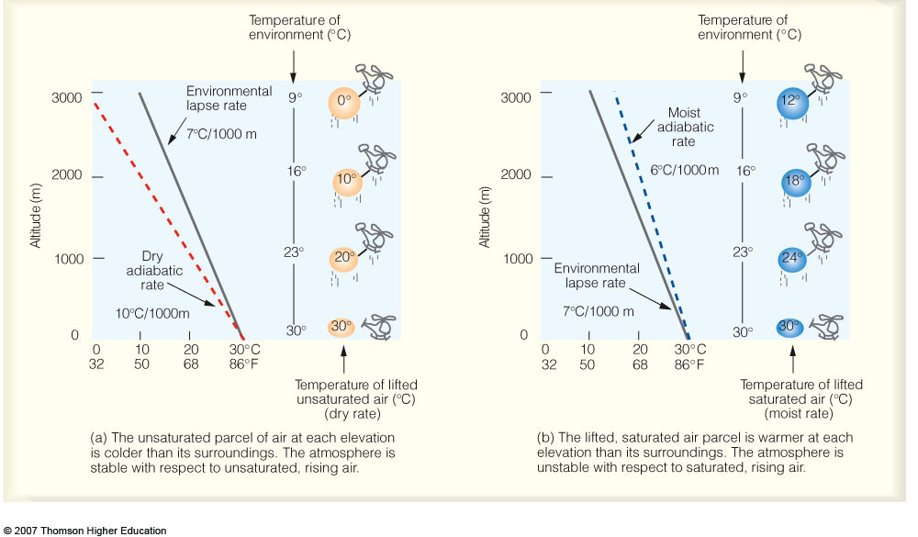
Conditionally unstable atmosphere
The atmosphere is stable if the rising air is unsaturated (a), but unstable if the rising air is saturated (b). A conditionally unstable atmosphere occurs when the environmental lapse rate is between the moist adiabatic rate and the dry adiabatic rate.

Slide 32
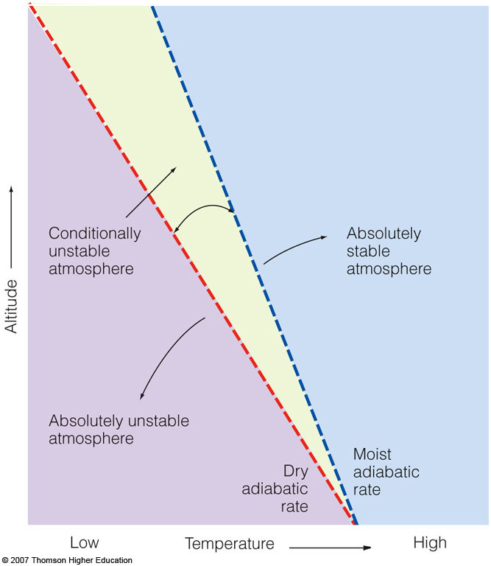
When the environmental lapse rate is greater than the dry adiabatic rate, the
atmosphere is absolutely unstable. When the environmental lapse rate is less than the moist adiabatic rate, the atmosphere is absolutely stable. And when the environmental lapse rate lies between the dry adiabatic rate and the moist adiabatic rate (shaded green area), the atmosphere is conditionally unstable.
Notes:
.

Slide 34
Saturated adiabatic process
First, a parcel of air rises at dry adiabatic lapse rate
When air becomes saturated, further lifting results in condensation-latent heat is released
The rate of decrease in temperature with height is smaller
If the condensation products fall out, the process is called pseudo-adiabatic
Γ_{s} = -dT/dz
Namely, the parcel will not cool as fast as under
adiabatic conditions

Slide 35
The magnitude of Γ_{s} is not constant but depends on pressure and temperature.
Actual values of Γ_{s} range from 4 deg/km near the ground in warm moist air masses to 7 deg/km in the middle troposphere.
Near the tropopause Γ_{s} is only slightly less than Γ_{d} because the moisture capacity is so small that the effect of condensation is negligible.

Slide 36

The potential temperature is the temperature an unsaturated parcel would have if lowered (or raised) to a level of 1000 mb (100 kPa). Thepotential temperature is conserved, or remains the same, for a parcel of air that is unsaturated and remains unsaturated as it rises and sinks.
The potential temperature of a parcel of fluid at pressure P is the temperature that the parcel would acquire if adiabatically brought to a standard reference pressure P_{0}, usually 1000 millibars. The potential temperature is denoted \theta and, for air, is often given by
\theta = T \left(\frac{P_0}{P}\right)^{R/c_p},
where T is the current absolute temperature (in K) of the parcel, R is the gas constant of air, and c_p is the specific heat capacity at a constant pressure. R/c_p = 0.286 for air (meteorology).

Slide 37
The concept of potential temperature applies to any stratified fluid. It is most frequently used in the atmospheric sciences and oceanography.^{[1]} The reason that it is used in both fluids is that changes in pressure result in warmer fluid residing under colder fluid- examples being the fact that air temperature drops as one climbs a mountain and water temperature can increase with depth in very deep ocean trenches and within the ocean mixed layer. When potential temperature is used instead, these apparently unstable conditions vanish.

Slide 38
Potential temperature is a more dynamically important quantity than the actual temperature. This is because it is not affected by the physical lifting or sinking associated with flow over obstacles or large-scale atmospheric turbulence. A parcel of air moving over a small mountain will expand and cool as it ascends the slope, then compress and warm as it descends on the other side- but the potential temperature will not change in the absence of heating, cooling, evaporation, or condensation (processes that exclude these effects are referred to as dry adiabatic). Since parcels with the same potential temperature can be exchanged without work or heating being required, lines of constant potential temperature are natural flow pathways.
Under almost all circumstances, potential temperature increases upwards in the atmosphere, unlike actual temperature which may increase or decrease. Potential temperature is conserved for all dry adiabatic processes, and as such is an important quantity in the planetary boundary layer (which is often very close to being dry adiabatic).
Potential temperature is a useful measure of the static stability of the unsaturated atmosphere. Under normal, stably stratified conditions, the potential temperature increases with height,

Slide 39


and vertical motions are suppressed. If the potential temperature decreases with height,
he atmosphere is unstable to vertical motions, and convection is likely. Since convection acts to quickly mix the atmosphere and return to a stably stratified state, observations of decreasing potential temperature with height are uncommon, except while vigorous convection is underway or during periods of strong insolation. Situations in which the equivalent potential temperature decreases with height, indicating instability in saturated air, are much more common.
Since potential temperature is conserved under adiabatic or isentropic air motions, in steady, adiabatic flow lines or surfaces of constant potential temperature act as streamlines or flow surfaces, respectively. This fact is used in isentropic analysis, a form of synoptic analysis which allows visualization of air motions and in particular analysis of large-scale vertical motion.^{[2][3}

Slide 40
potential temperature
The temperature that an unsaturated parcel of dry air would have if brought adiabatically and reversibly from its initial state to a standard pressure, p0, typically 100 kPa.
Its mathematical expression is
where θ is the potential temperature, T is temperature, and κ is the Poisson constant. This exponent is often assumed to be 2/7, the ratio of the gas constant to the specific heat capacity at constant pressure for an ideal diatomic gas.
See virtual potential temperature, liquid water potential temperature, equivalent potential temperature, wet-bulb potential temperature.
In oceanography, the temperature that a water sample would attain if raised adiabatically to the sea surface.
For the deepest points of the ocean, which are just over 10 000 m, the adiabatic cooling would be less than 1.5°C.

Slide 41
These are defined as:
In thermodynamics, using the equation of state, namely:
One can show that:
R is known as the gas constant

Slide 42
Discussed Stability: Relationship between environmental lapse rate and the parcel lapse rate.

