Slide 1
AOSC400-2015
November 05, Lecture # 18
Chapter 9:
Connection between Chapter 4 and Chapter 9
Components of the Surface Energy Budget (SEB)-in addition to radiation also fluxes of heat and moisture
Fluxes of heat and moisture are transported by turbulence
What is Planetary Boundary Layer (PBL)? Capping Inversion
What is turbulence? How do we represent it? Reynolds Averaging
Copyright@2015 University of Maryland
This material may not be reproduced or redistributed, in whole or in part, without written permission of Rachel T. Pinker
*Sources of information used for this lecture are listed in updated Syllabus.

Slide 2
Components of the Surface Energy Budget (SEB):
One Component of SEB: Surface Radiation Budget
Other components:
Surface Turbulent Fluxes of heat and moisture
Heat into ground
So far, in the following slide we have discussed only the radiative fluxes. We will continue to discuss the additional terms, namely sensible and latent heat.

Slide 3
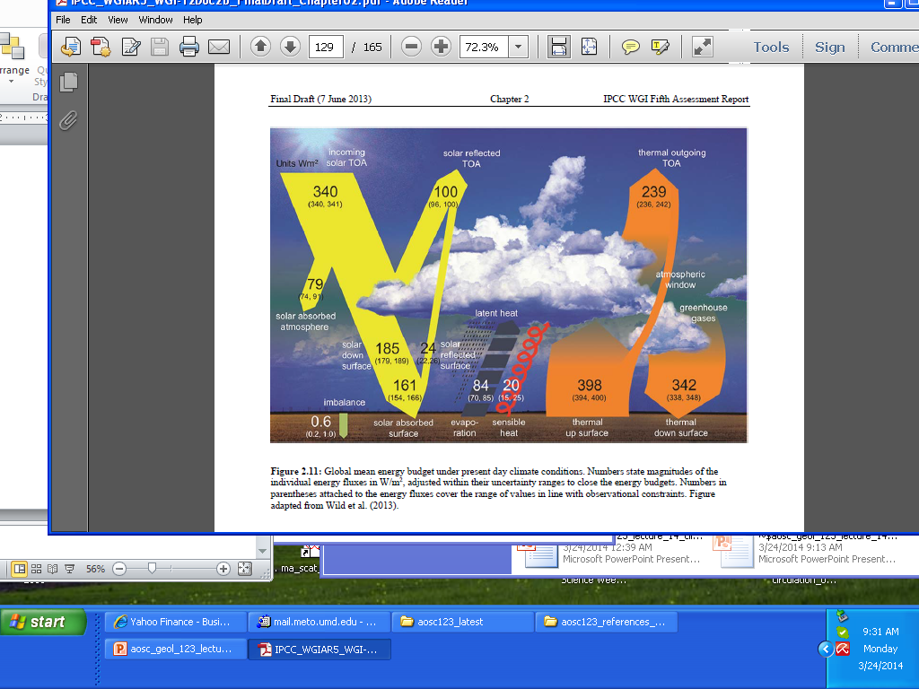
Global mean energy budget under present day climate conditions (from IPCC 2013)

Slide 4
Radiation Balance at the Earth Surface
The net flux of radiation at the earth’s surface results from a balance between the solar and terrestrial
Radiative fluxes:
^{Fsfc}rad ⁼ F_{SW} ⁺ F_{LW}
The short-wave and long-wave radiation balance can
be expressed:
F_{SW} = F_{SW}↓ - F_{SW}↑
F_{LW} = F_{LW}↓ -F_{LW}↑
The net radiation balance being:
F^{sfc}_{rad} = F_{SW}↓ - F_{SW}↑ +F_{LW}↓ - F_{LW}↑

Slide 5
The incident solar radiation F_{SW}↓ is the sum of the direct and diffuse solar radiation.
It has a pronounced diurnal and seasonal variation, and is also strongly affected by clouds.
The outgoing short-wave solar radiation is the part reflected by the surface F_{SW}↑=A_{sfc}F_{SW}↓, where A_{sfc} is the surface albedo so that the net short-wave radiation is:
F_{SW} = (1 – A_{sfc}) F_{SW}↓
The outgoing long-wave radiation F_{LW}↑ is given by the Stefan-Boltzmann law, assuming a given emissivity є for the earth’s surface.
The net radiation flux at the surface is then given by :
F^{sfc}_{rad} = F_{SW}↓ (1 – A_{sfc}) – σєT⁴
+ F_{LW}↓
sfc

Slide 6
Energy Balance at the Earth Surface
The main part of the energy absorbed at the surface is used to evaporate water,
Another part is lost to the atmosphere as sensible heat, and a smaller part is lost to the underlying layers or used to melt snow and ice.
There are essentially four types of energy fluxes at the earth’s surface. They are the net radiation flux F_{rad}, the sensible heat flux F_{SH}↑, the latent heat flux F_{LH}↑, and the heat flux into the subsurface layers F_{G}↓.
Under steady conditions the balance equation for the energy is given by:
F^{sfc}_{rad} - F_{SH}↑ - F_{LH}↑ - F_{G}↓ - F_{M} = 0

Slide 7
Diurnal variation of the components of the surface energy budget in cloudless conditions at a rural mid-latitude site.

Slide 8
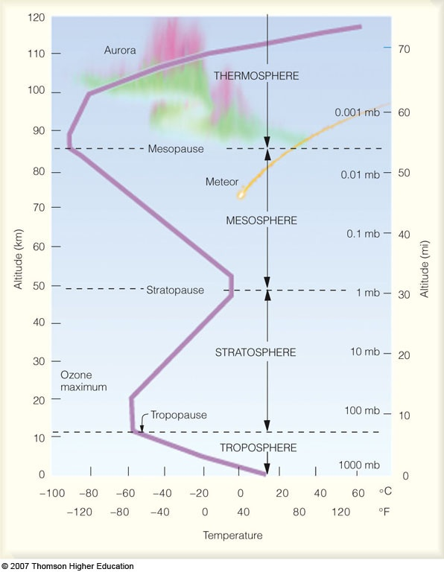
Main layers of the atmosphere were identified previously:
Troposphere, Stratosphere, Mesosphere, Thermosphere

Slide 9
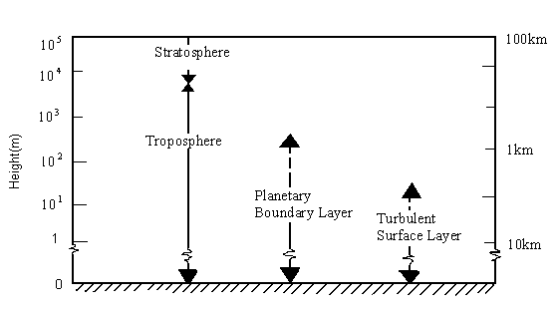

The troposphere can be subdivided as follows:

Slide 10
The Earth's surface is the bottom boundary of the atmosphere.
The portion of the atmosphere most affected by that boundary is called the Atmospheric Boundary Layer (ABL)
The thickness of the boundary layer is quite vari­able in space and time. Normally -1 or 2 km thick (i.e., occupying the bottom 10 to 20% of the troposphere), it can range from tens of meters to 4 km or more.
Turbulence and static stability conspire to sand­wich a strong stable layer (capping inversion) between the boundary layer below and the rest of the troposphere above ( called the free atmosphere).
This stable layer traps pol­lutants, moisture and prevents the surface friction from being felt by the free atmosphere.

Slide 11
From the Textbook:
Reprinted with permission of Brooks/Cole, a division of Thomson Learning: www.thomsonrights.com. Fax 800-
730-22150.]

Slide 12
How if heat transported?
Conduction – principal method of heat transfer in ground.
Air temperature – determined principally by –
a) Radiative flux divergence
b) Advection
c) Convection
d) Latent heat exchanges by evaporation and condensation

Slide 13
Heat transfer from soil to air (and vice versa) in surface near air – a complex process. We can distinguish a three-layer structure:
1) A laminar boundary layer without turbulence (heat transfer by Brownian motion < 1mm).
2) A transitional boundary layer with incipient convection 1mm – 2cm.
3) Upper boundary layer with turbulent transfer that at its upper limit has fully free flow

Slide 14

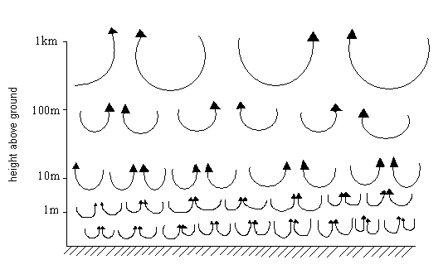

Turbulent eddies.

Slide 15
Turbulence is responsible for efficiently dispersing the pollutants
However, the capping inversion traps these pollutants within the boundary layer,
Turbulent communication between the sur­face and the air is quite rapid, allowing the air to quickly take 'on characteristics of the underlying sur­face.
In fact, one definition of the boundary layer is that portion of the lower troposphere that feels the effects of the underlying surface within about 30 min or less.

Slide 16
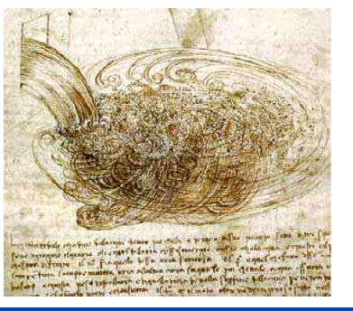
Leonardo da Vinci’s view of turbulence
View of turbulence by
Leonardo
da Vinci (1452-1519)
who recognized the
multi-scale nature
of turbulence.

Slide 17
Three kinds of turbulence recognized:
Mechanical turbulence
Turbulence caused by shear
Turbulence caused by buoyancy

Slide 18
Mechanical turbulence is caused by air flowing over rough features, such as hills or buildings.
https://www.meted.ucar.edu/EUMETSAT/at_dust/media/video/mech_turbulence.mp4
Note: In order to be able to view the clip, you need to register on the
NCAR site. It is very simple. Once you do so, you will
have access to educational resources of NCAR. They have many
interesting presentations.

Slide 19
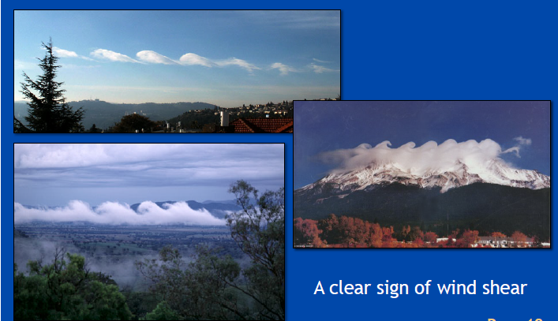
Turbulence from shear can result from differences in wind speed and/or direction.
https://www.meted.ucar.edu/EUMETSAT/at_dust/media/video/shear_turbulence.mp4
Sometimes clouds show these patterns known
also as Kelvin-Helmholtz vortex patterns

Slide 20
Buoyancy turbulence can be caused by a parcels of air rising during the diurnal heating of the surface.
In such case, buoyancy is governed by the stability of the atmosphere.
https://www.meted.ucar.edu/EUMETSAT/at_dust/media/video/buoy_turb.mp4

Slide 21
Turbulence is very complex, consisting of a superposition of swirls called eddies that interact nonlinearly to create quasi-random, chaotic motions.
An infinite number of equations is required to fully describe these motions.
A complete solution has not been found.
But when averaged over many eddies, we can observe persistent patterns.

Slide 22
Sonic anemometer recording at 25 Hz
30 minute

Slide 23
• Need: fast response instrument
• For winds: a sonic anemometer

Slide 24
͞w
w' = w − w͞

Slide 25
Another example of turbulent fluctuations. Most turbulent close to the ground.

Slide 26
Despite the difficulties of deterministic descrip­tions of turbulence, scientists have been able to cre­ate a statistical description of turbulence.
The goal of this approach is to describe the net effect of many eddies, rather than the exact behavior of any individual eddy.

Slide 27
From Textbook:
Based on an average over a time
period T ( say half an hour):
In the atmosphere, this mean value can change from one half-hour period to the next, resulting in a slow variation of the mean-wind components with time.
Subtracting the mean from the instantaneous com­ponent u gives just the fluctuating (gust) portion of the flow (indicated with a prime)

Slide 28
The intensity of tur­bulence in the u direction is then defined by the variance:
In the atmosphere, fluctuations in velocity are often accompanied by fluctuations in scalar values such as temperature, humidity, or pollutant concentration.
For example, in a field of thermals there are regions where warm air is rising (positive potential temperature ϑ' accompanies positive vertical velocity w'), surrounded by regions where cold air is sinking (negative ϑ' accompanies negative w'). One measure of the amount that ϑ and w vary together is the covariance (cov) .

Slide 30
Reynolds Averaging
Will also help to explain how eq. 9.5 in Textbook was derived.
http://twister.caps.ou.edu/MM2002/Chapter2.2.pdf

Slide 31
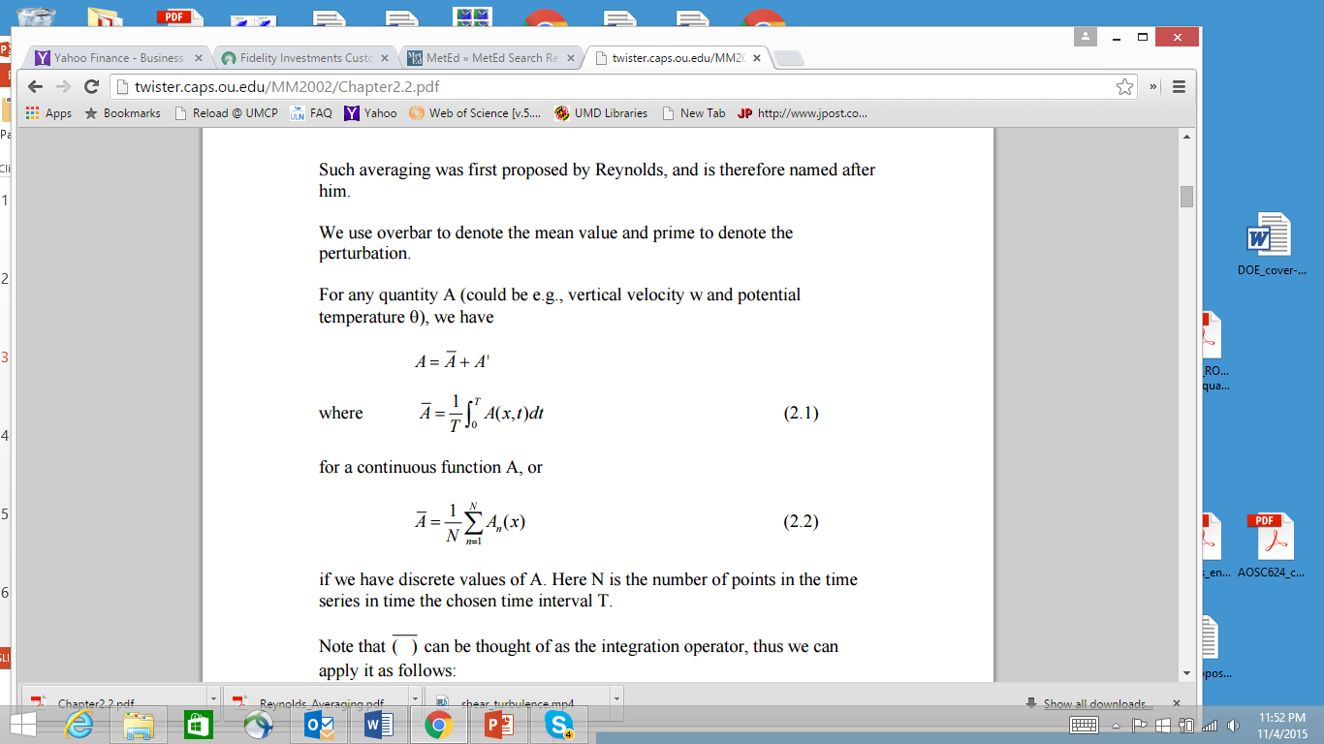

Slide 32
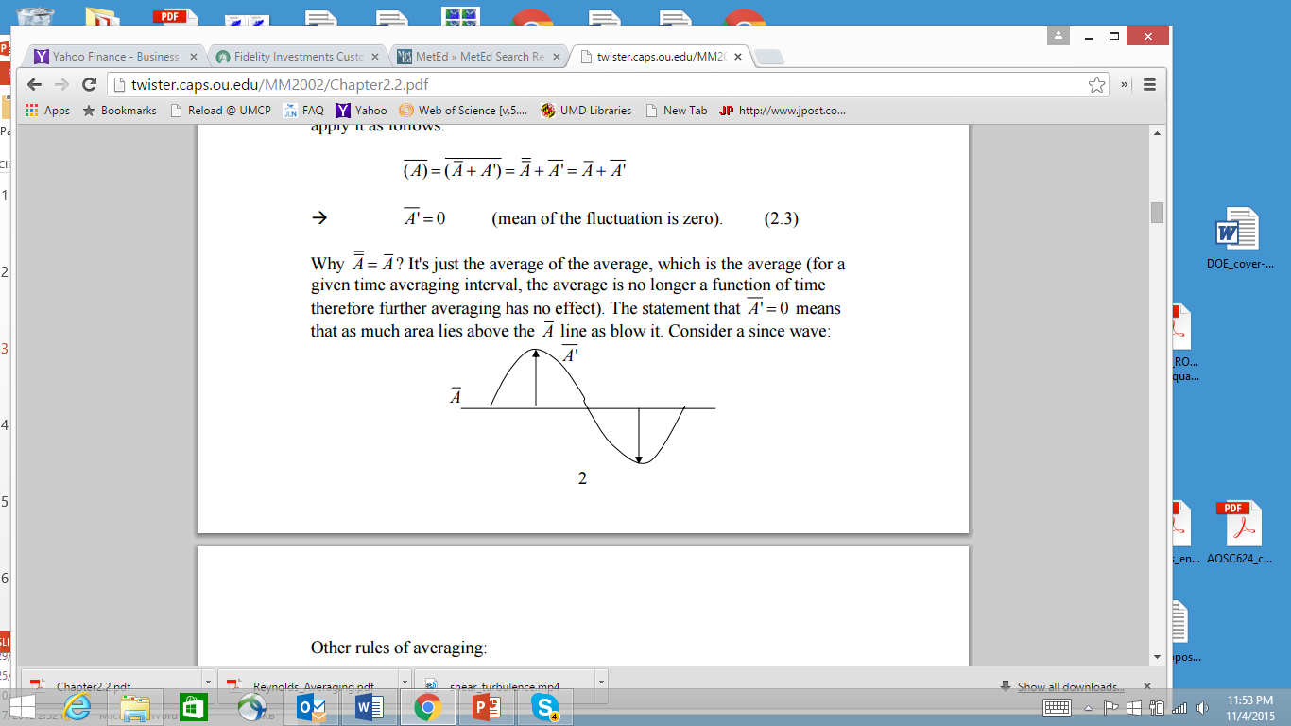

Slide 33
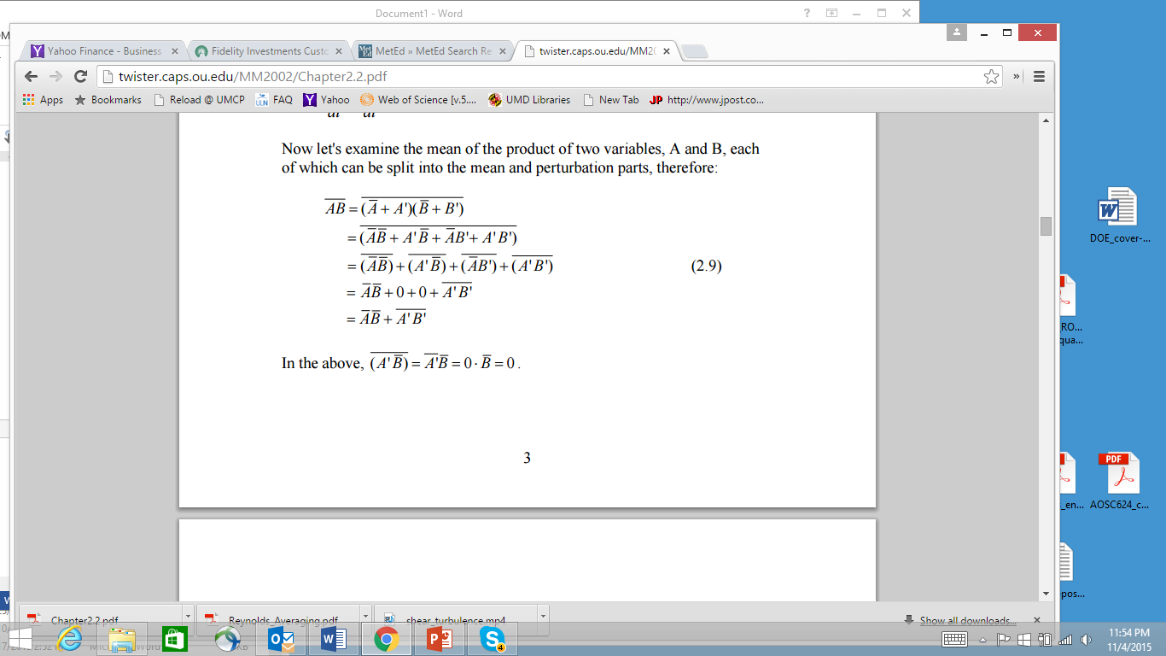

Slide 34
