Slide 1
AOSC400-2015
November 05, Lecture # 18
Chapter 9:
Connection between Chapter 4 and Chapter 9
Components of the Surface Energy Budget (SEB)-in addition to radiation also fluxes of heat and moisture.
Fluxes of heat and moisture are transported by turbulence
What is Planetary Boundary Layer (PBL)?
Concept of Capping Inversion
What is turbulence? How do we represent it?
Copyright@2015 University of Maryland
This material may not be reproduced or redistributed, in whole or in part, without written permission of Rachel T. Pinker
*Sources of information used for this lecture are listed in updated Syllabus.

Slide 2
Components of the Surface Energy Budget (SEB):
One Component of SEB: Surface Radiation Budget
Other components:
Surface Turbulent Fluxes of heat and moisture
Heat into ground
So far, in the following slide we have discussed only the radiative fluxes. We will continue to discuss the additional terms, namely sensible and latent heat.

Slide 3
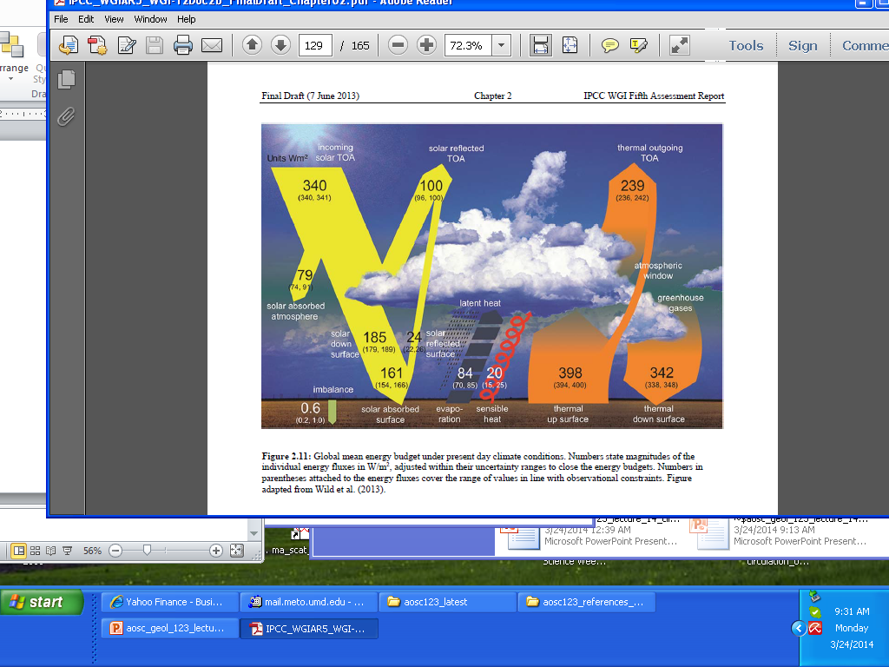
Global mean energy budget under present day climate conditions (from IPCC 2013)

Slide 4
Radiation Balance at the Earth Surface
The net flux of radiation at the earth’s surface results from a balance between the solar and terrestrial
Radiative fluxes:
^{Fsfc}rad ^{= sfc}SW ^{+ sfc}LW
The short-wave and long-wave radiation balance can
be expressed:
F_{SW} = F_{SW}↓ - F_{SW}↑
F_{LW} = F_{LW}↓ -F_{LW}↑
The net radiation balance being:
F^{sfc}_{rad} = F_{SW}↓ - F_{SW}↑ +F_{LW}↓ - F_{LW}↑

Slide 5
The incident solar radiation F_{SW}↓ is the sum of the direct and diffuse solar radiation.
It has a pronounced diurnal and seasonal variation, and is also strongly affected by clouds.
The outgoing short-wave solar radiation is the part reflected by the surface F_{SW}↑=A_{sfc}F_{SW}↓, where A_{sfc} is the surface albedo so that the net short-wave radiation is:
F_{SW} = (1 – A_{sfc}) F_{SW}↓
The outgoing long-wave radiation F_{LW}↑ is given by the Stefan-Boltzmann law, assuming a given emissivity є for the earth’s surface.
The net radiation flux at the surface is then given by :
F^{sfc}_{rad} = F_{SW}↓ (1 – A_{sfc}) – σєT⁴
+ F_{LW}↓
sfc

Slide 6
Energy Balance at the Earth Surface
The main part of the energy absorbed at the surface is used to evaporate water,
Another part is lost to the atmosphere as sensible heat, and a smaller part is lost to the underlying layers or used to melt snow and ice.
There are essentially four types of energy fluxes at the earth’s surface. They are the net radiation flux F_{rad}, the sensible heat flux F_{SH}↑, the latent heat flux F_{LH}↑, and the heat flux into the subsurface layers F_{G}↓.
Under steady conditions the balance equation for the energy is given by:
F^{sfc}_{rad} - F_{SH}↑ - F_{LH}↑ - F_{G}↓ - F_{M} = 0

Slide 7
Diurnal variation of the components of the surface energy budget in cloudless conditions at a rural mid-latitude site.

Slide 8
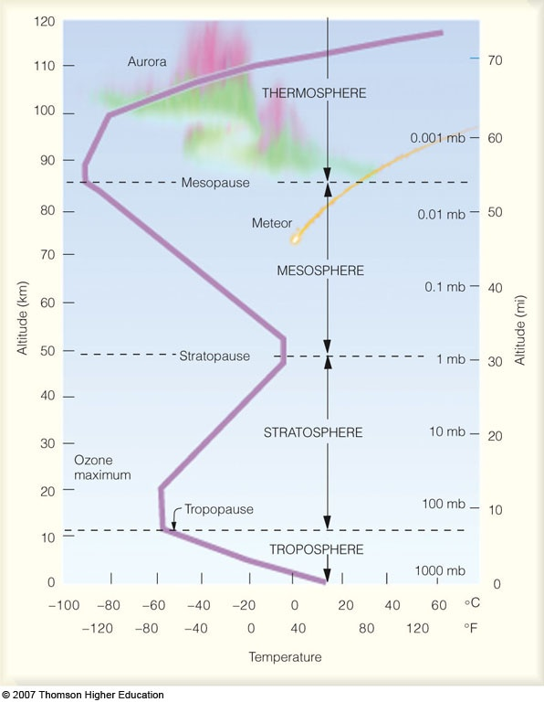
Main layers of the atmosphere
Troposphere, Stratosphere, Mesosphere, Thermosphere

Slide 9
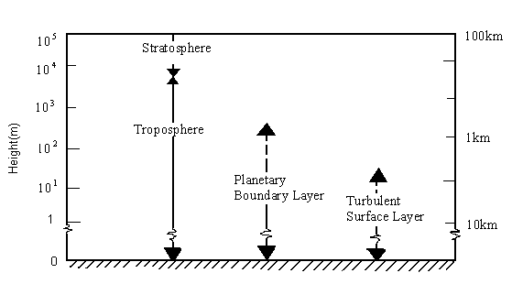


Slide 10
The Earth's surface is the bottom boundary of the atmosphere.
The portion of the atmosphere most affected by that boundary is called the atmospheric boundary layer (ABL)
The thickness of the boundary layer is quite vari­able in space and time. Normally -1 or 2 km thick (i.e., occupying the bottom 10 to 20% of the troposphere), it can range from tens of meters to 4 km or more.
Turbulence and static stability conspire to sand­wich a strong stable layer (capping inversion) between the boundary layer below and the rest of the troposphere above ( called the free atmosphere).
This stable layer traps pol­lutants, moisture and prevents the surface friction from being felt by the free atmosphere.

Slide 11
Reprinted with permission of Brooks/Cole, a division of Thomson Learning: www.thomsonrights.com. Fax 800-
730-22150.]

Slide 12
How if heat transported?
Conduction – principal method of heat transfer in ground.
Air temperature – determined principally by –
a) Radiative flux divergence
b) Advection
c) Convection
d) Latent heat exchanges by evaporation and condensation

Slide 13
Heat transfer from soil to air (and vice versa) in surface near air – a complex process. We can distinguish a three-layer structure:
1) A laminar boundary layer without turbulence (heat transfer by Brownian motion < 1mm).
2) A transitional boundary layer with incipient convection 1mm – 2cm.
3) Upper boundary layer with turbulent transfer that at its upper limit has fully free flow

Slide 14

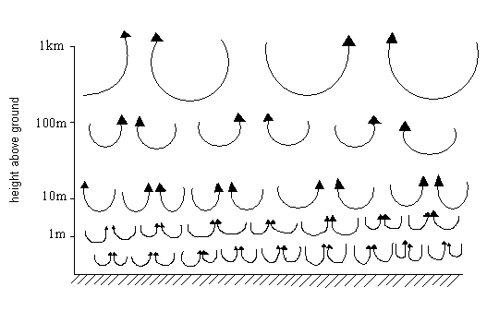

Turbulent eddies.

Slide 15
Turbulence is responsible for efficiently dispersing the pollutants
However, the capping inversion traps these pollutants within the boundary layer,
Turbulent communication between the sur­face and the air is quite rapid, allowing the air to quickly take 'on characteristics of the underlying sur­face.
In fact, one definition of the boundary layer is that portion of the lower troposphere that feels the effects of the underlying surface within about 30 min or less.

Slide 16
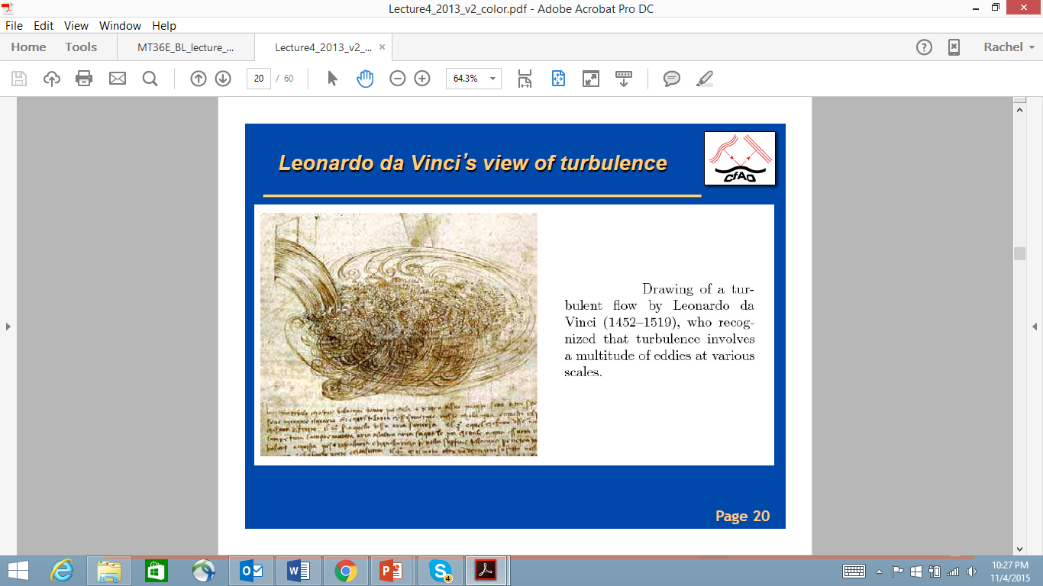
Leonardo da Vinci’s view of turbulence

Slide 17
Three kinds of turbulence recognized:
Mechanical turbulence
Turbulence caused by shear
Turbulence caused by buoyancy

Slide 18
Mechanical turbulence is caused by air flowing over rough features, such as hills or buildings.
https://www.meted.ucar.edu/EUMETSAT/at_dust/media/video/mech_turbulence.mp4

Slide 19
Turbulence from shear can result from differences in wind speed and/or direction.
https://www.meted.ucar.edu/EUMETSAT/at_dust/media/video/shear_turbulence.mp4

Slide 20
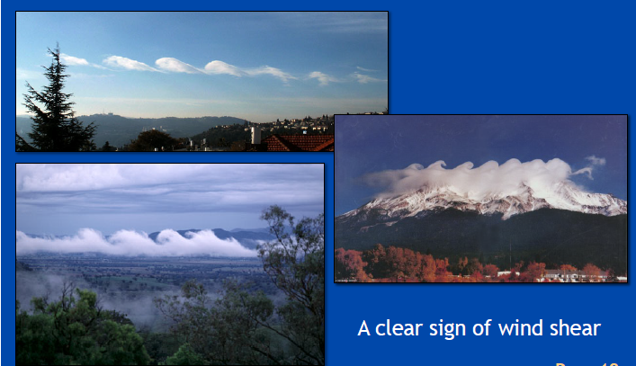
Sometimes clouds show these patterns known
also as Kelvin-Helmholtz vortex patterns

Slide 21
Buoyancy turbulence can be caused by a parcels of air rising during the diurnal heating of the surface.
In such case, buoyancy is governed by the stability of the atmosphere.
https://www.meted.ucar.edu/EUMETSAT/at_dust/media/video/buoy_turb.mp4

Slide 22
Turbulence is inspiringly complex, consisting of a superposition of swirls called eddies that interact nonlinearly to create quasi-random, chaotic motions.
An infinite number of equations is required to fully describe these motions.
A complete solution has not been found.
But when averaged over many eddies, we can observe persistent patterns.

Slide 23
Sonic anemometer recording at 25 Hz
30 minute

Slide 24
• Need: fast response instrument
• For winds: a sonic anemometer

Slide 25
͞w
w' = w − w

Slide 27
Despite the difficulties of deterministic descrip­tions of turbulence, scientists have been able to cre­ate a statistical description of turbulence.
The goal of this approach is to describe the net effect of many eddies, rather than the exact behavior of any individual eddy.

Slide 28
Based on an average over a time period T ( say half an hour):
In the atmosphere, this mean value can change from one half-hour period to the next, resulting in a slow variation of the mean-wind components with time.
Subtracting the mean from the instantaneous com­ponent u gives just the fluctuating (gust) portion of the flow (indicated with a prime)

Slide 29
The intensity of tur­bulence in the u direction is then defined by the variance:
In the atmosphere, fluctuations in velocity are often accompanied by fluctuations in scalar values such as temperature, humidity, or pollutant concentration.
For example, in a field of thermals there are regions where warm air is rising (positive potential temperature ϑ' accompanies positive vertical velocity w'), surrounded by regions where cold air is sinking (negative ϑ' accom-arries negative w'). One measure of the amount that ϑ and w vary together is the covariance (cov)

Slide 31
Reynolds Averaging

Slide 32
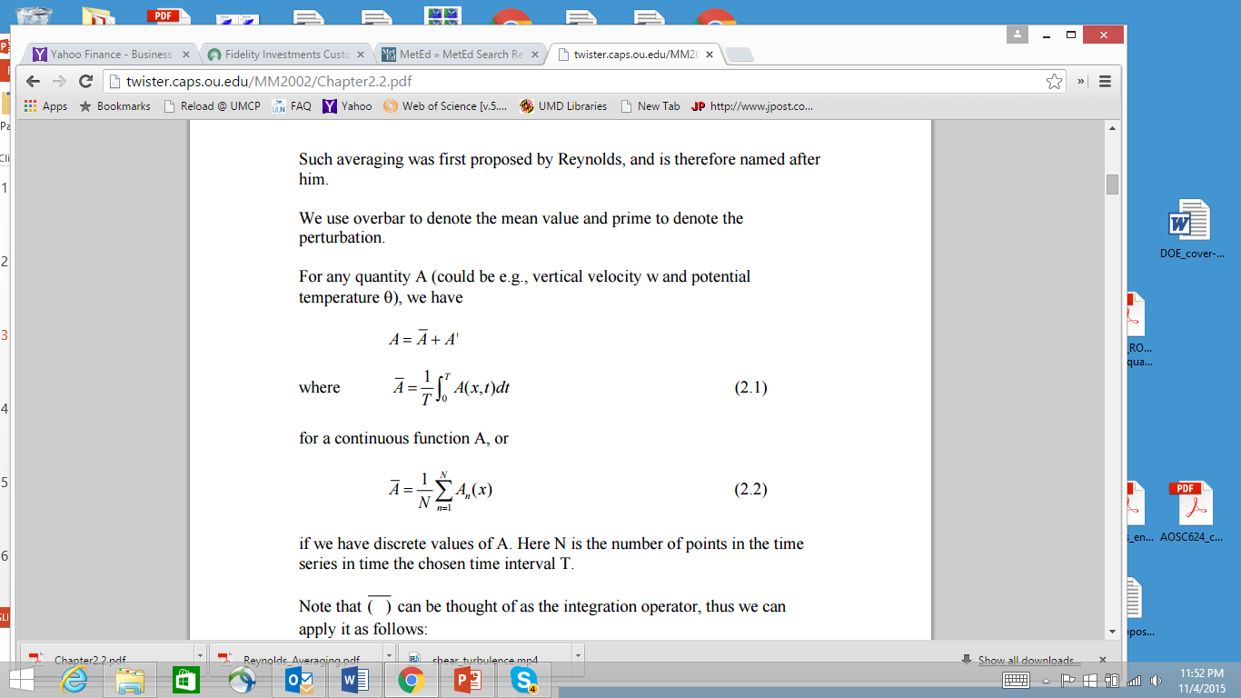

Slide 33
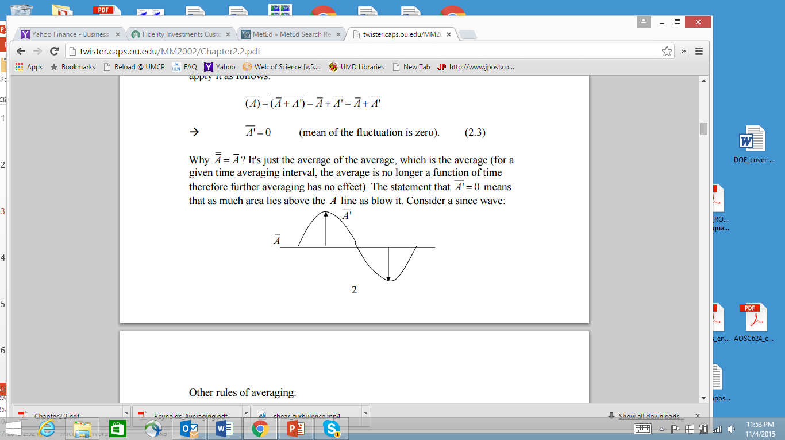

Slide 34
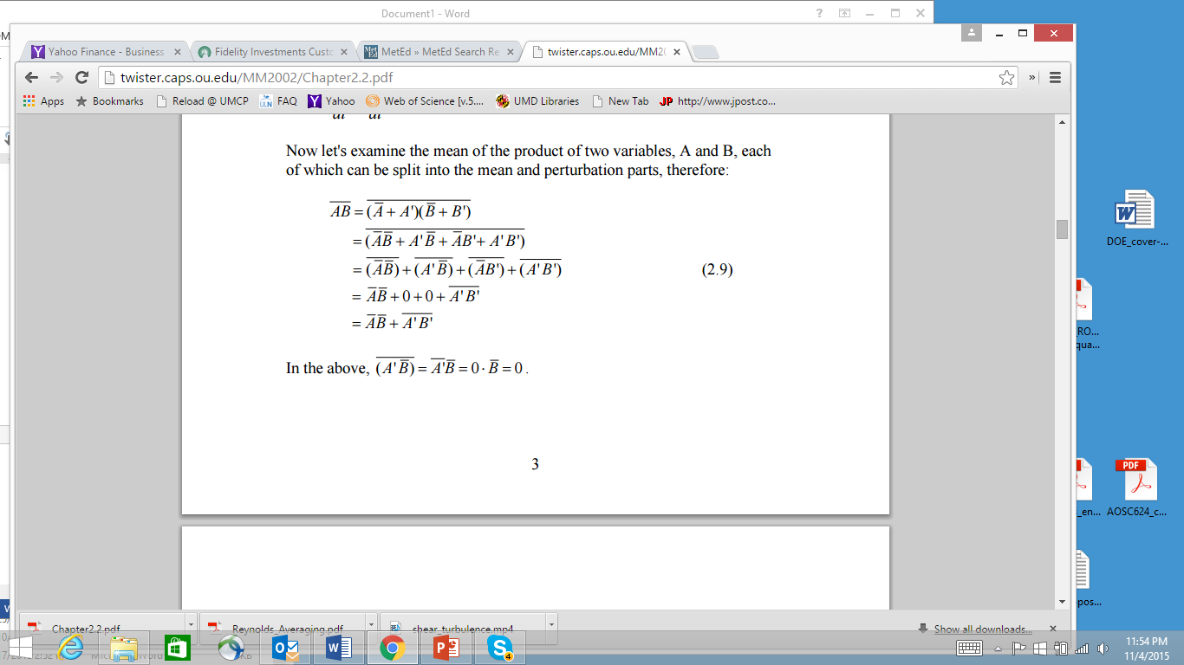

Slide 35
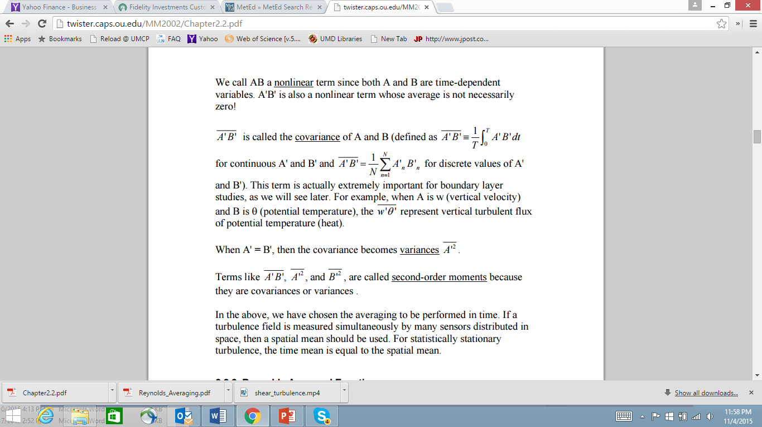

Slide 36
If warm air parcels are rising and cold parcels are sinking, as in a thermally direct circulation, then w' ϑ' > 0. Covariances can also be negative or zero for different situations in the atmosphere.
The power of the statistical approach is that the velocity variance is more than just a statistic-it represents the kinetic energy associated with the motions on the scale of the turbulence.

Slide 38
Turbulence kinetic Energy and Turbulence Intensity
Kinetic energy is defined as:
where m is mass and V is velocity. In meteorology we often use specific kinetic energy, namely KE/m, or the kinetic energy per unit mass. Similarly, we can define specific kinetic energy associated with turbulent fluctuations :
where TKE is turbulence kinetic energy. For laminar flow, which contains no rnicro-scale motions, TKE = 0, even though u, v, w are not necessarily zero. Larger values of TKE indicate a greater intensity of the microscale turbulence. We see now that the three components of velocity variance represent three con­tributions to the scalar TKE.

Slide 39
Using what we already know about mechanical and thermal generation of turbulence, aud of viscous dissipation, we can write in descriptive form an Eulerian (i.e., fixed relative to the ground) forecast equation for turbulence kinetic energy:

Slide 41
Or using eq. 9.4
where TKE is turbulence kinetic energy. For laminar flow, which contains no rnicro-scale motions, TKE = 0, even though
are not necessarily zero. Larger values of TKE indicate a greater intensity of the microscale turbulence. We see now that the three components of velocity variance represent three con­tributions to the scalar TKE.

Slide 42
Using what we already know about mechanical and thermal generation of turbulence, and of viscous dissipation, we can write in descriptive form an Eulerian (i.e., fixed relative to the ground) forecast equation for turbulence kinetic energy:
the advection of TKE by the mean wind, M is mechanical generation of turbulence, B is buoyant generation or consumption of turbulence, Tr is trans­port of turbulence energy by turbulence itself, and ε is the viscous dissipation rate.

Slide 43
The terms Ad and Tr neither create nor destroy TKE, they just redistribute it by moving it from one location to another. M is usually positive ( or zero if there is no shear) and
therefore generates turbulence, while B can be posi­tive or negative. Dissipation is always negative and can be approximated by
Where L_{ε} is the dissipation length scale.

Slide 45
In the absence of the terms Ad, M, B, and Tr, we see that as long as TKE is nonzero, the last term will always cause TKE to decrease toward zero. For this reason, turbulence is said to be dissipative.
In statically stable environments the buoyancy term can reduce TKE by converting it to potential energy by moving cold air up and warm air down. In such situations, the existence of turbulence depends on the relative strengths of mechanical generation (M) by wind shear versus buoyant consumption (B) by static stability.

Slide 47
The ratio of these two terms defines the dimensionless Richardson number, Ri, which can be approximated by the vertical gradients of wind and potential temperature
Laminar flow becomes turbulent when Ri drops below the critical value Ric = 0.25. Turbulent flow often stays turbulent, even for Richardson numbers
as large as 1.0, but becomes laminar at larger values of Ri. The presence or absence of turbulence for 0.25 < Ri < 1.0 depends on the history of the
flow: a behavior analogous to hysteresis. Flows for which Ric < 0.25 are said to be dynamically unstable.

Slide 51
statically stable environments the buoyancy term can reduce TKE by converting it to potential energy by moving cold air up and warm air down. In such situations, the existence of turbulence depends on the relative strengths of mechanical generation (M) by wind shear versus buoyant consumption (B) by static stability. The ratio of these two terms
defines the dimensionless Richardson number, Ri, which can be approximated by the vertical gradients of wind and potential temperature
where the term in the numerator is equivalent to the square of the Brunt Vaisala frequency, as defined in

Slide 52
(3.75). Laminar flow becomes turbulent when Ri drops below the critical value Ric = 0.25. Turbulent flow often stays turbulent, even for Richardson num­bers as large as 1.0, but becomes laminar at larger values of Ri. The presence or absence of turbulence for 0.25 < Ri < 1.0 depends on the history of the flow: a behavior analogous to hysteresis. Flows for
which Ric < 0.25 are said to be dynamically unstable. When the shear in laminar flow across a density interface ( e.g., between cold air below and warm air above) increases to the point at which the flow becomes dynamically unstable, the turbulence onset
grows as a Kelvin-Helmholtz (KH) instability on the interface.

Slide 53
First, small waves appear that grow in ampli­tude and curl over on themselves. If sufficient mois­ture is present in the atmosphere, a cloud can form in the rising portions of each curl, giving rise to a pattern that looks like breaking waves at the beach when viewed from the side (Fig. 9.7a). When viewed from above or below, these features appear as closely spaced para.lie! bands of clouds, called KH billows or billow clouds (Fig. 9.7b), which are perpendicular to the vertical shear vector av/ az. The overturning ofthe billows introduces static instabilities (i.e., locally unstable lapse rates) that further accelerate the transi­tion to turbulence within the shear layer.

Slide 54
2.1 The theory of turbulence in the Earth’s atm
The turbulence in the Earth’s atmosphere is always subsonic. To a very good degree one can regard the velocity ﬁelds to be divergence-free. That means that the turbulence in the Earth’s atmosphere is entirely carried by solenoidal motions: i.e. vorticity. It is caused by many diﬀerent phenomena:
•

Slide 55
Convection: If the lower parts of the atmosphere heat up, the atmosphere can be-come convectively unstable, leading to convective bubbles of gas rising to higher altitudes. Often these bubbles produce cumulus clouds, the strongest of which, the cumulonimbus clouds, cause lightning storms. But not all convection leads to clouds, and convection happens on all scales. For instance, if an asphalt road gets heated up by intense sunlight, the few centimeter thick layers of air above it convectively rise, while cooler air sinks. This leads to “seeing” eﬀects one can often observe in those conditions.
• Wind shear: Diﬀerent layers of the atmosphere may have diﬀerent horizontal ve-locities. If the vertical gradient of this horizontal velocity dvx/dz is strong enough, the Kelvin-Helmholtz instability can set in, leading to a turbulent layer. For this to happen, the Richardson number Ri≡ g/[∆h (dvx/dz)2], where g is the gravitational acceleration and ∆h is the altitude diﬀerence between the adjacent layers, must obey Ri􀀁 1.
• Wind over objects: If a wind ﬂows over objects, such as a mountain or the telescope dome, then turbulence can also be induc

Slide 56
2.2 Kolmogorov turbulence
Turbulence is a very complex phenomenon. A precise simulation of turbulence still often exceeds the capacities of modern supercomputers, although much progress has been made over the last decades. However, certain statistical properties of turbulence can be derived and understood without much computational eﬀort.
The basic idea is that we start from some large scale stirring, inducing solenoidal motions of wave number k0 =2π/L0 where L0 is the spatial scale of these large scale motions. Now, as we know from stirring milk in a cup of coﬀee: the large motions tend to break up in ever smaller-scale motions. In fact, it is this property of turbulence that leads to the quick dissolution of sugar in a cup of tea. This down-scaling of the turbulence is called a turbulent cascade. Energy is transferred from large-scale motions to ever smaller scale
motions, until one reaches a spatial scale Lν 􀀁 L0 which is the viscous dissipation scale: the spatial scale where the viscosity of the gas/ﬂuid starts to prohibit further cascading.
At this scale the kinetic energy of the gas motions is converted into heat. An important dimensionless number characterizing the turbulence is the Reynolds number:

Slide 57
where V0 is the typical turbulent velocity at the largest scale and ν (in units of cm2/s for CGS units) is the kinematic viscosity of the gas or ﬂuid. For air at 0 degrees Celsius this is ν =0.132cm2/s, and at -40 degrees Celcius it is ν =0.104cm2/s. We can deﬁne a turbulent viscosity

Slide 58
so that νturb = Re ν. For Re􀀂 1 the ratio L0/Lν 􀀂 1, though Re and L0/Lν are not linearly related.
If we assume that there is a constant random stirring at the scale L0, then this input energy cascades down to Lν where it is dissipated. The turbulent cascade is thus char-acterized by an energy input rate per gram of gas ε in units of erg gram−1 sec−1 which in this stationary state is the same as the energy dissipation rate. In k-space this is the energy ﬂow rate from small k to large k. Let us now try to characterize the energy stored in each mode k per gram of gas, written as E(k). The quantity E(k)dk has the dimension erg gram−1. Since k has the dimension cm−1, E(k) has the dimension erg cm gram−1.
Using these dimensions we can start a dimensional analysis. If we write erg = gram cm2 sec−2 then we get the following dimensions:

Slide 59
If kν 􀀂 k0 then there is a large region in k-space, k0 􀀁 k 􀀁 kν where the function E(k) must be independent on what is happening at k0 or kν. The only “information” that it
has in this intermediate-k region is k itself and the energy ﬂow ε. Somehow we must be
able to write E(k) ∝ εαkβ . Using the above dimensionalities you can see that this only
makes dimensional sense if α =2/3 and β = −5/3, i.e.

Slide 64
Eddy correlation, gradient-flux, and bulk transfer methods
According to Fick’s law the net vertical flux of water vapor across the earth’s surface is proportional to the specific humidity (concentration) gradient, a similar manner as for momentum and heat.
The proportionality coefficient for the vapor flux is the molecular diffusivity for water vapor:

Slide 65
This expression is only valid in the laminar viscous sublayer.
This mechanism operates at the air-water, air-soil, and air-vegetation interfaces.
The lower region of the surface boundary layer is almost always turbulent so that in this layer the water is transferred away from the molecular sublayer by turbulence.

Slide 66
The vertical flux is the given by
The transport in this mixed layer depends on surface roughness, wind shear, and thermal stratification.
The rate of transfer of water vapor (evaporation) depends on all these factors as well as on the gradient of specific humidity.

Slide 67
We can than accept a gradient-flux relation
Where by analogy the eddy diffusivity for water vapor replaces the molecular diffusivity .

Slide 68
In a similar way as in the bulk transfer approach for determining the heat flux, we can also write and equivalent expression for the evaporation as

Slide 69
Where is the bulk transfer coefficient for water vapor.
The value of is not well established particularly at high wind speeds, such as for .

Slide 70
Sometimes and are used although they have a somewhat different behavior depending on the stability and wind shear or on the two factors combined in terms of the Richardson number.
The main difficulty in applying this last method is that the specific humidity at the surface q(0) is not easy to measure or estimate over land.

Slide 71
Energy balance method
The energy equation at the surface (6.40) can be written as
Solving for E we find
where B is the Bowen ratio.
Knowing the Bowen ratio and the other fluxes, this can be used to compute the evapotranspiration.

Slide 72
The Bowen ratio can be computed from the gradient-flux relationship for heat (10.33) and water vapor (10.37), assuming that :
or

Slide 73
Thus, to evaluate B one needs to measure the temperature difference and the specific humidity difference between two levels in the surface mixed layer.
,we can express B in terms on the vapor pressure e instead of q, so that

Slide 74
where
is the Bowen constant, the well-known psychomotor constant with a mean value of mb º for p=1000 mb.

Slide 75


Eddy correlation, gradient-flux, and bulk transfer methods
According to Fick’s law the net vertical flux of water vapor across the earth’s surface is proportional to the specific humidity (concentration) gradient, in a similar manner as for momentum and heat. The proportionality coefficient for the vapor flux is the molecular diffusivity for water vapor:
This expression is only valid in the laminar viscous sublayer, where the molecular exchange is the prevalent transfer mechanism. This mechanism operates at the air-water, air-soil, and air-vegetation interfaces.
The lower region of the surface boundary layer is almost always turbulent so that in this layer the water is transferred away from the molecular sublayer by turbulence. The vertical flux is the given by
The transport in this mixed layer depends on surface roughness, wind shear, and thermal stratification. Therefore, the rate of transfer of water vapor (evaporation) depends on all these factors as well as on the gradient of specific humidity. We can than accept a gradient-flux relation
Where by analogy the eddy diffusivity for water vapor replaces the molecular diffusivity .

Slide 76
Where by analogy the eddy diffusivity for water vapor replaces the molecular diffusivity .
In a similar way as in the bulk transfer approach for determining the heat flux, (10.34), we can also write and equivalent expression for the evaporation as
Where is the bulk transfer coefficient for water vapor. Over land, Eq. (10.38) gives only a measure of the potential not necessarily the actual evaporation. The value of is not well established particularly at high wind speeds, such as for , for which there are as yet no direct estimates. Sometimes for convenience and are used although they have a somewhat different behavior depending on the stability and wind shear or on the two factors combined in terms of the Richardson number (10.22). The main difficulty in applying this last method is that the specific humidity at the surface q(0) is not easy to measure or estimate over land.

Slide 79
Evaporative processes play a critical role in the climate
system, coupling the surface and the atmosphere and
linking the water, energy, and carbon cycles.

Slide 81
2.2. Reynolds averaging and Reynolds averaged equations We will study several aspects of the PBL. Before that, we need to develop a set of equations that are suitable for studying turbulent flows. 2.2.1. Reynolds Averaging
To obtain a wind speed measurement representative of the large-scale flow, we obtain take an average over a time period long enough to smooth over the fluctuations but still short enough for keep the trend. The trend can be early identified in the above

Slide 82
http://twister.caps.ou.edu/MM2002/Chapter2.2.pdf

Slide 86
Typically, wind shear creates the turbulence and horizontal roll vortices that loft dust up and away

Slide 88
0:02
0:01
0:09
Turbulence acts to disperse dust plumes and keep the dust particles in suspension. Without turbulence, dust generally settles at a rate of 305 meters (1,000 feet) per hour. However, this is highly dependent on environmental conditions. Any turbulence will slow the settlement rate.

Slide 89
A) Forced – flow across rough surface
B) Free – caused by density or buoyancy differences within a moving fluid
C) Natural – occurs over a heated surface when there is no wind.

Slide 90
Air masses1 are boundary layers that form over different surfaces. Temperature differences between neighboring air masses cause baroclinicity that drives extratropical cyclones. Heat and humidity trapped in the boundary layer are important fuels for convec­tive clouds. The capping inversion inhibits thunder­storm formation, allowing the buildup of convective available potential energy ( CAPE) in the free atmos­phere. Wind shear in the boundary layer, caused by drag near the ground, generates horizontal vorticity that can be tilted by the updrafts in convective clouds to form tornadoes. Dissipation of kinetic energy within the boundary layer serves as a brake on large­scale wind system

Slide 91
Bowen ratio
The nature of the ABL is determined by the balance between H and E, which depends on surface moisture availability.
A convenient parameter is the Bowen ratio, defined as
B= H / E
It is not suitable for parameterisation schemes in numerical models but it is conceptually helpful. Typical values at midday over different surfaces are:

Slide 102
How if heat transported?
Conduction – principal method of heat transfer in ground.
Air temperature – determined principally by –
a) Radiative flux divergence
b) Advection
c) Convection
d) Latent heat exchanges by evaporation and condensation
Advection import – if earth surface not uniform (motion of warm air across a cooler lake). Advection term doesn’t appear in energy balance because wind flow is horizontal.

Slide 103
Air masses1 are boundary layers that form over different surfaces. Temperature differences between neighboring air masses cause baroclinicity that drives extratropical cyclones. Heat and humidity trapped in the boundary layer are important fuels for convec­tive clouds. The capping inversion inhibits thunder­storm formation, allowing the buildup of convective available potential energy ( CAPE) in the free atmos­phere. Wind shear in the boundary layer, caused by drag near the ground, generates horizontal vorticity that can be tilted by the updrafts in convective clouds to form tornadoes. Dissipation of kinetic energy within the boundary layer serves as a brake on large­scale wind system

Slide 104
The Earth's surface is the bottom boundary of the atmosphere.
The portion of the atmosphere most affected by that boundary is called the atmospheric boundary layer (ABL) layer for
The thickness of the boundary layer is quite vari­able in space and time. Normally -1 or 2 km thick (i.e., occupying the bottom 10 to 20% of the troposphere), it can range from tens of meters to 4 km or more.
Turbulence and static stability conspire to sand­wich a strong stable layer ( called a capping inversion) between the boundary layer below and the rest of the troposphere above ( called the free atmosphere).
This stable layer traps turbulence, pol­lutants, and moisture below it and prevents most of the surface friction from being felt by the free atmosphere.

Slide 105
Turbulence is responsible for efficiently dispersing the pollutants
However, the capping inversion traps these pollutants within the boundary layer,
Turbulent communication between the sur­face and the air is quite rapid, allowing the air to quickly take 'on characteristics of the underlying sur­face.
In fact, one definition of the boundary layer is that portion of the lower troposphere that feels the effects of the underlying surface within about 30 min or less.

Slide 106
The Earth's surface is the bottom boundary of the atmosphere.
The portion of the atmosphere most affected by that boundary is called the atmospheric boundary layer (ABL) layer for
The thickness of the boundary layer is quite vari­able in space and time. Normally -1 or 2 km thick (i.e., occupying the bottom 10 to 20% of the troposphere), it can range from tens of meters to 4 km or more.
Turbulence and static stability conspire to sand­wich a strong stable layer ( called a capping inversion) between the boundary layer below and the rest of the troposphere above ( called the free atmosphere).
This stable layer traps turbulence, pol­lutants, and moisture below it and prevents most of the surface friction from being felt by the free atmosphere.

Slide 107
Turbulence is responsible for efficiently dispersing the pollutants
However, the capping inversion traps these pollutants within the boundary layer,
Turbulent communication between the sur­face and the air is quite rapid, allowing the air to quickly take 'on characteristics of the underlying sur­face.
In fact, one definition of the boundary layer is that portion of the lower troposphere that feels the effects of the underlying surface within about 30 min or less.

Slide 108
Fluxes are defined by:
QH = ρCp w'θ '
QLE = ρ Lv w'q'
• w’: turbulent fluctuations of upward wind velocity
• q’: turbulent fluctuations of humidity
θ
Turbulent fluctuations of temperature

Slide 109
9.1 Turbulence
Atmospheric flow is a complex superposition of many different horizontal scales of motion (Table 9.1), where the "scale" of a phenomenon describes its typi­cal or average size. The largest are planetary-scale circulations that have sizes comparable to the circum­ference of the Earth. Slightly smaller than planetary scale are synoptic scale cyclones, anticyclones, and waves in the jet stream. Medium-size features are called mesoscale and include frontal zones, rain bands, the larger thunderstorm and cloud complexes, and various terrain-modulated flows.
Smaller yet are the microscales, which contain boundary-layer scales of about 2 km, and the smaller turbulence scales contained within it and within clouds. The mesoscale and microscale are further subdivided, as indicated in Table 9.1. This chapter focuses on the microscales, starting with the smaller ones.

Slide 110
When flows contain irregul'ar swirls of many sizes that are superimposed, the flow is said to be turbu­lent. The swirls are often called eddies, but each individual eddy is evanescent and quickly disap­pears to be replaced by a succession of different eddies. When the flow is smooth, it is said to be laminar. Both laminar and turbulent flows can exist at different times and locations in the boundary layer.
Turbulence can be generated mechanically, ther­mally,, and inertially. iWechanical turbulence, also known as forced convection, can form if there is shear in the mean wind. Such shear can be caused by frictional drag, which causes slower winds near the ground than aloft; by wake turbulence, as the wind swirls behind obstacles such as trees, buildings, and islands (Fig. 9.2); and by free shear in regions away from any solid surface (Fig. 9.3).

Slide 112
Thermal or convective turbulence, also known as free convection, consists of plumes or thermals of warm air that rises and cold air that sinks due to buoyancy forces. Near the ground, the rising air is often in the form of intersecting curtains or sheets of updrafts, the intersections of which we can identify as plumes with diameters about 100 m. Higher in the boundary layer, many such plumes and updraft curtains merge to form larger diameter (-1 km) thermals. For air containing sufficient moisture, the tops of these thermals contain cumu­lus clouds (Fig. 9.4).

Slide 113
Small eddies can also be generated along the edges of larger eddies, a process called the turbulent cascade, where some of the inertial energy of the larger eddies is lost to the smaller eddies, as elo­quently described by Richardson's poem (see Chapter 1 ). Inertial turbulence is just a special form of shear turbulence, where the shear is generated by larger eddies. The superposition of all scales of eddy motion can be quantified via an energy spectrum (Fig. 9.5), which indicates how much of the total tur­bulence kinetic energy is associated with each eddy scale.
t affects all turbulent scales because of the turbulent cascade of energy from larger to smaller scales. For turbulence to exist, there must be continual genera­tion of turbulence from shear or buoy ancy (usually into the larger scale eddies) to offset the transfer of kinetic energy down the spectrum of ever-smaller eddy sizes toward eventual dissipation. But why does nature produce turbulence?

Slide 114
The intensity of tur­bulence in the u direction is then defined by the variance:
Again, this is the variance averaged over a half-hour period so this variance value can vary slowly with time over subsequent averaging periods. Similar equations can be defined for the other velocity components.
For situations in which u,7 is relatively constant with time (e.g., the same now as an hour ago), the turbulent nature of the flow is said to be stationary. When ua is relatively uniform in space ( e.g., the same value in one town as in a neighboriug town), the flow is said to be homogeneous. For situations in which the turbulence intensity at any one point is the same in all directions (u,7 = u3 = u,i), the flow is said to be isotropic.
In the atmosphere, fluctuations in velocity are often accompanied by fluctuations in scalar values such as temperature, humidity, or pollutant concentration. For example, in a field of thermals there are regions where warm air is rising (positive potential temperature O' accompanies positive vertical velocity w'), surrounded by regions where cold air is sinking (negative O' accom-arries negative w'). One measure of the amount that O and w vary together is the covariance (cov)

