Slide 1
Objective
In Lecture # 14, defined heating rate of the atmosphere, namely, it is given by the radiative flux divergence at each level.
If the total net flux at a given height is given by:
F(z) = F (Z) - F (z)
Denoting the net flux F(z + Δ z) at the level z + Δz, the net flux divergence for the layer Δz is:
ΔF = F (z+ Δ z) - F(z)

Slide 2
Heating Rates (namely, radiative flux divergence)
is the net flux and ρ is the total density of air.

Slide 3
The radiative heating or cooling rate is defined as the rate of temperature change of the layer dz due to radiative energy gain or loss, given as:
(3)
c_{p} is the specific heat at constant pressure
(c_{p} = 1004.67 J/kg/K and ρ is the air density in a given layer.
In order to understand how the last term was obtained from the previous one, we need to use the hydrostatic equation.
First, what is hydrostatic balance?

Slide 4
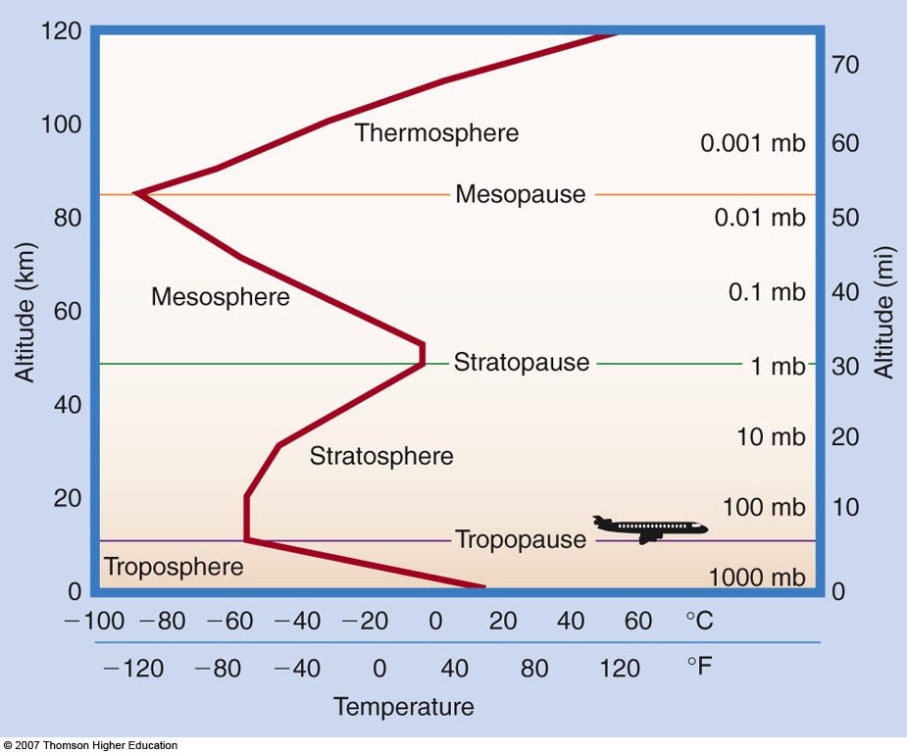
Main layers of the atmosphere Troposphere, Stratosphere, Mesosphere, Thermosphere, Separated by conceptual partitions-called pauses (tropopause)

Slide 5
The Hydrostatic Equation
Air is in hydrostatic equilibrium when the upward-directed pressure gradient force is exactly balanced by the downward force of gravity.
Next figure shows air in hydrostatic equilibrium. Since there is no net vertical force acting on the air, there is no net vertical acceleration, and the sum of the forces is equal to zero.

Slide 6
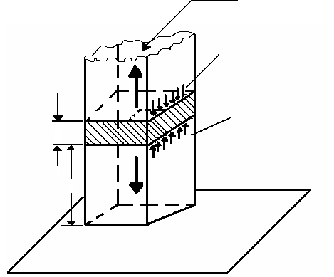

Slide 7
Since we know that pressure decreases with height, dp must be a negative quantity, and the upward pressure on the lower face of the shaded block must be slightly greater than the downward pressure on the upper face of the block.
Thus the net vertical force on the block due to the vertical gradient of pressure is upward and given by – dp as indicated in the figure. The balance of forces in the vertical requires that
or
The second equation is termed the hydrostatic equation. It should be noted that the negative sign in equation 2 ensures that the pressure decreases with increasing height.
Since ρ = 1/α, equation 2 can be rearranged to give

Slide 8
If pressure at height z is p(z), we have, from equation 2,
Or, since p ( ) – 0,
That is, the pressure at level z is equal to the weight of the air in the vertical column of unit cross-sectional area lying above that level. If the mass of earth’s atmosphere were uniformly distributed over the globe, the pressure at sea level would be 1013 mb, or 1.013 × 10PA, which is referred to a normal atmosphere pressure and abbreviated as 1 atm.

Slide 9
Hydrostatic equation
The upward pressure gradient force acting on a thin slice of air (p decreases with z) is generally very closely in balance with the downward force due to gravitational force. Or:
If there is no vertical motion, the difference in presuure (dp) between two levels (dZ) is caused by the weight of the layer of the air –
mass * acceleration due to gravity.

Slide 10
If pressure at height z is p(z), we have, from equation 2,
Or since p ( ) – 0,
That is, the pressure at level z is equal to the weight of the air in the vertical column of unit cross-sectional area lying above that level. If the mass of earth’s atmosphere were uniformly distributed over the globe, the pressure at sea level would be 1013 mb, or 1.013 × 10PA, which is referred to a normal atmosphere pressure and abbreviated as 1 atm.

Slide 11
Why is it of interest in the following expression to change from dependence in z to dependence on p?
To evaluate the heating rate in equation one needs profile of IR upwelling and downwelling fluxes
To compute the IR downward and upward fluxes, one needs the vertical structure of various parameters describing the atmosphere. For various reasons, it is more convenient to work in pressure coordinates than in height coordinates.

Slide 13
The Hydrostatic Equation
Air is in hydrostatic equilibrium when the upward-directed pressure gradient force is exactly balanced by the downward force of gravity. Next figure shows air in hydrostatic equilibrium. If there is no net vertical force acting on the air, there is no net vertical acceleration, and the sum of the forces is equal to zero.

Slide 14
Consider the vertical balance of any wedge (hatched area) of area A in the column below. The pressure
on the lower
area is p.
The
pressure
on the
upper
area is
p+dp.

Slide 15
Hydrostatic equation
If there is no vertical motion in the
atmosphere, the difference in pressure (dp)
between two levels (dz) is balanced by the
weight of the layer of the airmass * acceleration due to gravity = am=gm
m=ρV=ρAdz
(the volume V of the shaded wedge in previous figure is the area (A) times height (dz) (common to assume A=1, unit area)
Note: P = F/A; A -Area

Slide 16
Since we know that pressure decreases with height, dp must be a negative quantity, and the upward pressure on the lower face of the shaded block must be slightly greater than the downward pressure on the upper face of the block.
Thus the net vertical force on the block due to the vertical gradient of pressure is upward and given by – dp as indicated in the figure. The balance of forces in the vertical requires that
(1)
or
(2)
The second equation is termed the hydrostatic equation. It should be noted that the negative sign in equation 2 ensures that the pressure decreases with increasing height.
Since ρ = 1/α, equation 2 can be rearranged to give
(3)

Slide 17
If pressure at height z is p(z), we have, from equation 2,
Since p(∞) = 0
(5)
Namely, the pressure at level z is equal to the weight of the air in the vertical column of unit cross-sectional area lying above that level. If the mass of earth’s atmosphere were uniformly distributed over the globe, the pressure at sea level would be 1013 mb or 1.013 × 10PA, which is referred to a normal atmosphere pressure and abbreviated as 1 atm.
∫_{z}∞ gρdz
(4)
∞
∫_{z} gρdz

Slide 18
Time permitting:
Explain the relationship between actual lapse rate and adiabatic lapse rate.

Slide 19
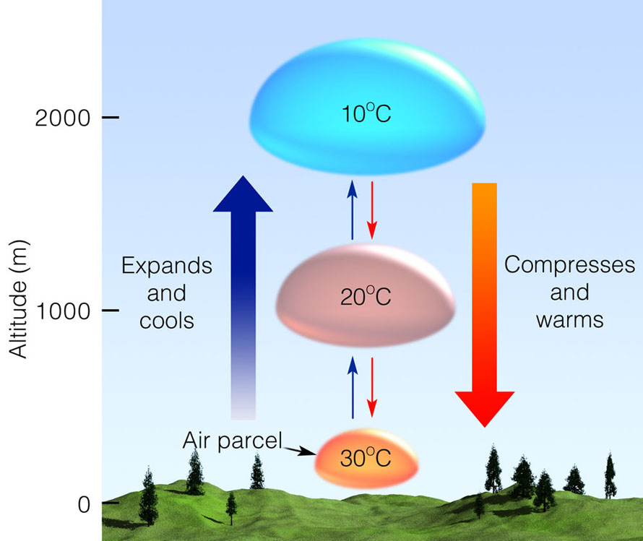

Slide 20
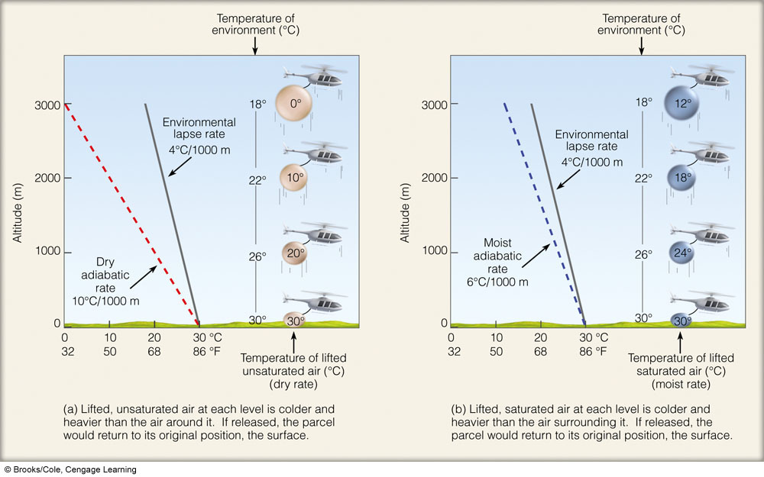
Ability of the parcel to rise depends on: Relationship between environmental lapse rate; dry adiabatic lapse rate; moist adiabatic lapse rate

Slide 21
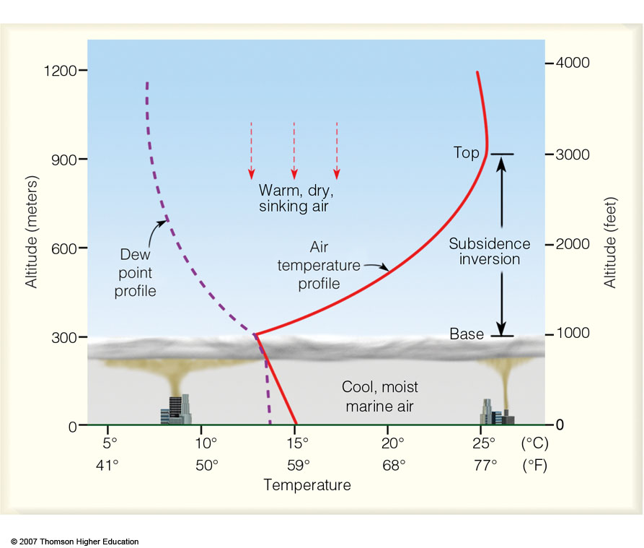
A strong subsidence inversion along the coast of California. The base of the stable inversion acts as a cap or lid on the cool, marine air below. An air parcel rising into the inversion layer would sink back to its original level because the rising parcel would be colder and more dense than the air surrounding it.
Notes:
Figure 1
A strong subsidence inversion along the coast of California. The base of the stable inversion acts as a cap or lid on the cool, marine air below. An air parcel rising into the inversion layer would sink back to its original level because the rising parcel would be colder and more dense than the air surrounding it.

