Slide 1
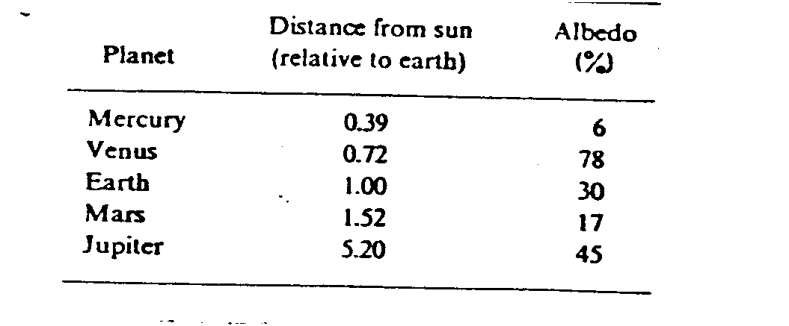
6. The following table gives that distance of various planets from the sun and their albedos. Employing the result in Exercise 5, compute the equilibrium temperatures of these planets.

Slide 2
%Yicheng He%AOSC400%Homework 2%10/30/15close all; clear all; clc;
%Problem 6% --------------------------------- code----------------------------------distance= [0.39,0.72,1.52,5.2];albedo=[0.06,0.78,0.17,0.45];
S=1372; %Solar flux of earthF=S.*(1./distance).^2; %Get solar flux of planets
EffectiveTemperature=((1-albedo).*F./4./(5.67*10^-8)).^(1/4) %----------------------------------output---------------------

Slide 4
7. The flux density of atmospheric long - wave radiation is highly correlated with air temperature near the surface (because concentration of the emitting gases is temperature dependant and about 1/2 of the total flux comes from the lowest 100m). One of the empirical equations for computing L in ly/min from air temperature T_{a} in °K is given by Idso and Jackson as:
L = ε_{a} σ T_{a}⁴
where the apparent atmospheric emissivity ε_{a} is:
ε_{a} = 1 - 0.261 exp{-7.77 (10⁻⁴)(273 - T_{a} )²}
Plot atmospheric longwave radiation under clear skies as a function of temperature (in range -40 to +40°)

Slide 5
%Problem 7% --------------------------------- code----------------------------------x = linspace(233,313,100);%convert celsius to kelveny = (1 - 0.261*exp(-7.77*(10.^-4)*(273 - x).^2)).*(5.670373*10.^-8).*x.^4; figureplot(x,y)%----------------------------------output------------------------------

