Slide 1
AOSC624 Class 24: May 8, 2012
Leaf Area Index ()LAI)
Soil Moisture
Radiative Fluxes
SW
LW

Slide 2
Example how NDVI is used in operations:
ENCEP Eta Model:
Regional mesoscale model used by NOAA for forecasting. Has 40 km resolution.
If NDVI is used as average index for a grid box large errors are obtained in Eta model output. If NDVI is used in conjunction with area distribution within that box, a better output results from Eta model.

Slide 3
Leaf Area Index (LAI)
Provides information for inside of canopy; amount of green leaf per unit area of the surface
Beer's Law I = I_{o} * e^{(-LAI * t)}
where t = transmission
LAI acts as an extinction coefficient for radiation going through canopy to surface.
Photosynthesis depends on photosynthetically active radiation (PAR) (0.4 - 0.7μm)
Absorbed PAR ~ NDVI
APAR = absorbed photosynthetically active radiation

Slide 4
Soil moisture
Attempts have been made to derive soil moisture from:
Visible
IR
Microwave
Physical principles for visible:
Surface albedo changes with soil moisture content. Many satellites look at surface albedo with the goal of getting soil moisture.
wet soil = lower albedo
dry soil = higher albedo
A profile of abedo depends on time and shows a "U" shape, noon occurring at the bottom of the "U" .
Idso, S. B. et al., 1975. The dependence of bare soil albedo on soil water content. J. Applied Meteor., 14, 109-113

Slide 5
Physical principles for IR:
Thermal Inertia
P=(ρcλ)^{1/2}
Where ρ=density of soil (gm-cm⁻³)
C=heat capacity (cal-gm⁻¹-⁰ C⁻¹
λ=thermal conductivity (cal-cm-1-sec⁻¹-⁰ C⁻¹)
The Heat Capacity Mapping Mission (HCMM) was designed to sense the magnitude of the diurnal temperature cycle by obtaining thermal data at the peak of the cycle and near the early morning minimum. The amplitude depends on soil moisture. HCMM was the first of planned series of Application Explorer Missions (AEM), which involved the placement of a small spacecraft in a special orbit.

Slide 6
Diurnal variation of surface temperature as a function of thermal inertia

Slide 7
After T. Schmugge

Slide 8
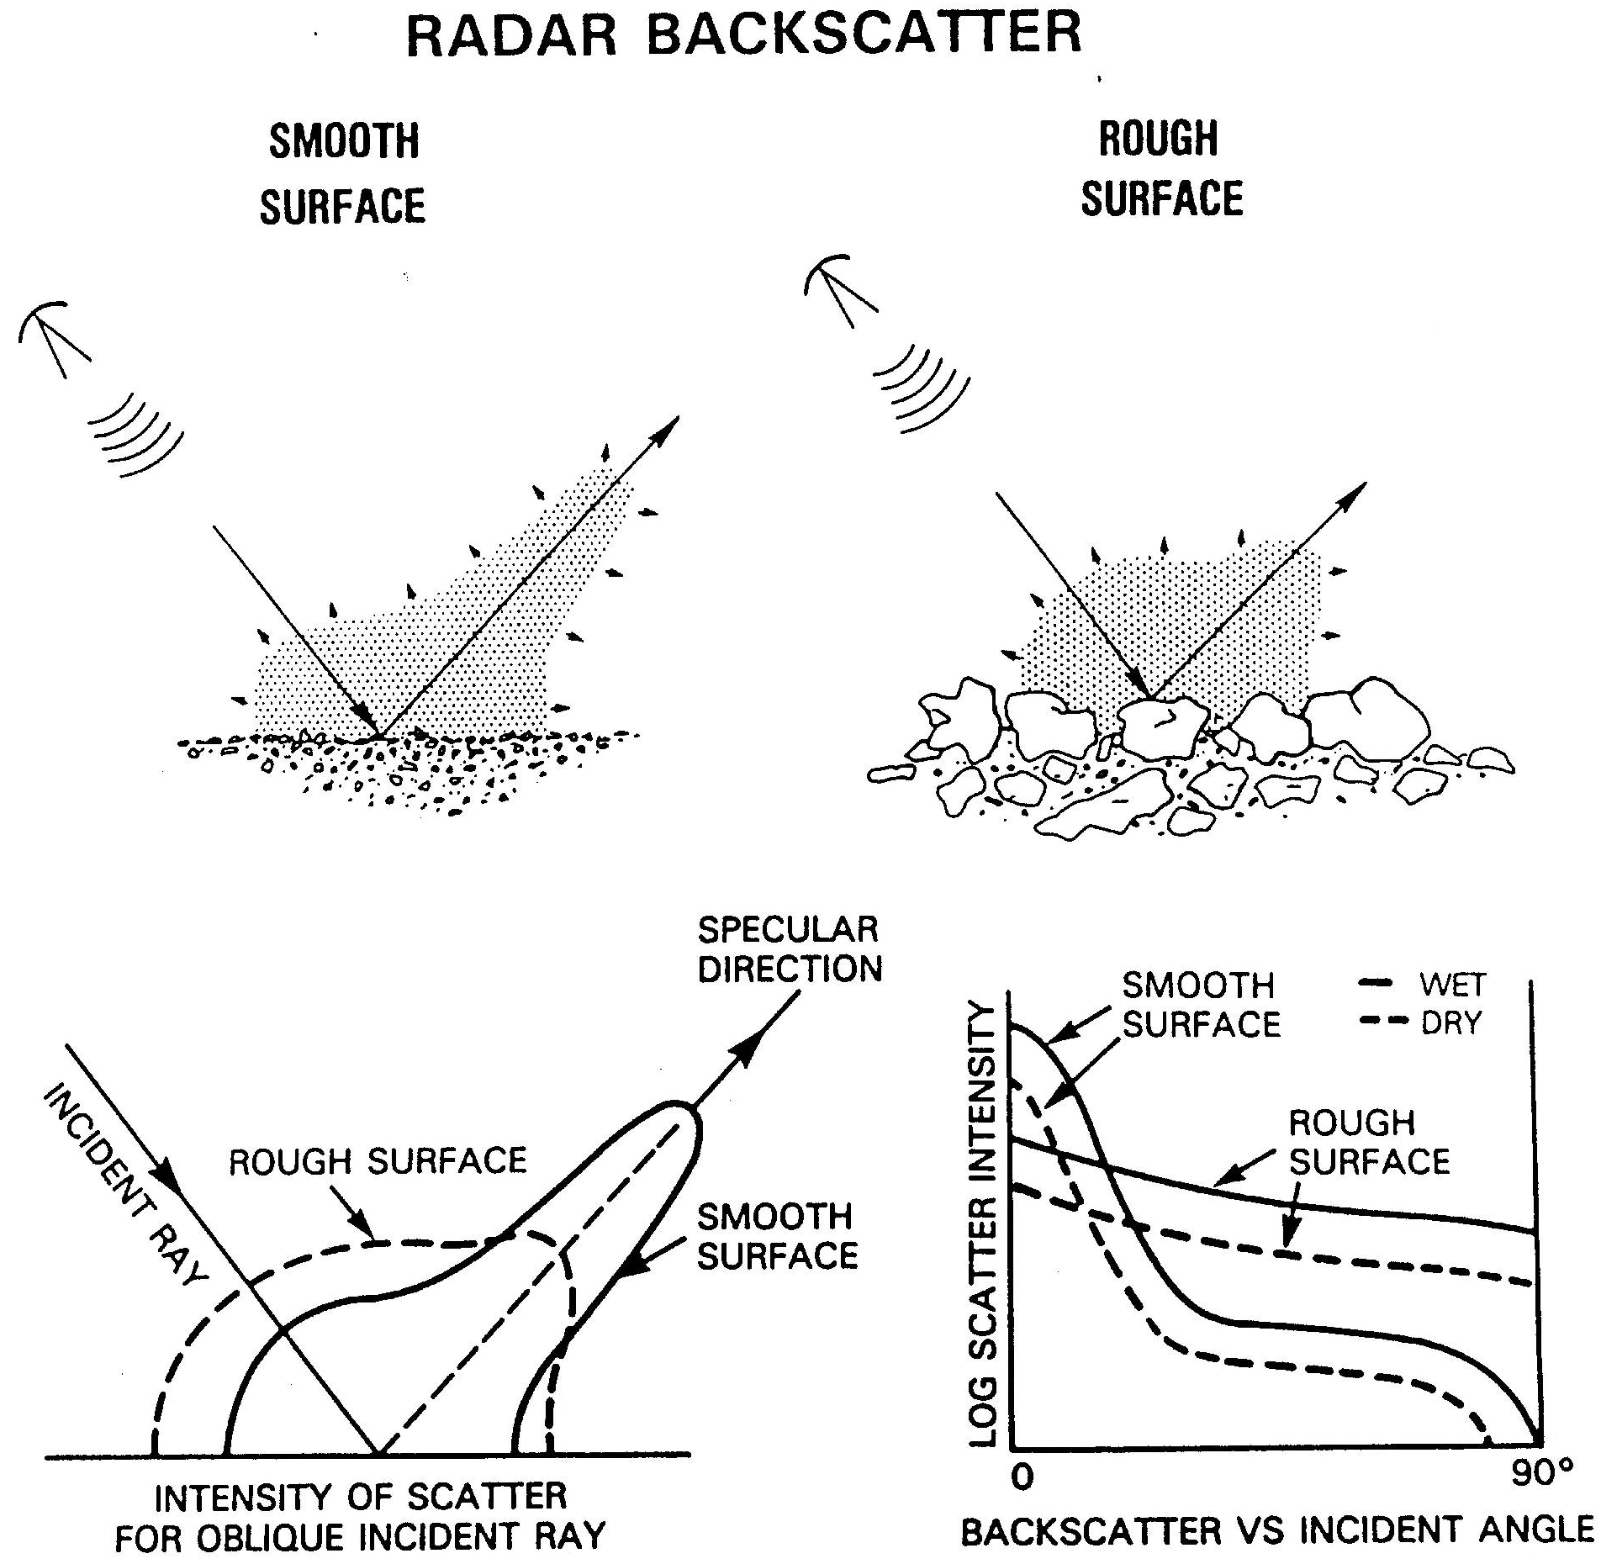

Slide 11
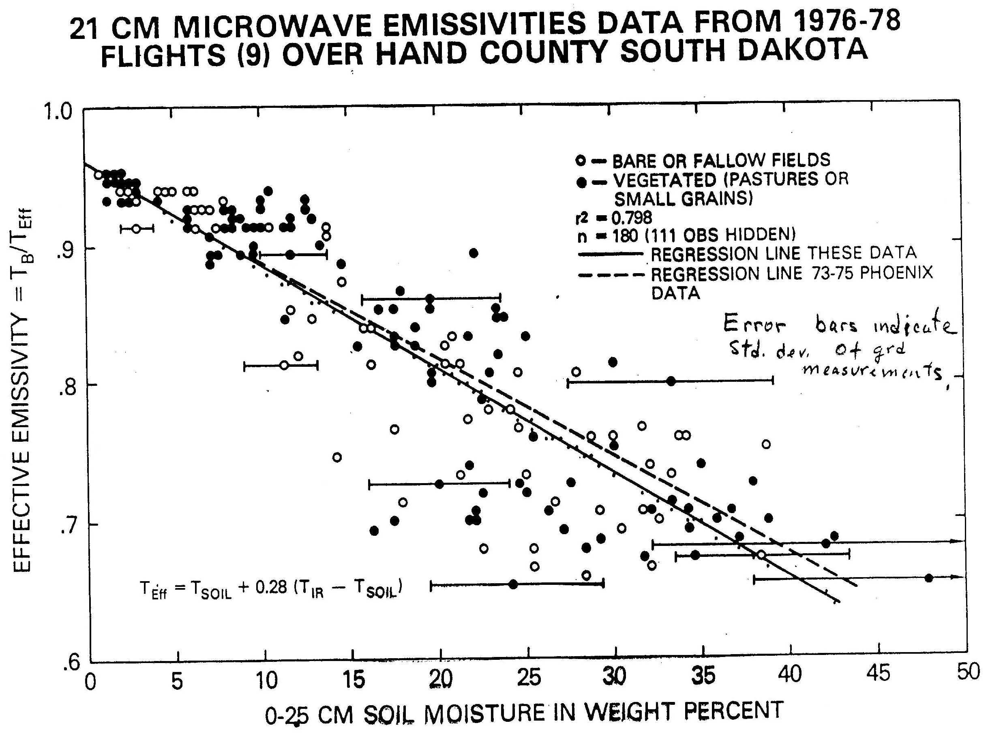

Slide 12
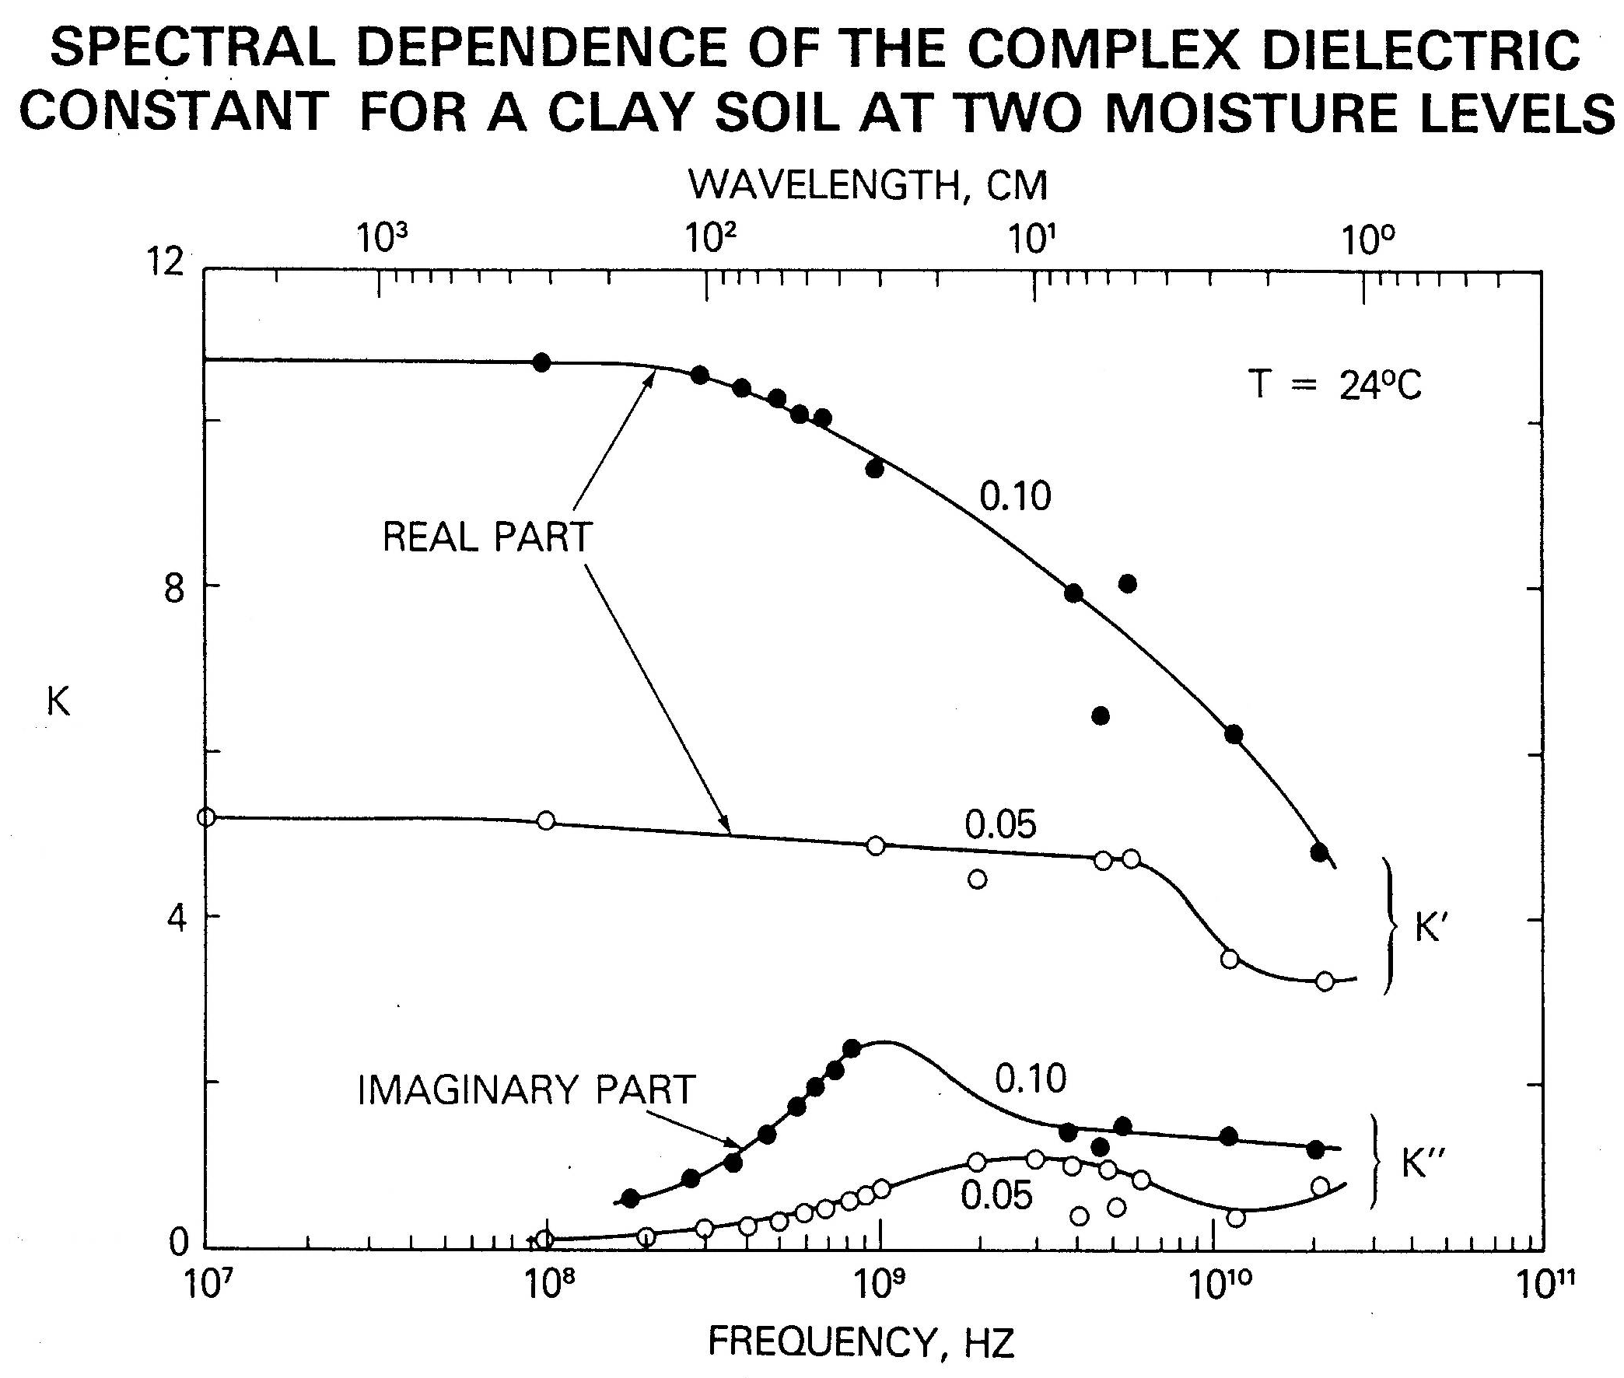

Slide 14
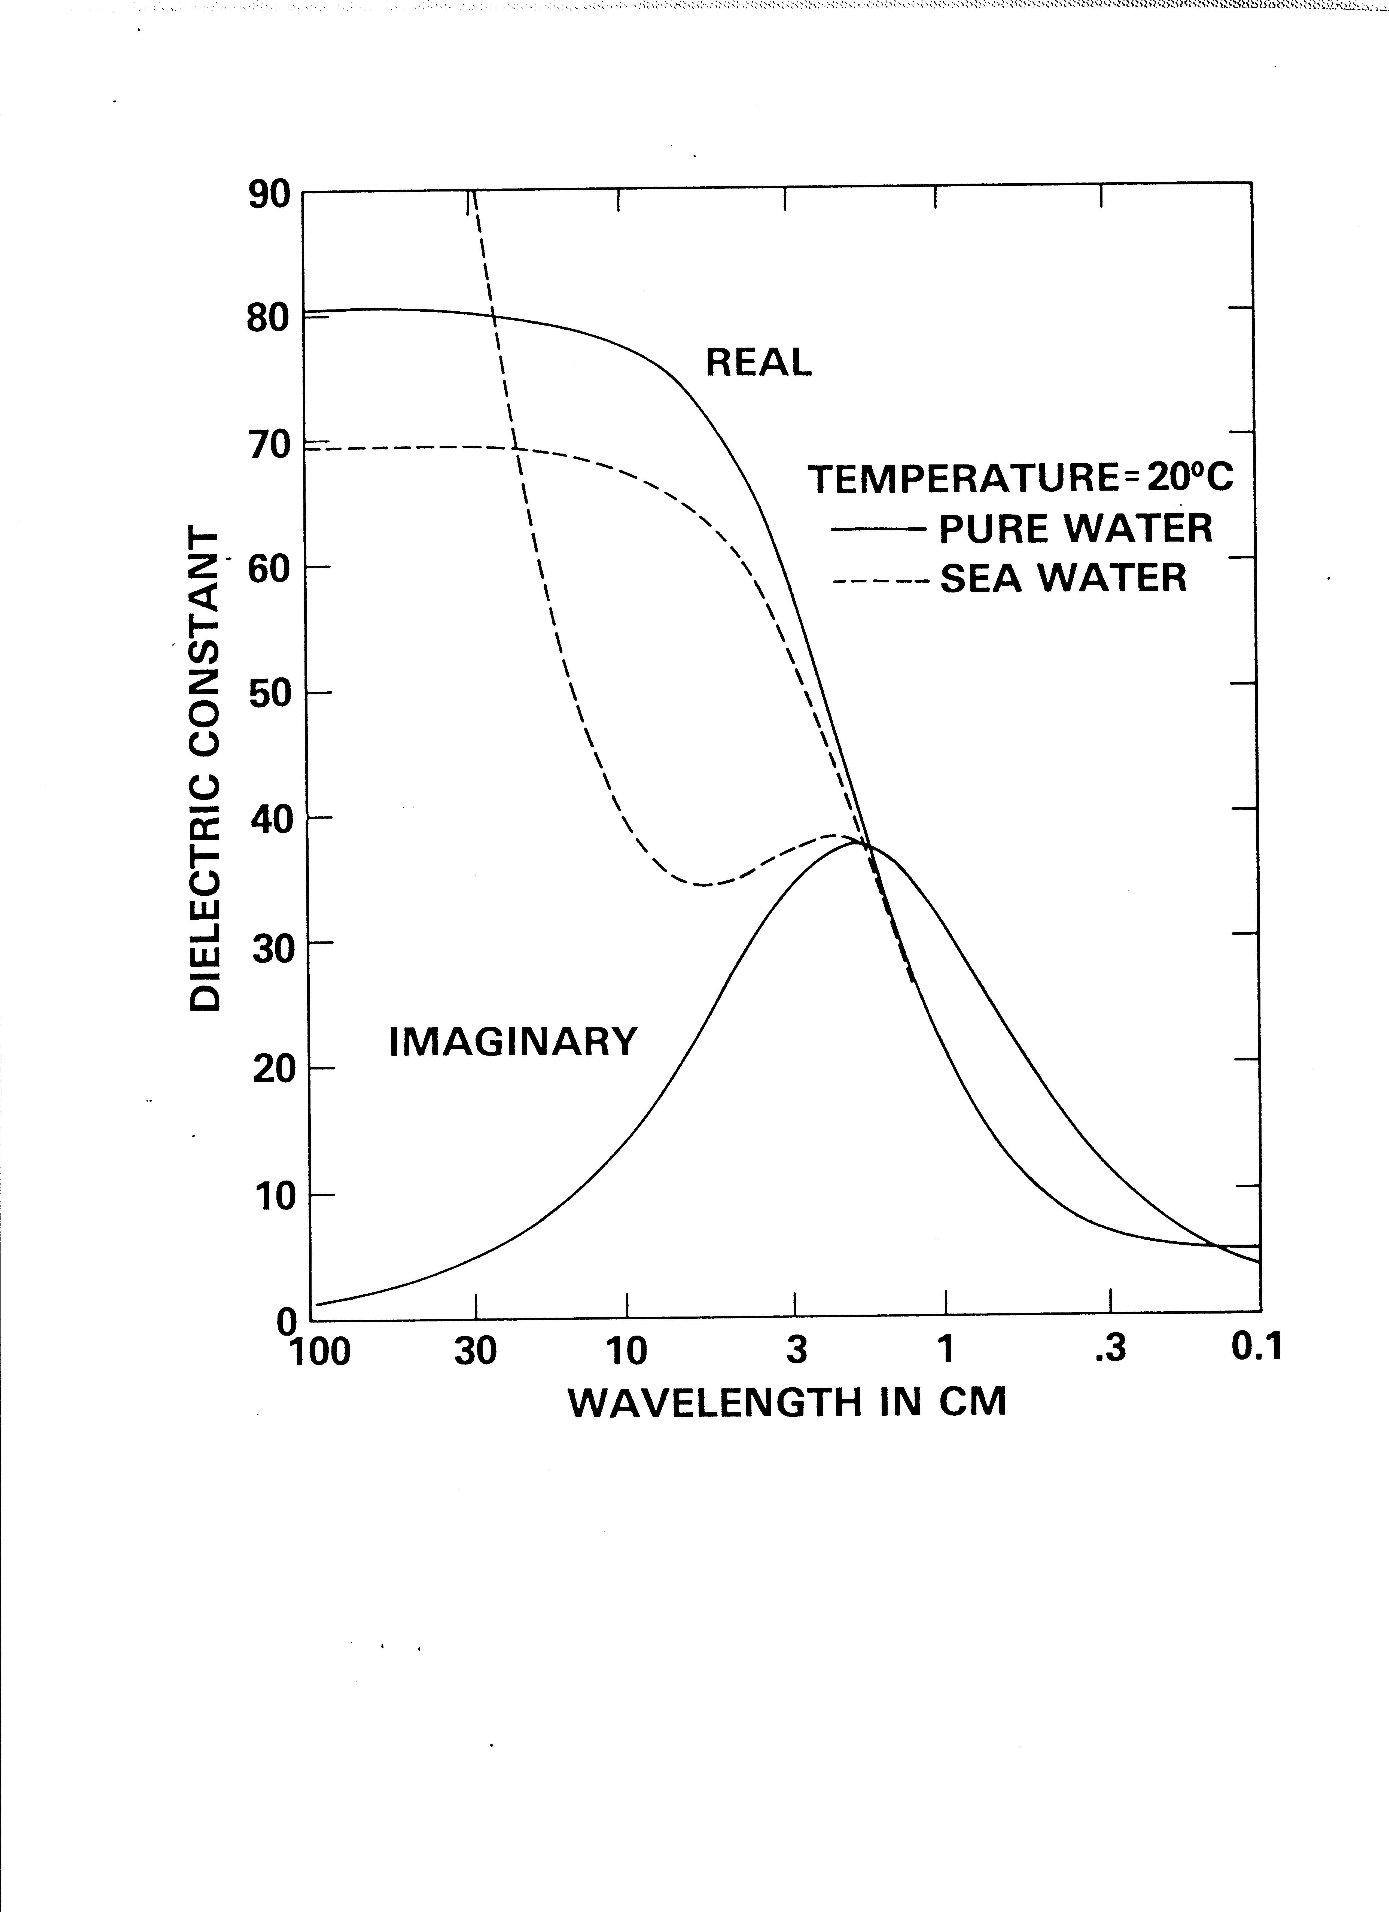

Slide 15
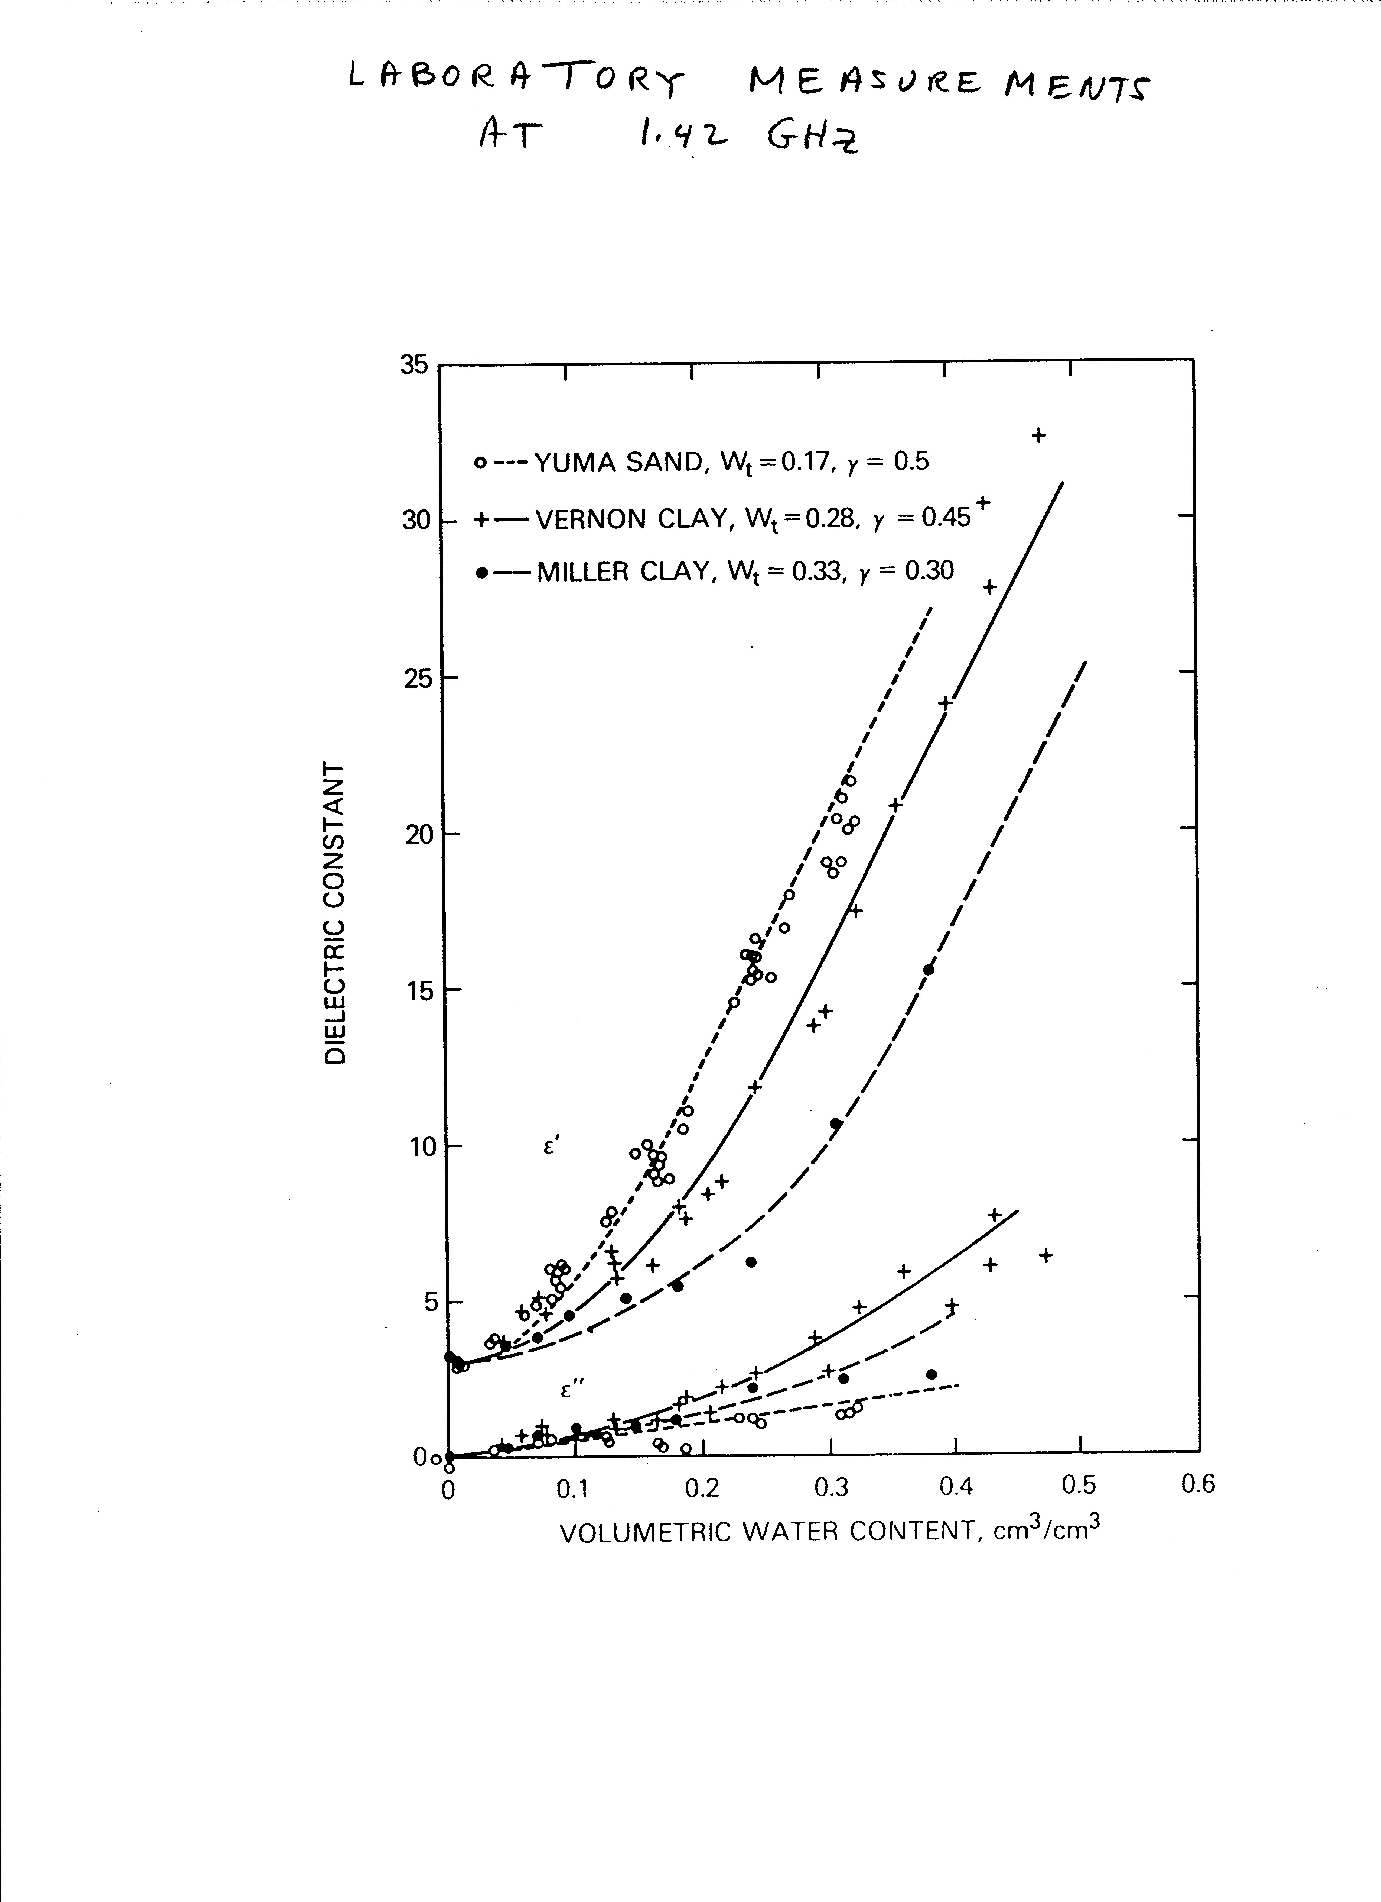

Slide 16
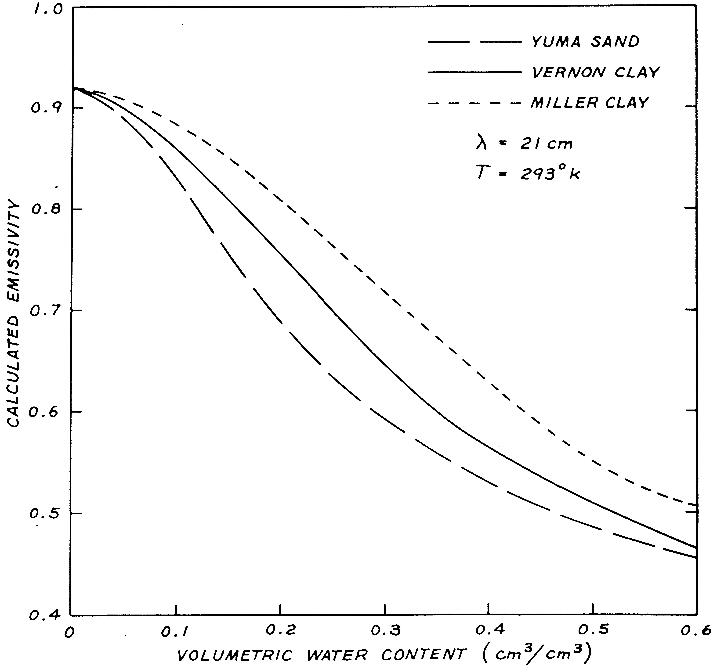

Slide 17
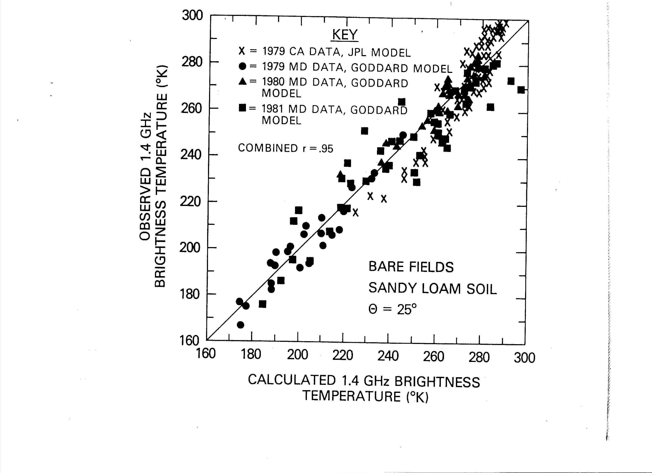

Slide 19
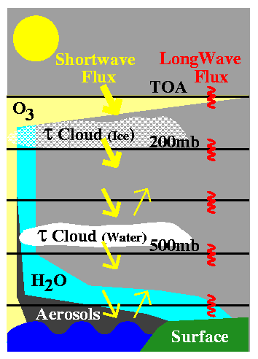
Surface and Atmospheric Radiation Budget
Calculations of Radiative Flux Profiles
Collect Inputs
Water vapor profiles
Temperature profiles
Ozone profiles
Cloud properties
Aerosol properties
Surface properties
Compute Fluxes
with radiative transfer code

Slide 20
What are TOA and Surface Fluxes?
As the radiation from Sun reaches Earth it first interacts with top of the atmosphere (TOA) layers, then with various atmospheric layers containing gases, clouds, aerosols, and/or other constituents
before reaching the surface. In each of these material layers solar radiation is being scattered and/or absorbed. Moreover, these atmospheric and surface constituents emit their own share of radiation. Due to the specifics of this complex interaction, one can separate its energetics it in two primary spectral parts:
the shortwave (SW) and the longwave (LW).
Depending on the specifics of the physical processes under investigation, this broad spectra can be further divided into finer and finer spectral intervals.

Slide 22
CERES Calculations of Radiative Fluxes
Compare With CERES TOA Fluxes
Adjust Appropriate Inputs

Slide 23
Physical Principles for shortwave fluxes
Schmetz (1989) has stressed the importance of the close linear coupling between SW (0.2–4.0μm) reflected radiance at the top of the atmosphere (albedo) and the surface irradiance. Cloud extinction (transmittance) and albedo are linearly related since atmospheric constituents do not emit radiation at solar wavelength. There is dependence on solar enith angle, gaseous and aerosol absorption and scattering, surface reflectivity, and clouds.

Slide 24
REVIEW OF SELECTED INFERENCE SCHEMES
Methods spanning a wide range of complexities have been
developed to derive surface radiative fluxes from satellite
observations. Several have been reviewed in Schmetz
(1989, 1991, 1993) who critically evaluated sensitivities to
input parameters, as well as the physical principles of these
methodologies. In this review, emphasis will be on methods
that have consistently provided data sets relevant in climate
research. In reviews that followed, the different parts of
the spectrum were discussed independently. The current
status of SW retrievals is summarized in Pinker et al. (1995)
and Whitlock et al. (1995). Methods for deriving PAR are
described in Frouin and Pinker (1995). A summary of
current and future satellite observations of relevance for
SRB research is presented in Wielicki et al. (1995).

Slide 25
The radiation travels through the atmosphere (determined by the solar zenith angle), and to a lesser degree, on the albedo of the surface. Once transmittance (T) is known, surface downward flux is obtained as F_{sd} = TF_{td} . The algorithm estimates T from
satellite-derived TOA albedo. Once F_{sd} is known, upward
flux at the surface (F_{su}) is calculated as F_{su} = A_{s}F_{sd}, where
As is surface albedo. Similarly, flux reflected to space by
the earth–atmosphere system (TOA upward flux, F_{tu}) is
obtained from the product of F_{td} and the TOA albedo (A_{t} ),
namely, F_{tu} = A_{t}F_{td} . T is determined from a comparison
of modeled values of shortwave (0.2–4.0μm) TOA
albedos to shortwave TOA albedo obtained from satellite
measurement, and transmittance corresponding to modeled
TOA albedo that matches satellite-derived value is selected.

Slide 26
For practical reasons, pairs of albedos and transmittances are calculated for atmospheres with a nonreflecting lower boundary. Surface reflection is added in a separate step.
Modeled TOA albedos and corresponding transmittances can be calculated spectrally for discrete values of solar zenith angle, amount of water vapor and ozone, aerosol and cloud optical thickness, using a radiative transfer method of preference. Radiative properties of aerosols and clouds can be obtained from the independent sources. or others.

Slide 27
Absorption by ozone and water vapor needs to be parameterized, for example, as proposed by Ramaswamy and Freidenreich (1992).
The albedo-transmittance pairs are made available in a lookup table for the algorithm separately for clear and cloudy atmospheres, and the flux transmittances for clear and cloudy skies are determined by matching the
satellite-observed clear and cloudy shortwave TOA albedos, respectively.

Slide 28
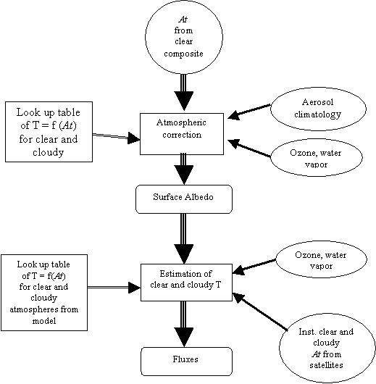

Slide 30
Downwelling Long-wave Radiation L ↓
Downwelling long-wave radiation L ↓ at the surface originates from radiatively active gases in the atmosphere (principally water vapor and carbon dioxide) and from clouds when present. Gaseous emission is present in specific wavebands in the range 0.3–30 μm, whereas emission from clouds corresponds to black body radiation at
the temperature of cloud base.

Slide 31
From cloudless skies, more than half the long-wave flux received at the ground comes from gases in the lowest 100 m, and roughly 90% from the lowest kilometer. Consequently, L ↓ is often estimated as
L ↓= ε_{a}σT ⁴_{a}
where ε_{a} is an estimated broadband atmospheric
emissivity, σ is the Stefan–Boltzmann constant (5.67 ×
10−8Wm−2 K−4), and T_{a} is a bulk atmospheric temperature (in Kelvin) usually approximated by air temperature near the ground. Formulae for estimating ε_{a} for cloudless
skies have been reviewed by Prata (1996) and Niemela
et al. (2001a). The Prata equation (Prata, 1996) was most successful
ε_{a} = 1 − (1 + aw)e−(b+cw)0.5

Slide 32
where w is the precipitable water content of the atmosphere, given approximately by
w = 4.65e_{a}T_{a}
where e_{a} is the vapor pressure near the ground (the units of w are kgm−2 when e_{a} is in P_{a} and T_{a} is in K; the empirical constants are a = 0.10 kg−1 m2, b = 1.2,
c = 0.30 kg−1 m2).

Slide 33
Comparison of SW and LW at Global Scale
Monthly Averaged for March 2001

Slide 34
Statement of Problem (3)
DSLW is the most difficult radiative component to estimate
Global Energy and Water Cycle Experiment (GEWEX) has demonstrated a need for energy budgets within an accuracy of 10 W m⁻² (WCRP-5, 1985)
Current estimates have global accuracies (compared to ground observations on daily time-scale) 22 – 31 W m⁻² (Nussbaumer and Pinker, 2011)
Model | CC | RMSE (W m⁻²) | Bias (W m⁻²)
ERA-Interim | 0.95 | 26.23 | -8.00
NCEP DOE II | 0.97 | 27.73 | -14.68
GEWEX SRB | 0.96 | 22.36 | -1.23
ISCCP-FD | 0.92 | 31.50 | 8.85
Notes:
Sparse ground in-situ measurements
Decoupled from Top of Atmosphere (TOA) observations
Large cloud contribution in higher latitudes
Passive satellite measurements of outgoing longwave radiation (OLR) are decoupled from DSLW

Slide 35
Statement of Problem (4)
High latitudes estimates are more problematic
Accuracies of estimates from current models at high latitudes at daily time scale range from 27 to 37 Wm⁻²
Model | CC | RMSE (W m⁻²) | Bias (W m⁻²)
ERA-Interim | 0.93 | 28.14 | -3.22
NCEP DOE II | 0.94 | 37.45 | -27.18
GEWEX SRB | 0.93 | 27.43 | -0.37
ISCCP-FD | 0.90 | 34.69 | 11.24

Slide 36
Available Methods to Estimate DSLW
 | Advantage | Disadvantage | Example
Satellite models Cloud and meteorological data from satellites | Based observations | Inhomogeneity in satellite observations | ISCCP-FD
Numerical models Cloud internally generated | Full global coverage | Accurate as representative physics | ERA Interim NCEP/DOE II
Hybrid models Cloud data from satellites Meteorological data from re-analysis | Use best information from each source | Discrepancies in spatial and temporal resolution of satellite observations and re-analysis | DSLW/UMD v1 & v2 GEWEX SRB

Slide 37
DSLW/UMD Models
Two models, with distinct advantages developed to estimate DSLW
Model | Calculation Type | Input data | Advantage
DSLW/UMD v1 | Parameterizations | Satellite Cloud Data Re-analysis Meteorological Data | Minimal Input Data Globally Derived Parameterization Computationally Efficient
DSLW/UMD v2 | Artificial Neural Networks | Satellite Cloud Data Re-analysis Meteorological Data | Computationally Efficient Improved Cloud Vertical Structure Model
The calculation of DSLW is broken down into two components
Clear sky contribution
Cloud contribution
Allows for estimation of longwave cloud forcing

Slide 38
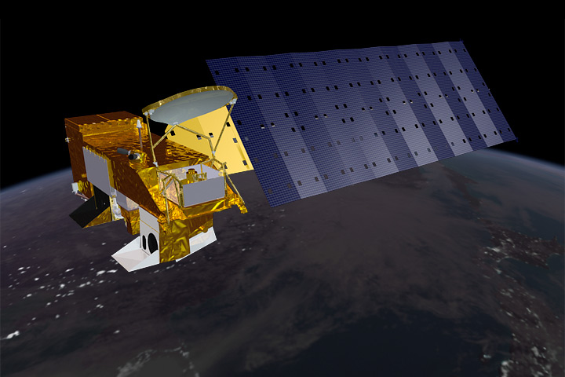
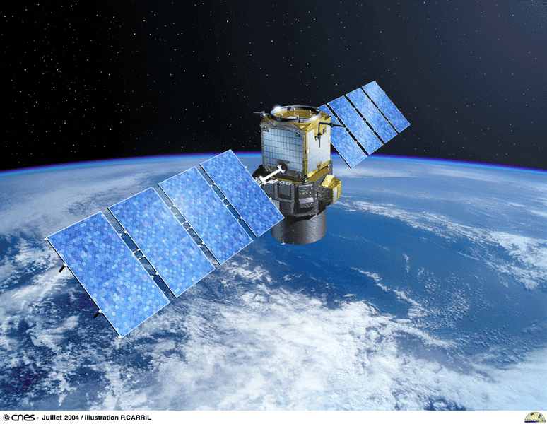
Satellite Observation of Clouds
Passive Satellite
Global spatial coverage
Cloud top properties
Active Satellite
Limited coverage
Cloud vertical structure
Aqua Satellite with Moderate Resolution Spectroradiometer (MODIS)
CALIPSO satellite with Cloud-Aerosol Lidar with Orthogonal Polarization (CALIOP)
Notes:
MODIS 36 spectral bands 0.4 µm to 14.4 µm. Global coverage every one to two days
Cloud-Aerosol Lidar and Infrared Pathfinder Satellite Observations (CALIPSO)
cloud profiling radar system on the CloudSat satellite. The Cloud Profiling Radar (CPR) is a 94-GHz nadir-looking radar which measures the power backscattered by clouds as a function of distance from the radar.

Slide 39
Cloud Contribution
Cloud base temperature artificial neural network has same architecture as clear sky contribution network
Training data from spatially and temporally co-located passive and active satellite sensors and re-analysis data
Input Data
MODIS => Cloud Top Properties
ERA-Interim => Meteorological Data
Target Data
CPR/CALIOP => Cloud Base Height (CBH)
ERA-Interim => Interpolate CBH to find Cloud Base Temperature (CBT)
MODIS
Passive Instrument
CPR/CALIOP
Active Instrument
ERA-Interim Meteorological

Slide 40
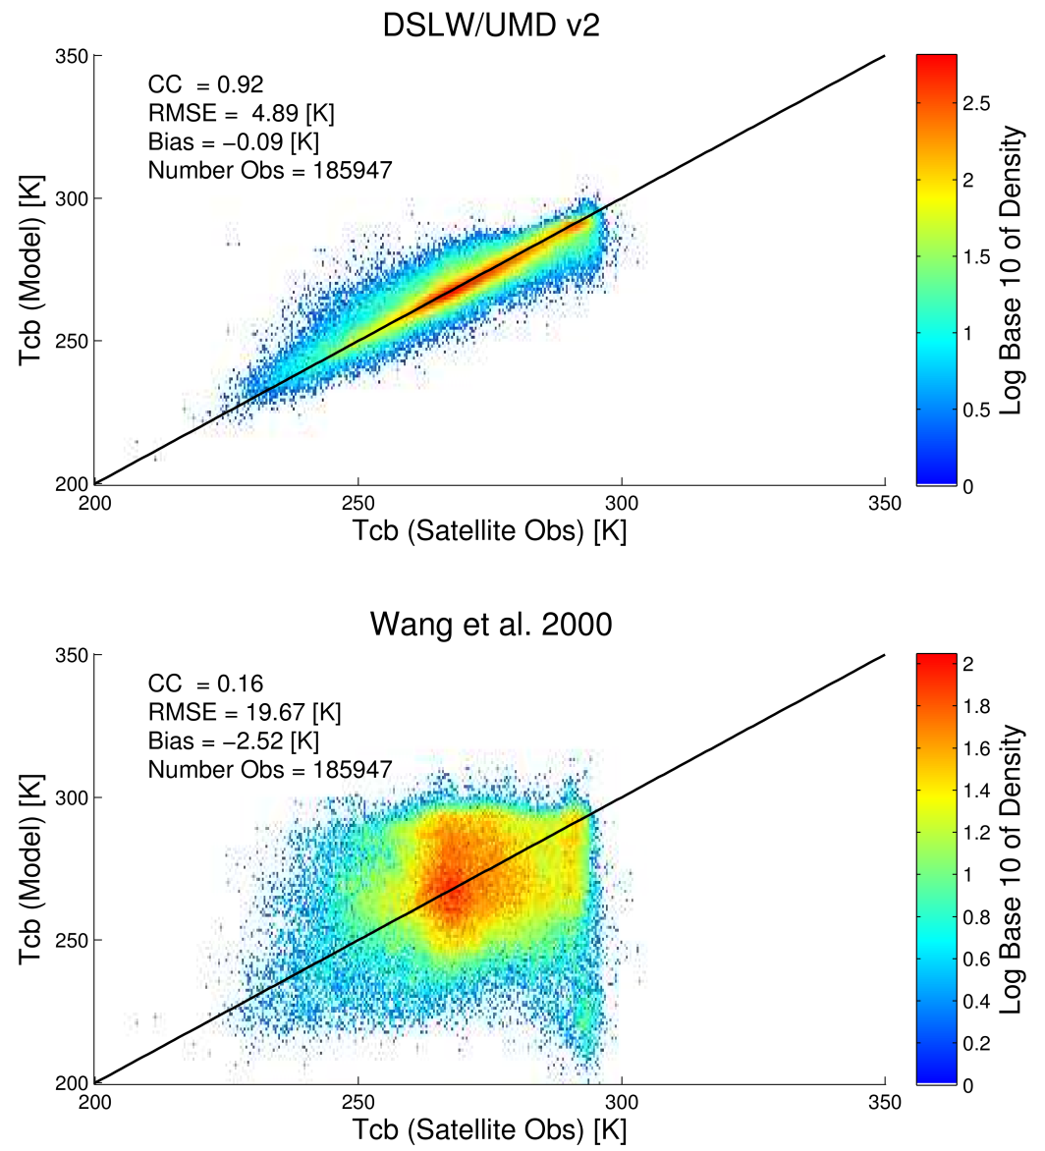
Cloud Vertical Structure Model
Neural Network Model based on satellite data
Statistical Model based on radiosonde data

Slide 41
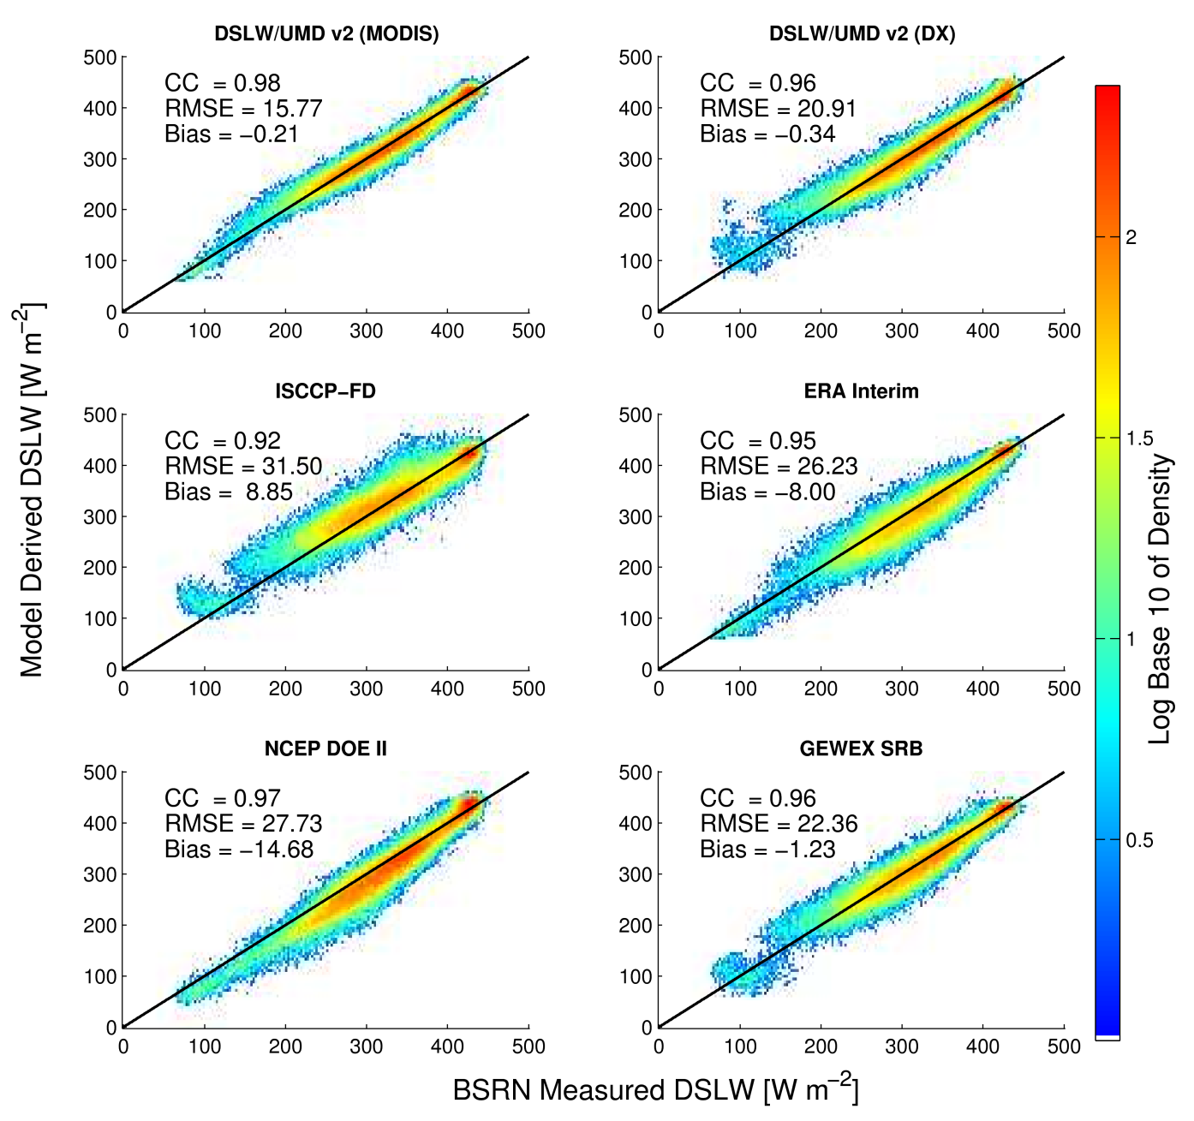
All Sky Evaluation DSLW/UMD v2
Global evaluation of models for 2003-2009
All ground stations
All daily observations between 2003-2009
Units of RMSE and Bias in Wm⁻²
 | DSLW/UMD v1 | DSLW/UMD v2
CC | 0.97 | 0.98
RMSE (W m⁻²) | 17.07 | 15.77
Bias (W m⁻²) | 0.82 | -0.21

Slide 42
All Sky Evaluation DSLW/UMD v2
Evaluation of models for 2003-2009 at daily time scale
Compared against BSRN ground stations
Model | CC | RMSE (W m⁻²) | Bias (W m⁻²)
DSLW/UMD v2 (MODIS) | 0.98 | 15.77 | -0.21
DSLW/UMD v2 (DX) | 0.96 | 20.91 | -0.34
ISCCP-FD | 0.92 | 31.50 | 8.85
ERA-Interim | 0.95 | 26.23 | -8.00
NCEP DOE II | 0.97 | 27.73 | -14.68
GEWEX SRB | 0.96 | 22.36 | -1.23

Slide 43
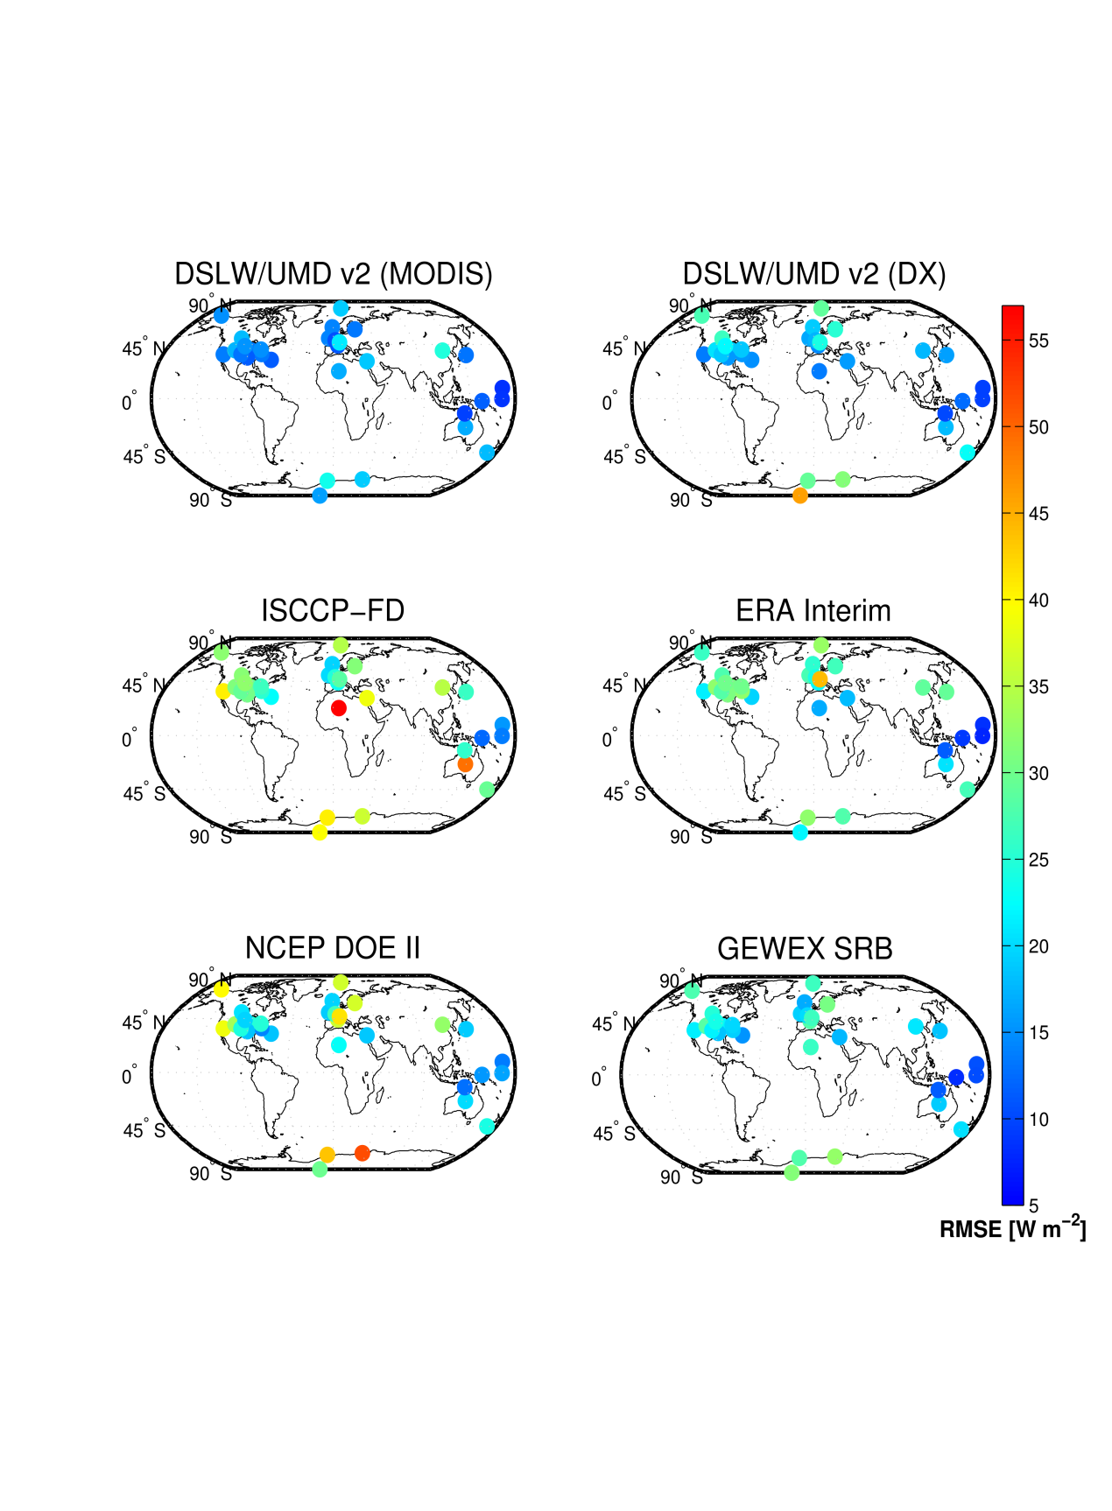
All Sky Evaluation DSLW/UMD v2: For Individual Stations
Notes:
$∆$F = $σ$($T_{}^{4}−T_{}^{4}$). Assuming an average Arctic temperature of 0degC 273.15K. $σ$ = 5.6704*10^-8 W m^-2 K^-4
40 W m^-2 => ~ 8.3 deg C for initial temp of 0 deg C.

Slide 44
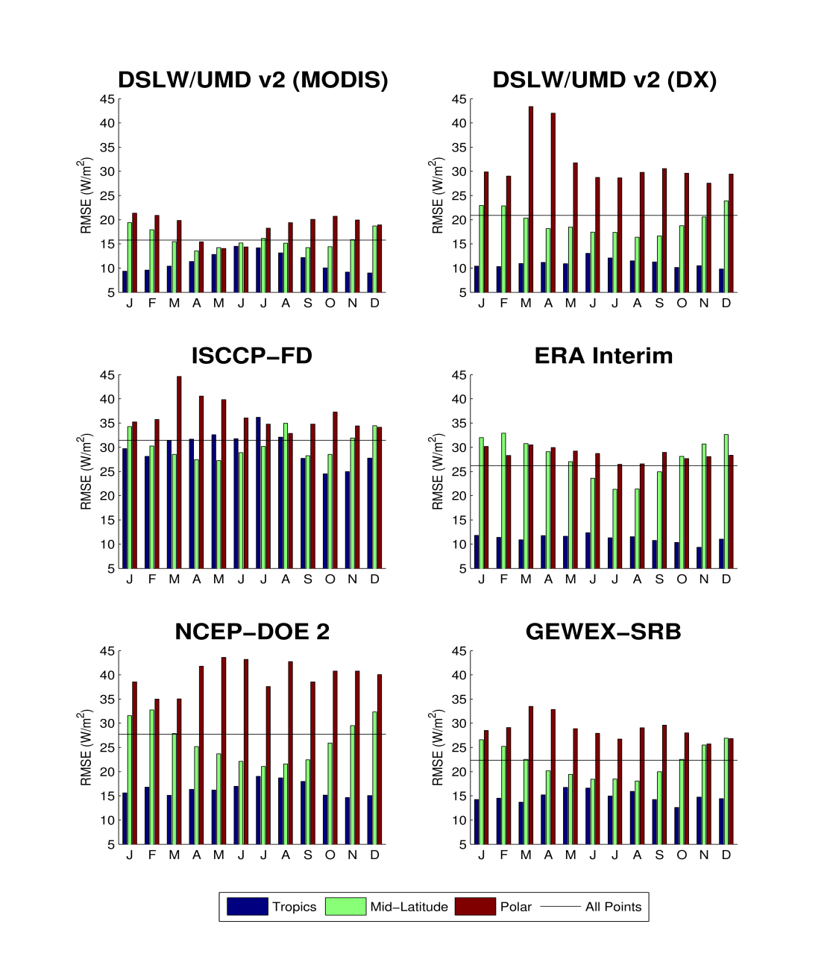
All Sky Evaluation DSLW/UMD v2: By Latitude
RMSE (Wm⁻²)
RMSE (Wm⁻²)
RMSE (Wm⁻²)
RMSE (Wm⁻²)
RMSE (Wm⁻²)
RMSE (Wm⁻²)

Slide 45
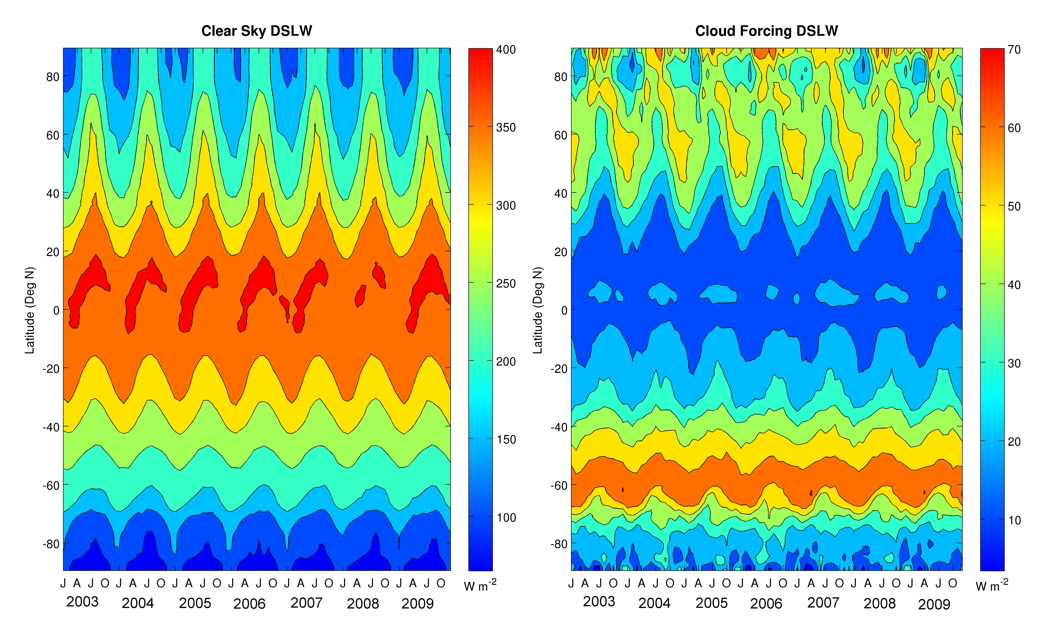
Global DSLW from DSLW/UMD v2
Hovmoller plots show inter-annual variability over latitudes

Slide 46
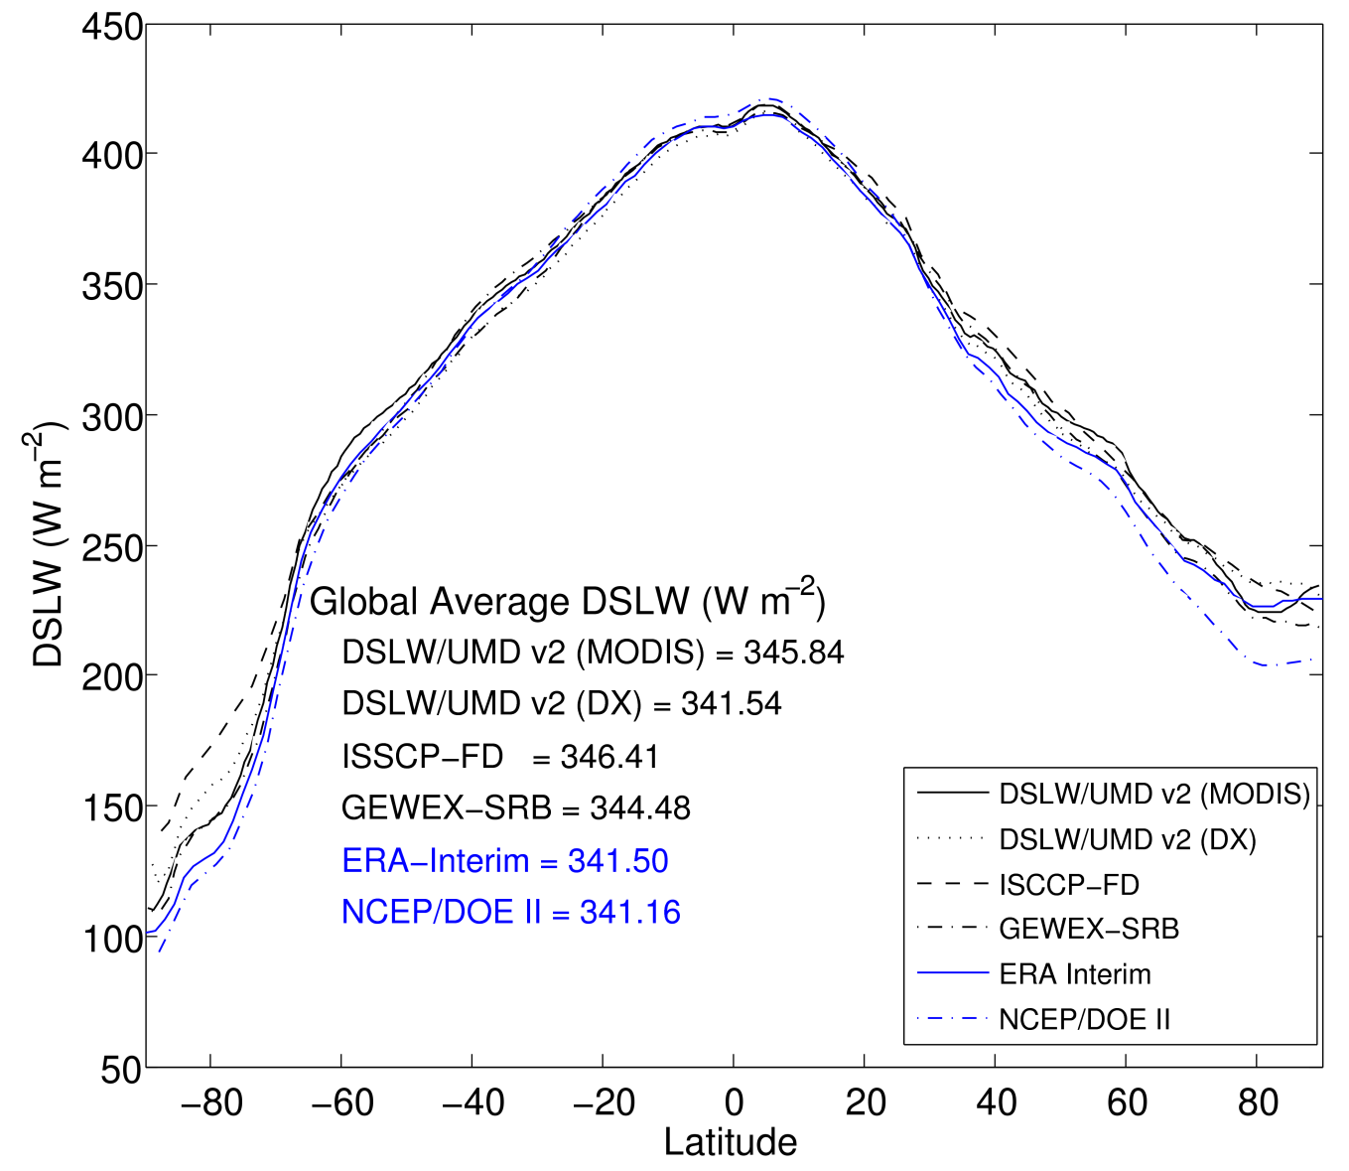
Global DSLW from DSLW/UMD v2
Global DSLW averaged by latitude for 2003-2007
Highest variability among model occurs at higher latitudes
Numerical models show lower estimates of global average DSLW than satellite based models
Lower values occur at higher latitudes

Slide 47
Global DSLW from DSLW/UMD v2
Zonally averaged DSLW (DSLW/UMD v2) for 2003-2009
Clear Sky Contribution
Cloud Contribution
Shaded region represents bounds as given by zonally averaged daily data for 2003-2009

Slide 49
Satellite Observation of Clouds
Passive Satellite
Global spatial coverage
Cloud top properties
Active Satellite
Limited coverage
Cloud vertical structure
Aqua Satellite with Moderate Resolution Spectroradiometer (MODIS)
CALIPSO satellite with Cloud-Aerosol Lidar with Orthogonal Polarization (CALIOP)
Notes:
MODIS 36 spectral bands 0.4 µm to 14.4 µm. Global coverage every one to two days
Cloud-Aerosol Lidar and Infrared Pathfinder Satellite Observations (CALIPSO)
cloud profiling radar system on the CloudSat satellite. The Cloud Profiling Radar (CPR) is a 94-GHz nadir-looking radar which measures the power backscattered by clouds as a function of distance from the radar.

Slide 50
Cloud Contribution
Cloud base temperature artificial neural network has same architecture as clear sky contribution network
Training data from spatially and temporally co-located passive and active satellite sensors and re-analysis data
Input Data
MODIS => Cloud Top Properties
ERA-Interim => Meteorological Data
Target Data
CPR/CALIOP => Cloud Base Height (CBH)
ERA-Interim => Interpolate CBH to find Cloud Base Temperature (CBT)
MODIS
Passive Instrument
CPR/CALIOP
Active Instrument
ERA-Interim Meteorological

Slide 51
Cloud Vertical Structure Model
Neural Network Model based on satellite data
Statistical Model based on radiosonde data

Slide 52
All Sky Evaluation DSLW/UMD v2
Global evaluation of models for 2003-2009
All ground stations
All daily observations between 2003-2009
Units of RMSE and Bias in Wm⁻²
 | DSLW/UMD v1 | DSLW/UMD v2
CC | 0.97 | 0.98
RMSE (W m⁻²) | 17.07 | 15.77
Bias (W m⁻²) | 0.82 | -0.21

Slide 53
All Sky Evaluation DSLW/UMD v2
Evaluation of models for 2003-2009 at daily time scale
Compared against BSRN ground stations
Model | CC | RMSE (W m⁻²) | Bias (W m⁻²)
DSLW/UMD v2 (MODIS) | 0.98 | 15.77 | -0.21
DSLW/UMD v2 (DX) | 0.96 | 20.91 | -0.34
ISCCP-FD | 0.92 | 31.50 | 8.85
ERA-Interim | 0.95 | 26.23 | -8.00
NCEP DOE II | 0.97 | 27.73 | -14.68
GEWEX SRB | 0.96 | 22.36 | -1.23

Slide 54
All Sky Evaluation DSLW/UMD v2: For Individual Stations
Notes:
$∆$F = $σ$($T_{}^{4}−T_{}^{4}$). Assuming an average Arctic temperature of 0degC 273.15K. $σ$ = 5.6704*10^-8 W m^-2 K^-4
40 W m^-2 => ~ 8.3 deg C for initial temp of 0 deg C.

Slide 55
All Sky Evaluation DSLW/UMD v2: By Latitude
RMSE (Wm⁻²)
RMSE (Wm⁻²)
RMSE (Wm⁻²)
RMSE (Wm⁻²)
RMSE (Wm⁻²)
RMSE (Wm⁻²)

Slide 56
Global DSLW from DSLW/UMD v2
Hovmoller plots show inter-annual variability over latitudes

Slide 57
Global DSLW from DSLW/UMD v2
Global DSLW averaged by latitude for 2003-2007
Highest variability among model occurs at higher latitudes
Numerical models show lower estimates of global average DSLW than satellite based models
Lower values occur at higher latitudes

Slide 58
Global DSLW from DSLW/UMD v2
Zonally averaged DSLW (DSLW/UMD v2) for 2003-2009
Clear Sky Contribution
Cloud Contribution
Shaded region represents bounds as given by zonally averaged daily data for 2003-2009

Slide 60
How is LW calculated? Since not measured directly, the LW TOA radiance is
determined using the TOT – SW
measurements, each corrected for its spectral response.
The LW TOA flux is
determined by applying an empirical Angular
Distribution Model (ADM) anisotropic correction
factor to the LW radiance.
What is TOA? The TOA, Top-of-the-Atmosphere, is a surface approximately 20 km above the Earth surface. Specifically, the TOA is an ellipsoid x²/a² + y²/a² + z²/b² = 1 ; where a = 6408.1370 km and b = 6386.6517 km

Slide 61
To help a non-expert gain a basic understanding of the Eddy Covariance method and to point out valuable references
To provide explanations in a simplified manner first, and then elaborate with specific details
To promote a further understanding of the method via more advanced sources (textbooks, papers)
To help design experiments for the specific needs of a new Eddy
Covariance user for scientific, environmental and industrial applications

Slide 62
What are the CERES Data scene types

Slide 63
Physical Model
Clear-air model
Where
upward shortwave radiant flux at the satellite (W m )
F instantaneous shortwave solar radiant flux at the top of the atmosphere
[ (W m )]

Slide 64
reflection coefficient for bean radiation (dimensionless)
reflection coefficient for diffuse radiation (dimensionless)
,
absorption coefficients for slant water vapor paths
for sun angle and
for satellite angle (dimensionless)
zenith angle of the sun
surface albedo (dimensionless, ratio of outgoing flux to incident flux)
(2)
(3)
. (4)
(5)

Slide 67
Solar Radiation
Solar radiant energy incident at the earth’s surface is a quantity of increasing importance in agricultural monitoring and solar power development. The techniques to estimating incident solar radiation at the surface from satellite data can be summarized as below:
Empirical:
Statistical,
Physical
Theoretical:
Broadband,
Spectral
Most physical models for estimating surface insolation from satellite observation are based on inferring atmospheric transmittance from the reflected radiation observed by the satellite.
The models require information on the state of the atmosphere and/or the surface, to derive a relationship between transmittance and reflectance.
The satellite observed reflectance is then matched with the computed reflectance, and a transmittance is derived.
The transmittance/reflectance relationships will vary according to the information used about the atmosphere and surface.
The selection of a particular climatological model will affect the surface insolation estimate. Therefore, there is a need for realistic aerosol climatologies and surface reflectance models.

Slide 68
Example of a statistical and physical combined method:
(Tarpley, 1976)
The visible clear brightness from the target can be fitted to a regression equation of the form:
B = a + b cosχ + c sinχ cosφ + d sinχ cos²φ,
Where χ the local solar zenith angle, φ the azimuth angle between sun and satellite, and a, b, c and d are regression coefficients.
The second term on the right of the equation accounts for changes incident flux; the last two terms account for changes in apparent target brightness caused by shadowing at the surface and anisotropic scattering.
The data were stratified according to cloud amount in the target to better account for different physical processes depleting the incoming radiation under clear, partly cloudy and overcast conditions.

Slide 69
The fractional cloud amount n for each target determines which of the following equations was used to obtain hourly insolation:
n<0.4,
0.4≤n<1.0,
n=1.0,
Where Q_{s} hourly surface insolation, ψ transmittance of a clear atmosphere taking into account water vapor and Rayleigh scattering and water vapor absorption, n fractional cloud amount, I_{m} mean target brightness, I_{cld} mean cloud brightness, B predicted clear brightness, B₀ normalized clear brightness [=B (χ=45º, φ=105º)], and a, b, c, d and e regression coefficients.
The standard error is less than 10% of the mean daily insolation; it is better than 5% on clear days.
The relative accuracy is greater for daily total than for hourly insolation on mostly clear days because of partial cancellation of random errors in the hourly values.

Slide 70
LW Techniques
Fu Liou-used in CERES Processing
GEWEX SRB-Gupta (1989); Gupta et al. (1992
LW radiative fluxes are computed using a fast parameterization with inputs from the ISCCP datasets.
LWDWN is computed as
LWDWN = LWCS + F2 * AC
where LWCS is the clear-sky LWDWN
F2 is the cloud forcing factor, and AC is the fractional cloud cover.
LW cloud forcing is the difference between the total-sky net LW flux and the clear-sky net LW flux.
LWNET is computed as
LWNET = LWDWN - SIGMA * TS**4
where SIGMA is the Stefan-Boltzman constant (5.67E-08 W/(m**2 K**4)), and TS is the surface temperature.
Cloud-base pressure is obtained by combining cloud-top pressure (from ISCCP) with climatological estimates of cloud thickness which depend upon cloud height and latitude.
Details of the development of the parameterizations of LWCS and F2 in terms of the meteorological parameters are given in Gupta (1989) and Gupta et al. (1992).

Slide 74
clear and cloudy skies are determined by matching the
satellite-observed clear and cloudy shortwave TOA albedos,
respectively. For a given solar zenith angle, surface
albedo and amount of ozone and water vapor, the matching
process involves the adjustment of the aerosol optical
depth for clear sky and that of the cloud optical depth for
cloudy sky. For example, for GCIP/GAPP, the satelliteobserved
TOA shortwave albedo is obtained from the
visible (0.55–0.75μm) radiance measured by the imager
instrument onboard the GOES satellites through spectral
and angular transformations (Zhou et al., 1996). The clearsky
radiance as observed by the satellite is affected both
by the surface albedo and the intervening atmosphere. It is
quite difficult to separate the affects of each independently.
Therefore, at times, information on surface albedo is taken
from independent sources or estimated from the “clearest”
shortwave TOA radiative flux (or albedo) observed
over a number of days (clear-sky composite albedo), and
then nominally corrected for Rayleigh scattering, aerosol
extinction, and absorption by ozone and water vapor. Next,
albedo-transmittance pairs are selected from the lookup
table according to the solar zenith angle, water vapor and
ozone amount, and are combined with the surface albedo to
yield shortwave TOA albedos. One set of pairs is for varying
values of aerosol optical depth (clear atmosphere), and
the other is for varying values of cloud optical depth (cloudy
atmosphere). Finally, the shortwave albedos derived from
the instantaneous satellite-observed clear-sky and cloudysky
radiances are matched with the clear and cloudy sets
of albedo-transmittance pairs and clear-sky and cloudy-sky
transmittances, and from these, clear-sky and cloudy-sky
fluxes are obtained. The clear-sky and cloudy-sky fluxes
are then weighted according to the cloud cover (defined as
the ratio of number of cloudy pixels to the total number
of pixels) to determine the all-sky fluxes. The implementation
of the model requires preprocessing of the satellite
data and separation of clear and cloudy radiances. The
ISCCP D1 and DX data sets provide such information.
When original satellite observations are used, there is a need
to first separate between clear and cloudy pixels. For the
GCIP/GAPP product, this is performed at NOAA/NESDIS
(Tarpley et al., 1996). The Clouds and Earth’s Radiant
Energy System (CERES) instrument on board several Earth
Observing System (EOS) satellites from NASA’s Earth
Science Enterprise (ESE) program provides an opportunity
for deriving accurate estimate of SW fluxes (Wielicki
et al., 1995). CERES provides a direct measurement of
TOA broadband reflectance and augments this measurement
with higher resolution retrievals of atmospheric, cloud, and
aerosol properties to estimate radiative fluxes. The Surface
and Atmospheric Radiation Budget (SARB) component of
CERES computes the surface and atmospheric fluxes by
iterating retrieved atmospheric properties with the measured
TOA flux

Slide 75
Absorption of solar radiation in the cloudless atmosphere
is mostly from ozone, water vapor, carbon dioxide, and
oxygen. Clouds may absorb up to 20% of solar radiation.
Modeling Solar Radiation
Apart from astronomical and geographical factors (latitude,
elevation), K ↓ is influenced by cloud, turbidity, absorption,
and scattering. Empirical models based on these factors
or other climatological variables have been developed
by several investigators including Kasten (1983), Thornton
and Running (1999), and Meza and Varas (2000). Methods
for calculating instantaneous values of K ↓ are given by
Campbell and Norman (1998). Methods using observations
of sunshine hours or cloud cover can be very effective for
estimating K ↓ for monthly mean or other longer period
calculations. Iziomon and Mayer (2001) concluded that
the Angstrom–Prescott formula agreed with observations
within 2.5% for a lowland site and 3.4% for a mountain
site when its empirical coefficients were calibrated for the
sites. The formula is:
K ↓
E0
= A + B
S
S0

Slide 80
where w is the precipitable water content of the atmosphere,
given approximately by
w = 4.65ea
Ta
(5)
where ea is the vapor pressure near the ground (the
units of w are kgm−2 when ea is in Pa and Ta is in
K; the empirical constants are a = 0.10 kg−1 m2, b = 1.2,
c = 0.30 kg−1 m2). By using equations (4) and (5) with
equation (3), values of L ↓ from cloudless skies can be
calculated. A simpler expression for L ↓ from cloudless
skies was given by Monteith and Unsworth (1990)
L ↓= a + bσT 4
a (6)
where the empirical coefficients determined in central
England were a = −119 ± 16Wm−2 and b = 1.06 ± 0.04.
A similar expression was derived by Swinbank (1963) from
measurements in Australia.
Effects of clouds on L ↓ are harder to model because
cloud fraction, height, and type have radiative impacts.
For climatological averages, Monteith and Unsworth (1990)
suggested that the emissivity εa(c) of sky covered with a
fraction c of cloud was given by
εa(c) = (1 − 0.84c)εa + 0.84c (7)
Offerle et al. (2003) and Sugita and Brutsaert (1993)
developed more complex expressions to account for clouds.
Measuring Downwelling Long-wave Radiation
Downwelling long-wave radiation may be measured with
a pyrgeometer: a thermopile instrument that uses a silicon
dome with a vacuum-deposited interference filter that
allows transmission of long-wave radiation while excluding
shortwave radiation. Pyrgeometers (precision infrared

