Slide 1
AOSC624 Class 23: May 3, 2012
Surface albedo
NDVI
Remotely sensed information on surface albedo and NDVI is used in climate modeling and research.
Above parameters and surface temperature and radiative fluxes needed for surface energy balance.

Slide 2
First, some augmentation of last lecture on: Surface Fluxes Must account for transfer of latent heat, which depends on rate of evapotranspiration. Model must know if vegetation is transpiring fully or if under water stress.
Moisture moves through the canopy and also from canopy level to the atmosphere. Since these are two processes and need to be combined, it is easier to introduce the concept of “resistence” to the flow of moisture than deal with transfer coefficient (can combine them in parallel like in Ohm’s Law)

Slide 4
Typical representation of wind and temperature profiles in the surface layer

Slide 7
Info from Remote Sensing

Slide 11
Aerodynamic Resistance
The aerodynamic resistance controls the rate of water vapor
transfer away from the surface and is intuitively inversely
proportional to the wind speed. It can be expressed for
conditions of neutral stability as:

Slide 15
SURFACE ALBEDO
Albedo=radiation reflected from a surface/radiation incident on the surface
Surface albedo generally refers to the total solar spectrum integrated over all angles. Albedo is used in climate to form surface energy budgets. For this purpose, the integrated albedo is needed.
TWO options for measuring albedo measure in broadband
1a) do atmospheric correction; gives you surface broadband reflectance
APPROACH 1 = assume isotropy to get albedo
APPROACH 2 = use surface bi-directional models
APPROACH 3 - borrow top of atmosphere bi-directional models

Slide 16
1b) (same thing, different order)
take broadband reflectance at top of atmosphere,
apply bi-directional model of top of
atmosphere,
get top of atmosphere broadband albedo,
do atmospheric correction applied to total flux to get surface albedo.
measure narrowband-spectral reflectance (more complicated because we have to integrate over spectral intervals and account for angular variability)

Slide 17
2a) apply atmospheric correction to get surface spectral reflectance; do APPROACH 1, 2, or 3, but also must do spectral integration; need a model of spectral characteristics of surface type to do spectral integration.
Albedo of snow, clouds, ice, water:
Fresh snow 75 to 95
Clouds (thick) 60 to 90
Clouds (thin) 30 to 50
Ice 30 to 40
Water 10
Earth and atmosphere 30

Slide 18
Incident radiation includes beam and/or diffuse radiation. Reflected radiation however, depends on surface properties.
The two limiting characteristics of a surface reflectivity are Diffuse and Specular.
Isotropic Diffuse Reflection has equal magnitude in all directions. After reflection from a diffuse surface, all signs of the incident radiation are completely obliterated.
Anisotropic Diffuse Reflection has greater magnitude away from the incident angle of radiation.
Specular surfaces are very smooth with respect to the wavelength of the incident radiation.
Perfectly Specular has equal angles of incidence and reflectance.
Bidirectionally Spectral has unequal angles of incidence and reflectance.
Each method of finding surface albedo has some faults.
An inverted pyranometer is capable of obtaining upwelling radiation.
To design satellite instruments requires knowledge of surface spectral and angular properties.

Slide 19
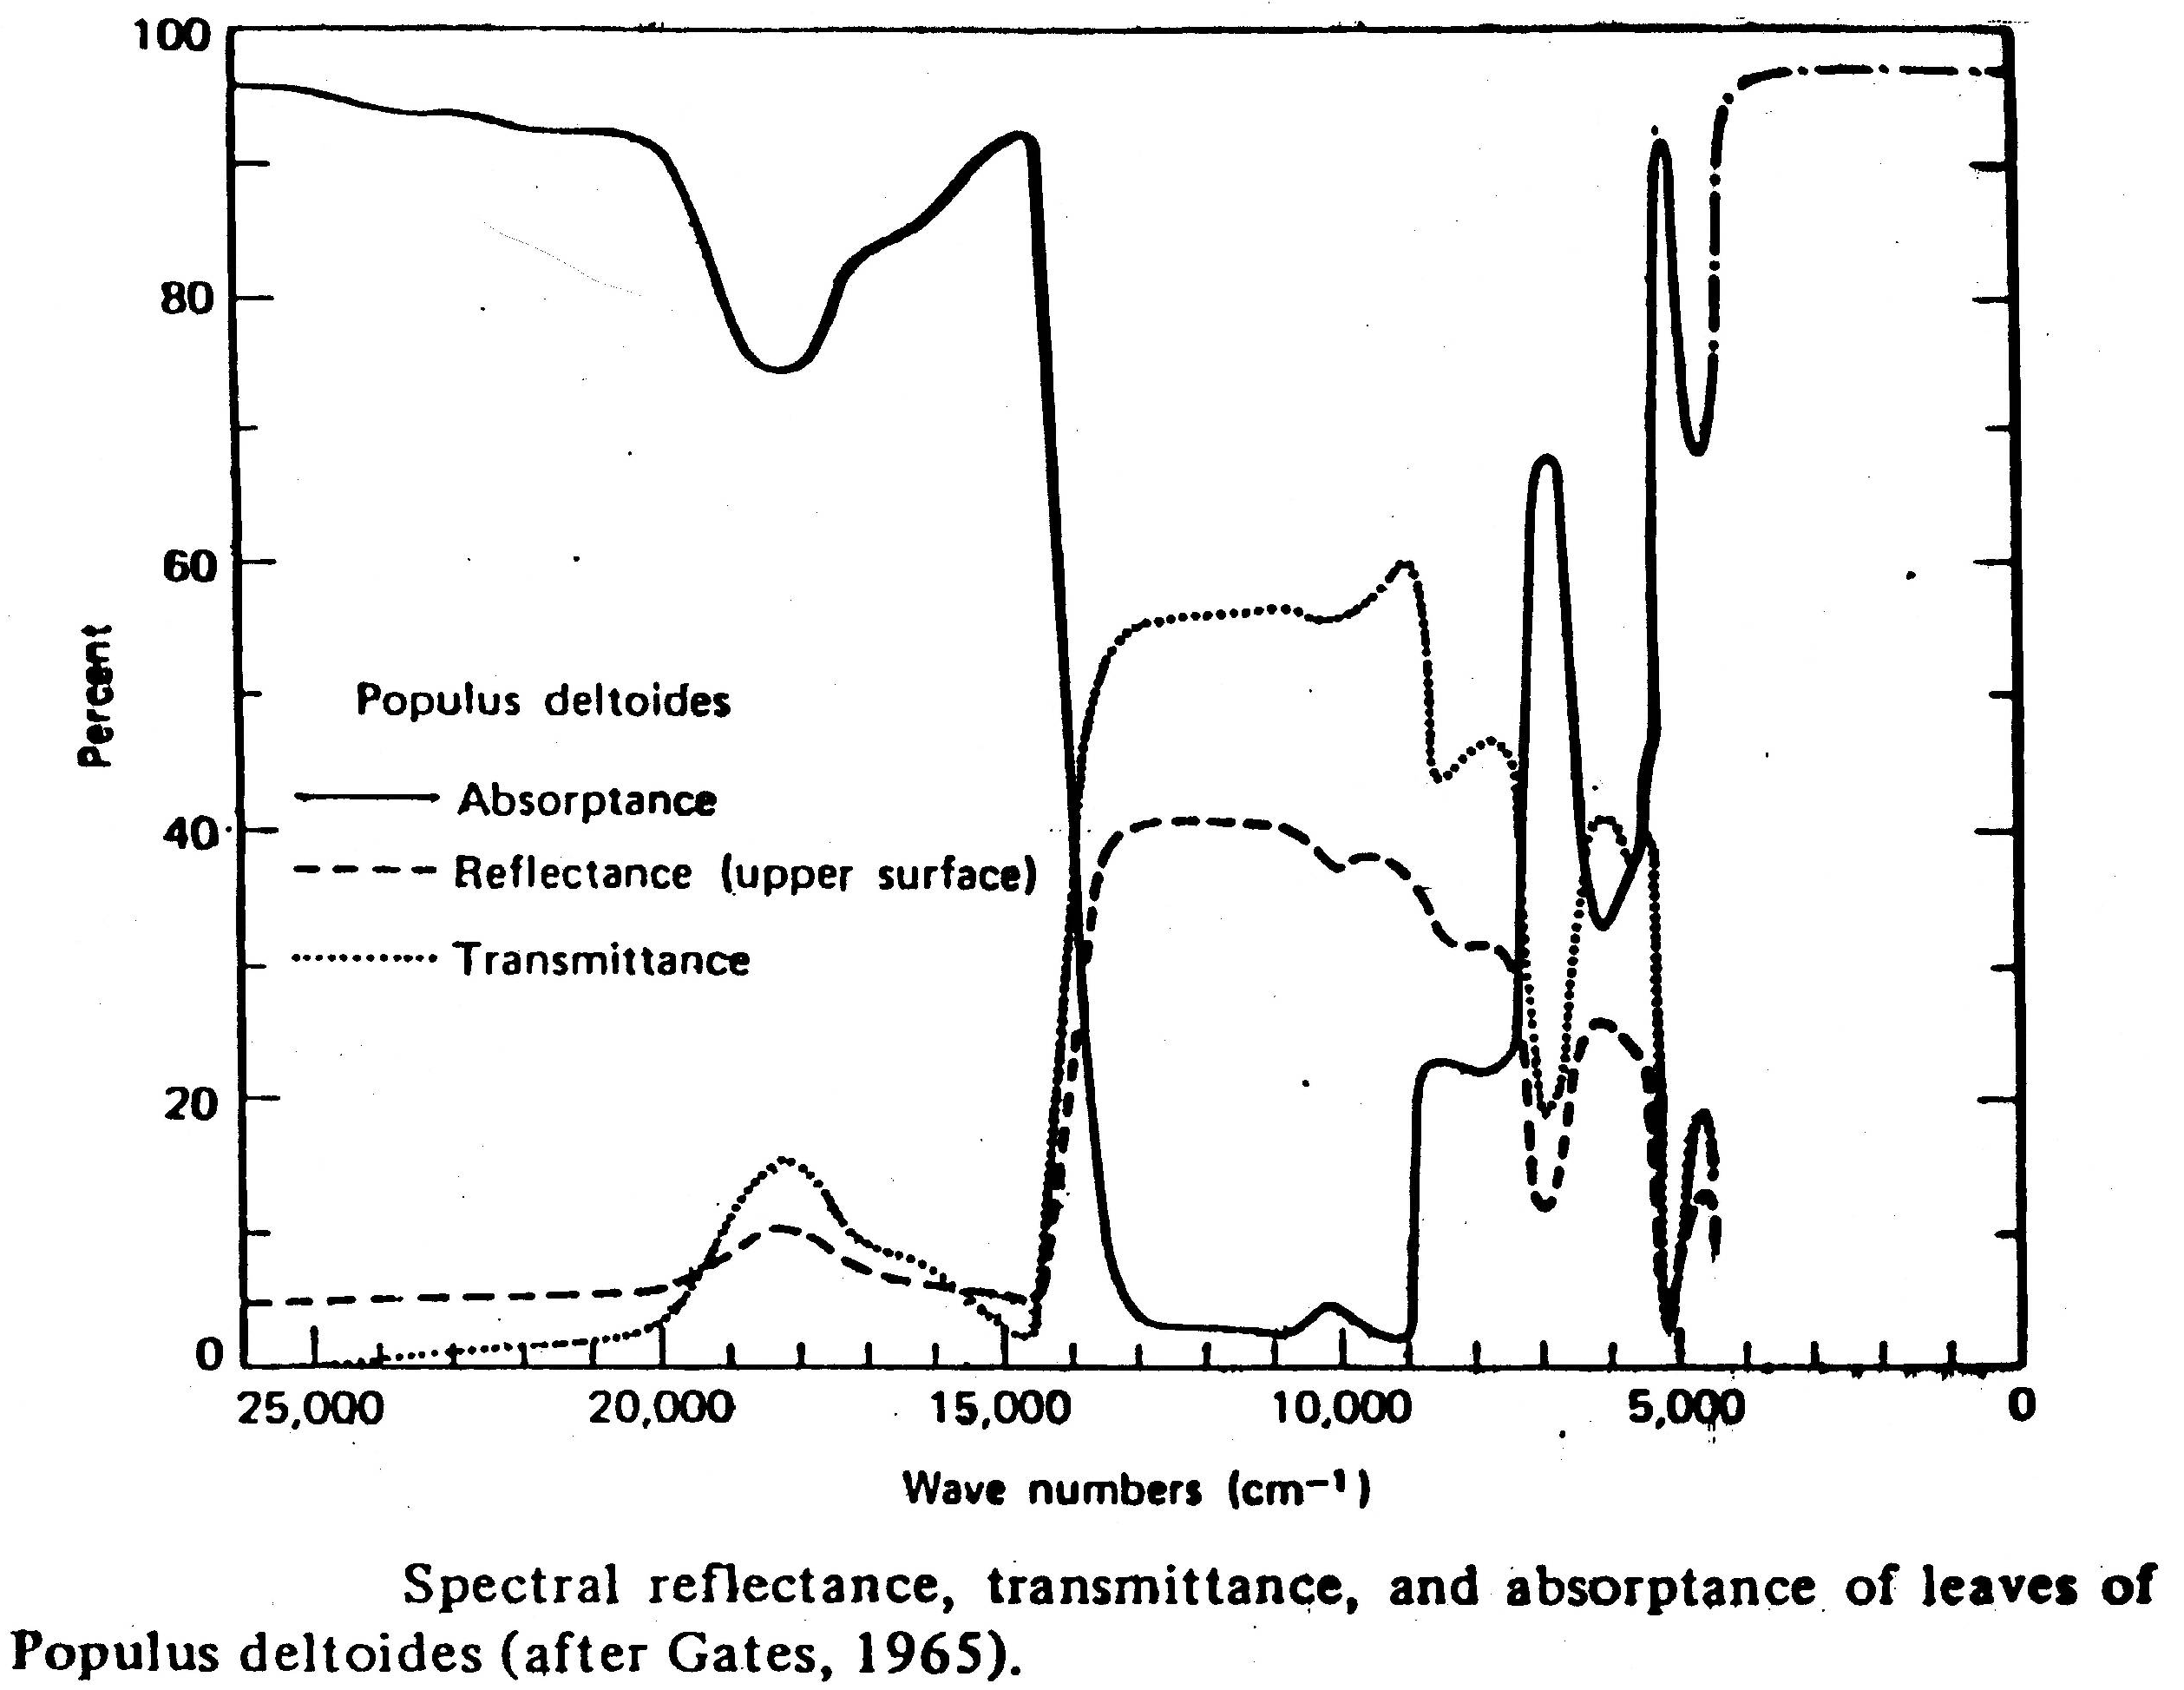

Slide 20
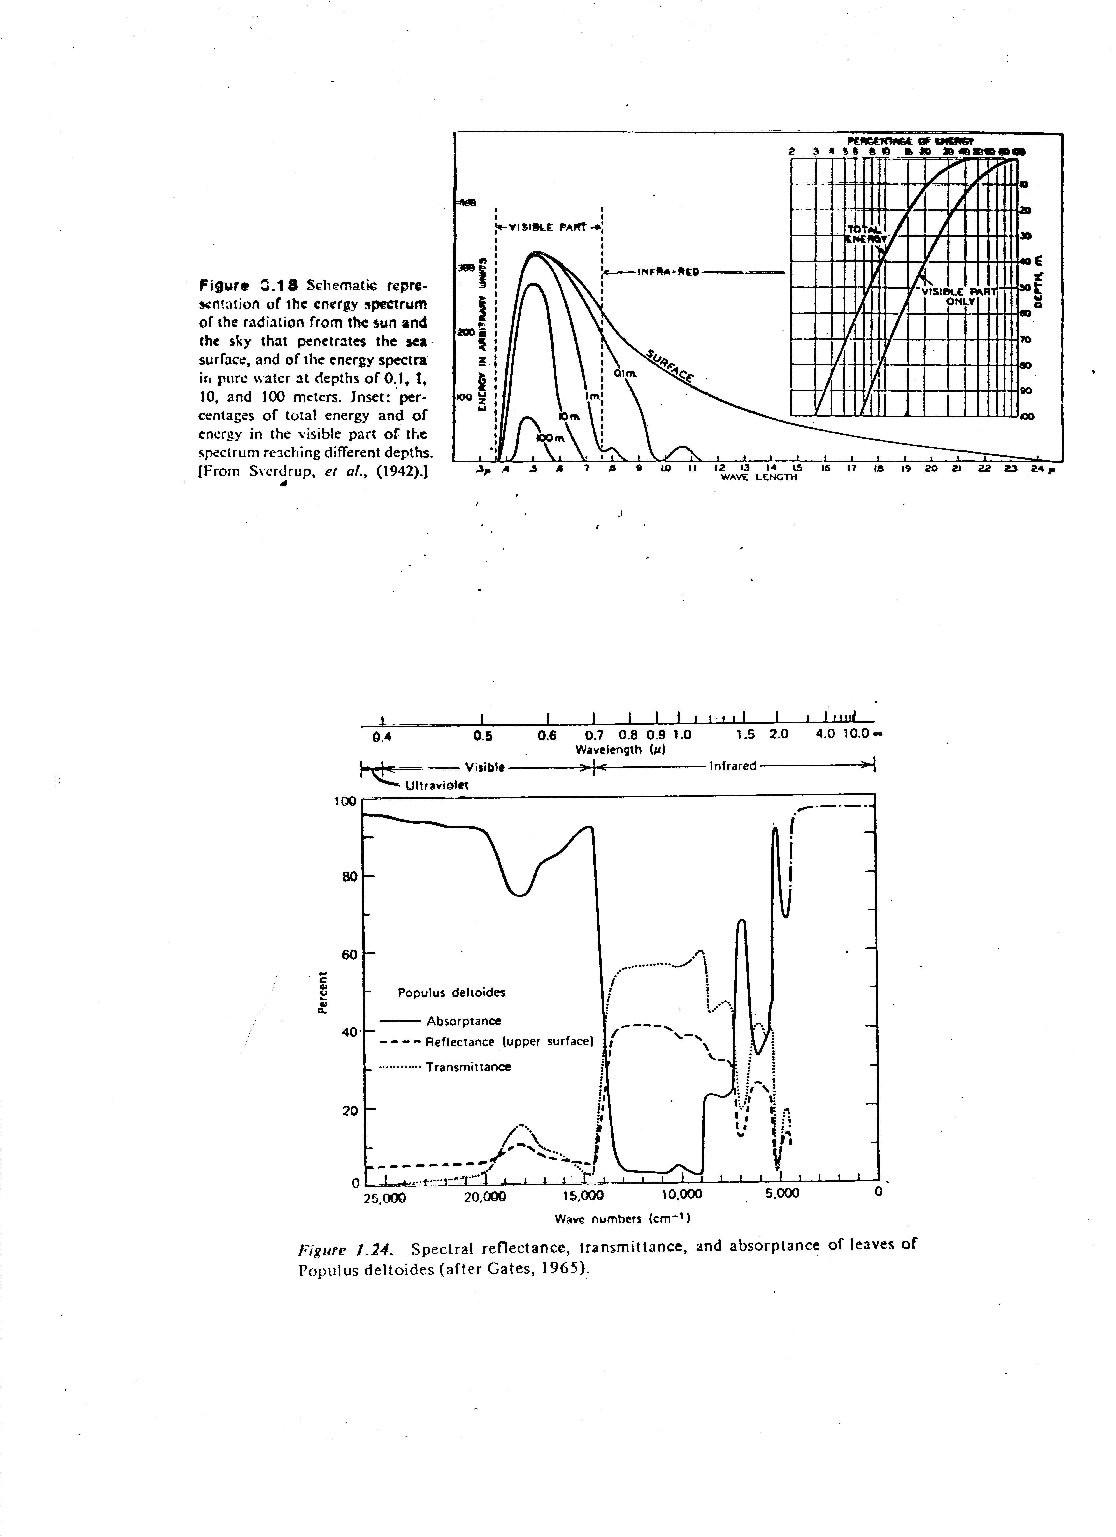

Slide 21
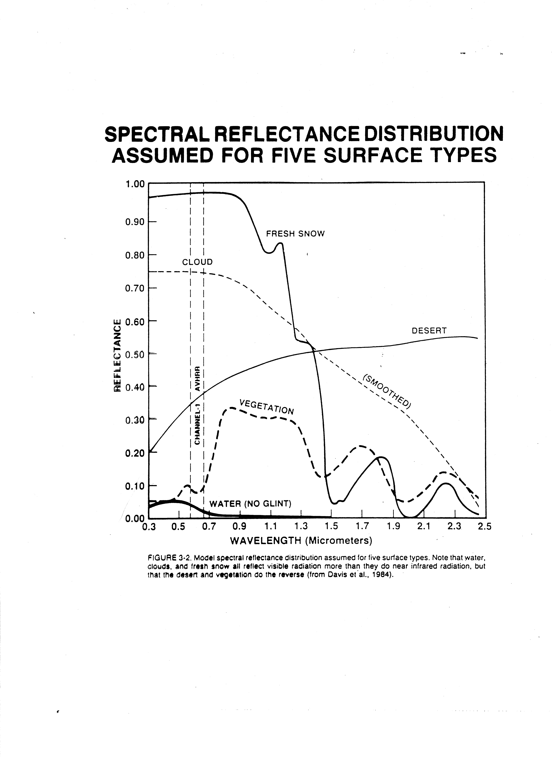

Slide 22
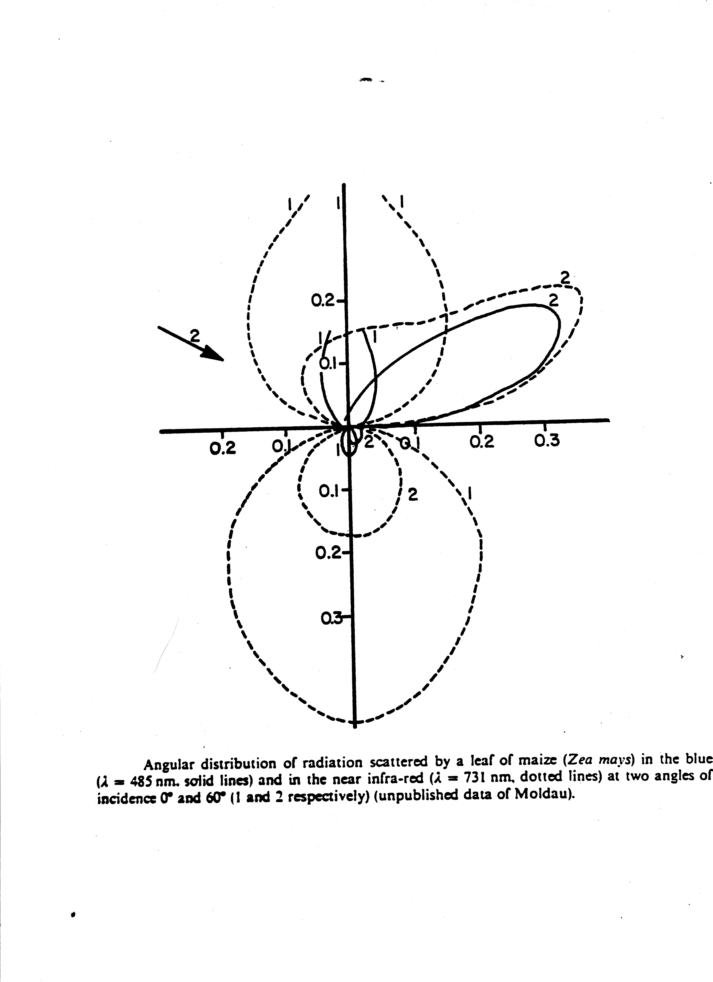

Slide 23
Optical Properties of vegetation
A = 1-R-T
Reflection R
Transmission T
Absorption A
Some characteristic values for the optical properties:
PAR NIR Short-wave
R . 09 . 51 . 3
T . 06 . 34 . 2
A . 85 . 15 . 5
R and T spectra are similar

Slide 24
In UV, A is large for vegetation, relatively constant, between 90-99%.
Differences in species and leaf structure have only a small effect upon the optical properties of leaves in UV.
Absorption of PAR is about 90% in the blue-violet (380-480nm) and in the orange-red (620-680nm); it is caused by chlorophyll and other pigments.
The absorption minimum is in the green and varies between 50-90%. Starting from 690 nm, A decreases drastically in the NIR, with a minimum (5-25%) between 750-1200nm. Beyond 1200nm, A increases and reaches a max of 70-95% in the absorption bands of liquid water at 1500, 2000 and beyond 2800nm.
The angular distribution of scattered radiation is affected by the structure of the leaf

Slide 25
Scattering of matted leaves is almost uniform in all directions; for glossy leaves there is a strong dependence on angle of incidence of radiation. Optical properties of leaves change with adaptation. Sunny leaves show a higher degree of absorption than shaded leaves.
In the longwave spectrum, all plant parts absorb strongly:
A ~ 95%, T ~ 0%, R ~ 5%
The angular distribution of the longwave radiation is unknown. In the transfer of longwave radiation in plants, they are treated as grey bodies for which Kirchhoff's laws are valid.

Slide 26
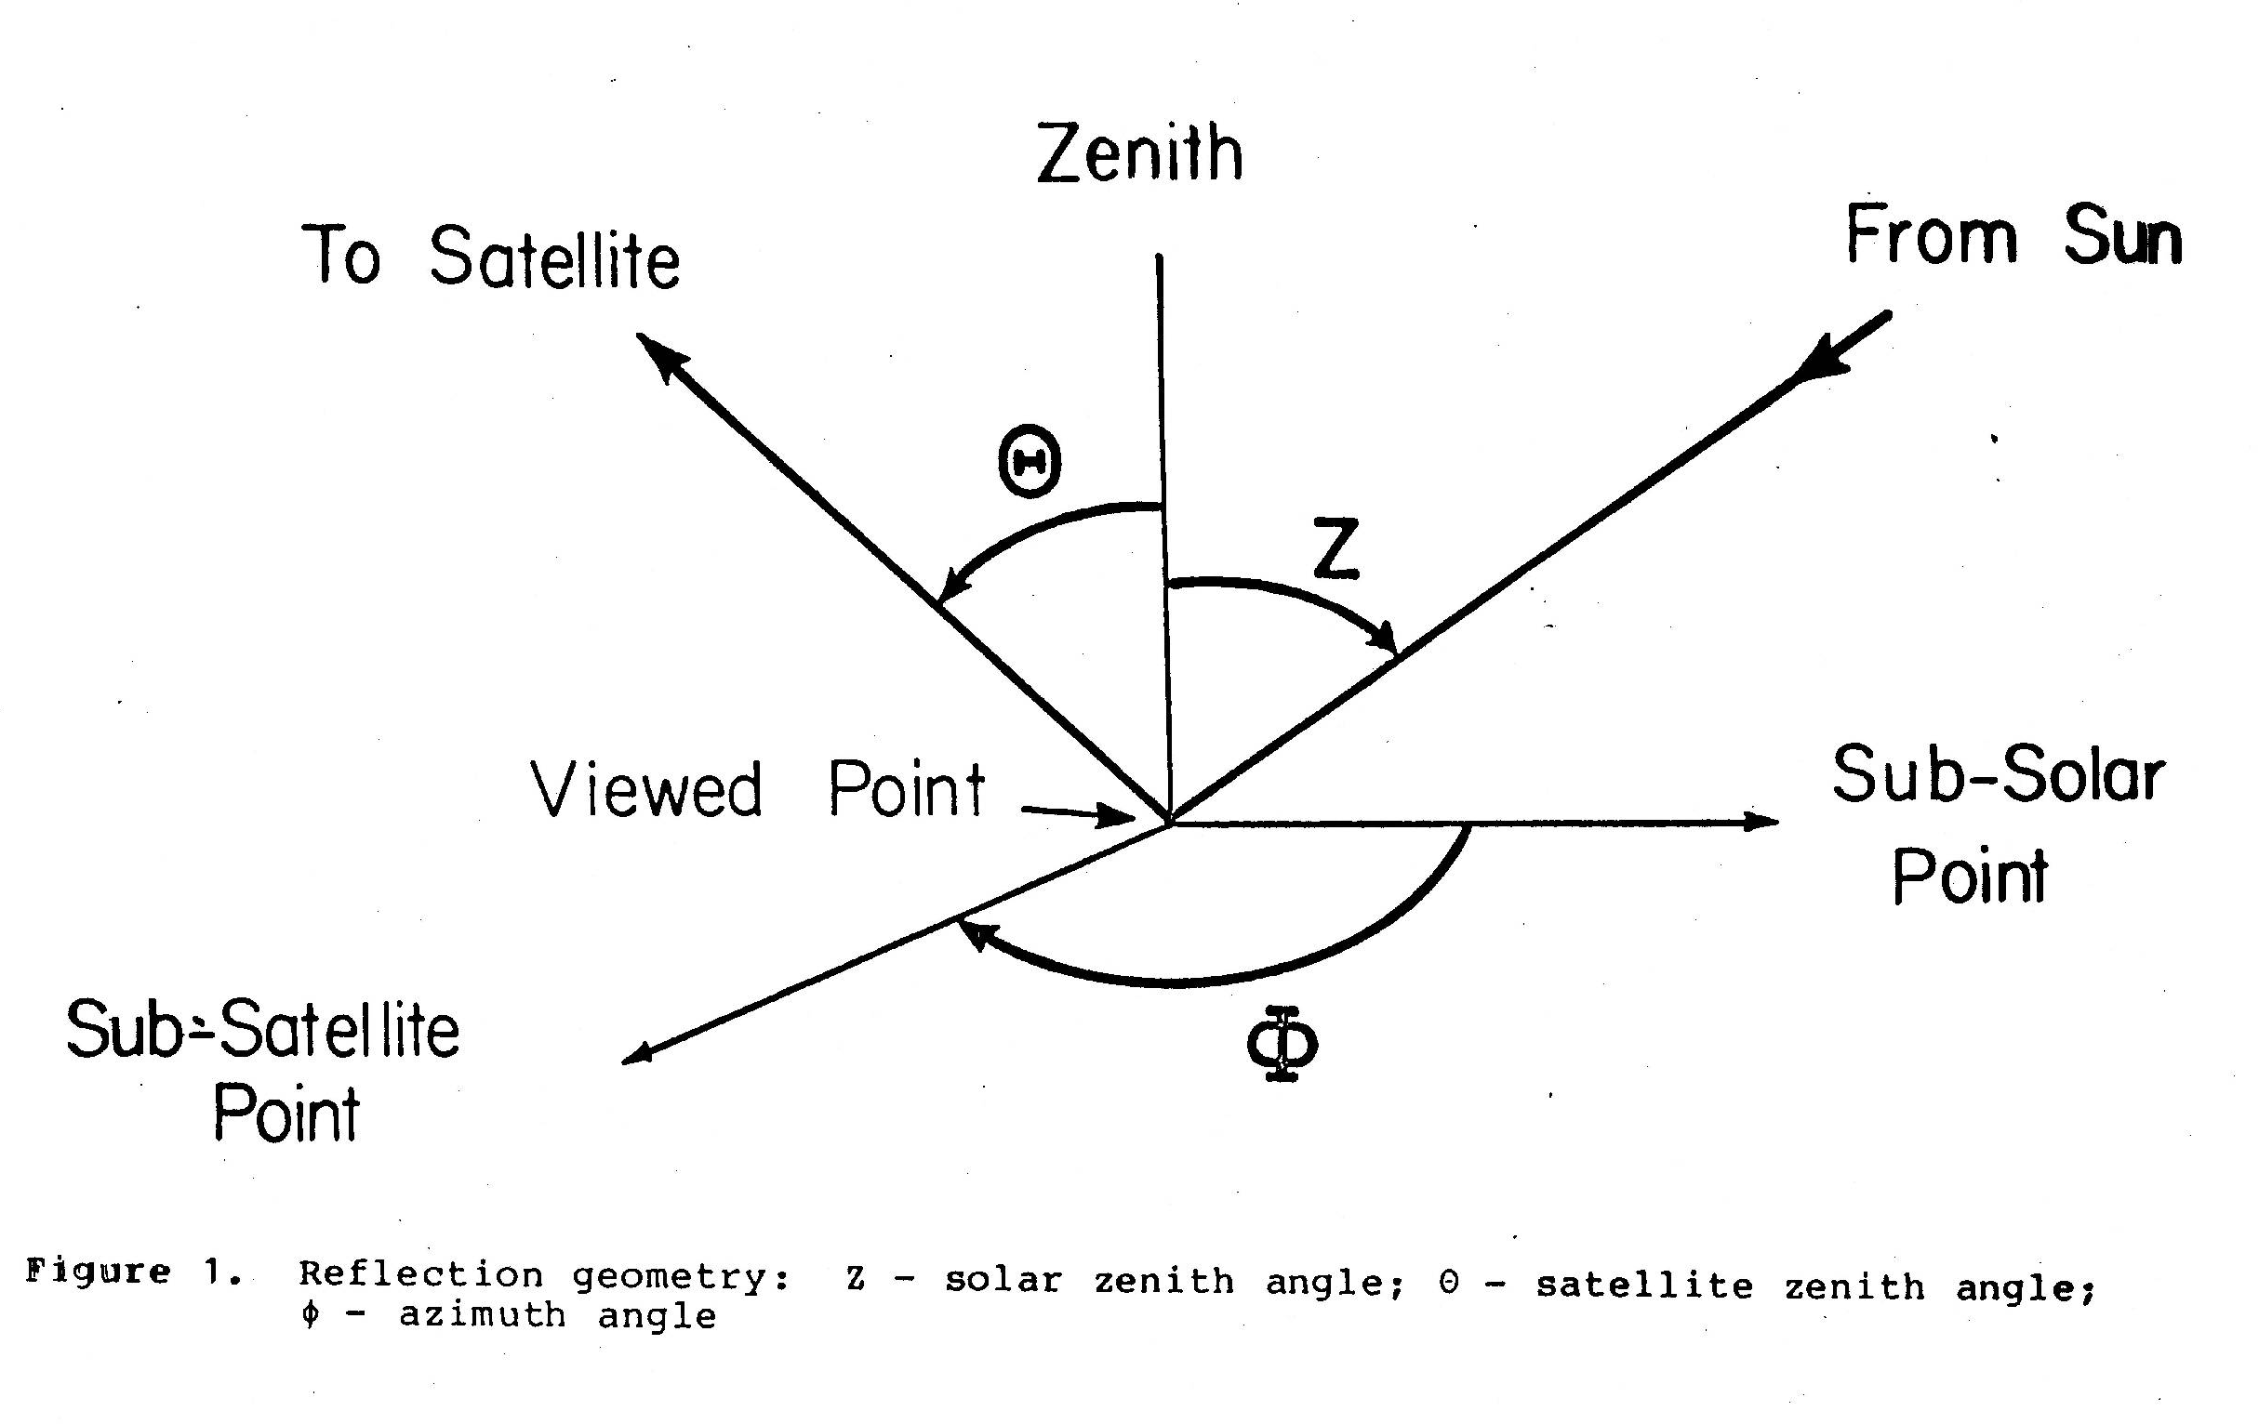
Satellite issues

Slide 27
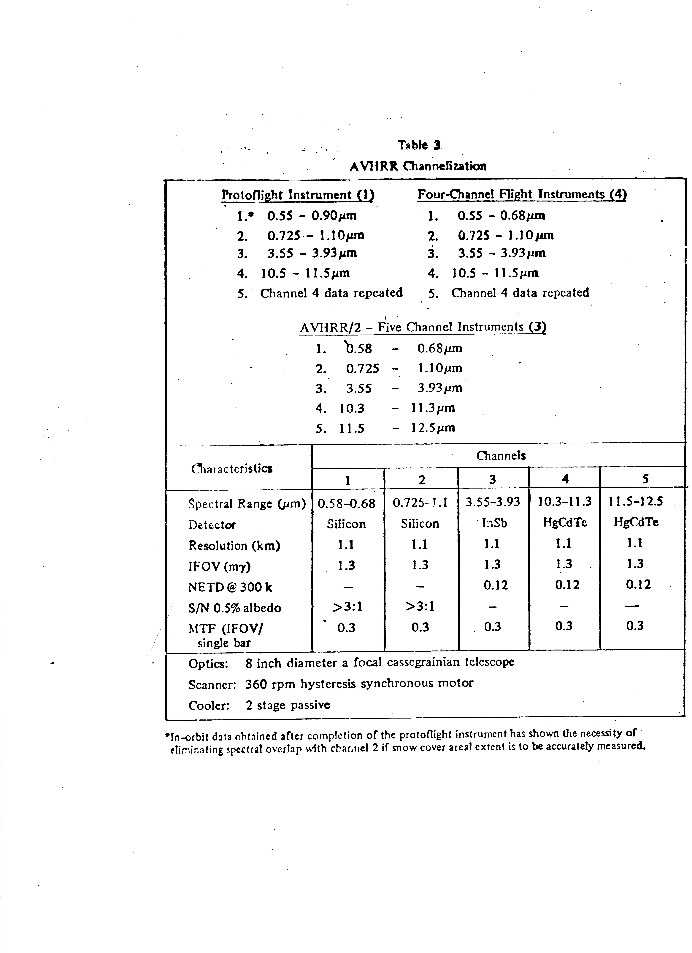

Slide 28
Vegetation Index (VI)
what is a VI?
why do we need it?
what issues are involved?
There are numerous variants of VI.
Normalized Difference Vegetation Index (NDVI) uses indices of reflectance in VIS and NIR.
NDVI=(ρ_{nir}-ρ_{red})/(ρ_{nir}-ρ_{red})
Looks at difference between 2 channels, which minimizes atmospheric effects. Large NIR reflectance is used to detect vegetation.
More recent NDVI studies now use atmospheric corrections

Slide 29
Soil Adjusted Vegetation Index (SAVI)
Used to account for variations in area with vegetation and soil. SAVI (Huete, 1988)-shown to be very sensitive to discriminate vegetation amount in sparsely vegetated areas. NDVI comes from top of canopy.
SAVI=(ρ_{nir}-ρ_{red})/(ρ_{nir}-ρ_{red}+L)
Where L=0.5 and is supposed to account for first order soil-vegetation optical interactions.

Slide 30
The Global Environmental Monitoring Index (GEMI)
Claimed to be less affected by soil and atmospheric variations than NDVI (Pinty and Verstraete, 1992). It is a non-linear index composed of a ratio of a fifth-order polynomial by a fourth-order one:
GEMI=η(1-0.25η)-(ρ_{r}-0.125)/(1-ρ_{r})
Where η=[2(ρ_{n}²-ρ_{r}²)+1.5ρ_{n}+0.5ρ_{r}]/(ρ_{n}+ρ_{r}+0.5)
Also proved to be more sensitive to burned area discrimination.

Slide 31
The Burned Area Index (BAI)
Defined by Martin (1998) specifically to discriminate fire-affected areas. This index is computed from the spectral distance from each pixel to a reference spectral point, where recently burned areas tend to converge:
BAI=1/((ρc_{r}­ρ_{r})²+(ρc_{nir}­ρ_{nir})²)
where ρc_{r} and ρc_{nir} are the red and near-infrared reference reflectances, respectively, and ρ_{r} and ρ_{nir} are the pixel reflectances in the same bands. Values of ρc_{r} and ρc_{nir} were defined as 0.1 and 0.06, respectively, based on literature and analysis of several sets of satellite sensor images.

Slide 32
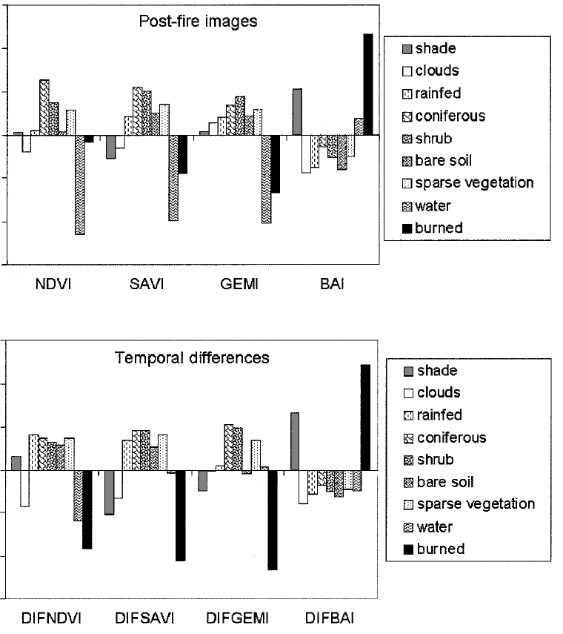

Slide 33
Average standardized values ((value–mean)/standard deviation) of the diVerent spectral indices for the land covers of Bun ol site (Landsat TM data). DIFNDVI, DIFSAVI, DIFGEMI and DIFBAI refer to the temporal diVerence of NDVI, SAVI, GEMI and BAI values, respectively.

Slide 34
Examples
ENCEP Eta Model:
Regional mesoscale model used by NOAA for forecasting. Has 40 km resolution.
If NDVI is used as average index for a grid box large errors are obtained in Eta model output. If NDVI is used in conjunction with area distribution within that box, a better output results from Eta model.

Slide 35
LAI: Leaf Area Index-provides information for inside of canopy; amount of green leaf per unit area of the surface
Beer's Law I = I_{o} * e^{(-LAI * t)}
where t = transmission
LAI acts as an extinction coefficient for radiation going through canopy to surface.
Photosynthesis depends on photosynthetically active radiation (PAR) (0.4 - 0.7μm)
Absorbed PAR ~ NDVI
APAR = absorbed photosynthetically active radiation

Slide 36
Land Surface Processes and Climate:
Surface Albedos and Energy Balance
(R. Dickinson et al., 1983)
Intent to bridge gap between atmospheric studies and surface climate emphasis on physics of land surface albedos. Previous studies used fixed albedos. Albedos depend on wavelength and incidence angle of incoming solar radiation. Surface albedo depends on texture, structure, and composition of incoming radiation.
Schemes developed to include vegetation along with surface albedo. Some of these schemes want surface albedo in VIS and IR independently.
30% of Earth's surface = land
1/4 of land = desert
1/4 of land = forest
1/8 of land = farmland and cities
1/8 of land = tundra, fresh water
Incoming solar flux reaches top of atmosphere. At top of atmosphere half of incident is <700 nm and half is >700 nm. Chlorophyll absorption bands occur at 700 nm and less. Over snow we must account for multiple scattering.
Diffuse radiation is assumed to be isotropic.
Diffuse fraction of incident radiation varies from 0.1 (overhead sun, clear) to >0.9 (below thick clouds).
Radiation flux at surface has 4 categories:
1) direct VIS beam
2) diffuse VIS beam
3) direct NIR beam
4) diffuse NIR beam
Surface albedos change the fraction of solar radiation reflected from the earth-atmosphere system. Temperature of earth-atmosphere surface is highly sensitive to albedo changes.

Slide 37
Soil moisture
Attempts have been made to derive soil moisture from:
Visible
IR
Microwave
Physical principles for visible:
Surface albedo changes with soil moisture content. Many satellites look at surface albedo with the goal of getting soil moisture.
wet soil = lower albedo
dry soil = higher albedo
(Idso, S. B. et al., 1975. The dependence of bare soil albedo on soil water content. J. Applied Meteor., 14, 109-113.(See handout).
A profile of abedo depends on time and shows a "U" shape, noon occurring at the bottom of the "U"

Slide 38
Physical principles for IR:
Thermal Inertia
P=(ρcλ)^{1/2}
Where ρ=density of soil (gm-cm⁻³)
C=heat capacity (cal-gm⁻¹-⁰ C⁻¹
λ=thermal conductivity (cal-cm-1-sec⁻¹-⁰ C⁻¹)
The Heat Capacity Mapping Mission (HCMM) was designed to sense the magnitude of the diurnal temperature cycle by obtaining thermal data at the peak of the cycle and near the early morning minimum. The amplitude depends on soil moisture. HCMM was the first of planned series of Application Explorer Missions (AEM), which involved the placement of a small spacecraft in a special orbit.

Slide 40
The Normalized Difference Vegetation Index (NDVI )
The Soil Adjusted Vegetation Index (SAVI) (Huete, 1988)-shown to be very sensitive to discriminate vegetation amount in sparsely vegetated areas.
The Global Environmental Monitoring Index (GEMI),
claimed to be less affected by soil and atmospheric variations than NDVI (Pinty and Verstraete, 1992).
Also proved to be more sensitive to burned area discrimination.

Slide 41
The Burned Area Index (BAI), defined by Martin (1998) specifically to discriminate fire-affected areas. This index is computed from the spectral distance from each pixel to a reference spectral point, where recently burned areas tend
to converge:
BAI=1/((ρc_{r} ­ ρ_{r})²+(ρc_{nir} ­ ρ_{nir})²)
where ρc_{r} and ρc_{nir} are the red and near-infrared reference reflectances, respectively, and ρ_{r} and ρ_{nir} are the pixel reflectances in the same bands. Values of ρc_{r} and ρc_{nir} were defined as 0.1 and 0.06, respectively, based on literature and analysis of several sets of satellite sensor images.

