Slide 1
AOSC624
Class 22: May 1, 2012
At Issue:
How can satellites help to estimate the Surface Energy Budget (SEB)
One Component of SEB:
Surface Radiation Budget (Review)
Other components:
Surface Turbulent Fluxes of heat and moisture Heat into ground
How do we evaluate the turbulent fluxes? Overview of Eddy Covariance Principles

Slide 2
Radiation Balance at the Earth Surface
The net flux of radiation at the earth’s surface results from a balance between the solar and terrestrial
radiation fluxes:
^{Fsfc}rad ^{= F}SW ^{+ F}LW
The short-wave and long-wave radiation balance can
be expressed:
F_{SW} = F_{SW}↓ - F_{SW}↑ F_{LW} = F_{LW}↓ - F_{LW}↑
The net radiation balance being:
F^{sfc}_{rad} = F_{SW}↓ - F_{SW}↑ +
F_{LW}↓ - F_{LW}↑

Slide 3
The incident solar radiation F_{SW}↓ is the sum of the direct and diffuse solar radiation. It has a pronounced diurnal and seasonal variation, and is also strongly affected by clouds. The outgoing short-wave solar radiation is the part reflected by the surface F_{SW}↑=A_{sfc}F_{SW}↓, where A_{sfc} is the surface albedo so that the net short-wave radiation is:
F_{SW} = (1 – A_{sfc}) F_{SW}↓
The outgoing long-wave radiation F_{LW}↑ is given by the Stefan-Boltzmann law, assuming a given emissivity є for the earth’s surface.
The net radiation flux at the surface is then given by :
F^{sfc}_{rad} = F_{SW}↓ (1 – A_{sfc}) – σєT⁴
+ F_{LW}↓
sfc

Slide 4
Energy Balance at the Earth Surface
The main part of the energy absorbed at the surface is used to evaporate water, another part is lost to the atmosphere as sensible heat, and a smaller part is lost to the underlying layers or used to melt snow and ice. Thus, there are essentially four types of energy fluxes at the earth’s surface. They are the net radiation flux F_{rad}, the (direct) sensible heat flux F_{SH}↑, the (indirect) latent heat flux F_{LH}↑, and the heat flux into the subsurface layers F_{G}↓. Under steady conditions the balance equation for the energy is given by
F^{sfc}_{rad} - F_{SH}↑ - F_{LH}↑ - F_{G}↓ - F_{M} = 0

Slide 5
These surface fluxes are associated with land processes and depend on:
vertical stability; roughness
surface temperature
subsurface heat conduction
vegetation
surface hydrological balance
potential evapotranspiration
radiative flux

Slide 6
Theoretical aspects of satellite remote sensing of energy balance
Thermal equilibrium at the surface is maintained by a combination of thermodynamic and physiological processes.
The net energy absorbed by the surface through radiative processes, net radiation R_{n}, must be balanced by that transported to the atmosphere and ground (sensible, latent, and ground heat flux):
R_{n} = H + LE + G.
(1)
R_{n} is simply the difference between the incident and reflected shortwave radiation and the incident and emitted long wave radiation at the surface, that is:
R_{n} = S{1 - α} + L_{wd} - L_{wu},
(2)
where S is downwelling shortwave radiation energy flux (Wm⁻²).

Slide 7
Surface energy balance formulae
For the sensible and latent heat components in eq. 1, closed-form solutions cannot be obtained. Commonly used semi-empirical relations are:
For Sensible heat:
H = ρC_{p} (T_{aero} - T_{a})/r_{a}
(3)
where H sensible heat flux, W m⁻²; ρ density of air, kg m⁻³;
C_{p} specific heat of air, J kg^{-1 o}C⁻¹;
T_{a} reference height air temperature, ºC;
T_{aero} canopy temperature, ºC;
r_{a} aerodynamic resistance for heat and water vapor, s m⁻¹.

Slide 8
In this formulation the aerodynamic resistance, r_{a}, relates the vertical gradient in temperature, T_{aero} - T_{a,} to the sensible heat flux.
The r_{a} value is semi-empirical and is intended to characterize the efficiency of the very complex transfer of heat by turbulent air movement through the canopy into the air above; r_{a} is normally derived using empirical arguments to adjust the surface momentum transfer coefficient, a term that relates the vertical gradient in boundary layer wind speed to surface shear stress.
A number of such empirical formulations are available for r_{a} ( see Hall et al,. 1991), such as:

Slide 9
ln(z − 0.56h) ln[(z − 0.56h) / (0.0189h)]
^{ra =} 0.16U {1 + [5g(z − 0.56h)(T
,
− T ) / T U ² ]}^{3/4}
a a
where U is windspeed, m s⁻¹; z is reference height for measurement of T_{a} and U ; h is height of canopy (m); and g is gravitational acceleration, m s⁻².
For more details and additional formulation for Aerodynamic Resistance see the provided paper:
Measurement and estimation of the aerodynamic resistance
S. Liu, D. Mao, and L. Lu
aero

Slide 10
For latent heat:
LE = ρC_{p}[e*(T_{aero})- e_{a})](g_{c}g_{a})/γ(g_{c} + g_{a}),
(5)
•
where e_{a}
T_{a}
e*(T_{aero}) mbar;
vapor pressure at reference height, mbar; air temperature at reference height, ºk;
psychometric constant, mbar ºk⁻¹; as defined in (2);
bulk stomatal conductance of canopy, m s⁻¹; bulk aerodynamic conductance of canopy (1/ r_{a}), m
saturated vapor pressure in the canopy air space,
•
•
•
g_{a s}-1.
γ
ρC_{p}
g_{c}
•
These first-order solutions to the turbulent transport equations served as the primary model for investigating relationship between the properties of land surface vegetation, energy- mass balance, and remote sensing of these interactions in FIFE.

Slide 11
Sensible heat
For H in (3), remote sensing measures of surface radiometric temperature have been evaluated as a surrogate for T_{aero}.
•
However, T_{aero} is not explicitly T_{rad} but, as discussed above, a theoretical construct that parameterizes a “convective” temperature. Vining and Blad (1991) investigated the relationship between T_{aero} and T_{rad}.

Slide 12
Latent heat
For latent heat estimation (eq. 5) the main focus of remote sensing techniques is the conductance term g_{c} and the T_{aero} term in estimating canopy air-space vapor pressure.
The canopy conductance term g_{c} can be
modeled after Jarvis (1976) as a product of functions with range (0, 1) where each function characterizes the dependence of g_{c} on APAR (absorbed PAR), δe, T, and leaf water potential
ψ.

Slide 13
That is:
g = g (APAR)g(δe)g(T
)g(ψ)
(6)
*
c c aero
where g* (APAR) is “unstressed” canopy
c
conductance and g (δe), g (T_{aero}), g (ψ) are
functions with ranges (0, 1) describing the fraction of stomatal closure by vapor pressure deficit, leaf temperature, and leaf water
potential.
The most accurate method to estimate turbulent fluxes is the “Eddy Correlation Method “to be explained in what follows:

Slide 14
What is Flux
Flux – how much of something moves through a unit area per unit time
Flux is dependent on: (1) number of things crossing the area; (2) size of the area being crossed, and (3) the time it takes to cross this area

Slide 15
Flux Measurements
Flux measurements are widely used to estimate heat, water, and CO₂ exchange, as well as methane and other trace gases
Eddy Covariance is one of the most direct and defensible ways to measure such fluxes
The method is mathematically complex, and requires a lot of care setting up and processing data .

Slide 16
“A Brief Practical Guide to Eddy Covariance Flux Measurements: Principles and Workflow Examples for Scientific and Industrial Applications”
G. Burba and D. Anderson of LI-COR Biosciences
To help a non-expert gain a basic understanding of the Eddy Covariance method and to point out valuable references
To provide explanations in a simplified manner first, and then elaborate with specific details

Slide 17
Introduction
The Eddy Covariance method is one of the most accurate, direct and defensible approaches available to date for measurements of gas fluxes
and monitoring of gas emissions from areas with sizes ranging from a few hundred to millions of square
meters
The method relies on direct and very fast measurements of actual gas transport by a 3-D wind speed in real time in situ, resulting in calculations
of turbulent fluxes within the atmospheric boundary layer

Slide 18
Modern instruments and software make this
method easily available and potentially widely-used in studies beyond micrometeorology, such as in ecology, hydrology, environmental and industrial monitoring, etc.
Main challenge of the method for a non- expert is the shear complexity of system design, implementation and processing the large volume of data

Slide 19
The Eddy Covariance method provides measurements
of gas emission and also allows measurements of fluxes of sensible heat, latent
heat and momentum, integrated over an area.
This method was widely used in micrometeorology for over 30 years, but now, with firmer
methodology and more advanced instrumentation, it can be available to any discipline, including science, industry, environmental monitoring and inventory.

Slide 20
Several networks have been established over the globe to measure turbulent fluxes Existing Flux Networks:
Fluxnet, Fluxnet-Canada, AsiaFlux, CarboEurope and AmeriFlux networks
They collect Eddy Covariance information. http://gcmd.nasa.gov/records/GCMD_AMERIFLU
X_SHIDLER-CDIAC.html
http://terraweb.forestry.oregonstate.edu/chair2. htm

Slide 21



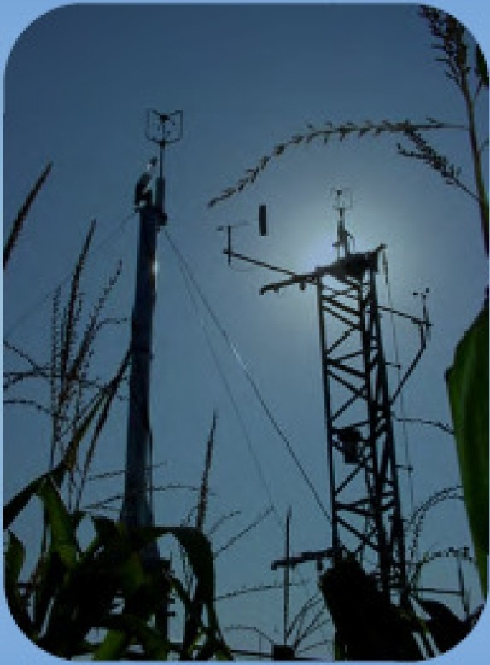
There is currently no unifom[ inology
or a single methodo logy for EC method
A lot of effort is being placed by networ ks (e.g.,Fluxnet) to unify various approaches
Here we present one of the conventional ways of implement ing the Eddy Covariance method

Slide 22



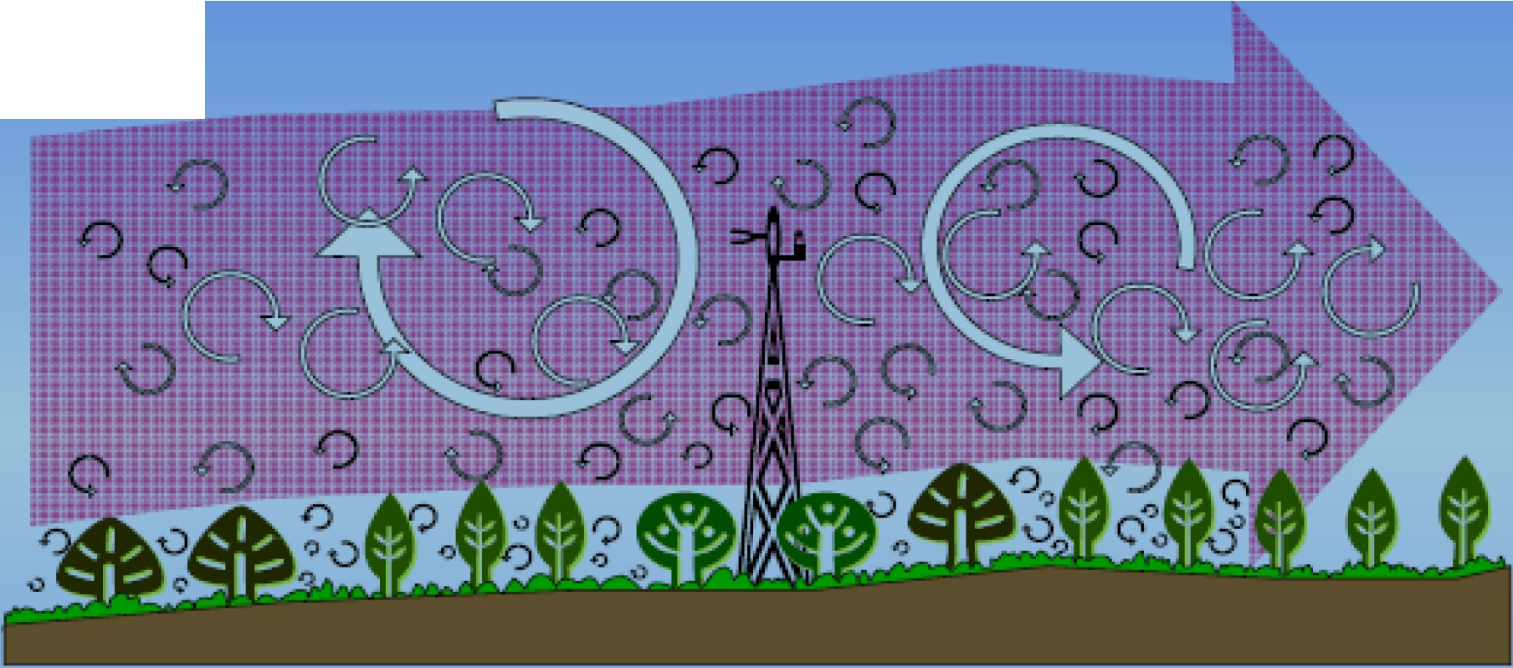
WI D
Airflow can be imagined as a horizontalflow of numerous rotating eddies
Each eddy has 3-D components,including a vertical wind component
• The diagram looks chaotic but componentscan bemeasured from tower

Slide 23





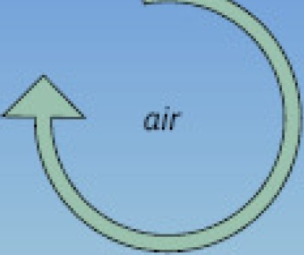
time:i. eddy:i.
time 2
eddy 2
[;J
lW
GJ
GJ
air
,_
t
2
_{W}2
GJ
At a single point on the tower:
Eddy 1moves parcel of air c down with the speed w
1 1
then Ed dy 2 moves parcel c₂ up with the speed w₂
Each pa cel has concentration,temperature, hum idity;
if we know these and the speed -we know the flux

Slide 24



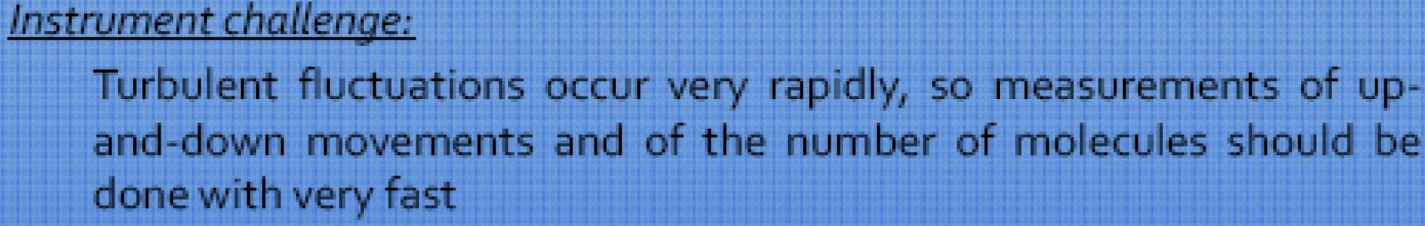
Thegeneral principle:
If we know how many molecules went up with eddies at time 1, and how many molecules went down with eddies at time 2 at the same point - we can calculate verticalflux at that point and over that time period
Essenceof method:
Vertical flux can be represented as a cova ria nce of the vertical
velocity and concentration of the entity of interest

Slide 25


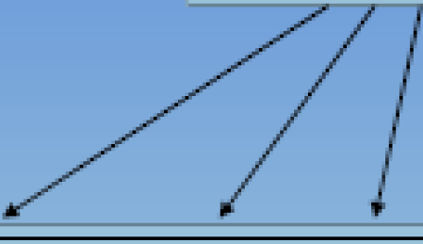

In turbulent flow, vertical flux can be presented as:
(s-p/pa is the mixing ratio of substance 'cin air)
F = JliliS
lF= (pa + p 'Q)(,..,+ lt·'')(s +s' )
Reynolds decomposition is used then to break i nto means and deviations:
"
Opening the parentheses:
--- -
-
F =(pa11.1s+ pa
' pa 1 · pa 1v's'+p al
p 'a11 '+p 'a1i"s + p 'a11-¹ )
1
Averoged deviationfrom theavemge is zem
--- ---
Equation is simplified: F = (pali¹s+ pa ,i,'s' +11- p'a.S' + sp 'a11¹ + pi ' ,i,'s')

Slide 26


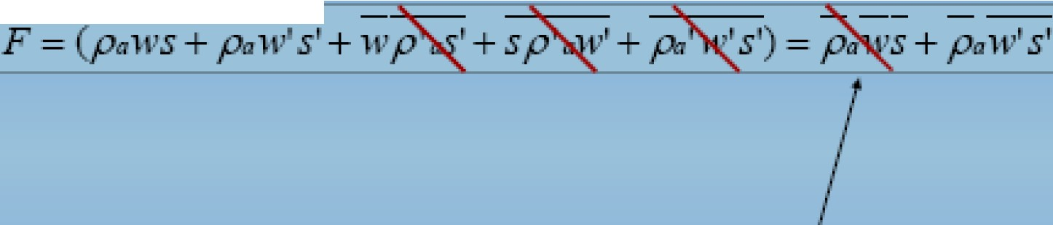
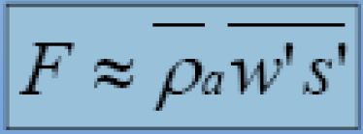
Now an important assumption is made (forconventional Eddy
Covariance)- Le. air density fluctuations areassumed negligible:
!
--- ---
Then another important assumption is made - mean v rticalflow 1s assumed negligible for horizontalhomogeneous terrain (no divergence/c onvergence):
'Eddy flux'

Slide 27


General equation: IF ::::::: Pa W ^{I}S ^{I}I
H == p C ,1,' T '
Sensible heat flux:
a p
LE = .11,
'l .1\. .1.,.. / J\f.a --, ,
Latent heat flux:
"'_{p} p lt..' e
/J
Ca11bondioxide flux: F
l{ p C '
C
NOTE: Instruments usually do not measure mixing ratio s,so there is yet another assumptioninthe practicalformulas (such as: p,,w's'= w''P'c

Slide 28


Measurements at a pointcan represent an upwind area
Measurements are done inside the boundary layer of interest
Fetch/footprint is adequate -fluxes are measured only at the area of interest
Flux is fully turbulent -most of the net vertical transfer is done by eddies Terrain is horizontal and unitorm: average of fluctuations is zero;
air density fluctuations ,flow convergence & divergence are negligible
Instruments can detect very small changes at very high frequency
r -· I

Slide 29




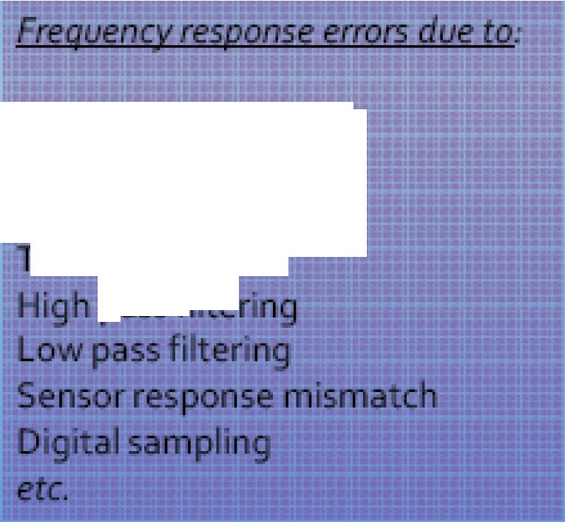
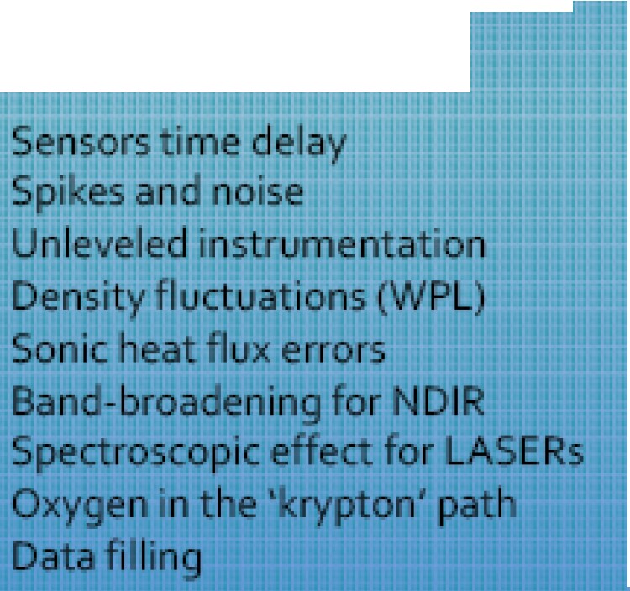
Measurements are not perfect:due to assumptions,physical phenomena,instrument problems,and specificities of terrain and setup
There could be a number of flux errors introduced if not corrected:
Other key error sources:
System time response
Sensor separation
Sc arpa h aver-,ing ube lon
11KllD R.,.,..._cr

Slide 30

These errors are not trivial- they may combine toover 10o% of the flux
To minimize or avoid such errors a number of procedures could be performed
Errors due to Affected fluxes Approximate Range
Frequency response | all | 5-30%
T me deray | all | 5-15%
Spikes,no se | all | 0-15%
Unleveled mstrument/flow | all | 0-25%
Density fluctuatton | H20,co>' CH.. | 0-50%
Sonic heat error | sensible heat | 0..10%
Band Broadening for NDtR | mostly C0₃ | 0..5%
Spectroscop..:effect for LASER | any gas | 0•3o96
Oxygen ln the path | some H30 | 0 1096
Messing data fill Ing | all | O·

Slide 31


Errors Remedy
Fruency respo se | frequency respo se corrections
Time lay | adjust• g for delay
Spikes,noise | spike removal
Unleveled inst1ument/ ow | coord ate rotatio
Density f luctuation | Webb..Pearman Leun ng correction
Son c heat error | son c temperature correction
Ba d Broaden g for NDIR | nd..broadening correctton
SpKtroscopic effect for LASER | no uniform W1dely used correcnon
Oxyge int e path | oxygen correct•on
Miss• g data fill•ng | Methodology/tests: Monte-Carlo etc-

Slide 32

Measures fluxes transported by eddies
Requires turbulent flow
Requires state-of-the-art instruments
Calculated as covariance of w' and c'
Many assumptions to satisfy
Complex calculations
Most direct way to measure flux
Continuous new developments

Slide 33
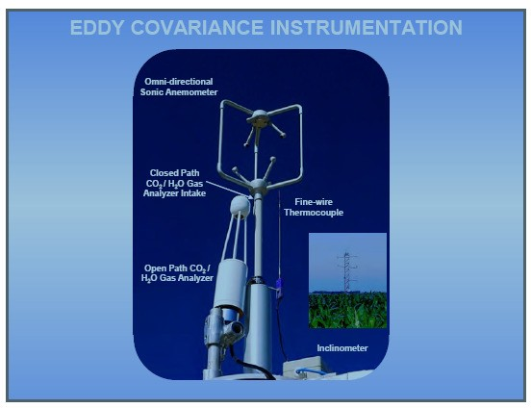

Slide 34


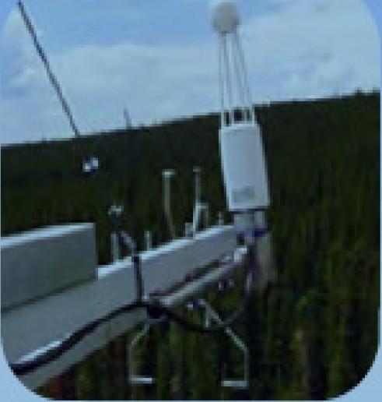
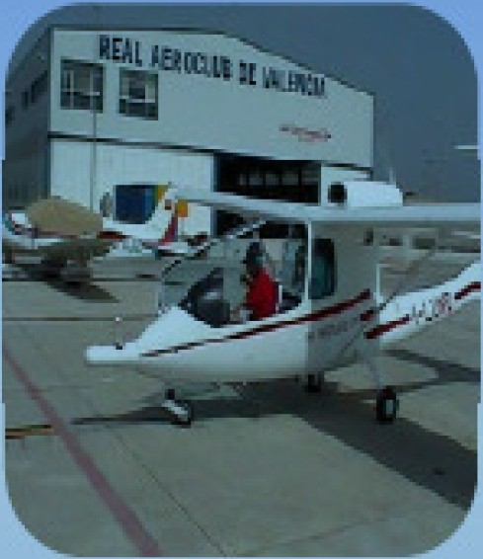
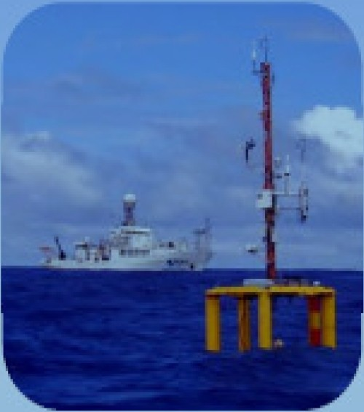
TERRESTRIAL
OCEANOGRAPHIC
<1%of apphcabOns May need customized
coating, LPS3
May be affected by precipitation,dew,& gyroscopic effects
98% of applications
<1%of applications
May need customized
reinforcement
May be affected by extreme temperatures and vibrations
Designed for stafonary use
Limited by precipitation,
fog,& dew

Slide 35
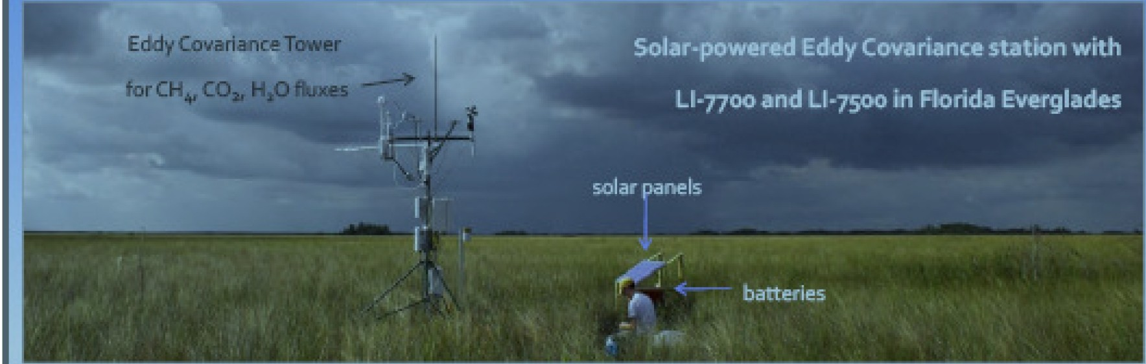
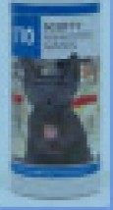
The power consumption by the entire Eddy Covariance station inthe Florida Everglades
,Ll-7500 for C0:1/H₂ 0,some anemometer,and air temperature/relative humidity sensors and barometer
was <30Watts,including Ll-noo for CH₄
The 12 lb.(5.5 kg) open path methane anatyzer was carried Into the wetland by
one person inthe backpack, along with tools,other sensors,and a laptop
•Insuch remote places occasionalcalibrationchecks can be done using small
hand-earned gastanks with known CH₄ concentration and CH₄-free air

Slide 36
Remote sensing the surface energy budget
The First International Satellite Land Surface Climatology Project (ISLSCP) Field Experiment (FIFE) was an international, land-surface-atmosphere experiment centered on a 15 x 15 km test site near Manhattan, Kansas.
The objectives of FIFE:
to better understand the role
of biology in controlling the interactions between the atmosphere and the vegetated land surface and to investigate the use of satellite observations for inferring climatologically significant land surface parameters. Specifically:

Slide 37
to verify the basic flux relationships for the homogeneous patches;
to assess the ability to remotely sense parametric inputs to these relationships;
to examine how these relationships and remote sensing algorithms scale from the patch level to heterogeneous collections of patches at the meso- scale level;
to determine how well existing calibration, atmospheric correction, and radiometric rectification techniques permit to extend satellite observations between dates and sensors
to determine to what degree existing and future satellite designs satisfy the requirements for periodic monitoring of surface energy balance components on a global scale.

Slide 38
Below are a few examples of the sources of information on the various methods of flux measurements, and specifically on the Eddy Covariance method:
Micrometeorology, 2009. By T. Foken. Springer-Verlag.
Handbook of Micrometeorology: A Guide for Surface Flux Measurement and Analysis, 2008. By X. Lee; W. Massman; B. Law (Eds.). Springer-Verlag.
Principles of Environmental Physics, 2007. By J. Monteith and M. Unsworth. Academic Press.
Microclimate: The Biological Environment. 1983. By N. Rosenberg, B. Blad, S. Verma. Wiley Publishers.
Baldocchi, D.D., B.B. Hicks and T.P. Meyers. 1988. 'Measuring biosphere- atmosphere exchanges of biologically related gases with micrometeorological methods', Ecology, 69, 1331-1340
Verma, S.B., 1990. Micrometeorological methods for measuring surface fluxes of mass and energy. Remote Sensing Reviews, 5: 99-115.
Wesely, M.L., D.H. Lenschow and O.T. 1989. Flux measurement techniques. In: Global Tropospheric Chemistry, Chemical Fluxes in the Global Atmosphere.
NCAR Report. Eds. DH Lenschow and BB Hicks. pp 31-46

