Slide 2
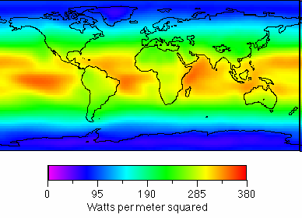
Annual Average Surface Downward Shortwave
Top of atm: ~1400W/m²
Albedo effect: 700W/m ²
Due to day/night cycle:
350W/m²
^{average per day}

Slide 3
Earth’s surface is heated by the absorbed radiation at the surface-temperature will increase
Temperature-measure of its average kinetic energy, average speed of atoms and molecules

Slide 4
Properties of objects: Blackbody
The blackbody concept serves as a useful standard for comparing the radiative properties of real surfaces with an ideal surface.
A real surface will partly reflect and partly absorb incident radiation. It can also partly transmit the incident radiation, namely:
1= α_{λ} + ρ_{λ} + τ_{λ}
α_{λ} is the monochromatic absorption, namely, the ratio of energy absorbed to incident energy
ρ_{λ} is the monochromatic reflectance, namely, the ratio of energy reflected to incident
τ_{λ} is the monochromatic transmittance, namely, the ratio of energy transmitted to incident.

Slide 5
Radiation Laws
The average or bulk properties of electromagnetic radiation interacting with matter can be summarized in a simple set of rules called radiation laws. These laws apply when the radiating body is what physicists call a blackbody radiator. Generally, blackbody conditions apply when the radiator has very weak interaction with the surrounding environment and can be considered to be in a state of equilibrium.
All objects with a temperature above absolute zero emit radiation

Slide 6
Planck Radiation Law
The primary law governing blackbody radiation is the Planck Radiation Law, which governs the intensity of radiation emitted by unit surface area into a fixed direction (solid angle) from the blackbody as a function of wavelength for a fixed temperature. The law is named after Max Planck, who originally proposed it in 1900. Namely, Planck's law describes the amount of electromagnetic energy with a certain wavelength radiated by a black body in thermal equilibrium (i.e. the spectral radiance of a black body).

Slide 7
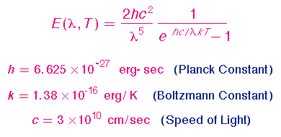
The Planck Law can be expressed through the following equation:

Slide 8

or
where B is the spectral radiance, T is the absolute temperature of the black body, k_{B} is the Boltzmann constant, h is the Planck constant, and c is the speed of light.
This is not the only way to express the law; expressing it in terms of wavenumber (see slide 20 for definition) rather than frequency or wavelength is also common.
Max Planck developed the law in 1900, originally with only empirically determined constants, and later showed that, expressed as an energy distribution, it is the unique stable distribution for radiation in thermodynamic equilibrium.

Slide 9
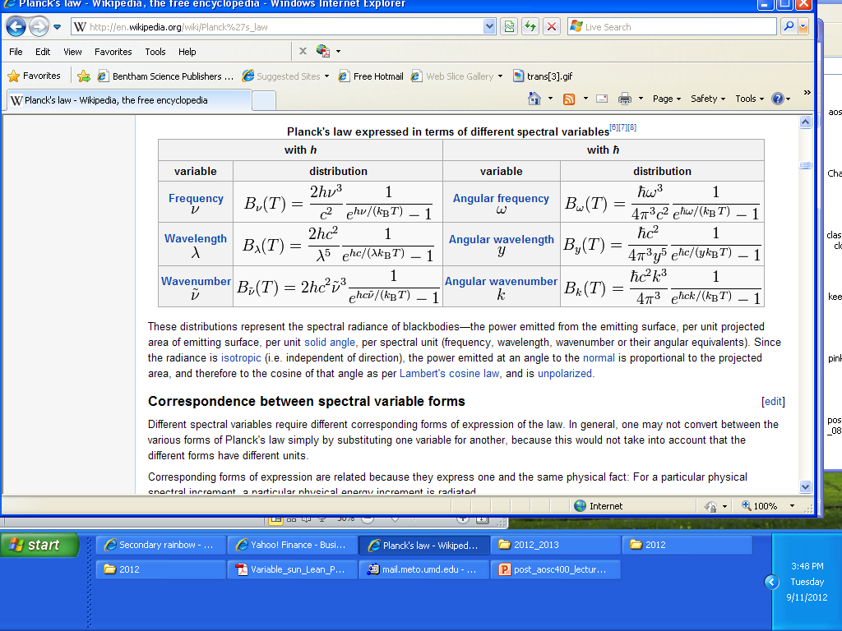
Planck's law expressed in terms of different spectral variables

Slide 10
The Wien and Stefan-Boltzmann Laws
The behavior of blackbody radiation is described by the Planck Law, but we can derive from the Planck Law two other radiation laws that are very useful. The Wien Displacement Law, and the Stefan-Boltzmann Law to be illustrated in the following equations.

Slide 11
The Wien displacement law
Temperature of the emitting body affects the wavelength of the maximal radiant energy emitted.
German physicist Wilhelm Wien won the 1911 Nobel Prize in physics for this discovery. Wien’s Law can be summarized as, the hotter an object, the shorter the wavelength of maximum emission of radiation.
Wavelength (µm) of max energy= 2900/object temp (K)
λ_{max}=2900/T

Slide 12
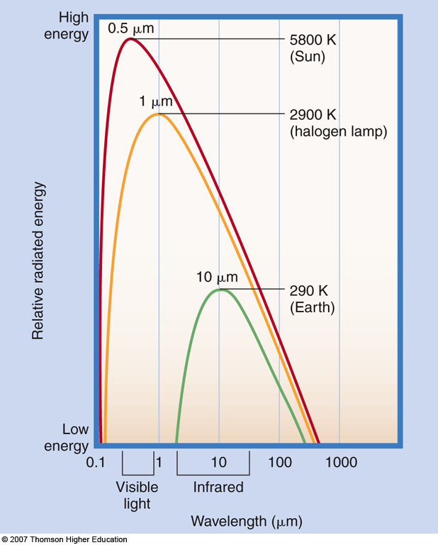
Wien’s Law
λ_{max}=2900/T

Slide 13
Stefan-Boltzman Law
Stefan-Boltzmann Law states that the amount of energy per square meter per second that is emitted by an object is related to the fourth power of its Kelvin temperature: E~T⁴
Therefore, a warmer object emits significantly more radiation than a cooler object- the Sun emits more energy than the Earth.
Note: Sir William Herschel discovered the infrared portion of the spectrum when he placed thermometers above the red portion of a projected spectrum.

Slide 14
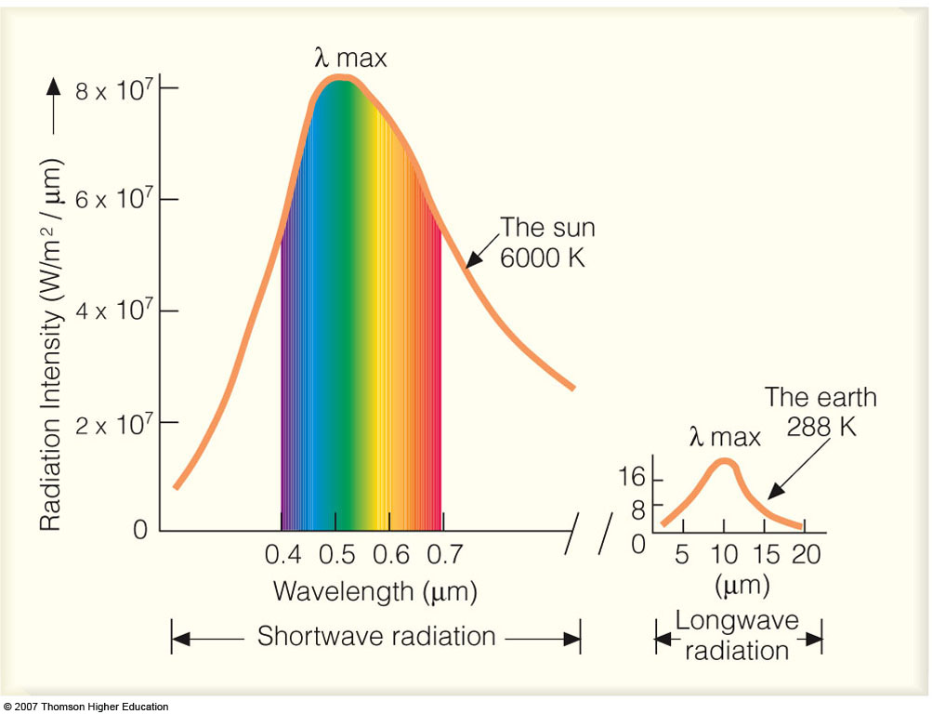
Implications of the Stefan-Boltzmann Law:
Since the temperature of the sun is much higher than the temperature of the Earth, the amount of energy emitted from the Earth is much less when compared to that from the sun.

Slide 15
The earth emits radiation called terrestrial or long wave radiation which is less energetic than solar radiation and therefore characterized by longer wavelengths (similar message as previous slide)

Slide 16
The Wien Law gives the wavelength of the peak of the radiation distribution, while the
Stefan-Boltzmann Law gives the total energy being emitted at all wavelengths by the blackbody (which is the area under the Planck Law curve). Thus, the Wien Law
explains the shift of the peak to shorter wavelengths as the temperature increases,
while the Stefan-Boltzmann Law explains the growth in the height of the curve as the
temperature increases.

Slide 17
a) The Planck function, or blackbody radiation curve; (b) Wien’s law; (c) the Stefan–Boltzmann law

Slide 18
Assumptions for formulating a simple radiation balance climate model: SW and LW fluxes balance each other

Slide 19
SIMPLE GLOBAL RADIATIVE EQUILIBRIUM MODEL
Can evaluate the global radiative equilibrium temperature from the balance of the incoming solar flux and outgoing thermal infrared flux:
R = Global Albedo
S =Solar Constant
a = Radius of the Earth
T = Temperature
σ= Stephan-Boltzman Constant
Over a long period of time the energy absorbed and emitted balance each other so that equilibrium temperature is maintained.

Slide 20
Stefan-Boltzmann Law states that total energy per square meter per second that is emitted by an object is related to the fourth power of its Kelvin temperature: E=σT⁴
From earth emitted:
E=σT⁴ x area of earth= E=σT⁴ x 4πr²
We can derive the equilibrium temperature T_{E} of Earth by requiring a balance between incoming solar (SW) and outgoing longwave (LW) radiation.

Slide 21
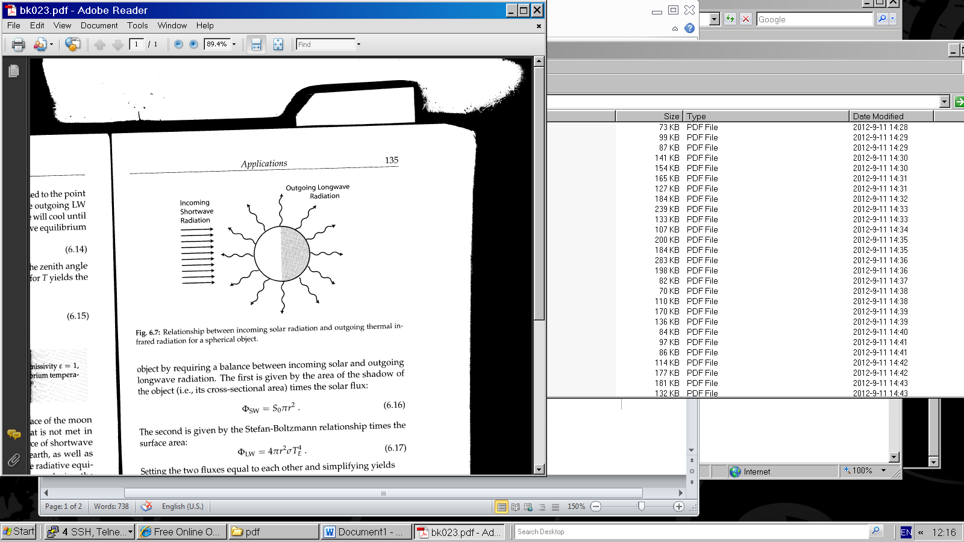
Relationship between incoming solar radiation and outgoing thermal infrared radiation for a spherical object.

Slide 22
The SW is given by the area of the shadow of the object (i.e., its cross-sectional area) times the solar flux:
πR² S₀
Part of the incoming SW is reflected back . If the albedo (capacity to reflect) is A:
Reflected part is: πR² S₀ xA
We subtract what comes down and what goes back:
πR² S₀-πR² S₀xA=πR² S₀(1-A)

Slide 23
The second is given by the Stefan-Boltzmann relationship times the surface area:
σT⁴ x 4πr²
Setting the two fluxes equal to each other yields
4πR²σT⁴ ⁼ πR² S₀(1-A)
Solve for T:
Average Temperature of Earth -18⁰ C

Slide 24
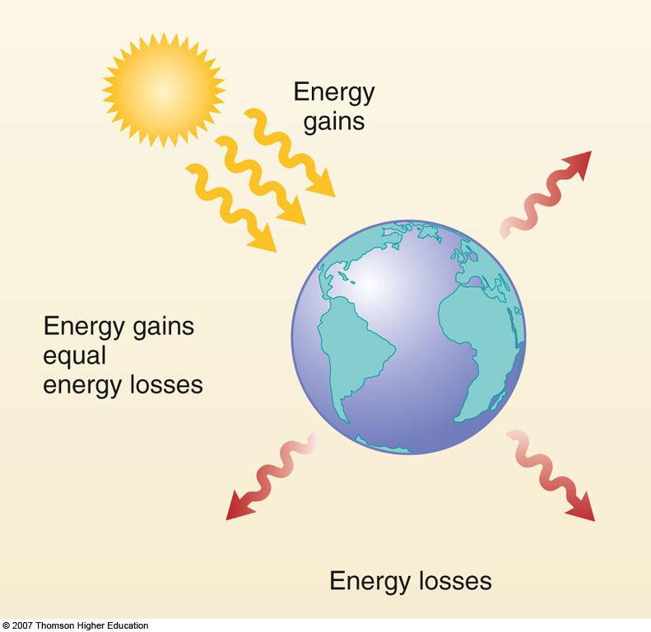
Basic Climate Model
This model yields an average earth temperature
of -18⁰ C ; Actual value is 15⁰ C.

Slide 25
The reason that the actual average Earth temperature is
about 15⁰ C is due to the role of Atmospheric Greenhouse Gases

Slide 26
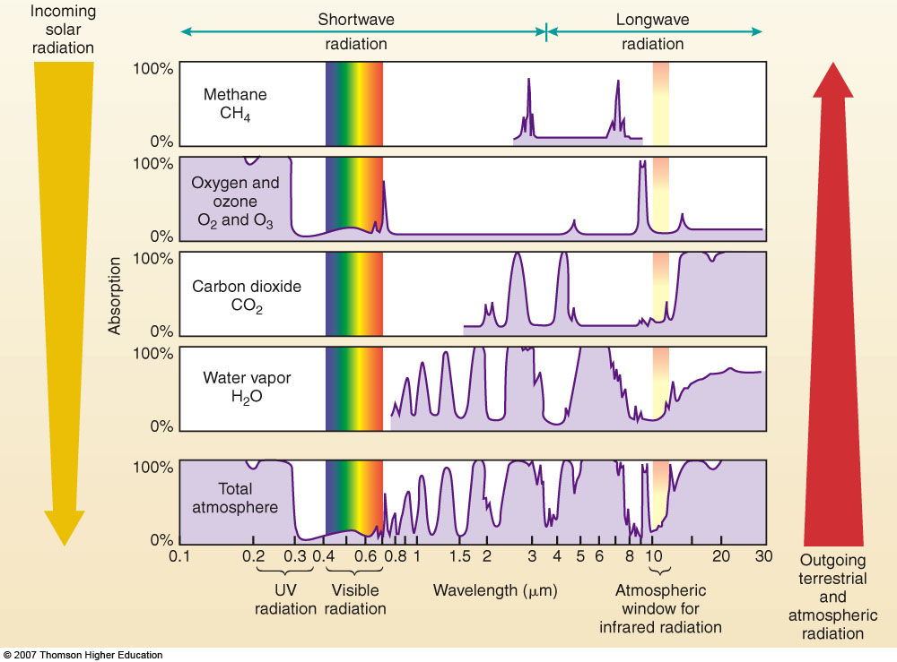
Properties of the atmosphere

Slide 27
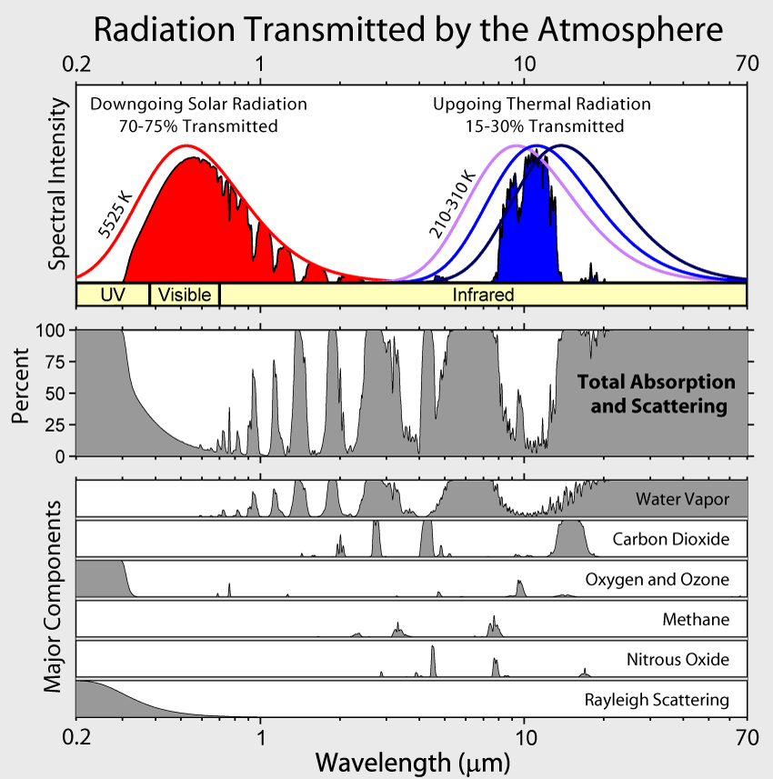
Transformation of radiation that reaches the earth, the Red line indicates radiation that reaches the outer atmosphere, whereas the painted red area is the radiation as it reaches the surface, Aerosols can lower this even more.

Slide 28
Absorption of 100% - no radiation penetrates the atmosphere. The large absorption beyond 13 μm is caused by CO₂ and H₂O. Both gases also absorb solar radiation in the near infrared (wavelengths between about 0.7 and 5 μm). The absorption at 9.6 μm is caused by ozone.

Slide 29
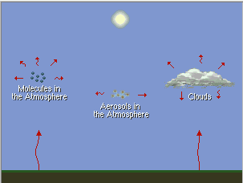
Re-emission of Infrared Radiation

Slide 30
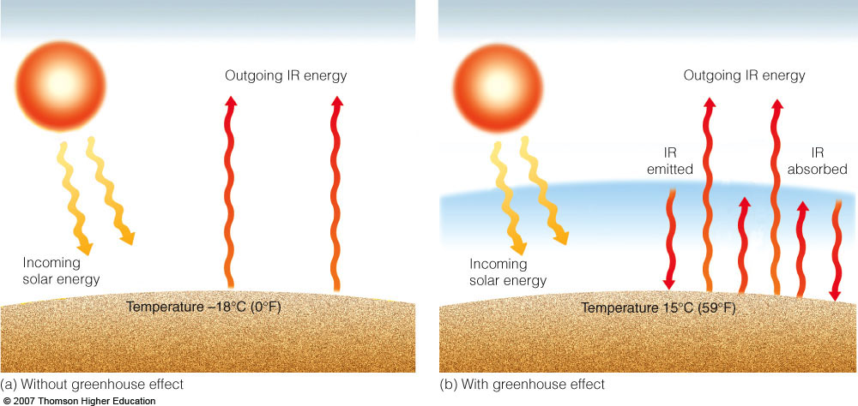
“The Greenhouse Effect”
T_{e}=[(1-r)S/4σ]^{1/4;} Actual value of T_{e} is 15⁰ C.

Slide 31
What drives climate to change? - “radiative forcing”: A small change in the energy balance of the earth can change surface temperatures, winds, precipitation patterns => its climate

Slide 32
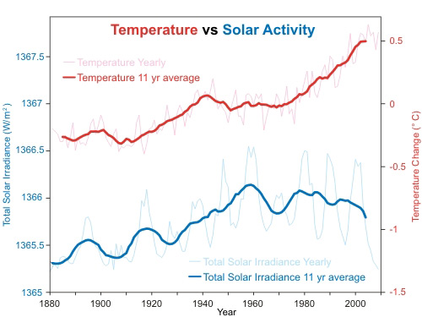
nnual global temperature change (thin light red) with 11 year moving average of temperature (thick dark red). Temperature from NASA GISS. Annual Total Solar Irradiance (thin light blue) with 11 year moving average of TSI (thick dark blue). TSI from 1880 to 1978 from Krivova et al 2007 (data). TSI from 1979 to 2009 from PMOD (see the PMOD index page for data updates).

Slide 33
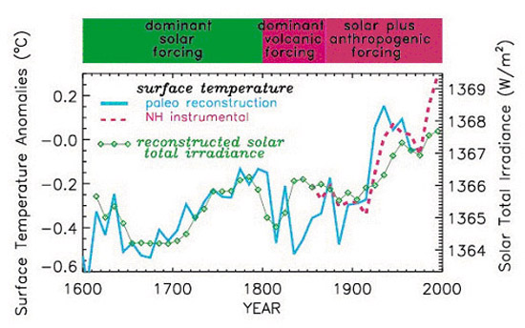

Slide 34
Direct normal (I_{on}) and horizontal (I_{o}) irradiance
SUN
ZENITH
Ion depends on the sun-earth distance.
The solar constant S is the value of I_{on} _{for mean solar distance.}
If we want always to use S instead of measuring I_{on}
_{we need to make adjustment} to the actual distance from the sun.
NORMAL
IRRADIANCE I_{on}
θ_{z}
HORIZONTAL
SURFACE
EARTH

Slide 35
Will explain how to derive each term in equation:
E=I_{on}cosθ_{z}/r²
I_{on} = S x (r₀/r)²
S is the solar constant which is the same as I_{on} but measured at mean sun-earth distance
Since I_{on} is the actual amount of radiation received outside the atmosphere perpendicular to sun’s rays, need to correct for actual distance, namely, multiply by (r₀/r)²

Slide 36
Reference Unit of Energy from the Sun
Solar Constant – S₀ is the irradiance of solar energy received on a surface exposed normal to sun’s rays (the I0n in previous slide) when the distance represent a mean value of the Earth-Sun distance and in absence of atmosphere
S₀ = 1372 W/m²
Watts per square meter
Note: Read the posted paper on: Living with a variable sun.

Slide 37
E₀ = (r₀/r)² = 1.000110+0.034221cosΓ+
0.001280sinΓ+0.000719cos2Γ+
0.000077sin2Γ
Here Γ is in radians and known as the day angle and equals:
Γ = 2π (d_{n}-1)/365
d_{n} is the day number of the year ranging from 1 on January 1 to 365 on December 31.
For engineering application:
E₀ = (r₀/r)2 = 1+0.033cos[(2Πd_{n}/365)]
E₀ is known as the earth-sun distance correction factor.

Slide 38
The next step is to understand how to compute the angle θ_{z}
Intuitively, this angle depends on where on earth we are (latitude), what is the time of the day (measured in hour angles) and the season of the year (declination). Namely, the following parameters:
φ – latitude
Ω - hour angle (the hourly distance from solar noon expressed in units of angles)
δ - declination
Each will be discussed in detail.

Slide 39
The amount of solar energy received at the surface depends on how high in the sky the sun is (not what is the local time). This is determined buy the “Solar Time”. Will explain the differences:
Solar Time = time based on the apparent angular motion of the sun across the sky, with solar noon the time the sun crosses the meridian of the observer.
It is necessary to convert standard time to solar time by applying two corrections:
First-a constant correction for the difference in longitude between the observer’s meridian and the meridian on which the local standard time is based. The sun takes 4 minutes to transverse 1⁰ longitude.

Slide 40
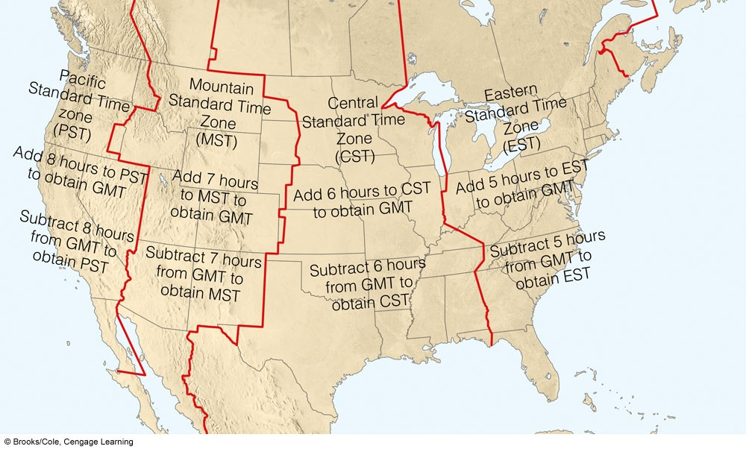
Time zones
In each time zone the local time is the same but the sun is not at highest position
at the same local time

Slide 41
Second correction-equation of time. Takes into account the perturbation in the earth rate of rotation which affect the time the sun crosses the observer’s meridian. Solar time is:
Solar time = standard time + 4(L_{st} – L_{loc}) + E
L_{st} is the standard meridian for local time zone
L_{loc} is the longitude of the location in degrees west
E = (0.000075+0.001868cosΓ-0.032077sinΓ-0.014615cos2Γ-0.04089sin2Γ) (229.18)
The number 229.18 converts radians into minutes. Γ = 2π(d_{n}-1)/365

Slide 42
The Seasons
Mean sun-earth distance is one astronomical unit: 1 AU=1.496x108 km
Declination (δ)-angle
between line
joining centers of sun
and earth to
equatorial plane
δ =0 at vernal and
autumnal equinoxes
δ =23.5 at summer solstice
δ =-23.5 at winter solstice

Slide 43
Declination
The plane of revolution of the earth around the sun is called the ecliptic plane.
The earth rotates around an axis called the polar axis which is inclined approximately 23.5⁰ from the normal to the ecliptic plane.
Earth’s rotation around its axis causes diurnal changes; the position of this axis relative to the sun causes seasonal changes in solar radiation.

Slide 44
The angle between a line joining the centers of the sun and the earth to the equatorial plane changes every day-the solar declination. It is zero at vernal and autumnal equinoxes and has a value of 23.5⁰ at summer solstice and – 23.5⁰ in winter solstice.
δ = (0.006918-0.399912cosΓ-
0.070257sinΓ-0.006758cos2Γ-
0.000907sin2Γ-0.002697cos3Γ-
0.00148sin3Γ)(180/π)

Slide 45
How to compute the solar zenith angle
cosθ_{z} = sin(δ)sin(φ)+ cos(δ)cos(φ) cos(ω)
φ – latitude
δ - declination
Ω - hour angle
Solar time = standard time + E + 4 ( L_{st} – L _{loc})
E - equation in time in minutes
L_{st} - standard meridian for local time zone
L _{loc} - longitude of location in degrees west
Handouts provided with examples

Slide 46
Annual Average Surface Downward Shortwave
Top of atm: ~1400W/m²
Albedo effect: 700W/m ²
Due to day/night cycle:
350W/m²
^{average per day}

Slide 47
How to compute the solar zenith angle
cosθ_{z} = sin(δ)sin(φ)+ cos(δ)cos(φ) cos(ω)
φ – latitude
δ - declination
Ω - hour angle
Solar time = standard time + E + 4 ( L_{st} – L _{loc})
E - equation in time in minutes
L_{st} - standard meridian for local time zone
L _{loc} - longitude of location in degrees west

Slide 48
Reference Unit of Energy from the Sun
Solar Constant – S₀ is the irradiance of solar energy received on a surface exposed normal to sun’s rays (the I₀n in previous slide) when the distance represent a mean value of the Earth-Sun distance and in absence of atmosphere
S₀ = 1372 W/m²
Watts per square meter
Note: Read the posted paper on: Living with a variable sun.

Slide 49
Direct normal (I_{on}) and horizontal (I_{o}) irradiance
SUN
ZENITH
Ion depends on the sun-earth distance.
The solar constant S is the value of I_{on} _{for mean solar distance.}
If we want always to use S instead of measuring I_{on}
_{we need to make adjustment} to the actual distance from the sun.
NORMAL
IRRADIANCE I_{on}
θ_{z}
HORIZONTAL
SURFACE
EARTH

Slide 50
Will explain how to derive each term in equation:
E=I_{on}cosθ_{z}/r²
I_{on} = S x (r₀/r)²
S is the solar constant which is the same as I_{on} but measured at mean sun-earth distance
Since I_{on} is the actual amount of radiation received outside the atmosphere perpendicular to sun’s rays, need to correct for actual distance, namely, multiply by (r₀/r)²

Slide 51
E₀ = (r₀/r)² = 1.000110+0.034221cosΓ+
0.001280sinΓ+0.000719cos2Γ+
0.000077sin2Γ
Here Γ is in radians and known as the day angle and equals:
Γ = 2π (d_{n}-1)/365
d_{n} is the day number of the year ranging from 1 on January 1 to 365 on December 31.
For engineering application:
E₀ = (r₀/r)2 = 1+0.033cos[(2Πd_{n}/365)]
E₀ is known as the earth-sun distance correction factor.

Slide 52
The next step is to understand how to compute the angle θ_{z}
Intuitively, this angle depends on where on earth we are (latitude), what is the time of the day (measured in hour angles) and the season of the year (declination). Namely, the following parameters:
φ – latitude
Ω - hour angle (the hourly distance from solar noon expressed in units of angles)
δ - declination
Each will be discussed in detail.

Slide 53
The amount of solar energy received at the surface depends on how high in the sky the sun is (not what is the local time). This is determined buy the “Solar Time”. Will explain the differences:
Solar Time = time based on the apparent angular motion of the sun across the sky, with solar noon the time the sun crosses the meridian of the observer.
It is necessary to convert standard time to solar time by applying two corrections:
First-a constant correction for the difference in longitude between the observer’s meridian and the meridian on which the local standard time is based. The sun takes 4 minutes to transverse 1⁰ longitude.

Slide 54
Time zones
In each time zone the local time is the same but the sun is not at highest position
at the same local time

Slide 55
Second correction-equation of time. Takes into account the perturbation in the earth rate of rotation which affect the time the sun crosses the observer’s meridian. Solar time is:
Solar time = standard time + 4(L_{st} – L_{loc}) + E
L_{st} is the standard meridian for local time zone
L_{loc} is the longitude of the location in degrees west
E = (0.000075+0.001868cosΓ-0.032077sinΓ-0.014615cos2Γ-0.04089sin2Γ) (229.18)
The number 229.18 converts radians into minutes. Γ = 2π(d_{n}-1)/365

Slide 56
The Seasons
Mean sun-earth distance is one astronomical unit: 1 AU=1.496x108 km
Declination (δ)-angle
between line
joining centers of sun
and earth to
equatorial plane
δ =0 at vernal and
autumnal equinoxes
δ =23.5 at summer solstice
δ =-23.5 at winter solstice

Slide 57
Declination
The plane of revolution of the earth around the sun is called the ecliptic plane.
The earth rotates around an axis called the polar axis which is inclined approximately 23.5⁰ from the normal to the ecliptic plane.
Earth’s rotation around its axis causes diurnal changes; the position of this axis relative to the sun causes seasonal changes in solar radiation.

Slide 58
The angle between a line joining the centers of the sun and the earth to the equatorial plane changes every day-the solar declination. It is zero at vernal and autumnal equinoxes and has a value of 23.5⁰ at summer solstice and – 23.5⁰ in winter solstice.
δ = (0.006918-0.399912cosΓ-
0.070257sinΓ-0.006758cos2Γ-
0.000907sin2Γ-0.002697cos3Γ-
0.00148sin3Γ)(180/π)

Slide 59
How to compute the solar zenith angle
cosθ_{z} = sin(δ)sin(φ)+ cos(δ)cos(φ) cos(ω)
φ – latitude
δ - declination
Ω - hour angle
Solar time = standard time + E + 4 ( L_{st} – L _{loc})
E - equation in time in minutes
L_{st} - standard meridian for local time zone
L _{loc} - longitude of location in degrees west
Handouts provided with examples

Slide 60
Assumptions for formulating a simple radiation balance climate model: SW and LW fluxes balance each other

Slide 61
SIMPLE GLOBAL RADIATIVE EQUILIBRIUM MODEL
Can evaluate the global radiative equilibrium temperature from the balance of the incoming solar flux and outgoing thermal infrared flux:
R = Global Albedo
S =Solar Constant
a = Radius of the Earth
T = Temperature
σ= Stephan-Boltzman Constant
Over a long period of time the energy absorbed and emitted balance each other so that equilibrium temperature is maintained.

Slide 62
Stefan-Boltzmann Law states that total energy per square meter per second that is emitted by an object is related to the fourth power of its Kelvin temperature: E=σT⁴
From earth emitted:
E=σT⁴ x area of earth= E=σT⁴ x 4πr²
We can derive the equilibrium temperature T_{E} of Earth by requiring a balance between incoming solar (SW) and outgoing longwave (LW) radiation.

Slide 63
Relationship between incoming solar radiation and outgoing thermal infrared radiation for a spherical object.

Slide 64
The SW is given by the area of the shadow of the object (i.e., its cross-sectional area) times the solar flux:
πR² S₀
Part of the incoming SW is reflected back . If the albedo (capacity to reflect) is A:
Reflected part is: πR² S₀ xA
We subtract what comes down and what goes back:
πR² S₀-πR² S₀xA=πR² S₀(1-A)

Slide 65
The second is given by the Stefan-Boltzmann relationship times the surface area:
σT⁴ x 4πr²
Setting the two fluxes equal to each other yields
4πR²σT⁴ ⁼ πR² S₀(1-A)
Solve for T:
Average Temperature of Earth -18⁰ C

Slide 66
Basic Climate Model
This model yields an average earth temperature
of -18⁰ C ; Actual value is 15⁰ C.

