Slide 2
Homosphere
the lower of two divisions of the earth's atmosphere, extending to a height of c. 70 km (c. 43 mi), characterized by a relatively constant composition of its component gases

Slide 3
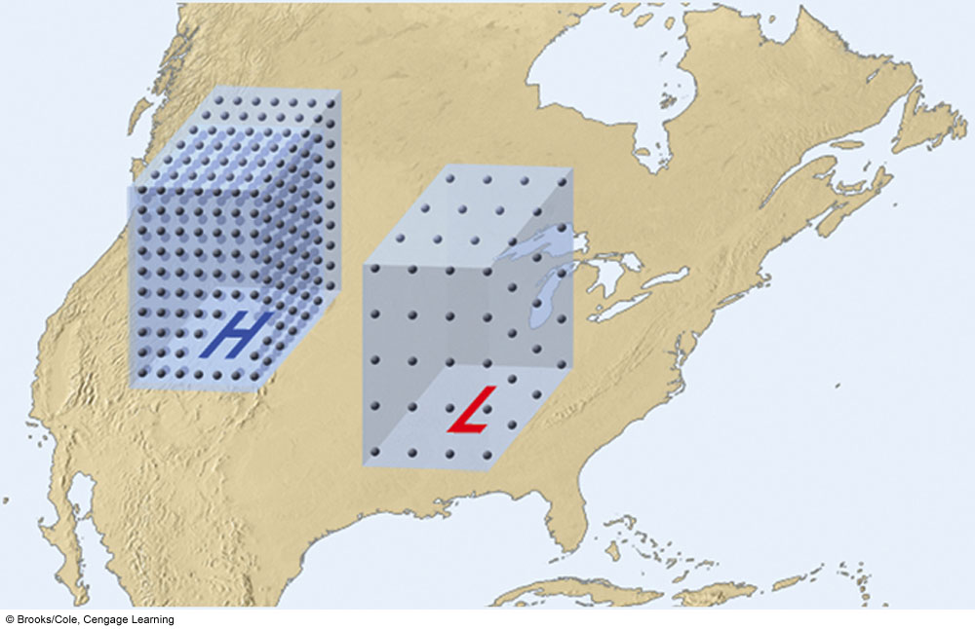
Air above a region of surface high pressure is more dense than air above
a region of surface low pressure (at the same temperature).

Slide 4
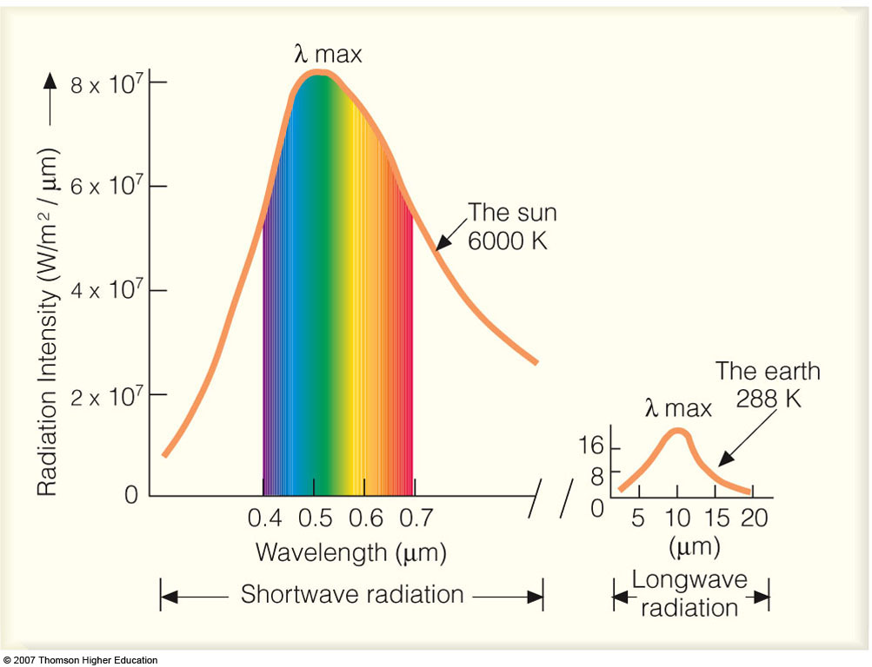
The visible spectrum

Slide 5
Electromagnetic waves can be described by their wavelengths, energy, and frequency. All three describe a different property of light, yet they are related to each other mathematically. The unit used to describe the wavelength of light is the micrometer (μm)
1 micrometers (μm)=10⁻⁶ m
1 μm=1000 nm (nanometer)
1 nm= 10 A⁰ (Angstrom)

Slide 6
Review: Main layers of the atmosphere Troposphere, Stratosphere, Mesosphere, Thermosphere

Slide 7
Photoionization and the thermosphere
Radiation of λ < 0.1 μm is absorbed above 90 km where photoionization of N₂, O₂ and O give rise to E and F layers of the ionosphere.
The thin air at these levels is inefficient at disposing of energy by radiative transfer.
In order to maintain thermal equilibrium, temperature must increase with height rapidly enough so that random molecular motions can conduct heat down at the same rate as solar energy is absorbed at higher levels.

Slide 8
What is a Dobson Unit?
The Dobson Unit is the most common unit for measuring ozone concentration. One Dobson Unit is he number of molecules of ozone that would be required to create a layer of pure ozone 0.01 millimeters thick at a temperature of 0 degrees Celsius and a pressure of 1 atmosphere (the air pressure at the surface of the Earth). A column of air with an ozone concentration of 1 Dobson Unit would contain about 2.69x1016 ozone molecules for every square centimeter of area at the base of the column. Over the Earth’s surface, the ozone layer’s average thickness is about 300 Dobson Units or a layer that is 3 millimeters thick.

Slide 9
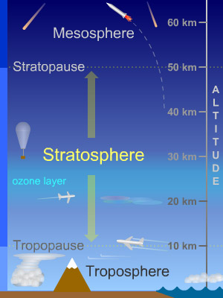
The Stratosphere
The stratosphere is a layer of Earth's atmosphere. The stratosphere is the second layer, as one moves upward from Earth's surface, of the atmosphere. The stratosphere is above the troposphere and below the mesosphere.
The top of the stratosphere occurs at 50 km (31 miles) altitude. The boundary between the stratosphere and the mesosphere above is called the stratopause. The altitude of the bottom of the stratosphere varies with latitude and with the seasons, occurring between about 8 and 16 km (5 and 10 miles, or 26,000 to 53,000 feet). The bottom of the stratosphere is around 16 km (10 miles or 53,000 feet) above Earth's surface near the equator, around 10 km (6 miles) at mid-latitudes, and around 8 km (5 miles) near the poles. It is slightly lower in winter at mid- and high-latitudes, and slightly higher in the summer. The boundary between the stratosphere and the troposphere below is called the tropopause.

Slide 10
Ozone, an unusual type of oxygen molecule that is relatively abundant in the stratosphere, heats this layer as it absorbs energy from incoming ultraviolet radiation from the Sun. Temperatures rise as one moves upward through the stratosphere. This is exactly the opposite of the behavior in the troposphere in which we live, where temperatures drop with increasing altitude. Because of this temperature stratification, there is little convection and mixing in the stratosphere, so the layers of air there are quite stable. Commercial jet aircraft fly in the lower stratosphere to avoid the turbulence which is common in the troposphere below.
The stratosphere is very dry; air there contains little water vapor. Because of this, few clouds are found in this layer; almost all clouds occur in the lower, more humid troposphere. Polar stratospheric clouds (PSCs) are the exception. PSCs appear in the lower stratosphere near the poles in winter. They are found at altitudes of 15 to 25 km (9.3 to 15.5 miles) and form only when temperatures at those heights dip below -78° C. They appear to help cause the formation of the infamous holes in the ozone layer by "encouraging" certain chemical reactions that destroy ozone. PSCs are also called nacreous clouds.

Slide 11
Air is roughly a thousand times thinner at the top of the stratosphere than it is at sea level. Because of this, jet aircraft and weather balloons reach their maximum operational altitudes within the stratosphere.
Due to the lack of vertical convection in the stratosphere, materials that get into the stratosphere can stay there for long times. Such is the case for the ozone-destroying chemicals called CFCs (chlorofluorocarbons). Large volcanic eruptions and major meteorite impacts can fling aerosol particles up into the stratosphere where they may linger for months or years, sometimes altering Earth's global climate. Rocket launches inject exhaust gases into the stratosphere, producing uncertain consequences.
Various types of waves and tides in the atmosphere influence the stratosphere. Some of these waves and tides carry energy from the troposphere upward into the stratosphere; others convey energy from the stratosphere up into the mesosphere. The waves and tides influence the flows of air in the stratosphere and can also cause regional heating of this layer of the atmosphere.
A rare type of electrical discharge, somewhat akin to lightning, occurs in the stratosphere. These "blue jets" appear above thunderstorms, and extend from the bottom of the stratosphere up to altitudes of 40 or 50 km (25 to 31 miles).

Slide 12
Origins of the Atmosphere
􀂉 When the Earth was formed 4.6 billion years ago, Earth’s atmosphere
was probably mostly hydrogen (H) and helium (He) plus hydrogen
compounds, such as methane (CH4) and ammonia (NH3).
􀃎 Those gases eventually escaped to the space.
􀂉 The release of gases from rock through volcanic eruption (so-called
outgassing) was the principal source of atmospheric gases.
􀃎 The primeval atmosphere produced by the outgassing was mostly
water vapor (H2O), with some Nitrogen (N2) and Carbon dioxide
(CO2), and trace amounts of other gases.

Slide 13
What Happened to H2O?
􀂉 The atmosphere can only hold
small fraction of the mass of
water vapor that has been
injected into it during volcanic
eruption, most of the water
vapor was condensed into
clouds and rains and gave rise to
rivers, lakes, and oceans.
􀃎 The concentration of water
vapor in the atmosphere was
substantially reduced.

Slide 14
Chemical weather is the primary
process to remove CO2 from the
atmosphere.
􀃎 In this process, CO2 dissolves in
rainwater producing weak
carbonic acid that reacts
chemically with bedrock and
produces carbonate compounds.
􀂉 This biogeochemical process
reduced CO2 in the atmosphere
and locked carbon in rocks and
mineral
What happened to CO2?

Slide 15
Where Did Argon Come from?
􀂉 Radioactive decay in the planet’s bedrock
added argon (Ar) to the evolving atmosphere.
􀃎 Argon became the third abundant gas in the
atmosphere.

Slide 17
Water Vapor (H2O)
􀂉 Water vapor is supplied to the atmosphere by evaporation from
the surface and is removed from the atmosphere by
condensation (clouds and rains).
􀂉 The concentration of water vapor is maximum near the surface
and the tropics (~ 0.25% of the atmosphere) and decreases
rapidly toward higher altitudes and latitudes (~ 0% of the
atmosphere).
􀂉 Water vapor is important to climate because it is a greenhouse
gas that can absorb thermal energy emitted by Earth, and can
release “latent heat” to fuel weather phenomena.

Slide 22
Temperature reported - measured at about 2 m level in a protected and ventilated shelter.

Slide 23
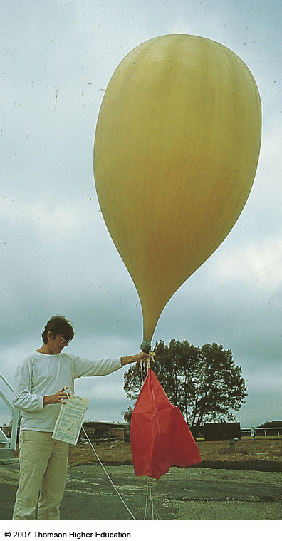
Radiosonde-measures temperature, humidity and wind at higher levels of the atmosphere

Slide 24
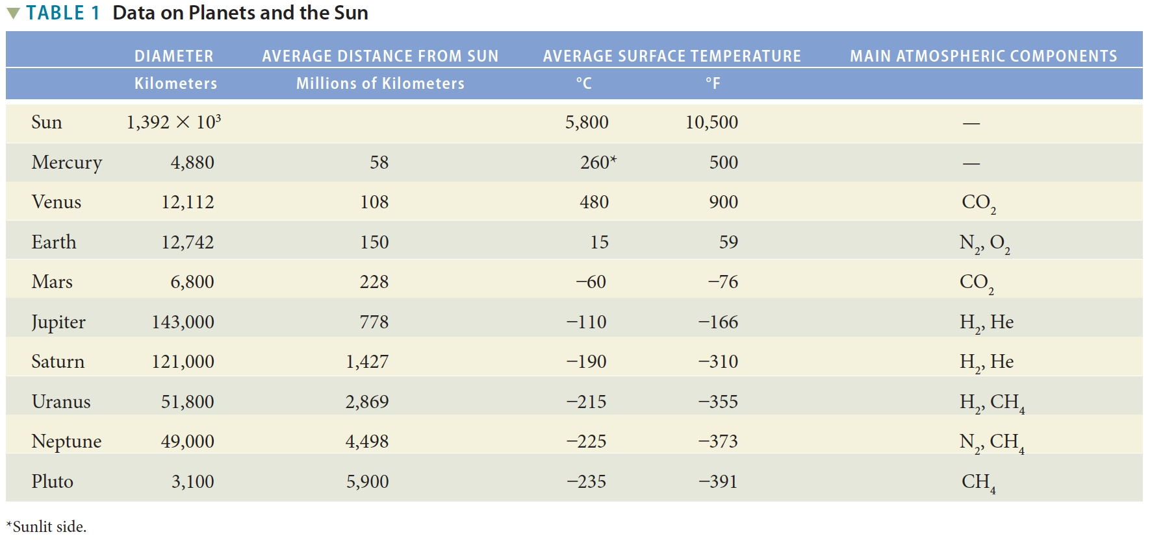
Table 1-1 p15

Slide 25
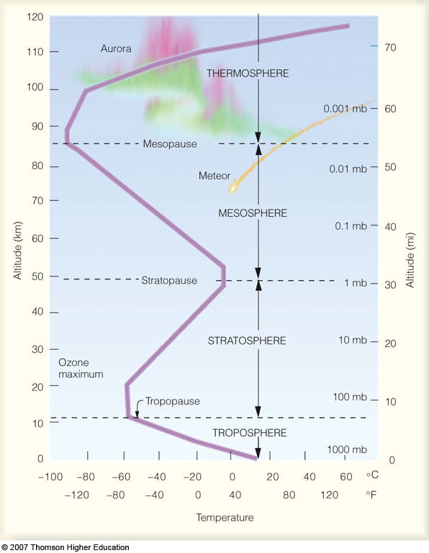
Pressure scale on the right side
Why the observed structure to temperature variability?

Slide 26
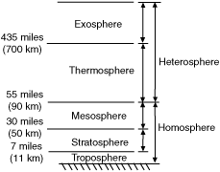
Homosphere-characterized by a relatively constant composition of its component gases; this part of the atmosphere circulates so that
the principal atmospheric gases are well mixed.
Heterosphere-dominated by lighter gases with increasing altitude, such
as hydrogen and helium.

Slide 27
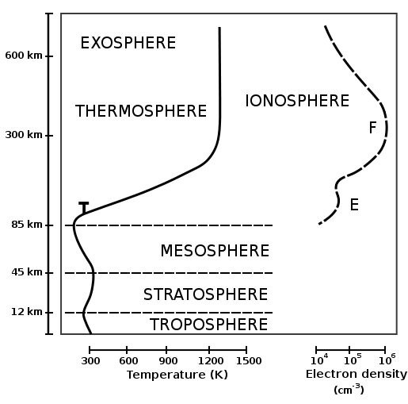
The ionosphere is a part of the upper atmosphere, comprising portions of the mesosphere, thermosphere and exosphere, distinguished because it is ionized by solar radiation. It plays an important part in atmospheric electricity. It has practical importance because, among other functions, it influences radio propagation to distant places on the Earth.

Slide 28
Regions of the Ionosphere
The ionosphere is broken down into the D, E and F regions. The breakdown is based on what wavelength of solar radiation is absorbed in that region most frequently. The D region is the lowest in altitude, though it absorbs the most energetic radiation, hard x-rays. The D region doesn't have a definite starting and stopping point, but includes the ionization that occurs below about 90 km.
The E region peaks at about 105 km. It absorbs soft x-rays.
The F region starts around 105 km and has a maximum around 600 km. It is the highest of all of the regions. Extreme ultra-violet radiation (EUV) is absorbed there.
On a more practical note, the D and E regions reflect AM radio waves back to Earth. Radio waves with shorter lengths are reflected by the F region. Visible light, television and FM wavelengths are all too short to be reflected by the ionosphere. TV stations are made possible by satellite transmissions.

Slide 29
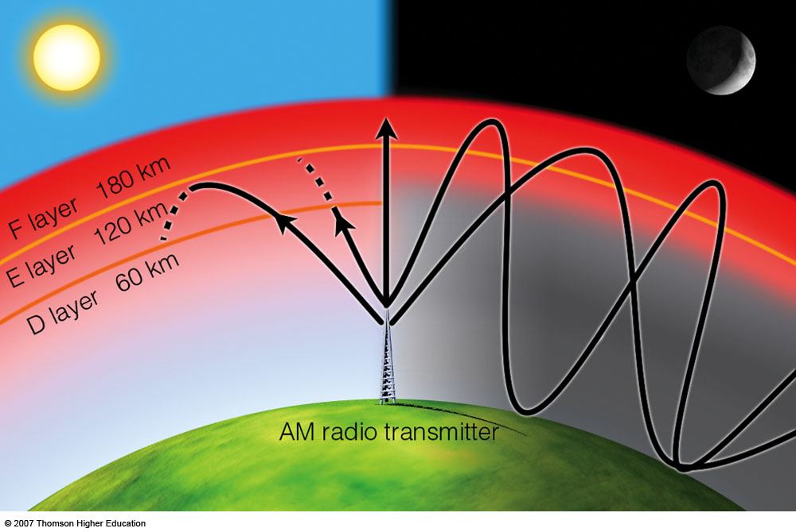
For 0.1 < λ < μm, radiation is absorbed above 90 km where photoionization
of N₂, O₂ and O give rise to E and F layers of the ionosphere.
The reaction is described as: O₂ + hν = 2O
The atomic oxygen produced in this reaction is a major atmospheric constituent at levels above 100 km.

Slide 30
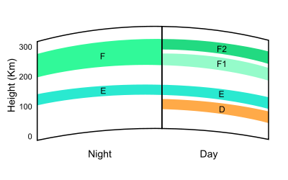
Photoionization - The physical process in which an incident photon ejects one or more electrons from an atom, ion or molecule. Ionosphere absorbs cosmic rays, gamma rays, X-rays, some UV rays
Ultraviolet (UV), X-Ray and shorter wavelengths of solar radiation are ionizing, since photons at these
frequencies contain sufficient energy to dislodge an electron from a neutral gas atom or molecule upon absorption.

Slide 31
Radio propagation is affected by the daily changes of water vapor in the troposphere and ionization in the upper atmosphere, due to the Sun.
Since radio propagation is not fully predictable, such services as emergency locator transmitters, in-flight communication with ocean-crossing aircraft, and some television broadcasting have been moved to communications satellites. A satellite link, can offer highly predictable and stable line of sight coverage of a given area.

Slide 32
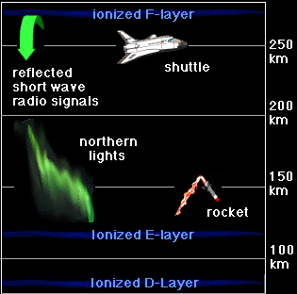
Another look at the ionosphere

Slide 33
Weather Maps
Many variables are needed to described weather conditions.
We need to see all the numbers describing weathers at many locations - weather maps.

Slide 34
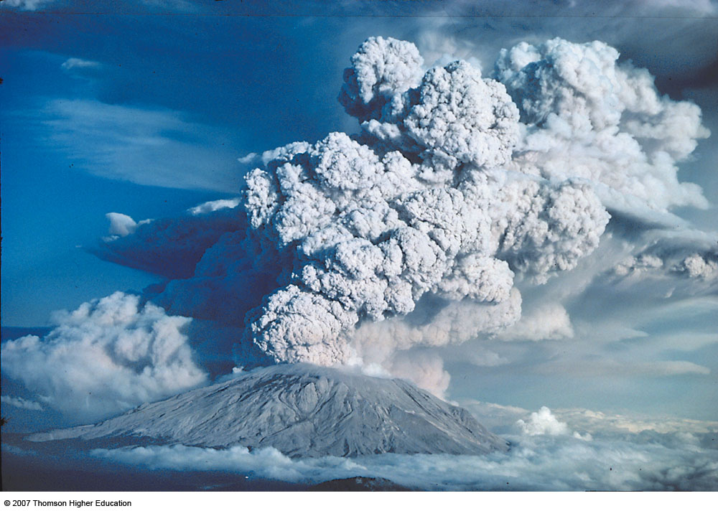
Volcanic eruptions

Slide 35
A photon of UV "light" hits an oxygen molecule. The energy from the photon breaks the molecule apart. It becomes two separate oxygen atoms. Photodissociation happens a lot in Earth's atmosphere (e.g., photodissociation of Molecular Nitrogen, N₂ )

Slide 36
Oxygen is highly reactive, so even at lower levels where it is a trace constituent, it plays a vital role in a large number of chemical reactions.
Of particular importance:
O₂ + O + M = O₃ + M
the dominant mechanism for the production of ozone (M - a third molecule required to carry away the excess energy released in the reaction)

Slide 37
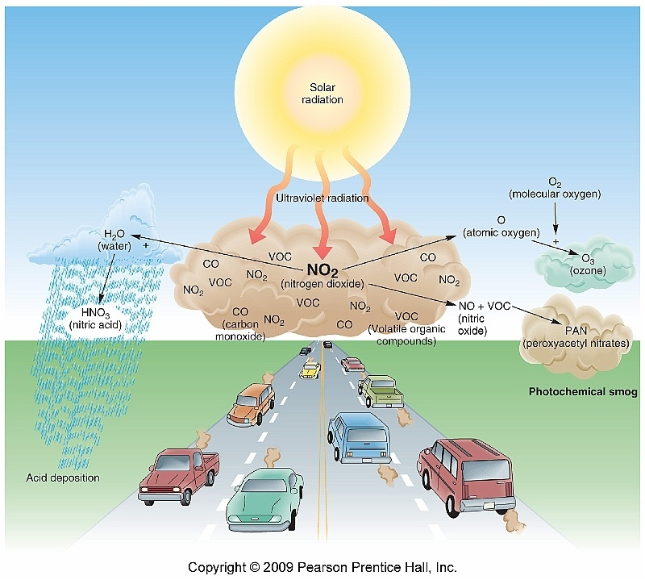

Slide 38
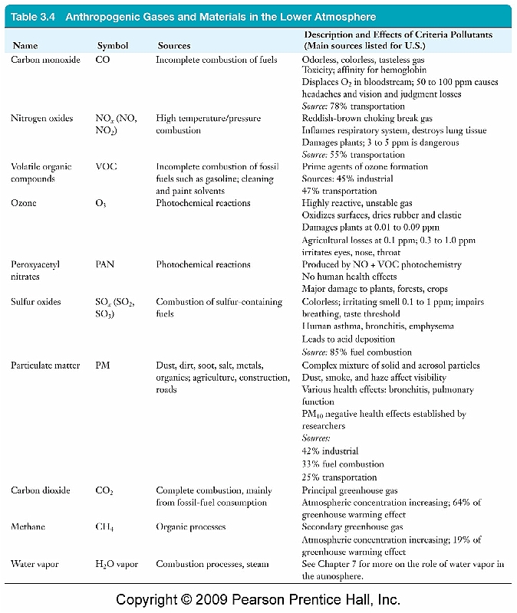
In what follows will focus on ozone and CO₂

Slide 39
Origin of the atmosphere
The atmosphere of today-believed to have come from expulsion of volatile substances from the interior associated with volcanic activity.
The atmosphere is a component of a coupled system: hydrosphere (water substances on or above the surface); biosphere; lithosphere (earth’s crust)
Total mass of volatile material contained in this coupled system is 0.025% of the mass of the earth.
Prevailing belief:
Atmosphere of earth, deficient in noble gases (helium, neon, argon, xenon, krypton)
Either earth formed in a way that systematically excluded these gases, or:
Gaseous materials were lost soon after the earth formed (4.5x10⁹ years ago)

