Slide 2
Chase the Rainbow
Matt Evans, 8, runs through the fountain at Georgetown Waterfront Park. Friday was humid with a high close to 90 degrees. It will be similar on Saturday until a cold front brings the possibility of severe storms in the late afternoon and evening.
09/08/2012 (Washington Post)

Slide 3
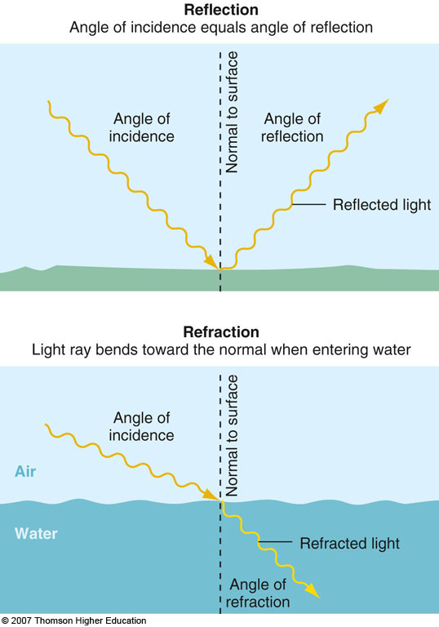

Slide 4
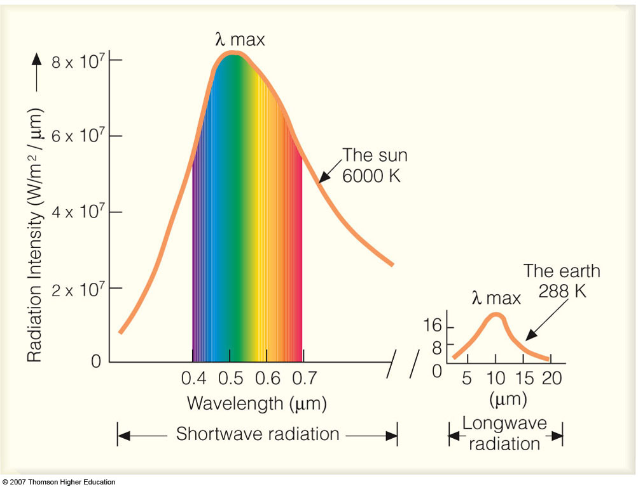
The visible spectrum
Sir Isaac Newton used a prism to split sunlight into its fundamental colors of the rainbow.

Slide 5
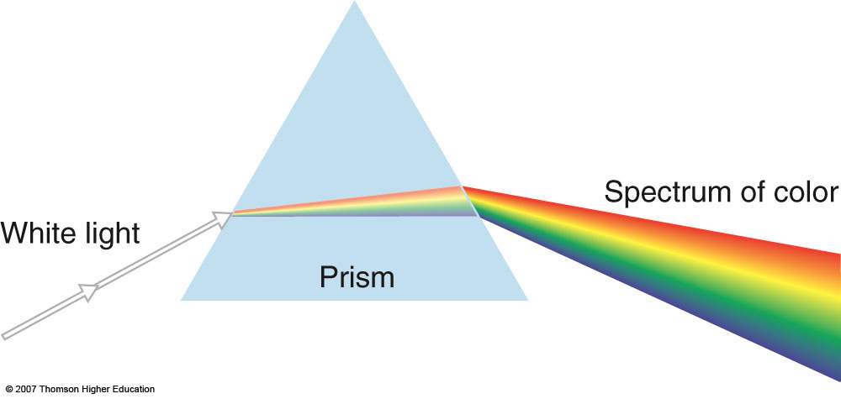
Each wavelength is refracted differently

Slide 6
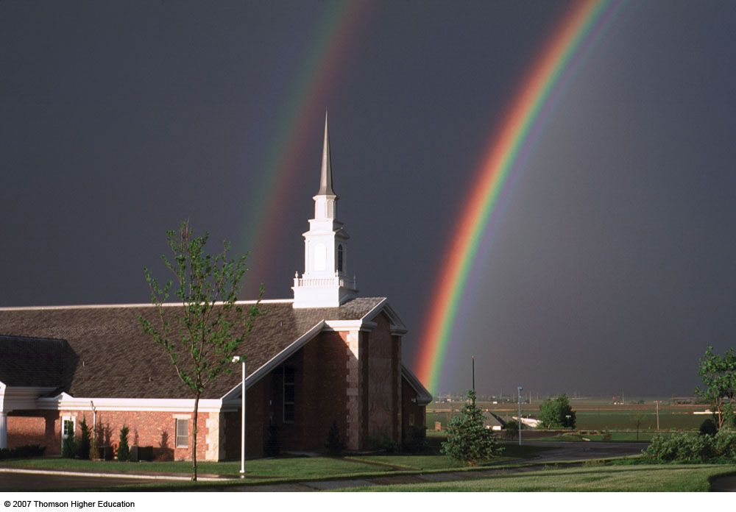
Example of the concepts of refraction and reflection: The Rainbow
Rainbows result from refraction of sunlight in falling water droplets plus reflection of the light from the back of the droplet.

Slide 7
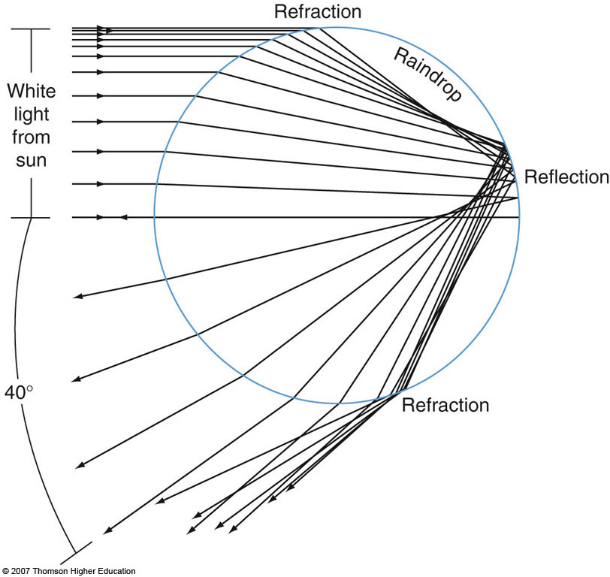
Principle of rainbow formation

Slide 8
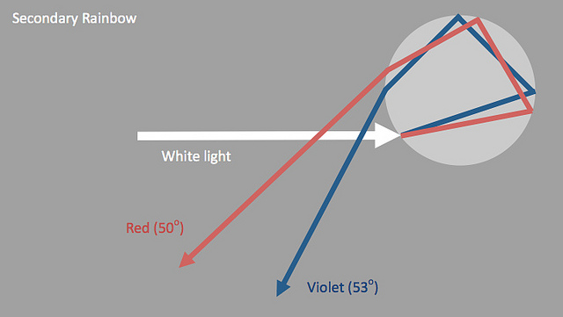
Light can be reflected more than once inside a raindrop. Rays escaping after two reflections make a secondary bow

Slide 9
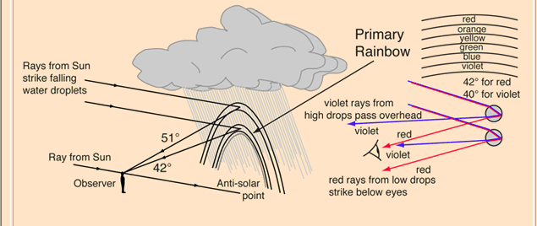
More details on rainbow formation:
The primary rainbow forms between about 40° and 42° from the anti-solar point. The light path involves refraction and a single reflection inside the water droplet. If the drops are large, 1 millimeter or more in diameter, red, green, and violet are bright but there is little blue.

Slide 10
Rainbows are not seen in midday since the whole 42° circle is below the horizon at most latitudes. So rainbows tend to be seen most in the later afternoon when a thundershower has passed and the sun from the west is illuminating the receding edge of an eastwardly moving raincloud. It is possible to see the entire circle of the rainbow from an airplane since there can be falling droplets both above and below you.

Slide 11
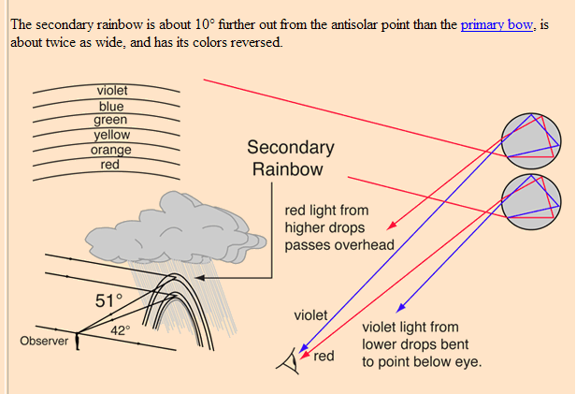
More details on secondary rainbow:

Slide 12
Light playing on water drops, dust or ice crystals in the atmosphere produces a host of visual spectacles - rainbows, halos, glories, coronas and many more. Some can be seen almost every day or so, some are once in a lifetime sights. Find out where to see them and how they are formed. Then seek and enjoy them outdoors.
Dust, small aerosols and moisture droplets scatter light to make the sun's rays visible and cloud and mountain shadowed air dark by comparison. Air and very small particles scatter colours selectively to paint the blues of skies and fires of sunsets. Air at varied temperatures and densities refracts the rays of setting suns and moons to fashion fantastic shapes and green flashes. Perspective generates apparent glows around shadows even on the airless Moon.

Slide 13
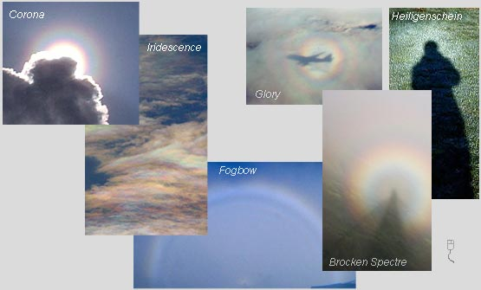

Slide 14
Haloes
his section covers the optical effects caused by ice crystals. For those living in temperate latitudes displays are usually limited to cirrus clouds. Displays showing all the phenomena are rare because it needs a very large area of sky to be covered in ice crystals with the right optical properties. The most spectacular displays are usually seen from very cold climates when the ice crystals surround the observer.
Because some effects are often only visible in a single patch of cirrus they may last for just a few minutes and are easily missed. The key is knowing what to look for and checking the sky whenever possible.

Slide 15
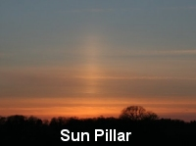
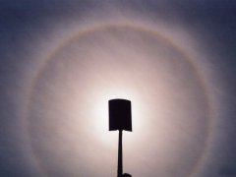
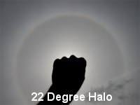
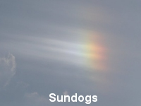
Corona around the sun.
The central blindingly bright disk fringed with red is the aureole. Two rings surround it. The rings in this corona are slightly off centre because of a gradation in droplets sizes in the cloud.
Imaged by Richard Fleet (Glows, Bows & Haloes) in Wiltshire, England during the summer of 2003.

Slide 16
A corona may be seen when thin clouds partially veil the sun or moon. Look for one around the moon when it is near to full and the sky is dark. When searching for a solar corona, shield the sun and reduce the light intensity to safer levels by looking at the sky reflected in a pool of water or a mirror of plain glass. Staring directly at or near to the sun can permanently damage eyesight.
Coronae have an intensely bright central aureole which is almost white and fringed with yellows and reds. Sometimes that is all to be seen but the better coronas have one or more successively fainter and gently coloured soft rings surrounding the aureole. The first ring is bluish on the inside grading through greens and yellows to red outermost. The colours are subtle mixtures rather than the more direct hues of the rainbow. The corona can be 15º or so in diameter and often it shrinks and swells as different clouds scud across the moon.
The coronae is much smaller than the 22° halo which can also ring the sun and moon. The corona also has nothing to do with the Sun's outer atmosphere visible during a total eclipse and confusingly given the same name.
Coronae are produced by the diffraction of light by tiny cloud droplets or sometimes small ice crystals.

