Slide 1
AOSC400-2015
October 1, Lecture # 9
How is the Beer’s Law used?
To study atmospheric transmissivity
To study the impact of aerosols
Introduction to AERONET
Rayleigh scattering
Copyright@2015 University of Maryland
This material may not be reproduced or redistributed, in whole or in part, without written permission of Rachel T. Pinker

Slide 2
Review Beer’s Law:

Slide 4
Assume, above term is zero (no emission or scattering contribution).
where k_{λ}: mass absorption cross section/absorption coefficient
If the medium is homogeneous and k is independent of distance:
Beer’s Law
determines attenuation of radiant energy by scattering and/or absorption passing through atmosphere.

Slide 5
T_{λ}

Slide 6
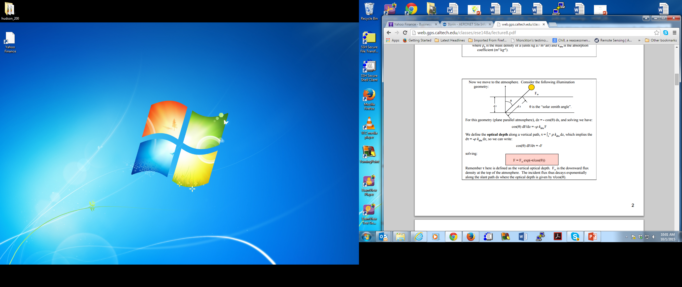
dF = -ρ k F ds
The incident flux thus decays exponentially along the slant path ds where the optical depth is given by τ/cos(θ).

Slide 7
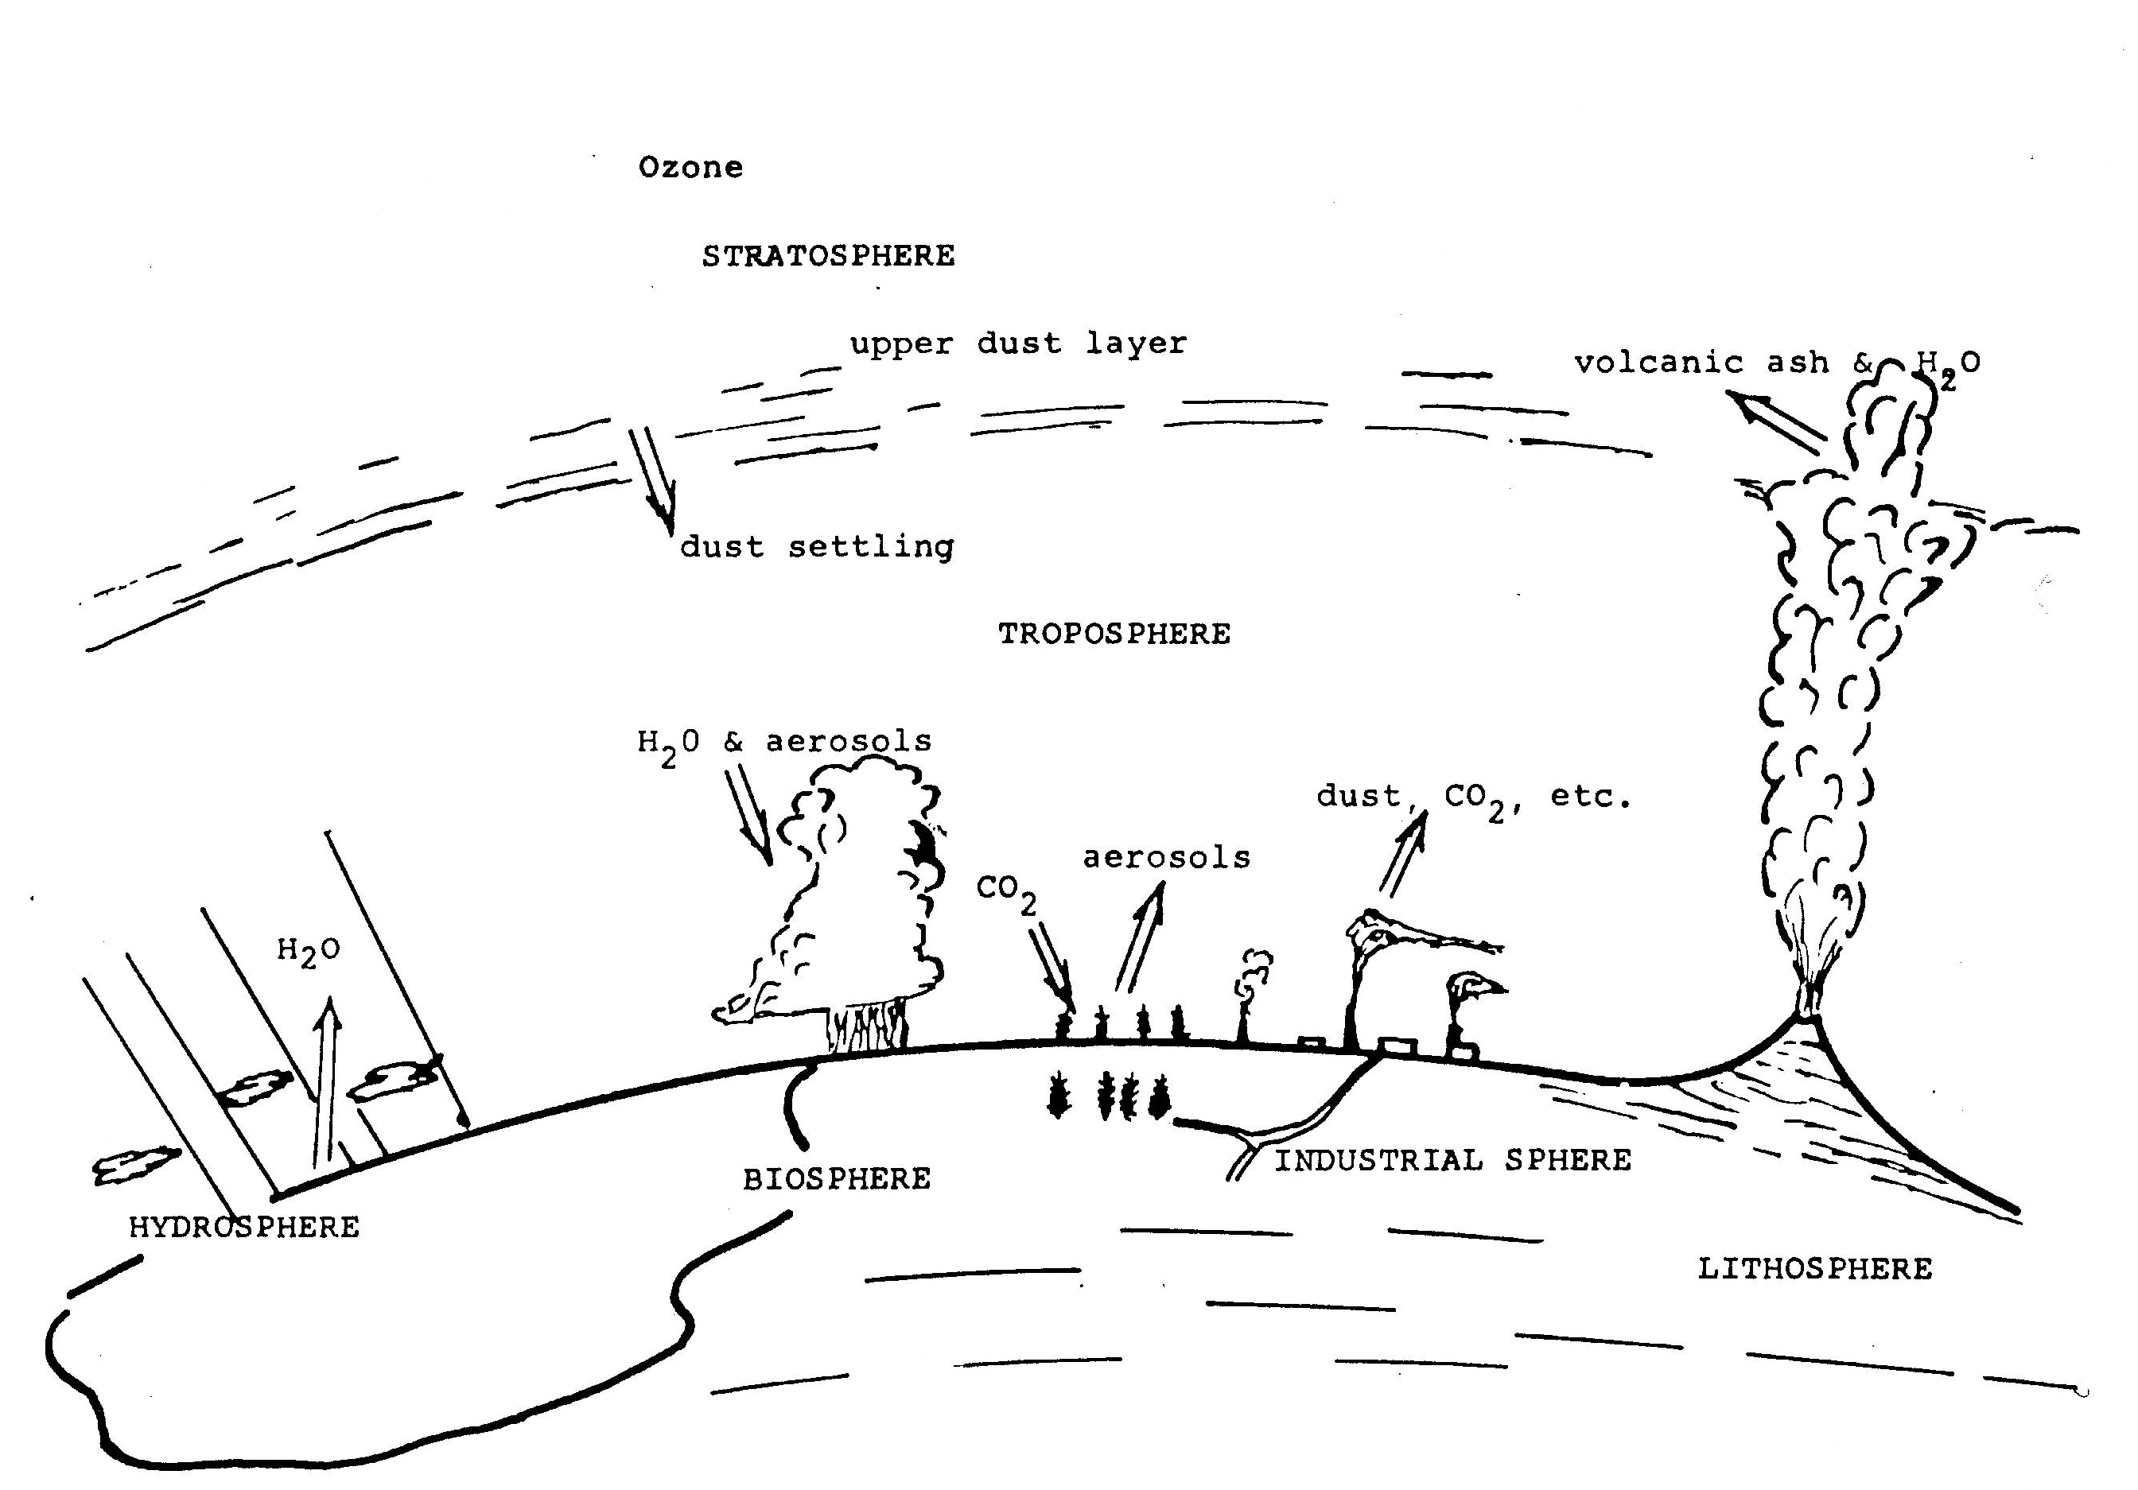
What is in the atmosphere that affects the transfer of radiation?
Possible processes: Absorption, reflection, scattering

Slide 8
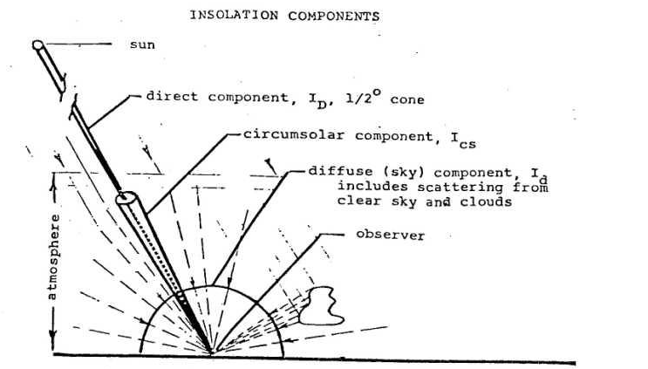
Insolation Components

Slide 9
Pandithurai G., R. T. Pinker, T. Takamura and P. C. S. Devara, 2004. Aerosol Radiative Forcing over a Tropical Urban Site in India (GRL, 2004)

Slide 10
Langley Plots
Objective:
Determine extraterrestrial radiation
Calibration of sun-photometers
Effective path length of the air mass = u sec θ₀
θ₀ = solar zenith angle; z₁ is the height of the station

Slide 11
Langley plot
Effective path length of the air mass = u sec θ₀
ln F_{λ}
ln F_{λ0}
m = secθ₀

Slide 12
Solar constant S:
If instrument measures F₀ (integrated over all wavelengths), possible to derive solar constant.

Slide 14
where τRλ is due to Rayleigh scattering τ_{ozλ} is due to ozone absorption τ_{wvλ} is due to water vapor absorption τ_{Dλ} is due to aerosol extinction
Assuming 3 out of the 4 terms are known, the 4th can be estimated.
Most commonly, assumed that the first 3 terms are known and the 4th (aerosol extinction) needs to be estimated.

Slide 15
In principle, it is not necessary to know all of them. It is possible to measure the direct beam in spectral intervals where the effect of some of the absorption terms is minimal. Instruments, known as Sun- Photometers of various level of complexity have been build to measure “aerosol optical depth”, namely, extinction due to aerosols. To build a sun photometer, the instrument bands are chosen so that the attenuation by unwanted material is minimal.

Slide 16

Aerosols
Stable suspension of solid or liquid particles in a gas.
An object of 0.001 µm - 100 µm in diameter that can be kept suspended in a gas for a reasonable period of time. Ash, smoke, dust, fog, mist, drizzle, smog, haze, etc. are aerosols.
e
e
e
e

Slide 17
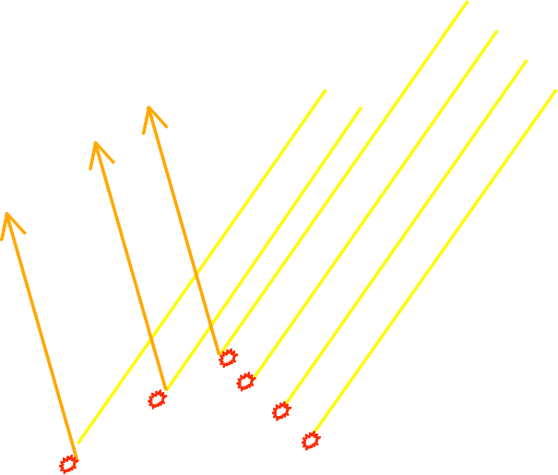
What is radiative forcing of aerosol?
No aerosol With aerosol
Molecular scattering Gaseous absorption
Molecular scattering Gaseous absorption
Aerosol scattering and absorption
Aerosol increases atmospheric scattering and absorption
Aerosol increases reflection of sunlight to space and reduces sunlight reaching the surface
  Aerosol absorption changes the temperature profile in the atmosphere

Slide 18
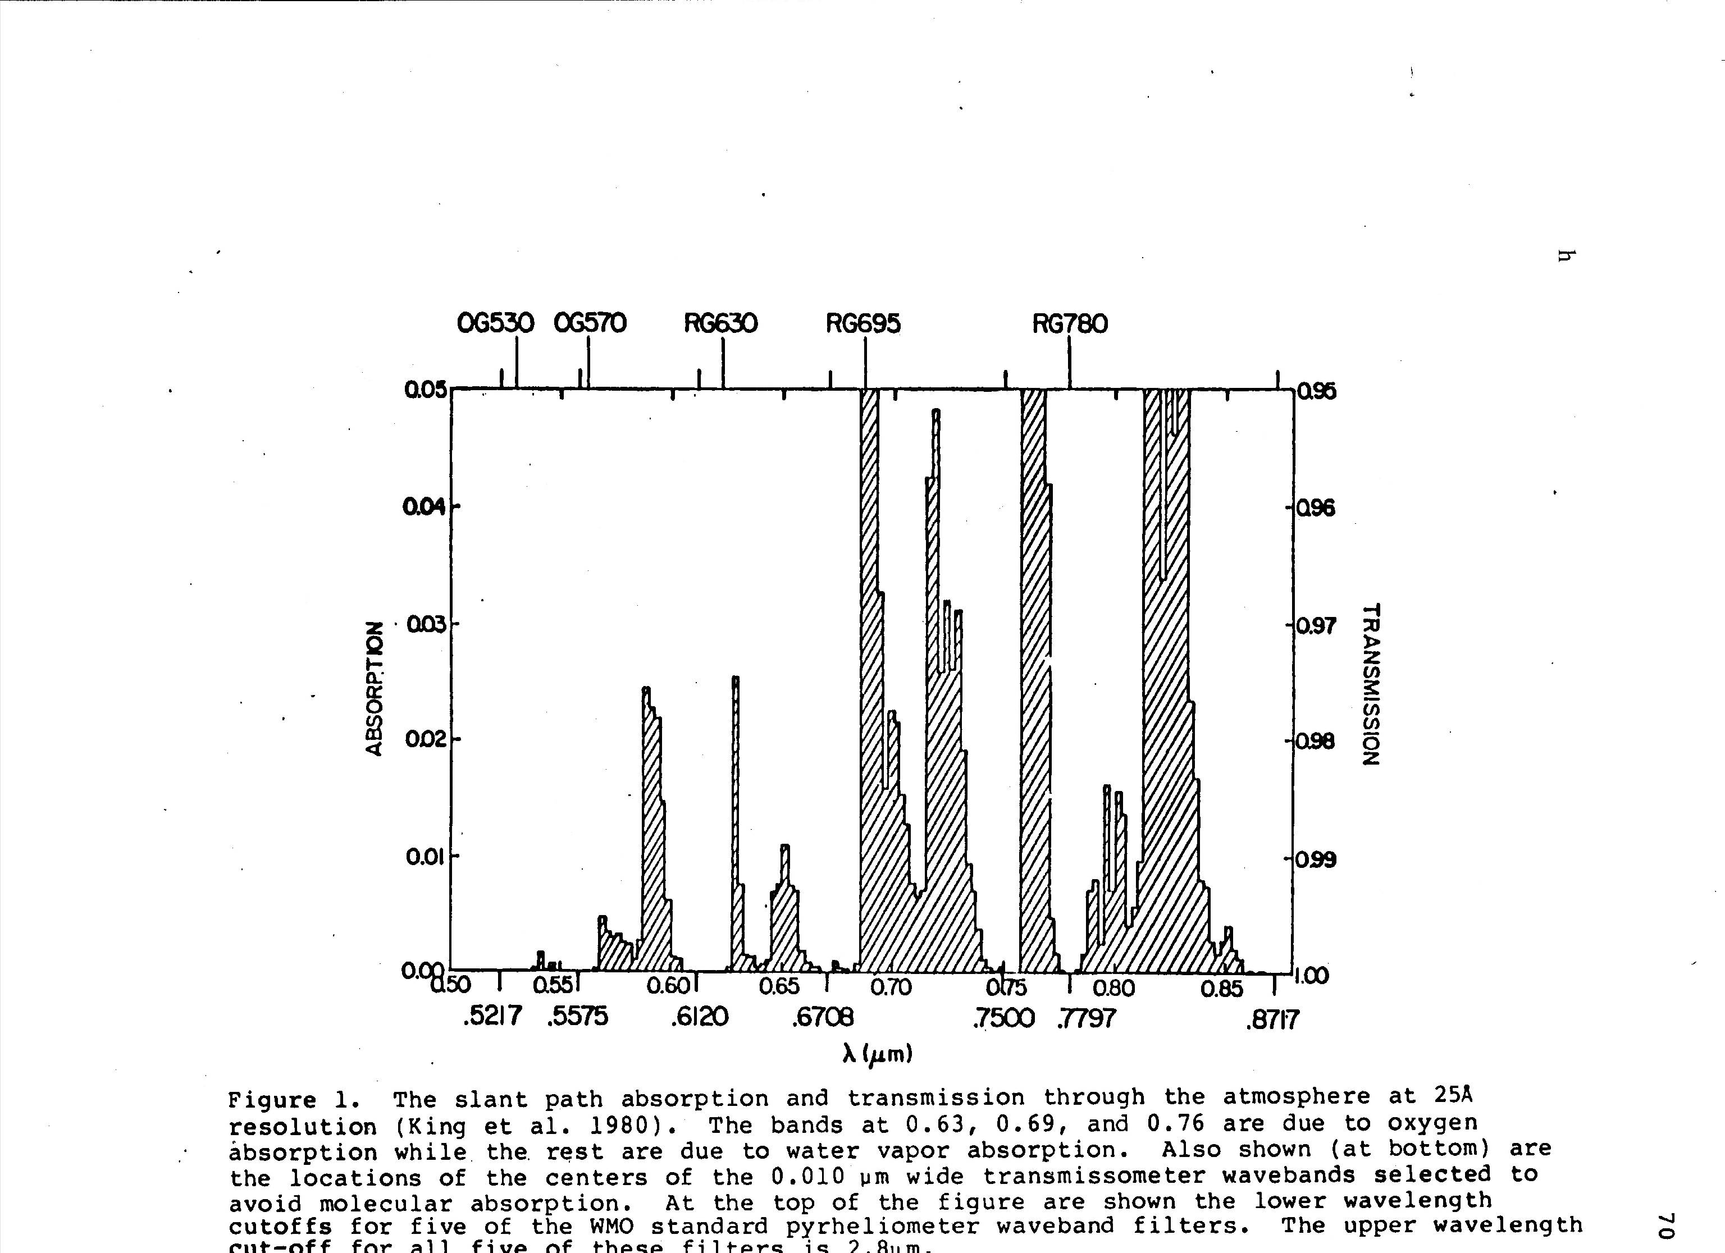

Slide 19

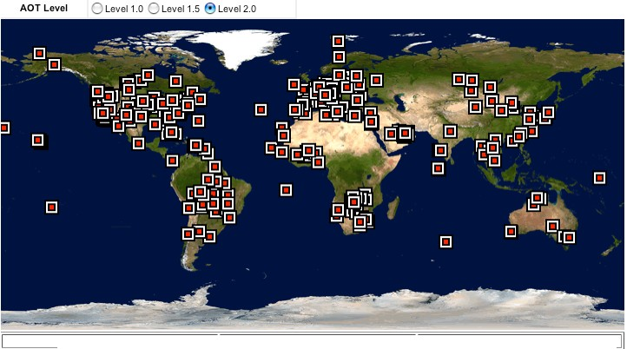
+ OPERATIONS + PAPERS + CAMPAIGNS
http://aeronet.gsfc.nasa.gov/
http://aeronet.gsfc.nasa.gov/new_web/photo_db/Ilorin.html

Slide 20




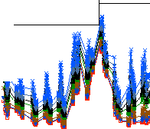
AERONET Data Display Site:Ncs_Ziona
AERONET Level 2.0.Quality As.sured Data.
DISCLAIMER
The following AERONET data arc pre and post field calibrated,automat ically cloud cleared and manually inspected.
The principalinvestigator(s) of the 'Nes_Ziona• sije: Brent Holben
If you intend to use the followingdata please contact principalinvestiJator(s) via e,.mail:
brent@aeronet.gsfc.nasa.gov
Return to the World Map
Choose Display Options:
AERONET Data Type:0AOT Owater Vapcr 0440-8701\ngstrom AOT Level:0Level 1.0 0Level 1.5 0Level 2.0
Data Format:0All points ODaily averages Triplet Error Bars (All Points Only): 0Off QOn
SELECT CHARTS FOR LARGER IMAGES
Data Display Controls
Related Product Availability for Ncs_Ziona (select eachday below):
Show Inverted Spherical alld Spheroi:l Almucantars
Show Back Trajectory Anatyses .Disclaimer
MPLNET Images (Check Availability) .More Information
MODIS Images (C k Availability) .More Information
Visible Satellije Images (Check Availabiity) .More Information
Infrared Satellije Images (Check Avalability) • More Information
Choose year : | I | 2001 | II | 2002 | II | 2003
 | I | FEB | II | MAR | II | APR
Choose month of 2003 : | _{I} | JUN | II | JUL | II | AUG
Choose dav of SEP 2003
AOT Level 2.0 data from SEP of 2003
Nes_Ziona , N 31 55'19", E 34 47'20", Alt 40 Jn,
AOT Love 2.0 data from SEP 15 of 2003
PI :Brent Holben, brent@aeronet.gsfc.nasa.gov Level 2.0 AOT; Data frOJn SEP 2003
Nes_Ziona , N 31 55'19", E 34 47'20", Alt 40 Jn,
PI :Brent Holben, brent@aeronet.gsfc.nasa.gov Level 2.0 AOT; Data frOJn 15 SEP 2003
:<0.059>
<0.069>
<0.099>
<0.167>
<0.200>
<0 .247>
<0.289>
OT_1020 :<0.132>
OT_870 <0.139>
..
OT_670 OT_500
<0.158>
<0.197>
......
....
l...
OT_440
<0.214>
"'
0.6
0.5
0.4
8' 0.3
0.2
0.1
0.0
OT_380 <0 .242>
"il'l
"
0.4
-;:
OT_340
<0.276>
i.l.l
.₋.;:.
......
..
·
...
·""
.....
0.3
0
-"'![
rt/
..
•
"
....
8'
0.2
"'
....
x
₀•
i
".,
15
"..
0.1
>+'.It
r;fl,
<
<"
101 103 105 107 109 111
SEP
2003
11.3 115 <- Day in GNT
O.O 000102 030405 06070809101112 1314 <- Hour in GNT
15 <- Day in Q>tT
SEP
2003
AOT Level 1.0 | AERONET DOWNLOAD Raw Almucantars | a More AERONET |  | AOT Level 1.0 | AERONET DOWNLOAD Raw Almucantars | a More AERONET
AOT Level 1.5 | Raw Principal Planes | Downloadable Products.. |  | AOT Level 1.5 | Raw Principal Planes | Downloadable Products..
AOT Level 2.0 |  |  |  | AOT Level 2.0

Slide 21
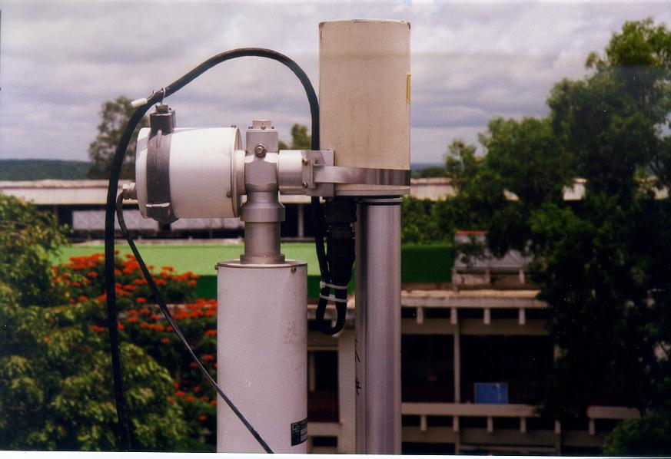
Ilorin, Nigeria

Slide 22
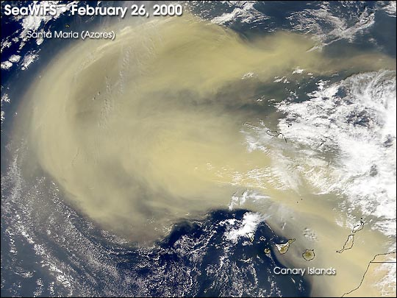

Slide 23
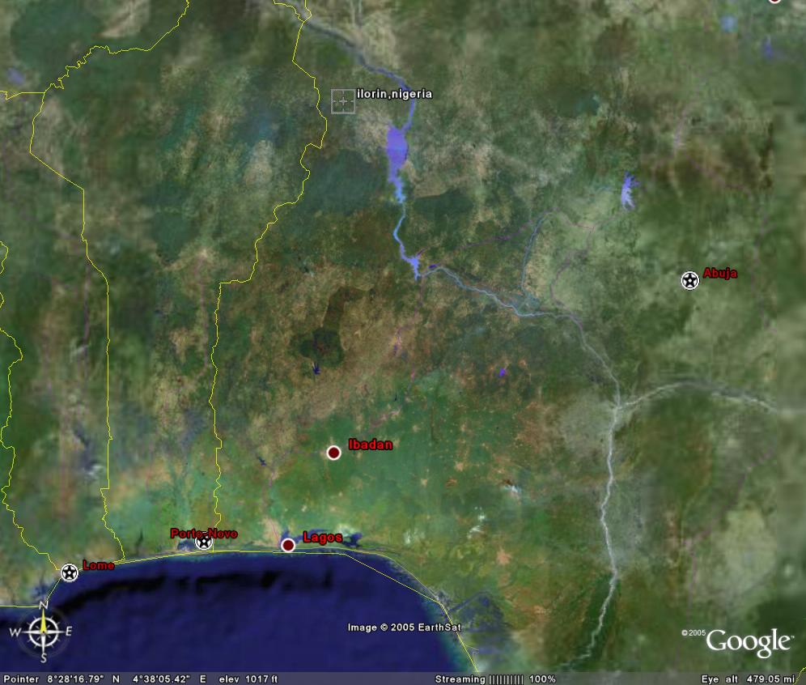
Some Results from observational site at Ilorin, Nigeria, Africa

Slide 24
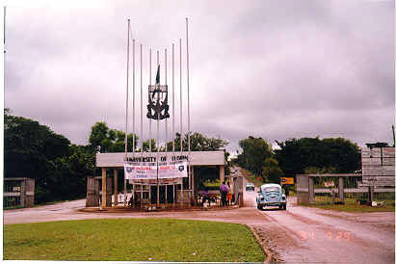
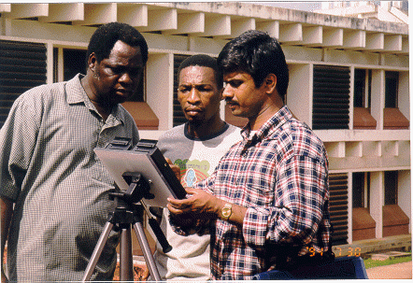
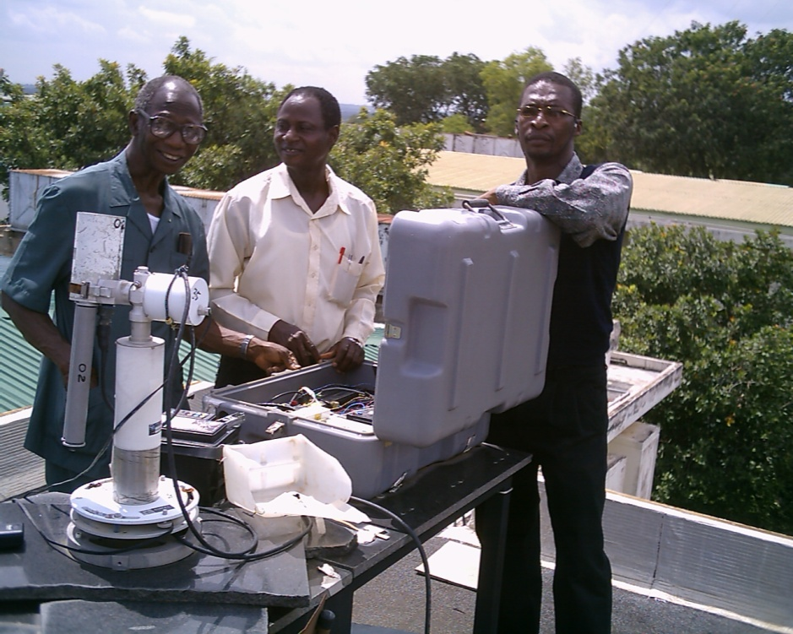
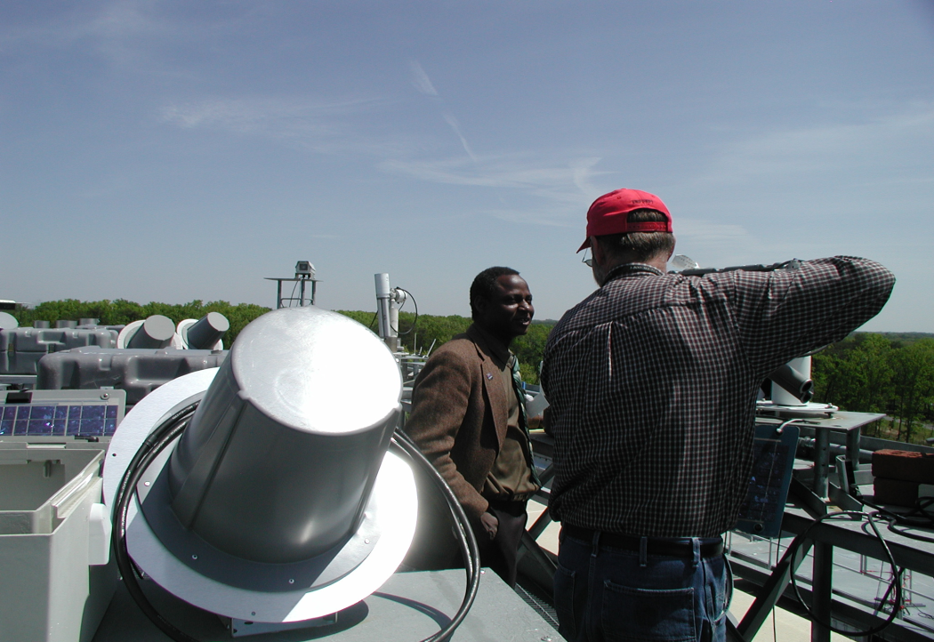
Entrance to the campus of the University of Ilorin

Slide 25
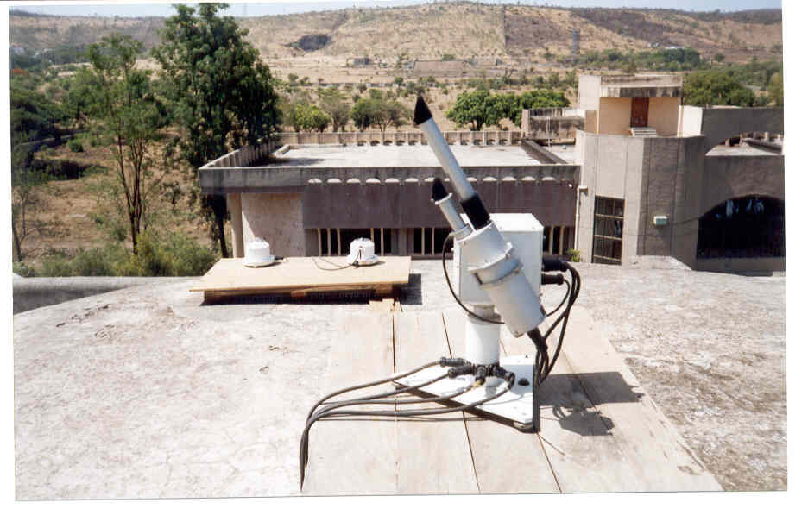
Sky radiometer (PREDE)
Pune, India

Slide 26
Rayleigh scattering
It is assumed that the scattering particle is
spherical; the diameter is smaller than 2λ the
particles scatter independently of one another and the refractive index is close to one..
The scattering is in a peanut shape. Less scattering is
in the direction normal to the incident beam. θ is the
angle between direction of incidence and the direction
of scattering and n is the refractive index. Max scattering occurs in the forward and backward direction. There is strong dependence on λ.

Slide 27
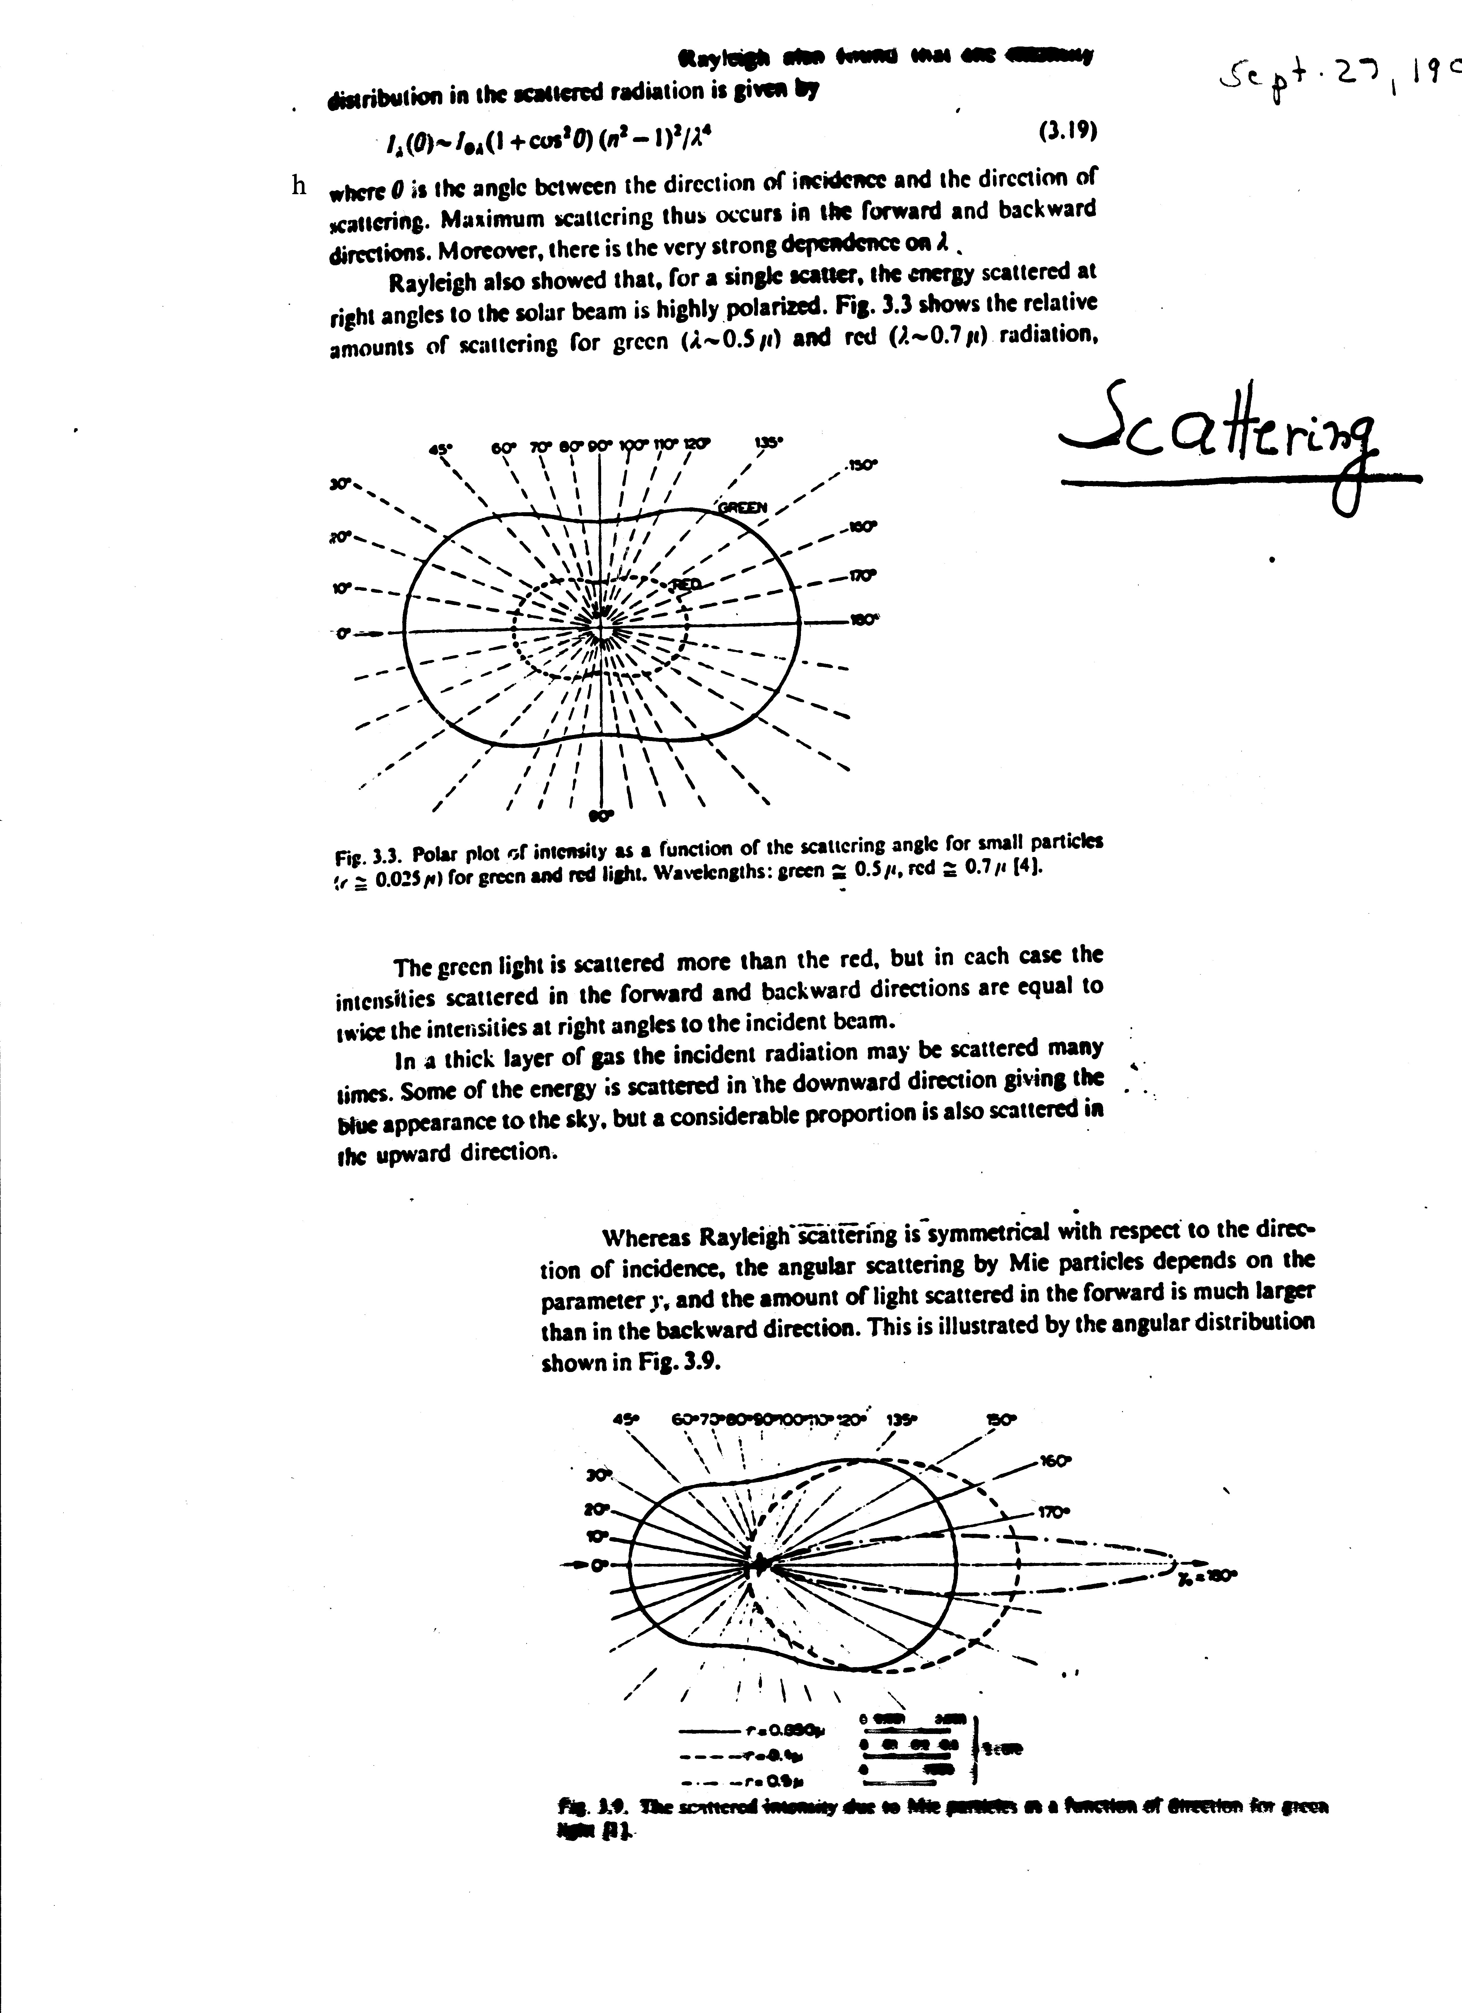
Rayleigh scattering
Polar plot of intensity as a function of scattering angle for
small particles (r~ 0.025 μm) for green and red light.
Green: 0.5 μm; red 0.7 μm

Slide 29
“Small size parameter approximation”
The size of a scattering particle is parameterized by the ratio x of its characteristic dimension r and wavelength λ:
        x= 2πr/λ
Rayleigh scattering can be defined as scattering in the small size parameter regime x ≪ 1.

Slide 30
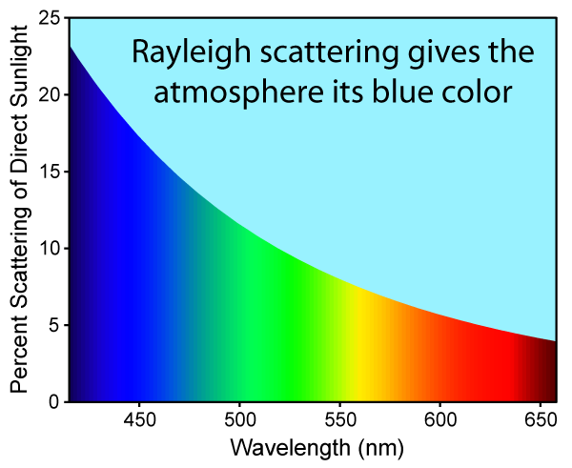
Rayleigh scattering of sunlight in the atmosphere causes diffuse sky radiation, which is the reason for the blue color of the sky and the yellow tone of the sun itself

Slide 31
The amount of Rayleigh scattering that occurs for a beam of light depends upon the size of the particles and the wavelength of the light. Specifically, the intensity of the scattered light varies as the sixth power of the particle size, and varies inversely with the fourth power of the wavelength:

Slide 32

A more explicit formulation: the intensity I of light scattered by a single small particle from a beam of unpolarized light of wavelength λ and intensity I₀ is given by:
where R is the distance to the particle, θ is the scattering angle, n is the refractive index of the particle, and d is the diameter of the particle.
The Rayleigh scattering coefficient for a group of scattering particles is given as:

Slide 33

The amount of Rayleigh scattering from a single particle can also be expressed as a cross section σ. For example, the major constituent of the atmosphere, nitrogen, has a Rayleigh cross section of 5.1×10⁻³¹ m² at a wavelength of 532 nm (green light). This means that at atmospheric pressure, about a fraction 10⁻⁵ of light will be scattered for every meter of travel.

Slide 36

Mie scattering:
For large particle to wavelength ratio. The larger the particle, the more forward scattering is.
Rayleigh scattering is symmetrical with respect to the direction of incidence; the angular scattering by Mie particles - the amount of light scattered in the forward is much larger than in the backward direction .

Slide 37
For a more rigorous treatment of the concept of scattering read Hansen and Travis (1974) pages: 533-535.
For a more rigorous treatment of the concept of RAYLEIGH SCATTERING read Hansen and Travis (1974) pages 540-544.

Slide 42
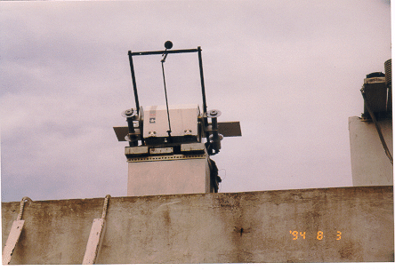
Assess effect of shading on LW
During various observational periods at the site, LW was measured under different shading conditions and showed discontinuities. To investigate the difference introduced by shading, parallel operation of a shaded and an un-shaded pyrgeometer were carried out. A shading disk was used (shown in figure).
Platform holds pyrgeometer and pyranometer to allow shading

Slide 43
Sun photometers
Instruments used to measure aerosol optical depth.
To build a sun photometer, the instrument bands are chosen so that the attenuation by unwanted material is minimal.

Slide 44
Pandithurai G., R. T. Pinker, T. Takamura and P. C. S. Devara, 2004. Aerosol Radiative Forcing over a Tropical Urban Site in India (GRL, 2004)

Slide 45
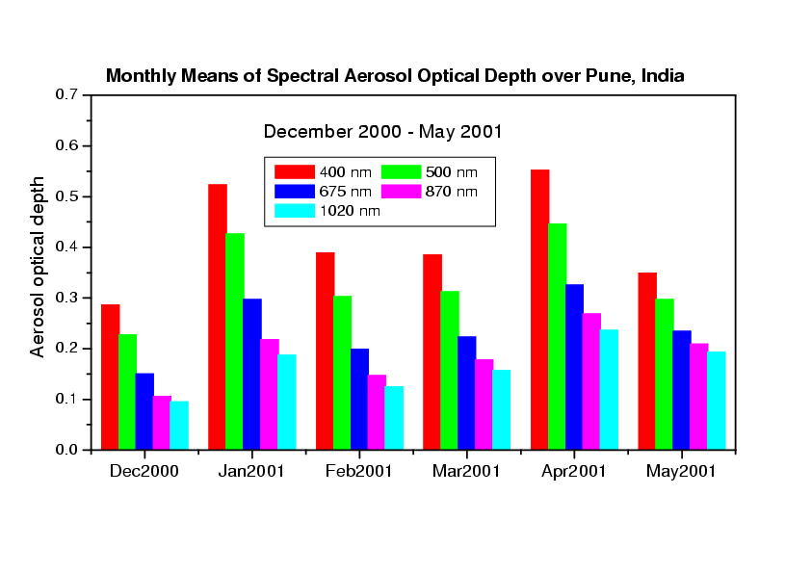
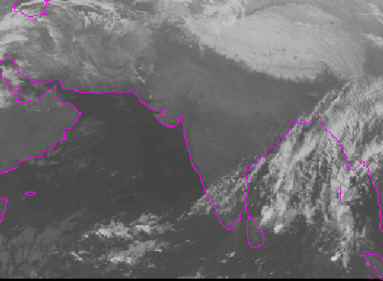
  Meteosat-5 has been moved over India during INDOEX
  Existing collaboration with the Indian Institute of Tropical Meteorology
Meteosat-5 over India 1 Jan 2002 01Z Observed SW flux at Pune, India

Slide 46
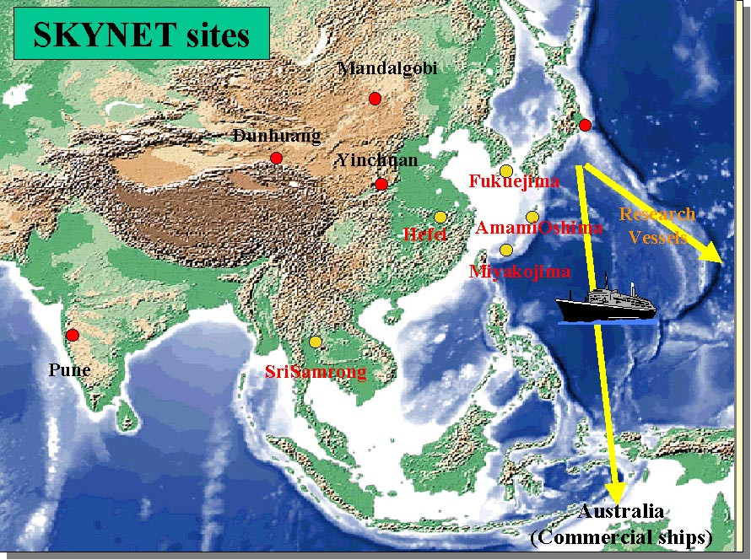

Slide 47
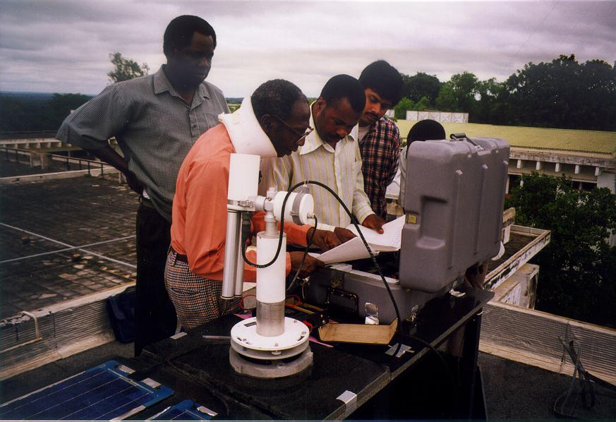
Ilorin, Nigeria

Slide 48
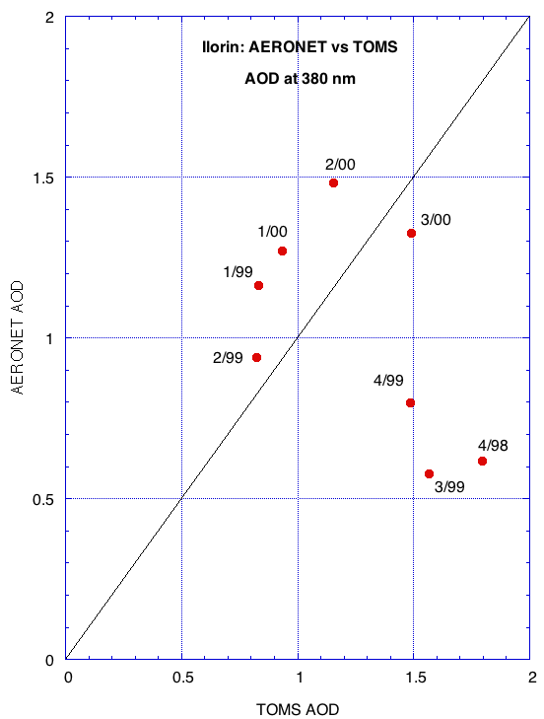

Slide 49
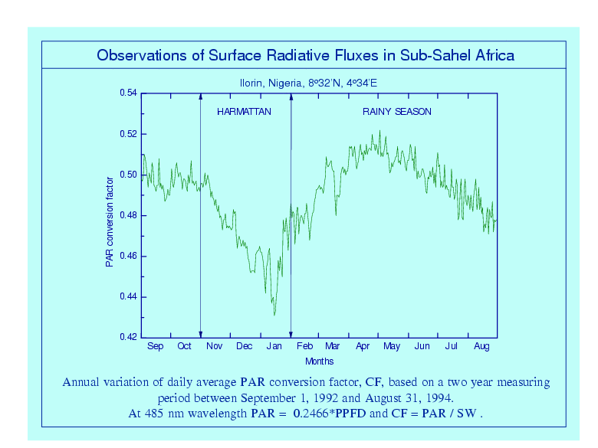

Slide 54
Next Table shows that the ozone concentration is
greatest in spring in both hemispheres.
The variation in the tropics is smaller than in the
extra-tropics as tropics have smaller variability in the
solar energy received.
As the production of ozone required sunlight, the
productivity is greatest during the summer months.
It can be seen that ozone has a large
latitudinal and seasonal variations. It can be explained
using the stratospheric circulation. Time is
required to transport fresh ozone away from the
source region.

Slide 56
Figure from King et al.(1980): Wavelength Selection for Aerosol Retrieval

Slide 61
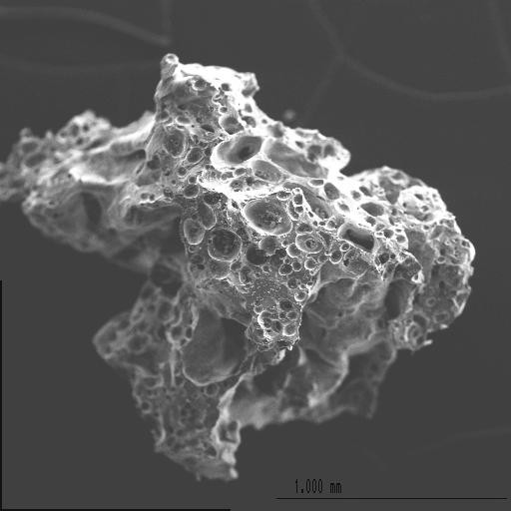
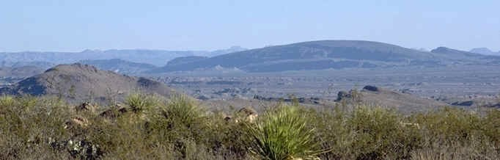
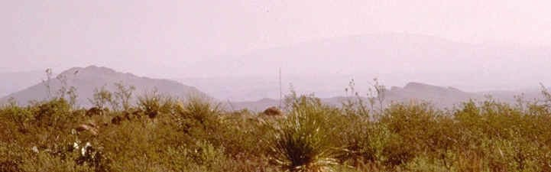
Aerosol:
Aerosol particle:
Related terms:
Stable suspension of solid or liquid particles in a gas.
An object of 0.001 μm - 100 μm in diameter that can be kept suspended in a gas by Brownian motion or convection for a reasonable period of time.
Ash, smoke, dust, fog, mist, drizzle, smog, haze, etc.
Importance of atmospheric particles (20 nm to 10
μm):
v' Chemistry (dry and wet deposition, photochemical smog, heterogeneous catalysis, etc.)
v' Cloud formation (cloud condensation nuclei)
v' Climate (light scattering, light absorption, indirect effect on cloud albedo)
This particle is too large (≈ 1mm) to stay suspended long enough. However, it has a highly irregular shape just like many smaller solid particles do. Atmospheric aerosols can be highly inhomogeneous both in composition and shape.
v' Health effects (many clinical proofs)
Loss of visibility is the most obvious effect of aerosol particles on the atmosphere

Slide 65
Assume, above term is zero (no emission or scattering contribution).
where k_{λ}: mass absorption cross section/absorption coefficient
If the medium is homogeneous and k is independent of distance:

Slide 66
Beer-Bouguer-Lambert Law
The Beer-Bouguer-Lambert Law (also know as Beer law or Bouguer law or Lambert law)
determines attenuation of radiant energy by scattering and/or absorption passing through atmosphere.

Slide 68
Utilizing measurement of the direct beam as taken at the surface

Slide 69
However, this method is not accurate to estimate S because there is energy loss:
Absorption of UV by ozone;
Absorption of IR by water vapor and CO_{2;}
Unknown amount of diffuse radiation entering the
instrument;
Variations of k_{λ} and aerosols; and measurement errors.

Slide 70
If the atmospheric properties do not change during the observational period, T_{λ} is constant and the Langley Plot is a straight line.
The y-interception is ln (F _{λ 0}), and the slope is ln (T_{λ}).
This method can be used for sun photometer calibration.
It is usually carried out in the early morning on a high mountain. It can be assumed
that the atmosphere is stable and that the distribution of aerosols does not change
much during the measurement.
Solar constant S:
If instrument measures F₀ (integrated over all wavelengths), possible to derive solar constant.

