Slide 1
AOSC400-2015
September 29, Lecture # 8
Radiative Properties of Non-black Materials
Simple radiation balance climate model-the greenhouse effect
Physics of Scattering and Absorption and Emission
Simple aspects of radiative transfer in the visible
Beer-Bouguer-Lambert Law
Langley Plots
Copyright@2015 University of Maryland
This material may not be reproduced or redistributed, in whole or in part, without written permission of Rachel T. Pinker

Slide 2
What drives climate to change? - “radiative forcing”: A small change in the energy balance of the earth can change surface temperatures, winds, precipitation patterns => it’s climate

Slide 3
Radiative Properties of Nonblack Materials
Blackbodies absorb all incident radiation
Nonblack bodies such (e.g., gaseous media) can also
reflect and transmit radiation.
Their behavior can be represented by applying the
radiation laws derived for blackbodies.
For this purpose
It is useful to define the (monochromatic) emissivity ε_{λ}, i.e., the ratio of the monochromatic intensity of the radiation emitted by the body to the corresponding blackbody radiation
ελ = Iλ (emitted)/B λ (T) (4.13)
_{Then:} F_{E =} ε_{λ}σT⁴

Slide 4
or:
For infrared radiation, the radiative behavior of fresh snow is similar to a blackbody.
Typical values of the emissivity in the IR region for several surface types.

Slide 5
The (monochromatic) absorptivity, reflectivity, and transmissivity, the fractions of the incident monochromatic intensity that a body absorbs, reflects, and transmits, are:

Slide 6
The Greenhouse Effect
Water vapor, carbon dioxide, and other gases absorb radiation more strongly in the longwave part of the spectrum occupied by outgoing terrestrial radiation than the shortwave part occupied by incoming solar radiation.
Incoming solar radiation passes through the atmosphere quite freely, whereas terrestrial radiation emitted from the Earth's surface is absorbed and re-emitted in its upward passage through the atmosphere.
Following shows how such greenhouse gases in the atmosphere tends to warm the surface of the planet.

Slide 7
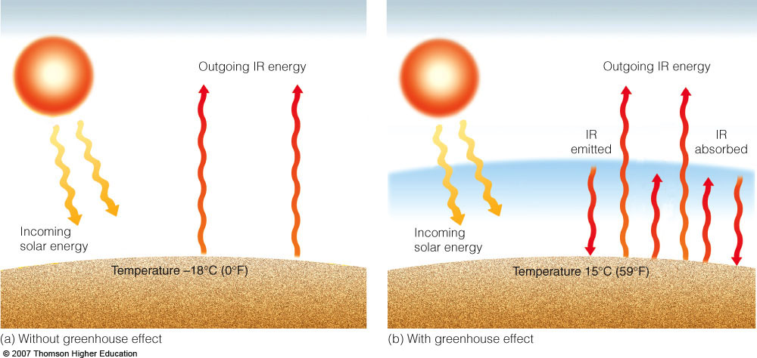
“The Greenhouse Effect”
T_{e}=[(1-r)S/4σ]^{1/4;} Actual value of T_{e} is 15⁰ C.

Slide 8
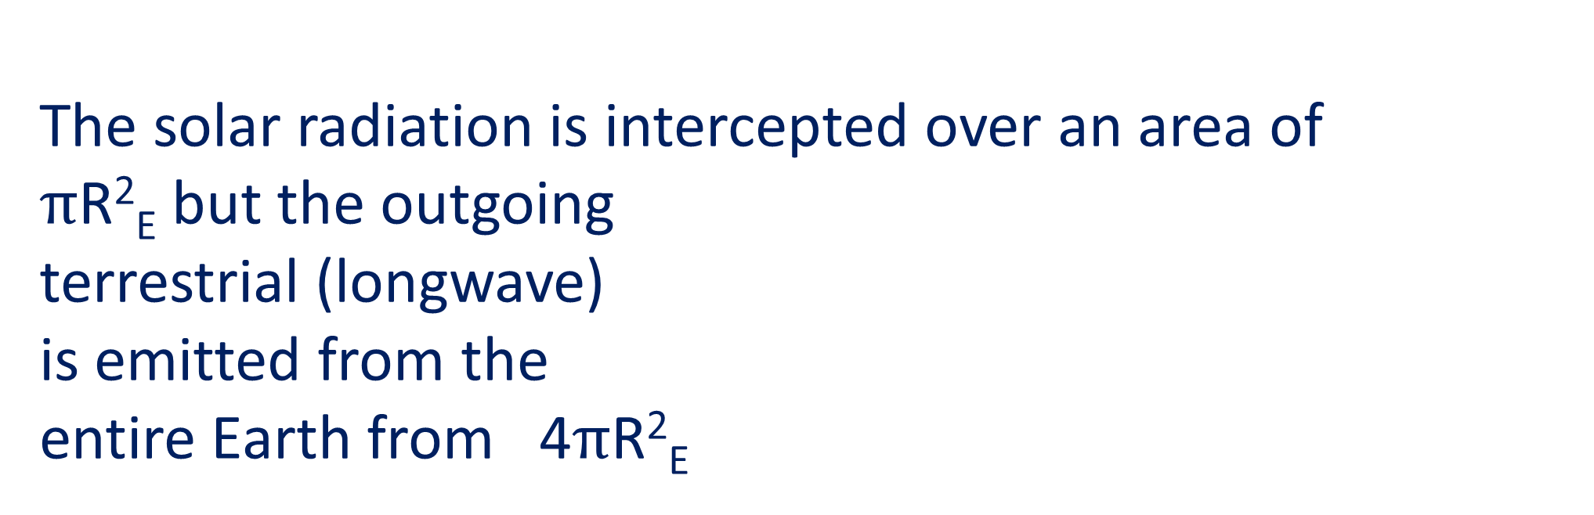
Important to note:
The solar radiation is intercepted over an area of
$π$R²_{E} but the outgoing
terrestrial (longwave)
is emitted from the
entire Earth from 4$π$R²_{E}

Slide 10
Assume that the atmospheric layers and the surface of the planet are in radiative equilibrium. How is the surface temperature of the planet affected by the presence of this atmosphere?
Replace the textbook discussion of above by following:

Slide 11
Consider the atmosphere as a layer at a given distance from the Earth's surface. Let us assume that nothing happens in the region between the
surface and the layer .
From the radiative
properties of the atmosphere
(strong absorption of the
infrared radiations and
atmospheric window for the
visible radiations),
we assume that:

Slide 12
The layer and the Earth are at radiative equilibrium
• The layer reflects a fraction A of the incident solar radiation Fs. It
absorbs a frac­tion a_{s} and transmits to the Earth a fraction (1 - a_{s}) of
the remaining radiation (1 - A) F_{s.} The Earth is supposed to absorb
the whole received radiation;
• the Earth emits longwave radiations U (up): a fraction (a_{T}) is
absorbed by the layer while the remaining part ( 1 - a_{T}) is
transmitted to space;
• the layer is then heated and emits a radiation D (down): a
fraction a is transmitted to the Earth and then absorbed.
Let us investigate the sensitivity of the Earth's temperature (T) with respect to the absorption coefficient of the layer
for the terrestrial radiation (a_{T} ).

Slide 13
Taking
data from this figure:

Slide 14
We get:

Slide 16
Physics of Scattering and Absorption and Emission
The scattering and absorption of radiation by gas molecules and aerosols all contribute to the extinction of the solar and terrestrial radiation passing through the atmosphere.
Each of these contributions is linearly proportional to:
(1) the intensity of the radiation at that point along the ray path
(2) the local concentration of the gases and/or particles that are responsible for the absorption and scattering, and:
(3) the effectiveness of the absorbers or scatterers.

Slide 20
Assume, above term is zero (no emission or scattering contribution).
where k_{λ}: mass absorption cross section/absorption coefficient
If the medium is homogeneous and k is independent of distance:

Slide 21
Beer-Bouguer-Lambert Law
The Beer-Bouguer-Lambert Law (also know as Beer law or Bouguer law or Lambert law)
determines attenuation of radiant energy by scattering and/or absorption passing through atmosphere.

Slide 23
Utilizing measurement of the direct beam as taken at the surface

Slide 24
Langley Plots
Objective: Determine extraterrestrial radiation
Effective path length of the air mass = u sec θ₀
θ₀ = solar zenith angle
z₁ is the height of the station

Slide 25
Langley plot
Effective path length of the air mass = u sec θ₀
ln F_{λ}
ln F_{λ0}
m = secθ₀

Slide 26
If the atmospheric properties do not change during the observational period, T_{λ} is constant and the Langley Plot is a straight line.
The y-interception is ln (F _{λ 0}), and the slope is ln (T_{λ}).
Solar constant S:
If instrument measures F₀ (integrated over all wavelengths), possible to derive solar constant.

Slide 27
However, this method is not accurate to estimate S because there is energy loss:
Absorption of UV by ozone;
Absorption of IR by water vapor and CO_{2;}
Unknown amount of diffuse radiation entering the
instrument;
Variations of k_{λ} and aerosols; and measurement errors.
This method can also be used for sun photometer calibration.
It is usually carried out in the early morning on a high mountain. It can be assumed that the atmosphere is stable and that the distribution of aerosols does not change much during the measurement.

Slide 29
where τRλ is due to Rayleigh scattering τ_{ozλ} is due to ozone absorption τ_{wvλ} is due to water vapor absorption τ_{Dλ} is due to aerosol extinction
Assuming 3 out of the 4 terms are known, the 4th can be estimated.
Most commonly, assumed that the first 3 terms are known and the 4th (aerosol extinction) needs to be estimated.

Slide 30
In principle, it is not necessary to know all of them. It is possible to measure the direct beam in spectral intervals where the effect of some of the absorption terms is minimal. Instruments, known as Sun- Photometers of various level of complexity have been build to measure “aerosol optical depth”, namely, extinction due to aerosols. To build a sun photometer, the instrument bands are chosen so that the attenuation by unwanted material is minimal.

Slide 31
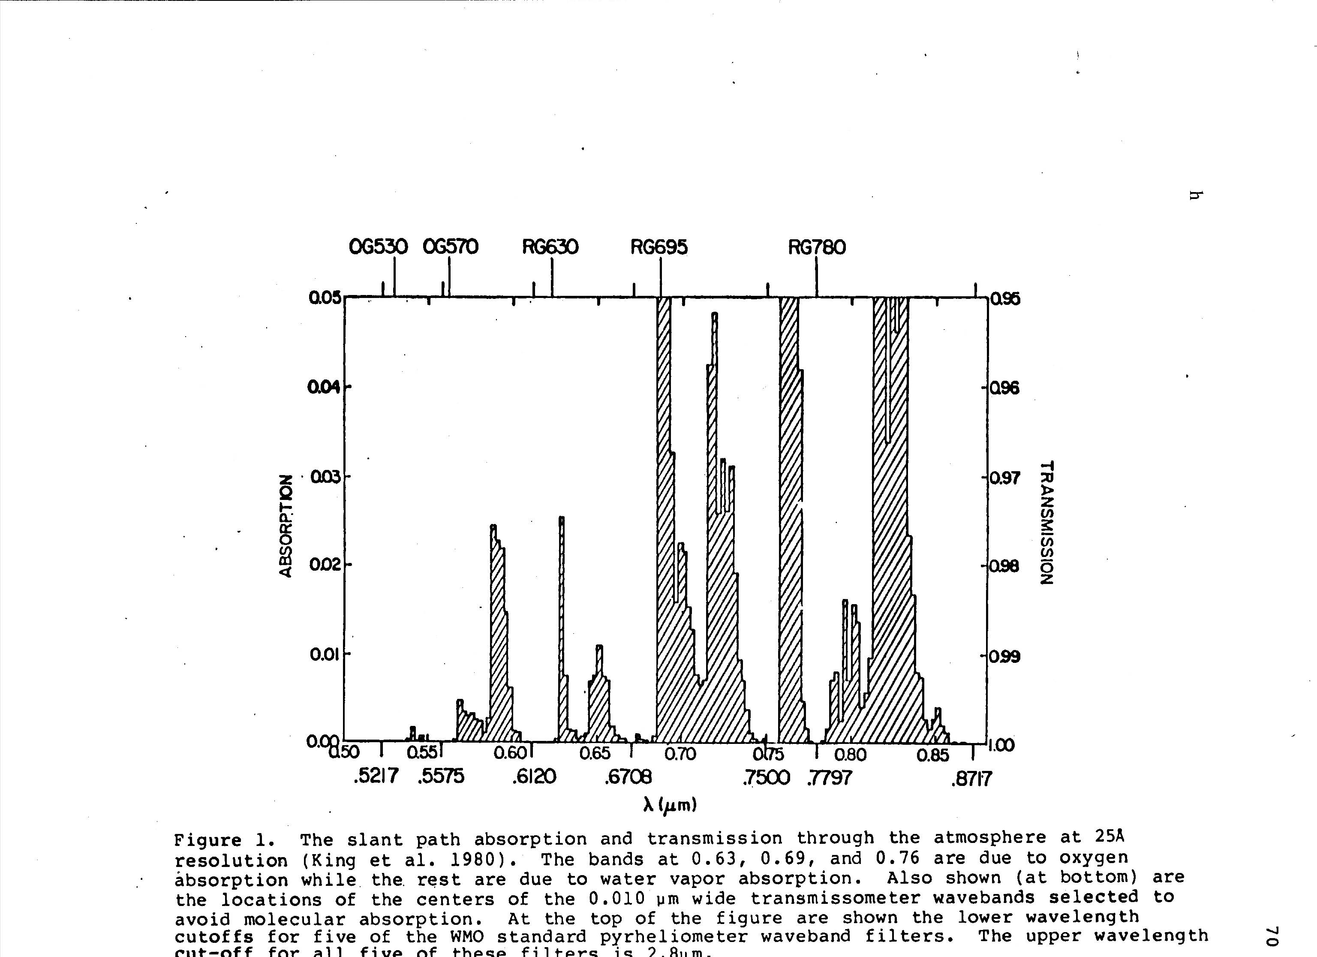
Figure from King et al.(1980): Wavelength Selection for Aerosol Retrieval

Slide 36
Lambert-Bouguer law) governs the reduction in the radiation intensity h at wave­length).. (Fig. 2.5). Ifs stands for the medium thickness (oriented in the direction of propagation), the evolution of the radiation intensity is
where a,(s) is the absorption coefficient at wavelength ).. (depending on the medium). The unit of a, is, for instance, m- 1 or cm-1• Assuming that the medium is homogeneous, then a, has a constant value and

Slide 37
Consider a medium composed of p absorbing species, with densities n; (i = !, ... , p), expressed in moleculecm-3. The absorbing coefficient is then obtained by summing over all species. For a given species, the contribution depends on the density and on the so-called absorption cross section (the effective cross sectionesulting in absorption), o';° (),., s ), usually expressed in cm2
A way to define the absorption cross section is to consider an incident flux of energy per surface, F (in W cm-2). The resulting absorbed energy is then Fa = a0 x F (expressed in W).
Another classical concept is the so-called optical depth r, (unitless), defined for a monochromatic radiation by
Rewriting the Beer-Lambert law yields

Slide 38
Let us consider the fa te of a beam of radiation
passing through an arbitrarily thin layer of the
atmosphere along a specific path, as depicted in Fig.
4.10. For each kind of gas molecule and particle that
the beam encounters, its monochromatic intensity is
decreased by the increment

Slide 39
where N is the number of particles per unit volume
of air, u is the areal cross section of each particle,
K;,. is the (dimensionless) scattering or abs01ption
efficiency, and ds is the differential path length
along the ray path of the incident radiation. An
extinction efficiency, which represents the combined
effects of scattering and absorption in depleting the
intensity of radiation passing through the layer, can
be defined in a similar manner. The product KnNs is
called the scattering, absorption, or extinction cross
section. In the case of a gaseous atmospheric
constituent, it is sometimes convenient to express
the rate of scattering or absorption in the form
(4.17)

Slide 40
where p is the density of the air, r is the mass of the
absorbing gas per unit mass of air, and kA is the mass
abso1ption coefficient, which has units of m2 kg-1.
In the aforementioned expressions the products
are volume scattering, absorption, or
extinction coefficients, depending on the context,
and have units of m- 1. The contributions of the
various species of gases and particles are additive

Slide 41
as
are the contributions of scattering and absorption
to the extinction of the incident beam of radiation; i.e.,

Slide 43
Beer’s Law
Determine attenuation of radiant energy by scattering and/or absorption passing through atmosphere
Where T 1 is optical depth of layer, Optical depth is path length required for attenuation to 1/e of original energy , Depends on attenuation coefficients and density , Transmissivlty Is proportion of original energy remaining:

Slide 44
Depends on optical depth and zenith angle , With no scattering, monochromatic absorptivity is:

Slide 45
Energy in beam decreases monotonically with increasing geometric depth , Rate of decrease approximately proportional to amount of energy and density
Maximum rate of decrease occurs about where optical depth = 1

Slide 46
• Scattering and Absorption
o Coefficients of absorption, reflection and transmission must sum to 1
o Extinction increased by multiple scattering
• Increases path length
• Increases likelihood of back scattering
• Increases possibility of absorption
• Cloud droplets mostly forward scatter, but high volume of droplets means great manyscattering events
• Small likelihood of back scatter with each event adds up to significant contribution
o Impact of large particles like aerosols, cloud droplets and ice crystals characterized by set of parameters
• Volume extinction coefficient

Slide 47
r Effects of aerosols, water droplets, etc. on planetary albedo depends on variations in above parameters
• Increasing single scattering albedo while fixing other two increases backscatter and albedo
• Strong forward scattering (asymmetry parameter) reduces impact of aerosols at low zenith angles
• Layers with high optical thickness produce multiple scattering, increasing backscatter
• Water droplets in clouds mainly forward scatter, but multiple scattering leads to highbackscatter and high albedo

Slide 51
4 .4.1 Scattering by Air Molecules
and Particles
At any given place and time, particles including
aerosols with a wide variety of shapes and sizes, as
well as cloud droplets and ice crystals, may be present.
Non etheless it is instructive to consider the
case of scattering by a spherical particle of radius r,
for which the scattering, absorption, or extinction
efficiency KA in ( 4.16) can be prescribed on the

Slide 52
4.4 Physics of Scattering
and Absorption and Emission
- ' The scattering and absorption of radiation by gas
molecules and aerosols all contribute to the extinction
of the solar and terrestrial radiation passing
through the atmosphere. Each of these contributions
is linearly proportional to (1) the intensity of the
radiation at that point along the ray path, (2) the
local concentration of the gases and/or particles
that are responsible for the absorption and scattering,
and (3) the effectiveness of the absorbers or
scatterers. Let us consider the fate of a beam of radiation
passing through an arbitrarily thin layer of the
atmosphere along a specific path, as depicted in Fig.
4.10. For each kind of gas molecule and particle that
the beam encounters, its monochromatic intensity is
decreased by the increment

Slide 53
where N is the number of particles per unit volume
of air, er is the areal cross section of each particle,
KA is the (dimensionless) scattering or absorption
efficiency, and ds is the differential path length
along the ray path of the incident radiation. An
extinction efficiency, which represents the combined
effects of scattering and absorption in depleting the
intensity of radiation passing through the layer, can
be defined in a similar manner. The product KnNs is
called the scattering, absorption, or extinction cross
ection. In the case of a gaseous atmospheric constituent, it is sometimes convenient to express the rate of scattering or absorption in the form

Slide 54
where pis the density of the air, r is the mass of the absorbing gas per unit mass of air, and k;,, is the mass absorption coefficient, which has units of m2 kg-1.
In the aforementioned expressions the products NaK,1 and prk,1 are volume scattering, absorption, or extinction coefficients, depending on the context, and have units of m -1. The contributions of the various species of gases and particles are additive (i.e., K;,,Nu = (K,1)1 Niu1 + (K;,,)i N2u2 + .... ), as are the contributions of scattering and absorption to the extinction of the incident beam of radiation; i.e.,

Slide 55
4.4.1 Scattering by Air Molecules and Particles
At any given place and time, particles including aerosols with a wide variety of shapes and sizes, as well as cloud droplets and ice crystals, may be pres­ent. Nonetheless it is instructive to consider the case of scattering by a spherical particle of radius r, for which the scattering, absorption, or extinction efficiency K;,, in ( 4.16) can be prescribed on the
Fig. 4.10 Extinction of incident parallel beam solar radia􀀁 tion as it passes through an infinitesimally thin atmospheric layer containing absorbing gases and/or aerosols.

Slide 56
Fig. 4.11 Size parameter x as a function of wavelength (A) of the incident radiation and particle radius r.
basis of theory, as a function of a dimensionless size parameter
Fig. 4.11 Size parameter x as a function of wavelength (A) of the incident radiation and particle radius r.
basis of theory, as a function of a dimensionless size parameter

Slide 57
and a complex index of refraction of the particles (m = m, + im;), whose real part m, is the ratio of the speed of light in a vacuum to the speed at which light travels when it is passing through the particle. Figure 4.11 shows the range of size param­eters for various kinds of particles in the atmos­phere and radiation in various wavelength ranges. For the scattering of radiation in the visible part of the spectrum, x ranges from much less than 1 for air molecules to -1 for haze and smoke particles to
> 1 for raindrops.Particles with x < < 1 are relatively ineffective atcattering radiation. Within this so-called Rayleigh scattering regime the expression for the scattering efficiency is of the form

Slide 58
nd the scattering is divided evenly between the forward and backward hemispheres, as indicated in Fig. 4.12a. For values of the size parameter compara­ble to or greater than 1 the scattered radiation is directed mainly into the forward hemisphere, as indi­cated in subsequent panels.
Figure 4.13 shows K;,, as a function of size parame­ter for particles with m, = 1.5 and a range of values of m;. Consider just the top curve that corresponds

Slide 59
Fig. 4.12 Schematic showing the angular distribution of the radiation at visible (0.5 µm) wavelength scattered by spherical particles with radii of(a) 10-4 µm, (b) 0.1 µm, and (c) 1 µm. The forward scattering for the 1-µm aerosol is extremely large and is scaled for presentation purposes. (Adapted from K. N. Liou, An Introduction to Atmospheric Radiation, Academic Press, p. 7, Copyright (2002}, with permission from Elsevier.]

Slide 60
Fig. 4.13 Scattering efficiency KA as a function of size parameter x, plotted on a logarithmic scale1 for four different refractive indices with m, = 1.5 and m; ranging from O to 1, as indicated. (From K. N. Liou, An Introduction to Atmospheric Radiation, Academic Press, p. 191, Copyright (2002), with permission from Elsevier.]
tom; = 0 (no absorption). For 0.1 ,,;; x :S 50, referred to as the lvfie10 scattering regime, K>. exhibits a damped oscillatory behavior, with a mean around a value of 2, and for x ;,; 50, the range referred to as
he geometric optics regime, the oscillatory behavior is less prominent and K>. = 2.

Slide 61
Hence, the preponderance of blue in light scattered by air molecules, as evidenced by the blueness of the sky on days Figure when 4.14 the shows air is an relatively example free of from the aerosols.coloring
of the sky and sunlit objects imparted by Rayleigh scat­tering. The photograph was taken just after sunrise. Blue sky is visible overhead, while objects in the foreground, including the aerosol layer, are illumi­nated· by sunlight in which the shorter wavelengths (bluer colors) have been depleted by scattering along its long, oblique Ground-based path weather through radars the and atmosphere.remote
sensing of rainfall from instruments carried aboard satellites exploit the size strong dependence of scattering efficiency K upon size parameter x for microwave radiation in the 1- to 10-cm wavelength range inci­dent upon clouds with droplet radii on the order of millimeters. In contrast to infrared radiation, which

Slide 62
Fig. 4.11 Size parameter x as a function of wavelength (},.)
of the incident radiation and particle radius r.
basis of theory, as a function of a dimensionless size
parameter

Slide 63
(4.19)
and a complex index of refraction of the particles
(m == m,. + imi), whose real part m,. is the ratio of
the speed of light in a vacuum to the speed at
which light travels when it is passing through the
particle. Figure 4.11 shows the range of size parameters
for various kinds of particles in the atmosphere
and radiation in various wavelength ranges.
For the scattering of radiation in the visible part of
the spectrum, x ranges from much Jess than 1 for
air molecules to - 1 for haze and smoke particles to
> > 1 for raindrops.
Particles with x << 1 are relatively ineffective at
scattering radiation. Within this so-called Rayleigh
scattering regime the expression for the scatte1ing
efficiency is of the form
(4.20)
and the scattering is divided evenly between the
forward and backward hemispheres, as indicated in
Fig. 4.12a. For values of the size parameter comparable
to or greater than 1 the scattered radiation is
directed mainly into the forward hemisphere, as indicated
in subsequent panels.

Slide 64
Figure 4.13 shows KA as a function of size parameter
for particles with m,. = 1.5 and a range of values
of m;. Consider just the top curve that corresponds

Slide 65
Fig. 4.12 Schematic showing the angular distribution of the
radiation at visible (0.5 μ,m) wavelength scattered by spherical
particles with radii of(a) 10- 4 μ,m , (b) 0.1 μ,m, and (c) 1 μ,m.
The forward scattering for the 1-μ,m aerosol is extremely large
, and is scaled for presentation purposes. [Adapted from
K. N. Liou, An Introduction to Atmospheric Radiation, Academic
Press, p. 7, Copyright (2002), with permission from Elsevier.]

Slide 67
Fig. 4 .13 Scattering efficiency KA as a function of size
parameter x, plotted on a logarithmic scale, for four different
refractive indices with m, = 1.5 and m; ranging from Oto 1, as
indicated. [From K. N. Liou, An Introduction to Atmospheric
Radiation, Academic Press, p. 191, Copyright (2002), with
permission from Elsevier.]
tom;= 0 (no absorption). For 0.1 ~ x :5 50, referred
to as the Mie10 scattering regime, KA exhibits a
damped oscillatory behavior, with a mean around a
value of 2, and for x ~ 50, the range referred to
the geometric optics regime, the oscillatory behavior
is less prominent and KA = 2.

Slide 68
Exercise 4.9 Estimate the relative efficiencies with
which red light (A= 0.64μ,m) and blue light
(A= 0.47 μ,m) are scattered by air molecules.
Solution: From ( 4.20)
K(blue) = (0.64)4 = 3.45
K(red) 0.47'

Slide 69
Hence, the preponderance of blue in light scattered by
air molecules, as evidenced by the blueness of the sky
on days when the air is relatively free from aerosols.
Figure 4.14 shows an example of the coloring of
the sky and sunlit objects imparted by Rayleigh scattering.
The photograph was taken just after sunrise.
Blue sky is visible overhead, while objects in the
foreground, including the aerosol layer, are illuminated
by sunlight in which the shorter wavelengths
(bluer colors) have been depleted by scattering along
its long, oblique path through the atmosphere.
Ground-based weather radars and remote sensing
of rainfall from instruments carried aboard satellites
exploit the size strong dependence of scattering
efficiency K upon size parameter x for microwave
radiation in the 1- to 10-cm wavelength range incident
upon clouds with droplet radii on the order of
millimeters. In contrast to infrared radiation, which

Slide 70
is strongly absorbed by clouds, microwave radiation
passes through clouds with droplets ranging up to
hundreds of micrometers in radius with little or no
scattering. Radiation backscattered from the pulsed
radar signal by the larger drops reveals the regions of
heavy precipitation.
Scattering of parallel beam solar radiation and
moonlight gives rise to a number of distinctive optical
effects, that include
• rainbows (Figs. 4.15 and 4.16) formed by the
refraction and internal reflection of sunlight in
water drops (usually raindrops). The bow
appears as a circle, rarely complete, centered on
the antisolar point, which lies on the line from
the sun passing through the eye of the observer.
The colors of the rainbow from its outer to its
inner circumference are red, orange, yellow,
green, blue, indigo, and violet. Rainbows are
usually seen in falling rain with drop diameters
of a few millimeters. Because the drops are much
larger than the wavelength of the light, the
classical theory of geometric optics provides a
reasonable description for the primary bow.
• bright haloes produced by the refraction of light
by hexagonal, prismshaped ice crystals in high,
thin cirrostratus cloud decks, the most common
of which are at angles of 22° and 46°, as shown in
Fig. 4.17 and the schematic Fig. 4.18.1

Slide 74
Scattering Regimes
The scattering of the incident electromagnetic wave by a gas-phase molecule or by a particle mainly depends on the comparison between the wavelength (A) and the characteristic size (d). We recall that d '.c:'. 0.1 nm for a gas-phase molecule, d E [lOnm, 10 µm] for an aerosol and d E [10, lOO]µm for a liquid water drop (Chap. !). The wide range covered by the body size will induce different behaviors.
Three scattering regimes are usually distinguished: the Rayleigh scattering (typi­cally for gases), the scattering represented by the optical geometry's laws (typically for liquid water drops) and the so-called Mie scattering (for aerosols).
Rayleigh Scattering If d « >,, (the case for gases), the electromagnetic field can be assumed to be homogeneous at the level of the scattering body. This defines the so-called Rayleigh scattering (also referred to as molecular scattering).
The scattered intensity in a direction with an angle O to the incident direction, at the distance r from the scatteting body (see Fig. 2.7), for a media of mass con­centration C, composed of spheres of diameter d and of density p, is then given by ((89])

Slide 76
he incident intensity is Io. m is the complex refractive index, specific to the scat­tered body: it is defined as the ratio of the speed of light in the vacuum to that in the body, and depends on the chemical composition for aerosols (e.g. m = 1.34 for water at A = 450 nm, Table 2.3).
This formula is inversely proportional to A 4: scattering is therefore much stronger for the shortwave radiations (Remark 2.1.2 devoted to the sky color). As a result, the tetTestrial longwave radiations are weakly scattered.
Note that the Rayleigh scattering is an increasing function of the size (d) and is a decreasing function of the distance (r). Moreover, Rayleigh scattering is symmetric between the backward and forward directions: 1(0, r) = I(n -0, r).

Slide 78
Optical Geometry If d » >.. (this is the case of liquid water drops with respect to the solar radiation), the laws of optical geometry can be applied, leading to the un­derstanding of many physical phenomena (e.g. rainbow formation). The scattering weakly depends on the wavelength.
Mie Scattering If d '.:::'.),, (the case for most of atmospheric aerosols), the simpli­fications used above are no longer valid. A detailed calculation of the interaction between the electromagnetic field and the scattering body is required: this is given by the Mie the01)•.
The intensity of the scattered radiation in the direction with an angle e to the incident direction, at a distance r, is ((89])

Slide 79
where i I and i2 are the intensity Mie parameters, given as complicated functions of d/>.., e and m. The parameters it and i2 are characterized by a set of maxima as a function of the angle e. Note that the forward fraction of the scattering intensity is dominant (Fig. 2.8).
Remark 2.1.2 (Sky Color) In a simplified approach, the intensity scattered by aerosols can be parameterized as a function proportional to ),, -t .3. As a result, the scattering does not filter specific wavelengths, which explains why polluted skies (with high concentrations of particulate matter) are gray (Sect. 2.2.5).
On the opposite, for a "clean" sky (sometimes refen-ed to as "Rayleigh sky"), Rayleigh scattering can be applied. The scattering bodies are gas-phase molecules,
such as N2 and 02, whose characteristic size is about one angstrom (0.1 nm). The solar radiation is mainly in the visible region (the X-rays and the ultraviolet radia­
tion have been filtered in the ionosphere and in the stratosphere, respectively). The
dependence in ),, -4 peaks the scattered intensity in the smallest wavelengths (those
corresponding to the blue color).

Slide 81
ig. 2.8 Scattering of an incident radiation of wavelength!. by an aerosol (gray sphere) of diam­eter d. The size of the vectors originating from the aerosol is proportional to the scattered intensity in the vector direction

Slide 82
.1.S.2 Modeling of Scattering
Modeling the scattering requires us to describe the intensity as a function of not only
the medium thickness (s) but also of the solid angle Q = (0, ¢).

Slide 83
he evolution of the intensity is given b
The first term, similar to the Beer-Lambert law, corresponds to an extinction of the1 ncident radiation. The scattering coefficient d, (s) (for instance expressed in cm- )

Slide 87
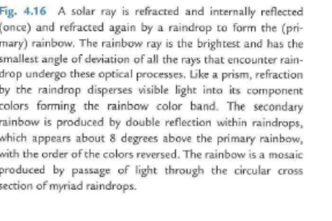

Slide 88
Fig. 4.16 A solar ray is refracted and internally reflected
( once) and refracted again by a raindrop to form the (primary)
rainbow. The rainbow ray is the brightest and has the
smallest angle of deviation of all the rays that encounter raindrop
undergo these optical processes. Like a prism, refraction
by the raindrop disperses visible light into its component
colors forming the rainbow color band. The secondary
rainbow is produced by double reflection within raindrops,
which appears about 8 degrees above the primary rainbow,
with the order of the colors reversed. The rainbow is a mosaic
produced by passage of light through the circular cross
section of myriad raindrops.

Slide 90
Fig. 4.17 Haloes of 22° and 46° (faint) formed in a thin
cloud consisting of ice crystals. (Photograph courtesy of
Alistair Fraser.]

Slide 91
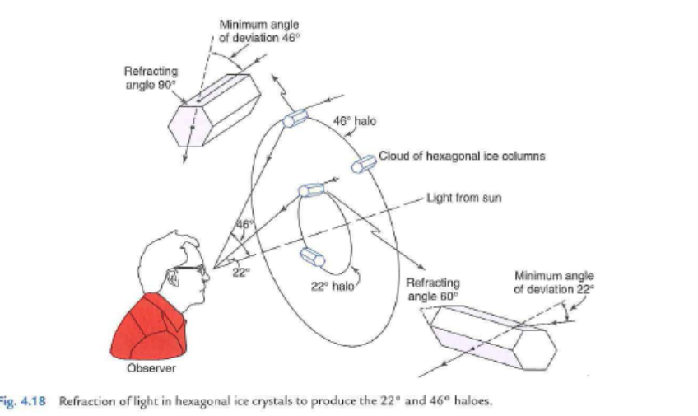
Fig. 4.18 Refraction of light in hexagonal ice crystals to produce the 22 ° and 46° haloes.

Slide 92
• coronas produced by the diffraction of light in
water droplets in low or (sometimes) middle
cloud decks. They consist of colored rings at
an angular radius of less than 15° from the
light sources, e.g., the sun or moon. If the
cloud droplets are fairly uniform in size,
several sequences of rings may be seen: the
spacing of the rings depends upon droplet
size. In each sequence the inside ring is violet
or blue and the outside ring is red. An example
is shown in Fig. 4.19.

Slide 94
4.4.2 Absorption by Particles
The absorption of radiation by particles is of
interest in its own right, and affects scattering as
well. The theoretical framework discussed in the
previous subsection ( commonly referred to as
Mie theory) predicts both the scattering and the
absorption of radiation by homogeneous spherical
particles, where the real part of the refractive
index relates to the scattering and the imaginary
part relates to the absorption. This brief section
mentions just a few of the consequences of absorption
. In the plot of K versus x (Fig. 4.13) the presence
of absorption tends to damp the oscillatory
behavior in the Mie regime. In the limit of x > > 1,

Slide 95
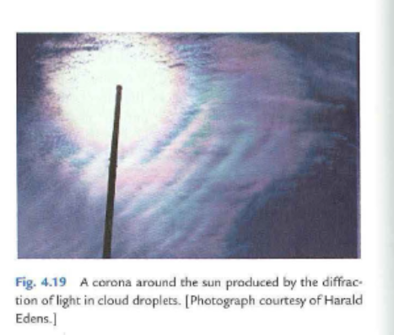
Fig. 4.19 A corona a round the sun produced by the d iffraction
of light in cloud droplets. [Photograph courtesy of Harald
Edens.]

Slide 96
the extinction coefficient always approaches 2 but,
in accordance with (4.13) the scattering coefficient,
ranges from as low as 1 in the case of strong absorption
to as high as 2 for negligible absorption. In the
longwave part of the electromagnetic spectrum,
cloud droplets absorb radiation so strongly that
even a relatively thin cloud layer of clouds behaves
as a blackbody, absorbing virtually all the radiation

Slide 97
4.3.3 The Stefan:..Boltzmann Law
The blackbody flux density (or irradiance) obtained
by integrating the Planck function TTBA over all wavelengths
is given by the Stefan7- Boltzmann law
where σ, the Stefan- Boltzmann constant, is equal
to 5.67 X 10-s W m-2 K-4. Given measurements of
the flux density F from any black or non black body,
(4.12) can be solved for the equivalent blackbody
temperature (also referred to as the effective emission
temperature) TE; that is, the temperature
TE that a blackbody would need to be at in order
to emit radiation at the measured rate F. If the
body in question emits as a blackbody, its actual
temperature and its equivalent blackbody temperature
will be the same. Applications of the
Stefan- Boltzmann law and the concept of equivalent
blackbody temperature are illustra ted in the
following exercises.

Slide 98
Exercise 4.5 Calculate the equivalent blackbody
temperature TE of the solar photosphere (i.e., the
outermost visible layer of the sun) based on the
following information. The flux density of solar
radiation reaching the Earth, Fs, is 1368 W m-2. The
Earth- sun distance d is 1.50 x 1011 m and the radius
of the solar photosphere Rs is 7.00 X 10s m.
Solution: We first calculate the flux density at
the top of the layer, making use of the inverse square
law (4.7).
(

Slide 99
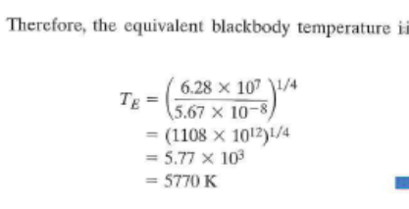
T = ( 6.28 x 101 )1/4
E 5.67 X 10-8
= (1108 x 101 2)1/4
= 5.77 X 103
= 5770 K • •
That this value is slightly lower than the sun's color
temperature estimated in the previous exercise is evidence
that the spectrum of the sun's emission differs
slightly from the blackbody spectrum prescribed by
Planck's law ( 4.10).

Slide 100
Exercise 4. 7 A small blackbody satellite is orbiting
the Earth at a distance far enough away so that the flux
density of Earth radiation is negligible, compared to
that of solar radiation. Suppose that the satellite suddenly
passes into the Earth's shadow. At what rate will
it initially cool? The satellite has a mass m = 103 kg
and a specific heat c = 103 J (kg K)- 1: it is spherical
with a radius r = 1 m, and temperature is uniform over
its surface.
Solution: Consideration of the energy balance, as
in the previous problem, but with an albedo of zero
yields an emission F = 342 W m-2 from the satellite,
which implies an equivalent blackbody temperature
TE = 279 K. When the satellite passes into the
Earth's shadow, it will no longer be in radiative equilibrium.
The flux density of solar radiation abruptly
drops to zero while the emitted radiation, which is
determined by the temperature of the satellite,
drops gradually as the satellite cools by emitting
radiation. The instant that the satellite passes into
the shadow, its temperature is still equal to TE, so we
can write

Slide 101
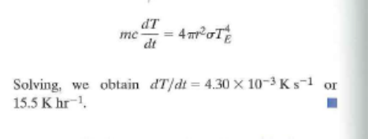
Solving, we obtain dT/dt = 4.30 x 10- 3 K s- 1 or
15.5 Khr-1. •

Slide 104
Quantum mechanics describes the energy levels of a given molecule. The key point is that the energy levels are given by a discrete sequence, let us say (Enln, specific of the spectroscopic properties of the molecule.
The simplest illustration is detailed in Exercise 2.1, with the case of a particle supposed to be "trapped in a well".
Consider a molecule with a given energy level, let us say E 1, The emission of a photon by this molecule corresponds to a transition from E 1 to a lower energy level, let us say E2 < E 1 . On the opposite, the absorption of a photon by this molecule implies the transition from E 1 to a higher energy level, let us say E2 > E 1 . The wavelength of the photon is fixed by the energy transition. Planck's law (Fig. 2.3) states that

Slide 105
A photon can therefore be absorbed or emitted only if its wavelength corresponds to a possible transition. As a result, for a given molecule, absorption and emission are possible only in specific parts of the radiation spectrum (determined by the spectro­scopic properties of the molecule).
If). has a small value, the energy gap is large: the shortwave radiations (e.g. ultra­violet radiation) are the most energy-containing ones (Fig. 2.1 ). On the other hand, if the wavelength has a large value, the energy gap is low: the longwave radiations (e.g. infrared radiation) do not contain a lot of radiative energy.
Fig. 2.3 En1ission and absorption of a photon: transition bet,veen two energy levels E 1 and E2 (E1 < E2). The wavelength is given by Planck's law,).= hc/(E2 - E1)

Slide 110
Consider the atmosphere as a virtual layer at a given distance from the Earth's surface. Let us assume that nothing happens in the region between the surface and the layer (Fig. 2.15).
From the radiative properties of the atmosphere (strong absorption of the infrared radiations and atmospheric window for the visible radiations), we assume that:
he layer and the Earth are at radiative equilibrium: in a first approximation, we neglect the non-radiative energy flux;
• the layer reflects a fraction A of the incident solar radiation Fs. It absorbs a frac­tion as and transmits to the Earth a fraction (1 - as) of the remaining radiation (1 - A) f,. The Earth is supposed to absorb the whole received radiation;
• the Earth emits longwave radiations U (up): a fraction (ar) is absorbed by the layer while the remaining part ( 1 - ar) is transmitted to space;
• the layer is then heated and emits a radiation D (down): a fraction a is transmitted to the Earth and then absorbed.

Slide 111
Let us investigate the sensitivity of the Earth's temperature (T) with respect to the absorption coefficient of the layer
for the te1rnstrial radiation (ar ).
Taking into account the previous data (Fig. 2.14) yield
The budget energy for the Earth and the atmospheric layer reads

Slide 116
Consider an atmosphere composed of a single isothermal layer. Because the layer is
opaque in the longwave part of the spectrum, the equivalent blackbody temperature of the planet corresponds
to the temperature of the atmosphere. Hence, the atmosphere must emit F units radiation to space
as a blackbody to balance the F units of incoming solar radiation transmitted downward through the top
of the atmosphere. Because the layer is isothermal, it also emits F units of radiation in the downward direction.
Hence, the downward radiation at the surface of the planet is F units of incident solar radiation plus F
units of longwave radiation emitted from the atmosphere, a total of 2F units, which must be balanced by
an upward emission of 2F units of longwave radiation from the surface. Hence, from the Stefan- Boltzmann
law the temperature of the surface of the planet is 303 K, i.e., 48 K higher than it would be in the
absence of an atmosphere, and the temperature of the atmosphere is the same as the temperature of the surface
of the planet .

Slide 117
If a second isothermal, opaque layer is added, as
illustrated in Fig. 4.9, the flux density of downward
radiation incident upon the lower layer will be 2F
Fig. 4 .9 Radiation balance for a planetary atmosphere that is
transparent to solar radiation and consists of two isothermal
layers that are opaque to planetary radiation. Thin downward
arrows represent the flux of F units of shortwave solar radiation
transmitted downward through the atmosphere. Thicker arrows
represent the emission of longwave radiation from the surface
of the planet and from each of the layers. For radiative equilibrium
the net radiation passing through the Earth's surface and
the top of each of the layers must be equal to zero.

Slide 118
(F units of solar radiation plus F units of longwave
radiation emitted by the upper layer). To balance the
incident radiation, the lower layer must emit 2F units
of longwave radiation. Because the layer is isothermal,
it also emits 2F units of radiation. in the downward
radiation. Hence, the downward radiation at
the surface of the planet is F units of incident solar
radiation plus 2Funits of longwave radiation emitted
from the atmosphere, a total of 3F units, which must
be balanced by an upward emission of 3F units of
longwave radiation from the surface. •

Slide 119
By induction, the aforementioned analysis can be
extended to an N-layer atmosphere. The emissions
fi:om the atmospheric layers, working downward
from the top, are F, 2F, 3F ... NF and the corresponding
radiative equilibrium temperatures are 303,
335 .... [(N + l)F/σ]1/4 K. The geometric thickness
of opaque layers decreases approximately exponentially
as one descends through the atmosphere due to
the increasing density of the absorbing medium with
depth. Hence, the radiative equilibrium lapse rate
steepens with increasing depth. In effect, radiative
transfer becomes less and less efficient at removing
the energy absorbed at the surface of the planet due
to the increasing blocking effect of greenhouse gases.
Once the radiative equilibrium lapse rate exceeds the
adiabatic lapse rate (Eq. 3.53), convection becomes
the primary mode of energy transfer.
That the global mean surface temperature of the
Earth is 289 K rather than the equivalent blackbody
temperature 255 K, as calculated in Exercise 4.6, i

Slide 120
attributable to the greenhouse effect. Were it not for
the upward transfer of latent and sensible heat by
fluid motions within the Earth's atmosphere, the disparity
would be even larger.
To perform more realistic radiative transfer calculations,
it will be necessary to consider the dependence
of absorptivity upon the wavelength of the
radiation. It is evident from the bottom part of
Fig. 4.7 that the wavelength dependence is quite pronounced,
with well-defined absmption bands identified
with specific gaseous constituents, interspersed
with windows in which the atmosphere is relatively
transparent. As shown in the next section, the
wavelength dependence of the absorptivity is even
more complicated than the low-resolution absorption
spectra in Fig. 4.7 would lead us to believe.

Slide 121
Extinction Processes in the Atmosphere:
Absorption, reflection, scattering

