Slide 1
AOSC400-2015
September 29, Lecture # 8
Supplementary comments on radiation units terminology
Simple radiation balance climate model
Radiative Properties of Nonblack
Materials
Copyright@2015 University of Maryland
This material may not be reproduced or redistributed, in whole or in part, without written permission of Rachel T. Pinker

Slide 2
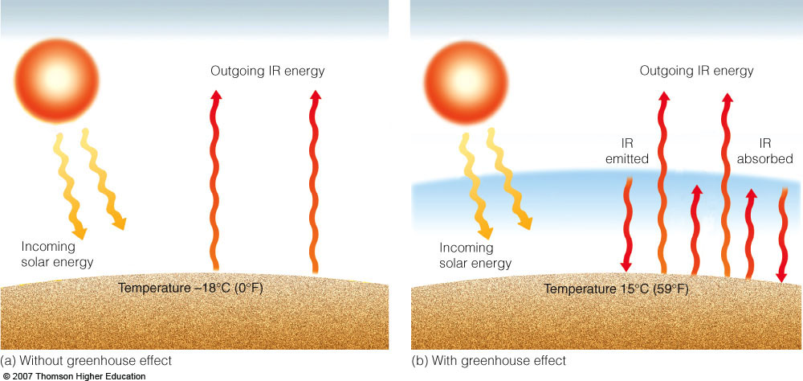
“The Greenhouse Effect”
T_{e}=[(1-r)S/4σ]^{1/4;} Actual value of T_{e} is 15⁰ C.

Slide 3
What drives climate to change? - “radiative forcing”: A small change in the energy balance of the earth can change surface temperatures, winds, precipitation patterns => its climate

Slide 7
4.3.3 The Stefan:..Boltzmann Law
The blackbody flux density (or irradiance) obtained
by integrating the Planck function TTBA over all wavelengths
is given by the Stefan7- Boltzmann law
where σ, the Stefan- Boltzmann constant, is equal
to 5.67 X 10-s W m-2 K-4. Given measurements of
the flux density F from any black or non black body,
(4.12) can be solved for the equivalent blackbody
temperature (also referred to as the effective emission
temperature) TE; that is, the temperature
TE that a blackbody would need to be at in order
to emit radiation at the measured rate F. If the
body in question emits as a blackbody, its actual
temperature and its equivalent blackbody temperature
will be the same. Applications of the
Stefan- Boltzmann law and the concept of equivalent
blackbody temperature are illustra ted in the
following exercises.

Slide 8
Exercise 4.5 Calculate the equivalent blackbody
temperature TE of the solar photosphere (i.e., the
outermost visible layer of the sun) based on the
following information. The flux density of solar
radiation reaching the Earth, Fs, is 1368 W m-2. The
Earth- sun distance d is 1.50 x 1011 m and the radius
of the solar photosphere Rs is 7.00 X 10s m.
Solution: We first calculate the flux density at
the top of the layer, making use of the inverse square
law (4.7).
(

Slide 9
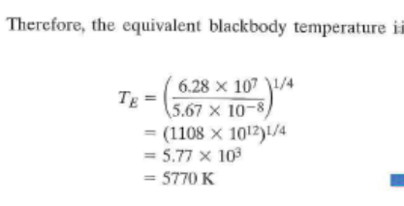
T = ( 6.28 x 101 )1/4
E 5.67 X 10-8
= (1108 x 101 2)1/4
= 5.77 X 103
= 5770 K • •
That this value is slightly lower than the sun's color
temperature estimated in the previous exercise is evidence
that the spectrum of the sun's emission differs
slightly from the blackbody spectrum prescribed by
Planck's law ( 4.10).

Slide 10
Exercise 4. 7 A small blackbody satellite is orbiting
the Earth at a distance far enough away so that the flux
density of Earth radiation is negligible, compared to
that of solar radiation. Suppose that the satellite suddenly
passes into the Earth's shadow. At what rate will
it initially cool? The satellite has a mass m = 103 kg
and a specific heat c = 103 J (kg K)- 1: it is spherical
with a radius r = 1 m, and temperature is uniform over
its surface.
Solution: Consideration of the energy balance, as
in the previous problem, but with an albedo of zero
yields an emission F = 342 W m-2 from the satellite,
which implies an equivalent blackbody temperature
TE = 279 K. When the satellite passes into the
Earth's shadow, it will no longer be in radiative equilibrium.
The flux density of solar radiation abruptly
drops to zero while the emitted radiation, which is
determined by the temperature of the satellite,
drops gradually as the satellite cools by emitting
radiation. The instant that the satellite passes into
the shadow, its temperature is still equal to TE, so we
can write

Slide 11
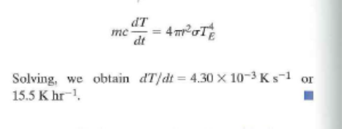
Solving, we obtain dT/dt = 4.30 x 10- 3 K s- 1 or
15.5 Khr-1. •

Slide 12
Radiative Properties of Nonblack
Materials
4.3.4 Unlike blackbodies, which absorb all incident radiation,
nonblack bodies such as gaseous media can also
reflect and transmit radiation. However, their behavior
can nonetheless be understood by applying the
radiation laws derived for blackbodies. For this purpose
it is useful to define the (monochromatic) emissivity
sA, i.e., the ratio of the monochromatic intensity
of the radiation emitted by the body to the corresponding
blackbody radiation

Slide 14
and the (monochromatic) absorptivity, reflectivity, and transmissivityS the fractions of the incident monochromatic intensity that a body absorbs, reflects, and transmits, i.e.,

Slide 15
4.3.6 The Greenhouse Effect
Solar and tenestrial radiation occupy different ranges
of the electromagnetic spectrum that we have been
referring to as shortwave and longwave. For reasons
explained in the next section, water vapor, carbon
dioxide, and other gases whose molecules have electric
dipole moments absorb radiation more strongly in the
longwave part of the spectrum occupied by outgoing
terrestrial radiation than the shortwave part occupied
by incoming solar radiation. This distinction is reflected
in the transmissivity spectra of the atmosphere shown
in the lower part of Fig. 4.7. Hence, incoming solar
radiation passes through the atmosphere quite freely,
whereas tenestrial radiation emitted from the Earth's
surface is absorbed and reernitted in its upward passage
th.rough the atmosphere. The following highly
simplified exercise shows how the presence of such
greenhouse gases in a planetary atmosphere tends to
wam1 the surface of the planet.

Slide 16
Exercise 4.8 The Earth-like planet considered in
Exercise 4.6 has an atmosphere consisting of multiple
isothermal layers, each of which is transparent to
shortwave radiation and completely opaque to longwave
radiation. The layers and the surface of the
planet are in radiative equilibrium. How is the surface
temperature of the planet affected by the presence
of this atmosphere?

Slide 17
Solution: Begin by considering an atmosphere composed
of a single isothermal layer. Because the layer is
opaque in the longwave part of the spectrum, the
equivalent blackbody temperature of the planet corresponds
to the temperature of the atmosphere. Hence,
the atmosphere must emit F units radiation to space
as a blackbody to balance the F units of incoming
solar radiation transmitted downward through the top
of the atmosphere. Because the layer is isothermal, it
also emits F units of radiation in the downward direction.
Hence, the downward radiation at the surface of
the planet is F units of incident solar radiation plus F
units of longwave radiation emitted from the atmosphere,
a total of 2F units, which must be balanced by
an upward emission of 2F units of longwave radiation
from the surface. Hence, from the Stefan- Boltzmann
law ( 4.12) the temperature of the surface of the planet
is 303 K, i.e., 48 K higher than it would be in the
absence of an atmosphere, and the temperature of the
atmosphere is the same as the temperature of the surface
of the planet calculated in Exercise 4.6.

Slide 18
If a second isothermal, opaque layer is added, as
illustrated in Fig. 4.9, the flux density of downward
radiation incident upon the lower layer will be 2F
Fig. 4 .9 Radiation balance for a planetary atmosphere that is
transparent to solar radiation and consists of two isothermal
layers that are opaque to planetary radiation. Thin downward
arrows represent the flux of F units of shortwave solar radiation
transmitted downward through the atmosphere. Thicker arrows
represent the emission of longwave radiation from the surface
of the planet and from each of the layers. For radiative equilibrium
the net radiation passing through the Earth's surface and
the top of each of the layers must be equal to zero.

Slide 19
(F units of solar radiation plus F units of longwave
radiation emitted by the upper layer). To balance the
incident radiation, the lower layer must emit 2F units
of longwave radiation. Because the layer is isothermal,
it also emits 2F units of radiation. in the downward
radiation. Hence, the downward radiation at
the surface of the planet is F units of incident solar
radiation plus 2Funits of longwave radiation emitted
from the atmosphere, a total of 3F units, which must
be balanced by an upward emission of 3F units of
longwave radiation from the surface. •
By induction, the aforementioned analysis can be
extended to an N-layer atmosphere. The emissions
fi:om the atmospheric layers, working downward
from the top, are F, 2F, 3F ... NF and the corresponding
radiative equilibrium temperatures are 303,
335 .... [(N + l)F/σ]1/4 K. The geometric thickness
of opaque layers decreases approximately exponentially
as one descends through the atmosphere due to
the increasing density of the absorbing medium with
depth. Hence, the radiative equilibrium lapse rate
steepens with increasing depth. In effect, radiative
transfer becomes less and less efficient at removing
the energy absorbed at the surface of the planet due
to the increasing blocking effect of greenhouse gases.
Once the radiative equilibrium lapse rate exceeds the
adiabatic lapse rate (Eq. 3.53), convection becomes
the primary mode of energy transfer.
That the global mean surface temperature of the
Earth is 289 K rather than the equivalent blackbody
temperature 255 K, as calculated in Exercise 4.6, i

Slide 20
attributable to the greenhouse effect. Were it not for
the upward transfer of latent and sensible heat by
fluid motions within the Earth's atmosphere, the disparity
would be even larger.
To perform more realistic radiative transfer calculations,
it will be necessary to consider the dependence
of absorptivity upon the wavelength of the
radiation. It is evident from the bottom part of
Fig. 4.7 that the wavelength dependence is quite pronounced,
with well-defined absmption bands identified
with specific gaseous constituents, interspersed
with windows in which the atmosphere is relatively
transparent. As shown in the next section, the
wavelength dependence of the absorptivity is even
more complicated than the low-resolution absorption
spectra in Fig. 4.7 would lead us to believe.

Slide 26
4.4 Physics of Scattering and Absorption and Emission
The scattering and absorption of radiation by gas
molecules and aerosols all contribute to the extinction
of the solar and terrestrial radiation passing
through the atmosphere. Each of these contributions
is linearly propor tional to (1) the intensity of the
radiation at that point along the ray path, (2) the
local concentration of the gases and/or par ticles
that are responsible for the absorption and scattering,
and (3) the effectiveness of the absorbers or
scatterers.

Slide 27
Let us consider the fa te of a beam of radiation
passing through an arbitrarily thin layer of the
atmosphere along a specific path, as depicted in Fig.
4.10. For each kind of gas molecule and particle that
the beam encounters, its monochromatic intensity is
decreased by the increment

Slide 28
where N is the number of particles per unit volume
of air, u is the areal cross section of each particle,
K;,. is the (dimensionless) scattering or abs01ption
efficiency, and ds is the differential path length
along the ray path of the incident radiation. An
extinction efficiency, which represents the combined
effects of scattering and absorption in depleting the
intensity of radiation passing through the layer, can
be defined in a similar manner. The product KnNs is
called the scattering, absorption, or extinction cross
section. In the case of a gaseous atmospheric
constituent, it is sometimes convenient to express
the rate of scattering or absorption in the form
(4.17)

Slide 29
where p is the density of the air, r is the mass of the
absorbing gas per unit mass of air, and kA is the mass
abso1ption coefficient, which has units of m2 kg-1.
In the aforementioned expressions the products
are volume scattering, absorption, or
extinction coefficients, depending on the context,
and have units of m- 1. The contributions of the
various species of gases and particles are additive

Slide 30
as
are the contributions of scattering and absorption
to the extinction of the incident beam of radiation; i.e.,

Slide 31
4 .4.1 Scattering by Air Molecules
and Particles
At any given place and time, particles including
aerosols with a wide variety of shapes and sizes, as
well as cloud droplets and ice crystals, may be present.
Non etheless it is instructive to consider the
case of scattering by a spherical particle of radius r,
for which the scattering, absorption, or extinction
efficiency KA in ( 4.16) can be prescribed on the

Slide 33
Fig. 4.11 Size parameter x as a function of wavelength (},.)
of the incident radiation and particle radius r.
basis of theory, as a function of a dimensionless size
parameter

Slide 34
(4.19)
and a complex index of refraction of the particles
(m == m,. + imi), whose real part m,. is the ratio of
the speed of light in a vacuum to the speed at
which light travels when it is passing through the
particle. Figure 4.11 shows the range of size parameters
for various kinds of particles in the atmosphere
and radiation in various wavelength ranges.
For the scattering of radiation in the visible part of
the spectrum, x ranges from much Jess than 1 for
air molecules to - 1 for haze and smoke particles to
> > 1 for raindrops.
Particles with x << 1 are relatively ineffective at
scattering radiation. Within this so-called Rayleigh
scattering regime the expression for the scatte1ing
efficiency is of the form
(4.20)
and the scattering is divided evenly between the
forward and backward hemispheres, as indicated in
Fig. 4.12a. For values of the size parameter comparable
to or greater than 1 the scattered radiation is
directed mainly into the forward hemisphere, as indicated
in subsequent panels.

Slide 35
Figure 4.13 shows KA as a function of size parameter
for particles with m,. = 1.5 and a range of values
of m;. Consider just the top curve that corresponds

Slide 36
Fig. 4.12 Schematic showing the angular distribution of the
radiation at visible (0.5 μ,m) wavelength scattered by spherical
particles with radii of(a) 10- 4 μ,m , (b) 0.1 μ,m, and (c) 1 μ,m.
The forward scattering for the 1-μ,m aerosol is extremely large
, and is scaled for presentation purposes. [Adapted from
K. N. Liou, An Introduction to Atmospheric Radiation, Academic
Press, p. 7, Copyright (2002), with permission from Elsevier.]

Slide 38
Fig. 4 .13 Scattering efficiency KA as a function of size
parameter x, plotted on a logarithmic scale, for four different
refractive indices with m, = 1.5 and m; ranging from Oto 1, as
indicated. [From K. N. Liou, An Introduction to Atmospheric
Radiation, Academic Press, p. 191, Copyright (2002), with
permission from Elsevier.]
tom;= 0 (no absorption). For 0.1 ~ x :5 50, referred
to as the Mie10 scattering regime, KA exhibits a
damped oscillatory behavior, with a mean around a
value of 2, and for x ~ 50, the range referred to
the geometric optics regime, the oscillatory behavior
is less prominent and KA = 2.

Slide 39
Exercise 4.9 Estimate the relative efficiencies with
which red light (A= 0.64μ,m) and blue light
(A= 0.47 μ,m) are scattered by air molecules.
Solution: From ( 4.20)
K(blue) = (0.64)4 = 3.45
K(red) 0.47'

Slide 40
Hence, the preponderance of blue in light scattered by
air molecules, as evidenced by the blueness of the sky
on days when the air is relatively free from aerosols.
Figure 4.14 shows an example of the coloring of
the sky and sunlit objects imparted by Rayleigh scattering.
The photograph was taken just after sunrise.
Blue sky is visible overhead, while objects in the
foreground, including the aerosol layer, are illuminated
by sunlight in which the shorter wavelengths
(bluer colors) have been depleted by scattering along
its long, oblique path through the atmosphere.
Ground-based weather radars and remote sensing
of rainfall from instruments carried aboard satellites
exploit the size strong dependence of scattering
efficiency K upon size parameter x for microwave
radiation in the 1- to 10-cm wavelength range incident
upon clouds with droplet radii on the order of
millimeters. In contrast to infrared radiation, which

Slide 41
is strongly absorbed by clouds, microwave radiation
passes through clouds with droplets ranging up to
hundreds of micrometers in radius with little or no
scattering. Radiation backscattered from the pulsed
radar signal by the larger drops reveals the regions of
heavy precipitation.
Scattering of parallel beam solar radiation and
moonlight gives rise to a number of distinctive optical
effects, that include
• rainbows (Figs. 4.15 and 4.16) formed by the
refraction and internal reflection of sunlight in
water drops (usually raindrops). The bow
appears as a circle, rarely complete, centered on
the antisolar point, which lies on the line from
the sun passing through the eye of the observer.
The colors of the rainbow from its outer to its
inner circumference are red, orange, yellow,
green, blue, indigo, and violet. Rainbows are
usually seen in falling rain with drop diameters
of a few millimeters. Because the drops are much
larger than the wavelength of the light, the
classical theory of geometric optics provides a
reasonable description for the primary bow.
• bright haloes produced by the refraction of light
by hexagonal, prismshaped ice crystals in high,
thin cirrostratus cloud decks, the most common
of which are at angles of 22° and 46°, as shown in
Fig. 4.17 and the schematic Fig. 4.18.1

Slide 47
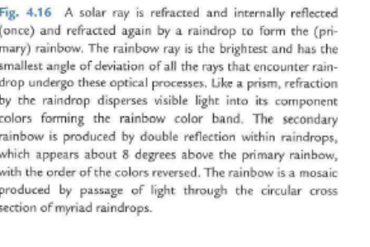

Slide 48
Fig. 4.16 A solar ray is refracted and internally reflected
( once) and refracted again by a raindrop to form the (primary)
rainbow. The rainbow ray is the brightest and has the
smallest angle of deviation of all the rays that encounter raindrop
undergo these optical processes. Like a prism, refraction
by the raindrop disperses visible light into its component
colors forming the rainbow color band. The secondary
rainbow is produced by double reflection within raindrops,
which appears about 8 degrees above the primary rainbow,
with the order of the colors reversed. The rainbow is a mosaic
produced by passage of light through the circular cross
section of myriad raindrops.

Slide 50
Fig. 4.17 Haloes of 22° and 46° (faint) formed in a thin
cloud consisting of ice crystals. (Photograph courtesy of
Alistair Fraser.]

Slide 51
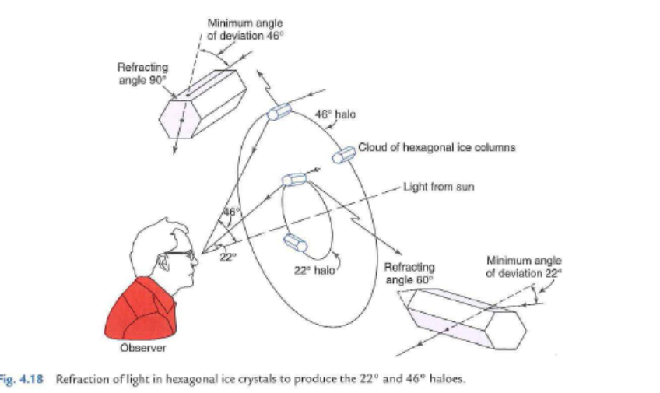
Fig. 4.18 Refraction of light in hexagonal ice crystals to produce the 22 ° and 46° haloes.

Slide 52
• coronas produced by the diffraction of light in
water droplets in low or (sometimes) middle
cloud decks. They consist of colored rings at
an angular radius of less than 15° from the
light sources, e.g., the sun or moon. If the
cloud droplets are fairly uniform in size,
several sequences of rings may be seen: the
spacing of the rings depends upon droplet
size. In each sequence the inside ring is violet
or blue and the outside ring is red. An example
is shown in Fig. 4.19.

Slide 54
4.4.2 Absorption by Particles
The absorption of radiation by particles is of
interest in its own right, and affects scattering as
well. The theoretical framework discussed in the
previous subsection ( commonly referred to as
Mie theory) predicts both the scattering and the
absorption of radiation by homogeneous spherical
particles, where the real part of the refractive
index relates to the scattering and the imaginary
part relates to the absorption. This brief section
mentions just a few of the consequences of absorption
. In the plot of K versus x (Fig. 4.13) the presence
of absorption tends to damp the oscillatory
behavior in the Mie regime. In the limit of x > > 1,

Slide 55
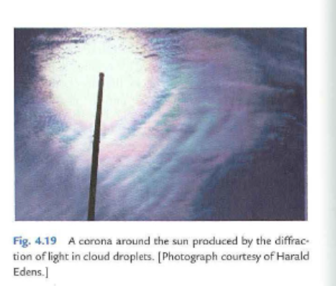
Fig. 4.19 A corona a round the sun produced by the d iffraction
of light in cloud droplets. [Photograph courtesy of Harald
Edens.]

Slide 56
the extinction coefficient always approaches 2 but,
in accordance with (4.13) the scattering coefficient,
ranges from as low as 1 in the case of strong absorption
to as high as 2 for negligible absorption. In the
longwave part of the electromagnetic spectrum,
cloud droplets absorb radiation so strongly that
even a relatively thin cloud layer of clouds behaves
as a blackbody, absorbing virtually all the radiation

