Slide 1
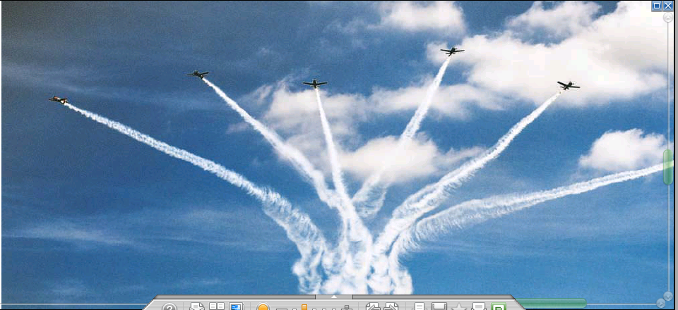
Joint Base Andrews Air Show on Saturday
Sept 19, 2015 in Price George’s County, MD.
Melanie Russ [mailto:melanie@ucar.edu]

Slide 2
How to determine the length of a day?

Slide 3
How to determine sun elevation θ?
SUN
ZENITH
HORIZONTAL
IRRADIANCE I_{o}
NORMAL
IRRADIANCE I_{on}
θ_{z}
HORIZONTAL
SURFACE
EARTH

Slide 4
How to compute the solar zenith angle
Based on spherical geometry, the following relationship between the relevant angles is derived:
cosθ_{z} = sin(δ)sin(φ)+ cos(δ)cos(φ) cos(ω)
φ – latitude
δ - declination
ω hour angle
Hour angle ω is the distance in angle units from the solar noon (one hour is 15 deg). So first we need to derive the solar time for the location under consideration.
Solar time = standard time + E + 4 ( L_{st} – L _{loc})
E - equation in time in minutes
L_{st} - standard meridian for local time zone
L _{loc} - longitude of location in degrees west
sin (h) = sin (φ) * sin (δ) + cos (φ) * cos (δ) * cos (ω)

Slide 5
Example:
Compute length of day for June 21, at lat of 48⁰
June 21, δ =23.5°, φ =48°
Substitute in:
cosθ_{z} = sin(δ)sin(φ)+ cos(δ)cos(φ) cos(ω)
we get ω = 118.9°
corresponding to 7.93 hours (since ω =360° corresponds to 24 hours)
The Sun rises 7.93 hours before solar noon and sets 7.93 hours after, length of solar day is about 15.85 hours.
http://www.srrb.noaa.gov/highlights/sunrise/sunrise.html

Slide 6
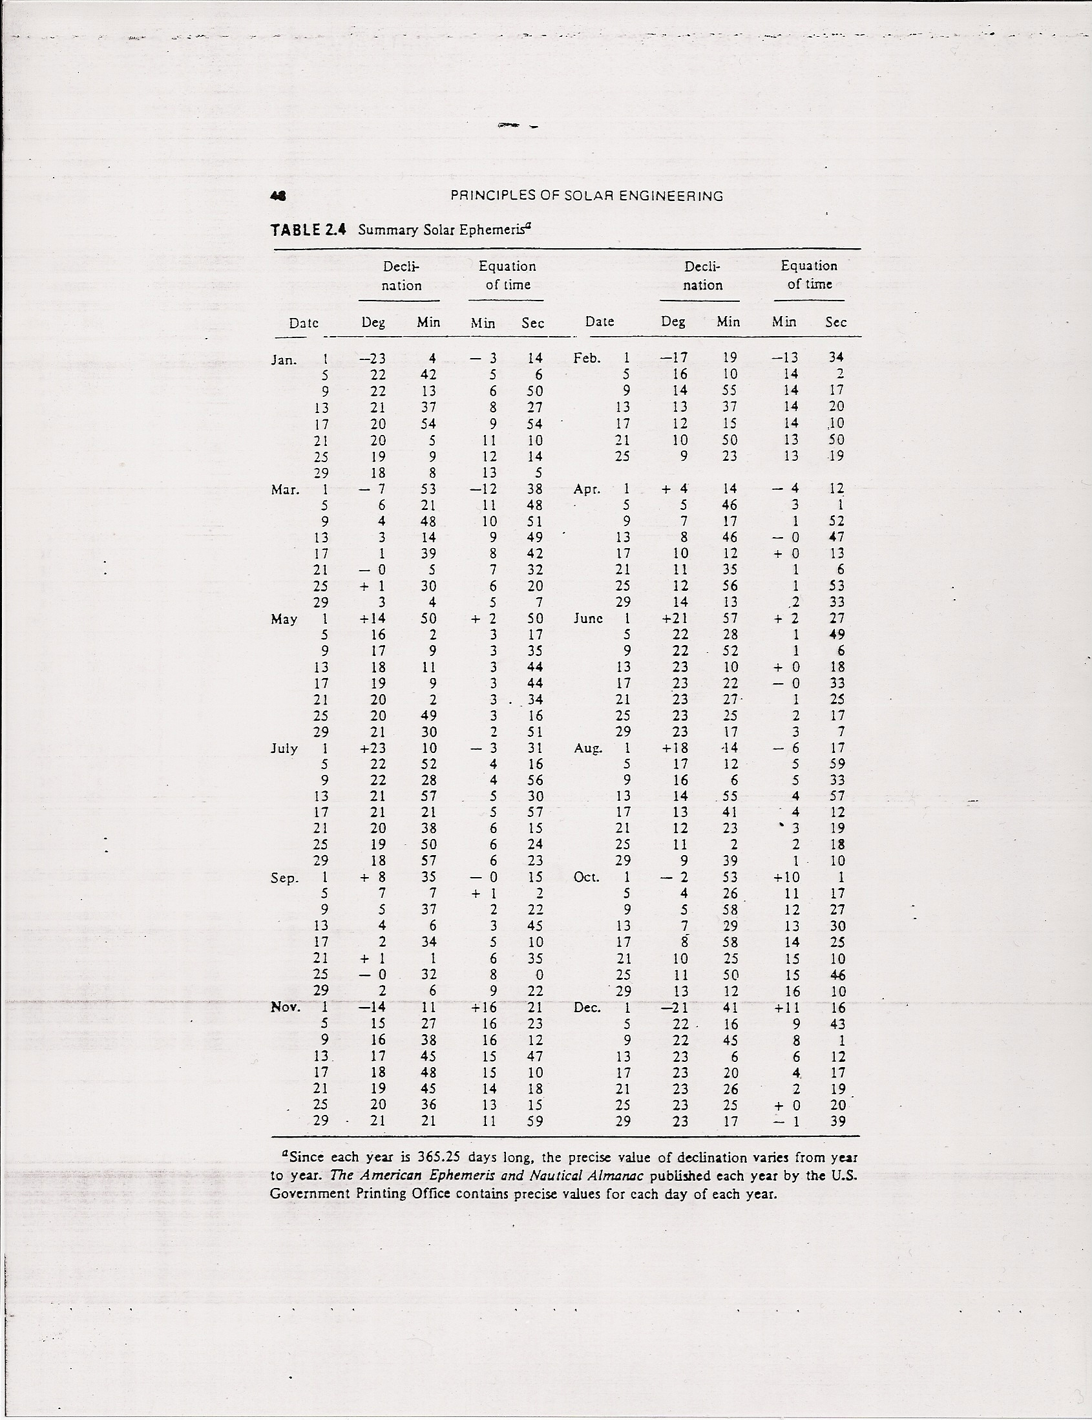

Slide 7
Solar Calculators
http://www.srrb.noaa.gov/surfrad/
http://www.srrb.noaa.gov/highlights/sunrise/sunrise.html

Slide 8
AOSC400-2015
September 22, Lecture # 6
Reflection/Refraction
Relative optical path length
Empirical expression for air mass
Thermal radiation
Basic long-wave (thermal) radiation laws:
Plank; Stefan-Boltzmann; Wien
Simple radiation balance climate model
Copyright@2015 University of Maryland
This material may not be reproduced or redistributed, in whole or in part, without written permission of Rachel T. Pinker

Slide 9
The Energy Source for Weather and Climate is Solar Radiation from the Sun
Of interest: what fraction of received goes back
The ratio between the reflected part and the incoming part is called albedo (A)

Slide 10
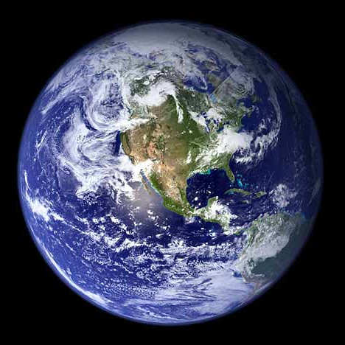
Earth’s albedo that includes clouds can be estimated from satellites
The various elements that affect the Earth’s albedo cover a large range of values:
Water: 10%
Snow: 80-90%
Desert sand: 40%
Earth average: 31%

Slide 11
Reflection is the change of direction of wave.
It can be categorized as the specular reflection, bi-directionally specular reflection and diffuse reflection. It is one of the ways to loss information.
Absorption, scattering and reflection can happen at the same time.
Surface albedo generally refers to the total solar spectrum integrated over all angles.
Albedo is used in climate to form surface
energy budgets. For this purpose, the integrated albedo is needed.

Slide 12
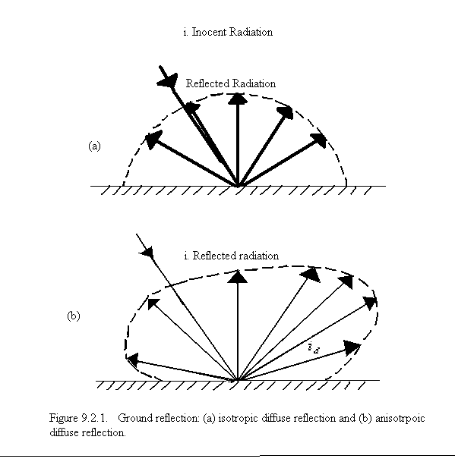

Slide 13
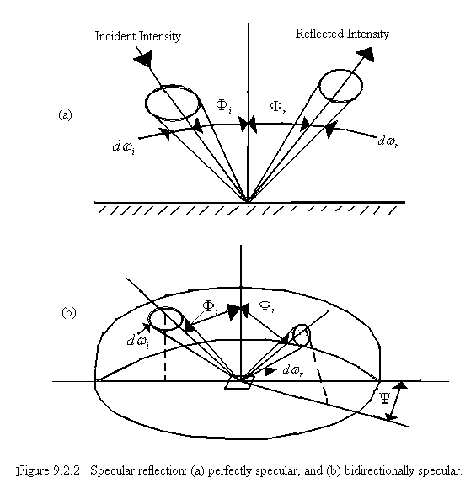

Slide 14
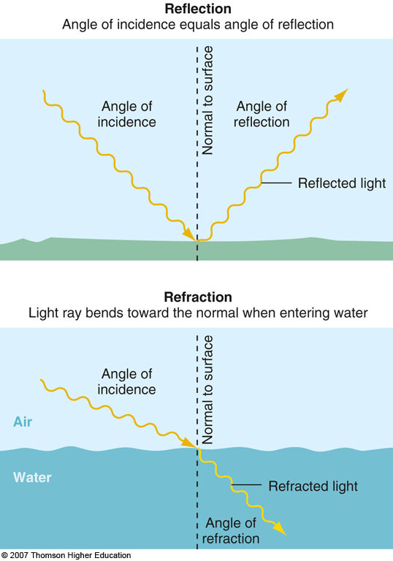

Slide 15
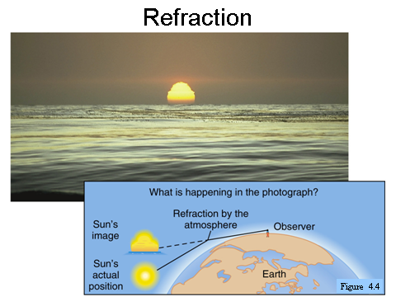

Slide 16
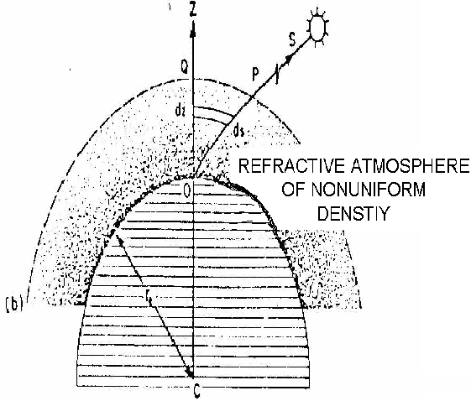
The trajectory of a solar ray through the earth’s atmosphere. (a) Nonrefractive plane parallel atmosphere of uniform density. (b) Refractive spherical atmosphere of variable density.

Slide 17
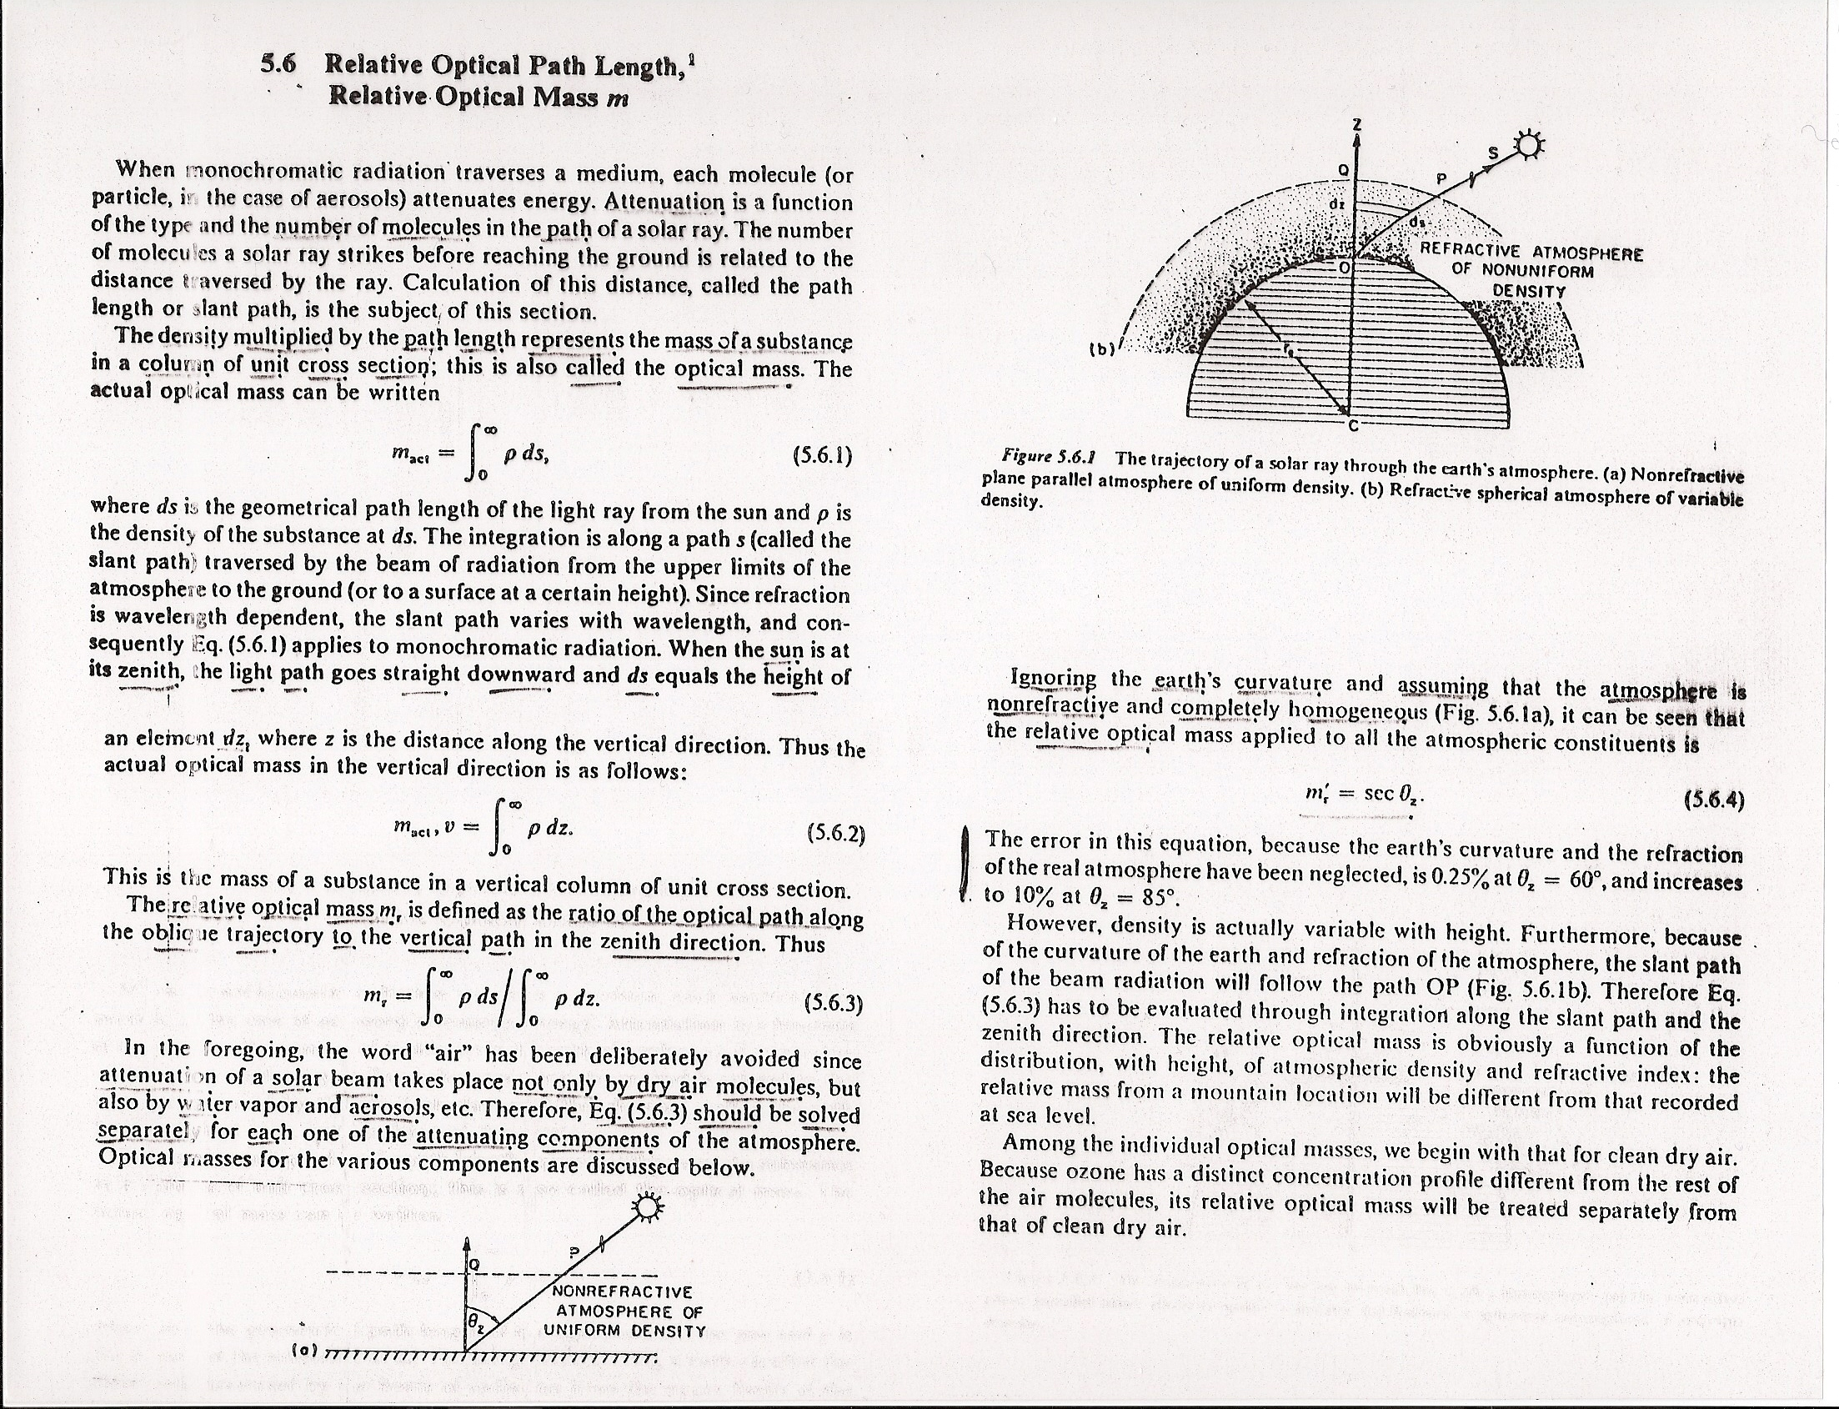

Slide 21
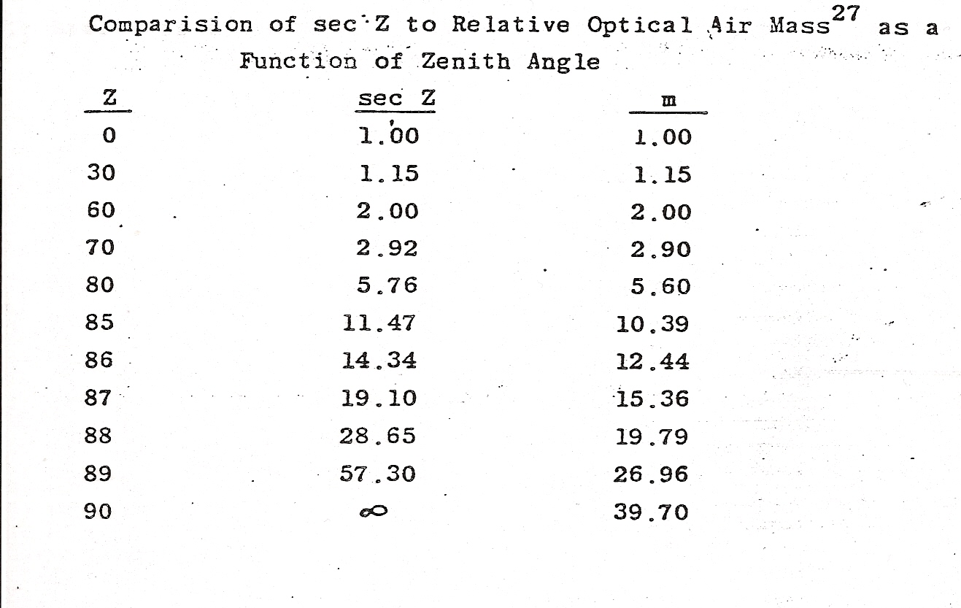

Slide 22
Empirical expression for air mass suggested by Rosenberg (1966) is:
m(θ₀) = (cos θ₀ +0.025 e ^{-11cos θ0} ) ⁻¹
The second term accounts for the curvature of e-a system.
Contributes significantly only for
θ₀ > 80⁰

Slide 23
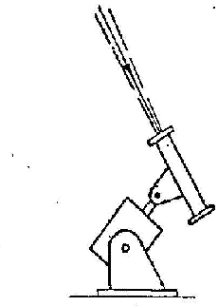
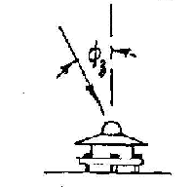
Instruments and their Response
Normal incidence pyrheliometer (NIP) responds to direct and circumsolar components output =
Pyranometer (horizontal mount) responds to direct + circumsolar + diffuse components output =

Slide 24
Measuring The Solar Radiation
Campbell-Stokes sunshine recorder
This type of equipment is the most widely found in traditional meteorological stations.
It distinguishes itself for its reliability, but only measures the number of insolation hours. To determine the solar radiation based on the number of hours of insolation, the Angström method is used.

Slide 25
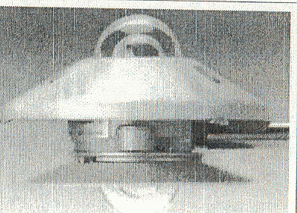
Pyranometer
This is the most widely-used equipment to measure global solar radiation.
There are different types of pyranometers ; the most common those with sensors composed of thermopiles or photovoltaic cells.
The photovoltaic sensors are in general much less precise than the thermopiles due to the fact that the spectral response is not the same in the entire solar radiation spectrum.

Slide 26
Shaded pyranometer
Used to measure diffuse solar radiation.
It needs a shading device so that the sensor cannot “see” the sun, thus allowing, in this way, that the radiation which comes directly from the sun not be measured.

Slide 27
Pyranometer With Shading Disc
More expensive solution for diffuse solar radiation measurement.
Measured data do not require correction, because the disc obstructs only the path of direct radiation.
On the other hand, requires a sun-tracking device, which can be one or two axis.

Slide 28
Pyrheliometer
This equipment is used to measure direct solar radiation. It works in a similar way as to the pyranometer, but a tube only allows that the direct solar radiation reaches the sensor.
Since the position of the sun changes during the day, it is necessary to have a device, which does the sun-tracking, that is, it always needs to be aligned with the sun.
The pyrheliometer is also utilized as a calibration reference of solar radiation sensors.

Slide 29
Angström Compensation Pyrheliometer
First instrument for precise direct solar radiation measurements
(end of XIX century).

Slide 30
Pyrgeometer
Pyrgeometer is used to measure long-wave radiation.
It is utilized with or without shading to block the direct solar radiation.
The protecting dome has
filters to avoid the entrance
of radiation of other
wavelengths.

Slide 31
Albedometer
Albedo is the measurement which quantifies how much the medium (vegetation, buildings, mountains, soil, snow, etc.) reflects solar radiation that falls on it.
A value is calculated by dividing the total solar radiation reflected by the medium by the global solar radiation incident at the location.
To assure a more precise measurement, it is generally installed several meters above the surface.
http://www.youtube.com/watch?v=9UJKVa2ClCU
https://www.youtube.com/watch?v=QgzggbEQ2MY

Slide 32
Components of radiation
Terms |  | Descriptions
Short-wave radiation (solar radiation) |  | radiation of wavelength <0.2-5μm
Long-wave radiation (terrestrial radiation) |  | radiation of wavelength >2.5μm
Direct solar radiation |  | Solar radiation coming from the solid angle of the sun’s disc on a surface perpendicular the axis of the solid angle.
Diffuse solar radiation ( sky radiation) |  | downward solar radiation as received on a horizontal surface from a solid angle of 2π with the exception of the solid angle subtended by the sun’s disc

Slide 33
(Continued)
Global solar radiation |  | downward direct and diffuse radiation as received on a horizontal surface from a solid angle 2π
Vertical component of direct solar radiation |  | direct radiation as received by horizontal surface
Atmospheric radiation |  | radiation emitted by the atmosphere, and upward terrestrial radiation which includes both atmosphere and surface radiation
Net radiation |  | net of the upward and downward components of both short and long wave radiation

Slide 34
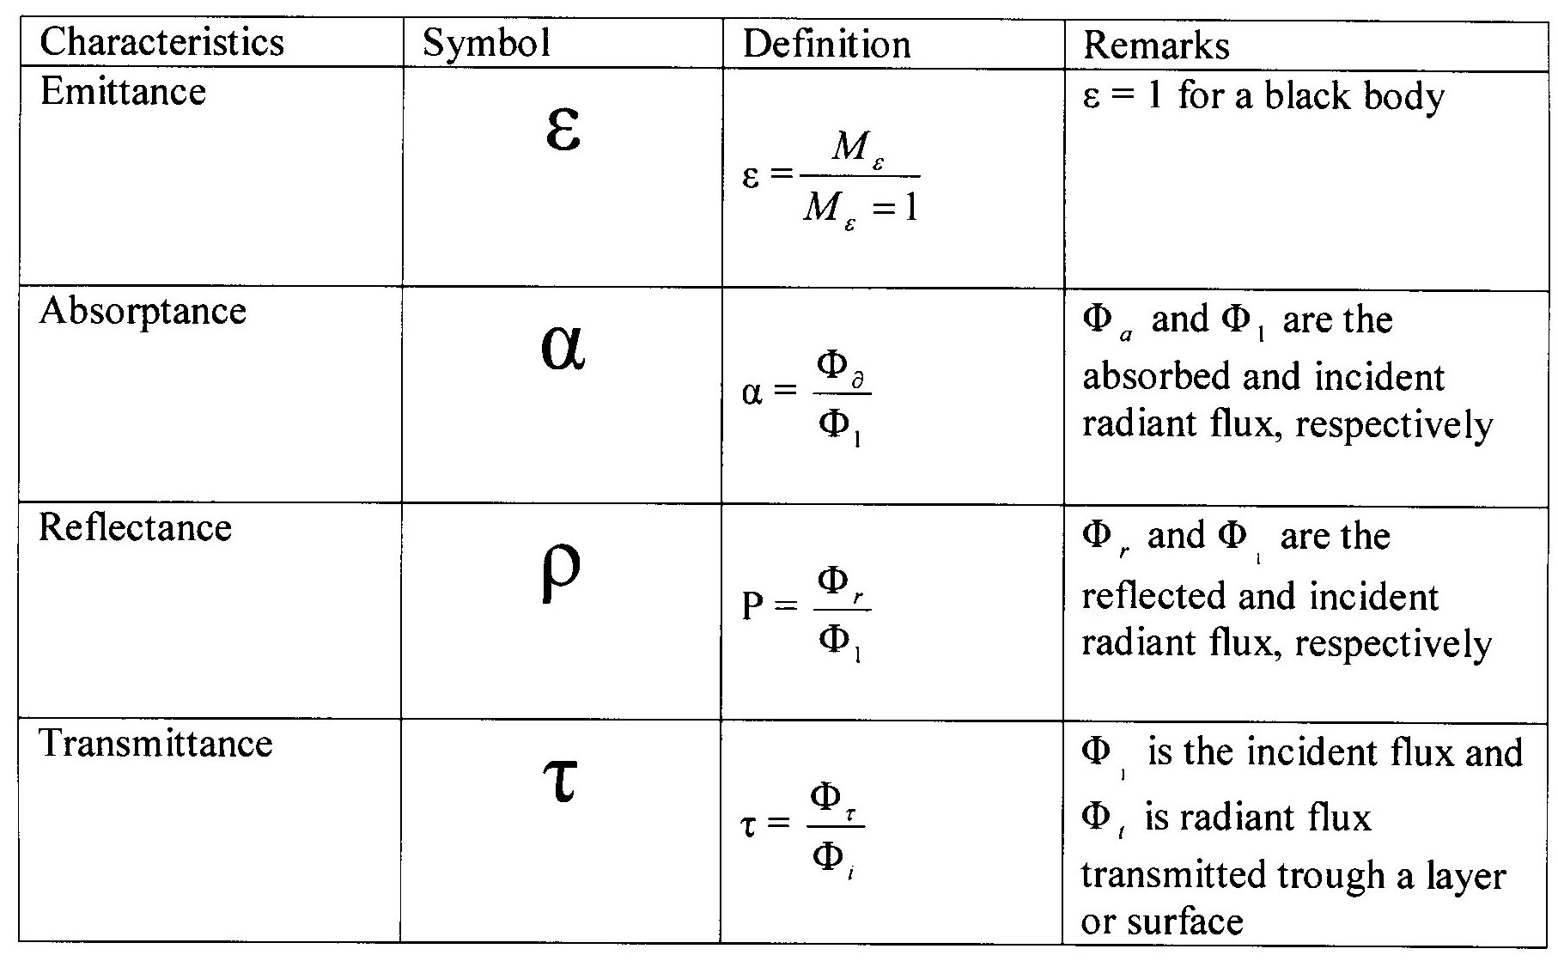
Material characteristics

Slide 35
Properties of objects: Blackbody
The blackbody concept serves as a useful standard for comparing the radiative properties of real surfaces with an ideal surface.
A real surface will partly reflect and partly absorb incident radiation. It can also partly transmit the incident radiation, namely:
1= α_{λ} + ρ_{λ} + τ_{λ}
α_{λ} is the monochromatic absorption, namely, the ratio of energy absorbed to incident energy
ρ_{λ} is the monochromatic reflectance, namely, the ratio of energy reflected to incident
τ_{λ} is the monochromatic transmittance, namely, the ratio of energy transmitted to incident.

Slide 36
Radiation Laws
The average or bulk properties of electromagnetic radiation interacting with matter can be summarized in a simple set of rules called radiation laws.
These laws apply when the radiating body is what physicists call a blackbody radiator. Generally, blackbody conditions apply when the radiator has very weak interaction with the surrounding environment and can be considered to be in a state of equilibrium.
All objects with a temperature above absolute zero emit radiation

Slide 37
Planck Radiation Law
The primary law governing blackbody radiation is the Planck Radiation Law, which governs the intensity of radiation emitted by unit surface area into a fixed direction (solid angle) from the blackbody as a function of wavelength for a fixed temperature.
The law is named after Max Planck, who originally proposed it in 1900. Namely, Planck's law describes the amount of electromagnetic energy with a certain wavelength radiated by a black body in thermal equilibrium (i.e. the spectral radiance of a black body).

Slide 38
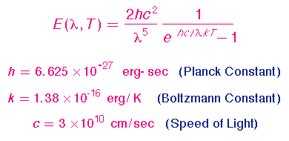
The Planck Law can be expressed through the following equation:

Slide 39
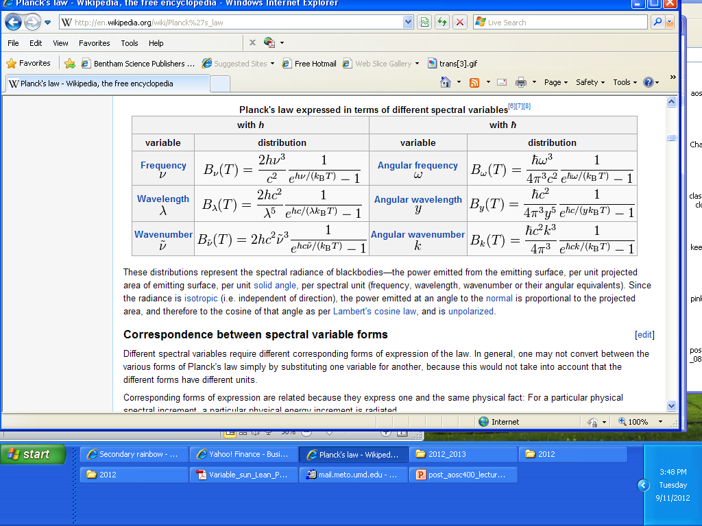
Planck's law expressed in terms of different spectral variables

Slide 40
The Wien and Stefan-Boltzmann Laws
The behavior of blackbody radiation is described by the Planck Law, but we can derive from the Planck Law two other radiation laws that are very useful.
The Wien Displacement Law, and the
Stefan-Boltzmann Law
to be illustrated in the following equations.

Slide 41
The Wien displacement law
Temperature of the emitting body affects the wavelength of the maximal radiant energy emitted.
German physicist Wilhelm Wien won the 1911 Nobel Prize in physics for this discovery. Wien’s Law can be summarized as, the hotter an object, the shorter the wavelength of maximum emission of radiation.
Wavelength (µm) of max energy= 2900/object temp (K)
λ_{max}=2900/T

Slide 42
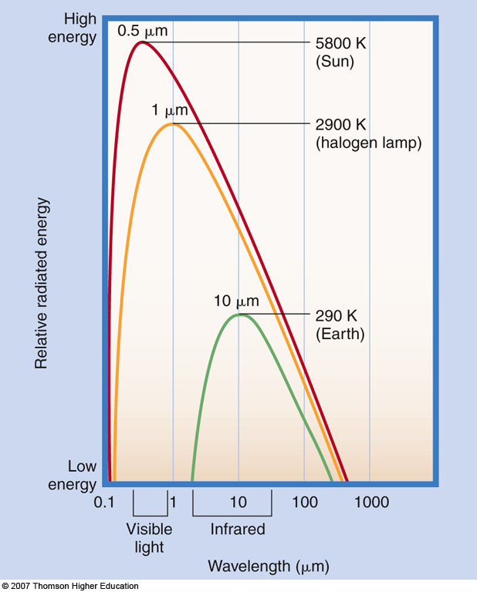
Wien’s Law
λ_{max}=2900/T

Slide 43
Stefan-Boltzman Law
Stefan-Boltzmann Law states that the amount of energy per square meter per second that is emitted by an object is related to the fourth power of its Kelvin temperature: E~T⁴
Therefore, a warmer object emits significantly more radiation than a cooler object- the Sun emits more energy than the Earth.
Note: Sir William Herschel discovered the infrared portion of the spectrum when he placed thermometers above the red portion of a projected spectrum.

Slide 44
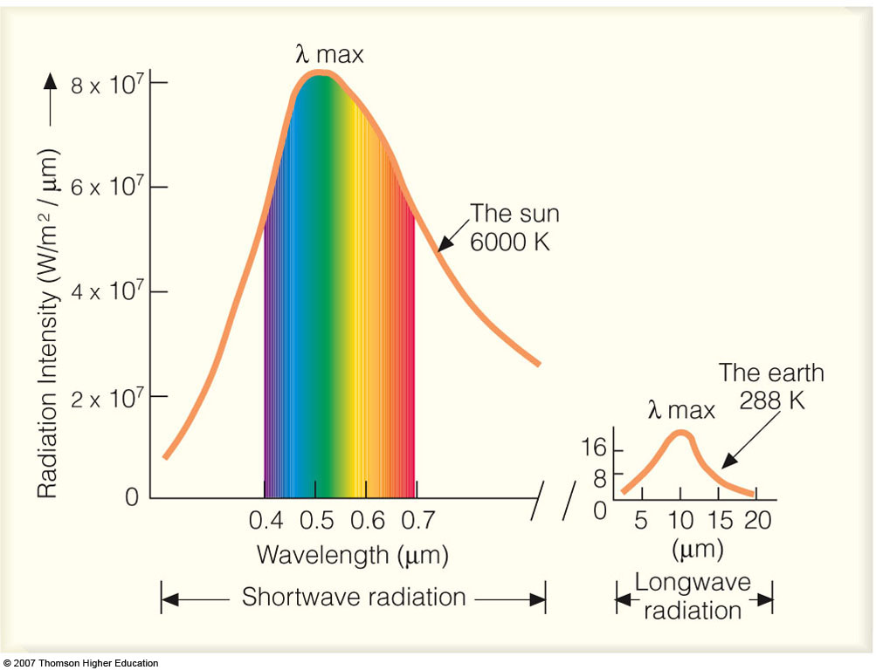
Implications of the Stefan-Boltzmann Law:
Since the temperature of the sun is much higher than the temperature of the Earth, the amount of energy emitted from the Earth is much less when compared to that from the sun.

Slide 45
The earth emits radiation called terrestrial or long wave radiation which is less energetic than solar radiation and therefore characterized by longer wavelengths (similar message as previous slide)

Slide 46
The Wien Law gives the wavelength of the peak of the radiation distribution, while the
Stefan-Boltzmann Law gives the total energy being emitted at all wavelengths by the blackbody (which is the area under the Planck Law curve). Thus, the Wien Law
explains the shift of the peak to shorter wavelengths as the temperature increases,
while the Stefan-Boltzmann Law explains the growth in the height of the curve as the
temperature increases.

Slide 47
a) The Planck function, or blackbody radiation curve; (b) Wien’s law; (c) the Stefan–Boltzmann law

Slide 48
SIMPLE GLOBAL RADIATIVE EQUILIBRIUM MODEL
Can evaluate the global radiative equilibrium temperature from the balance of the incoming solar flux and outgoing thermal infrared flux:
R = Global Albedo
S =Solar Constant
a = Radius of the Earth
T = Temperature
σ= Stephan-Boltzman Constant
Over a long period of time the energy absorbed and emitted balance each other so that equilibrium temperature is maintained.

Slide 49
Stefan-Boltzmann Law states that total energy per square meter per second that is emitted by an object is related to the fourth power of its Kelvin temperature: E=σT⁴
From earth emitted:
E=σT⁴ x area of earth= E=σT⁴ x 4πr²
We can derive the equilibrium temperature T_{E} of Earth by requiring a balance between incoming solar (SW) and outgoing longwave (LW) radiation.

Slide 50
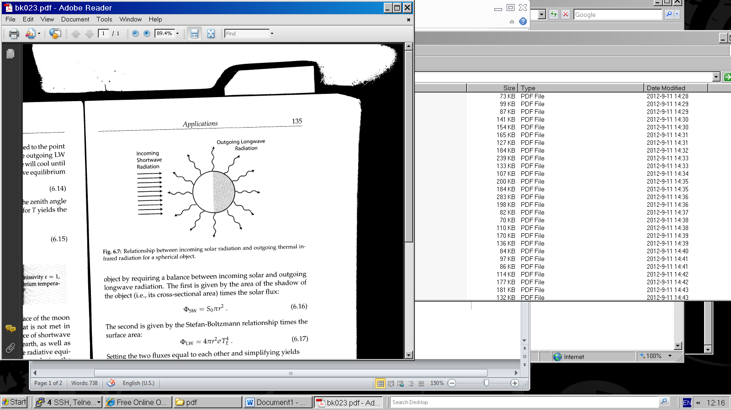
Relationship between incoming solar radiation and outgoing thermal infrared radiation for a spherical object.

Slide 51
The SW is given by the area of the shadow of the object (i.e., its cross-sectional area) times the solar flux:
πR² S₀
Part of the incoming SW is reflected back. If the albedo (capacity to reflect) is A:
Reflected part is: πR² S₀ xA
We subtract what comes down and what goes back:
πR² S₀-πR² S₀xA=πR² S₀(1-A)

Slide 52
The second is given by the Stefan-Boltzmann relationship times the surface area:
σT⁴ x 4πr²
Setting the two fluxes equal to each other:
4πR²σT⁴ ⁼ πR² S₀(1-A)
Solve for T:
Average Temperature of Earth -18⁰ C

Slide 53
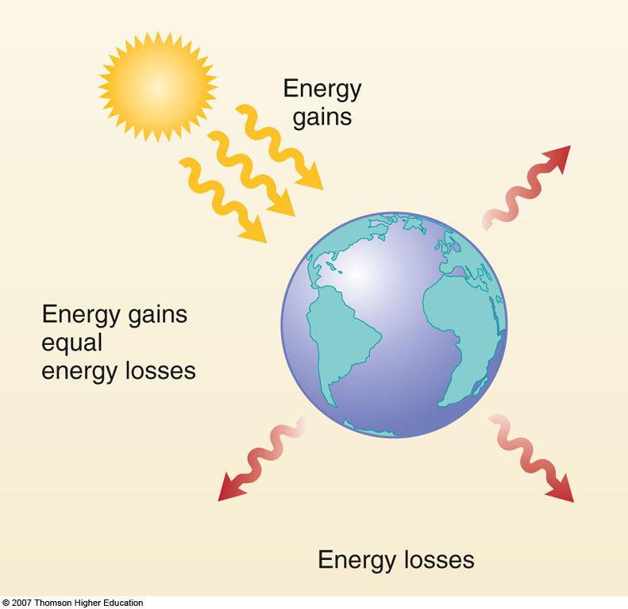
Basic Climate Model
This model yields an average earth temperature
of -18⁰ C ; Actual value is 15⁰ C.

Slide 54
The reason that the actual average Earth temperature is
about 15⁰ C is due to the role of Atmospheric Greenhouse Gases

Slide 55
Assumptions for formulating a simple radiation balance climate model: SW and LW fluxes balance each other

Slide 56
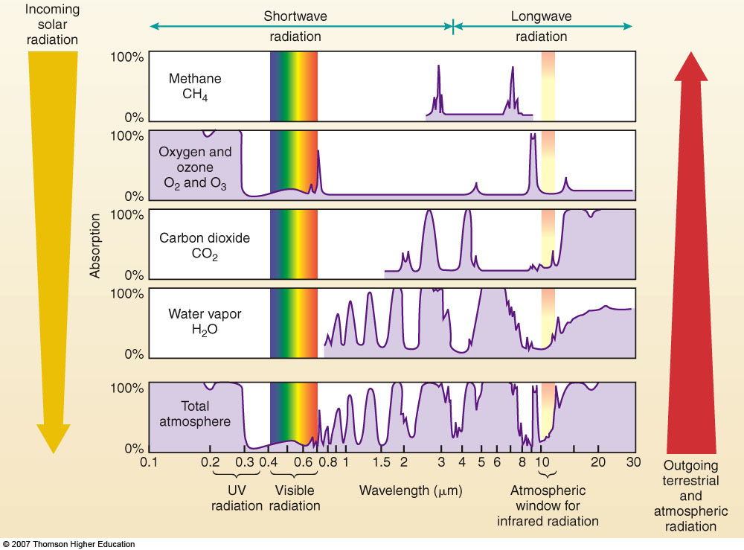
Properties of the atmosphere

Slide 57
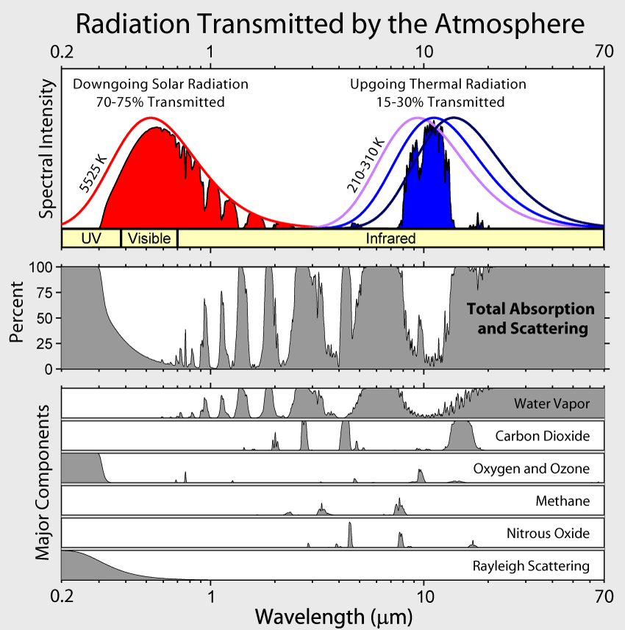
Transformation of radiation that reaches the earth, the Red line indicates radiation that reaches the outer atmosphere, whereas the painted red area is the radiation as it reaches the surface, Aerosols can lower this even more.

Slide 58
Absorption of 100% - no radiation penetrates the atmosphere. The large absorption beyond 13 μm is caused by CO₂ and H₂O. Both gases also absorb solar radiation in the near infrared (wavelengths between about 0.7 and 5 μm). The absorption at 9.6 μm is caused by ozone.

Slide 59
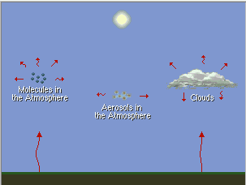
Re-emission of Infrared Radiation

Slide 60
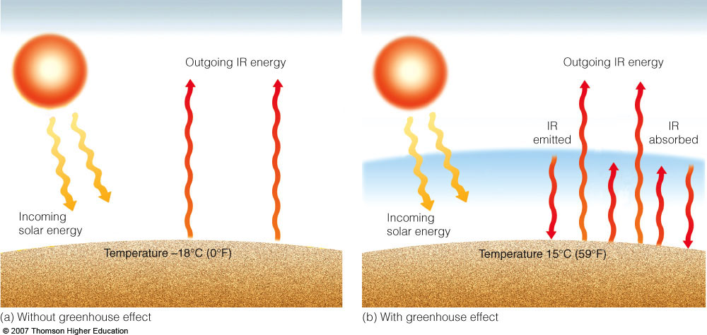
“The Greenhouse Effect”
T_{e}=[(1-r)S/4σ]^{1/4;} Actual value of T_{e} is 15⁰ C.

Slide 61
What drives climate to change? - “radiative forcing”: A small change in the energy balance of the earth can change surface temperatures, winds, precipitation patterns => its climate

Slide 62
Radiation Laws
The average or bulk properties of electromagnetic radiation interacting with matter can be summarized in a simple set of rules called radiation laws. These laws apply when the radiating body is what physicists call a blackbody radiator. Generally, blackbody conditions apply when the radiator has very weak interaction with the surrounding environment and can be considered to be in a state of equilibrium.
All objects with a temperature above absolute zero emit radiation

Slide 63
Properties of objects: Blackbody
The blackbody concept serves as a useful standard for comparing the radiative properties of real surfaces with an ideal surface.
A real surface will partly reflect and partly absorb incident radiation. It can also partly transmit the incident radiation, namely:
1= α_{λ} + ρ_{λ} + τ_{λ}
α_{λ} is the monochromatic absorption, namely, the ratio of energy absorbed to incident energy
ρ_{λ} is the monochromatic reflectance, namely, the ratio of energy reflected to incident
τ_{λ} is the monochromatic transmittance, namely, the ratio of energy transmitted to incident.

Slide 64
The Earth reflects part of the energy received from the sun
Of interest: what fraction of received goes back
The ratio between the reflected part and the incoming part is called albedo (A)

Slide 65
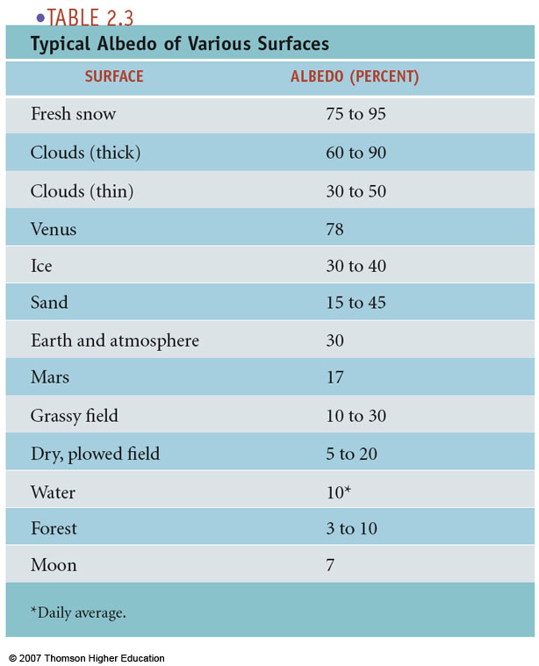

Slide 66
Combination of the two factors:
Simple statement
The irradiance over an area A depends on the angle between the overhead direction and the central ray to the sun and inversely to the distance from the sun
Mathematical statement
The irradiance over an area A is proportional to the cosine of the angle between the surface normal and the central ray and inversely to the distance from the sun
E=I_{on}cosθ/r²

Slide 67
More detail on the Inverse square law:
Energy received from sun at a distance of r₀
Is inversely proportional to distance square:
S₀ ~ 1/r₀²
Energy received from sun at a distance of r
Is inversely proportional to distance square:
S ~ 1/r²
Divide the two by each other:
S /S₀ = 1/r ²/1/r₀² =r₀²/r² = (r₀/r)²
or (like on previous slide):
S = S₀ (r₀/r)²
The ratio (r₀/r)² is denoted by ε₀
and can be computed as follows:

Slide 68
Formula for the reciprocal of the square of the radius vector of the earth-the eccentricity correction factor of the earth orbit, E₀ is:
E₀ = (r₀/r)² 1.000110+0.034221cosΓ+
0.001280sinΓ+0.000719cos2Γ+
0.000077sin2Γ
Here Γ is in radians and known as the day angle and equals:
Γ = 2Π(d_{n}-1)/365
d_{n} is the day number of the year ranging from 1 on January 1 to 365 on December 31.
For engineering application:
E₀ = (r₀/r)² = 1+0.033cos[(2Πd_{n}/365)]

Slide 69
Second-equation of time
Takes into account the perturbation in the earth rate of rotation which affect the time the sun crosses the observer’s meridian. Solar time is related to standard time by
Solar time = standard time + 4(L_{st} – L_{loc}) + E
E = (0.000075+0.001868cosΓ-0.032077sinΓ-0.014615cos2Γ-0.04089sin2Γ) (229.18)
The number 229.18 converts radians into minutes.
Γ = 2π(d_{n}-1)/365

Slide 70
Solar Calculators
http://www.srrb.noaa.gov/surfrad/
http://www.srrb.noaa.gov/highlights/sunrise/sunrise.html

Slide 71
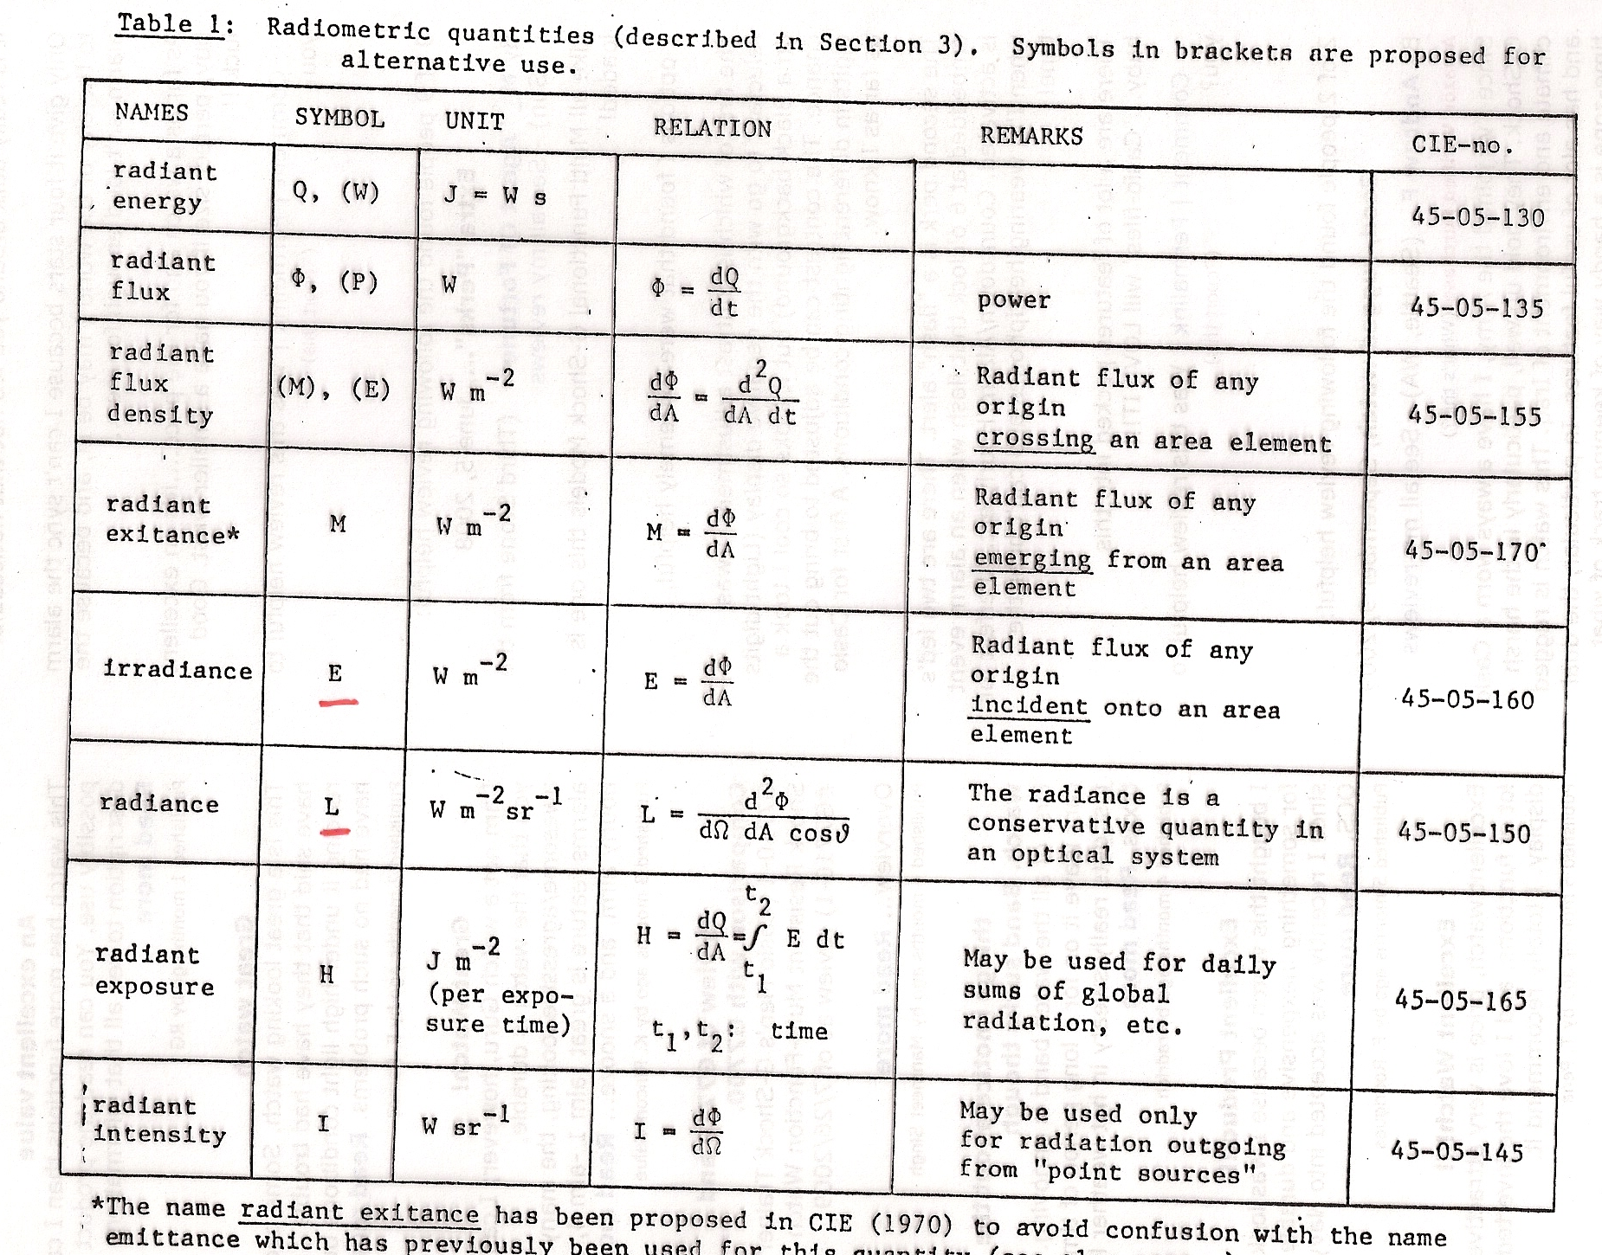

Slide 72
December 21, δ =-23.5°, φ =48° (Vienna), we get tau = 61.1°
corresponding to 4.07 hours (since tau=360° corresponds to 24 hours)
Sun rises 4.07 hours before transit (Culmination) and sets 4.07 hours after,
length of solar day is 8.15 hours,
exact value is: 8.36 hours.

Slide 73
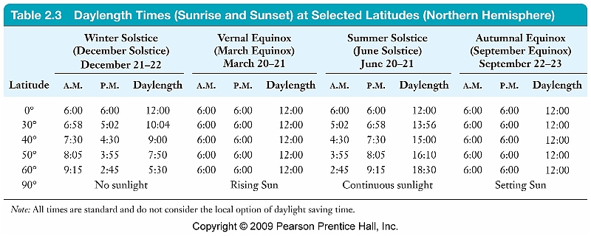
Once you know how to derive the solar zenith angle, you can estimate the length of the day. How?

Slide 74
Planck Radiation Law
The primary law governing blackbody radiation is the Planck Radiation Law, which governs the intensity of radiation emitted by unit surface area into a fixed direction (solid angle) from the blackbody as a function of wavelength for a fixed temperature. The law is named after Max Planck, who originally proposed it in 1900. Namely, Planck's law describes the amount of electromagnetic energy with a certain wavelength radiated by a black body in thermal equilibrium (i.e. the spectral radiance of a black body).

Slide 75
The Planck Law can be expressed through the following equation:

Slide 76
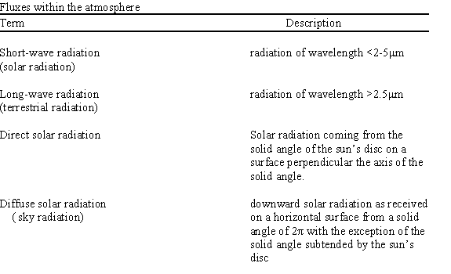

Slide 77
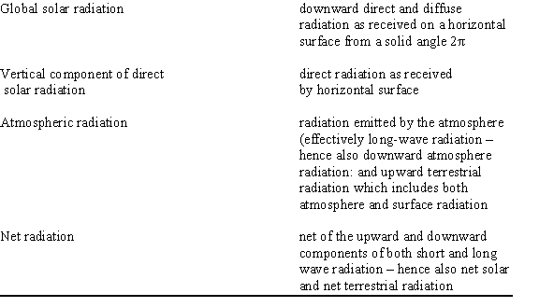

Slide 78
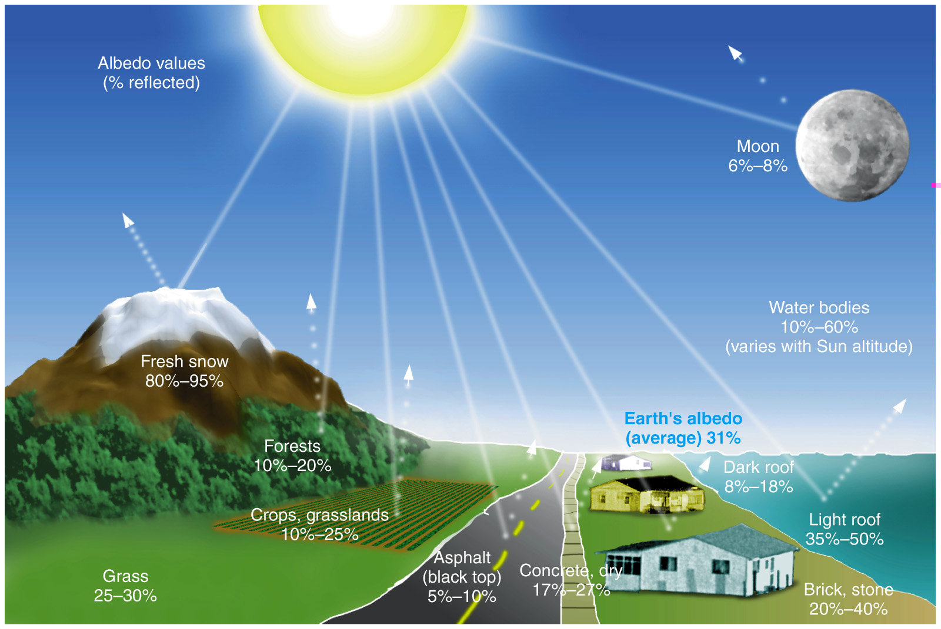
Earth’s albedo about 31% %

