Slide 1
post_aosc400_lecture_16_radiation_Continued_10_29_2015_short

Slide 2
AOSC400-2015
October 29, Lecture # 16
Global Radiation Budget
Climate Sensitivity to Clouds
Cloud Radiative Forcing
Results from Radiation Budget Missions (ERBE; CERES)
Special Programs to Better Understand Clouds (ARM)
Angular Distribution Models (ADM) Models
Copyright@2015 University of Maryland
This material may not be reproduced or redistributed, in whole or in part, without written permission of Rachel T. Pinker
*Sources of information used for this lecture are listed in updated Syllabus.

Slide 3
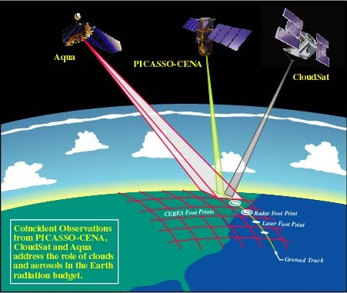
A configuration of several satellites with complimentary capabilities is considered as ideal for cloud research. In particular, the newer systems with active capabilities.
Aqua
CALIPSO
CloudSat

Slide 4
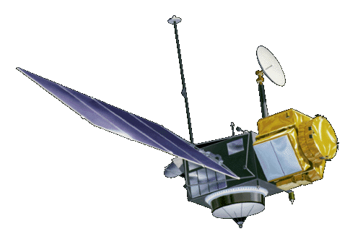


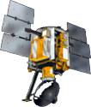
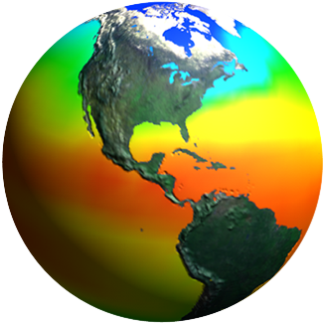
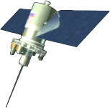
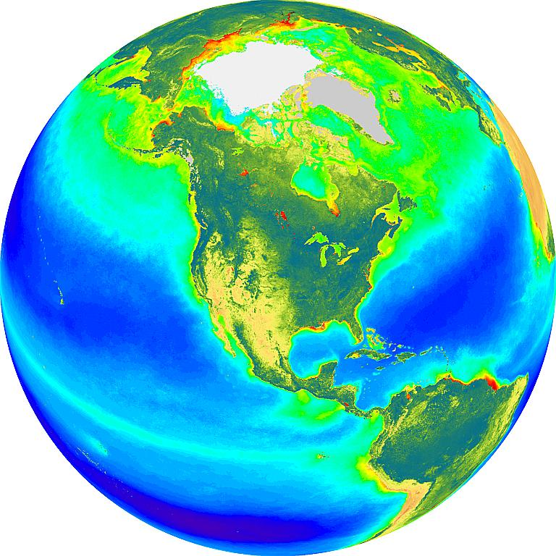
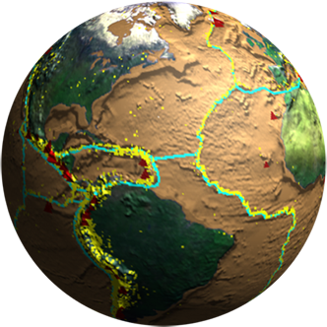
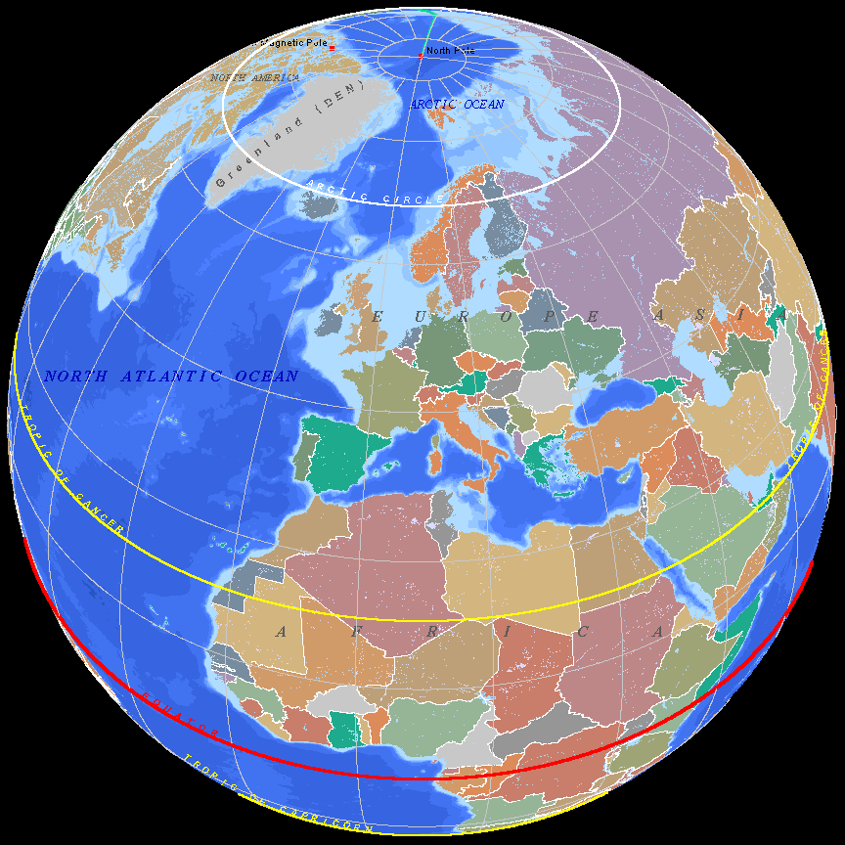
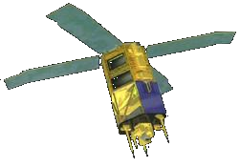
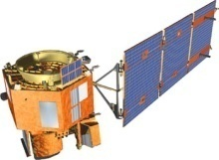
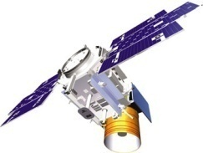
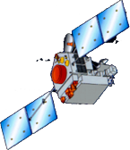
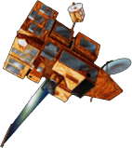
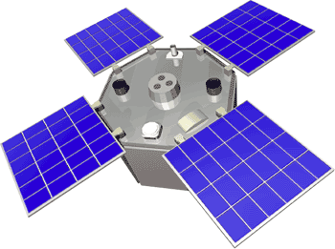
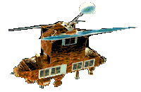
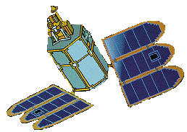
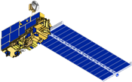
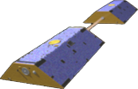
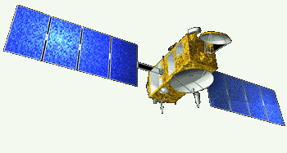
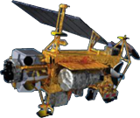
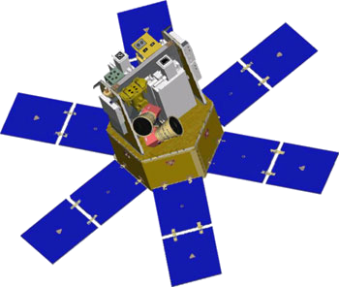
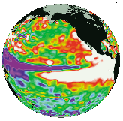
Spaceborne Earth Observation Systems
TOPEX/Poseidon
Landsat 7
SORCE
Aqua
QuikScat
Sage
EO-1
SeaWiFS
IceSat
TRMM
SeaWinds
ACRIMSAT
ERBS
Toms-EP
Grace
Jason
Terra
UARS

Slide 5
Key Areas of Uncertainty in
Understanding Climate & Global Change
Earth’s radiation balance and the influence of clouds on radiation and the hydrologic cycle
❑ Oceanic productivity, circulation and air-sea exchange
❑ Transformation of greenhouse gases in the lower
atmosphere, with emphasis on the carbon cycle
❑ Changes in land use, land cover and primary
productivity, including deforestation
❑ Sea level variability and impacts of ice sheet volume
❑ Chemistry of the middle and upper stratosphere,
including sources and sinks of stratospheric ozone
❑ Volcanic eruptions and their role in climate change
EOS Science Plan: The State of Science in the EOS Program (M. D. King, Ed. ). Available in hard copy and CD ROM versions from the EOS Project Science Office, NASA Goddard Space Flight Center

Slide 6
Suomi National Polar-orbiting Partnership, formerly known as the NPOESS Preparatory Project (NPP) will serve as a bridge between the EOS satellites and the forthcoming series of Joint Polar Satellite System (JPSS) satellites. Suomi NPP represents a critical first step in building this next-generation satellite system. The JPSS satellites, previously called the National Polar-orbiting Operational Environmental Satellite System (NPOESS), will be developed by NASA for the National Oceanic and Atmospheric Administration (NOAA).

Slide 7
The NPP satellite has 5 instruments on board: VIIRS, CERES, CrIS, ATMS, and OMPS. Each one will deliver a specific set of data helping weather prediction and climate studies.
In October 2011 when NASA launches its next-generation Earth-observing satellite, NPP (NPOESS Preparatory Project), one of the instruments aboard will be the latest in a series of instruments that has studied the Earth's climate for nearly 30 years.

Slide 8
Suomi NPP carries five instruments and will test key technologies for the JPSS missions. Suomi NPP is the first satellite mission to address the challenge of acquiring a wide range of land, ocean, and atmospheric measurements for Earth system science while simultaneously preparing to address operational requirements for weather forecasting.
Suomi NPP also represents the gateway to the creation of a U.S. climate monitoring system, collecting both climate and operational weather data and continuing key data records that are critical for global change science.

Slide 9
Key science objectives and capabilities of Suomi NPP:
Climate change -- contribute to long-term records of global environmental data critical for understanding the dynamics of climate change
Health of the ozone layer -- daily measurements of the atmospheric ozone layer that will determine whether the ozone layer is recovering as expected
Natural disasters -- monitor wildfires, volcanic eruptions, snowstorms, droughts, floods, hurricanes and dust plumes
Weather predictions -- a sounding instrument will collect information about cloud cover, atmospheric temperatures, humidity and other variables critical to accurate weather prediction
Vegetation -- map global land vegetation and quantify changes in plant productivity to understand the global carbon cycle and monitor agricultural processes to predict and respond to food shortages and famines

Slide 10
Global ice cover -- monitor changes to Earth’s sea ice, land ice and glaciers to track the pace of climate change
Air pollution -- monitor the spread of health-sapping pollutants such as soot, particulate matter, nitrogen dioxide and sulfur dioxide
Temperatures -- maintain a global record of atmospheric, land surface and sea surface temperatures critical to understanding the long-term dynamics of climate change
Earth’s energy budget -- make measurements to determine how much energy is entering and exiting Earth's atmosphere

Slide 11
The five instruments on the NPP satellite are:
Advanced Technology Microwave Sounder (ATMS)
22-channel passive microwave radiometer, to create global models of temperature and moisture profiles that meteorologists will enter into weather forecasting models.
Cross-track Infrared Sounder (CrIS)
Michelson interferometer, will monitor characteristics of the atmosphere, such as moisture and pressure that will be used to produce improvements in both short-and-long term weather forecasting.
Ozone Mapping and Profiler Suite (OMPS)
OMPS, built by Ball Aerospace, incorporates an advanced nadir-viewing sensor and a highly innovative limb-viewing sensor. OMPS instrument continues Ball's history of building ozone-measuring instruments and will continue the long-term continuous data record of ozone measurements from space.

Slide 12
Visible Infrared Imaging Radiometer Suite (VIIRS)
VIIRS, developed by Raytheon Space and Airborne Systems, has a 22-band radiometer similar to the MODIS instrument. It will collect visible and infrared views of Earth's dynamic surface processes, such as wildfires, land changes, and ice movement. VIIRS will also measure atmospheric and oceanic properties, including clouds and sea surface temperature.
Clouds and the Earth's Radiant Energy System (CERES)
3-channel radiometer measuring reflected solar radiation, emitted terrestrial radiation, and total radiation, will monitor the natural and anthropogenic effects on the Earth's total thermal radiation budget.

Slide 13
What is FOV?
The terms Field of View (FOV) and footprint are synonymous. The CERES FOV is determined by its PSF (Point Spread Function) which is a two-dimensional, bell-shaped function that defines the CERES instrument response to the viewed radiation field.

Slide 14


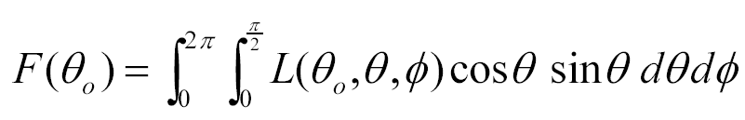
Instantaneous Fluxes at TOA and Angular Distribution Models
CERES Radiance Measurement
TOA Flux Estimate
SW
LW
WN
⇒
(after N. Loeb, 2009)

Slide 15
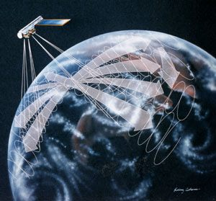
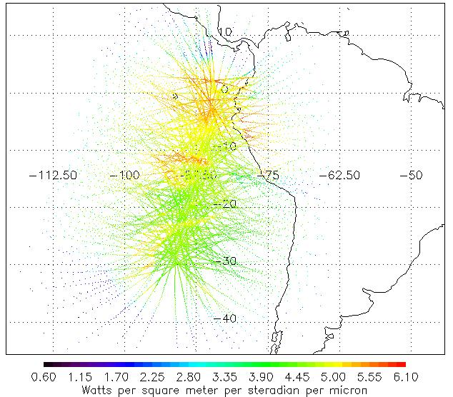
Angular Distribution Models
Multi-angle radiance data are collected using the rotating azimuth plane scanning (RAPS) mode of CERES
One CERES instrument dedicated to RAPS observations on Terra and Aqua

Slide 16
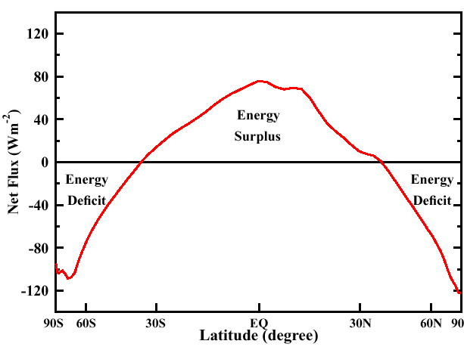
Annual Average Zonal Mean Net Flux Profile
CERES/TERRA, March 2000 to February 2001

Slide 17
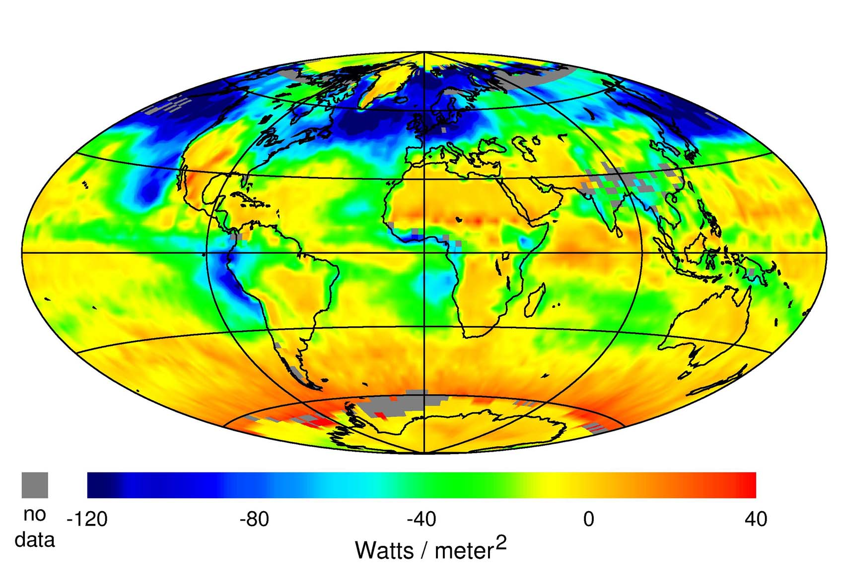
CERES Net Cloud Forcing (July, 2000)

Slide 18
Why is the cloud problem so hard?
We lack a good cloud database - historical record - only cloud fraction:
  hard to define what is a cloud
The existing database is very limited in number of variables, and controversial:
  Hahn/Warren surface climatology
  Terra (1999 launch) making first major effort to go beyond these limited efforts (but hard to validate!)
  Under the Atmospheric Radiation Measurement (ARM) Program, effort underway to develop a coordinated dataset of cloud and radiation variables.
  3 major sites operational, including development of many new instruments (incl. cloud radar)

Slide 19
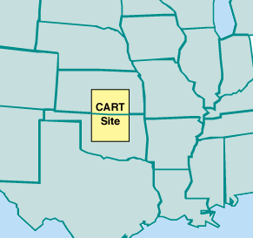
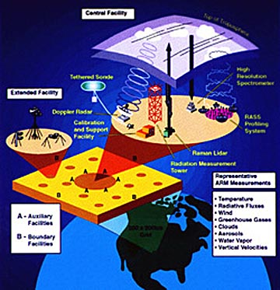
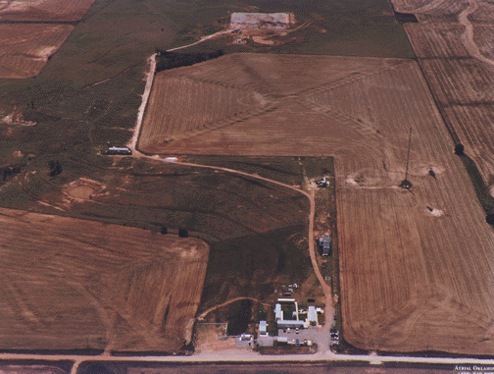
ARM Oklahoma: A “Field of Beams”

Slide 20
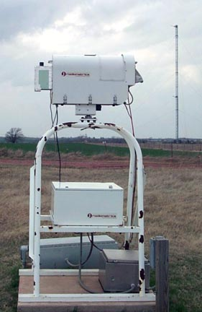
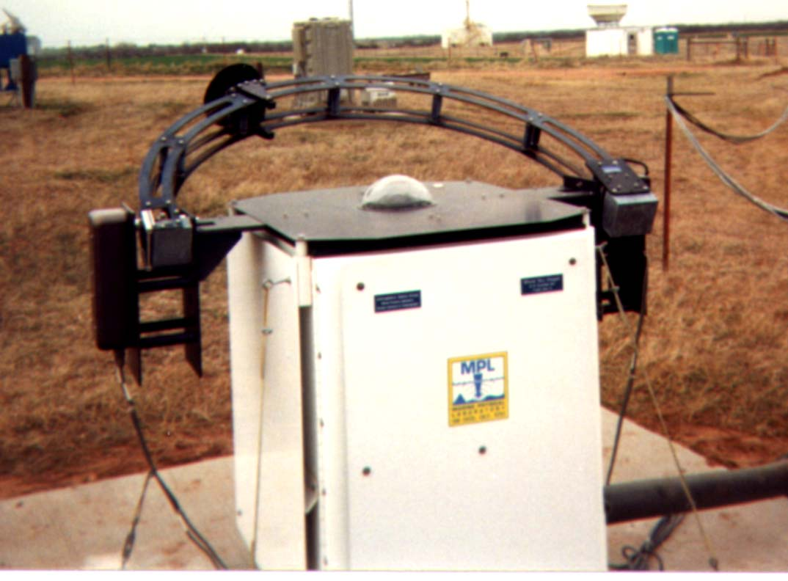
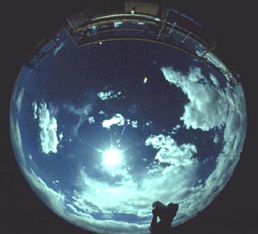
ARM: Major Cloud Characterization Instruments
Microwave radiometer
(for liquid water path)
Whole
Sky
Imager
(DoD)

Slide 21
Chase the Rainbow
Matt Evans, 8, runs through the fountain at Georgetown Waterfront Park. Friday was humid with a high close to 90 degrees. It will be similar on Saturday until a cold front brings the possibility of severe storms in the late afternoon and evening.
09/08/2012 (Washington Post)

Slide 22
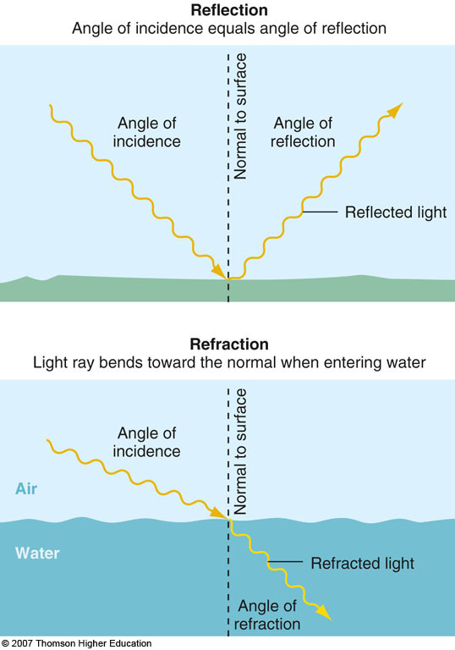

Slide 23
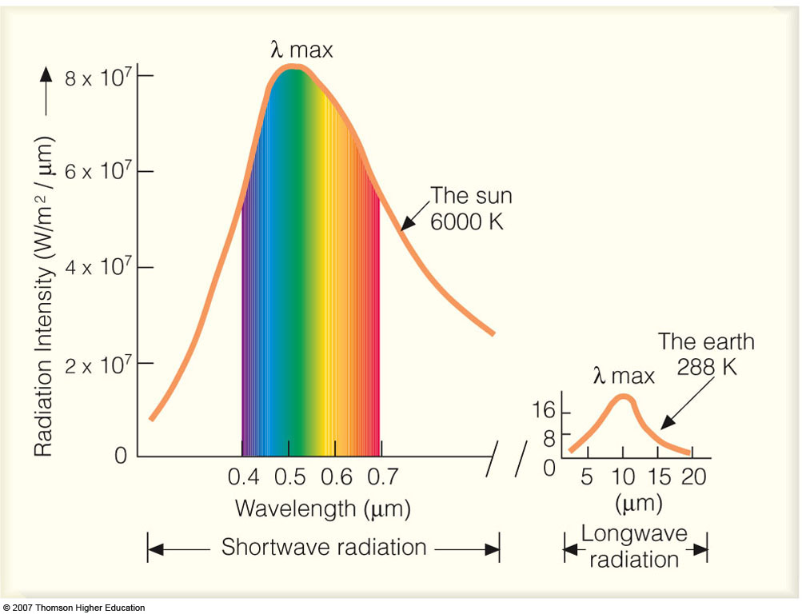
The visible spectrum
Sir Isaac Newton used a prism to split sunlight into its fundamental colors of the rainbow.

Slide 24
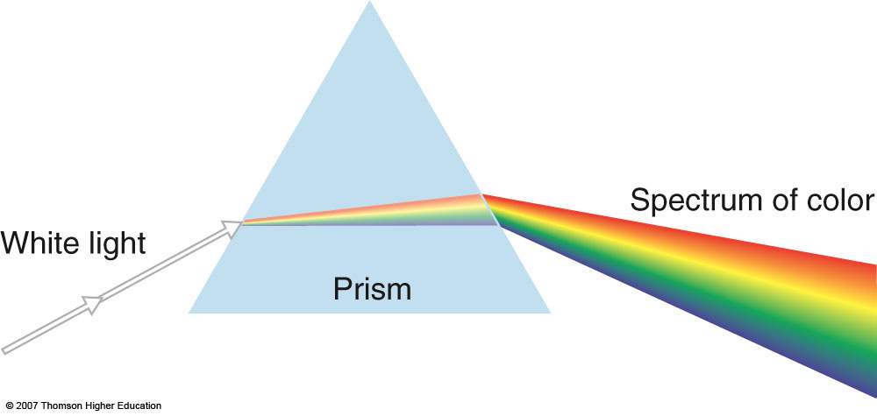
Each wavelength is refracted differently

Slide 25
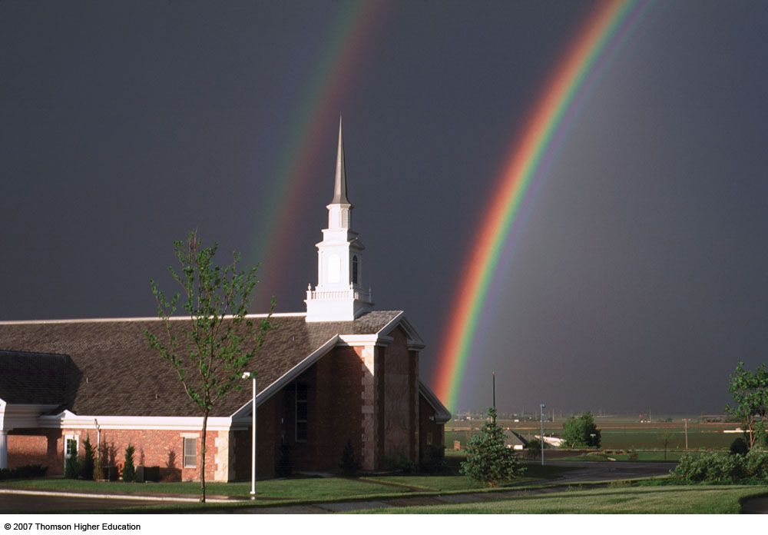
Example of the concepts of refraction and reflection: The Rainbow
Rainbows result from refraction of sunlight in falling water droplets plus reflection of the light from the back of the droplet.

Slide 26
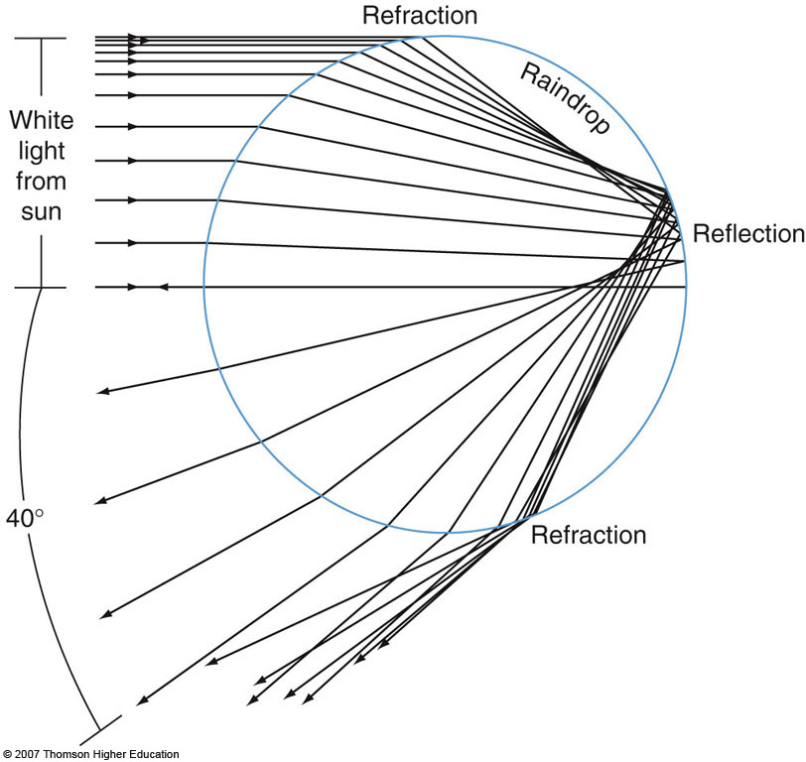
Principle of rainbow formation

Slide 27
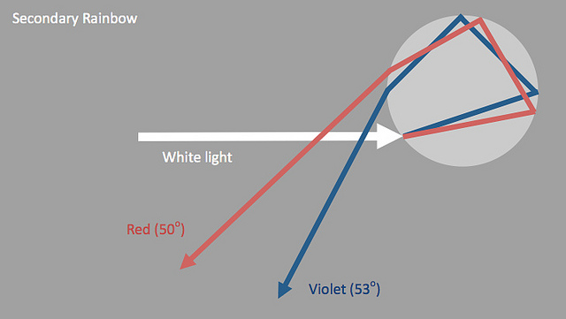
Light can be reflected more than once inside a raindrop. Rays escaping after two reflections make a secondary bow

Slide 28
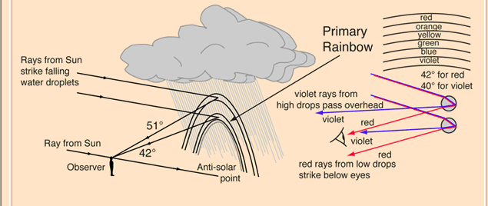
More details on rainbow formation:
The primary rainbow forms between about 40° and 42° from the anti-solar point. The light path involves refraction and a single reflection inside the water droplet. If the drops are large, 1 millimeter or more in diameter, red, green, and violet are bright but there is little blue.

Slide 29
Rainbows are not seen in midday since the whole 42° circle is below the horizon at most latitudes. So rainbows tend to be seen most in the later afternoon when a thundershower has passed and the sun from the west is illuminating the receding edge of an eastwardly moving raincloud. It is possible to see the entire circle of the rainbow from an airplane since there can be falling droplets both above and below you.

Slide 30
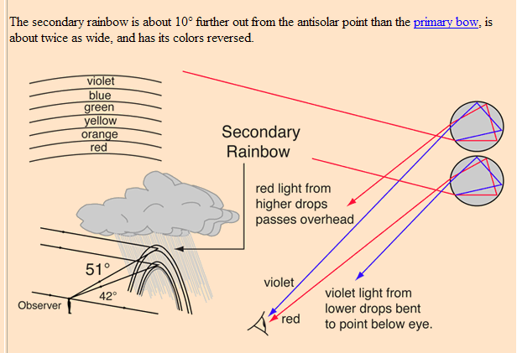
More details on secondary rainbow:

Slide 31
Light playing on water drops, dust or ice crystals in the atmosphere produces a host of visual spectacles - rainbows, halos, glories, coronas and many more. Some can be seen almost every day or so, some are once in a lifetime sights. Find out where to see them and how they are formed. Then seek and enjoy them outdoors.
Dust, small aerosols and moisture droplets scatter light to make the sun's rays visible and cloud and mountain shadowed air dark by comparison. Air and very small particles scatter colours selectively to paint the blues of skies and fires of sunsets. Air at varied temperatures and densities refracts the rays of setting suns and moons to fashion fantastic shapes and green flashes. Perspective generates apparent glows around shadows even on the airless Moon.

Slide 32
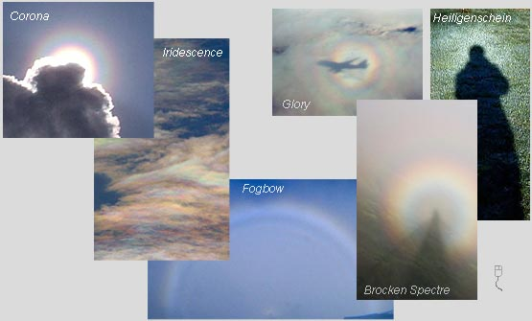

Slide 33
Haloes
his section covers the optical effects caused by ice crystals. For those living in temperate latitudes displays are usually limited to cirrus clouds. Displays showing all the phenomena are rare because it needs a very large area of sky to be covered in ice crystals with the right optical properties. The most spectacular displays are usually seen from very cold climates when the ice crystals surround the observer.
Because some effects are often only visible in a single patch of cirrus they may last for just a few minutes and are easily missed. The key is knowing what to look for and checking the sky whenever possible.

Slide 34
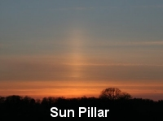
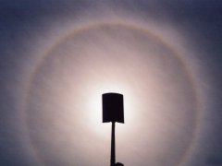
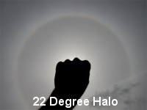
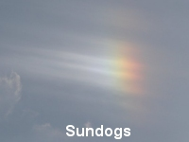
Corona around the sun.
The central blindingly bright disk fringed with red is the aureole. Two rings surround it. The rings in this corona are slightly off centre because of a gradation in droplets sizes in the cloud.
Imaged by Richard Fleet (Glows, Bows & Haloes) in Wiltshire, England during the summer of 2003.

Slide 35
A corona may be seen when thin clouds partially veil the sun or moon. Look for one around the moon when it is near to full and the sky is dark. When searching for a solar corona, shield the sun and reduce the light intensity to safer levels by looking at the sky reflected in a pool of water or a mirror of plain glass. Staring directly at or near to the sun can permanently damage eyesight.
Coronae have an intensely bright central aureole which is almost white and fringed with yellows and reds. Sometimes that is all to be seen but the better coronas have one or more successively fainter and gently coloured soft rings surrounding the aureole. The first ring is bluish on the inside grading through greens and yellows to red outermost. The colours are subtle mixtures rather than the more direct hues of the rainbow. The corona can be 15º or so in diameter and often it shrinks and swells as different clouds scud across the moon.
The coronae is much smaller than the 22° halo which can also ring the sun and moon. The corona also has nothing to do with the Sun's outer atmosphere visible during a total eclipse and confusingly given the same name.
Coronae are produced by the diffraction of light by tiny cloud droplets or sometimes small ice crystals.

