Slide 2
AOSC400-2015
October 29, Lecture # 16
Global Radiation Budget
Climate Sensitivity to Clouds
Cloud Radiative Forcing
Results from Radiation Budget Missions (ERBE; CERES)
Special Programs to Better Understand Clouds (ARM)
Angular Distribution Models (ADM) Models
Copyright@2015 University of Maryland
This material may not be reproduced or redistributed, in whole or in part, without written permission of Rachel T. Pinker
*Sources of information used for this lecture are listed in updated Syllabus.

Slide 3
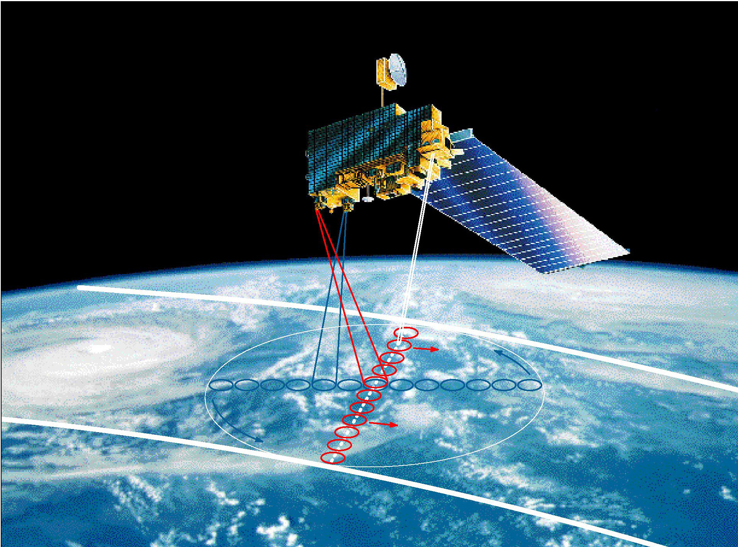
Clouds and the Earth’s Radiant Energy System
Is the global energy budget changing?
Effect of clouds on the radiation budget.

Slide 4
Why are Clouds So Important?
Cess et al. (1990):
“Eighteen atmospheric GCMs, using prescribed SSTs, have been compared to top-of-atmosphere radiation fluxes from ERBE. A small subset does a reasonable job of replicating the ERBE data, but typically the models tend to overestimate cloud cooling. This is because their clouds are either too bright, or at too low an altitude, or both.”

Slide 5
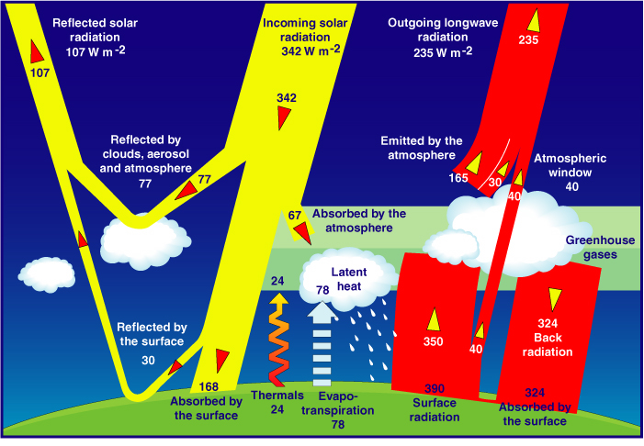
Satellites serve as source of information on the Global Energy Budget
As estimated from models (Kiehl and Trenberth, 1997)

Slide 6
Effect of Clouds
Clouds interact both with solar radiation, in the shortwave region of the spectrum, and with the radiation thermally emitted by the earth and atmosphere, in the longwave region.
Clouds reduce the net absorption of solar radiation by increasing the earth albedo, and they decrease the loss of terrestrial radiation to space by decreasing the effective radiative brightness temperature of the earth.
The solar radiation effect and the thermal emission effect are in opposite directions as far as net radiation at the top of the atmosphere is concerned.
Each effect, by itself, is large, but the combine effect is relatively small and will depend significantly on the cloud-free profile of atmospheric temperature, humidity, and aerosols, and upon surface temperature and optical properties.
The net effect is the difference of two large terms; led to a debate in the 70s on the role clouds play in the climate system.

Slide 7
The effect of cloud cover on solar radiation depends primarily on the thickness of the cloud, but also it depends upon particle size and phase.
The longwave effect depends primarily upon cloud top temperature, which is a function of cloud height, and, for thin clouds, upon emissivity, which is related to optical thickness.

Slide 8
The concept of Radiative Forcing
Radiative forcing is a measure of the influence a factor has in altering the balance of incoming and outgoing energy in the Earth-atmosphere system and is an index of the importance of the factor as a potential climate change mechanism.
Well known examples of this concept are related to greenhouse gases or other atmospheric constituents as shown in next figure.

Slide 9
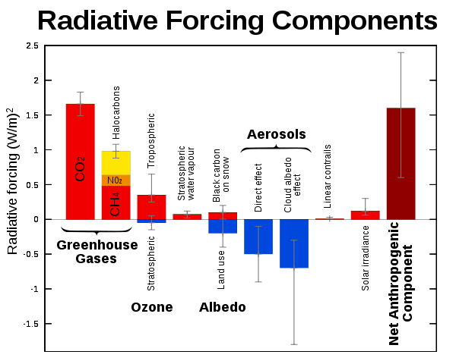
Changes in radiative forcings between 1750 and 2005 as estimated by the IPCC 2007

Slide 10
Another example is related to direct aerosol forcing. Direct TOA Aerosol Radiative Effects are defined as:
DF (AER) = F (no AER) - F (OBS)
Where:
F(OBS) = SW TOA flux inferred from cloud-free SW radiances
F(no AER) = “No aerosol” flux approximated by the intercept of TOA flux against aerosol optical depth
Similar concepts apply to clouds:

Slide 11
Cloud Radiative Effects
The effect of clouds on the Earth's radiation balance is measured as the difference between clear-sky and all-sky radiation results
F^{X}(cloud) = F^{X}(clear) – F^{X}(all-sky)
F^{Net}(cloud) = F^{SW}(cloud) + F^{LW}(cloud)
where X= SW or LW
Negative F^{Net}(cloud) => Clouds have a cooling effect on Climate
Positive F^{Net}(cloud) => Clouds have a warming effect on Climate

Slide 12
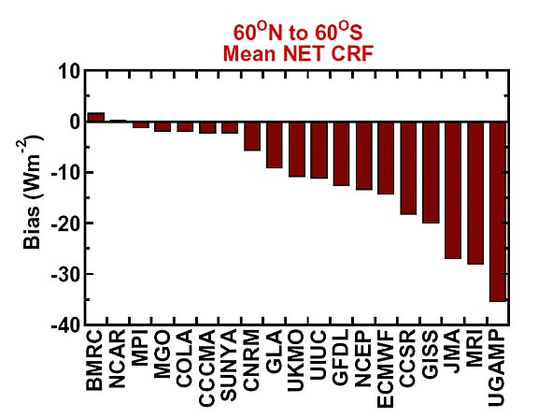
Net Cloud Radiative Forcing from 19 GCMs
“Back of the envelope “ computation from Loeb et al. shown in next slide:

Slide 13
Cloud Forcing for Different Cloud Types
Optically thick low-level clouds: Reflect more SW radiation back to space than the darker surface would in their absence. Thus, less solar energy is available.
=> cooling effect
High thin cirrus clouds: Transmit most of the incoming solar radiation while, simultaneously, they absorb some of the Earth's infrared radiation and radiate it back to the surface
=> warming effect
- Deep convective clouds: Have neither a warming nor a cooling effect because their cloud greenhouse effect, although large, is nearly balanced by the reflected SW radiation due to their high albedo

Slide 14
Climate Sensitivity
Radiative Effect at the Top of the Atmosphere
For a 50% Increase in Climate Parameter
Cloud
Height
High Cloud
Amount
Particle Size
(Low Clouds)
Stratospheric
Ozone
Carbon
Dioxide
Radiative
Effect
(W/m²)
Low Cloud
Amount
Cloud Optical
Depth
Indirect Aerosol
Forcing
Direct Anthropogenic
Aerosol Forcing
Land Albedo
Low clouds
COD

Slide 15
What is currently known on the
Radiation Budget (from IPCC 2013)
The radiation budget at the Top Of Atmosphere (TOA) includes the absorption of solar radiation by Earth, determined as the difference between the incident and reflected solar radiation at the TOA, as well as the thermal outgoing radiation emitted to space.
The surface radiation budget takes into account the solar fluxes absorbed at Earth’s surface, as well as the upward and downward thermal radiative fluxes emitted by the surface and atmosphere.

Slide 16
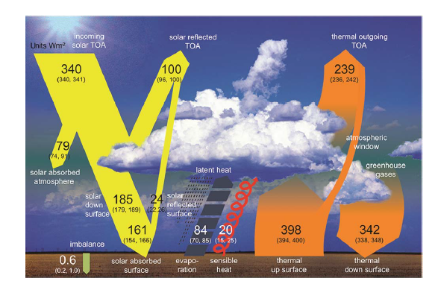
Global mean energy budget under present day climate conditions (from IPCC 2013)

Slide 17
Global Mean Radiation Budget
The total solar irradiance (TSI) incident at the TOA is now much better known, with the SORCE Total Irradiance Monitor (TIM) instrument reporting uncertainties as low as 0.035%, compared to 0.1% for other TSI instruments (Kopp et al., 2005).
Observed from space-borne platforms such as the Clouds and the Earth’s Radiant Energy System (CERES, Wielicki et al., 1996) and the Solar Radiation and Climate Experiment (SORCE) (Kopp and Lawrence, 2005

Slide 18
Kopp and Lean (2011) conclude that the SORCE/TIM value of TSI is the most credible value because it is validated by a National Institute of Standards and Technology calibrated cryogenic radiometer.
This revised TSI estimate corresponds to a solar irradiance close to 340 W/m² globally averaged over Earth’s sphere.

Slide 19
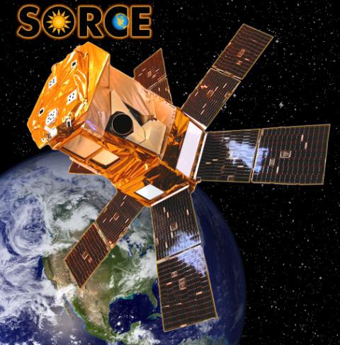
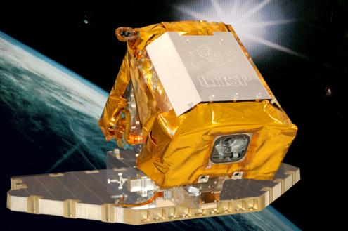
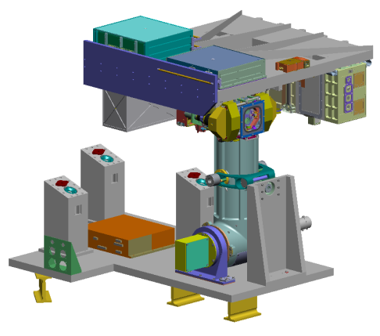
Continuity of 34+year TSI Record
Loss of Glory-TIM at launch on March 4, 2011
Delay of TSIS Flight Opportunity to 2015+
SORCE/TIM
Glory/TIM
JPSS Free Flyer/TSIS
SORCE : 2003 – 2015 ??
2011 - 2014
(failed)
TSIS : July, 2016
TSI record continued since 1978 TCTE : 2013-2016 (expected)
Notes:
TIM was originally planned to fly on three missions with more than 6 month overlap.
SORCE : continuing, however battery Degrading, lost 4 cells out of 11, unexpected degrading may happen without warning
Glory : failed but provided
TSIS : Elimination of NPOESS climate mission decision on TSIS flight opportunity was delayed. TSIS flight is set to launch in July, 2016. This effectively eliminates all reasonable possibility of continuing the 35 year continuous solar irradiance data record.
TCTE may reduce the data gap, even though it cannot be a definite solution for the data continuity.
Success of TCTE is only limited to TSI record, but not for SSI. SSI record gap is inevitable.
STP : Space Test Program experimental satellite. Life time requirement is one year, but STPSat2 launched in Nov. 2010 continued its mission after the completion of the requirement

Slide 20
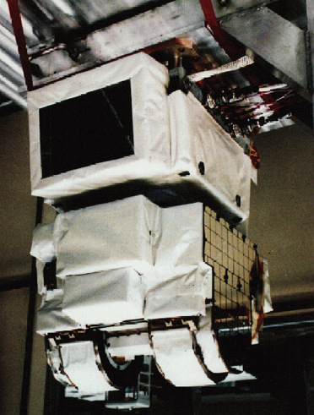
CERES Measurements
5 Instruments on 3 Satellites (TRMM, Terra, Aqua) for diurnal and angular sampling
3 Channels per instrument:
  Shortwave (0.2-4.0 mm) – Reflected solar radiation
  Total (0.2-100 mm) – Earth emitted radiation by subtracting SW
  Window (8-12 mm) – Thermal infrared emission
Coincident Cloud and Aerosol Properties from MODIS/VIRS
Flies in Formation with CALIPSO and CloudSat
(after N. Loeb et al., 2009)

Slide 21
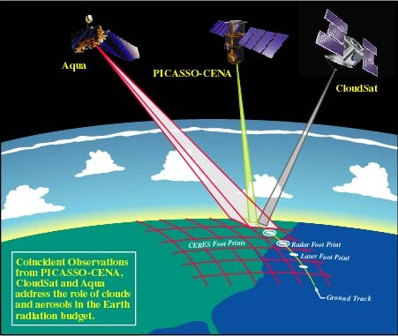
A configuration of several satellites with complimentary capabilities is considered as ideal for cloud research. In particular, the newer systems with active capabilities.
Aqua
CALIPSO
CloudSat

Slide 22
The stated uncertainty in the solar reflected TOA fluxes
from CERES due to uncertainty in absolute calibration alone is ~2% (2-sigma), or equivalently 2 W/m²
(Loeb et al., 2009).
The uncertainty of the outgoing thermal flux at the TOA as measured by CERES due to
calibration is ~3.7 W/m² (2σ).
In addition to this, there is uncertainty in removing the influence of instrument spectral response on measured radiance, in radiance-to-flux conversion, and in time-space averaging, which
adds up to another 1 W/m² (Loeb et al., 2009).

Slide 23
The components of the radiation budget at the surface are more uncertain than their counterparts at the TOA because they cannot be directly measured by passive satellite sensors.
Decadal changes in observational records of surface shortwave radiation (SSR) reported - a decline from the beginning of widespread measurements in the 1950s until the mid-1980s (known as 'global dimming', and a partial recovery from the 1980s onward ('brightening‘).

Slide 24
Estimates of absorbed solar radiation at Earth’s surface include considerable uncertainty. Published global mean values inferred from satellite retrievals, reanalyses and climate models range from below 160 W/m² to above 170 W/m².
Recent studies favor values towards the lower bound of this range, near 160 W/m², atmospheric solar absorption around 80 W/m² and a downward thermal flux slightly above 340 W/m².

Slide 25
Globally complete satellite estimates are available since the early 1980s. Since satellites do not directly measure the surface fluxes, they have to be inferred from measurable top-of-atmosphere signals using models to remove atmospheric perturbations.
Available satellite-derived products qualitatively agree on a brightening from the mid-1980s to 2000 averaged globally as well as over oceans, on the order of 2–3 W/m² per decade (Hatzianastassiou et al., 2005; Pinker et al., 2005; Hinkelman et al., 2009).

Slide 26
Knowledge of the decadal variation of aerosol burdens and optical properties, required in satellite retrievals of SSR and considered relevant for dimming/brightening particularly over land, is very limited.
Extensions of satellite-derived SSR beyond 2000 indicate tendencies towards a renewed dimming at the beginning of the new millennium .

Slide 27
Earth Radiation Budget from Satellites:
Historical Perspective
To provide a perspective on this topic, a brief review of a previous mission to measure the Earth Radiation Budget from space will be provided.
The ERBE Mission
Operational satellites support primarily weather needs (such as location and movement of cloud systems) which dictates the selection of the spectral intervals of the sensors. To measure the total Radiation Budget special missions were developed. At the GSFC the Earth Radiation Budget (ERBS) satellite was build in 1984 which had the first ERBE instrument.
ERBE instruments were also launched on two NOAA weather monitoring satellites, NOAA-9 and NOAA-10 in 1984 and 1986.

Slide 28
Two types of instruments were developed:
Scanner - A set of three co-planar detectors
(longwave, shortwave and total energy), all of which scan from one limb of the Earth to the other.
The scanner instrument has a smaller footprint (40 km at nadir) and scanned across the orbit plane to provide maximum spatial coverage. The scanner measures directional radiance; not hemispheric flux. The directional radiance is converted to hemispheric flux using empirical statistical model (ERBE ADM). The scanner is designed for regional to large scale analysis, and due to the smaller footprint, the scanner product is able to separate clear sky data from all-sky data to provide both clear-sky and all-sky estimates.

Slide 29
No scanner - A set of five detectors; one which measures the total energy from the Sun, two which measure the shortwave and total energy from the entire Earth disk, and two of which measure the shortwave and total energy from a medium resolution area beneath the satellite.
The No scanner instrument did not scan and pointed straight down to measure hemispheric flux from the Earth. The large footprint (1000 km) is designed only for large scale analysis, thus products provide only all-sky data. Because the non-scanner had less moving parts, it lasted a lot longer than the scanner instrument.

Slide 30
ERBS was in a precessing orbit (57⁰) allowing the ERBE instruments on board this satellite to provide complete diurnal sampling in 72 days. The ERBS satellite mission came to an official end on August 2005 after 20+ years of continuous operations.
NOAA-9 is the afternoon (2:30 PM LST) satellite and NOAA-10 is the morning (7:30 AM LST) satellite.
Total Channel: 0.2 to 50 microns
Shortwave Channel: 0.2 to 5 microns
Longwave Channel: 5 to 50 microns

Slide 31
ERBE net radiation is defined at top of the atmosphere (TOA) as:
Net (TOA) = Solar_down (TOA) - SW_up (TOA) - LW_up (TOA)
where Solar_down (TOA) is the solar incoming flux at TOA, SW_up (TOA) is the reflected shortwave flux at TOA, and LW_up (TOA) is outgoing longwave flux at TOA.
The sign convention for ERBE net radiation is that positive/negative sign represents a net radiative energy surplus/deficit of the Earth system, respectively.
Cloud radiative forcing (CRF) is not an ERBE parameter but can be calculated from the ERBE scanner dataset using the all-sky and the clear-sky parameters as:
Cloud Radiative Forcing = Clear-sky Flux - All-sky Flux
Cloud radiative forcing can not be calculated from the ERBE non-scanner dataset due to the lack of clear-sky parameters.
http://eosweb.larc.nasa.gov/PRODOCS/erbe/ERBE_FAQ.html#g_1

Slide 32
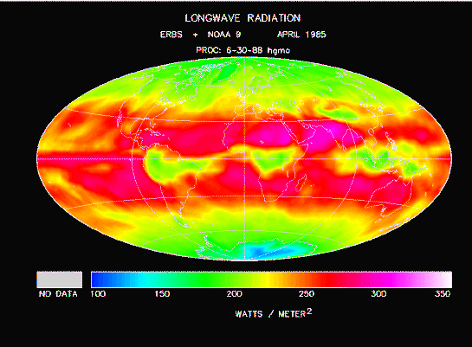
The Earth Radiation Budget Experiment (ERBE)

Slide 33
Why CERES? Key Areas of Uncertainty in
Understanding Climate & Global Change
Earth’s radiation balance and the influence of clouds on radiation and the hydrologic cycle
❑ Oceanic productivity, circulation and air-sea exchange
❑ Transformation of greenhouse gases in the lower
atmosphere, with emphasis on the carbon cycle
❑ Changes in land use, land cover and primary
productivity, including deforestation
❑ Sea level variability and impacts of ice sheet volume
❑ Chemistry of the middle and upper stratosphere,
including sources and sinks of stratospheric ozone
❑ Volcanic eruptions and their role in climate change
EOS Science Plan: The State of Science in the EOS Program (M. D. King, Ed. ). Available in hard copy and CD ROM versions from the EOS Project Science Office, NASA Goddard Space Flight Center

Slide 34
The second mission to study the Earth Radiation Budget:
Clouds and Earth's Radiant Energy System (CERES)
The first CERES instrument was launched in December of 1997 aboard NASA's Tropical Rainfall Measurement Mission (TRMM). CERES instruments are now collecting observations on three separate satellite missions, including the EOS Terra and Aqua observatories and now also on the NPOESS Preparatory Project (NPP) observatory. CERES products include both solar-reflected and Earth-emitted radiation from the top of the atmosphere to the Earth's surface. Cloud properties are determined using simultaneous measurements by other EOS and NPP instruments such as the (MODIS) and the Visible and Infrared Sounder (VIRS). Analyses build on previous experience such as the Earth Radiation Budget Experiment (ERBE), leading to a better understanding of the role of clouds and the energy cycle in global climate change.

Slide 35
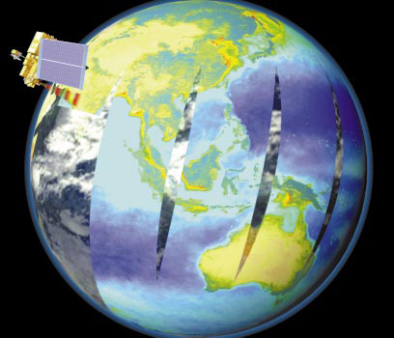
Two instruments aboard Terra—MODIS (as shown left) and CERES- see the entire surface of Earth almost every day
❑ MISR has a 9-day global coverage, while ASTER
takes 5 years

Slide 36
The NPP satellite has 5 instruments on board: VIIRS, CERES, CrIS, ATMS, and OMPS. Each one will deliver a specific set of data helping weather prediction and climate studies.
In October 2011 when NASA launches its next-generation Earth-observing satellite, NPP (NPOESS Preparatory Project), one of the instruments aboard will be the latest in a series of instruments that has studied the Earth's climate for nearly 30 years.

Slide 37
Suomi National Polar-orbiting Partnership, formerly known as the NPOESS Preparatory Project (NPP) will serve as a bridge between the EOS satellites and the forthcoming series of Joint Polar Satellite System (JPSS) satellites. Suomi NPP represents a critical first step in building this next-generation satellite system. The JPSS satellites, previously called the National Polar-orbiting Operational Environmental Satellite System (NPOESS), will be developed by NASA for the National Oceanic and Atmospheric Administration (NOAA).

Slide 38
Suomi NPP carries five instruments and will test key technologies for the JPSS missions. Suomi NPP is the first satellite mission to address the challenge of acquiring a wide range of land, ocean, and atmospheric measurements for Earth system science while simultaneously preparing to address operational requirements for weather forecasting.
Suomi NPP also represents the gateway to the creation of a U.S. climate monitoring system, collecting both climate and operational weather data and continuing key data records that are critical for global change science.

Slide 39
Key science objectives and capabilities of Suomi NPP:
Climate change -- contribute to long-term records of global environmental data critical for understanding the dynamics of climate change
Health of the ozone layer -- daily measurements of the atmospheric ozone layer that will determine whether the ozone layer is recovering as expected
Natural disasters -- monitor wildfires, volcanic eruptions, snowstorms, droughts, floods, hurricanes and dust plumes
Weather predictions -- a sounding instrument will collect information about cloud cover, atmospheric temperatures, humidity and other variables critical to accurate weather prediction
Vegetation -- map global land vegetation and quantify changes in plant productivity to understand the global carbon cycle and monitor agricultural processes to predict and respond to food shortages and famines

Slide 40
Global ice cover -- monitor changes to Earth’s sea ice, land ice and glaciers to track the pace of climate change
Air pollution -- monitor the spread of health-sapping pollutants such as soot, particulate matter, nitrogen dioxide and sulfur dioxide
Temperatures -- maintain a global record of atmospheric, land surface and sea surface temperatures critical to understanding the long-term dynamics of climate change
Earth’s energy budget -- make measurements to determine how much energy is entering and exiting Earth's atmosphere

Slide 41
The five instruments on the NPP satellite are:
Advanced Technology Microwave Sounder (ATMS)
22-channel passive microwave radiometer, to create global models of temperature and moisture profiles that meteorologists will enter into weather forecasting models.
Cross-track Infrared Sounder (CrIS)
Michelson interferometer, will monitor characteristics of the atmosphere, such as moisture and pressure that will be used to produce improvements in both short-and-long term weather forecasting.
Ozone Mapping and Profiler Suite (OMPS)
OMPS, built by Ball Aerospace, incorporates an advanced nadir-viewing sensor and a highly innovative limb-viewing sensor. OMPS instrument continues Ball's history of building ozone-measuring instruments and will continue the long-term continuous data record of ozone measurements from space.

Slide 42
Visible Infrared Imaging Radiometer Suite (VIIRS)
VIIRS, developed by Raytheon Space and Airborne Systems, has a 22-band radiometer similar to the MODIS instrument. It will collect visible and infrared views of Earth's dynamic surface processes, such as wildfires, land changes, and ice movement. VIIRS will also measure atmospheric and oceanic properties, including clouds and sea surface temperature.
Clouds and the Earth's Radiant Energy System (CERES)
3-channel radiometer measuring reflected solar radiation, emitted terrestrial radiation, and total radiation, will monitor the natural and anthropogenic effects on the Earth's total thermal radiation budget.

Slide 43
What is FOV?
The terms Field of View (FOV) and footprint are synonymous. The CERES FOV is determined by its PSF (Point Spread Function) which is a two-dimensional, bell-shaped function that defines the CERES instrument response to the viewed radiation field.

Slide 44
What is meant by Clear-Sky or All-Sky? :
All-Sky - The all-sky (or total) scene is determined from all CERES footprints (20 km nominal resolution) within the given temporal or spatial domain.
Clear-Sky - The clear-sky scene has different algorithms depending on the product, as explained below:
ERBE like - The clear-sky scene is determined from CERES footprints (20 km nominal resolution) that were crudely identified as clear using the ERBE (Wielicki and Green, 1989) scene id algorithm, which essentially uses climatological, zonal LW thresholds and a priori SW thresholds based on 12 scene ids. If there are no clear-sky footprints within the temporal or spatial domains the flux is default. CERES vs ERBE clear-sky scene identification comparison

Slide 45
SSF - The clear-sky scene is determined from CERES footprints (20 km nominal resolution) that are 99% clear, as identified by CERES-MODIS clear-sky mask from the MODIS pixels contained within the CERES footprint. However, there are many cloudy regions (like ITCZ, maritime stratus, etc.) that may not have any clear-sky observations for one particular month. The CERES SSF product makes no attempt to fill these regions.

Slide 46
EBAF - The clear-sky scene is determined from CERES footprints (20 km nominal resolution) that are 99% clear, as identified by CERES-MODIS clear-sky mask from the MODIS pixels contained within the CERES footprint. The EBAF (clear-sky filled) product has filled all non-observed clear-sky regional fluxes for a complete clear-sky global map. All temporal and spatial domains should have clear-sky fluxes.
The LW all-sky and clear-sky surface flux is calculated at all hourly increments during the month, regardless of cloud amount.
The GEOS-4 profile is the same for both clear-sky and all-sky conditions. The all-sky condition includes the cloud properties in the LW flux parameterization. The SW clear-sky/all-sky surface flux is only calculated from hourly increments that have an associated observed or CERES-only flux temporally interpolated TOA clear-sky SW flux/TOA all-sky SW flux during the month.

Slide 47
Many cloudy (ITCZ, maritime stratus) regions may not have CERES clear-sky footprint observations for the entire month; the CERES SSF product makes no attempt to fill these regions. If there are no clear-sky footprints within the temporal or spatial domains the surface SW flux is set to a default value.

Slide 48
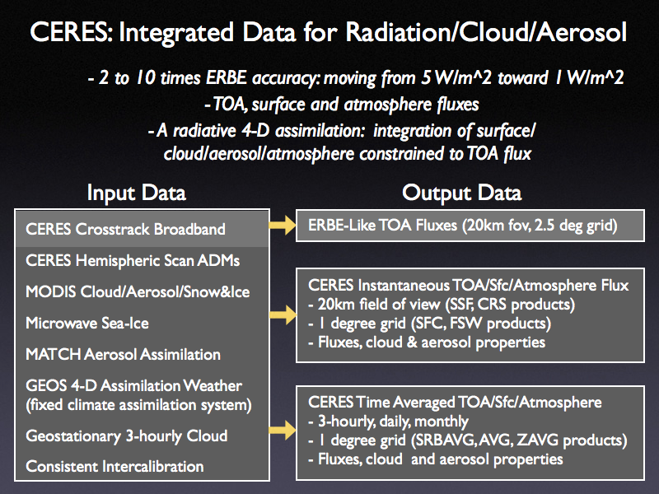
(after Wielicki)

Slide 49


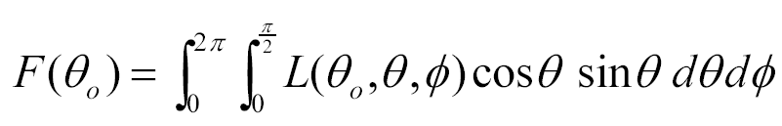
Instantaneous Fluxes at TOA and Angular Distribution Models
CERES Radiance Measurement
TOA Flux Estimate
SW
LW
WN
⇒
(after N. Loeb, 2009)

Slide 50
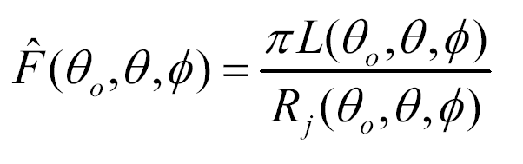
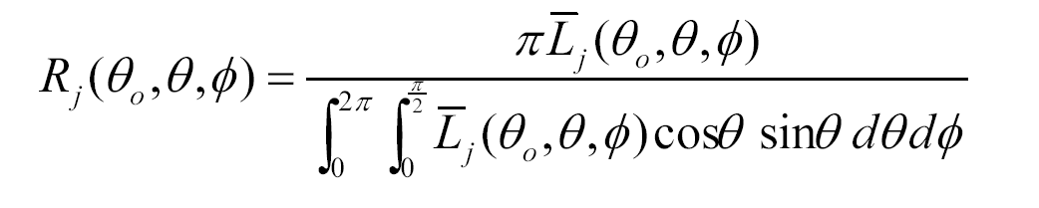
Instantaneous Fluxes at TOA
and Angular Distribution Models
TOA flux estimate from CERES radiance:
Where:
R_{j} (θ_{o} ,θ ,φ) is the Angular Distribution Model (ADM) for the “j^{th}” scene type

Slide 51
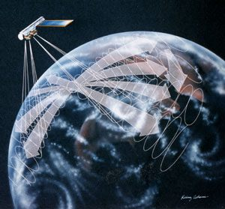
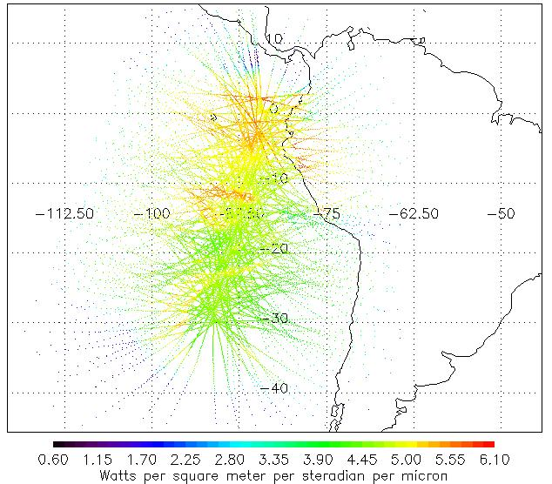
Angular Distribution Models
Multi-angle radiance data are collected using the rotating azimuth plane scanning (RAPS) mode of CERES
One CERES instrument dedicated to RAPS observations on Terra and Aqua

Slide 53
Geo-located and Calibrated TOA Radiances
Interpretation of CERES measurements
Convert raw counts to filtered radiances
(Wm⁻²sr⁻¹)
Geo-locate footprints on the ground
Derive SW, LW radiances from spectral unfiltering
Preserve radiometric scale across multiple instruments/missions
SUN
Emitted LW
Reflected SW
Earth / Atmosphere
Validation Protocol:
Comprehensive ground calibration/characterization program
Theoretical instrument models
LW and SW on-board calibration facilities
Comparison of measurements to theoretical radiative transfer models
Vicarious calibration sources including Tropical Deep Convective Clouds
Inter-instrument/platform consistency checks

Slide 54
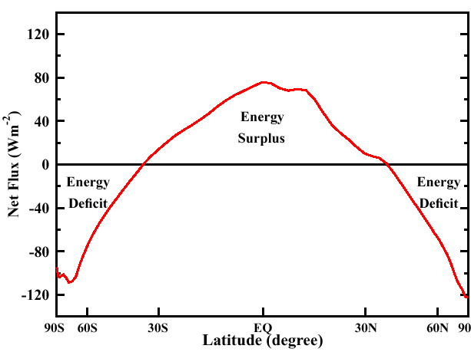
Annual Average Zonal Mean Net Flux Profile
CERES/TERRA, March 2000 to February 2001

Slide 55
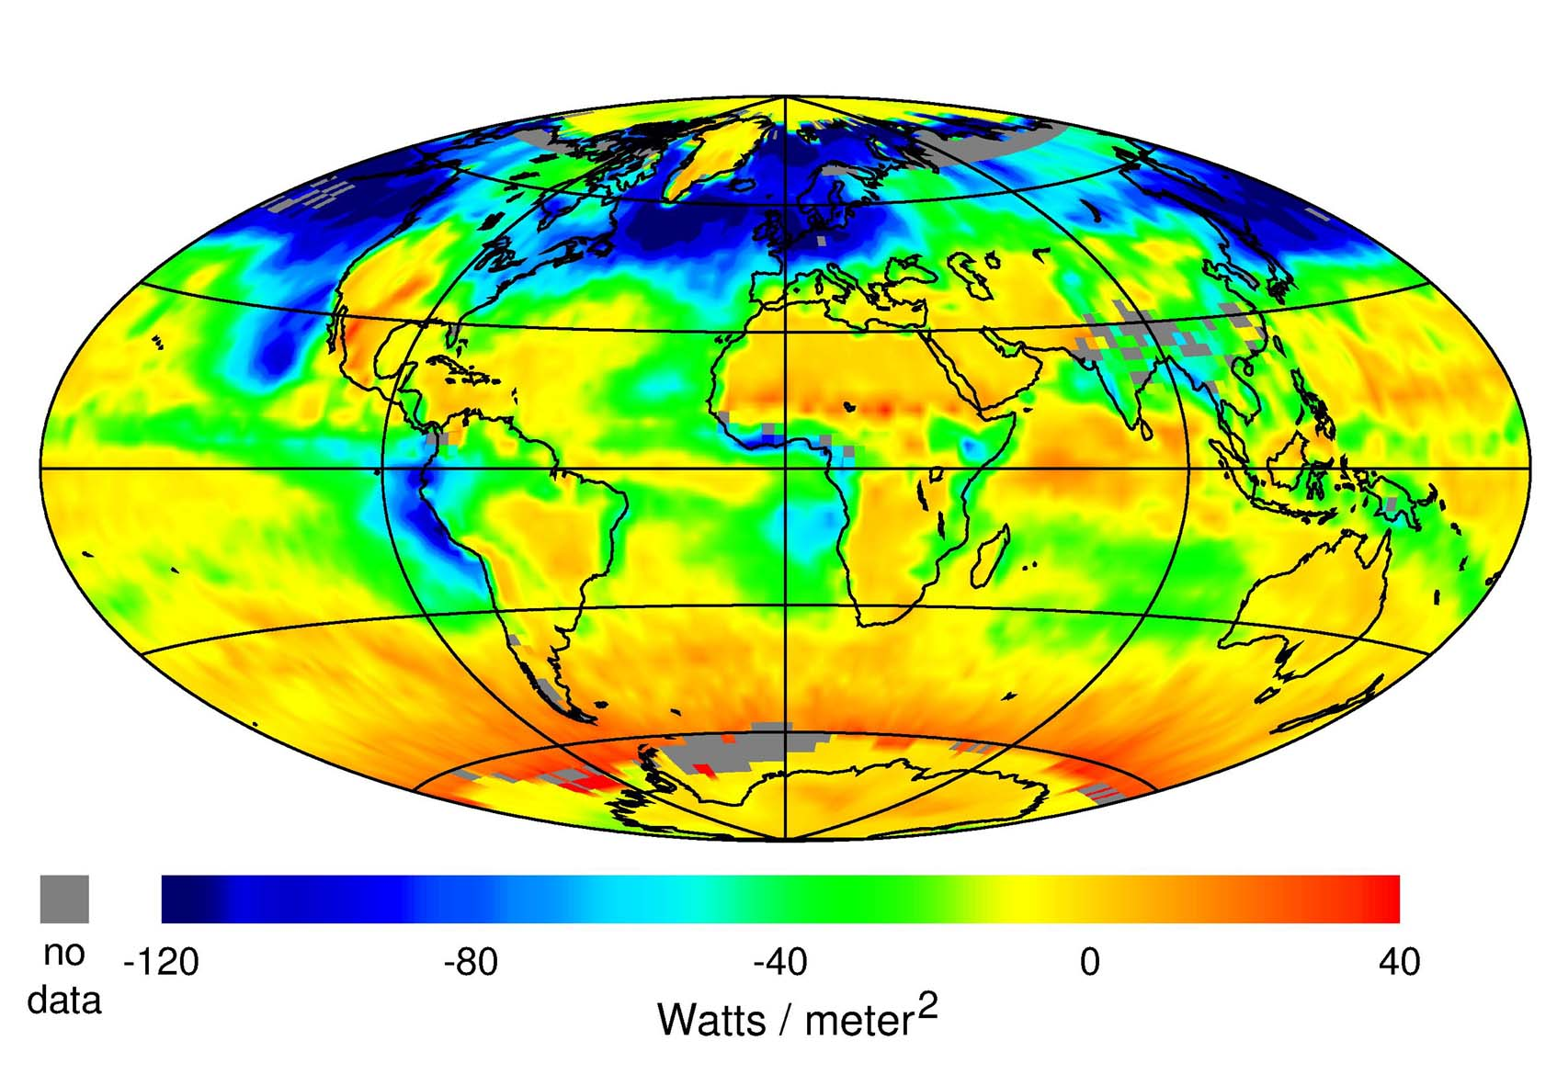
CERES Net Cloud Forcing (July, 2000)

Slide 56
Accuracy of top-of-atmosphere (TOA) ERBE observations:
Global annual net (SW-LW) ~ 5 Wm⁻²
Regional monthly uncertainty ~ 6 Wm⁻²
Year-to-year fidelity (if continuous) ~ 1-2 Wm⁻²
(CERES better by four)
Accuracy of surface observations:
Baseline Radiation Network (BSRN) operations Manual (WMO /TD-No. 879, 1998)
BSRN is a high quality standard to which the best stations may subscribe.
Ships/bouys do not meet BSRN standards for SW
Quantity at surface Capability Goal
Direct solar irradiance 1% or 2 Wm⁻²
Diffuse solar radiation 10 Wm-2 4% or 5 Wm⁻²
Global (SW) radiation 15 Wm-2 2% or 5 Wm⁻²
Reflected shortwave radiation 15 Wm-2 5%
Downwelling longwave radiation 30 Wm-2 5% or 10 Wm⁻²
Upwelling longwave radiation 30 Wm-2 5% or 10 Wm⁻²
IPCC 1995 forcing by well-mixed anthropgenic gases +2.45 Wm⁻²
Direct aerosol at TOA –0.2 to –0.8 Wm⁻²
Indirect aerosol at TOA ~0.0 to –1.5 Wm⁻²
World Ocean heat storage from mid-1950s to mid-1990s
“warming rate of 0.3 Wm⁻² (Levitus et al., 2000)
Geothermal heating ~0.06 Wm⁻² (Oort, 1992)

Slide 57
Why are Clouds So Important?
Cess:
“Eighteen atmospheric GCMs, using prescribed SSTs, have been compared to top-of-atmosphere radiation fluxes from ERBE. A small subset does a reasonable job of replicating the ERBE data, but typically the models tend to overestimate cloud cooling. This is because their clouds are either too bright, or at too low an altitude, or both.”

Slide 58
Why is the cloud problem so hard?
We lack a good cloud database - historical record - only cloud fraction:
  hard to define what is a cloud
The existing database is very limited in number of variables, and controversial:
  ISCCP (mean cloud optical depth = 3.5 ??)
  Hahn/Warren surface climatology
  Terra (1999 launch) making first major effort to go beyond these limited efforts (but hard to validate!)
  Under the Atmospheric Radiation Measurement (ARM) Program, effort underway to develop a coordinated dataset of cloud and radiation variables.
  3 major sites operational, including development of many new instruments (incl. cloud radar)

Slide 59
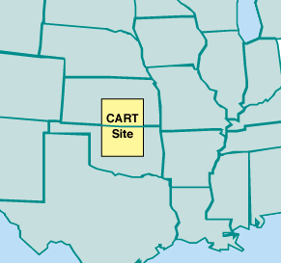
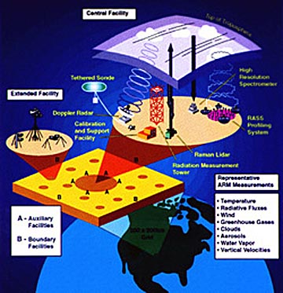
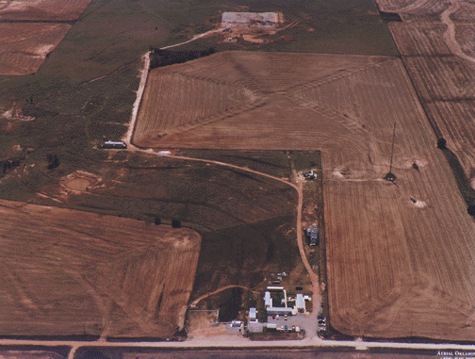
ARM Oklahoma: A “Field of Beams”

Slide 60
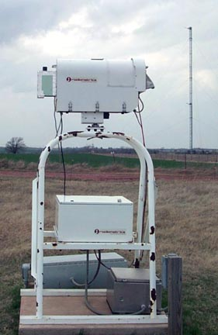
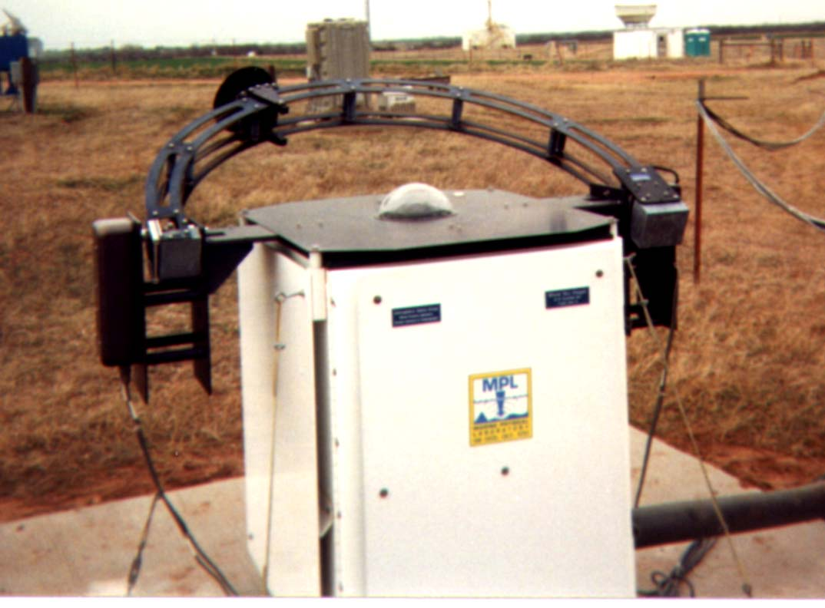
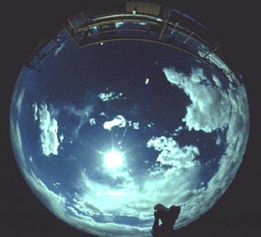
ARM: Major Cloud Characterization Instruments
Microwave radiometer
(for liquid water path)
Whole
Sky
Imager
(DoD)

Slide 63
Early studies of sensitivity to cloud amount
One of the early attempts to quantify the effect of clouds on the earth’s radiation budget is described in a technical report by London (1957), whose results were widely cited prior to satellite measurements.
Using temperature and cloud cover observations for the Northern Hemisphere, he computed solar and infrared fluxes at the top of the atmosphere with and without clouds.
He found that clouds have a net energy input primarily during the spring and summer seasons, with an annual average effect of ~35 W/m*2 a result not so different form modern satellite-based estimates to be discussed .

Slide 64
Later, Budyko (1969) used observations of the temperature (T_{s}) and cloud amount (A_{c}) compiled in Budyko (1963) to calculate outgoing infrared flux at the top of the atmosphere (F) and to derive a relationship based on regression:
  F = 223 + 2.2T_{s} - (48+1.6T_{s})A_{c}
where F is in W/m⁻² and T is in ⁰C. For a mean global surface temperature of 288 K, he finds the sensitivity of the infrared flux to clouds to be
δF/δA_{c} = -72 W/m⁻².

Slide 67

For the values adopted by Schneider (1989)
a_{c} = 0.5 and α₀ = 0.12
The solar radiation sensitivity coefficient is -130 W/m⁻²
(Here the results are normalized to the solar constant of 1368 W/m⁻²).
The net sensitivity to cloud amount is the difference between the
solar and infrared sensitivity coefficients:
which for Schneider’s model is -55 W/m⁻²

Slide 68
Climate Sensitivity
Radiative Effect at the Top of the Atmosphere
For a 50% Increase in Climate Parameter
Cloud
Height
High Cloud
Amount
Particle Size
(Low Clouds)
Stratospheric
Ozone
Carbon
Dioxide
Radiative
Effect
(W/m²)
Low Cloud
Amount
Cloud Optical
Depth
Indirect Aerosol
Forcing
Direct Anthropogenic
Aerosol Forcing
Land Albedo
Low clouds
COD

Slide 69
CLEAR-SKY AND CLOUD SENSITIVITY FROM 19 GCMS
Climate models are inconsistent in predicting the effects of clouds on climate
(Cess et al., 1990)

Slide 70
Over the last dozen years, NASA has launched a series of satellites – known collectively as the Earth Observing System (EOS) – that has provided critical insights into the dynamics of the entire Earth system: clouds, oceans, vegetation, ice, solid Earth and atmosphere (see next slide).
Now NASA is helping to create a new generation of satellites to extend and improve upon the Earth system data records established by EOS.

Slide 71
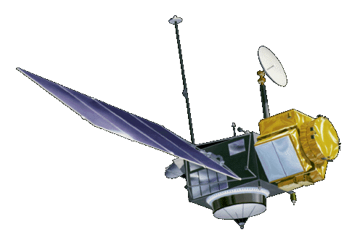


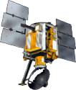
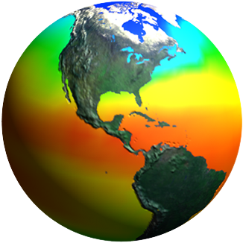
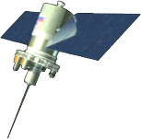
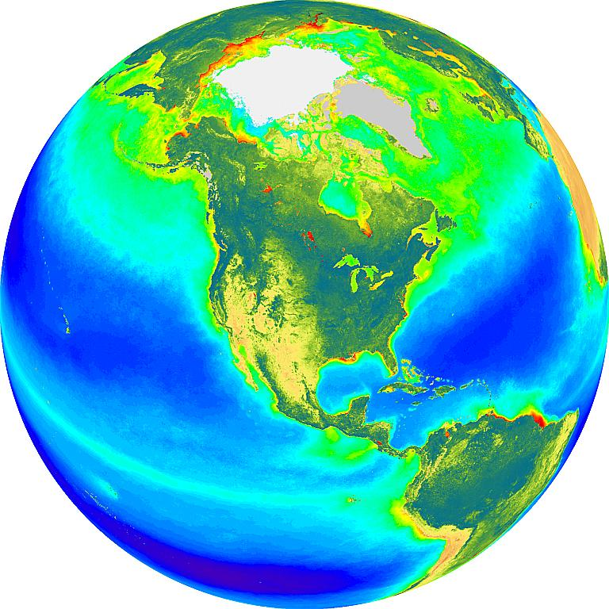
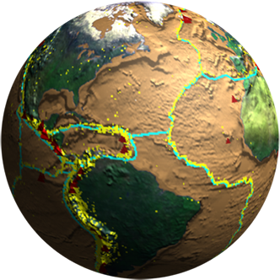
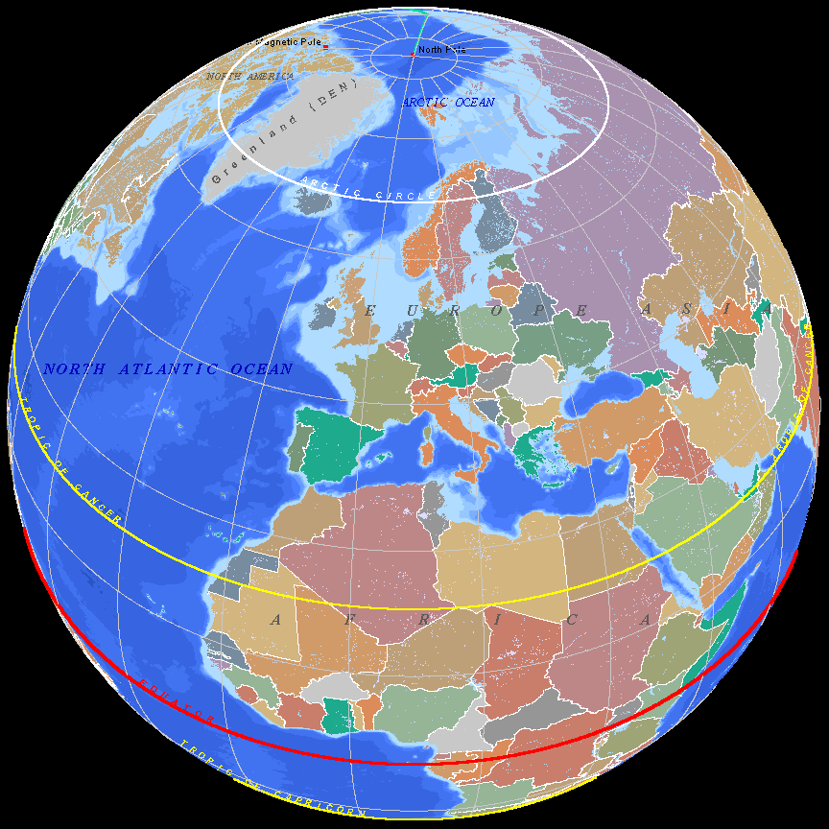
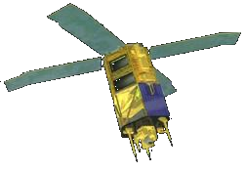
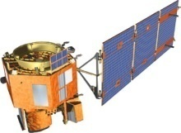
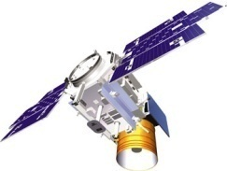
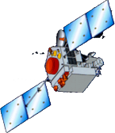
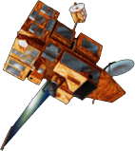
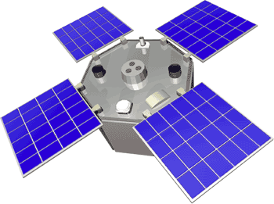
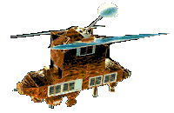
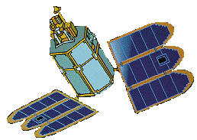
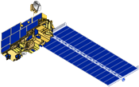
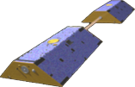
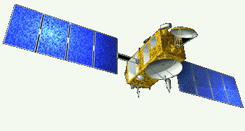
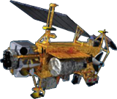
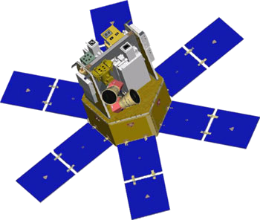
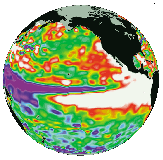
Spaceborne Earth Observation Systems
TOPEX/Poseidon
Landsat 7
SORCE
Aqua
QuikScat
Sage
EO-1
SeaWiFS
IceSat
TRMM
SeaWinds
ACRIMSAT
ERBS
Toms-EP
Grace
Jason
Terra
UARS

Slide 72
A configuration of several satellites with complimentary capabilities is considered as ideal for cloud research. In particular, the newer systems with active capabilities.
Aqua
CALIPSO
CloudSat

Slide 73
The solar radiation effect and the thermal emission effect are in opposite directions as far as net radiation at the top of the atmosphere is concerned.
Each effect, by itself, is large, but the combine effect is relatively small and will depend significantly on the cloud-free profile of atmospheric temperature, humidity, and aerosols, and upon surface temperature and optical properties.
The net effect is the difference of two large terms; led to a debate in the 70s on the role clouds play in the climate system.

