Slide 1
AOSC400-2015
October 27, Lecture # 15
Principles of Remote Sensing
Remote Sensing Methods
Passive and active sensors
Absorption spectrum in microwave
Principles of MW radiometry
Polarized wave
Microwave Instruments of focus
Solution of the transfer equation for a non-scattering atmosphere in MW
Spectral Intervals in (VIS, IR, MW) of interest in Remote Sensing
Copyright@2015 University of Maryland
This material may not be reproduced or redistributed, in whole or in part, without written permission of Rachel T. Pinker
*Sources of information used for this lecture are listed in updated Syllabus.

Slide 2
Spectral Intervals in (VIS, IR, MW) of interest in Remote Sensing
Several spectral regions are considered useful for remote sensing from satellites.
Windows to the atmosphere (regions of minimal atmospheric absorption) exist near 4 μm, 10 μm, 0.3 cm, and 1 cm (see next slide).
Infrared windows are used for sensing the temperature of the earth surface and clouds, while microwave windows help to investigate the surface emissivity and the liquid water content of clouds.

Slide 3
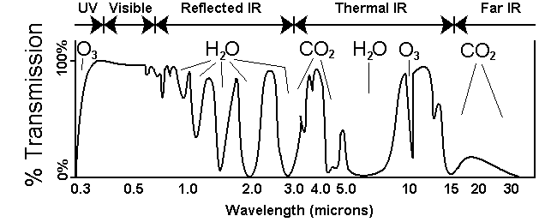
High transmission means low absorption. There is significant transmission of radiation at 0.5 microns, 2.5 microns, and 3.5 microns, but a great deal of atmospheric absorption at 2.0, 3.0, and about 7.0 microns.

Slide 4
Absorption bands
The CO₂ and O₂ absorption bands at 4.3 μm, 15 μm, 0.25 cm, and 0.5 cm are used for temperature profile retrieval
The water vapor absorption bands near 6.3 μm, beyond 18 μm, near 0.2 cm, and near 1.3 cm are sensitive to the water vapor concentration in the atmosphere.

Slide 5
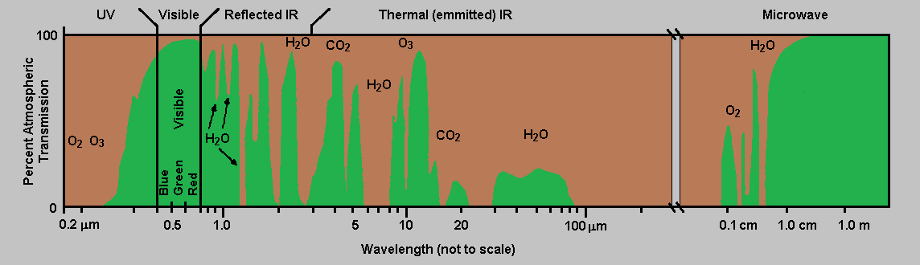

Slide 6
 | There are two types of remote sensing instruments—passive and active. Passive instruments detect natural energy that is reflected or emitted from the observed scene. Passive instruments sense only radiation emitted by the object being viewed or reflected by the object from a source other than the instrument. Reflected sunlight is the most common external source of radiation sensed by passive instruments. Scientists use a variety of passive remote sensors. Radiometer An instrument that quantitatively measures the intensity of electromagnetic radiation in some band of wavelengths in the spectrum. Usually a radiometer is further identified by the portion of the spectrum it covers; for example, visible, infrared, or microwave. Imaging Radiometer A radiometer that includes a scanning capability to provide a two-dimensional array of pixels from which an image may be produced is called an imaging radiometer. Scanning can be performed mechanically or electronically by using an array of detectors. Spectrometer A device designed to detect, measure, and analyze the spectral content of the incident electromagnetic radiation is called a spectrometer. Conventional, imaging spectrometers use gratings or prisms to disperse the radiation for spectral discrimination. Spectroradiometer A radiometer that can measure the intensity of radiation in multiple wavelength bands (i.e., multispectral). Oftentimes the bands are of a high spectral resolution—designed for the remote sensing of specific parameters such as sea surface temperature, cloud characteristics, ocean color, vegetation, trace chemical species in the atmosphere, etc. Active instruments provide their own energy (electromagnetic radiation) to illuminate the object or scene they observe. They send a pulse of energy from the sensor to the object and then receive the radiation that is reflected or backscattered from that object. Scientists use many different types of active remote sensors. Radar (Radio Detection and Ranging) A radar uses a transmitter operating at either radio or microwave frequencies to emit electromagnetic radiation and a directional antenna or receiver to measure the time of arrival of reflected or backscattred pulses of radiation from distant objects. Distance to the object can be determined since electromagnetic radiation propagates at the speed of light. Scatterometer A scatterometer is a high frequency microwave radar designed specifically to measure backscattered radiation. Over ocean surfaces, measurements of backscattered radiation in the microwave spectral region can be used to derive maps of surface wind speed and direction. Lidar (Light Detection and Ranging) A lidar uses a laser (light amplification by stimulated emission of radiation) to transmit a light pulse and a receiver with sensitive detectors to measure the backscattered or reflected light. Distance to the object is determined by recording the time between the transmitted and backscattered pulses and using the speed of light to calculate the distance traveled. Lidars can determine atmospheric profiles of aerosols, clouds, and other constituents of the atmosphere. Laser Altimeter A laser altimeter uses a lidar (see above) to measure the height of the instrument platform above the surface. By independently knowing the height of the platform with respect to the mean Earth's surface, the topography of the underlying surface can be determined. next: NASA Remote Sensing Accomplishments back: Color Images
Remote Sensing Methods
There are two types of remote sensing instruments:
Passive
Active
Passive instruments detect natural energy that is reflected or emitted from the observed scene. Reflected sunlight is the most common external source of radiation sensed by passive instruments.
Active instruments provide their own energy to illuminate the scene they observe.

Slide 7
Passive Remote Sensing by Satellites
Monitoring of radiation emitted by and reflected from the Earth system by satellite-borne radiome­ters provides information on weather and climate. Fields that are currently routinely mon­itored from space include: temperature, cloud cover, cloud droplet concentrations and sizes, rainfall rates, humidity, radiative fluxes, surface wind speed and direction, concentrations of trace constituents and aerosols, and lightning. Discussed will be just a few of the many applications of remote sensing in atmospheric science.

Slide 8
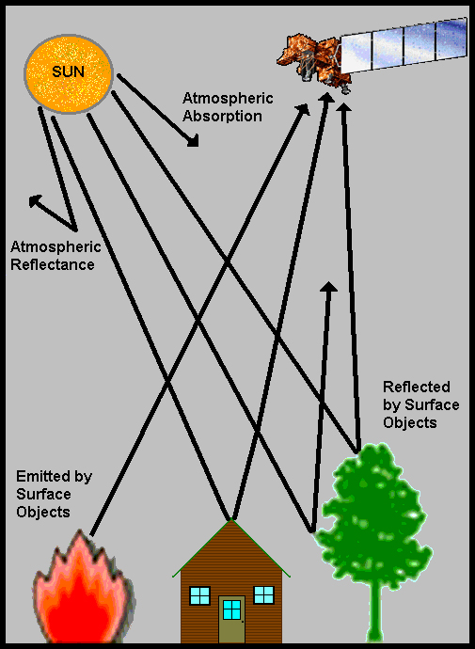
Passive Remote sensing
COPYRIGHT © 2010 Paul R. Baumann

Slide 9
Examples of passive remote sensors:
Radiometer
An instrument that quantitatively measures the intensity of electromagnetic radiation in some band of wavelengths in the spectrum. Usually a radiometer is further identified by the portion of the spectrum it covers; for example, visible, infrared, or microwave.
Imaging Radiometer
A radiometer that includes a scanning capability to provide a two-dimensional array of pixels from which an image may be produced is called an imaging radiometer. Scanning can be performed mechanically or electronically by using an array of detectors.

Slide 10
Spectrometer
A device designed to detect, measure, and analyze the spectral content of the incident electromagnetic radiation is called a spectrometer. Conventional, imaging spectrometers use gratings or prisms to disperse the radiation for spectral discrimination.
Many such instruments are carried on satellites.

Slide 11
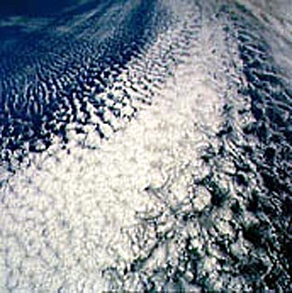
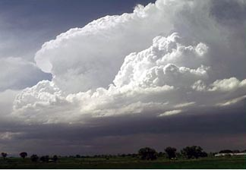
Due to their complexity, clouds are difficult to model
Satellites are useful for identifying clouds.

Slide 12
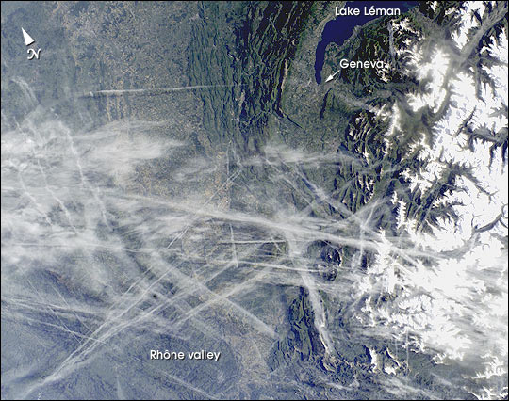
“Man made” clouds: Airplane Tracks

Slide 13
Cloud Observations from satellites
  Geostationary, polar orbiting
  Visible light provides a black and white picture of clouds
  Infrared approximates cloud temperature which infers height
  Satellites measure many other variables: sea surface temperatures, ozone, upper level features, snow cover, land cover
Notes:
13

Slide 14
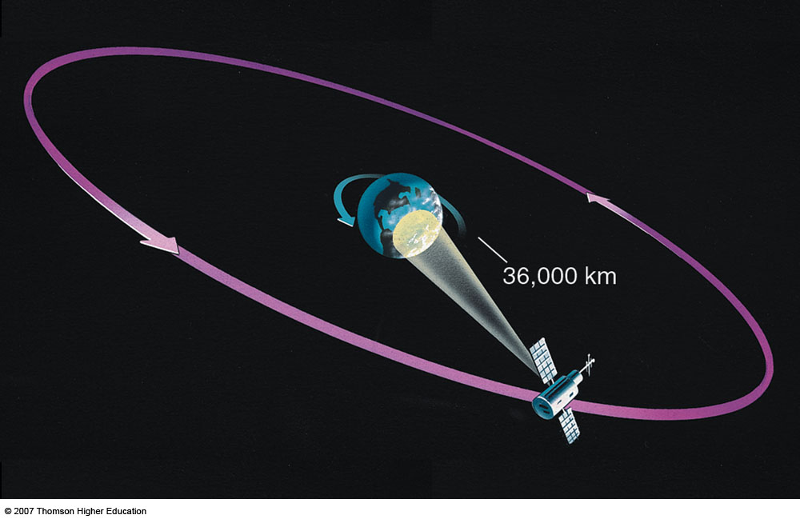
The geostationary satellite moves through space at the same rate that the earth rotates, so it remains above a fixed spot on the equator and monitors one area constantly.

Slide 15
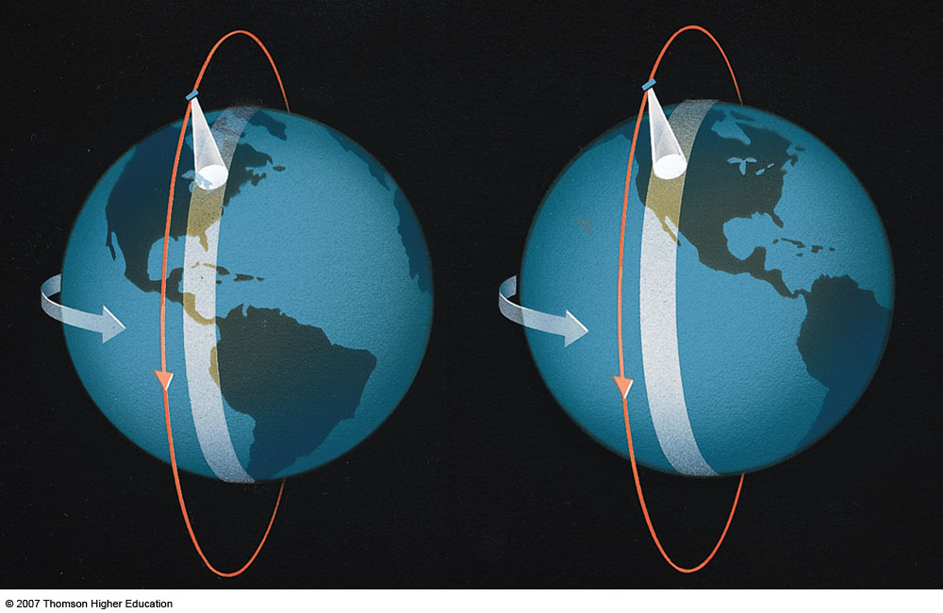
Polar-orbiting satellites scan from north to south, and on each successive orbit the satellite scans an area farther to the west.

Slide 16
Infra-red imagery
Responds to window at a wavelength of 10.7 µm, in which radiation emitted from the Earth's surface and cloud tops penetrates through cloud-free air with little absorption. Intensities in this channel are indicative of the temperatures of the surfaces from which the radiation is emitted as inferred from the Planck function.
In contrast to visible imagery, high clouds are usually clearly distinguishable from low clouds in infrared imagery by virtue of their lower temperatures.

Slide 17
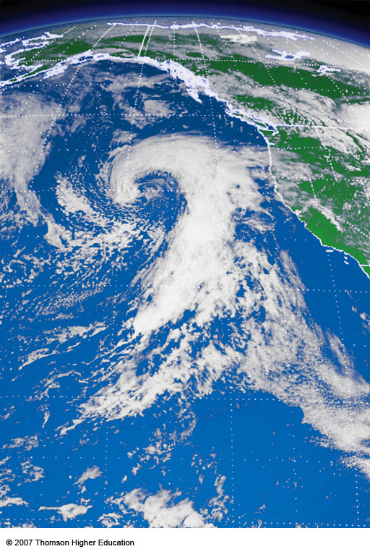
Figure (a)
A visible image of the eastern Pacific taken at just about the same time on the same day as the image in Fig. (b). Notice that the clouds in the visible image appear white
Notes:
.

Slide 18
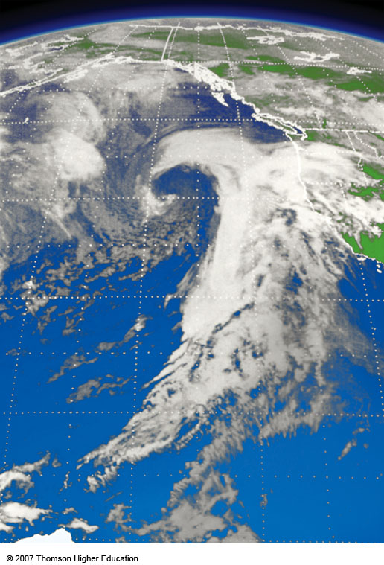
Figure (b)
Infrared image of the eastern Pacific taken at just about the same time on the same day as the image in Fig. (a). Notice that the low clouds in the infrared image appear in various shades of gray.
Notes:
Figure 5.34
Infrared image of the eastern Pacific taken at just about the same time on the same day as the image in Fig. 5.34 (a). Notice that the low clouds in the infrared image appear in various shades of gray.

Slide 19
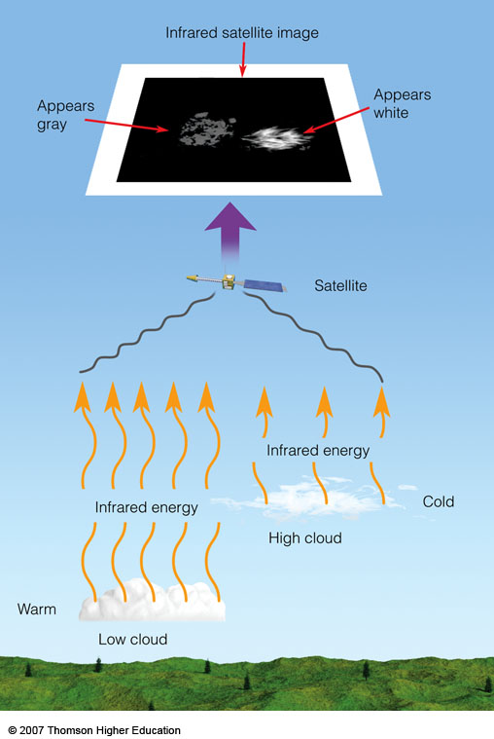
Generally, the lower the cloud, the warmer its top. Warm objects emit more infrared energy than do cold objects. Thus, an infrared satellite picture can distinguish warm, low (gray) clouds from cold, high (white) clouds.

Slide 20
Advanced Very High Resolution Radiometer - AVHRR
The AVHRR is a radiation-detection imager that can be used for remotely determining cloud cover and the surface temperature.
Note that the term surface can mean the surface of the Earth, the upper surfaces of clouds, or the surface of a body of water.
This scanning radiometer uses 6 detectors that collect different bands of radiation wavelengths (see next slide).
The first AVHRR was a 4-channel radiometer, first carried on TIROS-N (launched October 1978). This was subsequently improved to a 5-channel instrument (AVHRR/2) that was initially carried on NOAA-7 (launched June 1981). Later instrument version is AVHRR/3, with 6 channels, first carried on NOAA-15 launched in May 1998.
http://noaasis.noaa.gov/NOAASIS/ml/avhrr.html

Slide 21
AVHRR/3 Channel Characteristics
Channel Number | Resolution at Nadir | Wavelength (um) | Typical Use
1 | 1.09 km | 0.58 - 0.68 | Daytime cloud and surface mapping
2 | 1.09 km | 0.725 - 1.00 | Land-water boundaries
3A | 1.09 km | 1.58 - 1.64 | Snow and ice detection
3B | 1.09 km | 3.55 - 3.93 | Night cloud mapping, sea surface temperature
4 | 1.09 km | 10.30 - 11.30 | Night cloud mapping, sea surface temperature
5 | 1.09 km | 11.50 - 12.50 | Sea surface temperature

Slide 22
Active Remote Sensing
Active instruments provide their own energy to illuminate the scene they observe. They send a pulse of energy from the sensor to the object and then receive the radiation that is reflected or backscattered from that object. Scientists use many different types of active remote sensors.

Slide 23
Examples of passive remote sensors:
Radar (Radio Detection and Ranging)
A radar uses a transmitter operating at either radio or microwave frequencies to emit electromagnetic radiation and a directional antenna or receiver to measure the time of arrival of reflected or backscattred pulses of radiation from distant objects. Distance to the object can be determined since electromagnetic radiation propagates at the speed of light.
Scatterometer
A scatterometer is a high frequency microwave radar designed specifically to measure backscattered radiation. Over ocean surfaces, measurements of backscattered radiation in the microwave spectral region can be used to derive maps of surface wind speed and direction

Slide 24
Lidar
A lidar uses a laser to transmit a light pulse and a receiver with sensitive detectors to measure the backscattered or reflected light.
Distance to the object is determined by recording the time between the transmitted and backscattered pulses and using the speed of light to calculate the distance traveled.
Lidars can determine atmospheric profiles of aerosols, clouds, and other constituents of the atmosphere.
Laser Altimeter
A laser altimeter uses a lidar to measure the height of the instrument platform above the surface. By independently knowing the height of the platform with respect to the mean Earth's surface, the topography of the underlying surface can be determined.

Slide 25
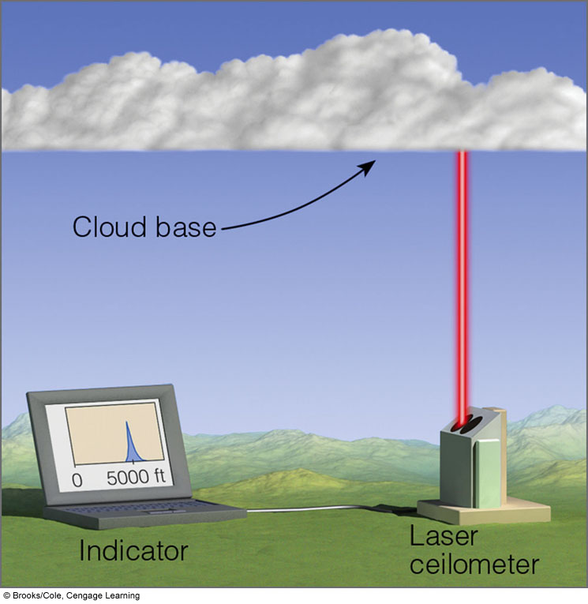
Cloud ceilings
Ceilometer used at airports to determine height from clouds by light or laser striking clouds and then reflected to a recorder. The interval of time between pulse transmission and return is a measure of cloud height, as displayed on the indicator screen.

Slide 26
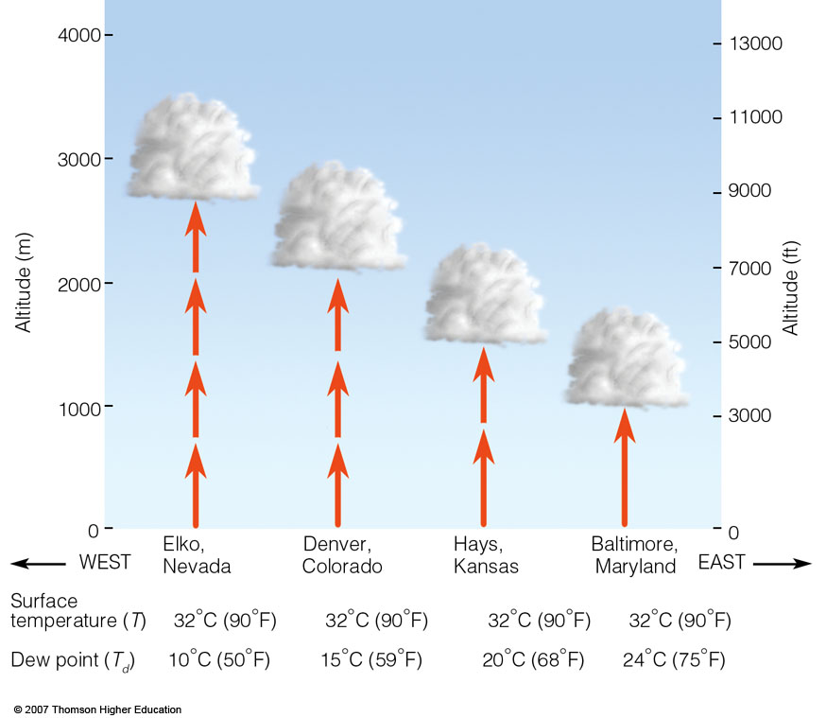
During the summer, cumulus cloud bases typically increase in elevation above the ground as one moves westward into the drier air of the Central Plains.

Slide 27
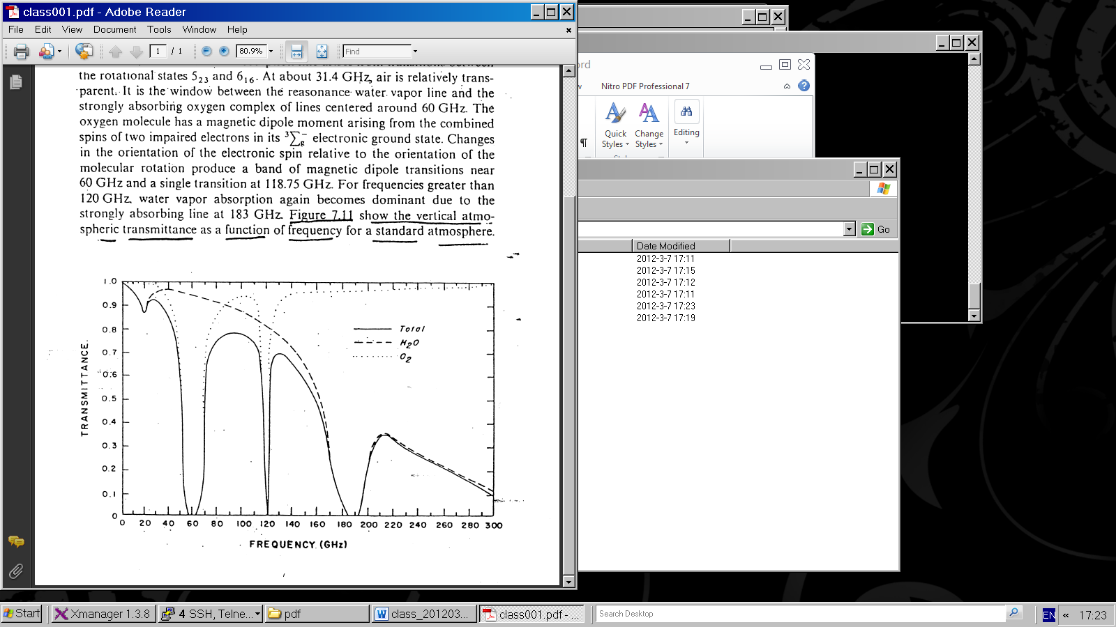
Issues and applications of microwave
Absorption spectrum in microwave
Figure 1

Slide 28
Water vapor and molecular oxygen exhibit absorption lines in the microwave region.
Below 40 GHz (1 GHz = 10⁹ cycles/sec; note 1 cm = 30 GHz) only the weakly absorbing pressure broadened 22.235 GHz water vapor line is dominant.
At about 31.4 GHz, air is relatively transparent.
For frequencies greater than 120 GHz. water vapor absorption again becomes dominant due to the strongly absorbing line at 183 GHz. Figure 1 show the vertical atmospheric transmittance as a function of frequency for a standard atmosphere.

Slide 29
Special problem in the use of microwave from a satellite platform is the emissivity of the earth surface. In the microwave region of the spectrum, emissivity values of the earth surface range from 0.4 to 1.0. The emissivity of the sea surface typically ranges between 0.4 and 0.5, depending upon such variables as salinity, sea ice, surface roughness and sea foam. This complicates interpretation of terrestrial and atmospheric radiation with earth surface reflections.

Slide 30
In addition, there is a frequency dependence with higher frequencies displaying higher emissivity values. Over land, the emissivity depends on the moisture content of the soil. Wetting of a soil surface results in a rapid decrease in emissivity. The emissivity of dry soil is on the order of 0.95 to 0.97, while for wet bare soil it is about 0.80 to 0.90, depending on the frequency. The surface emissivity appearing in the first term has a significant effect on the brightness temperature value.

Slide 31
Microwave Instruments of focus
Passive = radiometers
Scanning Multichannel Microwave Radiometer, Special Sensor Microwave Imager, Sounder
SMMR, SSM/I, SSMIS, TMI, AMSU-A, B-true workhorses
Active = radar types
Scatterometers, SEASAT, ERS 1, 2, QuikSCAT; also workhorses—Currently Metop’ s ASCAT
Altimeters, TOPEX, Poseidon, Jason 1, 2, others.
Synthetic Aperture Radars, SARs RADARSAT 1, 2 , ENVISAT/ASAR , Tetra-SAR X
Precipitation /Cloud Radars, TRMM, CloudSat

Slide 32
Principles of MW radiometry
Radiometers are passive instruments, so they detect radiation emitted by Earth’s atmosphere or surface. The ocean is a weak emitter with emissivity of the order of 50%, so its black body temperature in most MW wavelengths is 150 K. It is therefore acting like a mirror for the atmosphere and clouds above. The atmosphere has a strong emission line around 22GHz, so that frequency is used to measure the TOTAL COLUMN OF WATER VAPOR in the air. 19 GHz and 37 GHz are sensitive to the “Mie scattering” by cloud droplets, so these frequencies are used for TOTAL LQUID WATER content, and 85 GHz receives SCATTERING FROM ICE PARTICLES at the top of clouds, indication of possible rain.
The solid Earth is a strong emitter, so atmospheric signals cannot be separated out over land

Slide 33
Detection of MW radiation
Signals are received in so called “horns”, which have rectangular openings. The electro-magnetic radiation is received in horizontal or vertical planes, which means that the radiation is either horizontally or vertically polarized. The same is true for radiation sent out by a MW emitter that also can receive – a radar.

Slide 34
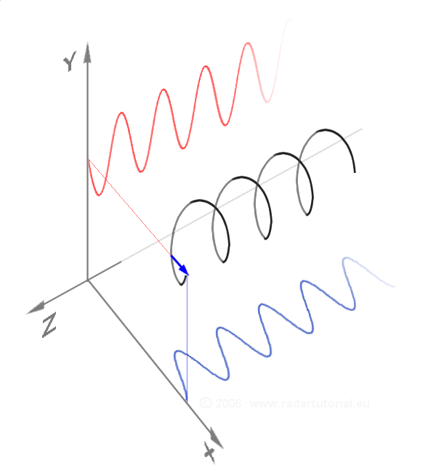
Vertically, horizontally and a circularly polarized wave as a sum of the two components

Slide 35
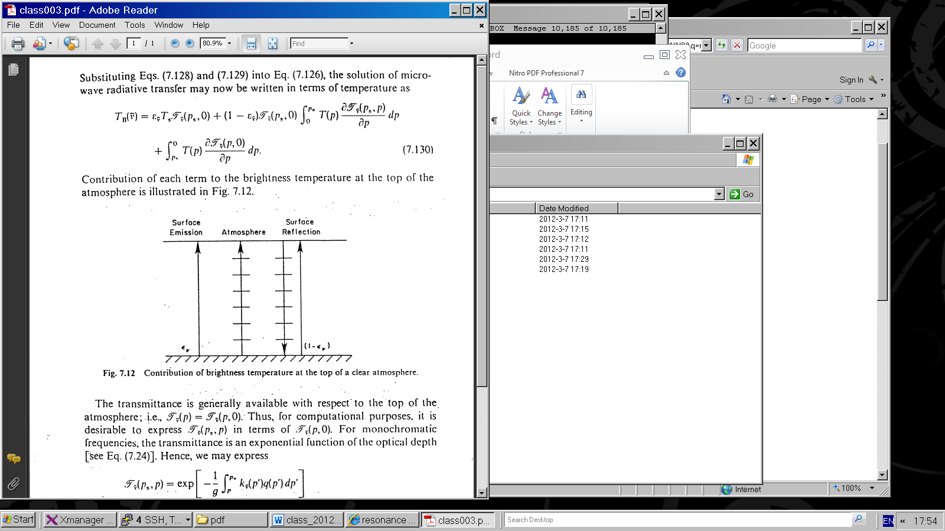
Since the emissivity in microwave is less than 1, there is a reflection contribution from the surface.
Contribution of each term to the brightness temperature at the top or the atmosphere

Slide 36
The radiance emitted from the surface is given as:
The first term in the right-hand side denotes the surface emission contribution, whereas the second term represents the emission contribution from the entire atmosphere to the surface, which is reflected back to the atmosphere at the same frequency.

Slide 37
Contribution of each term to the brightness temperature at the top of the atmosphere

Slide 38
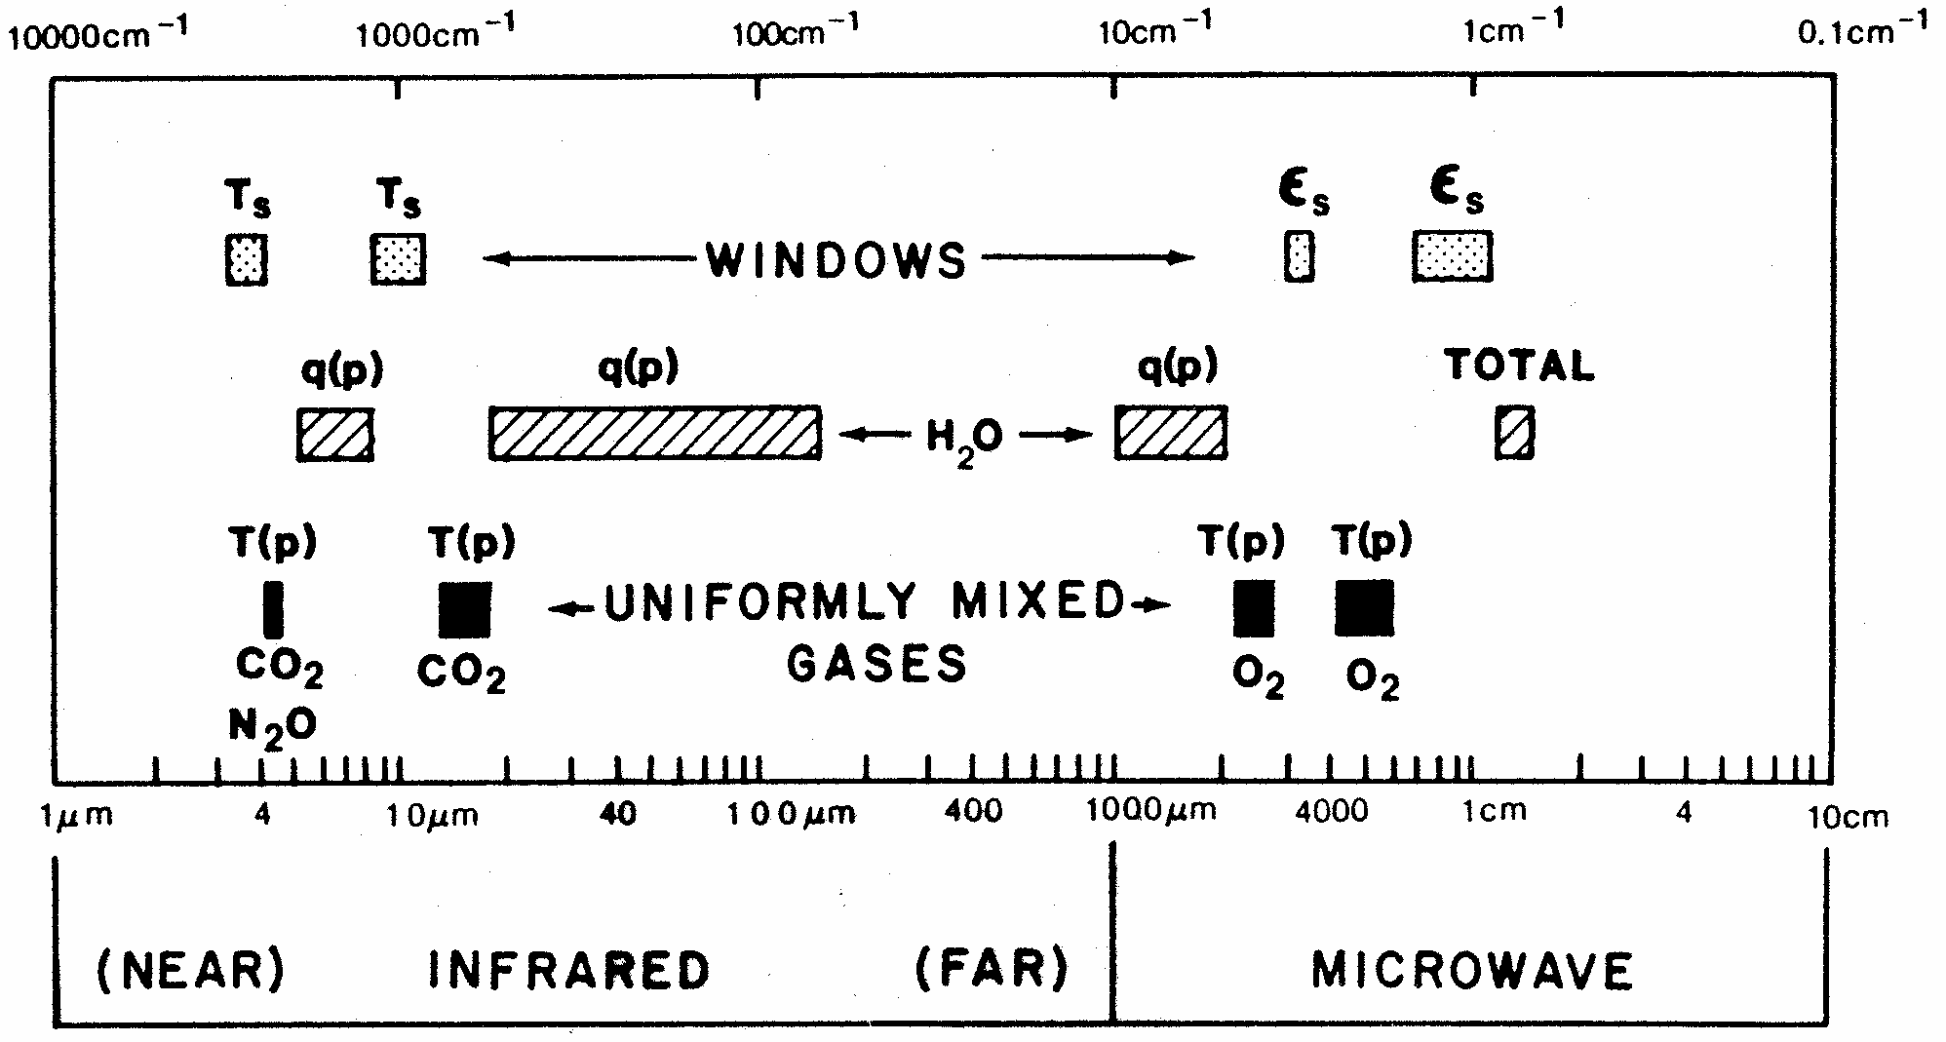
Spectral regions used for remote sensing of the earth atmosphere and surface from satellites. ε indicates emissivity, q denotes water vapor, and T represents temperature.

Slide 40
called the weighing function, represents the contribution from a layer of unit thickness
located at a level z to the radiance sensed by satellites

Slide 42
Satellite retrieval of temperature

Slide 44
Over the last dozen years, NASA has launched a series of satellites – known collectively as the Earth Observing System (EOS) – that has provided critical insights into the dynamics of the entire Earth system: clouds, oceans, vegetation, ice, solid Earth and atmosphere (see next slide).
Now NASA is helping to create a new generation of satellites to extend and improve upon the Earth system data records established by EOS.

Slide 45
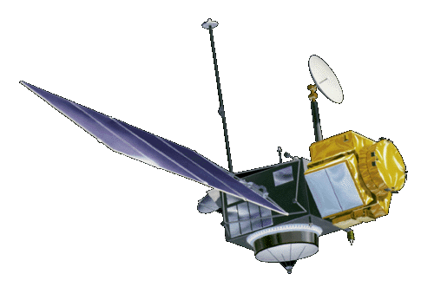


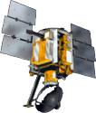
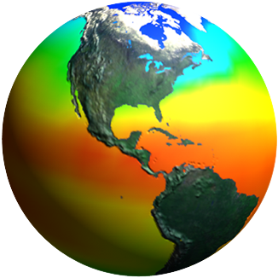
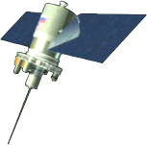
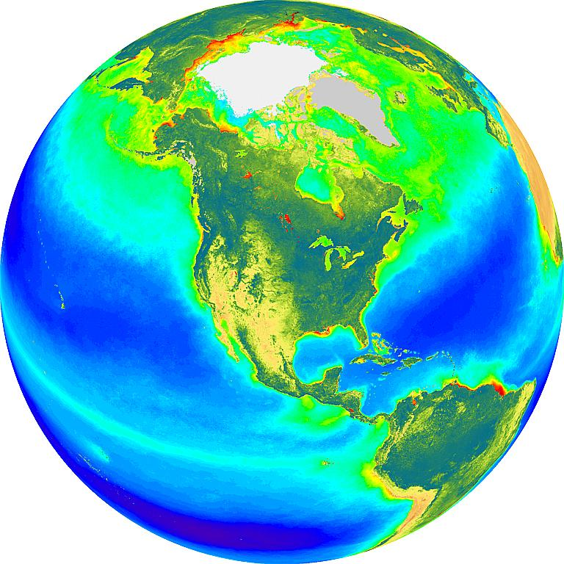
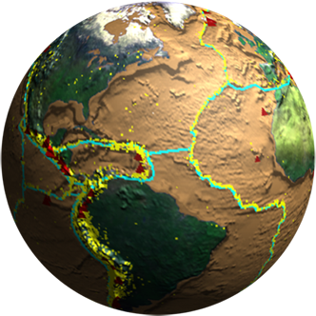
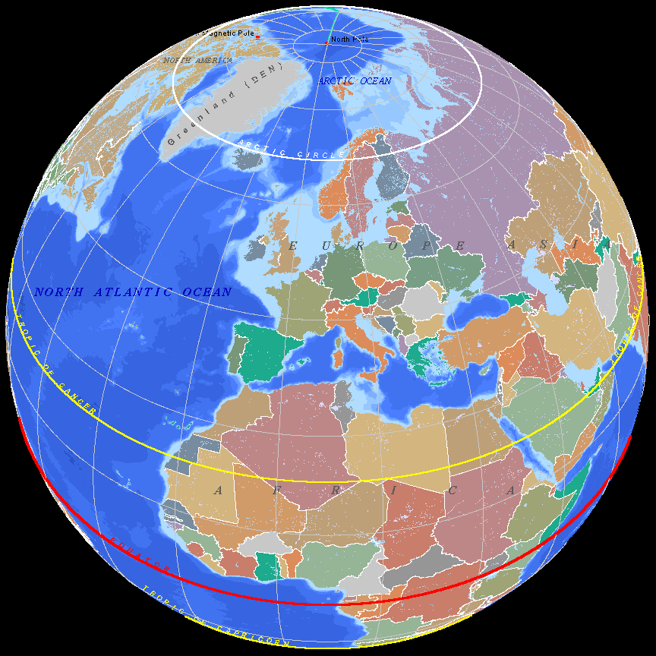
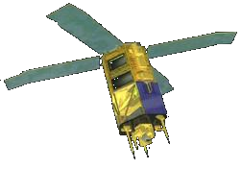
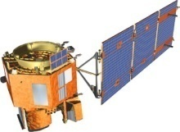
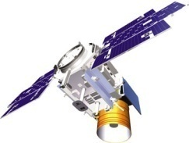
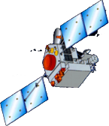
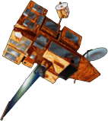
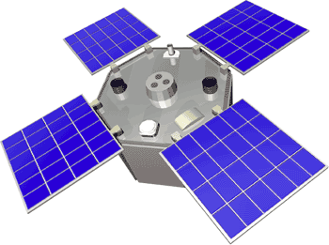
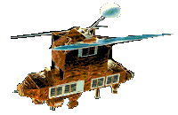
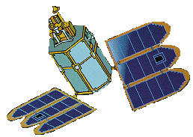
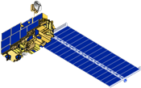
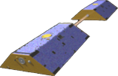
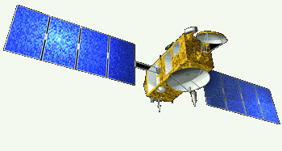
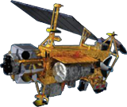
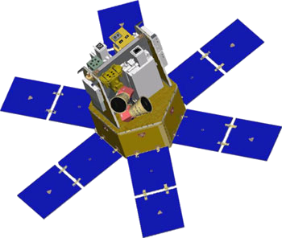
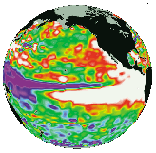
Spaceborne Earth Observation Systems
TOPEX/Poseidon
Landsat 7
SORCE
Aqua
QuikScat
Sage
EO-1
SeaWiFS
IceSat
TRMM
SeaWinds
ACRIMSAT
ERBS
Toms-EP
Grace
Jason
Terra
UARS

Slide 46
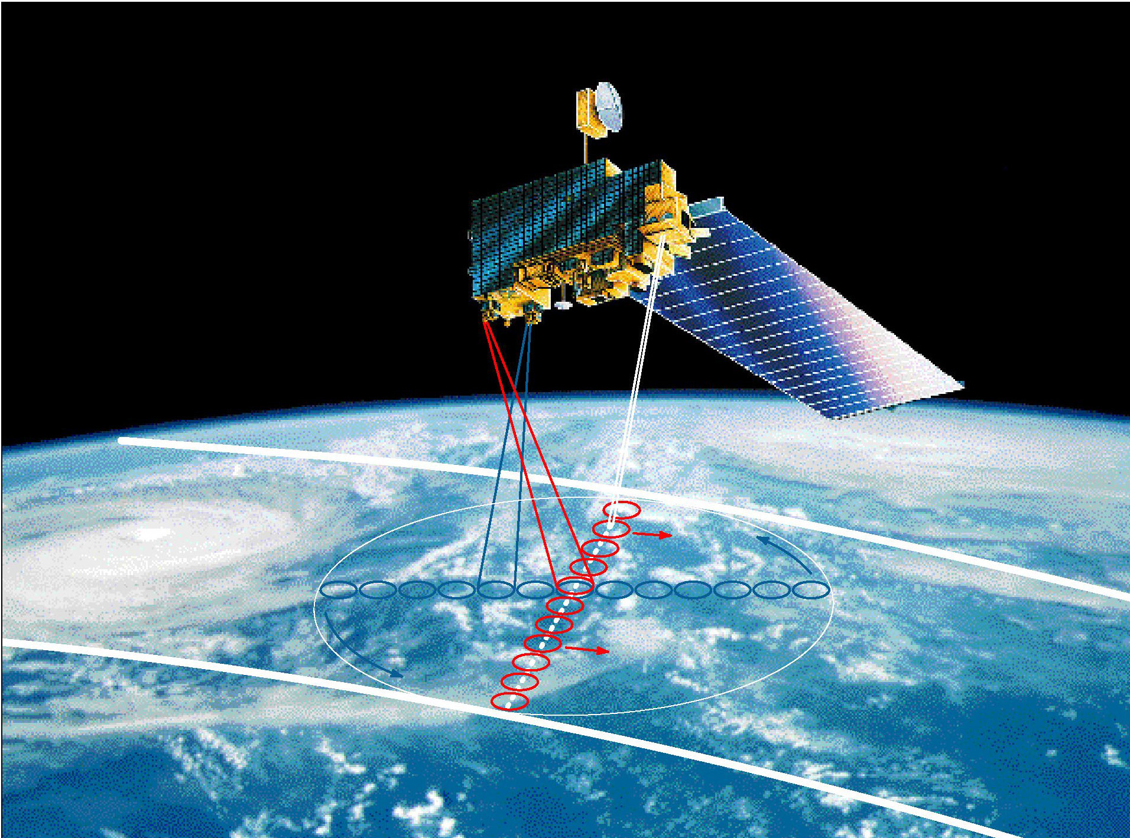
Clouds and the Earth’s Radiant Energy System
Is the global energy budget changing?
Effect of clouds on the radiation budget.

Slide 47
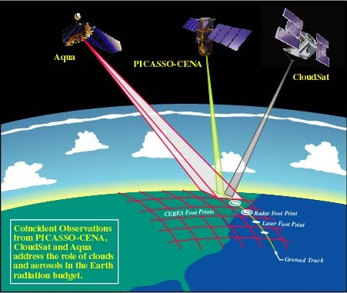
A configuration of several satellites with complimentary capabilities is considered as ideal for cloud research. In particular, the newer systems with active capabilities.
Aqua
CALIPSO
CloudSat

Slide 48
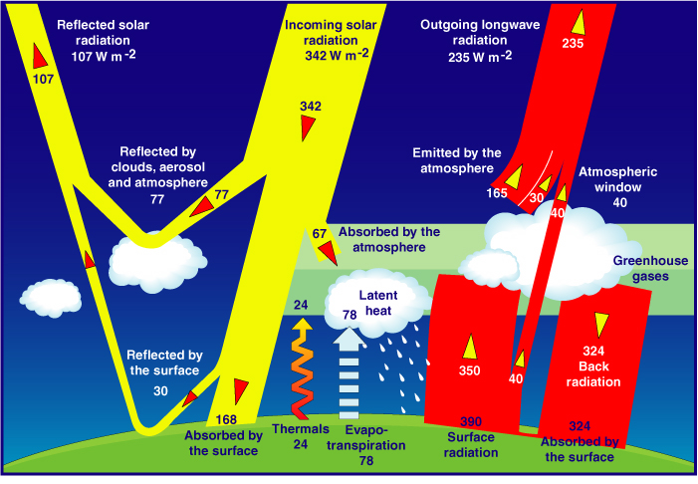
Satellites serve as source of information on the Global Energy Budget
As estimated from models (Kiehl and Trenberth, 1997)

Slide 49
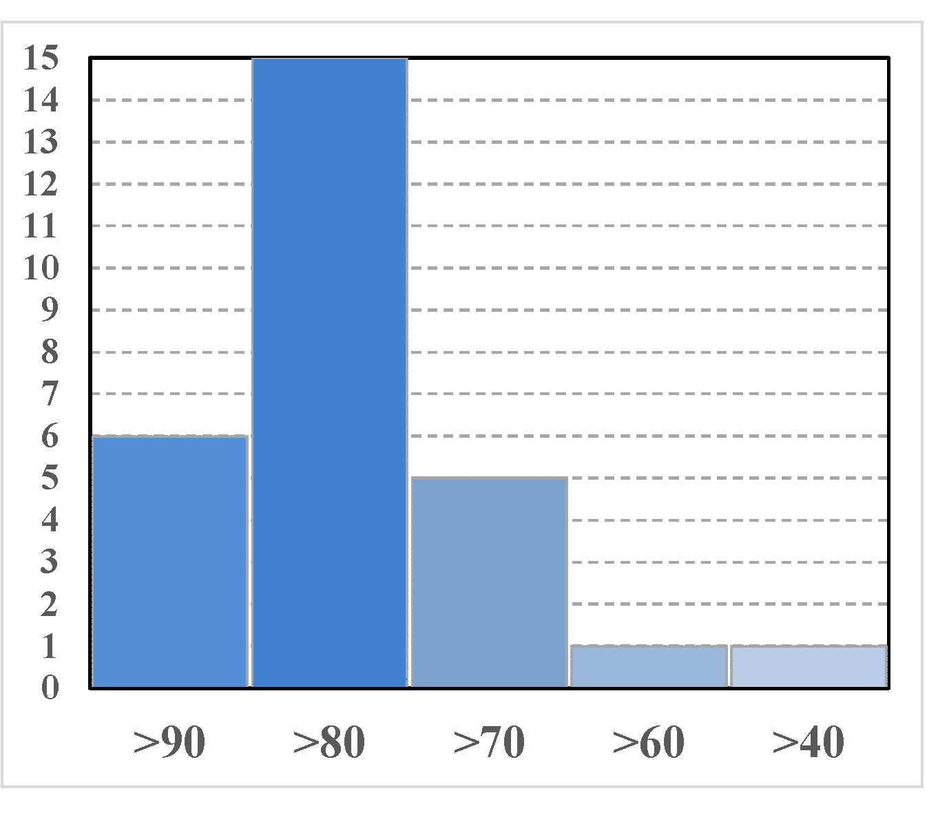
Grade distribution for Mid-Term

Slide 50
Spaceborne Earth Observation Systems
TOPEX/Poseidon
Landsat 7
SORCE
Aqua
QuikScat
Sage
EO-1
SeaWiFS
IceSat
TRMM
SeaWinds
ACRIMSAT
ERBS
Toms-EP
Grace
Jason
Terra
UARS

Slide 51
A configuration of several satellites with complimentary capabilities is considered as ideal for cloud research. In particular, the newer systems with active capabilities.
Aqua
CALIPSO
CloudSat

Slide 52
CLEAR-SKY AND CLOUD SENSITIVITY FROM 19 GCMS
Climate models are inconsistent in predicting the effects of clouds on climate
(Cess et al., 1990)

Slide 64
Microwave Instruments of focus
Passive = radiometers
Scanning Multichannel Microwave Radiometer, Special Sensor Microwave Imager, Sounder
SMMR, SSM/I, SSMIS, TMI, AMSU-A, B-true workhorses
Active = radar types
Scatterometers, SEASAT, ERS 1, 2, QuikSCAT; also workhorses—Currently Metop’ s ASCAT
Altimeters, TOPEX, Poseidon, Jason 1, 2, others.
Synthetic Aperture Radars, SARs RADARSAT 1, 2 , ENVISAT/ASAR , Tetra-SAR X
Precipitation /Cloud Radars, TRMM, CloudSat

Slide 65
Orbit considerations
Microwave emission is far out in the spectrum, wavelengths of mm to cm and longer, so detection requires large antennas (order of meters), therefore, we mount such instrument only on:
Polar orbiting satellites at 800 to 850 km height or in tropical orbits +/- 22 to 35 km. At the lower inclinations required for these orbits, the satellite cannot be in sun-synchronous orbit.
Active, i.e. radar type, MW instruments require much power, which also requires them to be in low earth orbit (800 km region).

Slide 66
Principles of MW radiometry
Radiometers are passive instruments, so they detect radiation emitted by Earth’s atmosphere or surface. The ocean is a weak emitter with emissivity of the order of 50%, so its black body temperature in most MW wavelengths is 150 K. It is therefore acting like a mirror for the atmosphere and clouds above. The atmosphere has a strong emission line around 22GHz, so that frequency is used to measure the TOTAL COLUMN OF WATER VAPOR in he air. 19 GHz and 37 GHz are sensitive to the “Mie scattering” by cloud droplets, so these frequencies are used for TOTAL LQUID WATER content, and 85 GHz receives SCATTERING FROM ICE PARTICLES at the top of clouds, indication of possible rain.
The solid Earth is a strong emitter, so atmospheric signals cannot be separated out over land

Slide 67
Variables obtained
Atmospheric Water Vapor and Cloud Liquid Water—first as total in the column, later as profiles of these quantities and interpreted in terms of different cloud particle sizes and precipitation size drops or even ice particles (through microwave scattering).
Multi-frequency instruments allow the various signals to be separated. The ocean which works as a background must be accounted for using special frequencies for effects of
Sea Surface Temperature, SST, and Wind.

Slide 68
Detection of MW radiation
Signals are received in so called “horns”, which have rectangular openings. The electro-magnetic radiation is received in horizontal or vertical planes, which means that the radiation is either horizontally or vertically polarized. The same is true for radiation sent out by a MW emitter that also can receive – a radar.

Slide 69
Vertically, horizontally and a circularly polarized wave as a sum of the two components

Slide 70
Since the emissivity in microwave is less than 1, there is a reflection contribution from the surface.
Contribution of each term to the brightness temperature at the top or the atmosphere

Slide 71
The radiance emitted from the surface is given as:
(2)
The first term in the right-hand side denotes the surface emission contribution, whereas the second term represents the emission contribution from the entire atmosphere to the surface, which is reflected back to the atmosphere at the same frequency.

Slide 72
Contribution of each term to the brightness temperature at the top of the atmosphere

Slide 73
Effect of Clouds
Clouds interact both with solar radiation, in the shortwave region of the spectrum, and with the radiation thermally emitted by the earth and atmosphere, in the longwave region.
Clouds reduce the net absorption of solar radiation by increasing the earth albedo, and they decrease the loss of terrestrial radiation to space by decreasing the effective radiative brightness temperature of the earth.

Slide 74
The effect of cloud cover on solar radiation depends primarily on the thickness of the cloud, but also it depends upon particle size and phase.
The longwave effect depends primarily upon cloud top temperature, which is a function of cloud height, and, for thin clouds, upon emissivity, which is related to optical thickness.

Slide 75
The solar radiation effect and the thermal emission effect are in opposite directions as far as net radiation at the top of the atmosphere is concerned.
Each effect, by itself, is large, but the combine effect is relatively small and will depend significantly on the cloud-free profile of atmospheric temperature, humidity, and aerosols, and upon surface temperature and optical properties.
The net effect is the difference of two large terms; led to a debate in the 70s on the role clouds play in the climate system.

Slide 76
Early studies of sensitivity to cloud amount
One of the early attempts to quantify the effect of clouds on the earth’s radiation budget is described in a technical report by London (1957), whose results were widely cited prior to satellite measurements. Using temperature and cloud cover observations for the Northern Hemisphere, he computed solar and infrared fluxes at the top of the atmosphere with and without clouds. He found that clouds have a net energy input primarily during the spring and summer seasons, with an annual average effect of ~35 W/m*2 a result not so different form modern satellite-based estimates to be discussed .

Slide 77
Later, Budyko (1969) used observations of the temperature (T_{s}) and cloud amount (A_{c}) compiled in Budyko (1963) to calculate outgoing infrared flux at the top of the atmosphere (F) and to derive a relationship based on regression:
  F = 223 + 2.2T_{s} - (48+1.6T_{s})Ac
where F is in W/m⁻² and T is in ⁰C. For a mean global surface temperature of 288 K, he finds the sensitivity of the infrared flux to clouds to be
δF/δA_{c} = -72 W/m⁻².

Slide 80

For the values adopted by Schneider (1989)
a_{c} = 0.5 and α₀ = 0.12
The solar radiation sensitivity coefficient is -130 W/m⁻²
(Here the results are normalized to the solar constant of
1368 W/m⁻²).
The net sensitivity to cloud amount is the difference between the
solar and infrared sensitivity coefficients:
which for Schneider’s model is -55 W/m⁻²

Slide 81
Climate Sensitivity
Radiative Effect at the Top of the Atmosphere
For a 50% Increase in Climate Parameter
Cloud
Height
High Cloud
Amount
Particle Size
(Low Clouds)
Stratospheric
Ozone
Carbon
Dioxide
Radiative
Effect
(W/m²)
Low Cloud
Amount
Cloud Optical
Depth
Indirect Aerosol
Forcing
Direct Anthropogenic
Aerosol Forcing
Land Albedo
Low clouds
COD

Slide 82
CLEAR-SKY AND CLOUD SENSITIVITY FROM 19 GCMS
Climate models are inconsistent in predicting the effects of clouds on climate
(Cess et al., 1990)

Slide 83
Over the last dozen years, NASA has launched a series of satellites – known collectively as the Earth Observing System (EOS) – that has provided critical insights into the dynamics of the entire Earth system: clouds, oceans, vegetation, ice, solid Earth and atmosphere (see next slide).
Now NASA is helping to create a new generation of satellites to extend and improve upon the Earth system data records established by EOS.

Slide 84
radiation along the path length ds due to the absorp­tion within the layer is

Slide 85
Spectroradiometer
A radiometer that can measure the intensity of radiation in multiple wavelength bands (i.e., multispectral). Oftentimes the bands are of a high spectral resolution—designed for the remote sensing of specific parameters such as sea surface temperature, cloud characteristics, ocean color, vegetation, trace chemical species in the atmosphere, etc.
Active instruments provide their own energy (electromagnetic radiation) to illuminate the object or scene they observe. They send a pulse of energy from the sensor to the object and then receive the radiation that is reflected or backscattered from that object. Scientists use many different types of active remote sensors.
Radar (Radio Detection and Ranging)
A radar uses a transmitter operating at either radio or microwave frequencies to emit electromagnetic radiation and a directional antenna or receiver to measure the time of arrival of reflected or backscattred pulses of radiation from distant objects. Distance to the object can be determined since electromagnetic radiation propagates at the speed of light.
Scatterometer

Slide 86
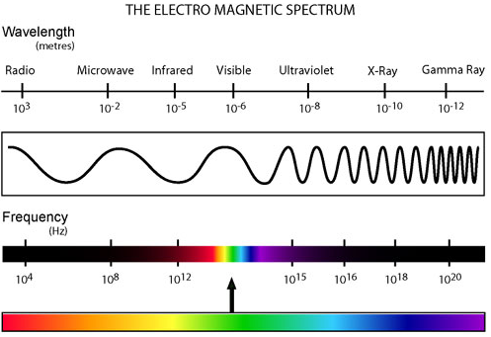
Remember: units in microwave are HZ of GHz:

Slide 87
A scatterometer is a high frequency microwave radar designed specifically to measure backscattered radiation. Over ocean surfaces, measurements of backscattered radiation in the microwave spectral region can be used to derive maps of surface wind speed and direction.
Lidar (Light Detection and Ranging)
A lidar uses a laser (light amplification by stimulated emission of radiation) to transmit a light pulse and a receiver with sensitive detectors to measure the backscattered or reflected light. Distance to the object is determined by recording the time between the transmitted and backscattered pulses and using the speed of light to calculate the distance traveled. Lidars can determine atmospheric profiles of aerosols, clouds, and other constituents of the atmosphere.
Laser Altimeter
A laser altimeter uses a lidar (see above) to measure the height of the instrument platform above the surface. By independently knowing the height of the platform with respect to the mean Earth's surface, the topography of the underlying surface can be determined.
next: NASA Remote Sensing Accomplishments
back: Color Images

Slide 88
Spectroradiometer
A radiometer that can measure the intensity of radiation in multiple wavelength bands (i.e., multispectral). Oftentimes the bands are of a high spectral resolution—designed for the remote sensing of specific parameters such as sea surface temperature, cloud characteristics, ocean color, vegetation, trace chemical species in the atmosphere, etc.
Active instruments provide their own energy (electromagnetic radiation) to illuminate the object or scene they observe. They send a pulse of energy from the sensor to the object and then receive the radiation that is reflected or backscattered from that object. Scientists use many different types of active remote sensors.
Radar (Radio Detection and Ranging)
A radar uses a transmitter operating at either radio or microwave frequencies to emit electromagnetic radiation and a directional antenna or receiver to measure the time of arrival of reflected or backscattred pulses of radiation from distant objects. Distance to the object can be determined since electromagnetic radiation propagates at the speed of light.
Scatterometer

Slide 89
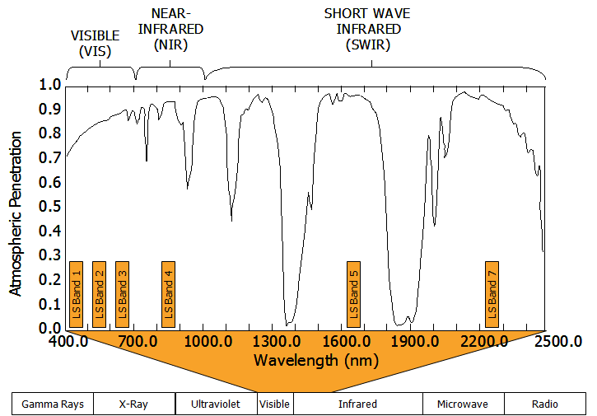

Slide 90
PASSIVE AND ACTIVE SENSOR SYSTEMS
FIGURE 1: Passive System.
Two types of sensors exist, namely passive and active. A passive sensor system needs an external energy source (Figure 1). In most cases this source is the sun. These sensors generally detect reflected and emitted energy wave lengths from a phenomenon. An active sensor system provides its own energy source. As an example, a radar sensor sends out sound waves and records the reflection waves coming back from the surface. Passive systems are much more common than active systems.
Most sensors record information about the Earth’s surface by measuring the transmission of energy from the surface in different portions of the electromagnetic (EM) spectrum (Figure 2). Because the Earth’s surface varies in nature, the transmitted energy also varies. This variation in energy allows images of the surface to be created. Human eyes see this variation in energy in the visible portion of the EM spectrum. Sensors detect variations in energy in both the visible and non-visible areas of the spectrum.
Energy waves in certain sections of the EM spectrum easily pass through the atmosphere, while other types do not. The ability of the atmosphere to allow energy to pass through it is referred to as its transmissivity, and varies with the wavelength/type of the radiation. The gases that comprise our atmosphere absorb energy in certain wavelengths while allowing energy with differing wavelengths to pass through.

Slide 91
Quite often, we need to obtain fluxes of modest accuracy with the least possible expen­diture of computational effort. That requires us to take advantage of highly simplified parameterizations of radiative absorption and emis­sion.

Slide 92
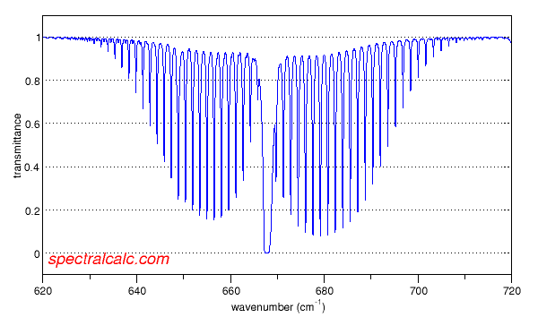
Transmittance spectrum for CO2
http://www.spectralcalc.com/calc/spectralcalc.php

Slide 93
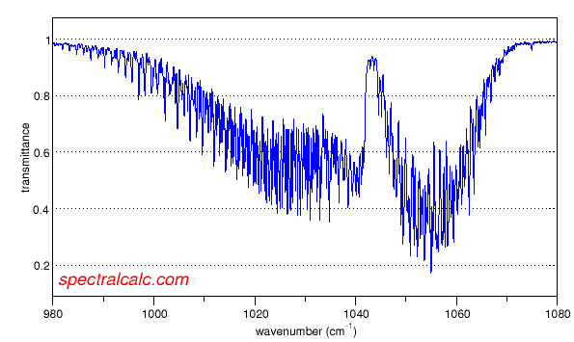
Transmittance spectrum for ozone (O3)
http://www.spectralcalc.com/calc/spectralcalc.php

Slide 98
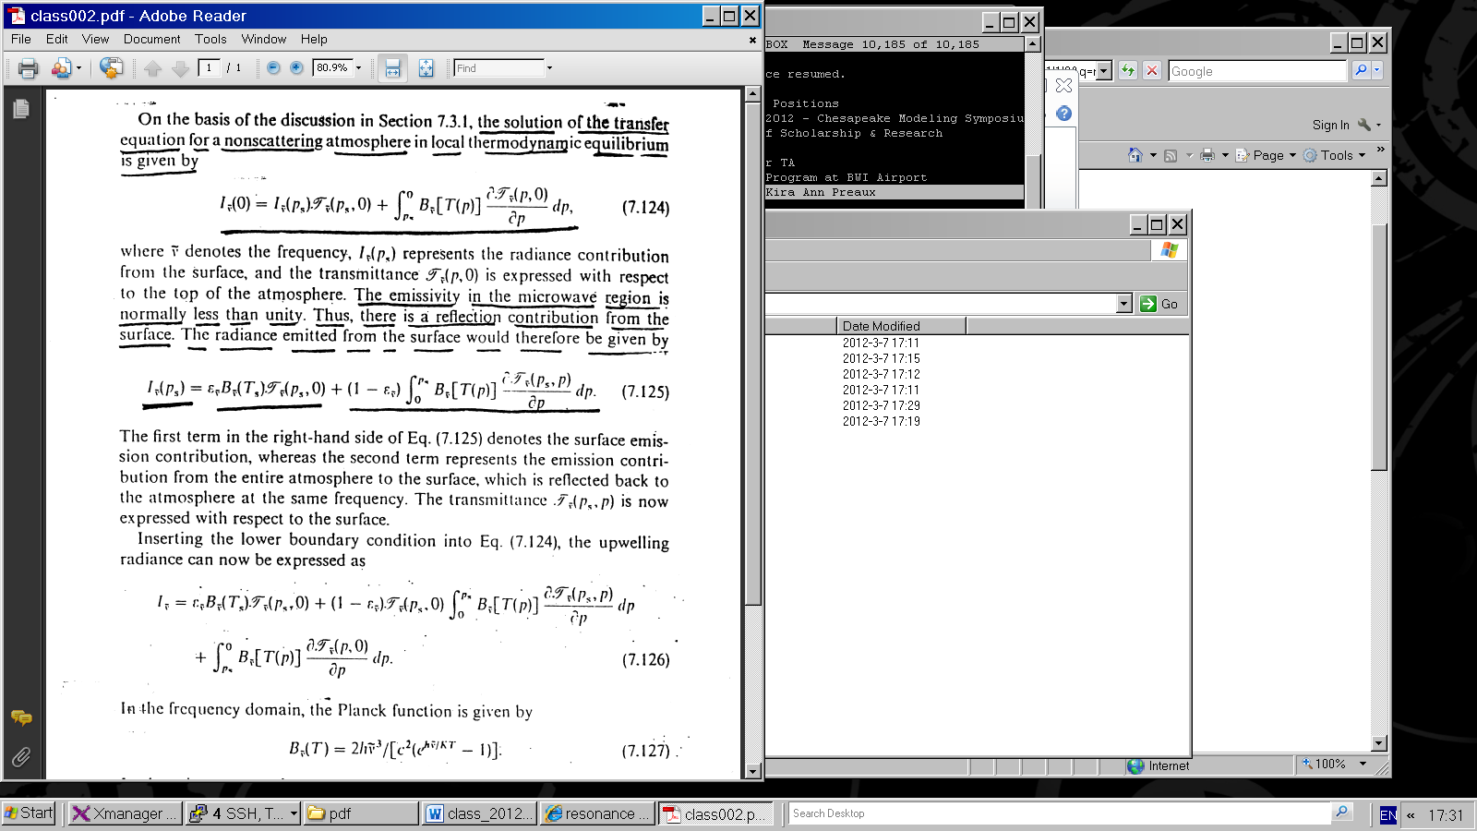
On the basis of previous discussion the solution of the transfer equation for a non-scattering atmosphere in local thermodynamic equilibrium is given by
(1)
Where denotes the frequency
I _{ṽ} (p_{s})
represents the radiance contribution from the surface and the transmittance is expressed with respect to the top of the atmosphere.

Slide 99
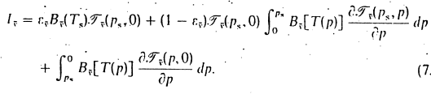
The transmittance is generally available with respect to the top of the atmosphere, namely, T _{ṽ} (p, 0).
For computational purposes it is desirable to express
T _{ṽ} (p_{s}, p) in terms of T _{ṽ} (p, 0) .
The transmittance T _{ṽ} (p_{s}, p) is now expressed with respect to the surface.
Inserting the lower boundary condition into Eq. (1) the upwelling radiance can now be expressed as:
(3)

Slide 100
Substituting eqs. (5) and (6) into eq. (3), the solution of microwave radiative transfer
may now be written in terms of temperature as:
(7)

Slide 101
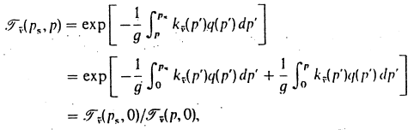
For monochromatic frequencies, the transmittance is an exponential function of the optical depth , hence, we may express
(8)
where T _{ṽ} (p, 0) is the the transmittance or the entire atmosphere, is a constant value, so:

Slide 102
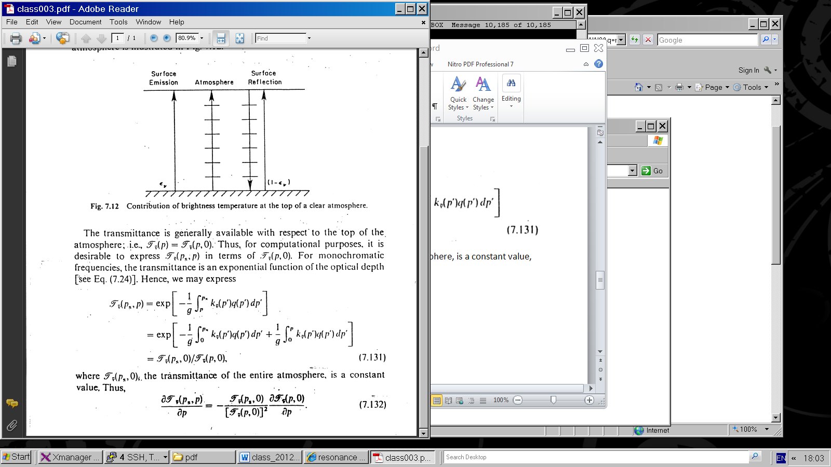
(9)
Substituting eq. 9 into eq. 7, rearranging terms and letting (p, 0) = (p)

Slide 105
where B = B_{λ}(T)

Slide 106
The transmittance is generally available with respect to the top of the atmosphere, namely, T _{ṽ} (p, 0).
For computational purposes it is desirable to express
T _{ṽ} (p_{s}, p) in terms of T _{ṽ} (p, 0) .
The transmittance T _{ṽ} (p_{s}, p) is now expressed with respect to the surface.
Inserting the lower boundary condition into Eq. (1) the upwelling radiance can now be expressed as:
(3)

Slide 107

In the frequency domain, the Planck function is given by
(4)
In the microwave region h ṽ /K T« 1,
the Planck function may be approximated by
(5)
Thus, the Planck radiance is linearly proportional to the temperature, which is referred to as the Rayleigh-Jeans Law.
Analogous to the above approximation, we may define an equivalent brightness temperature T_{B} such that:
(6)

Slide 108
Substituting eqs. (5) and (6) into eq. (3), the solution of microwave radiative transfer
may now be written in terms of temperature as:
(7)

Slide 109
For monochromatic frequencies, the transmittance is an exponential function of the optical depth , hence, we may express
(8)
where T _{ṽ} (p, 0) is the the transmittance or the entire atmosphere, is a constant value, so:

Slide 110
(9)
Substituting eq. 9 into eq. 7, rearranging terms and letting (p, 0) = (p)

Slide 111
Variables obtained
Atmospheric Water Vapor and Cloud Liquid Water—first as total in the column, later as profiles of these quantities and interpreted in terms of different cloud particle sizes and precipitation size drops or even ice particles (through microwave scattering).
Multi-frequency instruments allow the various signals to be separated. The ocean which works as a background must be accounted for using special frequencies for effects of
Sea Surface Temperature, SST, and Wind.

Slide 112
where B = B_{λ}(T)

Slide 113
Due to their complexity, clouds are difficult to model
Satellites are useful for identifying clouds.

Slide 114
“Man made” clouds: Airplane Tracks

Slide 115
Due to their complexity, clouds are difficult to model
Satellites are useful for identifying clouds.

Slide 116
“Man made” clouds: Airplane Tracks

