Slide 1
http://www.spectralcalc.com/calc/spectralcalc.php
Some helpful sources of information:
The first web site allows to display various spectra as well as provides a solar calculator you can use to verify your answers to homework assignments.
The second is an access to the Web of Science which allows to search research materials by author or topic. Useful for preparing your term paper. For UMD users, free download of articles.
http://apps.webofknowledge.com/UA_GeneralSearch_input.do?product=UA&search_mode=GeneralSearch&SID=1A9dMX2bGQ29DoDGxJc&preferencesSaved=
Review of basic concepts identifies in last lecture as needing a refresher.
Things to keep in mind if you use different textbooks on the topic of last lecture.

Slide 2
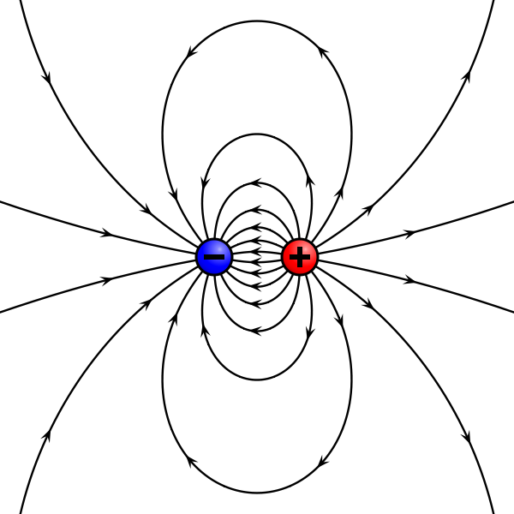
The presence of a dipole has implications for absorption/emission capabilities by a molecule.
What is a dipole?
An electric dipole is a separation of positive and negative charges. The simplest example of this is a pair of electric charges of equal magnitude but opposite sign, separated by some (usually small) distance.
If there is an excess of positive charge on one end of the molecule and an excess of negative charge on the other, the molecule has a dipole moment (i.e., a measurable tendency to rotate in an electric or magnetic field).The dipole moment (μ) is defined as the product of the magnitude of the charge, e, and the distance separating the charges.

Slide 3
Units used in different spectral regions
Note: Different units used for different spectral regions:
Spectra | Energy expressed as a function of
Visible | Wavelength λ
Infrared | Wave number n = 1/λ
Microwave | Frequency ν=1/t, in GHz (since Hz is small)
The hertz (symbol Hz) is a unit of frequency in the International System of Units (SI) and is defined as one cycle per second. It is named for Heinrich Rudolf Hertz, the first person to provide conclusive proof of the existence of electromagnetic waves.
Giga (G) denotes a factor of billion (10⁹)

Slide 4
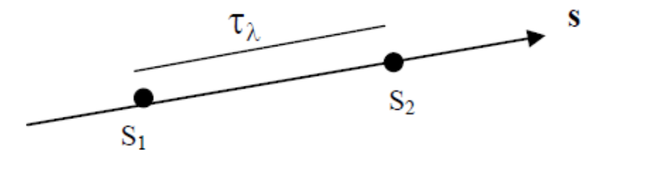
Keep in mind if using different textbooks:
Optical depth can be expressed in many ways:

Slide 5
What are the most accurate methods to model radiative transfer in the IR?
The method is known as a line-by line (LBL) approach. It accounts for all known gas absorption/emission lines in the wavenumber range of 0 to about
23,000 cm⁻¹.
The Fast Atmospheric Signature Code (FASTCODE) is the benchmark for testing simplified models both in the visible and IR part of the spectrum.
Need to keep in mind that atmospheric pressure affects absorption of gases (pressure broadening) which poses a difficult problem in computing the transfer of IR radiation in an atmosphere with changing pressure, temperature and concentration of gases.

Slide 6
High-resolution TRANsmission Spectroscopic database HITRAN of molecular absorption
http://cfa-www.harvard.edu/hitran//
A project started by the Air Force Cambridge Research Laboratories (AFCRL) in the late 60’s to provide detailed information on IR properties of the atmosphere.
Version 13.0 of the database contains 2,713,968 spectral lines for 39 different molecules. Provided is also information on UV line by line absorption cross section parameters, and aerosol indices of refraction.

Slide 7
Supplementary information on the still unsolved issue of what is known as the “Water Vapor Continuum” can be found at:
http://www.met.reading.ac.uk/caviar/water_continuum.html
For convenience, it is reproduced at the end of this lecture labeled as “Supplements”.

Slide 8
AOSC400-2015
October 22, Lecture # 14
Absorption and Emission by Gas Molecules
The Schwarzchild’s equation revisited
Heating of atmosphere in IR
Remote Sensing applications - start discussion
Supplements- more details on the Water Vapor Continuum issue.
Copyright@2015 University of Maryland
This material may not be reproduced or redistributed, in whole or in part, without written permission of Rachel T. Pinker
*Sources of information used for this lecture are listed in updated Syllabus.

Slide 9
Allowing both extinction and emission of radiation over a path s leads to
the Schwarzchild’s equation:
Where:
(1)
After several manipulations of this equation, we get:
(2)
Guidelines will be provided in homework # 3 how to get to (2) from (1).

Slide 10
Simple interpretation of eq. (2):
Imagine that you apply the equation to a case that represents emission from the surface to the Top of the Atmosphere (TOA).
The emitted radiation I_{λ} (s₁) at the TOA equals the emission from the surface attenuated over the entire path from the surface to the top of the atmosphere (first term) plus the emission from each layer attenuated by the atmosphere only above that layer.
Schematically, shown in following slide:

Slide 11
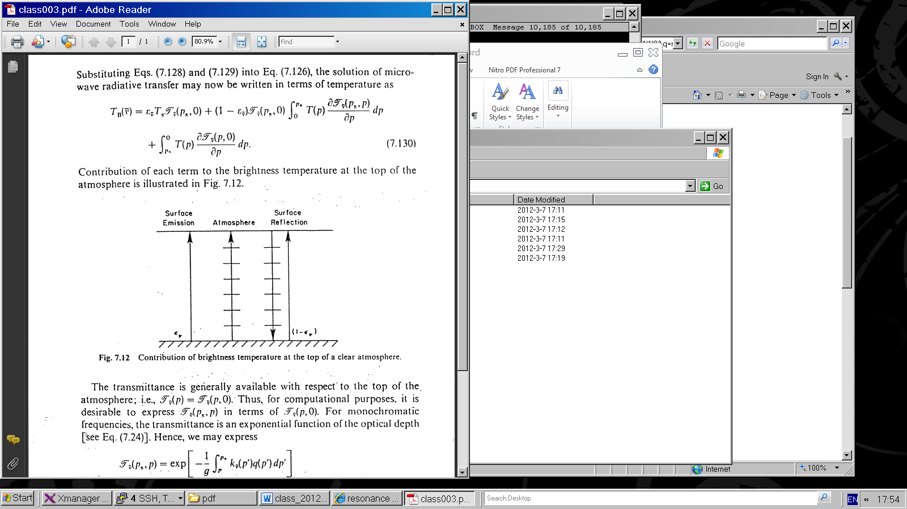
Contribution of each term to the emitted energy at the top or the atmosphere
For IR radiation, only the cases represented
by the first 3 arrows are relevant.
In microwave, the fourth arrow on the
right is important (to be discussed later.

Slide 12
In the textbook, the source function J_{λ} which gives the intensity of the emitted radiation is replaced by the blackbody emission function B_{λ}(T), yielding :
We obtain the Schwarzchild’s equation as given in textbook:
or:
Which is the
same as
eq. (2) on
slide 17

Slide 13
The plane parallel approximation
Many atmospheric radiative transfer calculations can be simplified by using the plane-parallel approximation in which temperature and the densi­ties of the various atmospheric constituents are assumed to be functions of height (or pressure) only.
Applying boundary conditions to eq. (2) at the TOA and at the surface and integrating I_{λ} over all wavelength and azimuthaly (in all directions) will yield the total flux at the two boundaries F and F
(the detailed derivation will be skipped).

Slide 14
So the total net flux at a given height is given by:
F(z) = F (Z) - F (z)
Denoting the net flux F(z + Δ z) at the level z + Δz, the net flux divergence for the layer Δz is:
ΔF = F (z+ Δ z) - F(z)

Slide 15
Heating Rates (namely, radiative flux divergence)
is the net flux and ρ is the total density of air.

Slide 16
The radiative heating or cooling rate is defined as the rate of temperature change of the layer dz due to radiative energy gain or loss, given as:
(3)
c_{p} is the specific heat at constant pressure
(c_{p} = 1004.67 J/kg/K and ρ is the air density in a given layer.
To evaluate the heating rate in equation (3), one needs:
Profile of IR upwelling and downwelling fluxes
To compute the IR downward and upward fluxes, one needs:
Atmospheric characteristics such as vertical profiles of T, P and density
The vertical profiles of IR radiatively active gases, clouds and aerosols

Slide 17
Heating rates by various
constituents as given in
Textbook
(both SW and LW
heatings
are illustrated)

Slide 18
When clouds are
present,
the computations
are more
complicated.

Slide 19
Passive Remote Sensing by Satellites
Monitoring of radiation emitted by and reflected from the Earth system by satellite-borne radiome­ters provides information on weather and climate. Fields that are currently routinely mon­itored from space include: temperature, cloud cover, cloud droplet concentrations and sizes, rainfall rates, humidity, radiative fluxes, surface wind speed and direction, concentrations of trace constituents and aerosols, and lightning. Discussed will be just a few of the many applications of remote sensing in atmospheric science.

Slide 20
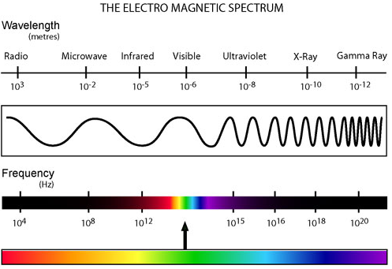
Remember: units in microwave are HZ of GHz:

Slide 21
Spectral Intervals in (VIS, IR, MW) of interest in Remote Sensing
Several spectral regions are considered useful for remote sensing from satellites.
Windows to the atmosphere (regions of minimal atmospheric absorption) exist near 4 μm, 10 μm, 0.3 cm, and 1 cm (see next slide).
Infrared windows are used for sensing the temperature of the earth surface and clouds, while microwave windows help to investigate the surface emissivity and the liquid water content of clouds.

Slide 22
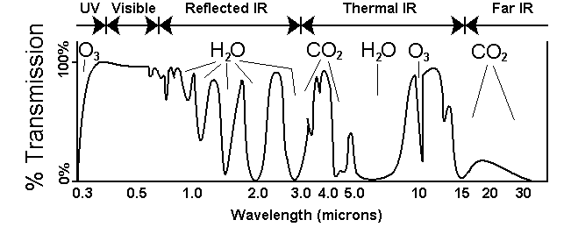
High transmission means low absorption. There is significant transmission of radiation at 0.5 microns, 2.5 microns, and 3.5 microns, but a great deal of atmospheric absorption at 2.0, 3.0, and about 7.0 microns.

Slide 23
The CO₂ and O₂ absorption bands at 4.3 μm, 15 μm, 0.25 cm, and 0.5 cm are used for temperature profile retrieval; because these gases are uniformly mixed in the atmosphere in known portions they lend themselves to this application. The water vapor absorption bands near 6.3 μm, beyond 18 μm, near 0.2 cm, and near 1.3 cm are sensitive to the water vapor concentration in the atmosphere.

Slide 24
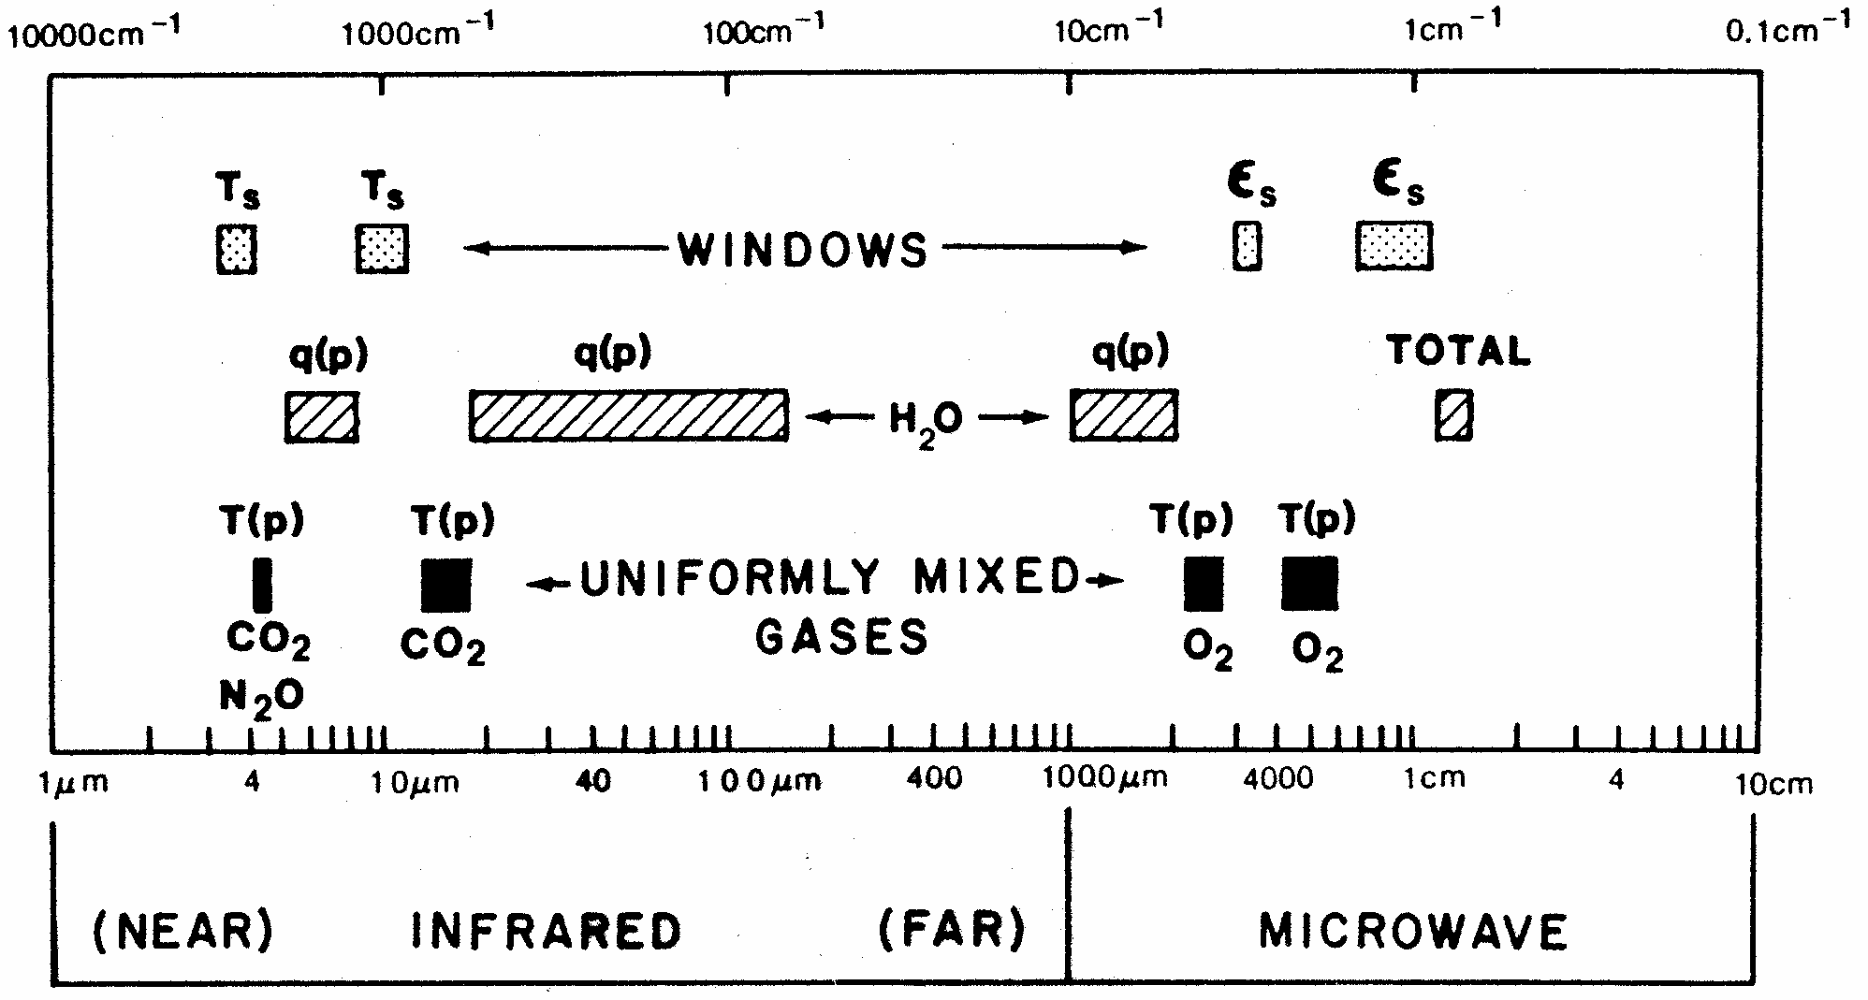
Spectral regions used for remote sensing of the earth atmosphere and surface from satellites. ε indicates emissivity, q denotes water vapor, and T represents temperature.

Slide 25
Supplement on Water vapour continuum
From:
http://www.met.reading.ac.uk/caviar/water_continuum.html
British use vapour for vapor.

Slide 26
Water vapour continuum
In addition to the spectral lines, it has long been recognized that water vapour possesses a continuum absorption which varies relatively slowly with wavelength and pervades the entire IR and microwave spectral region. This has a marked impact on the Earth's radiation balance with consequences for understanding present day weather and climate and predicting climate change. It is also important for remote sensing of the Earth and its atmosphere.
Discovered by Hettner (1918) as a low-frequency component of water vapour absorption in atmospheric transparency window 8-14 mcr, this phenomenon remained unexplained for 20 years, until Elsasser (1938) suggested that the continuum is an accumulated far-wing contribution of strong water vapour spectral lines from neighbour bands. This hypothesis was generally accepted until the end of 70th years when the strong quadratic pressure dependence of the continuum absorption (which could not be explained by Lorentz (1906) line profile) as well as the strong negative temperature dependence have been detected (Bignell et al.,1963; Penner and Varanasi,1967). In this connection Penner and Varanasi (1967) and Varanasi et al. (1968) suggested that the main contribution to the self-continuum could be caused not by far wings of water monomer lines but rather by water dimers. Similar assumption was made also by Viktorova and Zhevakin (1967) for microwave spectral region.

Slide 27
The dimer model have explained quite easily the pressure and temperature dependencies of the self-continuum absorption observed since then in many experiments (Mc Coy et al. 1969; Bignell, 1970; Burch, 1970; etc.). Since that time a long scientific discussion has started between adherents of the "monomer" (or "far-wings") and the "dimer" nature of the water vapour self-continuum, which is continuing up to the current time.
On the one hand, more sophisticated (than Lorentz theory) ab-initio (Tvorogov et al. 1994; Ma and Tipping 1999, 2002; etc.) and semi-empirical (Clough et al. 1989, 1995, etc; Mlawer et al. 1999; etc.) line shape models have been developed, which could explain quite well the experimental facts mentioned above, and due to which the dominating role of the far wings of water vapour lines in the continuum absorption, especially in atmospheric conditions, is most commonly accepted today.
On the other hand, water dimers have been and are being often discussed as a possible component of the water self-continuum absorption (Lowder, 1971; Penner, 1973; Roberts et al. 1976; Arefev and Dianov-Klokov 1977; Montgomery, 1978; Dianov-Klokov et al. 1981; Varanasi, 1988; Devir et al. 1994; Vigasin et al. 1989, 2000; Cormier et al. 2005, etc.).

Slide 28
Finally, collision-induced absorption, resulting from the generation of a short-lived complex of water vapour and colliding molecules, has been proposed as a dominant within water vapour bands in the recent MT_CKD continuum model (Mlawer et al., in preparation, http://rtweb.aer.com/continuum_frame.html).
The possibility of both collision-induced and water dimer marked contribution to the water continuum absorption is however highly disagreed by Tipping (personal communication; Brown and Tipping, 2003). This point of view is shared by Vigasin only in respect to the free pair states, which negligible role as compared to the metastable or true bound water dimers at near-room temperatures has been shown by Vigasin (1991) and by Epifanov and Vigasin (1997) on the basis of preliminary statistical partitioning of the pair states in water vapour.
Thus, a deep controversy on the nature of the water vapour continuum still remains unresolved. The atmospheric science community has largely sidestepped this controversy, and has adopted a pragmatic approach. Most radiative transfer codes used in climate modelling, numerical weather prediction and remote sensing use a semi-empirical formulation of the continuum - CKD-model (Clough et al. 1989). This formulation was tuned to available (mostly laboratory) observations in rather limited (far-infrared) spectral regions.

Slide 29
The CKD model has served the community extremely well but we lack confidence that its semi-empirical formulation works at wavelength, or in atmospheric conditions, away from those in which it has been tested. This lack of confidence is exacerbated by the recent up-to-date theoretical (Schofield and Kjaergaard, 2003; Daniel et al. 2004; Scribano et al. 2006) and experimental (Vigasin et al. 2000, 2005; Ptashnik et al. 2004, 2005, 2006; Cormier et al. 2005; Paynter et al. 2007) studies that very well correlate and supplement each other, indicating all together the marked water dimer contribution to the water vapour self-continuum in some spectral regions.

Slide 31
Infrared imagery corresponds to a spectral
window at a wavelength of 10.7 µm, in which radiation emitted from the Earth's surface and cloud tops penetrates through cloud-free air with little absorption. Intensities in this channel (or radiance}; as they are more commonly referred to in the remote sensing literature) are indicative of the temperatures of the surfaces from which the radiation is emitted as inferred from the Planck function. In contrast to visible imagery, high clouds are usually clearly distinguishable from low clouds in infrared imagery by virtue of their lower temperatures.

Slide 32
 | There are two types of remote sensing instruments—passive and active. Passive instruments detect natural energy that is reflected or emitted from the observed scene. Passive instruments sense only radiation emitted by the object being viewed or reflected by the object from a source other than the instrument. Reflected sunlight is the most common external source of radiation sensed by passive instruments. Scientists use a variety of passive remote sensors. Radiometer An instrument that quantitatively measures the intensity of electromagnetic radiation in some band of wavelengths in the spectrum. Usually a radiometer is further identified by the portion of the spectrum it covers; for example, visible, infrared, or microwave. Imaging Radiometer A radiometer that includes a scanning capability to provide a two-dimensional array of pixels from which an image may be produced is called an imaging radiometer. Scanning can be performed mechanically or electronically by using an array of detectors. Spectrometer A device designed to detect, measure, and analyze the spectral content of the incident electromagnetic radiation is called a spectrometer. Conventional, imaging spectrometers use gratings or prisms to disperse the radiation for spectral discrimination. Spectroradiometer A radiometer that can measure the intensity of radiation in multiple wavelength bands (i.e., multispectral). Oftentimes the bands are of a high spectral resolution—designed for the remote sensing of specific parameters such as sea surface temperature, cloud characteristics, ocean color, vegetation, trace chemical species in the atmosphere, etc. Active instruments provide their own energy (electromagnetic radiation) to illuminate the object or scene they observe. They send a pulse of energy from the sensor to the object and then receive the radiation that is reflected or backscattered from that object. Scientists use many different types of active remote sensors. Radar (Radio Detection and Ranging) A radar uses a transmitter operating at either radio or microwave frequencies to emit electromagnetic radiation and a directional antenna or receiver to measure the time of arrival of reflected or backscattred pulses of radiation from distant objects. Distance to the object can be determined since electromagnetic radiation propagates at the speed of light. Scatterometer A scatterometer is a high frequency microwave radar designed specifically to measure backscattered radiation. Over ocean surfaces, measurements of backscattered radiation in the microwave spectral region can be used to derive maps of surface wind speed and direction. Lidar (Light Detection and Ranging) A lidar uses a laser (light amplification by stimulated emission of radiation) to transmit a light pulse and a receiver with sensitive detectors to measure the backscattered or reflected light. Distance to the object is determined by recording the time between the transmitted and backscattered pulses and using the speed of light to calculate the distance traveled. Lidars can determine atmospheric profiles of aerosols, clouds, and other constituents of the atmosphere. Laser Altimeter A laser altimeter uses a lidar (see above) to measure the height of the instrument platform above the surface. By independently knowing the height of the platform with respect to the mean Earth's surface, the topography of the underlying surface can be determined. next: NASA Remote Sensing Accomplishments back: Color Images
Remote Sensing
Remote Sensing Methods
There are two types of remote sensing instruments—passive and active. Passive instruments detect natural energy that is reflected or emitted from the observed scene. Passive instruments sense only radiation emitted by the object being viewed or reflected by the object from a source other than the instrument. Reflected sunlight is the most common external source of radiation sensed by passive instruments. Scientists use a variety of passive remote sensors.
Radiometer
An instrument that quantitatively measures the intensity of electromagnetic radiation in some band of wavelengths in the spectrum. Usually a radiometer is further identified by the portion of the spectrum it covers; for example, visible, infrared, or microwave.
Imaging Radiometer
A radiometer that includes a scanning capability to provide a two-dimensional array of pixels from which an image may be produced is called an imaging radiometer. Scanning can be performed mechanically or electronically by using an array of detectors.
Spectrometer
A device designed to detect, measure, and analyze the spectral content of the incident electromagnetic radiation is called a spectrometer. Conventional, imaging spectrometers use gratings or prisms to disperse the radiation for spectral discrimination.

Slide 33
Spectroradiometer
A radiometer that can measure the intensity of radiation in multiple wavelength bands (i.e., multispectral). Oftentimes the bands are of a high spectral resolution—designed for the remote sensing of specific parameters such as sea surface temperature, cloud characteristics, ocean color, vegetation, trace chemical species in the atmosphere, etc.
Active instruments provide their own energy (electromagnetic radiation) to illuminate the object or scene they observe. They send a pulse of energy from the sensor to the object and then receive the radiation that is reflected or backscattered from that object. Scientists use many different types of active remote sensors.
Radar (Radio Detection and Ranging)
A radar uses a transmitter operating at either radio or microwave frequencies to emit electromagnetic radiation and a directional antenna or receiver to measure the time of arrival of reflected or backscattred pulses of radiation from distant objects. Distance to the object can be determined since electromagnetic radiation propagates at the speed of light.
Scatterometer

Slide 34
A scatterometer is a high frequency microwave radar designed specifically to measure backscattered radiation. Over ocean surfaces, measurements of backscattered radiation in the microwave spectral region can be used to derive maps of surface wind speed and direction.
Lidar (Light Detection and Ranging)
A lidar uses a laser (light amplification by stimulated emission of radiation) to transmit a light pulse and a receiver with sensitive detectors to measure the backscattered or reflected light. Distance to the object is determined by recording the time between the transmitted and backscattered pulses and using the speed of light to calculate the distance traveled. Lidars can determine atmospheric profiles of aerosols, clouds, and other constituents of the atmosphere.
Laser Altimeter
A laser altimeter uses a lidar (see above) to measure the height of the instrument platform above the surface. By independently knowing the height of the platform with respect to the mean Earth's surface, the topography of the underlying surface can be determined.
next: NASA Remote Sensing Accomplishments
back: Color Images

Slide 35
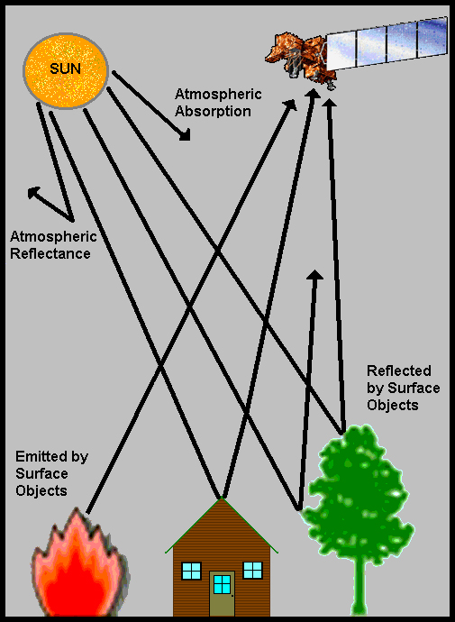
COPYRIGHT © 2010 Paul R. Baumann

Slide 36
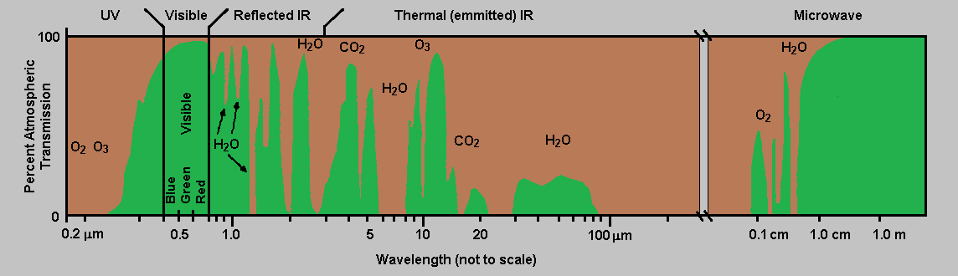

Slide 37
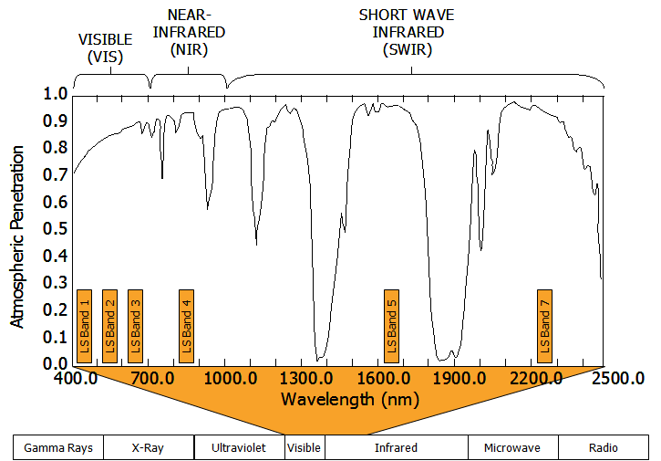

Slide 38
PASSIVE AND ACTIVE SENSOR SYSTEMS
FIGURE 1: Passive System.
Two types of sensors exist, namely passive and active. A passive sensor system needs an external energy source (Figure 1). In most cases this source is the sun. These sensors generally detect reflected and emitted energy wave lengths from a phenomenon. An active sensor system provides its own energy source. As an example, a radar sensor sends out sound waves and records the reflection waves coming back from the surface. Passive systems are much more common than active systems.
Most sensors record information about the Earth’s surface by measuring the transmission of energy from the surface in different portions of the electromagnetic (EM) spectrum (Figure 2). Because the Earth’s surface varies in nature, the transmitted energy also varies. This variation in energy allows images of the surface to be created. Human eyes see this variation in energy in the visible portion of the EM spectrum. Sensors detect variations in energy in both the visible and non-visible areas of the spectrum.
Energy waves in certain sections of the EM spectrum easily pass through the atmosphere, while other types do not. The ability of the atmosphere to allow energy to pass through it is referred to as its transmissivity, and varies with the wavelength/type of the radiation. The gases that comprise our atmosphere absorb energy in certain wavelengths while allowing energy with differing wavelengths to pass through.

Slide 39
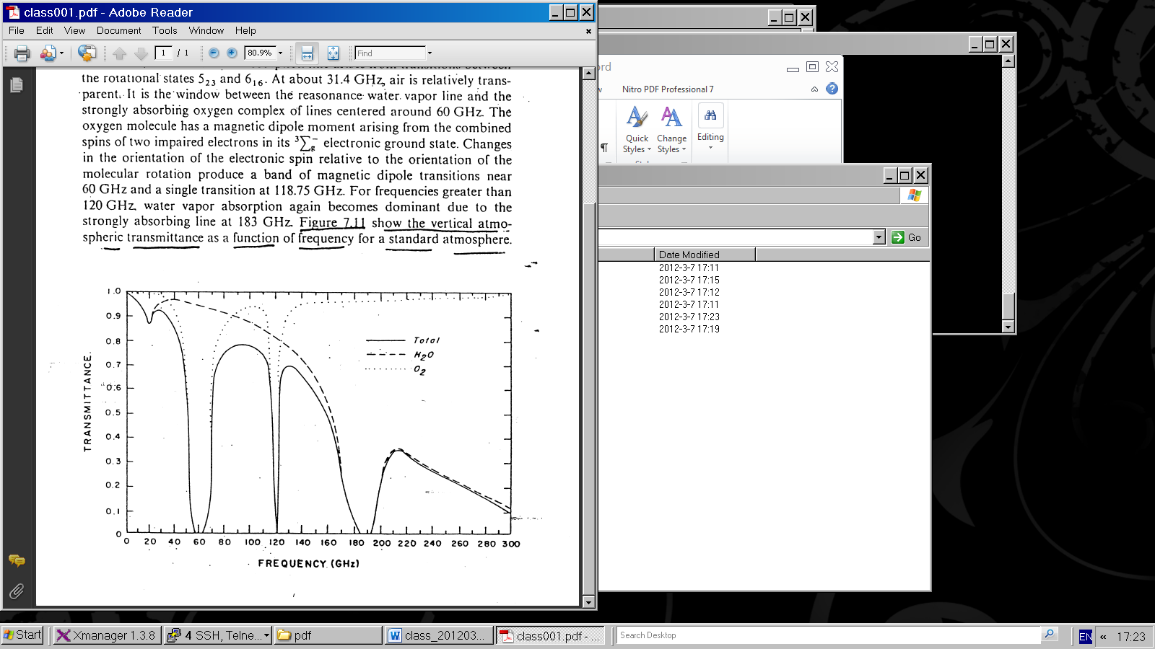
Absorption spectrum in microwave
Figure 1

Slide 40
Water vapor and molecular oxygen exhibit absorption lines in the microwave region.
Below 40 GHz (1 GHz = 10⁹ cycles/sec; note 1 cm = 30 GHz) only the weakly absorbing pressure broadened 22.235 GHz water vapor line is dominant.
At about 31.4 GHz, air is relatively transparent.
For frequencies greater than 120 GHz. water vapor absorption again becomes dominant due to the strongly absorbing line at 183 GHz. Figure 1 show the vertical atmospheric transmittance as a function of frequency for a standard atmosphere.

Slide 41
Special problem in the use of microwave from a satellite platform is the emissivity of the earth surface. In the microwave region of the spectrum, emissivity values of the earth surface range from 0.4 to 1.0. The emissivity of the sea surface typically ranges between 0.4 and 0.5, depending upon such variables as salinity, sea ice, surface roughness and sea foam. This complicates interpretation of terrestrial and atmospheric radiation with earth surface reflections.

Slide 42
In addition, there is a frequency dependence with higher frequencies displaying higher emissivity values. Over land, the emissivity depends on the moisture content of the soil. Wetting of a soil surface results in a rapid decrease in emissivity. The emissivity of dry soil is on the order of 0.95 to 0.97, while for wet bare soil it is about 0.80 to 0.90, depending on the frequency. The surface emissivity appearing in the first term has a significant effect on the brightness temperature value.

Slide 43
Microwave Instruments of focus
Passive = radiometers
Scanning Multichannel Microwave Radiometer, Special Sensor Microwave Imager, Sounder
SMMR, SSM/I, SSMIS, TMI, AMSU-A, B-true workhorses
Active = radar types
Scatterometers, SEASAT, ERS 1, 2, QuikSCAT; also workhorses—Currently Metop’ s ASCAT
Altimeters, TOPEX, Poseidon, Jason 1, 2, others.
Synthetic Aperture Radars, SARs RADARSAT 1, 2 , ENVISAT/ASAR , Tetra-SAR X
Precipitation /Cloud Radars, TRMM, CloudSat

Slide 44
Principles of MW radiometry
Radiometers are passive instruments, so they detect radiation emitted by Earth’s atmosphere or surface. The ocean is a weak emitter with emissivity of the order of 50%, so its black body temperature in most MW wavelengths is 150 K. It is therefore acting like a mirror for the atmosphere and clouds above. The atmosphere has a strong emission line around 22GHz, so that frequency is used to measure the TOTAL COLUMN OF WATER VAPOR in the air. 19 GHz and 37 GHz are sensitive to the “Mie scattering” by cloud droplets, so these frequencies are used for TOTAL LQUID WATER content, and 85 GHz receives SCATTERING FROM ICE PARTICLES at the top of clouds, indication of possible rain.
The solid Earth is a strong emitter, so atmospheric signals cannot be separated out over land

Slide 45
Variables obtained
Atmospheric Water Vapor and Cloud Liquid Water—first as total in the column, later as profiles of these quantities and interpreted in terms of different cloud particle sizes and precipitation size drops or even ice particles (through microwave scattering).
Multi-frequency instruments allow the various signals to be separated. The ocean which works as a background must be accounted for using special frequencies for effects of
Sea Surface Temperature, SST, and Wind.

Slide 46
Detection of MW radiation
Signals are received in so called “horns”, which have rectangular openings. The electro-magnetic radiation is received in horizontal or vertical planes, which means that the radiation is either horizontally or vertically polarized. The same is true for radiation sent out by a MW emitter that also can receive – a radar.

Slide 47
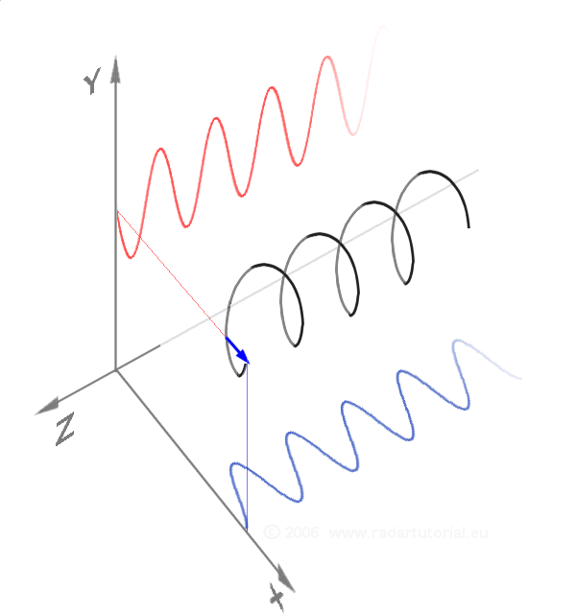
Vertically, horizontally and a circularly polarized wave as a sum of the two components

Slide 48
Since the emissivity in microwave is less than 1, there is a reflection contribution from the surface.
Contribution of each term to the brightness temperature at the top or the atmosphere

Slide 49
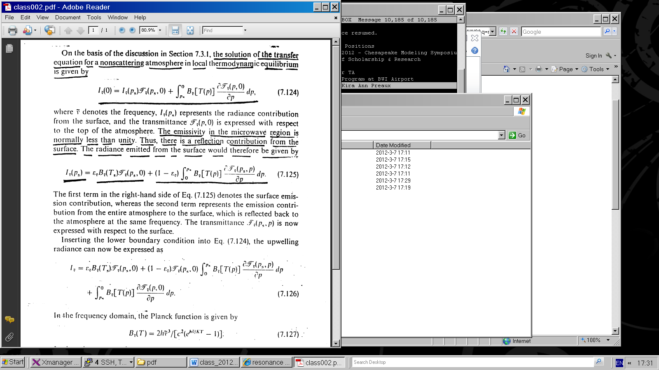
On the basis of previous discussion the solution of the transfer equation for a non-scattering atmosphere in local thermodynamic equilibrium is given by
(1)
Where denotes the frequency
I _{ṽ} (p_{s})
represents the radiance contribution from the surface and the transmittance is expressed with respect to the top of the atmosphere.

Slide 50
The radiance emitted from the surface is given as:
(2)
The first term in the right-hand side denotes the surface emission contribution, whereas the second term represents the emission contribution from the entire atmosphere to the surface, which is reflected back to the atmosphere at the same frequency.

Slide 51
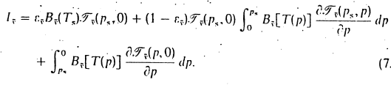
The transmittance is generally available with respect to the top of the atmosphere, namely, T _{ṽ} (p, 0).
For computational purposes it is desirable to express
T _{ṽ} (p_{s}, p) in terms of T _{ṽ} (p, 0) .
The transmittance T _{ṽ} (p_{s}, p) is now expressed with respect to the surface.
Inserting the lower boundary condition into Eq. (1) the upwelling radiance can now be expressed as:
(3)

Slide 52
Contribution of each term to the brightness temperature at the top of the atmosphere

Slide 54
Substituting eqs. (5) and (6) into eq. (3), the solution of microwave radiative transfer
may now be written in terms of temperature as:
(7)

Slide 55
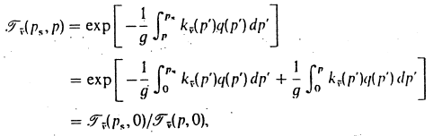
For monochromatic frequencies, the transmittance is an exponential function of the optical depth , hence, we may express
(8)
where T _{ṽ} (p, 0) is the the transmittance or the entire atmosphere, is a constant value, so:

Slide 56
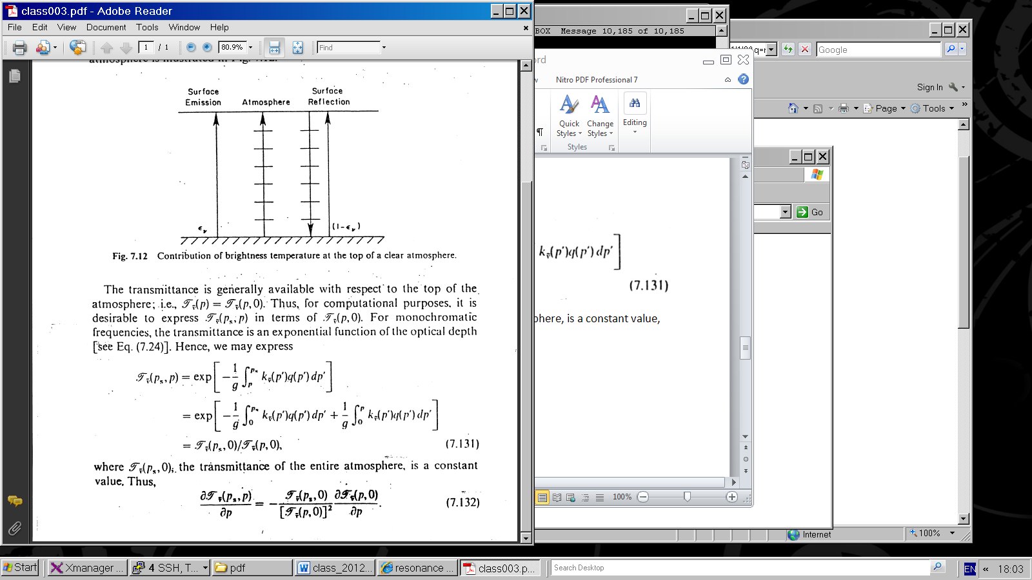
(9)
Substituting eq. 9 into eq. 7, rearranging terms and letting (p, 0) = (p)

Slide 59
Photons that carry sufficient energy to produce these reactions are absorbed and any excess energy is imparted to the kinetic energy of the molecules, rais­ing the temperature of the gas.
Since the energy required to liberate electrons and/or break molecular bonds is very large, the so-called absorption continua associated with these reactions are confined to the x-ray and ultraviolet regions of the spectrum. Most of the solar radiation with wavelengths longer than 0.31 µm penetrates to the Earth's surface.

Slide 64
The plane parallel approximation

Slide 65
The plane parallel approximation
Many atmospheric radiative transfer calculations can be simplified through the use of the plane-parallel approximation in which temperature and the densi­ties of the various atmospheric constituents are assumed to be functions of height (or pressure) only. With this simplification, the flux density passing through a given atmospheric level is given by:
where τ_{v} , the normal optical depth as defined in (4.32), is used as a vertical coordinate and the arrows denote that both upward and downward fluxes are taken into account.

Slide 66
Since this section focuses on infrared radiative transfer, we use wave number ( v) notation to be consistent with the literature in this subfield. Integrating over azimuth angle and denot­ing
we obtain:

Slide 68
Toe monochromatic intensity in this expression may be broken down into three components:
  Upward emission from the Earth's surface that reaches level τ_{v} without being absorbed.
  Upward emission from the underlying atmospheric layer.
  Downward emission from the overlying layer.
The expressions used in evaluating these terms are analogous to Beer's law, with the intensity transmis­ sivity Tv replaced by the flux transmissivity

Slide 69
For many purposes it is sufficient to estimate the flux transmissivity from the approximate formula
where the "average” or "effective zenith angle" is:

Slide 70
In other words, the flux transmissivity of a layer is equivalent to the intensity transmissivity of parallel beam radiation passing through it with a zenith angle ϑ = 53°. The factor
is widely used in
radiative transfer calculations and is referred to as the diffusivity factor. Applying the concept of a diffusivity factor (4.44) can be integrated over μ, to obtain

Slide 71
Integration over wave number
To calculate the flux density F, it is necessary to inte­grate the monochromatic flux density F_{v} over wave number, where the integrand involves the product of the slowly varying Planck function and a
rap­idly varying flux transmissivity For this purpose it is convenient to separate the smooth Bv dependence from the much more complex and dependences by breaking up the wave number spectrum into inter­vals narrow enough so that within each interval can be regarded as a function of T only. Hence, B may be taken outside the integral so that the integrands reduce to expressions for the flux transmissivities of various layers of the atmos­
phere. These wave number-integrated flux transmis­sivities for the respective wave number intervals
are the basic building blocks in infrared radiative transfer calculations.

Slide 72
Integration over wave number
To calculate the flux density F, it is necessary to inte­grate the monochromatic flux density F_{v} over wave number, where the integrand involves the product of the slowly varying Planck function and a
rap­idly varying flux transmissivity For this purpose it is convenient to separate the smooth Bv dependence from the much more complex and dependences by breaking up the wave number spectrum into inter­vals narrow enough so that within each interval can be regarded as a function of T only. Hence, B may be taken outside the integral so that the integrands reduce to expressions for the flux transmissivities of various layers of the atmos­
phere. These wave number-integrated flux transmis­sivities for the respective wave number intervals
are the basic building blocks in infrared radiative transfer calculations.

Slide 73
Integration of equations such as (4.44) over wave number, when performed in the conventional manner, requires resolution of myriads of absorption lines with half-widths ranging from 10⁻¹cm⁻¹ near the Earth's surface to 10-3cm-I in the upper atmosphere. A single line-by-line integration over the entire infrared

Slide 74
region of the spectrum requires a summation over roughly a million points. The transmissivity Tv needs to be calculated for each infinitesimal wavelength
interval and these values then need to be summed

Slide 75
In this expression g(k) is the cumulative probability density function; i.e., the fraction of the individual values of k ,, that lie within the broad frequency inter­ val /J.v with numerical values smaller than k .23 Unlike k,,k( g) is a monotonic, smooth function, which can be inverted, as illustrated in Fig. 4.27.
The integration is performed by grouping the ranked data into M bins, each spanning width !J.g. The transmissivity is estimated from the summation

Slide 76
Because the function g( k) is monotonic and very smooth, it can be closely approximated by the dis­ crete function gj(k) with only -10 bins, thereby enabling a reduction of several orders of magnitude in the number of calculations required to evaluate the transmissivity.
As noted in Section 4.4.3, kv is a function of temper­ ature and pressure, both of which vary along the path of the radiation. This dependence can be accounted for by assuming that within each spectral interval /J.v
_!_ ( e-/k,rxizd v = ('e-fk( o,p,T )rxizd g (4.51)
d v)a ,,
that is, g may replace v as an independent variable in the transmittance calculations. If the wave number spectrum k ,, is independent of height within the layer for which the integration is performed, then (4.51) is exact to within the degree of approximation inherent in estimating the integral, and the layer is said to be homogeneous. If k v varies significantly with height in

Slide 77
.5.4 Vertical Profiles of Radiative Heating Rate
The radiatively induced time rate of change of temperature due to the absorption or emission of radiation within an atmospheric layer is given by
dT d F( z )
pepdt = - (4.52)
where F = Fl - FI is the net flux and p is the total density of the air, including the radiatively inactive constituents. The contribution per unit wave number interval at \Vave number v is

Slide 78
where µ = cos e and ds = dz/ µ. Substituting for dl,Ids
from Schwarzschild's equation (4.41), we obtain
where µ, = 1.66 is the diffusivity factor, as defined in Eqs. (4.46) and (4.47). Based on the form of (4.56), it
can be inferred that pep( dT/ dt)v is greatest at and
( ddT )
= 2"' J'k ,r (lv - Bv)d µ
(4.54)
near the level where Tv = µ,, which corresponds to the level of unit optical depth for flux density. Using this
t v Cp -1
Here we describe an approximation of (4.54) that is widely used in estimating infrared radiative heating rates.
A thin, isothermal layer of air cools by emitting
iµfrared radiation to space, from which it receives no (infrared) radiation in return. Such a layer also exchanges radiation with the layers above and below it, and it may exchange radiation with the Earth's sur­ face as well, as illustrated in Fig. 4.28. 1f the lapse rate

Slide 79
Fig. 4.28 Radiation geometry in cooling to space. (a) The complete !ongwave radiative balance for the layer in question (not drawn to scale) and (b) the simplified balance based on the assumption of cooling to space.
were isothermal, these two-way exchanges would exactly cancel and the only net effect of infrared radiative transfer would be cooling to space. In the real atmosphere there often exists a s,;fficient degree of cancellation in these exchanges that they can be ignored in calculating the flux of radiation emitted from the layer. With this assumption (4.54) reduces to

Slide 80
where µ, = 1.66 is the diffusivity factor, as defined in Eqs. (4.46) and (4.47). Based on the form of (4.56), it
can be inferred that pep( dT/ dt)v is greatest at an
near the level where Tv = µ,, which corresponds to the level of unit optical depth for flux density. Using this
t v Cp -1
Here we describe an approximation of (4.54) that is widely used in estimating infrared radiative heating rates.
A thin, isothermal layer of air cools by emitting
iµfrared radiation to space, from which it receives no (infrared) radiation in return. Such a layer also exchanges radiation with the layers above and below it, and it may exchange radiation with the Earth's sur­ face as well, as illustrated in Fig. 4.28. 1f the lapse rate
24 The effects of tropospheric ozone are not included in this plot.
so-called cooling to space approximation, it is possible to estimate the radiative heating rates for water vapor and carbon dioxide surprisingly well, without the need for more detailed radiative transfer calculations. Vertical profiles of radiative heating rates for the atmosphere's three most important radiatively active greenhouse gases, H20, CO2, and 03, are. shown in Fig. 4.29. In the troposphere, all three constituents produce radiative cooling in the longwave part of the spectrum.24 Water vapor is the dominant contributor,

Slide 81
with the decline in water vapor mixing ratio. The cooling by troposph 0ric water vapor is partially off­ set by the absorption of solar radiation at near­ infrared wavelengths by water vapor molecules. However, the troposphere experiences net radiative cooling due to the presence of greenhouse gases.
In contrast to the troposphere, the stratosphere is very close to radiative equilibrium (i.e., a net radia­ tive heating rate of zero). Longwave cooling to space by CO2, H20, and 03 almost exactly balances the radiative heating due to the absorption of solar radi­ ation in the ultraviolet region of the spectrum by ozone molecules. The most important contributor to the longwave cooling at stratospheric levels is CO2• The 'Vertical distribution of heating in cloud layers is depicted schematically in Fig. 4.30. During the daytime, heating rates due to the absorption of
solar radiation by ice crystals and cloud droplets range from a few 'C day-1 in high cirrostratus cloud layers up to a few tens of 'C day-1 near the tops of dense stratus cloud layers. The emission of infrared radiation from the tops of low and middle
cloud decks results in cooling rates ranging up to 50 'C day-1 averaged over the 24-h day. If the base of the cloud layer is much colder th

Slide 82
surface (e.g., as in middle and high cloud decks in the tropics), the infrared radiation emitted from the Earth's surface and absorbed near the base of the layer can produce substantial heating as well. Hence, the overall effect of infrared radiative transfer is to increase the lapse rates within cloud layers, promot­ ing convection. During the daytime this tendency is counteracted by the shortwave heating near the top
·· of the cloud layer.
4.5.5 Passive Remote Sensing by Satellites
Monitoring of radiation emitted by and reflected from the Earth system by satellite-borne radiome­ ters provides a wealth of information on weather and climate. Fields that are currently routinely mon­ itored from space include temperaturt, cloud cover, cloud droplet concentrations and sizes, rainfall rates, humidity, surface wind speed and direction, concentrations of trace constituents and aerosols, and lightning. Many of these applications are illus­ trated in the figures that appear in the various chap­ ters of this book. This section focuses on just a few of the many applications of remote sensing in atmospheric science.
Satellite imagery
Many of the figures in this book are based on high (horizontal)-resolution satellite imagery in one of three discrete wavelength bands (or channels) identi­ fied in the bottom part of Fig. 4.6.

Slide 83
Visible imagery is based on reflected solar radiation and is therefore available only during the daylight hours. Because the atmosphere's gaseous constituents are nearly transparent at these wavelengths, visible imagery is used mainly for mapping the distributions of clouds and aerosols.
Infrared imagery corresponds to a spectral
window at a wavelength of 10.7 µm, in which radiation emitted from the Earth's surface and cloud tops penetrates through cloud-free air with little absorption. Intensities in this channel (or radiance}; as they are more commonly referred to in the remote sensing literature) are indicative of the temperatures of the surfaces from which the radiation is emitted as inferred from the Planck function (4.10). In contrast to visible imagery, high clouds are usually clearly distinguishable from low clouds in infrared imagery by virtue of their lower temperatures.25
Water vapor imagery exploits a region of the spectrum that encompasses a dense complex of absorption lines associated with
vibrational-rotational transitions of water vapor molecules near 6.7 µm. Inregions that are free of high clouds, the emission in this channel is largely determined by the vertical profile of humidity in the middle or upper troposphere

Slide 84
at the level where the infrared cooling rate in
vertical temperature profile or "sounding." Toe physi­ cal basis for remote temperature sensing is that (1) most of the radiation reaching the satellite in any given channel is emitted from near the level of unit optical depth for that channel and (2) wave number ranges with higher absorptivities are generally associated with higher levels of unit optical depth, and vice versa.
Figure 4.31 gives a qualitative impression- of how remote temperature sensing works, Toe smooth curves are radiance (or intensity) spectra as inferred from the Planck function (4.10) for various black­ body temperatures, plotted as a function of wave number. Toe jagged curve is an example of the emis­ sion spectrum along a cloud-free path through the atmosphere, as sensed by a satellite-borne instru­ ment called an infrared interferometer spectrometer. Toe monochromatic radiance at any given wave number can be identified with an equivalent black- body temperature for that wave number simply by noting which of the Planck function spectra B( v, 1) passes through that point on ,;_;:: plot. These wave­ length-dependent equivalent blackbody tempera­ tures are referred to as brightness temperatures.
:-:- 0.20-----------------
f 0.16
0
<-t 0.12
t
Fig. 4.29 drops off sharply with height. Toe more moist the air at these levels, the higher (and colder) the level of unit optical depth and the weaker the emitted radiation.26

Slide 85
vertical temperature profile or "sounding." Toe physi­ cal basis for remote temperature sensing is that (1) most of the radiation reaching the satellite in any given channel is emitted from near the level of unit optical depth for that channel and (2) wave number ranges with higher absorptivities are generally associated with higher levels of unit optical depth, and vice versa.
Figure 4.31 gives a qualitative impression- of how remote temperature sensing works, Toe smooth curves are radiance (or intensity) spectra as inferred from the Planck function (4.10) for various black­ body temperatures, plotted as a function of wave number. Toe jagged curve is an example of the emis­ sion spectrum along a cloud-free path through the atmosphere, as sensed by a satellite-borne instru­ ment called an infrared interferometer spectrometer. Toe monochromatic radiance at any given wave number can be identified with an equivalent black- body temperature for that wave number simply by noting which of the Planck function spectra B( v, 1) passes through that point on ,;_;:: plot. These wave­ length-dependent equivalent blackbody tempera­ tures are referred to as brightness temperatures

Slide 86
Fig. 4.31 Monochromatic intensity of radiation emitted from a point on the Earth measured by an infrared interferom· eter spectrometer carried aboard a spacecraft. The gray curves are blackbody spectra computed from Eq. (4.10). The mono­ chromatic intensity of the radiation at any given wavelength is · indicative of the tem perature of the layer of the atmosphere from which that radiation is emitted (i.e., the level of unit optical depth for that wavelength ), which can be inferred from the blackbody spectra. [Adapted from K. N. Liou, An Introduction to Atmospheric Radiation, Academic Press, p. 117, Copyright (2002), with permission from Elsevier.]

Slide 97
radiation along the path length ds due to the absorp­tion within the layer is

Slide 98
where "A is the absorptivity of the layer. The corre­sponding rate of change due to the emission of radiation is
d!A(emission) = BA(T)eA
Invoking Kirchhoff's law (4.15) and summing.the two expressions, we obtain Sc/11varzschild's21 equation
df; = -(IA - BA(T))kAprds (4.41)

Slide 100
By analogy with Beer's law [Eqs. (4.30)-(4.33)], it follows that as radiation passes through an isother­mal layer, its monochromatic intensity exponen­tially approaches that of blackbody radiation corresponding to the temperature of the layer. By the time the radiation has passed through an opti­cal thickness of 1, the departure IBA( T) - I, I has decreased by the factor l/e. It can also be argued, on the basis of Exercise (4.44), that the monochro­matic intensity of the radiation emitted to space is emitted from levels of the atmosphere near th􀁘 level of unit opti,al depth. For TA <,;:: 1, the emissiv-· ity is so small that the emission from the atmos­phere is negligible. For TA ::,,, 1, the transmissivity of the overlying layer is so small that only a minute fraction of the monochromatic intensity emitted

Slide 119
Quite often, we need to obtain fluxes of modest accuracy with the least possible expen­diture of computational effort. That requires us to take advantage of highly simplified parameterizations of radiative absorption and emis­sion.

Slide 120
Absorption continua
Extreme ultraviolet radiation with wavelengths
≤ 0.1 µm, emitted by gases in the sun's outer atmosphere, is energetic to strip electrons from atoms-
pho­toionization.
Solar radiation in this wavelength range (only around 3 millionths of the sun's total output) is absorbed in the ionosphere, at altitudes of 90 km and above, giving rise to sufficient numbers of free electrons to affect the propagation of radio waves.

Slide 121
Radiation at wavelengths up to 0.24 µm is
suffi­ciently energetic to break 0₂ molecules apart into oxygen atoms, a process referred to as photo- dissociation. The oxygen atoms liberated in this reaction are instrumental in the production of ozone (0₃) which in turn, is dissoci­ated by solar radiation with wavelengths extending up to 0.31 µm. This reaction absorbs virtually all of the ~2 % of the sun's potentially lethal ultraviolet radiation.

Slide 122
The ranges of heights and wavelengths of the primary photoionization and photodissosiation reactions in the Earth's atmosphere are shown in Fig.4.20.

Slide 123
Heating Rates

Slide 124
Heating Rates

Slide 136
Photons that carry sufficient energy to produce these reactions are absorbed and any excess energy is imparted to the kinetic energy of the molecules, rais­ing the temperature of the gas.
Since the energy required to liberate electrons and/or break molecular bonds is very large, the so-called absorption continua associated with these reactions are confined to the x-ray and ultraviolet regions of the spectrum. Most of the solar radiation with wavelengths longer than 0.31 µm penetrates to the Earth's surface.

Slide 138
radiation along the path length ds due to the absorp­tion within the layer is

Slide 139
where "A is the absorptivity of the layer. The corre­sponding rate of change due to the emission of radiation is
d!A(emission) = BA(T)eA
Invoking Kirchhoff's law (4.15) and summing.the two expressions, we obtain Sc/11varzschild's21 equation
df; = -(IA - BA(T))kAprds (4.41)

Slide 141
By analogy with Beer's law [Eqs. (4.30)-(4.33)], it follows that as radiation passes through an isother­mal layer, its monochromatic intensity exponen­tially approaches that of blackbody radiation corresponding to the temperature of the layer. By the time the radiation has passed through an opti­cal thickness of 1, the departure IBA( T) - I, I has decreased by the factor l/e. It can also be argued, on the basis of Exercise (4.44), that the monochro­matic intensity of the radiation emitted to space is emitted from levels of the atmosphere near th􀁘 level of unit opti,al depth. For TA <,;:: 1, the emissiv-· ity is so small that the emission from the atmos­phere is negligible. For TA ::,,, 1, the transmissivity of the overlying layer is so small that only a minute fraction of the monochromatic intensity emitted

Slide 148
In discussing the first law of thermodynam­ics in Chapter 3, we considered only changes E_{t} but in dealing with radiative transfer it is necessary to consider changes in the other components of the internal energy as well.

Slide 149
Doppler Broadening For moving molecules, the Doppler effect implies that the emission and absorption wavelengths are broadened. This is usually described by the so-called Doppler profile, centered at Ao, given by a Gaussian distribution with respect to the frequency
where aD and SD stand for the half width of the line and the line strength, respec­ tively. The half width of the line is related to the velocity of the molecule in the direction of the incident radiation, and is proportional to.
This shape is derived from the probability density function of the velocity, given by the Maxwell distribution
with m the molecule mass. The Doppler effect states that the frequency v appears shifted as seen by a stationary observer to the frequency v = v( l ± v/ c).

Slide 150
Pressure Broadening (Lorentz Effect) The collisions between the molecules contribute to broaden the lines. The distribution function is then
where aL and SL stand for the width and the strength of the line, respectively. The width is related to the collision frequency and is proportional to the product of the molecule density, 11, by the velocity (proportional to ,/f). With the ideal gas law,
11 0< P/ T ( P is the pressure), and thus aL 0< Pj ,/T .
The Lorentz effect is a decreasing function of altitude. For a hydrostatic atmo­ sphere (Chap. I ), supposed to be adiabatic (Chap. 3), the vertical profiles of pressure
and of temperature are indeed P (z) :,c Po exp( -z/ H) and T (z) :,c To - rz.
The typical shape of the Doppler and Lorentz profiles is shown in Fig. 2.6. Up to 40 kilometers, the Lorentz effect is the dominant effect (due to high densities), then the Doppler effect and, finally, the joint impact of both effects (described by the so-called Voigt profile ).

Slide 152
Photons that carry sufficient energy to produce these reactions are absorbed and any excess energy is imparted to the kinetic energy of the molecules, rais­ing the temperature of the gas.
Since the energy required to liberate electrons and/or break molecular bonds is very large, the so-called absorption continua associated with these reactions are confined to the x-ray and ultraviolet regions of the spectrum. Most of the solar radiation with wavelengths longer than 0.31 µm penetrates to the Earth's surface.

Slide 153
Absorption lines
Radiation at visible and infrared wavelengths does not possess sufficient energy to produce photoioniza­tion or photodissociation, but under certain condi­tions, appreciable absorption can nonetheless occur. To understand the processes that are responsible for absorption at these longer wavelengths, it is neces­sary to consider other kinds of changes in the state of a gas molecule.

Slide 154
Comparison of the Doppler and Lorentz profiles for equivalent line strengths and widths.

Slide 155
Doppler broadening
the Doppler shifting of frequencies at which the gas molecules experience the incident radiation by virtue of their random motions toward or away from the source of the radiation, and
pressure broadening: ( also referred to as collision broadening) associated with molecular collisions.

Slide 156
The absorption spectra in the vicinity of pressure ­and Doppler-broadened absorption lines can be represented by
is the line intensity, v₀ is the wave number on which the line is centered, and f is the so-called shape factor or line profile.

Slide 157
The shape factor for Doppler broadening is inferred from the Maxwell-Boltzmann distribution of the velocity of the molecules in a gas, which has the shape of the familiar Gaussian probability distribution. It is of the form
and the points at which the amplitude is equal to half the peak amplitude) is
m is the mass of the molecule and k is the Boltzmann's constant (1.381 X10-23 J K⁻¹ molecule^{-I}).

Slide 158
In this expression the so-called half-width of the line (i.e., the distance between the center of the line

Slide 159
(i.e., the distance between the center of the line and the points at which the amplitude is equal to half the peak amplitude) is
m is the mass of the molecule and k is the Boltzmann's constant (1.381 X10-23 J K⁻¹ molecule^{-I}).

Slide 160
The shape factor for pressure broadening, com­monly referred to as the Lorentz line shape, is given by
In this expression the half-width of the line is
deter­mined by

Slide 161
which is proportional to the frequency of molecular collisions. The exponent N ranges from 1/2 to 1 depending on the molecular species.
Shapes of absorption lines of the same strength and half-width, but broadened by these two dis­tinctly different processes, are contrasted in Fig. 4.21.
The "wings" of the absorption lines shaped by pressure broadening extend out farther from the center of the line than those shaped by Doppler broadening.
For a water vapor line at 400 cm^{-I} and a temperature of 300 K, the Doppler line width is 7 X 10-4 cm^{-I}.

Slide 162
A typical water vapor line width for air at the same temperature at the Earth's surface is -100 times wider due to the presence of pressure broadening.14 Below -20 km, pressure broadening is the dominant factor in determining the width of absorption lines, whereas above 50 km, where molecular collisions are much less frequent, Doppler broadening is the dominant factor. In the intermediate layer between 20 and 50 km, the line shape is a convolution of the Doppler and Lorentz shapes.

Slide 163
  Radiative Transfer Planetary Atmospheres
4.5.1 Beer's Law
Equations (4.17) and/or (4.16) may be integrated from the top of the atmosphere (z = oo) down to any level (z) to determine what fraction of the incident beam or "pencil" of radiation has been attenuated due to absorption and/or scattering and how much remains undepleted. Integrating (4.17) with ds = sec 8 dz yields

Slide 164
http://www.spectralcalc.com/calc/spectralcalc.php
http://www.geo.mtu.edu/~scarn/teaching/GE4250/AtmoEmission_lecture_slides.pdf

Slide 165
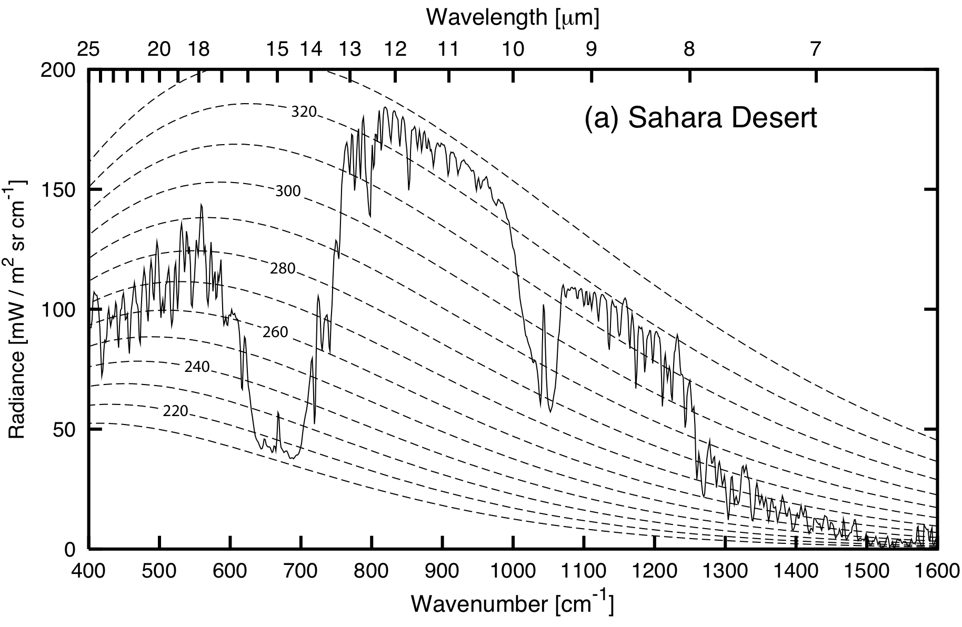
Atmospheric Emission

Slide 166
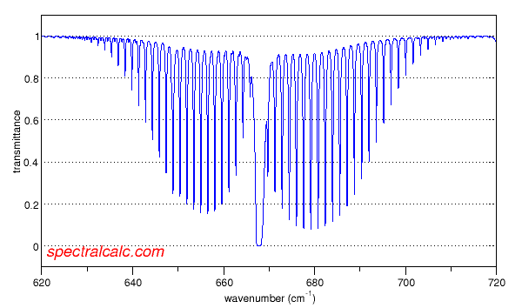
Transmittance spectrum for CO2
http://www.spectralcalc.com/calc/spectralcalc.php

Slide 167
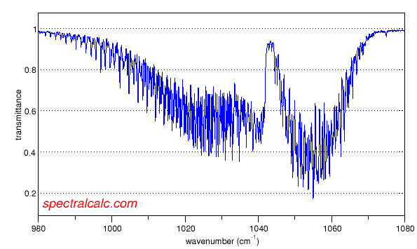
Transmittance spectrum for ozone (O3)
http://www.spectralcalc.com/calc/spectralcalc.php

Slide 170
where B = B_{λ}(T)

Slide 172
AOSC624
Class # 11: March 11, 2014
Microwave Remote Sensing
Note: Different units used for different
spectral regions:
Spectra | Energy expressed as a function of
Visible | Wavelength λ
Infrared | Wave number n = 1/λ
Microwave | Frequency ν=1/t, in GHz (since Hz is small)
Giga (G) denotes a factor of billion (10⁹)

Slide 174
Absorption spectrum in microwave
Figure 1

Slide 175
Water vapor and molecular oxygen exhibit absorption lines in the microwave region.
Below 40 GHz (1 GHz = 10⁹ cycles/sec; note 1 cm = 30 GHz) only the weakly absorbing pressure broadened 22.235 GHz water vapor line is dominant.
At about 31.4 GHz, air is relatively transparent.
For frequencies greater than 120 GHz. water vapor absorption again becomes dominant due to the strongly absorbing line at 183 GHz. Figure 1 show the vertical atmospheric transmittance as a function of frequency for a standard atmosphere.

Slide 176
Special problem in the use of microwave from a satellite platform is the emissivity of the earth surface. In the microwave region of the spectrum, emissivity values of the earth surface range from 0.4 to 1.0. The emissivity of the sea surface typically ranges between 0.4 and 0.5, depending upon such variables as salinity, sea ice, surface roughness and sea foam. This complicates interpretation of terrestrial and atmospheric radiation with earth surface reflections.

Slide 177
In addition, there is a frequency dependence with higher frequencies displaying higher emissivity values. Over land, the emissivity depends on the moisture content of the soil. Wetting of a soil surface results in a rapid decrease in emissivity. The emissivity of dry soil is on the order of 0.95 to 0.97, while for wet bare soil it is about 0.80 to 0.90, depending on the frequency. The surface emissivity appearing in the first term has a significant effect on the brightness temperature value.

Slide 178
Spectral Intervals in (VIS, IR, MW) of interest in Remote Sensing
Several spectral regions are considered useful for remote sensing from satellites.
Windows to the atmosphere (regions of minimal atmospheric absorption) exist near
4 μm, 10 μm, 0.3 cm, and 1 cm.
Infrared windows are used for sensing the temperature of the earth surface and clouds, while microwave windows help to investigate the surface emissivity and the liquid water content of clouds.

Slide 179
The CO₂ and O₂ absorption bands at
4.3 μm, 15 μm, 0.25 cm, and
0.5 cm are used for temperature profile retrieval; because these gases are uniformly mixed in the atmosphere in known portions they lend themselves to this application. The water vapor absorption bands near 6.3 μm, beyond 18 μm, near 0.2 cm, and near 1.3 cm are sensitive to the water vapor concentration in the atmosphere.

Slide 180
Spectral regions used for remote sensing of the earth atmosphere and surface from satellites. ε indicates emissivity, q denotes water vapor, and T represents temperature.

Slide 181
Microwave Instruments of focus
Passive = radiometers
Scanning Multichannel Microwave Radiometer, Special Sensor Microwave Imager, Sounder
SMMR, SSM/I, SSMIS, TMI, AMSU-A, B-true workhorses
Active = radar types
Scatterometers, SEASAT, ERS 1, 2, QuikSCAT; also workhorses—Currently Metop’ s ASCAT
Altimeters, TOPEX, Poseidon, Jason 1, 2, others.
Synthetic Aperture Radars, SARs RADARSAT 1, 2 , ENVISAT/ASAR , Tetra-SAR X
Precipitation /Cloud Radars, TRMM, CloudSat

Slide 182
Orbit considerations
Microwave emission is far out in the spectrum, wavelengths of mm to cm and longer, so detection requires large antennas (order of meters), therefore, we mount such instrument only on:
Polar orbiting satellites at 800 to 850 km height or in tropical orbits +/- 22 to 35 km. At the lower inclinations required for these orbits, the satellite cannot be in sun-synchronous orbit.
Active, i.e. radar type, MW instruments require much power, which also requires them to be in low earth orbit (800 km region).

Slide 183
Principles of MW radiometry
Radiometers are passive instruments, so they detect radiation emitted by Earth’s atmosphere or surface. The ocean is a weak emitter with emissivity of the order of 50%, so its black body temperature in most MW wavelengths is 150 K. It is therefore acting like a mirror for the atmosphere and clouds above. The atmosphere has a strong emission line around 22GHz, so that frequency is used to measure the TOTAL COLUMN OF WATER VAPOR in he air. 19 GHz and 37 GHz are sensitive to the “Mie scattering” by cloud droplets, so these frequencies are used for TOTAL LQUID WATER content, and 85 GHz receives SCATTERING FROM ICE PARTICLES at the top of clouds, indication of possible rain.
The solid Earth is a strong emitter, so atmospheric signals cannot be separated out over land

Slide 184
Variables obtained
Atmospheric Water Vapor and Cloud Liquid Water—first as total in the column, later as profiles of these quantities and interpreted in terms of different cloud particle sizes and precipitation size drops or even ice particles (through microwave scattering).
Multi-frequency instruments allow the various signals to be separated. The ocean which works as a background must be accounted for using special frequencies for effects of
Sea Surface Temperature, SST, and Wind.

Slide 185
Detection of MW radiation
Signals are received in so called “horns”, which have rectangular openings. The electro-magnetic radiation is received in horizontal or vertical planes, which means that the radiation is either horizontally or vertically polarized. The same is true for radiation sent out by a MW emitter that also can receive – a radar.

Slide 186
Vertically, horizontally and a circularly polarized wave as a sum of the two components

Slide 187
On the basis of previous discussion the solution of the transfer equation for a non-scattering atmosphere in local thermodynamic equilibrium is given by
(1)
Where denotes the frequency
I _{ṽ} (p_{s})
represents the radiance contribution from the surface and the transmittance is expressed with respect to the top of the atmosphere.

Slide 188
Since the emissivity in microwave is less than 1, there is a reflection contribution from the surface.
Contribution of each term to the brightness temperature at the top or the atmosphere

Slide 189
The radiance emitted from the surface is given as:
(2)
The first term in the right-hand side denotes the surface emission contribution, whereas the second term represents the emission contribution from the entire atmosphere to the surface, which is reflected back to the atmosphere at the same frequency.

Slide 190
The transmittance is generally available with respect to the top of the atmosphere, namely, T _{ṽ} (p, 0).
For computational purposes it is desirable to express
T _{ṽ} (p_{s}, p) in terms of T _{ṽ} (p, 0) .
The transmittance T _{ṽ} (p_{s}, p) is now expressed with respect to the surface.
Inserting the lower boundary condition into Eq. (1) the upwelling radiance can now be expressed as:
(3)

Slide 191
Contribution of each term to the brightness temperature at the top of the atmosphere

Slide 192
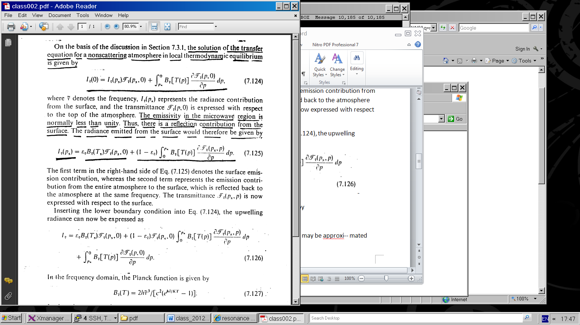
In the frequency domain, the Planck function is given by
(4)
In the microwave region h ṽ /K T« 1,
the Planck function may be approximated by
(5)
Thus, the Planck radiance is linearly proportional to the temperature, which is referred to as the Rayleigh-Jeans Law.
Analogous to the above approximation, we may define an equivalent brightness temperature T_{B} such that:
(6)

Slide 193
Substituting eqs. (5) and (6) into eq. (3), the solution of microwave radiative transfer
may now be written in terms of temperature as:
(7)

Slide 194
For monochromatic frequencies, the transmittance is an exponential function of the optical depth , hence, we may express
(8)
where T _{ṽ} (p, 0) is the the transmittance or the entire atmosphere, is a constant value, so:

Slide 195
(9)
Substituting eq. 9 into eq. 7, rearranging terms and letting (p, 0) = (p)

Slide 196
Determination of Planetary Radiation Budget
Angular Distribution Models (ADM) Models
Global Radiation Budget
Climate Sensitivity to Clouds
Cloud Radiative Forcing
Results from Radiation Budget Missions (ERBE; CERES)
Special Programs to Better Understand Clouds (ARM)

Slide 197
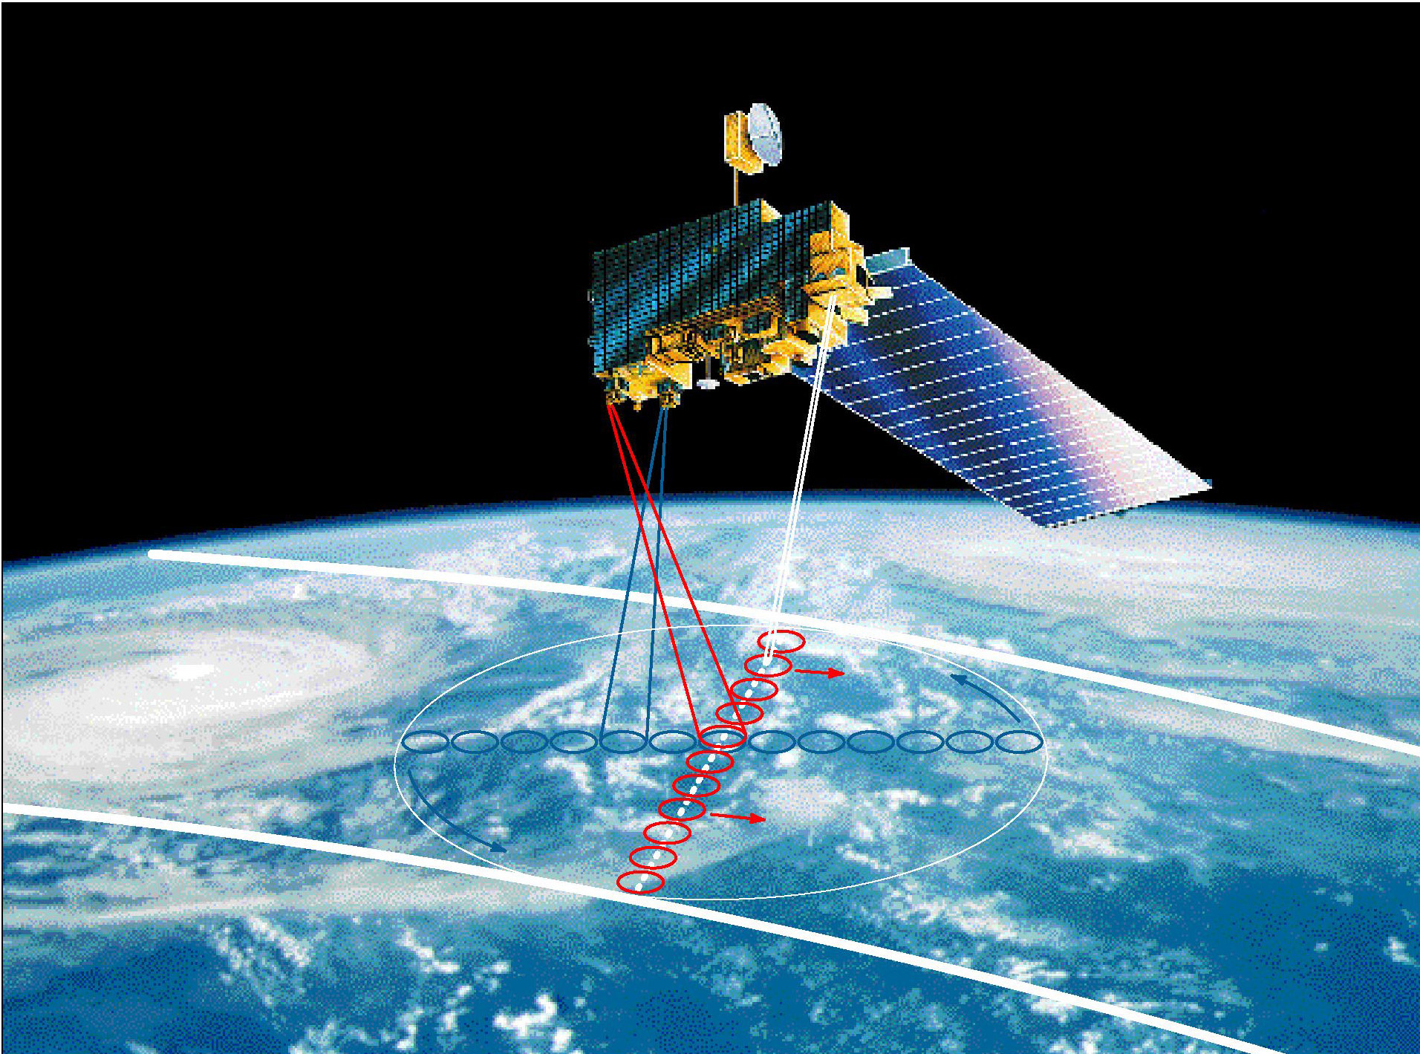
Clouds and the Earth’s Radiant Energy System
Is the global energy budget changing?
Effect of clouds on the radiation budget.

Slide 198
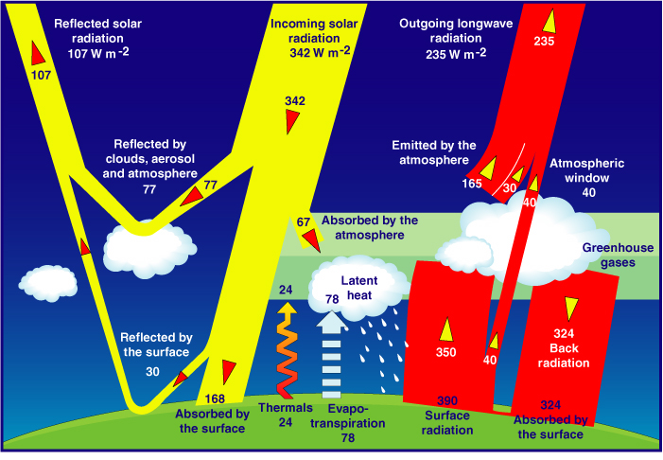
Satellites serve as source of information on the Global Energy Budget
As estimated from models (Kiehl and Trenberth, 1997)

Slide 199
Effect of Clouds
Clouds interact both with solar radiation, in the shortwave region of the spectrum, and with the radiation thermally emitted by the earth and atmosphere, in the longwave region.
Clouds reduce the net absorption of solar radiation by increasing the earth albedo, and they decrease the loss of terrestrial radiation to space by decreasing the effective radiative brightness temperature of the earth.

Slide 200
The effect of cloud cover on solar radiation depends primarily on the thickness of the cloud, but also it depends upon particle size and phase.
The longwave effect depends primarily upon cloud top temperature, which is a function of cloud height, and, for thin clouds, upon emissivity, which is related to optical thickness.

Slide 201
The solar radiation effect and the thermal emission effect are in opposite directions as far as net radiation at the top of the atmosphere is concerned.
Each effect, by itself, is large, but the combine effect is relatively small and will depend significantly on the cloud-free profile of atmospheric temperature, humidity, and aerosols, and upon surface temperature and optical properties.
The net effect is the difference of two large terms; led to a debate in the 70s on the role clouds play in the climate system.

Slide 202
Early studies of sensitivity to cloud amount
One of the early attempts to quantify the effect of clouds on the earth’s radiation budget is described in a technical report by London (1957), whose results were widely cited prior to satellite measurements. Using temperature and cloud cover observations for the Northern Hemisphere, he computed solar and infrared fluxes at the top of the atmosphere with and without clouds. He found that clouds have a net energy input primarily during the spring and summer seasons, with an annual average effect of ~35 W/m*2 a result not so different form modern satellite-based estimates to be discussed .

Slide 203
Later, Budyko (1969) used observations of the temperature (T_{s}) and cloud amount (A_{c}) compiled in Budyko (1963) to calculate outgoing infrared flux at the top of the atmosphere (F) and to derive a relationship based on regression:
  F = 223 + 2.2T_{s} - (48+1.6T_{s})Ac
where F is in W/m⁻² and T is in ⁰C. For a mean global surface temperature of 288 K, he finds the sensitivity of the infrared flux to clouds to be
δF/δA_{c} = -72 W/m⁻².

Slide 206

For the values adopted by Schneider (1989)
a_{c} = 0.5 and α₀ = 0.12
The solar radiation sensitivity coefficient is -130 W/m⁻²
(Here the results are normalized to the solar constant of
1368 W/m⁻²).
The net sensitivity to cloud amount is the difference between the
solar and infrared sensitivity coefficients:
which for Schneider’s model is -55 W/m⁻²

Slide 207
Climate Sensitivity
Radiative Effect at the Top of the Atmosphere
For a 50% Increase in Climate Parameter
Cloud
Height
High Cloud
Amount
Particle Size
(Low Clouds)
Stratospheric
Ozone
Carbon
Dioxide
Radiative
Effect
(W/m²)
Low Cloud
Amount
Cloud Optical
Depth
Indirect Aerosol
Forcing
Direct Anthropogenic
Aerosol Forcing
Land Albedo
Low clouds
COD

Slide 208
CLEAR-SKY AND CLOUD SENSITIVITY FROM 19 GCMS
Climate models are inconsistent in predicting the effects of clouds on climate
(Cess et al., 1990)

Slide 209
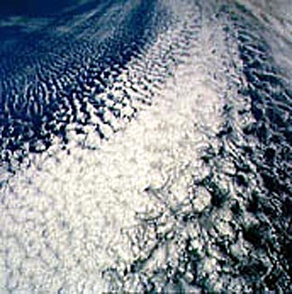
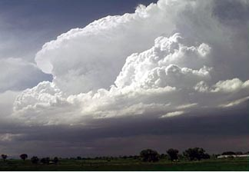
Due to their complexity, clouds are difficult to model
Satellites are useful for identifying clouds.

Slide 210
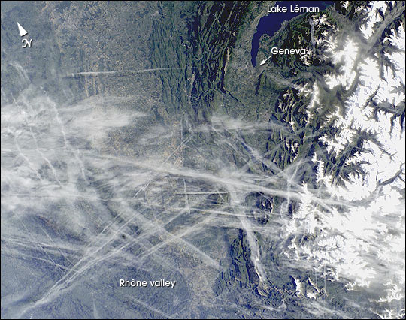
“Man made” clouds: Airplane Tracks

Slide 211
Over the last dozen years, NASA has launched a series of satellites – known collectively as the Earth Observing System (EOS) – that has provided critical insights into the dynamics of the entire Earth system: clouds, oceans, vegetation, ice, solid Earth and atmosphere (see next slide). Now NASA is helping to create a new generation of satellites to extend and improve upon the Earth system data records established by EOS.

Slide 212
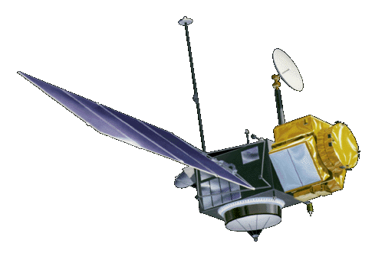



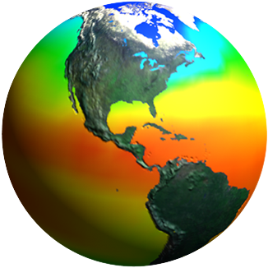
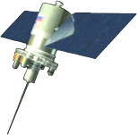
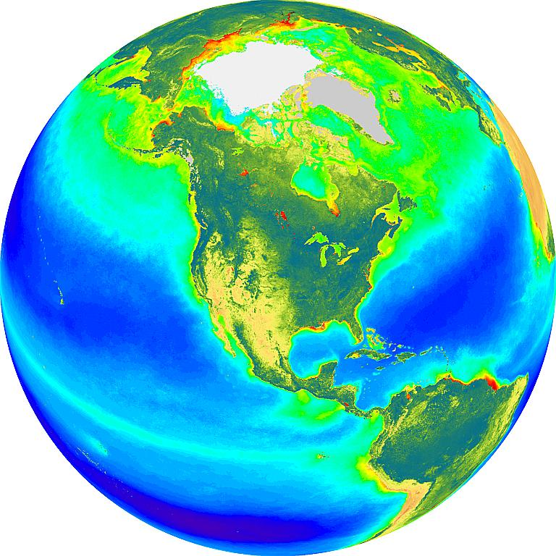
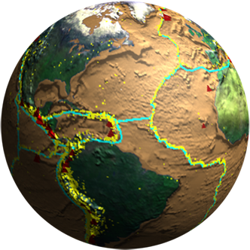
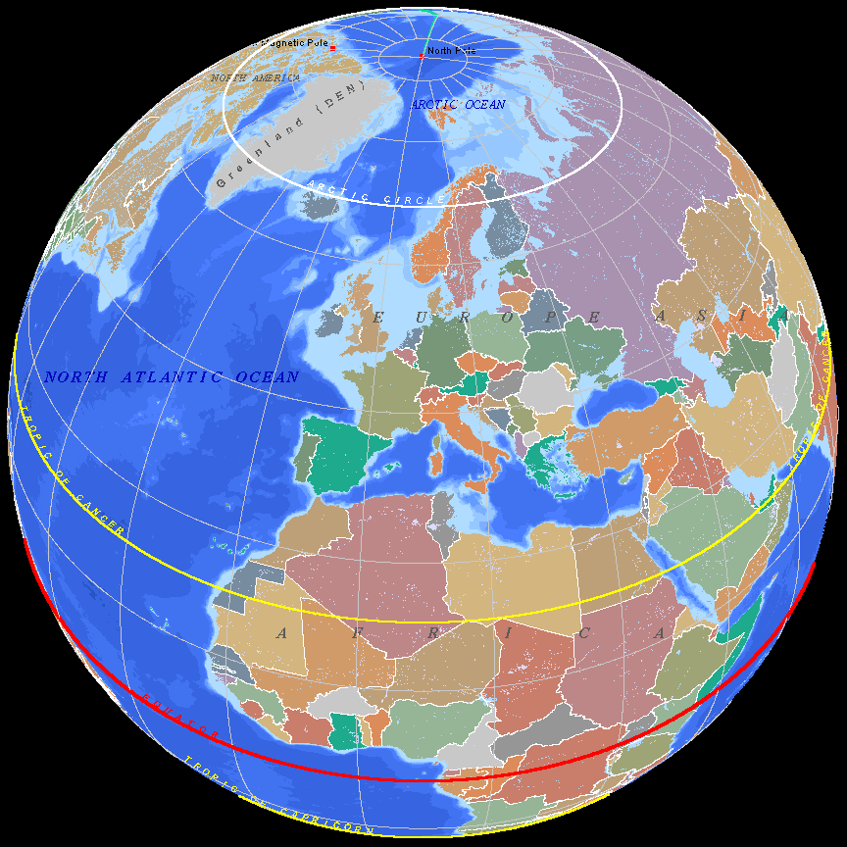
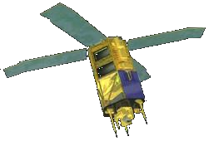
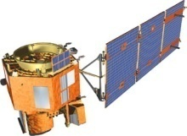
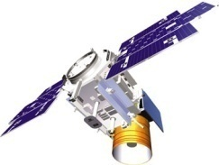
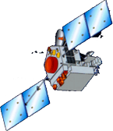

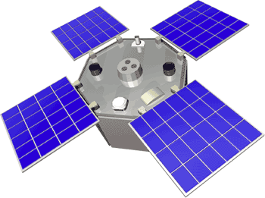
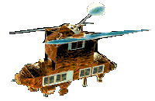
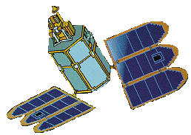
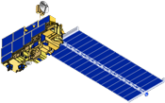
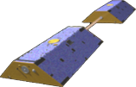
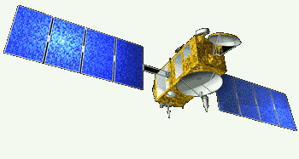
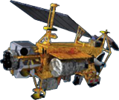
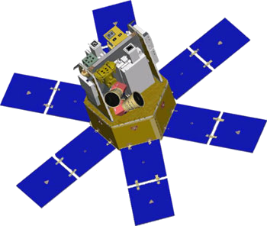
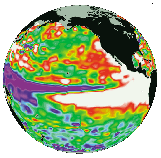
Spaceborne Earth Observation Systems
TOPEX/Poseidon
Landsat 7
SORCE
Aqua
QuikScat
Sage
EO-1
SeaWiFS
IceSat
TRMM
SeaWinds
ACRIMSAT
ERBS
Toms-EP
Grace
Jason
Terra
UARS

Slide 213
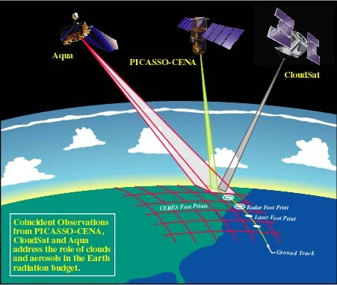
A configuration of several satellites with complimentary capabilities is considered as ideal for cloud research. In particular, the newer systems with active capabilities.
Aqua
CALIPSO
CloudSat

Slide 214
radiation along the path length ds due to the absorp­tion within the layer is

Slide 219
Integration of equations such as (4.44) over wave number, when performed in the conventional manner, requires resolution of myriads of absorption lines with half-widths ranging from 10⁻¹cm⁻¹ near the Earth's surface to 10-3cm-I in the upper atmosphere. A single line-by-line integration over the entire infrared

Slide 223
The plane parallel approximation
Many atmospheric radiative transfer calculations can be simplified through the use of the plane-parallel approximation in which temperature and the densi­ties of the various atmospheric constituents are assumed to be functions of height (or pressure) only. With this simplification, the flux density passing through a given atmospheric level is given by:
where τ_{v} , the normal optical depth is used as a vertical coordinate and the arrows denote that both upward and downward fluxes are taken into account.

Slide 224
Since this section focuses on infrared radiative transfer, we use wave number ( v) notation to be consistent with the literature in this subfield. Integrating over azimuth angle and denot­ing
we obtain:

Slide 225
Toe monochromatic intensity in this expression may be broken down into three components:
  Upward emission from the Earth's surface that reaches level τ_{v} without being absorbed.
  Upward emission from the underlying atmospheric layer.
  Downward emission from the overlying layer.
The expressions used in evaluating these terms are analogous to Beer's law, with the intensity transmis­sivity Tv replaced by the flux transmissivity

Slide 226
For many purposes it is sufficient to estimate the flux transmissivity from the approximate formula
where the "average” or "effective zenith angle" is:

Slide 227
In other words, the flux transmissivity of a layer is equivalent to the intensity transmissivity of parallel beam radiation passing through it with a zenith angle ϑ = 53°. The factor
is widely used in
radiative transfer calculations and is referred to as the diffusivity factor. Applying the concept of a diffusivity factor (4.44) can be integrated over μ, to obtain

Slide 228
Integration over wave number
To calculate the flux density F, it is necessary to inte­grate the monochromatic flux density F_{v} over wave number, where the integrand involves the product of the slowly varying Planck function and a
rap­idly varying flux transmissivity For this purpose it is convenient to separate the smooth Bv dependence from the much more complex and dependences by breaking up the wave number spectrum into inter­vals narrow enough so that within each interval can be regarded as a function of T only. Hence, B may be taken outside the integral so that the integrands reduce to expressions for the flux transmissivities of various layers of the atmos­
phere. These wave number-integrated flux transmis­sivities for the respective wave number intervals
are the basic building blocks in infrared radiative transfer calculations.

Slide 229
Integration of equations such as (4.44) over wave number, when performed in the conventional manner, requires resolution of myriads of absorption lines with half-widths ranging from 10⁻¹cm⁻¹ near the Earth's surface to 10-3cm-I in the upper atmosphere. A single line-by-line integration over the entire infrared

Slide 230
region of the spectrum requires a summation over roughly a million points. The transmissivity Tv needs to be calculated for each infinitesimal wavelength
interval and these values then need to be summed

Slide 231
Integration over wave number
To calculate the flux density F, it is necessary to inte­grate the monochromatic flux density F_{v} over wave number, where the integrand involves the product of the slowly varying Planck function and a
rap­idly varying flux transmissivity For this purpose it is convenient to separate the smooth Bv dependence from the much more complex and dependences by breaking up the wave number spectrum into inter­vals narrow enough so that within each interval can be regarded as a function of T only. Hence, B may be taken outside the integral so that the integrands reduce to expressions for the flux transmissivities of various layers of the atmos­
phere. These wave number-integrated flux transmis­sivities for the respective wave number intervals
are the basic building blocks in infrared radiative transfer calculations.

Slide 232
Integration over wave number
To calculate the flux density F, it is necessary to inte­grate the monochromatic flux density F_{v} over wave number, where the integrand involves the product of the slowly varying Planck function and a
rap­idly varying flux transmissivity For this purpose it is convenient to separate the smooth Bv dependence from the much more complex and dependences by breaking up the wave number spectrum into inter­vals narrow enough so that within each interval can be regarded as a function of T only. Hence, B may be taken outside the integral so that the integrands reduce to expressions for the flux transmissivities of various layers of the atmos­
phere. These wave number-integrated flux transmis­sivities for the respective wave number intervals
are the basic building blocks in infrared radiative transfer calculations.

Slide 233
region of the spectrum requires a summation over roughly a million points. The transmissivity Tv needs to be calculated for each infinitesimal wavelength
interval and these values then need to be summed

Slide 242
Orbit considerations
Microwave emission is far out in the spectrum, wavelengths of mm to cm and longer, so detection requires large antennas (order of meters), therefore, we mount such instrument only on:
Polar orbiting satellites at 800 to 850 km height or in tropical orbits +/- 22 to 35 km. At the lower inclinations required for these orbits, the satellite cannot be in sun-synchronous orbit.
Active, i.e. radar type, MW instruments require much power, which also requires them to be in low earth orbit (800 km region).
F and integrating I_{λ} over all wavelength and azimuthaly (in all directions)

Slide 251
http://www.foothill.edu/attach/1578/Chapter_13_IR.pdf
http://www.met.reading.ac.uk/caviar/water_continuum.html
https://www.arm.gov/publications/proceedings/conf09/extended_abs/mlawer_ej.pdf
http://www.bbc.co.uk/bitesize/higher/physics/radiation/refraction/revision/2/

