Slide 1
AOSC400-2015
October 20, Lecture # 13
Absorption and Emission by Gas Molecules
Basics of atomic and molecular absorption/emission spectra.
Spectral line shapes: Lorentz and Doppler profiles.
Absorption coefficient and transmission function.
Copyright@2015 University of Maryland
This material may not be reproduced or redistributed, in whole or in part, without written permission of Rachel T. Pinker
*Sources of information used for this lecture are listed in updated Syllabus.

Slide 2
Continuum, Emission, and Absorption Spectra
Types of spectra
Produced in different ways, and can tell us about the physical properties of the materials producing the spectra.
The three types of spectra are called “a continuous spectrum” (or continuum emission), “an emission line spectrum” and “an absorption line spectrum”. They look like the following

Slide 3
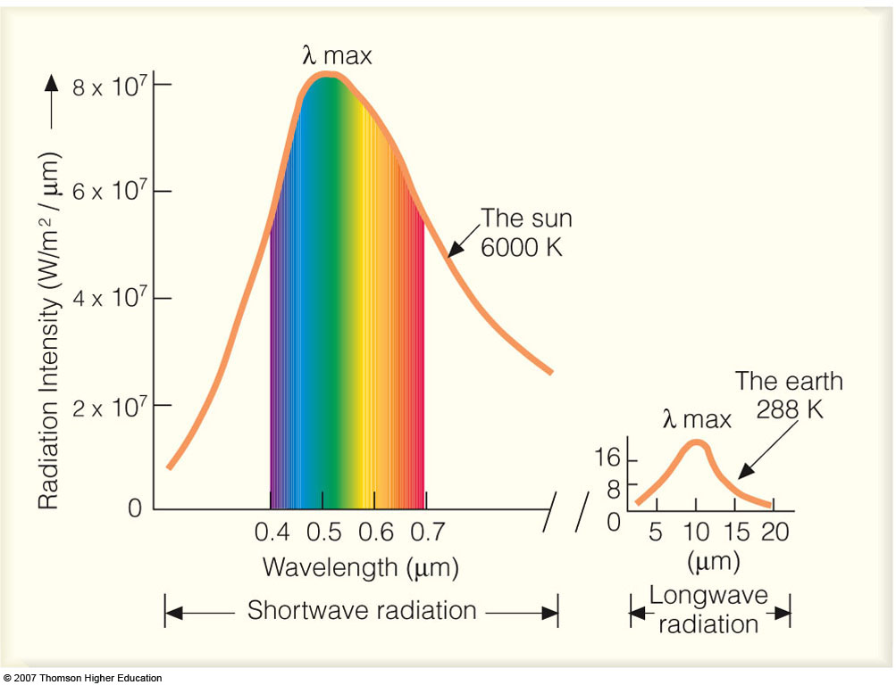
The visible spectrum
Sir Isaac Newton used a prism to split sunlight into its fundamental colors of the rainbow.

Slide 4
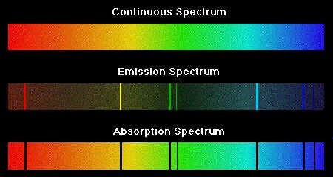

Slide 5

A continuous spectrum
Light from the Sun or any star, produces a continuous spectrum.
Light produced by incandescent light bulbs is a continuum spectrum; the filament gets extremely hot from having an electric current passed through it; when it gets to thousands of degrees, it gives off light.

Slide 6

An emission line spectrum
If we were to look at the spectrum of an object we would notice a different kind of spectrum; we would see a series of bright lines with a dark background.

Slide 7

An absorption line spectrum
An absorption line spectrum is in some ways the converse of an emission line spectrum. Rather than seeing a series of bright lines on a dark background, one sees dark lines on a continuous spectrum.
Absorption lines are usually seen as dark lines, or lines of reduced intensity, on a continuous spectrum. This is seen in the spectra of stars, where gas (mostly hydrogen) in the outer layers of the star absorbs some of the light from the underlying thermal blackbody spectrum.

Slide 8
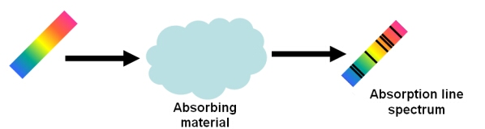
Absorption Line
An absorption line will appear in a spectrum if an absorbing material is placed between a source and the observer. This material could be the outer layers of a star, a cloud of interstellar gas or a cloud of dust.
The light that leaves the cloud shows absorption lines in the spectrum at discrete frequencies.

Slide 9
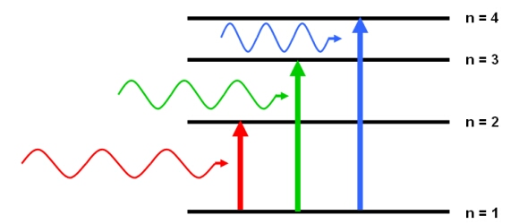
According to quantum mechanics, an atom or molecule can absorb photons with energies equal to the difference between two energy states.
Photons with specific
energies will be absorbed by an atom, ion or molecule
if this energy is equal to
the difference between the energy levels.
In this example, three
different photon
energies are required
to promote an electron from
the ground state (n=1)
to an excited state (n=2, 3 and 4)

Slide 10
Absorption and Emission by Gas Molecules
When radiation interacts with matter it is
absorbed, scattered, or emitted in discrete packets
called photons. Each photon contains energy
E = hν (4.21)
where h is Planck's constant (6.626 X 10⁻³⁴ J s).
The energy carried by a photon is inversely proportional
to the wavelength of the radiation.

Slide 11
A mol­ecule may undergo a transition to a higher energy level by absorbing electromagnetic radiation and it may drop to a lower level by emitting radiation.
Absorption and emission can occur only in associa­tion with discrete changes in energy level Δ E. The frequency of the absorbed or emitted radiation is related to the change in energy level through the relation
Δ E = hv (4.23)

Slide 12
Atomic absorption/emission spectra:
Radiation emission (absorption) occurs only when an electron makes a transition from one state with energy E_{k} to a state with lower (higher) energy E_{j}:
for emission: E_{k} - E_{j} = hc/λ

Slide 13
Examples of atomic emission spectra

Slide 14
Bohr’s model of a hydrogen atom:
The energy level is given as
n=1,2,3
where R_{H} is the Ryberg constant ( =1.092x10⁵ cm⁻¹ for hydrogen); h is the Planck’s constant , and c is the speed of light.
The wavenumber of emission/absorption lines of hydrogen atom:
where j and k are integers defining the lower and higher energy levels, respectively.

Slide 15
Molecular Absorption/Emission Spectra
Molecular absorption spectrum is more complicated than that of an atom because molecules have several forms of internal energy. This is the subject of spectroscopy and quantum theory.
Three types of absorption/emission spectra:
i) Sharp lines of finite widths
ii) Aggregations (series) of lines called bands;
iii) Spectral continuum extending over a broad range of wavelengths

Slide 17
Main underlying physical principles of molecular absorption/emission:
The origins of absorption/emission lie in exchanges of energy between gas molecules and electromagnetic field.
2) In general, total energy of a molecule can be given as:
E = E_{rot}+ E_{vib}+ E_{el} + E_{tr}

Slide 18
E_{rot} is the kinetic energy of rotation (energy of the rotation of a molecule as a unit body): about 1-500 cm⁻¹ (in the far-infrared to microwave region)
E_{vib} is the kinetic energy of vibration: energy of vibrating nuclei about their equilibrium positions; about 500 to 104 cm₋₁ (in the near- to far-IR)
E_{el} is the electronic energy: potential energy of electron arrangement; about 104-105 cm⁻¹ (in the UV and visible)
E_{tr} is translation energy: exchange of kinetic energy between the molecules during collisions; about 400 cm⁻¹ for T =300 K

Slide 19
Quantum mechanics predicts that only certain configurations of electron orbits are permitted within each atom, and only certain vibrational fre­quencies and amplitudes and only certain rotation rates are permitted for a given molecular species. Each possible combination of electron orbits, vibra­tion, and rotation is characterized by its own energy level, which represents the sum of the three kinds of energy.

Slide 20
Absorptivity at visible and longer wavelengths can thus be described in terms of a line spectrum consist­ing of extremely narrow absorption lines separated by much wider gaps in which the gas is virtually transparent to incident radiation.

Slide 21
The changes in state of molecules that give rise to these absorption lines may involve orbital, vibrational, or rotational transitions or combinations thereof. Orbital transitions are associated with absorption lines in the ultraviolet and visible part
of the spectrum; vibrational changes with near­ infrared and infrared wavelengths; and rotational lines, which involve the smallest changes in energy, with infrared and microwave radiation.

Slide 22
The absorp­tion spectra of the dominant species 0₂ and N₂ exhibit a sparse population of absorption lines because these molecular species do not possess an electric dipole, even when they are vibrating. In contrast, so-called "greenhouse gases" (notably H₂0, C0₂, 0₃, and trace species such as such as CH4, N2O, CO and chlorocarbons exhibit a myriad of closely spaced absorption lines in the infrared region of the spectrum that are due to pure rotational or simultaneous vibrational-rotational transitions.

Slide 23
Broadening of absorption lines
The absorption lines of molecules are of finite width due to the inherent uncertainty in quantizing their energy levels, but this "natural broadening" is inconsequential in comparison to the broadening attributable to the motions and collisions of the gas molecules.

Slide 24
What is the Heisenberg Uncertainty Principle
The Heisenberg Uncertainty Principle states that you can never simultaneously know the exact position and the exact speed of an object because everything in the universe behaves like both a particle and a wave at the same time

Slide 25

In quantum mechanics, the uncertainty principle, also known as Heisenberg's uncertainty principle, is any of a variety of mathematical inequalities asserting a fundamental limit to the precision with which certain pairs of physical properties of a particle, known as complementary variables, such as position x and momentum p, can be known simultaneously
Introduced first in 1927, by the German physicist Werner Heisenberg, it states that the more precisely the position of some particle is determined, the less precisely its momentum can be known, and vice versa. The formal inequality relates the standard deviation of position σx and the standard deviation of momentum σp (ħ is the reduced Planck constant, h / 2π).
From Wikipedia

Slide 26
Spectral line shapes: Lorentz profile, Doppler profile
Three main factors that define an absorption line: central position of the line, e.g., the central frequency
or the central wavenumber , strength of the
line (or intensity, S), and shape factor (or line profile, f).

Slide 27
Each line has a finite width (referred to as natural broadening of a spectral line).
• In the atmosphere, several processes may result in an additional broadening of a spectral line of the molecules:
1) collisions between molecules (referred to as the pressure broadening);
2) due to the differences in the molecule thermal
velocities (referred to as the Doppler broadening); and
3) the combination of the above processes.

Slide 28
Lorentz profile of a spectral line is used to characterize the pressure broadening and is defined as:
Where e is the shape factor of a spectral line;
is the wavenumber of a central position of a line;
α is the half-width of a line at the half maximum (in cm-1), (often called the line width)

Slide 30
The half-width of the Lorentz line shape is a function of pressure P and temperature T and can be expressed as:
where α₀ is the reference half-width for STP: T₀ = 273K; P=1013 mb.
α₀ is in the range from about 0.01 to 0.1 cm-1 for most atmospheric radiatively active gases. For most gases n=1/2

Slide 31
The above dependence on pressure is very important because atmospheric pressure varies by an order of 3 from the surface to about 40 km.
• The Lorentz profile is fundamental in the radiative transfer in the lower atmosphere where the pressure is high.
• The collisions between like molecules (self-broadening) produce the large line widths than do collisions between unlike molecules (foreign broadening).
Because radiatively active gases have low concentrations, the foreign broadening often dominates in infrared radiative transfer.

Slide 32
Doppler broadening is the broadening of spectral lines due to the Doppler effect caused by a distribution of velocities of atoms or molecules. Different velocities of the emitting particles result in different Doppler shifts, the cumulative effect of which is the line broadening. This resulting line profile is known as a Doppler profile. A particular case is the thermal Doppler broadening due to the thermal motion of the particles. Then, the broadening depends only on the frequency of the spectral line, the mass of the emitting particles, and their temperature, and therefore can be used for inferring the temperature of an emitting body.

Slide 33
Doppler profile is defined in the absence of collision effects (i.e., pressure broadening) as:

Slide 34
where c is the speed of light; k_{B} is the Boltzmann’s constant, m is the mass of the molecule.
The Doppler half-width at the half maximum is

Slide 35
The Doppler effect comes from random molecular motions. If the molecule moves with the thermal velocity V and emits at the frequency
it would appear that it emits at the frequency
where c is the speed of light and V << c.
The Doppler broadening is important at the altitudes from about 20 to 50 km.

Slide 36
Comparison of the Doppler and Lorentz profiles

Slide 37
Shapes of absorption lines broadened by these two dis­tinctly different processes, are contrasted in Fig. 4.21.
The "wings" of the absorption lines shaped by pressure broadening extend out farther from the center of the line than those shaped by Doppler broadening.
For a water vapor line at 400 cm^{-I} and a temperature of 300 K, the Doppler line width is 7 X 10-4 cm^{-I}.

Slide 38
A typical water vapor line width for air at the same temperature at the Earth's surface is -100 times wider due to the presence of pressure broadening.
Below -20 km, pressure broadening is the dominant factor in determining the width of absorption lines, whereas above 50 km, where molecular collisions are much less frequent, Doppler broadening is the dominant factor. In the intermediate layer between 20 and 50 km, the line shape is a convolution of the Doppler and Lorentz shapes.

Slide 40
Laboratory measurements of absorption spectra exist for only a very limited sampling of pressures and temperatures.
Through the use of theo­retically derived absorption line information, adjusted empirically to improve the fit with existing measure­ments, atmospheric physicists and climate modelers are able to calculate the absorption spectra for each of the radiatively important atmospheric gases for any specified thermodynamic conditions.

Slide 41
An exam­ple showing the excellent agreement between observed and theoretically derived absorption spec­tra is shown in Fig. 4.22. Note the narrowness of the lines, even when the effects of Doppler and pressure broadening are taken into account. The greatest uncertainties in theoretically derived absorption spectra are in the so-called "continua” where the superposition of the outermost parts of the wings of many different lines in nearby line clusters pro­duces weak but in some cases significant absorption.

Slide 43
Fig. 4.22 Comparisons of observed and calculated
transmis­sivity spectra:
Spectral range 1931 to 1939 cm- 1 for car­bon dioxide and
Spectral range 1156 to 1164 cm- 1 for ozone and nitrous oxide.
The upper plot in each panel is the observed spectrum and the lower plot is the calculated spec­trum.
From R. M. Goody, R. M. and Y. L. Yung, Atmospheric Radiation, 2nd ed., Oxford University Press (1995), p.120. By permission of Oxford University Press, Inc.

Slide 44
  Radiative Transfer Planetary Atmospheres
4.5.1 Beer's Law

Slide 50
Differential form of the radiative transfer equation-the Schwarzchild’s equation

Slide 83
is the transmissivity of the layer.
This set .Qf relationships and definitions, collec­ tively referred to here as Beer's law, but also known as Bouguer's law, and Lanzbert's lalv,16,17,18 states
that the monochromatic intensity I.I decreases monotonically with path length as the radiation
passes through the layer. The dimensionless quan­ tity .,-,, referred to as the normal optical depth or optical thickness depending on the context in which it is used, is a measure of the cumulative depletion that a beam of radiation directed straight
downward (zenith angle 8 = 0) would experience a
in passing through the layer. It follows that, in the absence of scattering, the monochromatic absorptivity

Slide 84
approaches unity exponentially with increasing opti­ cal depth. Optical depths for the scattering and
extinction of radiation passing through a medium is
containing aerosols or cloud droplets can be defined a,
in a similar manner.

Slide 85
Absorption and Emission of Infrared Radiation
The two previous subsections dealt with the scatter­ing and absorption of radiation in planetary atmos­pheres in the absence of emission. The relationships discussed in those subsections are applicable to the transfer of solar radiation through planetary atmos­pheres. The remainder of this section is concerned with the absorption and emission of infrared radia­tion in the absence of scattering. This simplified treatment is justified by the fact that the wavelength of infrared radiation is very long in comparison to the circumference of the air molecules so the scatter­ing efficiency is negligible.

Slide 86
Schwarzschild's equation
First we will derive the equation that governs the transfer of infrared radiation through a gaseous medium. Rewriting ( 4.17), the rate of change of the monochromatic intensity of outgoing terrestrial

Slide 87
radiation along the path length ds due to the absorp­tion within the layer is

Slide 88
where "A is the absorptivity of the layer. The corre­sponding rate of change due to the emission of radiation is
d!A(emission) = BA(T)eA
Invoking Kirchhoff's law (4.15) and summing.the two expressions, we obtain Sc/11varzschild's21 equation
df; = -(IA - BA(T))kAprds (4.41)

Slide 90
By analogy with Beer's law [Eqs. (4.30)-(4.33)], it follows that as radiation passes through an isother­mal layer, its monochromatic intensity exponen­tially approaches that of blackbody radiation corresponding to the temperature of the layer. By the time the radiation has passed through an opti­cal thickness of 1, the departure IBA( T) - I, I has decreased by the factor l/e. It can also be argued, on the basis of Exercise (4.44), that the monochro­matic intensity of the radiation emitted to space is emitted from levels of the atmosphere near th􀁘 level of unit opti,al depth. For TA <,;:: 1, the emissiv-· ity is so small that the emission from the atmos­phere is negligible. For TA ::,,, 1, the transmissivity of the overlying layer is so small that only a minute fraction of the monochromatic intensity emitted

Slide 110
Heating Rates

Slide 137
Quite often, we need to obtain fluxes of modest accuracy with the least possible expen­diture of computational effort. That requires us to take advantage of highly simplified parameterizations of radiative absorption and emis­sion.

Slide 138
Absorption continua
Extreme ultraviolet radiation with wavelengths
≤ 0.1 µm, emitted by gases in the sun's outer atmosphere, is energetic to strip electrons from atoms-
pho­toionization.
Solar radiation in this wavelength range (only around 3 millionths of the sun's total output) is absorbed in the ionosphere, at altitudes of 90 km and above, giving rise to sufficient numbers of free electrons to affect the propagation of radio waves.

Slide 139
Radiation at wavelengths up to 0.24 µm is
suffi­ciently energetic to break 0₂ molecules apart into oxygen atoms, a process referred to as photo- dissociation. The oxygen atoms liberated in this reaction are instrumental in the production of ozone (0₃) which in turn, is dissoci­ated by solar radiation with wavelengths extending up to 0.31 µm. This reaction absorbs virtually all of the ~2 % of the sun's potentially lethal ultraviolet radiation.

Slide 140
The ranges of heights and wavelengths of the primary photoionization and photodissosiation reactions in the Earth's atmosphere are shown in Fig.4.20.

Slide 141
Photons that carry sufficient energy to produce these reactions are absorbed and any excess energy is imparted to the kinetic energy of the molecules, rais­ing the temperature of the gas.
Since the energy required to liberate electrons and/or break molecular bonds is very large, the so-called absorption continua associated with these reactions are confined to the x-ray and ultraviolet regions of the spectrum. Most of the solar radiation with wavelengths longer than 0.31 µm penetrates to the Earth's surface.

Slide 142
Fig. 4 .20 Depth of-penetration of solar ultraviolet radiation in the Earth's atmosphere for overhead sun and an average ozone profile. [ Adapted from I<. N. Liou, An Introduction to Atmospheric Radiation, Academic Press, p. 78, Copyright (2002), with permission from Elsevier.]

Slide 143
Absorption lines
Radiation at visible and infrared wavelengths does not possess sufficient energy to produce photoioniza­tion or photodissociation, but under certain condi­tions, appreciable absorption can nonetheless occur. To understand the processes that are responsible for absorption at these longer wavelengths, it is neces­sary to consider other kinds of changes in the state of a gas molecule.

Slide 144
The internal energy of a gas molecule can be written in the form
E = E₀ + E_{v} + E_{r} + E_{t} (4.22)
where E₀ is the energy level of the orbits of the elec­trons in the atoms, E_{v} and E_{r} refer to the energy lev­els corresponding to the vibrational and rotational state of the molecule, and E_{t} is the translational energy associated with the random molecular motions.

Slide 145
Quantum mechanics predicts that only certain configurations of electron orbits are permitted within each atom, and only certain vibrational fre­quencies and amplitudes and only certain rotation rates are permitted for a given molecular species. Each possible combination of electron orbits, vibra­tion, and rotation is characterized by its own energy level, which represents the sum of the three kinds of energy.

Slide 146
A mol­ecule may undergo a transition to a higher energy level by absorbing electromagnetic radiation and it may drop to a lower level by emitting radiation.
Absorption and emission can occur only in associa­tion with discrete changes in energy level Δ E. The frequency of the absorbed or emitted radiation is related to the change in energy level through the relation
Δ E = hv (4.23)

Slide 147
Absorptivity at visible and longer wavelengths can thus be described in terms of a line spectrum consist­ing of extremely narrow absorption lines separated by much wider gaps in which the gas is virtually transparent to incident radiation.

Slide 148
The changes in state of molecules that give rise to these absorption lines may involve orbital, vibrational, or rotational transitions or combinations thereof. Orbital transitions are associated with absorption lines in the ultraviolet and visible part
of the spectrum; vibrational changes with near­ infrared and infrared wavelengths; and rotational lines, which involve the smallest changes in energy, with infrared and microwave radiation.

Slide 149
The absorp­tion spectra of the dominant species 0₂ and N₂ exhibit a sparse population of absorption lines because these molecular species do not possess an electric dipole, even when they are vibrating. In contrast, so-called "greenhouse gases" (notably H₂0, C0₂, 0₃, and trace species such as such as CH4, N2O, CO and chlorocarbons

Slide 150
exhibit a myriad of closely spaced absorption lines in the infrared region of the spectrum that are due to pure rotational or simultaneous vibrational-rotational transitions.

Slide 151
Broadening of absorption lines
The absorption lines of molecules are of finite width due to the inherent uncertainty in quantizing their energy levels, but this "natural broadening" is inconsequential in comparison to the broadening attributable to the motions and collisions of the gas molecules, i.e., Doppler broadening:
•

Slide 152
the Doppler shifting of frequencies at which the gas molecules experience the incident radiation by virtue of their random motions toward or away from the source of the radiation, and
pressure broadening: ( also referred to as collision broadening) associated with molecular collisions.

Slide 153
The absorption spectra in the vicinity of pressure ­and Doppler-broadened absorption lines can be represented by
is the line intensity, v₀ is the wave number on which the line is centered, and f is the so-called shape factor or line profile.

Slide 154
The shape factor for Doppler broadening is inferred from the Maxwell-Boltzmann distribution of the velocity of the molecules in a gas, which has the shape of the familiar Gaussian probability distribution. It is of the form
and the points at which the amplitude is equal to half the peak amplitude) is
m is the mass of the molecule and k is the Boltzmann's constant (1.381 X10-23 J K⁻¹ molecule^{-I}).

Slide 155
In this expression the so-called half-width of the line (i.e., the distance between the center of the line

Slide 156
(i.e., the distance between the center of the line and the points at which the amplitude is equal to half the peak amplitude) is
m is the mass of the molecule and k is the Boltzmann's constant (1.381 X10-23 J K⁻¹ molecule^{-I}).

Slide 157
The shape factor for. pressure broadening, com­monly referred to as the Lorentz line shape, is given by
In this expression the half-width of the line is deter­mined by

Slide 158
which is proportional to the frequency of molecular collisions. The exponent N ranges from 1/2 to 1 depending on the molecular species.
Shapes of absorption lines of the same strength and half-width, but broadened by these two dis­tinctly different processes, are contrasted in Fig. 4.21.
The "wings" of the absorption lines shaped by pressure broadening extend out farther from the center of the line than those shaped by Doppler broadening.
For a water vapor line at 400 cm^{-I} and a temperature of 300 K, the Doppler line width is 7 X 10-4 cm^{-I}.

Slide 159
A typical water vapor line width for air at the same temperature at the Earth's surface is -100 times wider due to the presence of pressure broadening.14 Below -20 km, pressure broadening is the dominant factor in determining the width of absorption lines, whereas above 50 km, where molecular collisions are much less frequent, Doppler broadening is the dominant factor. In the intermediate layer between 20 and 50 km, the line shape is a convolution of the Doppler and Lorentz shapes.

Slide 160
A typical water vapor line width for air at the same temperature at the Earth's surface is -100 times wider due to the presence of pressure broadening.14 Below -20 km, pressure broadening is the dominant factor in determining the width of absorption lines, whereas above 50 km, where molecular collisions are much less frequent, Doppler broadening is the dominant factor. In the intermediate layer between 20 and 50 km, the line shape is a convolution of the Doppler and Lorentz shapes.

Slide 161
Fig. 4.21 Contrasting absorption line shapes associated with Doppler broadening and pressure broadening. Areas under the two profiles, indicative of the line intensity 5, are the same. [Courtesy of Qiang Fu.]

Slide 162
Laboratory measurements of absorption spectra exist for only a very limited sampling of pressures and temperatures. However, through the use of theo­retically derived absorption line information, adjusted empirically to improve the fit with existing measure­ments, atmospheric physicists and climate modelers are able to calculate the absorption spectra for each of the radiatively important atmospheric gases for any specified thermodynamic conditions. IS An exam­ple showing the excellent agreement between observed and theoretically derived absorption spec­tra is shown in Fig. 4.22. Note the narrowness of the lines, even when the effects of Doppler and pressure broadening are taken into account. The greatest uncertainties in theoretically derived absorption spectra are in the so-called "continua” where the superposition of the outermost parts of the wings of many different lines in nearby line clusters pro­duces weak but in some cases significant absorption.

Slide 166
Fig. 4.22 Comparisons of observed and calculated transmis­
sivity spectra:
Spectral range 1931 to 1939 cm- 1 for car­ bon dioxide and
Spectral range 1156 to 1164 cm- 1 for ozone and nitrous oxide.
The upper plot in each panel is the observed spectrum and the lower plot is the calculated spec­trum. [From R. M. Goody, R. M. and Y. L. Yung, Atmospheric Radiation, 2nd ed., Oxford University Press (1995), p.120. By permission of Oxford University press, Inc.J

Slide 171
Assume, above term is zero (no emission or scattering contribution).
where k_{λ}: mass absorption cross section/absorption coefficient
If the medium is homogeneous and k is independent of distance:

Slide 172
Beer-Bouguer-Lambert Law
The Beer-Bouguer-Lambert Law (also know as Beer law or Bouguer law or Lambert law)
determines attenuation of radiant energy by scattering and/or absorption passing through atmosphere.

Slide 176
  Rad iative Transfer
in Planetary Atmospheres
4.5.1 Beer's Law
Equations (4.17) and/or (4.16) may be integrated from the top of the atmosphere (z = oo) down to any level (z) to determine what fraction of the incidentbeam or "pencil" of radiation has been attenuated due to absorption and/or scattering and how much remains undepleted. Integrating (4.17) with ds = sec 8 dz yields

Slide 178
is the transmissivity of the layer.
This set .Qf relationships and definitions, collec­ tively referred to here as Beer's law, but also known as Bouguer's law, and Lanzbert's lalv,16,17,18 states
that the monochromatic intensity I.I decreases monotonically with path length as the radiation
passes through the layer. The dimensionless quan­ tity .,-,, referred to as the normal optical depth or optical thickness depending on the context in which it is used, is a measure of the cumulative depletion that a beam of radiation directed straight
downward (zenith angle 8 = 0) would experience a
in passing through the layer. It follows that, in the absence of scattering, the monochromatic absorptivity

Slide 179
approaches unity exponentially with increasing opti­ cal depth. Optical depths for the scattering and
extinction of radiation passing through a medium is
containing aerosols or cloud droplets can be defined a,
in a similar manner.

Slide 180
Absorption and Emission of Infrared Radiation
The two previous subsections dealt with the scatter­ing and absorption of radiation in planetary atmos­pheres in the absence of emission. The relationships discussed in those subsections are applicable to the transfer of solar radiation through planetary atmos­pheres. The remainder of this section is concerned with the absorption and emission of infrared radia­tion in the absence of scattering. This simplified treatment is justified by the fact that the wavelength of infrared radiation is very long in comparison to the circumference of the air molecules so the scatter­ing efficiency is negligible.

Slide 181
a.Schwarzschild's equation
First we will derive the equation that governs the transfer of infrared radiation through a gaseous medium. Rewriting ( 4.17), the rate of change of the monochromatic intensity of outgoing terrestrial

Slide 183
radiation along the path length ds due to the absorp­tion within the layer is

Slide 184
where "A is the absorptivity of the layer. The corre­sponding rate of change due to the emission of radiation is
d!A(emission) = BA(T)eA
Invoking Kirchhoff's law (4.15) and summing.the two expressions, we obtain Sc/11varzschild's21 equation
df; = -(IA - BA(T))kAprds (4.41)

Slide 186
By analogy with Beer's law [Eqs. (4.30)-(4.33)], it follows that as radiation passes through an isother­mal layer, its monochromatic intensity exponen­tially approaches that of blackbody radiation corresponding to the temperature of the layer. By the time the radiation has passed through an opti­cal thickness of 1, the departure IBA( T) - I, I has decreased by the factor l/e. It can also be argued, on the basis of Exercise (4.44), that the monochro­matic intensity of the radiation emitted to space is emitted from levels of the atmosphere near th􀁘 level of unit opti,al depth. For TA <,;:: 1, the emissiv-· ity is so small that the emission from the atmos­phere is negligible. For TA ::,,, 1, the transmissivity of the overlying layer is so small that only a minute fraction of the monochromatic intensity emitted

Slide 200
In discussing the first law of thermodynam­ics in Chapter 3, we considered only changes E_{t} but in dealing with radiative transfer it is necessary to consider changes in the other components of the internal energy as well.

Slide 202
Doppler Broadening For moving molecules, the Doppler effect implies that the emission and absorption wavelengths are broadened. This is usually described by the so-called Doppler profile, centered at Ao, given by a Gaussian distribution with respect to the frequency
where aD and SD stand for the half width of the line and the line strength, respec­ tively. The half width of the line is related to the velocity of the molecule in the direction of the incident radiation, and is proportional to.
This shape is derived from the probability density function of the velocity, given by the Maxwell distribution
with m the molecule mass. The Doppler effect states that the frequency v appears shifted as seen by a stationary observer to the frequency v = v( l ± v/ c).

Slide 203
Pressure Broadening (Lorentz Effect) The collisions between the molecules contribute to broaden the lines. The distribution function is then
where aL and SL stand for the width and the strength of the line, respectively. The width is related to the collision frequency and is proportional to the product of the molecule density, 11, by the velocity (proportional to ,/f). With the ideal gas law,
11 0< P/ T ( P is the pressure), and thus aL 0< Pj ,/T .
The Lorentz effect is a decreasing function of altitude. For a hydrostatic atmo­ sphere (Chap. I ), supposed to be adiabatic (Chap. 3), the vertical profiles of pressure
and of temperature are indeed P (z) :,c Po exp( -z/ H) and T (z) :,c To - rz.
The typical shape of the Doppler and Lorentz profiles is shown in Fig. 2.6. Up to 40 kilometers, the Lorentz effect is the dominant effect (due to high densities), then the Doppler effect and, finally, the joint impact of both effects (described by the so-called Voigt profile ).

Slide 205
Photons that carry sufficient energy to produce these reactions are absorbed and any excess energy is imparted to the kinetic energy of the molecules, rais­ing the temperature of the gas.
Since the energy required to liberate electrons and/or break molecular bonds is very large, the so-called absorption continua associated with these reactions are confined to the x-ray and ultraviolet regions of the spectrum. Most of the solar radiation with wavelengths longer than 0.31 µm penetrates to the Earth's surface.

Slide 206
Absorption lines
Radiation at visible and infrared wavelengths does not possess sufficient energy to produce photoioniza­tion or photodissociation, but under certain condi­tions, appreciable absorption can nonetheless occur. To understand the processes that are responsible for absorption at these longer wavelengths, it is neces­sary to consider other kinds of changes in the state of a gas molecule.

Slide 207
Comparison of the Doppler and Lorentz profiles for equivalent line strengths and widths.

Slide 208
Doppler broadening
the Doppler shifting of frequencies at which the gas molecules experience the incident radiation by virtue of their random motions toward or away from the source of the radiation, and
pressure broadening: ( also referred to as collision broadening) associated with molecular collisions.

Slide 209
The absorption spectra in the vicinity of pressure ­and Doppler-broadened absorption lines can be represented by
is the line intensity, v₀ is the wave number on which the line is centered, and f is the so-called shape factor or line profile.

Slide 210
The shape factor for Doppler broadening is inferred from the Maxwell-Boltzmann distribution of the velocity of the molecules in a gas, which has the shape of the familiar Gaussian probability distribution. It is of the form
and the points at which the amplitude is equal to half the peak amplitude) is
m is the mass of the molecule and k is the Boltzmann's constant (1.381 X10-23 J K⁻¹ molecule^{-I}).

Slide 211
In this expression the so-called half-width of the line (i.e., the distance between the center of the line

Slide 212
(i.e., the distance between the center of the line and the points at which the amplitude is equal to half the peak amplitude) is
m is the mass of the molecule and k is the Boltzmann's constant (1.381 X10-23 J K⁻¹ molecule^{-I}).

Slide 213
The shape factor for pressure broadening, com­monly referred to as the Lorentz line shape, is given by
In this expression the half-width of the line is
deter­mined by

Slide 214
which is proportional to the frequency of molecular collisions. The exponent N ranges from 1/2 to 1 depending on the molecular species.
Shapes of absorption lines of the same strength and half-width, but broadened by these two dis­tinctly different processes, are contrasted in Fig. 4.21.
The "wings" of the absorption lines shaped by pressure broadening extend out farther from the center of the line than those shaped by Doppler broadening.
For a water vapor line at 400 cm^{-I} and a temperature of 300 K, the Doppler line width is 7 X 10-4 cm^{-I}.

Slide 215
A typical water vapor line width for air at the same temperature at the Earth's surface is -100 times wider due to the presence of pressure broadening.14 Below -20 km, pressure broadening is the dominant factor in determining the width of absorption lines, whereas above 50 km, where molecular collisions are much less frequent, Doppler broadening is the dominant factor. In the intermediate layer between 20 and 50 km, the line shape is a convolution of the Doppler and Lorentz shapes.

Slide 216
A typical water vapor line width for air at the same temperature at the Earth's surface is -100 times wider due to the presence of pressure broadening.14 Below -20 km, pressure broadening is the dominant factor in determining the width of absorption lines, whereas above 50 km, where molecular collisions are much less frequent, Doppler broadening is the dominant factor. In the intermediate layer between 20 and 50 km, the line shape is a convolution of the Doppler and Lorentz shapes.

Slide 217
  Radiative Transfer Planetary Atmospheres
4.5.1 Beer's Law
Equations (4.17) and/or (4.16) may be integrated from the top of the atmosphere (z = oo) down to any level (z) to determine what fraction of the incident beam or "pencil" of radiation has been attenuated due to absorption and/or scattering and how much remains undepleted. Integrating (4.17) with ds = sec 8 dz yields

Slide 218
http://www.spectralcalc.com/calc/spectralcalc.php
http://www.geo.mtu.edu/~scarn/teaching/GE4250/AtmoEmission_lecture_slides.pdf

Slide 219
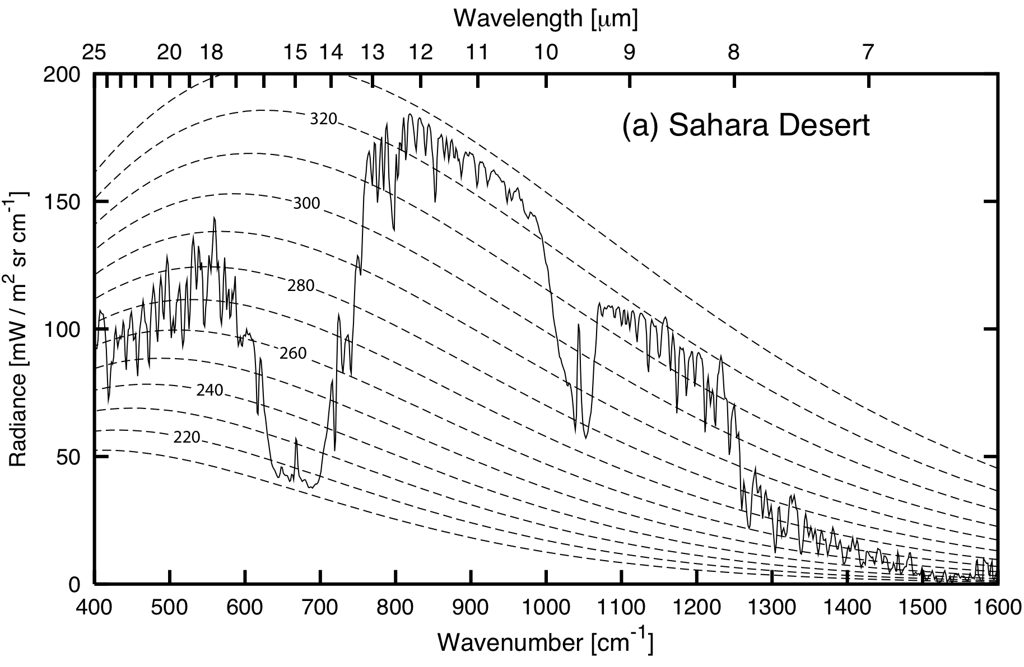
Atmospheric Emission

Slide 220
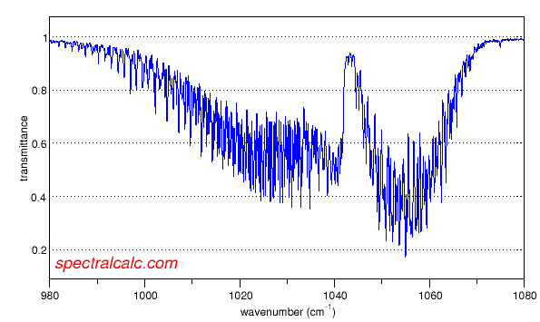
Transmittance spectrum for ozone (O3)
http://www.spectralcalc.com/calc/spectralcalc.php

Slide 221
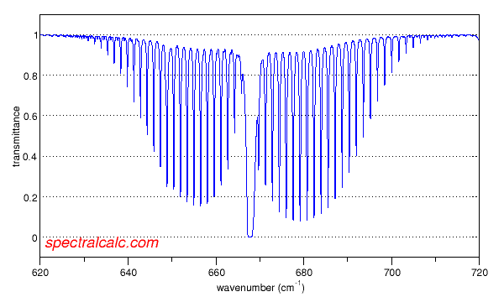
Transmittance spectrum for CO2
http://www.spectralcalc.com/calc/spectralcalc.php

Slide 225
where B = B_{λ}(T)

