Slide 1
AOSC400-2015 October 15, Lecture # 12
Back to Beer Law
Absorption by ozone
Absorption by water vapor
Solving Test Problems
Copyright@2015 University of Maryland This material may not be reproduced or redistributed, in whole or in part, without written permission of Rachel T. Pinker

Slide 2
In Lecture # 9 we have discussed how to account for molecular (Rayleigh)
Scattering in the Beer’s equation:

Slide 4
Rayleigh scatter “mean optical depth” and corresponding direct
beam irradiance as a function of relative air mass

Slide 5
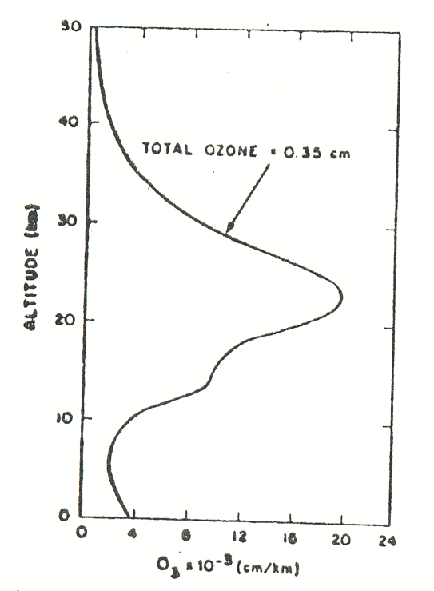
The two remaining issues are ozone and water vapor. Once we know how to accont for these two
it s possible to learn on the effect of aerosols on the extinction of the solar beam.
The ozone in the stratosphere filters about 99% UV from the sun. Figure shows the vertical distribution of ozone.
Total ozone is defined as:
All the ozone in a column of air condensed at standard
temperature and pressure (NTP/STP). It has a thickness
of about 3.5 cm.
Variation of ozone concentration with altitude. This figure represents average conditions at mid-altitudes.

Slide 6
Ozone absorption in the visible and UV
Ozone has 2 absorption bands, one in the visible region
(Chapuis band) and the other in the UV
region (Hartley-Huggins).
Next Figure shows the percent of total solar flux absorbed
as a function of ozone amount in each of these bands.
Because the ozone concentration in the
atmosphere is low (total ozone ~ 3.5cm), therefore, the UV region is used in instruments to measure the
amount of ozone in the atmosphere. In the UV
region, the sensitivity is much higher.

Slide 7
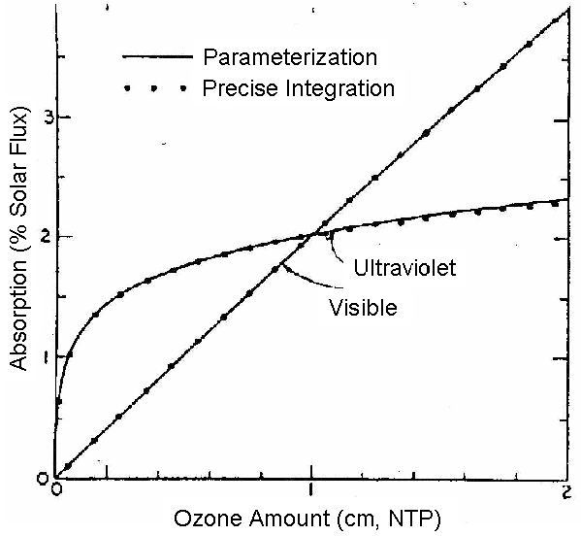

Slide 8
Percent of total solar flux absorbed as a function of ozone absorption coefficients of Howard et al. (1961) . The dotted curves are the results of integrations over wavelength using the wavelengths at which Howard et al. tabulate the absorption coefficient. The parameterization refers to equations from Lacis and Hansen (1974).

Slide 9
Hartley-Huggins ozone absorption band
Hartley bands are the strongest ozone bands in the solar spectrum region due to electronic transitions, and cover the region from 200~300 nm and are centered at 255.3nm.
The solar flux absorption in these bands takes place primarily in the upper stratosphere and in the mesosphere. Huggins bands are weak absorption bands and reside between 300 and 360 nm. The
weaker absorption bands in the visible and near-IR regions (Chappuis bands) are in the spectral intervals from about 440 nm to 1180 nm.

Slide 10
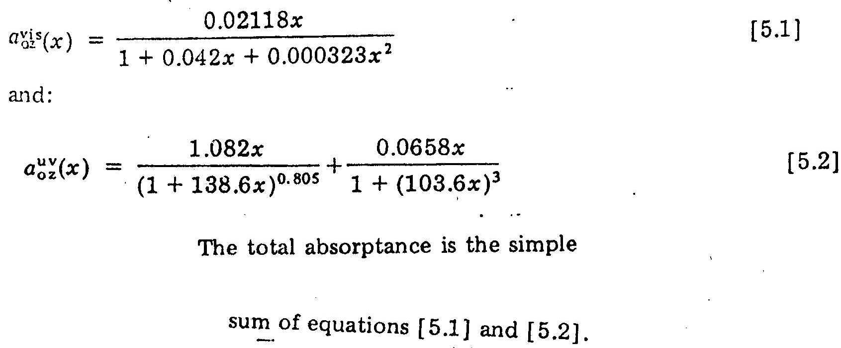
The solid curves of the figure are best-fit relations for absorptions (referred to the complete solar spectrum) as a function of ozone path x in centimeters:
(1)
(2)
Sum of eqs. 1 and 2

Slide 11
What is a Dobson Unit?
The Dobson Unit is the most common unit for measuring ozone concentration. One Dobson Unit is the number of molecules of ozone required to create a layer of pure ozone 0.01 mm at a temperature of 0⁰ C and a pressure of 1 atmos. A column of air with an ozone concentration of 1 Dobson Unit would contain about 2.69x1016 ozone molecules for every square centimeter of area at the base of the column. Over the Earth’s surface, the ozone layer’s average thickness is about 300 Dobson Units or a layer that is 3 millimeters thick.

Slide 12
December 31, 2006
Ozone Hole Watch Web:
http://ozonewatch.gsfc.nasa.gov/
Gives
latest status of the ozone layer over the South Pole.
Satellite instruments that
monitor the ozone layer:
OMI TOMS GOME NOAA SBUV/2 MLS Balloon Sondes

Slide 13
What is the Ozone Hole?
The ozone hole is a region of exceptionally depleted ozone in the stratosphere over the Antarctic that happens at the beginning of Southern Hemisphere Spring (August–October). It results in the destruction of up to 70% of the ozone normally found over Antarctica.
The average concentration of ozone in the atmosphere is about 300 Dobson Units; any area where the concentration drops
below 220 Dobson Units is considered part of the ozone hole.

Slide 14
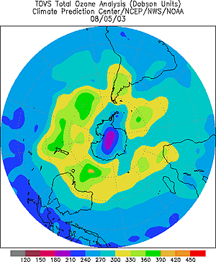
The ozone hole is defined as
the area having less than 220
Dobson units of ozone in the overhead column between ground and space.

Slide 16
Absorption by water vapor
In the visible, we use the unit μm for wavelength; in IR, we use wave number; and in microwave-GH.

Slide 17
Absorption by water vapor

Slide 19
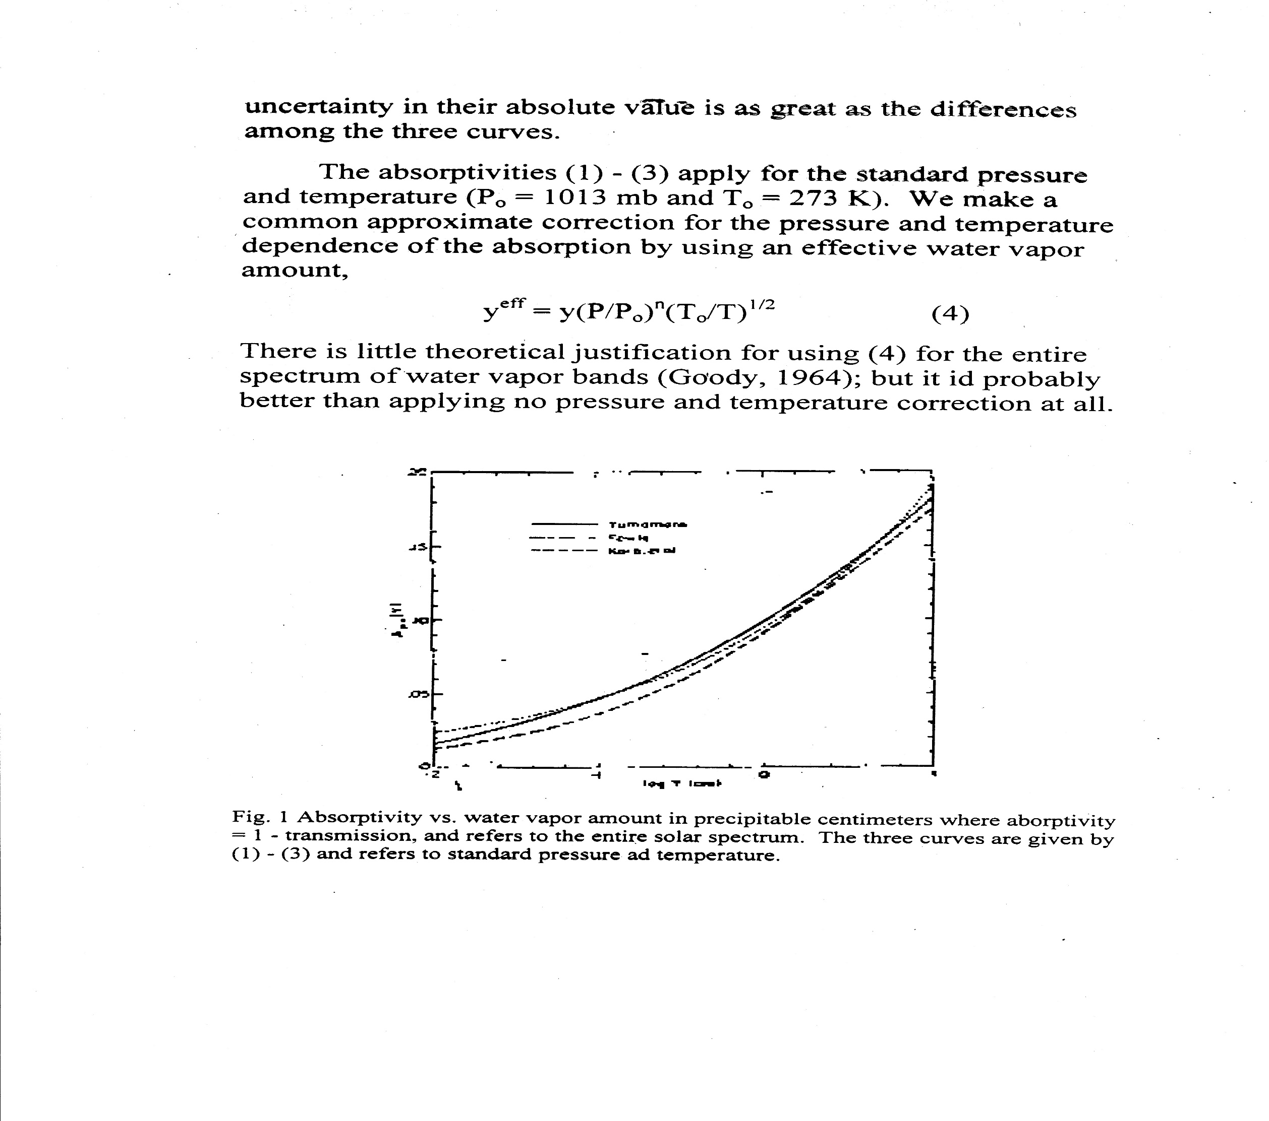

Slide 20
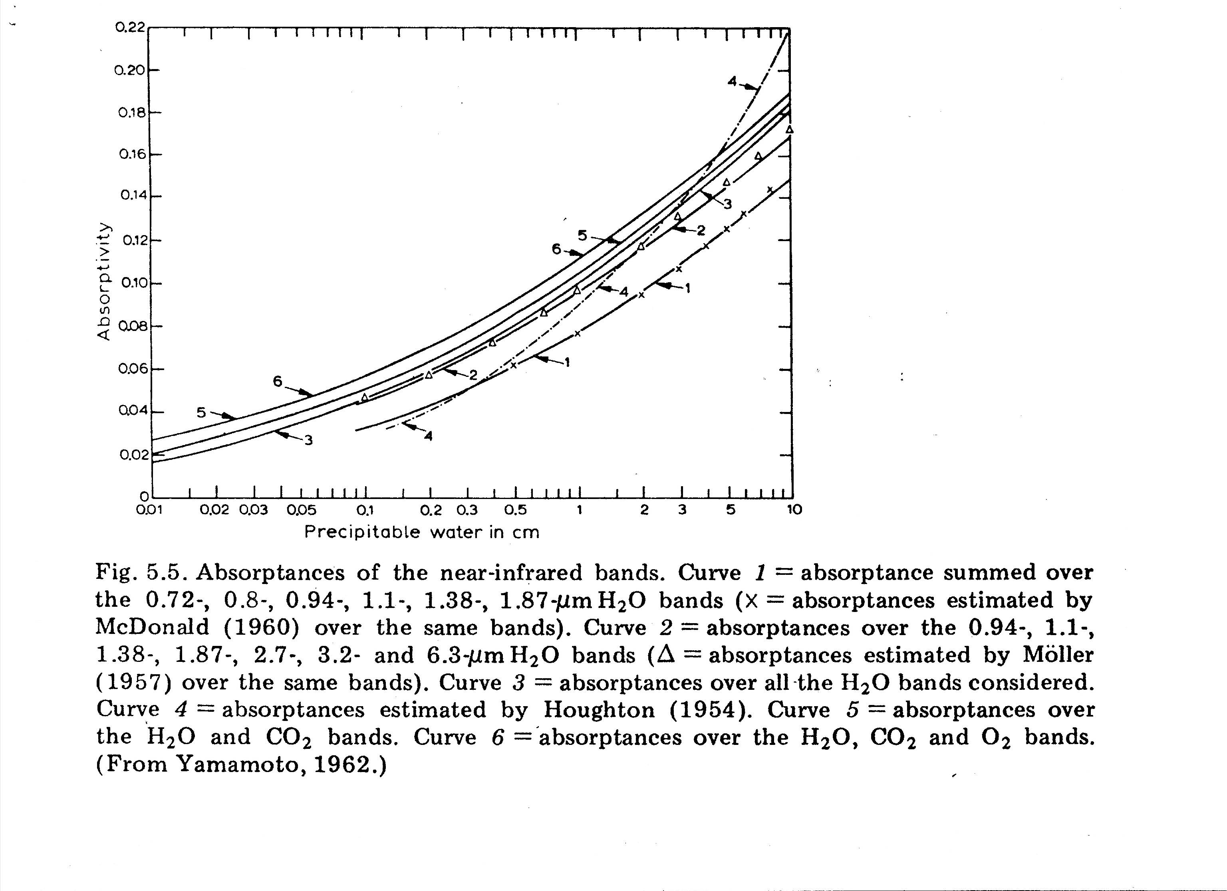

Slide 21
Assuming 3 out of the 4 terms responsible for extinction , namely:
are known, the 4th can be estimated.
where:
τRλ is due to Rayleigh scattering τ_{ozλ} is due to ozone absorption τ_{wvλ} is due to water vapor absorption τ_{Dλ} is due to aerosol extinction

Slide 22
Review of selected Test Questions:

Slide 23
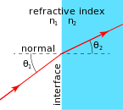
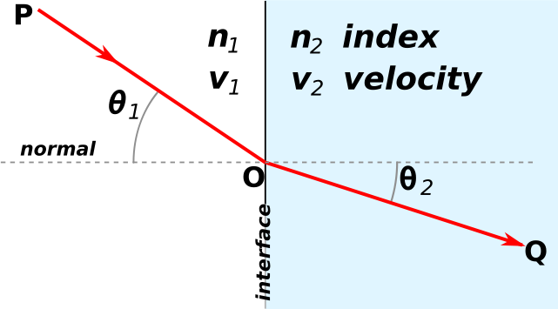
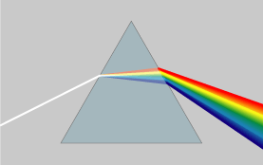
Reminder of what
discussed in class:
Snell's law

Slide 24
Problem # 9:
Calculate the angle of refraction of the ray in figure provided given:
ϑ₁ =50⁰
N_{water} = 1.33
ϑ₁=50⁰
n_{water}=1.33
Assume n₁ air is about 1 and plug in above equation to solve for ϑ₁

Slide 25
Problem # 6 : Compute the air mass for a zenith angle of 30⁰.
As was given in class, in the figure use eq. (5.6.4).

Slide 26
Problem # 8:
Use:
Solar time = standard time + E + 4 ( L_{st} – L _{loc})
Solar time = 10:00+ (-3.14)+4(75⁰-77⁰)
Solar time = 10:00-3.14-8=9:49

