Slide 1
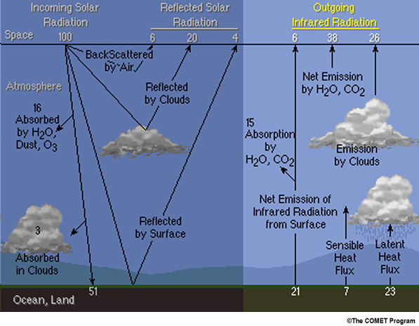
https://www.meted.ucar.edu/asmet/asmet1/print_3.htm

Slide 2
The graphic illustrates what happens to outgoing thermal radiation on a global scale. As earth emitted radiation enters the atmosphere, it is absorbed and re-emitted by clouds and atmospheric constituents. The numbers on the graph provide an estimate of the global mean percentages of those processes.
Summary:
About 70% of the incoming solar radiation is absorbed by the earth surface and atmosphere and re-emitted as thermal radiation primarily in the infrared
Outgoing infrared radiation is attenuated by atmospheric CO₂, H₂O, and O₃
The attenuation varies with wavelength; for example, an infrared window near 11.5 µm sees the earth's surface, but the water vapour channel at 6.7 µm sees only the upper half of the atmosphere
Emission by atmospheric molecules and clouds accounts for most of the outgoing infrared radiation
Sensible and latent heat flux, which vary greatly with location, redistribute 30% of the incoming solar energy

Slide 3
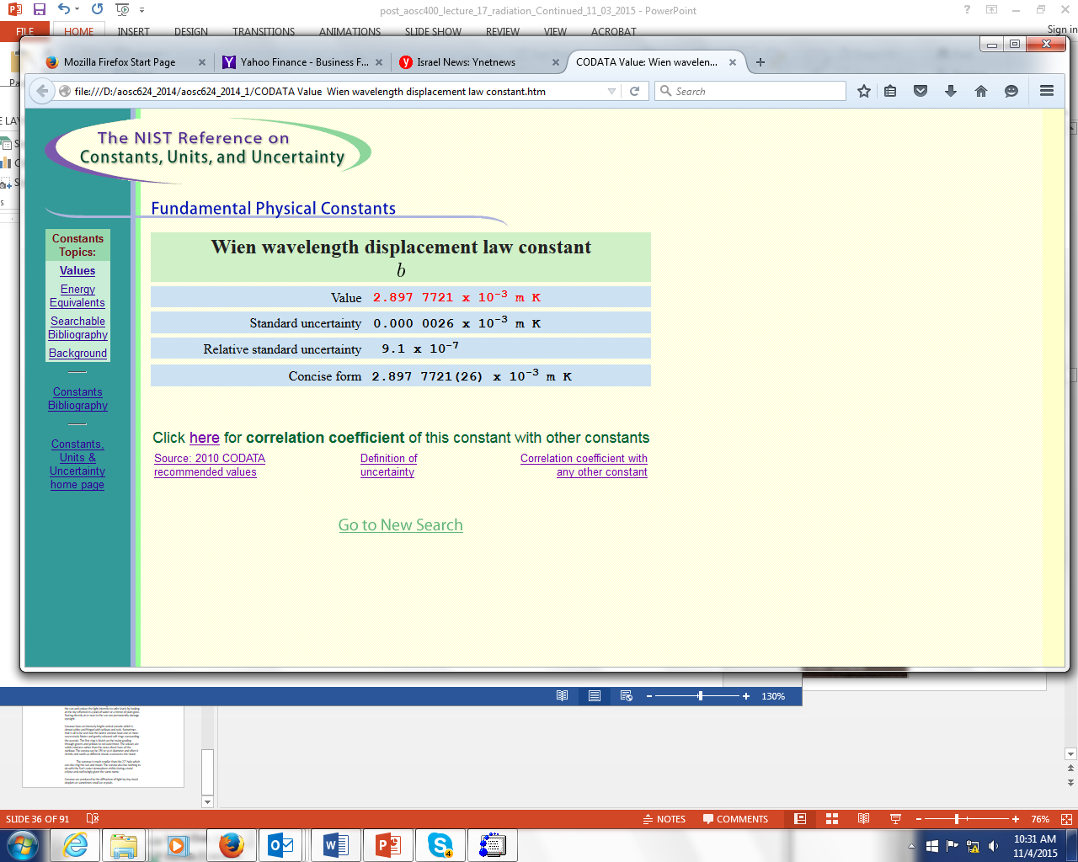

Slide 4
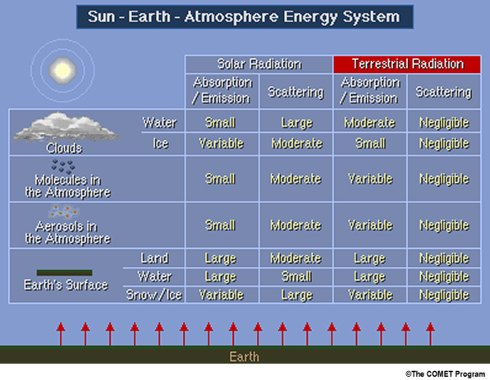

Slide 5
Radiation from the earth’s surface and from layers in the atmosphere is transmitted through the atmosphere to reach the satellite.
Beer's Law describes how energy is transmitted to the satellite from the surface or from a layer in the atmosphere.
The second equation shows the relationship between transmittance, represented by τ, and optical depth, represented by k(λ)u.
Optical depth is a measure of the opaqueness of a given atmospheric layer. The negative exponent means that as the optical depth increases, the transmittance decreases exponentially.
u is proportional to the number of absorbing molecules between the emitting source and the top of the atmosphere and is referred to as the density weighted path length. k is a measure of the efficiency of molecular attenuation at wavelength λ.

Slide 6
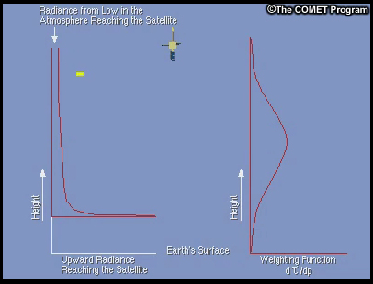
The weighting function for radiation at a given wavelength is shown on the right. It represents contributions from various atmospheric layers to the radiance reaching the top of the atmosphere.
The highlighted yellow area of the graphic on the left shows the contribution from the lowest levels of the atmosphere to the radiance reaching the top of the atmosphere.
As shown in the graphic, there is a substantial amount of energy available in the lower atmosphere, but only a small amount reaches the top of the atmosphere as indicated by the narrow band. This is due to the large optical depth that this radiation passes through.

Slide 7
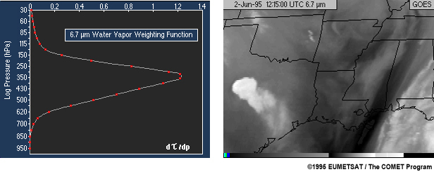
Water Vapour Channel: Weighting Function and Image
The 6.7 µm channel weighting function is given on the left.
A 6.7 µm channel image is given on the right. This channel is very sensitive to water vapour and receives the majority of its radiance from the mid and upper atmosphere.Dark regions are radiance from lower in the atmosphere (dry, warm) and light regions are from higher (moist, cold) or from cloud tops.

Slide 8
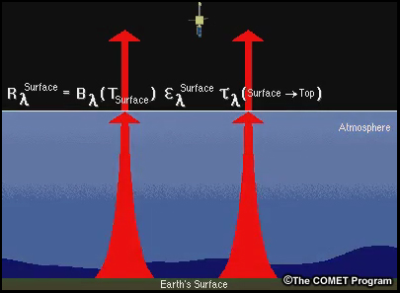
The infrared radiance detected by a satellite is emitted from both the surface of the earth and the atmosphere. The radiance from the surface is given as the product of its black body radiance, the emissivity of the surface at the given wavelength, and the transmittance from the surface to the top of the atmosphere. Most surfaces have a thermal emissivity near one.

Slide 9
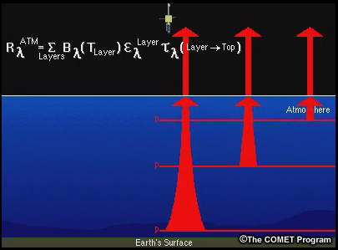
The radiance from an atmospheric layer is given as the product of its blackbody radiance, emissivity, and the transmittance from that layer to the top of the atmosphere. The sum of these layers is the atmospheric contribution at a given wavelength.

Slide 10
Summary
Earth emitted radiance must pass through the atmosphere, which selectively absorbs and emits infrared radiation
Beer's Law describes the radiance attenuation as a function of the absorbing strength and number of molecules between the source (earth and atmosphere) and the sensor (satellite)
Weighting functions indicate the contribution to the outgoing radiance from various layers of the atmosphere
Weighting functions for infrared windows peak at the earth's surface, as they primarily receive radiation from the earth's surface in cloud-free conditions
The radiative transfer equation summarizes the radiance from both the surface and different layers in the atmosphere

Slide 24
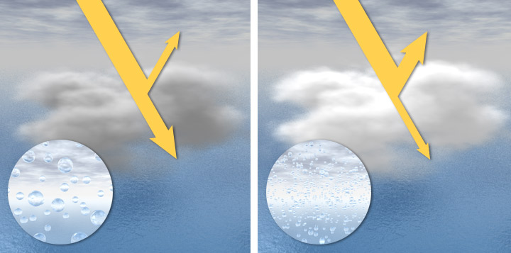
Indirect Effect
Clouds in clean air are composed of a relatively small number of large
droplets (left)-clouds are somewhat dark. When high concentration of aerosols, water can easily condense on the particles, creating a large number of small droplets (right). These clouds are dense, very reflective, and bright white. This influence of aerosols on clouds is called the “indirect effect,” and is a large source of uncertainty in projections of climate change

Slide 25
Brighter clouds, in turn, block sunlight from reaching Earth’s surface, shading the planet and producing net cooling. This cloud brightening effect—called the “cloud albedo effect”—may have a big impact on the climate, though only in recent years has it been possible to start quantifying the effect.

Slide 26
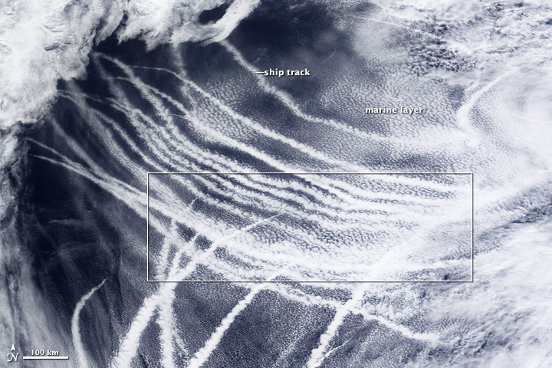
The effect of aerosols on clouds is clearly visible in ship tracks—the dense, bright marine clouds formed by the exhaust of passing ships

Slide 27
Aerosol type plays an important role in determining how aerosols affect clouds. Whereas reflective aerosols tend to brighten clouds and make them last longer, the black carbon from soot can have the opposite effect. Studies of pollution over the Indian Ocean and biomass burning smoke in the Amazon have shown that the black carbon warms the surrounding atmosphere and can cause cloud droplets to evaporate. This process, called the “semi-direct effect,” turns clouds into a smoky haze that suppresses precipitation.

Slide 28
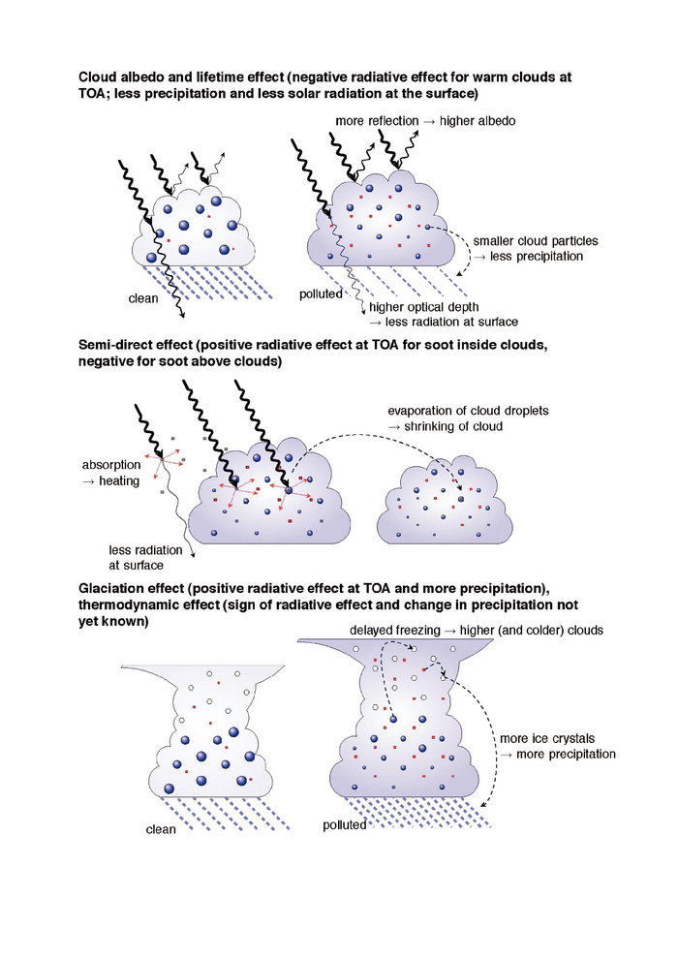

Slide 31
Climate Change 2007: Working Group I: The Physical Science Basis
7.5.2 Indirect Effects of Aerosols on Clouds and Precipitation
Aerosols can interact with clouds and precipitation in many ways, acting either as CCN or as absorbing particles, redistributing solar energy as thermal energy inside cloud layers. These indirect effects can be subdivided into different contributing processes. Cloud feedbacks remain the largest source of uncertainty in climate sensitivity estimates and the relatively poor simulation of boundary layer clouds in the present climate is a reason for some concern. Therefore the results discussed below need to be considered with caution.

Slide 32
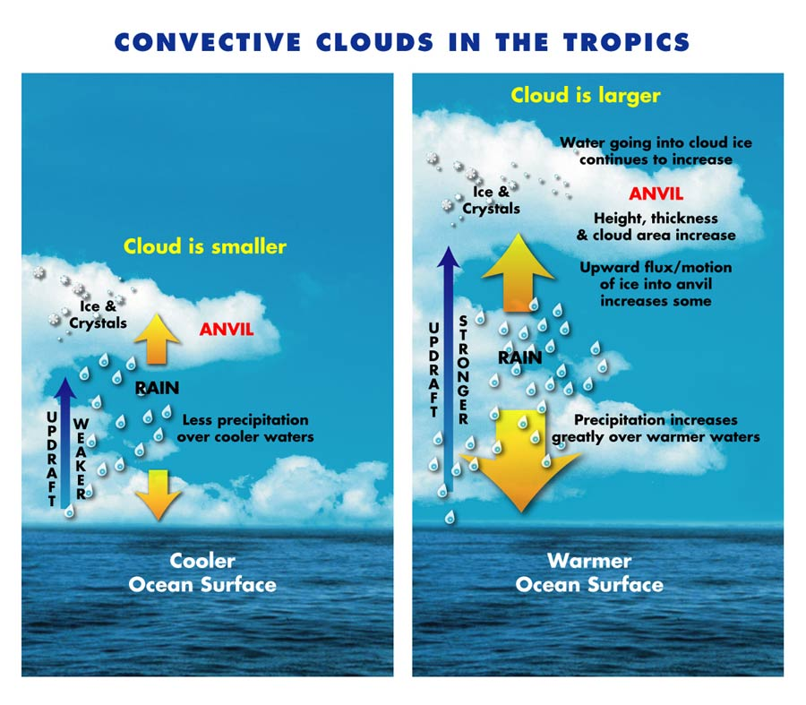
Example of trying to understand the complex nature of clouds

