Slide 1
AOSC624
Class # 5: February 11, 2014
Radiation Laws-longwave
Material Characteristics
Instruments for measuring
radiation
Example: How is albedo measured
Simple Review of extinction processes in the atmosphere

Slide 2
Absorption and Emission of Electromagnetic radiation
A blackbody is an object that absorbs all the electromagnetic energy that falls on the object, for all wavelength, and energy is emitted at all wavelengths.
A perfect blackbody does not exist, but the concept is a useful reference for determining how good a body is at emitting and absorbing radiation.
While an object may visually appear black, it
does not mean it is a blackbody.

Slide 3
Kirchhoff’s Law
If an object absorbs electromagnetic energy of a certain wavelength, it will also emit energy at that wavelength.
Stated more directly as:
A good absorber of radiation is also a good emitter of radiation at that same wavelength.

Slide 4

Emission
Object warmer than absolute zero can emit radiation. An object that emits the maximum possible radiation for its temperature is called a blackbody. Planck’s law gives the amount of blackbody monochromatic (single wavelength or color) radiation flux, called irradiance, :
Where T is absolute temperature and the asterisk indicates blackbody. The two constants are
To good approximation for typical temperature on the earth or sun, Plank’s law can be simplified to be:

Slide 5
The earth also emits radiation called terrestrial or long wave radiation which is less energetic than solar radiation and therefore characterized by longer wavelengths

Slide 6
The Planck curve for emission from the sun (T = 5780 K) has peak emissions in the visible range of wavelengths (0.4 um for violet light through 0.7 um for red light). Radiation from the sun is called solar radiation or short-wave radiation.
The Planck curve for emission from the whole earth—atmosphere system (T = 255 K) has peak emissions in the infrared range of 8 to 18 μm. This radiation is called terrestrial radiation, long-wave radiation, or infrared (IR) radiation.

Slide 7
More laws on radiation-Wien
Temperature of the emitting body affects the wavelength of the maximal radiant energy emitted.
German physicist Wilhelm Wien won the 1911 Nobel Prize in physics for this discovery. Wien’s Law can be summarized as, the hotter an object, the shorter the wavelength of maximum emission of radiation.
Wavelength (µm) of max energy=2900/object temp (K)
λ_{max}~2900/T
NIST value: 2.897 7721 x 10⁻³ m K

Slide 8
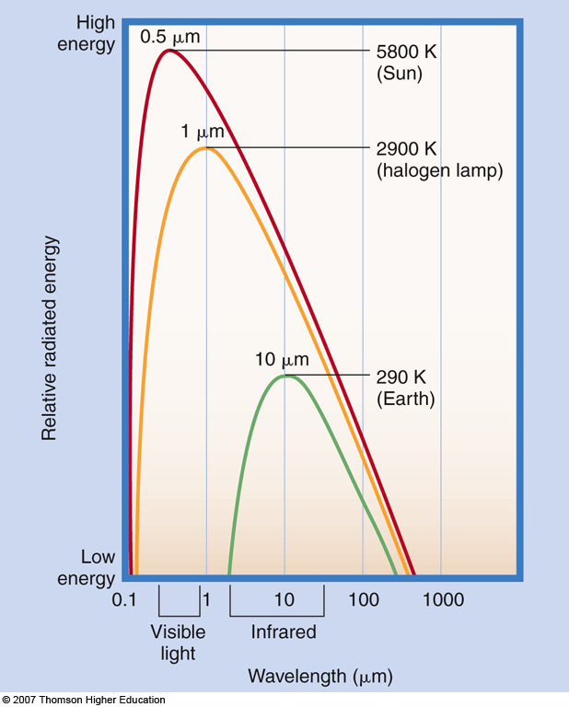
Wien’s Law
λ_{max}=2900/T

Slide 9
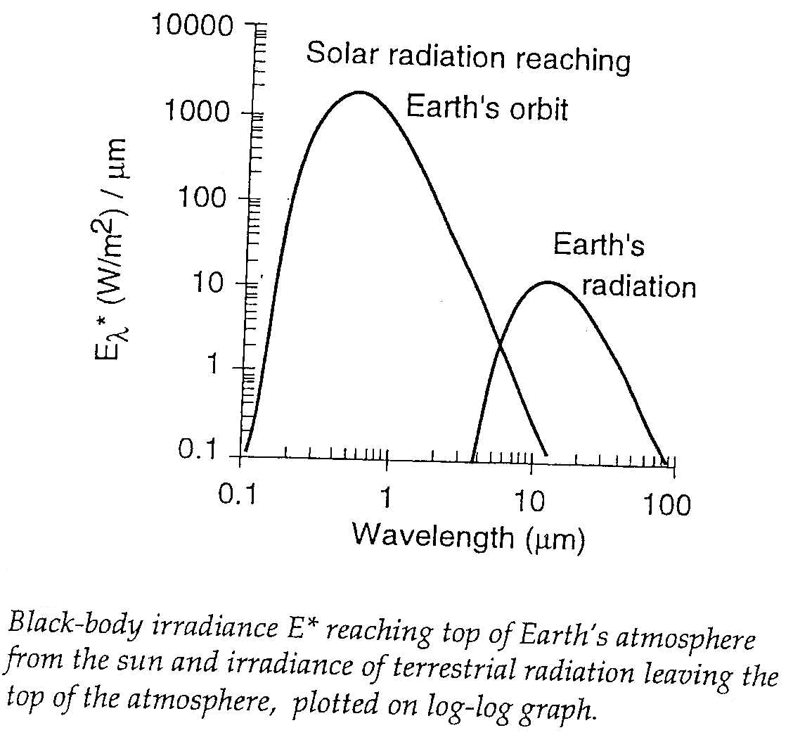
Stefan – Boltzmann law
E=εσT⁴
σ
where
σ is the Stefan-Boltzmann constant, and E* has units of

Slide 10
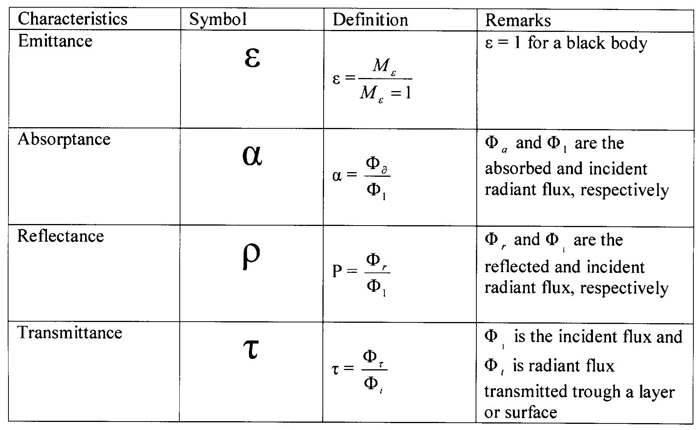
Material characteristics

Slide 11
a) The Planck function, or blackbody radiation curve;
(b) Wien’s law; (c) the Stefan–Boltzmann law

Slide 12
Putting everything together
Stefan-Boltzmann Law states that total energy per square meter per second that is emitted by an object is related to the fourth power of its Kelvin temperature:
E=εσT⁴
From earth emitted:
E=εσT⁴x area of earth

Slide 13
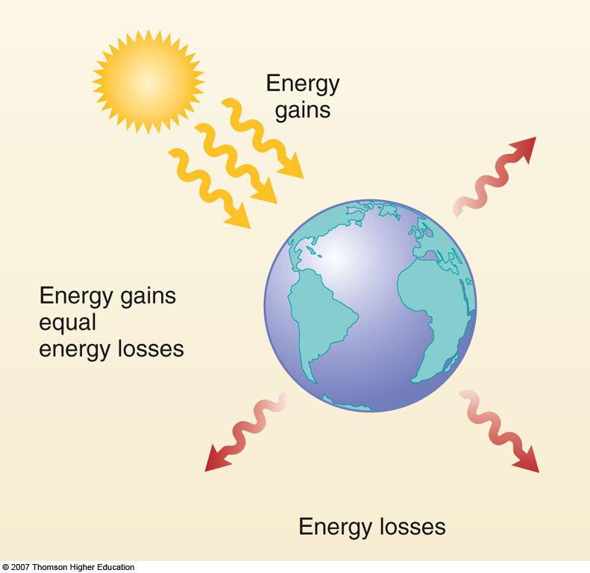
Basic Climate Model
This model yields an average earth temperature
of -18⁰ C ; Actual value is 15⁰ C.

Slide 14
SIMPLE RADIATION AND CLIMATE MODELS
GLOBAL RADIATIVE EQUILIBRIUM MODEL
The simplest climate model for the earth—atmosphere system is to consider the earth and the atmosphere as a whole and to evaluate the global radiative equilibrium temperature from the balance of the incoming solar flux and outgoing thermal infrared flux. Let the global albedo be , the solar constant be S, and the radius of the earth be . Over a long period of time, say one year, there should be a balance between the energy absorbed and emitted so that a radiative equilibrium temperature is maintained. Thus we should have
where represents the cross sectional area of the earth—atmosphere which intercepts the incoming solar flux, and the spherical area denotes emission in all directions. It follows that the equilibrium temperature of the system is
With this simple equation, we may study the effect of changes in the global albedo and/or the solar constant on the equilibrium temperature of the entire system. However, the surface temperature which is a fundamental parameter in climate studies cannot be related to the solar constant nor the global albedo change. The information of the surface temperature has to be related to the transparency and opacity of the atmosphere with respect to solar and thermal infrared radiation, respectively.

Slide 15
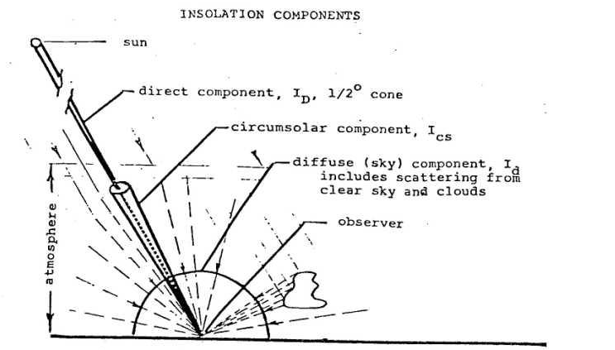
Insolation Components

Slide 16
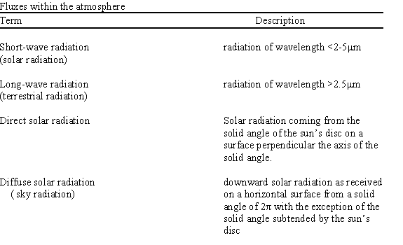
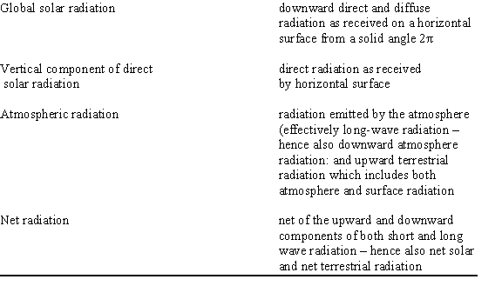

Slide 17
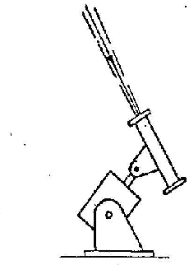
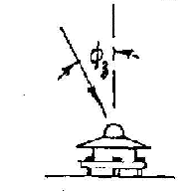
Instruments and their Response
Normal incidence pyrheliometer (NIP) responds to direct and circumsolar components output =
Pyranometer (horizontal mount) responds to direct + circumsolar + diffuse components output =

Slide 18
Measuring The Solar Radiation
Campbell-Stokes sunshine recorder
This type of equipment is the most widely found in traditional meteorological stations.
It distinguishes itself for its reliability, but only measures the number of insolation hours. To determine the solar radiation based on the number of hours of insolation, the Angström method is used.

Slide 19
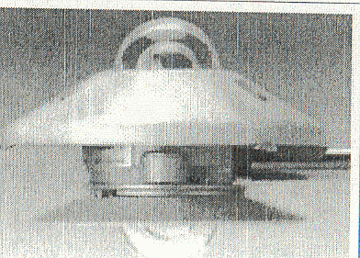
Pyranometer
This is the most widely-used equipment to measure global solar radiation.
There are different types of pyranometers ; the most common those with sensors composed of thermopiles or photovoltaic cells.
The photovoltaic sensors are in general much less precise than the thermopiles due to the fact that the spectral response is not the same in the entire solar radiation spectrum.

Slide 20
Shaded pyranometer
Used to measure diffuse solar radiation.
It needs a shading device so that the sensor cannot “see” the sun, thus allowing, in this way, that the radiation which comes directly from the sun not be measured.

Slide 21
Pyranometer With Shading Disc
More expensive solution for diffuse solar radiation measurement.
Measured data do not require correction, because the disc obstructs only the path of direct radiation.
On the other hand, requires a sun-tracking device, which can be one or two axis.

Slide 22
Pyrheliometer
This equipment is used to measure direct solar radiation. It works in a similar way as to the pyranometer, but a tube only allows that the direct solar radiation reaches the sensor.
Since the position of the sun changes during the day, it is necessary to have a device, which does the sun-tracking, that is, it always needs to be aligned with the sun.
The pyrheliometer is also utilized as a calibration reference of solar radiation sensors.

Slide 23
Angström Compensation Pyrheliometer
First instrument for precise direct solar radiation measurements
(end of XIX century).

Slide 24
Pyrgeometer
Pyrgeometer is used to measure long-wave radiation.
It is utilized with or without shading to block the direct solar radiation.
The protecting dome has
filters to avoid the entrance
of radiation of other
wavelengths.

Slide 25
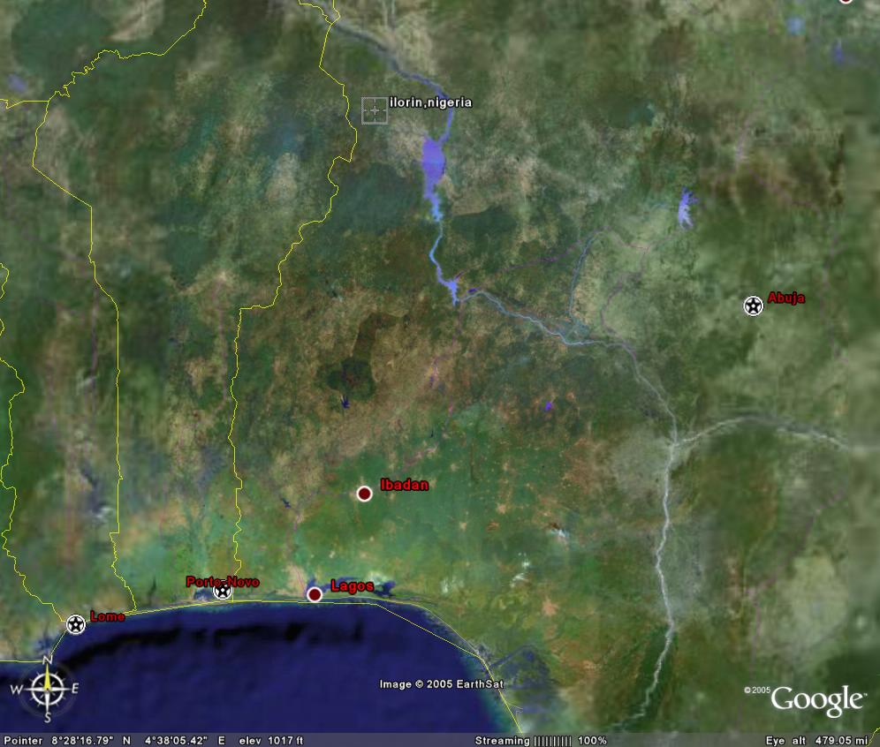
Some Results from observational site at Ilorin, Nigeria, Africa

Slide 26
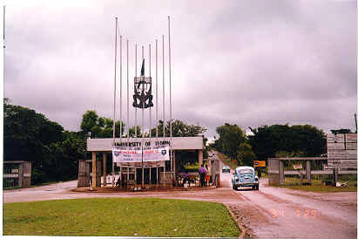
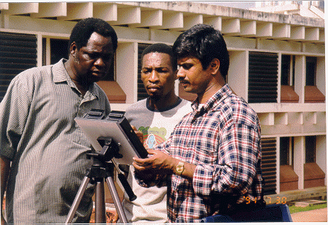
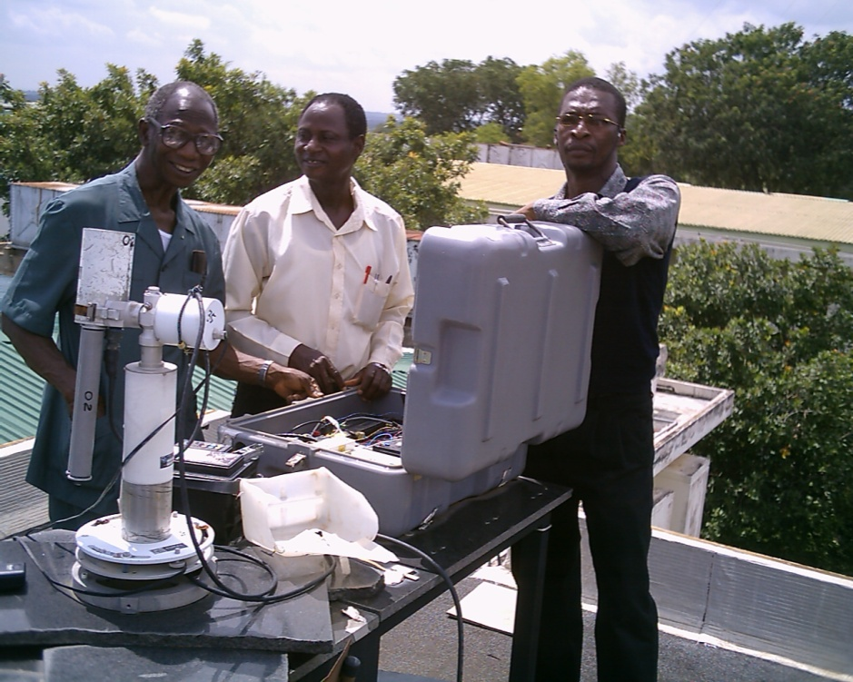
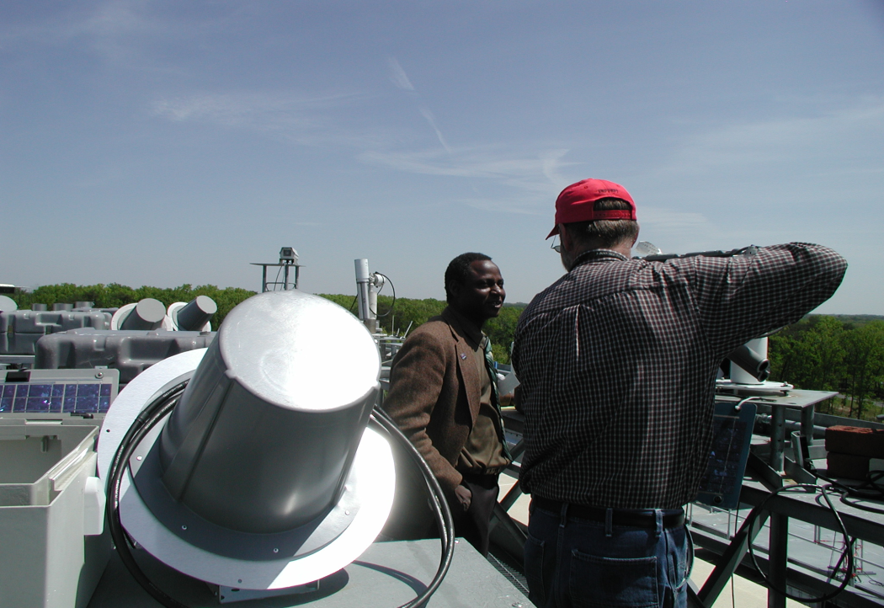
Entrance to the campus of the University of Ilorin

Slide 27
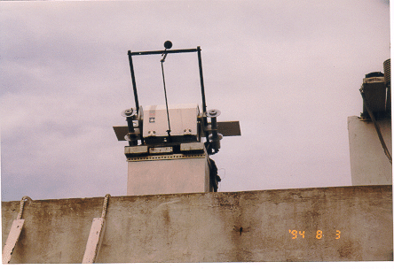
Assess effect of shading on LW
During various observational periods at the site, LW was measured under different shading conditions and showed discontinuities. To investigate the difference introduced by shading, parallel operation of a shaded and an un-shaded pyrgeometer were carried out. A shading disk was used (shown in figure).
Platform holds pyrgeometer and pyranometer to allow shading

Slide 28
LW shaded compared to LW un-shaded, most difference occurs at lower values. As downward LW increases, the shading effect is smaller. Smaller values are usually observed during clear sky conditions.

Slide 29
Albedometer
Albedo is the measurement which quantifies how much the medium (vegetation, buildings, mountains, soil, snow, etc.) reflects solar radiation that falls on it.
A value is calculated by dividing the total solar radiation reflected by the medium by the global solar radiation incident at the location.
To assure a more precise measurement, it is generally installed several meters above the surface.
http://www.youtube.com/watch?v=9UJKVa2ClCU
https://www.youtube.com/watch?v=QgzggbEQ2MY

Slide 30
Extinction in the atmosphere
Three extinction processes take place in the atmosphere:
Absorption
Scattering
Reflection
Special attention to:
Ozone
Water Vapor

Slide 31
Absorption converts energy to heat or photochemical changes. Absorption from ozone, CO₂, oxygen and water vapor is wavelength dependent while the absorption from dust (aerosol) is weakly wavelength dependent.
One of the problems in estimating the amount of absorption is the spatial distribution of absorbers and their temporal variations. For example, water vapor mixing ratio varies vertically. Therefore, some assumptions are made.
Ozone: mainly concentrates in stratosphere
CO2: mixing ratio is fixed.

Slide 32
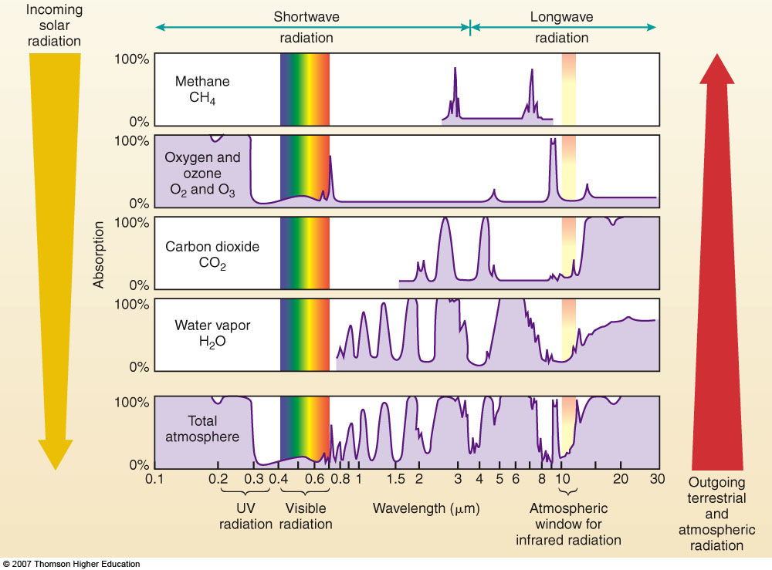
Properties of the atmosphere
Absorbs part of the radiant energy

Slide 33
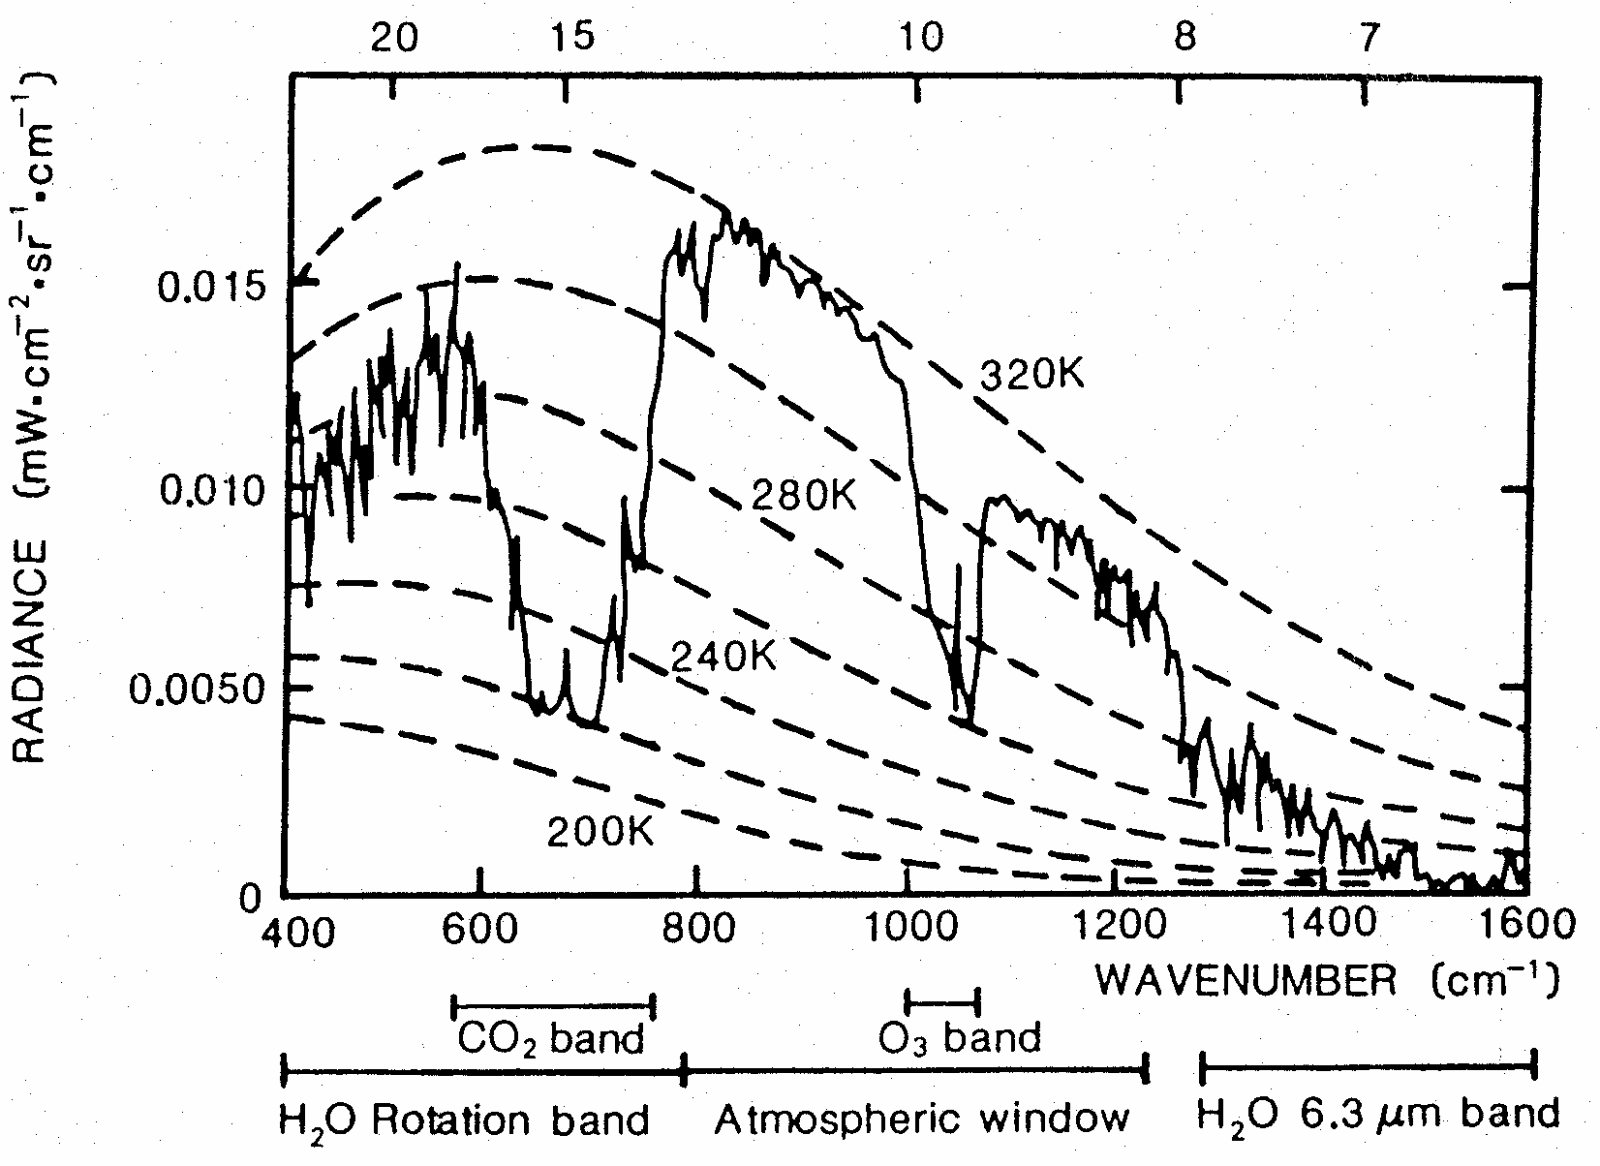
In the visible, we use the unit μm for wavelength; in IR, we use wave number;
and in microwave-GH.

Slide 34
Scattering is the angular redistribution of energy.
Dry air oxygen and nitrogen molecules, water vapor molecules and aerosols (dust, pollen) are some of the scatterers in the atmosphere.
There are 2 scattering mechanisms, the Rayleigh scattering and the Mie scattering, which will be discussed in the later section.

Slide 35
Reflection is the change of direction of wave.
It can be categorized as the specular reflection, bidirectionally specular reflection and diffuse reflection. It is one of the ways to loss information.
Absorption, scattering and reflection can happen at the same time.
Surface albedo generally refers to the total solar spectrum integrated over all angles.
Albedo is used in climate to form surface
energy budgets. For this purpose, the integrated albedo is needed.

Slide 36
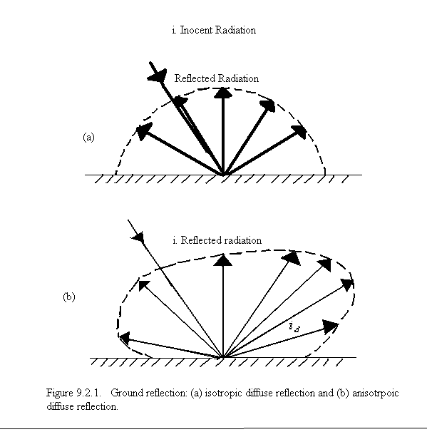

Slide 37
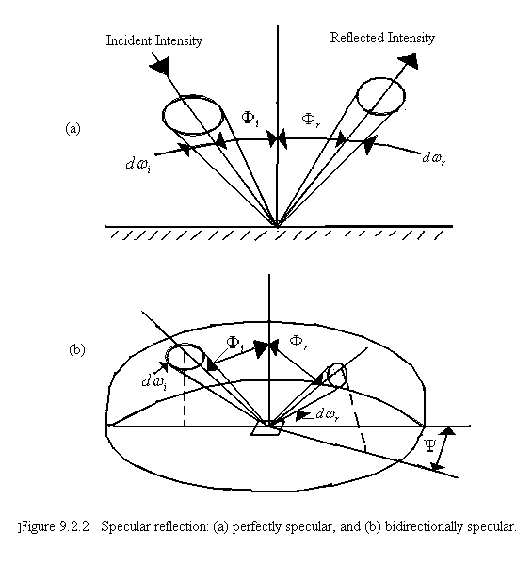

Slide 38
There are numerous sources of absorbers and scatterers:
Atmosphere:
  Stratosphere: Ozone
  Troposphere: CO2, water vapor, dust (aerosol)
Hydrosphere: water vapor, aerosol (sea salt)
Biosphere: CO₂, water vapor, industrial emission CO₂, dust, etc.
Lithosphere: volcanic ash, water vapor, sulphuric acid (can be transported to the stratosphere, therefore, has a long resident time).
Interaction of energy with absorbers and scatterers can influence the atmospheric turbidity and moisture content.

Slide 39
Variation of ozone concentration with geographic altitude. Adapted from Ekerman
This figure represents average conditions at mid-altitudes.

Slide 41
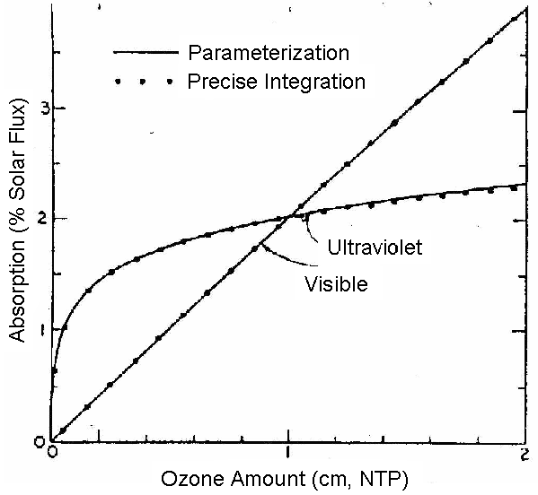
Percent of total solar flux absorbed as a function of ozone absorption coefficients of Howard et al. (1961) at — 44ºC. The dotted curves are the results of integrations over wavelength using the wavelengths at which Howard et al. tabulate the absorption coefficient. the parameterization refers to equations (5.1) and (5.2). (From Lacis and Hansen, 1974)

Slide 42
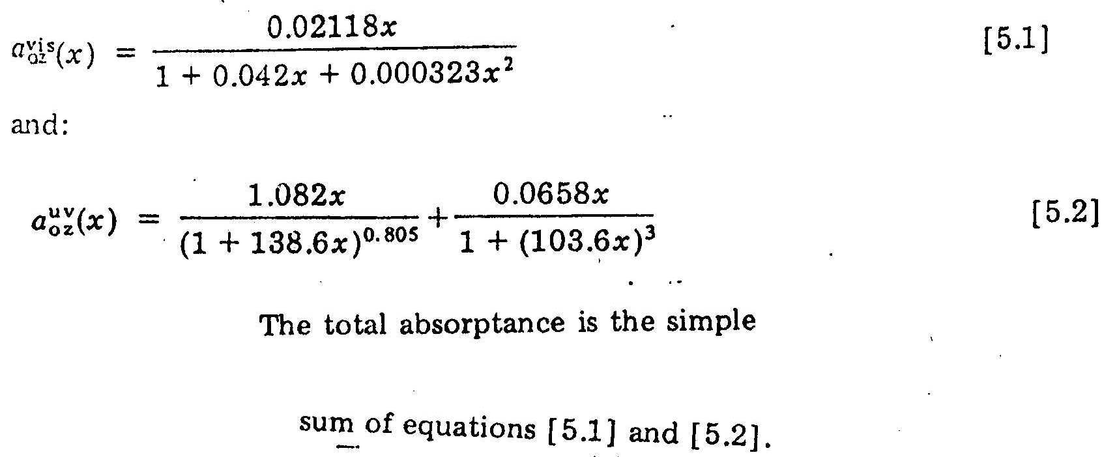
The solid curves of the figure are best-fit relations for absorptions a (referred to the complete solar spectrum) as a function of ozone path x in centimeters:

Slide 43
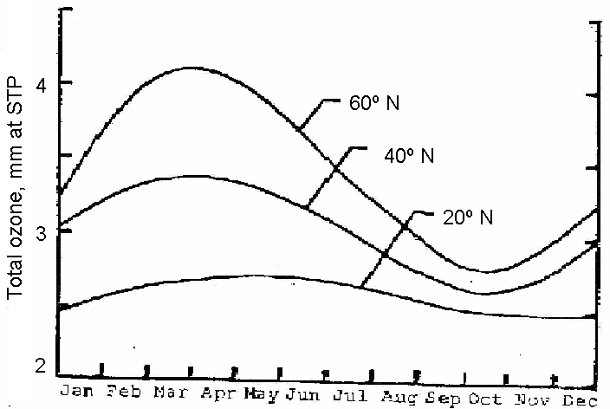
Annual variation of monthly mean atmospheric ozone (based on Godson, 1960); values are in millimeters at standard temperature and pressure.

Slide 44
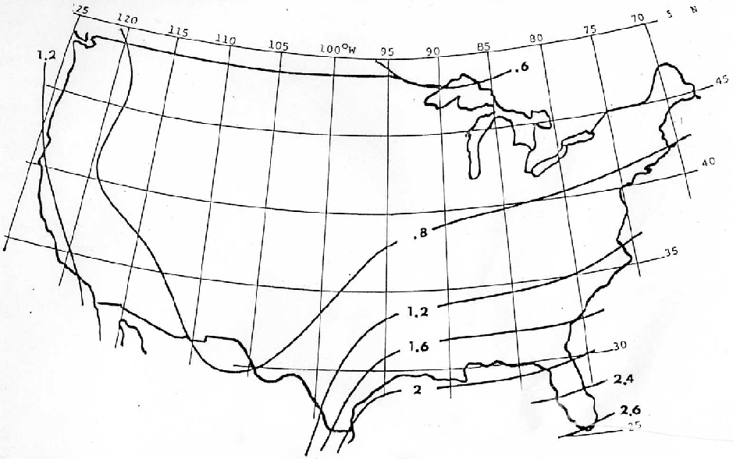
Mean precipitable water over the U.S. in January, centimeters.
Data from Greaves, Spiegler and Spiegler (1971).

Slide 45
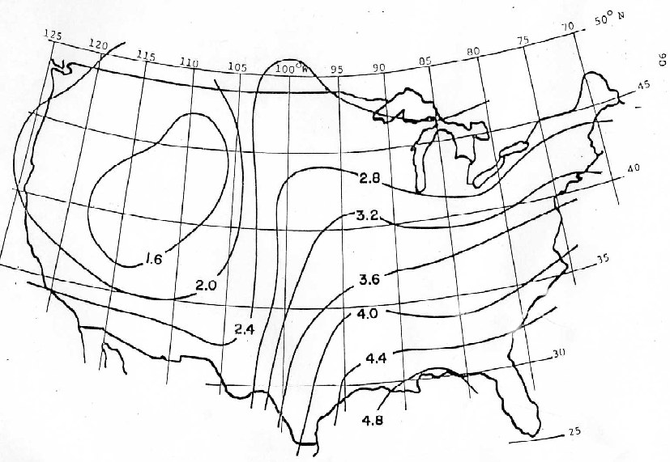
Mean precipitable water over the U.S., in July, centimeters.
Data from Greaves, Spiegler,and Spiegler (1971).

Slide 46
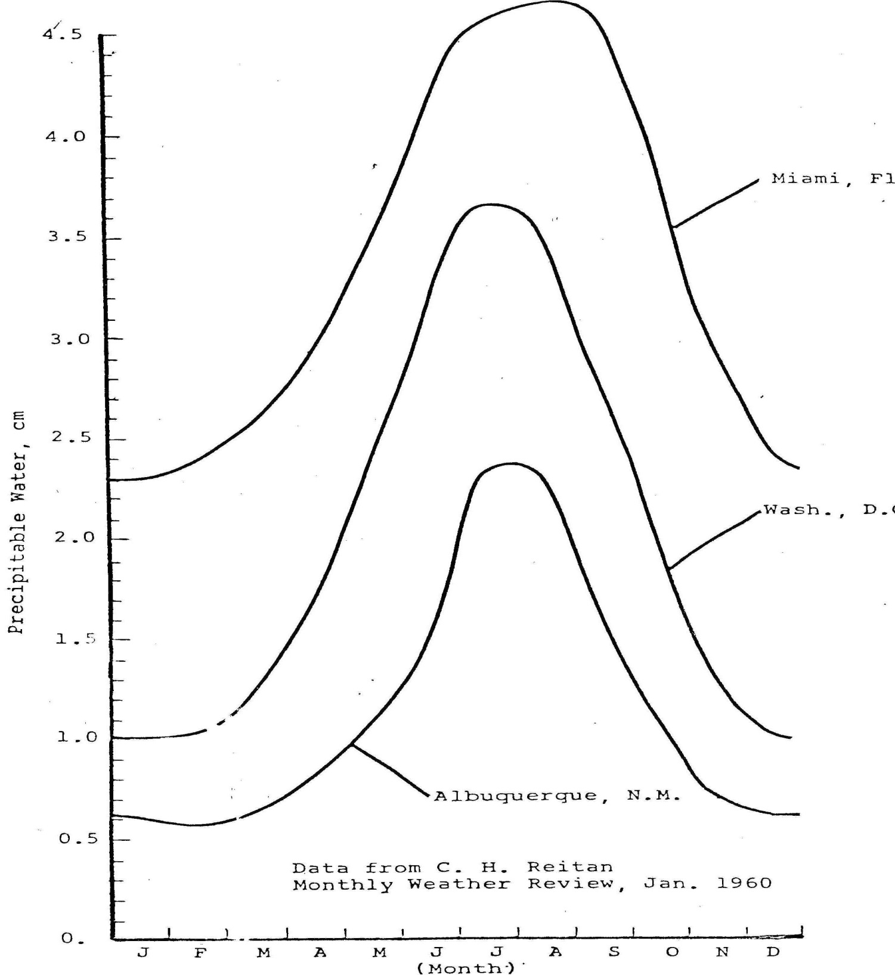
Mean values of precipitable water-

