Slide 1
AOSC624 Class 14: May 1, 2014
Finding Clouds
Cloud detection methods vary according to the satellite system used.
Reviewed will be approaches such as applied to AVHRR observations, to be followed with more recent methods.
Specific methods:
“Golden Arches”
Sounders and Kriebel-AVHRR principles (e.g., threshold, spatial coherence, ratio of NIR bi-directional reflectance to VIS bi-directional , difference between the 11μm and 12 μm brightness temp)
SEVIRI Cloud Detection algorithms
ISCCP Cloud Detection algorithms
Introduction to MODIS

Slide 2
Finding Clouds
Clouds are generally characterized by higher reflectance and lower temperature than the underlying earth surface.
As such, simple visible and infrared window threshold approach offers considerable skill in cloud detection.
There are many surface conditions when this characterization of clouds is inappropriate, most notably over snow and ice.

Slide 3
Some cloud types such as cirrus, low stratus, and roll cumulus are difficult to detect because of insufficient contrast with the surface radiance.
Cloud edges cause further difficulty since the field of view is not always completely cloudy or clear.
Multispectral approaches offer several opportunities for improved cloud detection so that many of these concerns can be mitigated.
Finally, spatial and temporal consistency tests offer confirmation of cloudy or clear sky conditions.

Slide 4
Development of Cloud Detection Methods
Reynolds, D. W. and T. H. Vonder Har, 1977. A bi-spectral method for cloud parameter determination. MWR, 105, 446-.
Coakley, J. A. and F. P. Bretherton, 1982. Cloud cover from High resolution Scanner data: Detecting and allowing for partially filled fields of view. JGR, 87, No. C7, 4917-4932.
Saunders, R. W. and K. T. Kriebel, 1988. An improved method for detecting clear sky and cloudy radiances from AVHRR data. Int. J. Remote sensing, 9, 123-150.
Rossow, W.B., and R.A. Schiffer, 1991: ISCCP Cloud Data Products. Bull. Amer. Met. Soc., 72, 2-20.
Ackerman S. A., Strabala K. I., Menzel W. P., et al., 1998. Discriminating clear sky from clouds with MODIS, J. Geophys. Res-Atmos., 103 (D24), 32141-32157

Slide 5
Coakley, J. A. and F. P. Bretherton, 1982. Cloud cover from High resolution Scanner data: Detecting and allowing for partially filled fields of view. JGR, 87, No. C7, 4917-4932. “Golden Arches” Based on the premise that: 1. over homogeneous cloud cover the spatial variability is small and the mean temperature is low 2. over homogeneous land surface the spatial variability is low and the mean temperature is high

Slide 6
The 11 µm local mean brightness temperature and local standard deviations for 8x8 arrays of GAC* data points for a given scene. The cluster of points near 293 K represents cloud free spots; the cluster near 283.5 K represents cloud covered spots. The points between the clusters represent partially covered field of view.
*GAC –global area coverage

Slide 7
ESTIMATING CLOUD COVER from “Golden Arches” approach
When only one layer is evident, we can estimate the cloud cover A_{c} from the clear sky radiance I_{s}, the cloudy sky radiance I_{c}, and the mean radiance I. For a given region we take the mean radiance to be given by:
In (1) and (2), A_{c} is often referred to as the 'effective' cloud
cover. Provided the clouds do not scatter at the wavelength
of the observations, A_{c} is taken to be the product of the
cloud emissivity and the fraction of the area that is overcast.

Slide 8
The effective cover gives the fraction of area that, based on the observed radiances, would have been covered had the clouds been black. If the clouds are nonblack, A_{c} will, in general, depend on the wavelength of the observed radiances.
When the clouds are black, A_{c} is independent of the wavelength and is the fraction of the area that is overcast.

Slide 9
Threshold methods
Many tests rely on radiance (temperature) thresholds in the infrared and reflectance thresholds in the visible, namely, threshold between background and clouds in certain spectral bands (e.g., cloud tops are much colder than surface). These thresholds vary with surface emissivity, atmospheric moisture, aerosol content, and viewing scan angle.
The total area covered is then determined by counting the scan-spots (fields of view) in which the threshold is exceeded.

Slide 10
Saunders and Kriebel (1988)-Cloud detection from AVHRR
Uses all channels of the AVHRR: 0.58-0.68; 0.72-1.10; 3.55-3.93; 10.3-11.3; and 11.5-12.5 μm*
Five daytime or five nighttime tests applied to each individual pixel to determine whether cloud-free, partly cloudy, or cloud-filled. The pixel is identified as cloud-free or cloud-filled if it passes all the tests to identify that condition; otherwise, assumed to be partly cloudy.
Surface parameters (skin temp, reflectance, NDVI, snow cover) can then be inferred from the cloud-free radiances.
Cloud parameters can be inferred (cloud top temp, optical depth, liquid water content) from cloud-filled radiances.
* Note: small changes in AVHRR channels with time (next slide).

Slide 12
TEST 1
Infrared threshold test applied to both day and night. Uses 12 μm brightness temperature as a check on cloud contamination.
If measured brightness temperature is below a certain threshold, pixel is rejected as cloud-contaminated. A built-in climatology tells what temperatures to expect for the location, time, and season.

Slide 13
TEST 2
Spatial coherence test applied on a 3x3-pixel array of 11μm brightness temperature. Horizontal temp variations over cloud-free land can be large, so during the day it is only applied over the sea.
Surface temperature variability over land is less at night, making a spatial coherence test possible, but with an increased standard deviation threshold.

Slide 14
TEST 3
Dynamic reflectance threshold test, identifies a cloud free reflectance peak and then sets a threshold value. All pixels with reflectance above this threshold are assumed to be cloud-contaminated. The test removes uncertainties due to variations in calibration and changes in surface reflectance with solar zenith/azimuth angles, etc. If a fixed reflectance threshold is applied these variations will mean that it is often too high or too low.

Slide 15
TEST 4
Used during the day, makes use of the ratio (Q) of NIR bi-directional reflectance to VIS bi-directional reflectance (Q=R₂/R₁)
Q ~ 1 over clouds
Reflectance of clouds decreases slightly at NIR and anisotropy effects are similar in both channels, and therefore, cancel.
Q ~ .5 over cloud-free water
Enhanced back-scattering at VIS wavelength due to molecular and aerosol scattering causes the visible reflectance to be often twice that of NIR
Q > 1 always over land
Over land, reflectance increases markedly at NIR compared to VIS; even over desert or in winter, reflectance is higher at NIR.

Slide 16
TEST 5
Examines difference between the 11μm and
12 μm brightness temps.
A pixel must pass all of the tests above to be assigned cloud-free.
Detection of cloud-contaminated pixel at night is similar, but all needs are solar reflectance are replaced by brightness temp differences between IR channels 3, 4, and 5.

Slide 17
Summary:
Based on five tests, i.e., the visible brightness threshold test for channel 1, the brightness temperature threshold test for channel 4, the reflectance ratio test of channels 2 and 1, the brightness temperature difference test of channels 4 and 5, and the spatial uniformity test (over ocean only). If one of the tests indicates a cloud, the pixel is considered as cloud contaminated. Only if no one of the tests indicates ‘no cloud’, the pixel is defined as cloud free.

Slide 18
Examples of Recent Algorithms:
Cloud Detection for MSG - Algorithm Theoretical Basis Document (ATBD)
The current generation of geostationary Meteosat (Meteosat Second Generation - MSG) has 12 channels with a horizontal resolution of 3 km at the sub-satellite point and an image repeat cycle of 15 minutes. The cloud-processing task within that prototype algorithm is split into two separate tasks - the cloud detection (called scenes analysis (SCE)) and the cloud analysis (CLA). The scenes analysis derives a cloud mask (cloud/no cloud decision) on pixel basis, while the cloud analysis derives detailed information on the cloud type. Here only the cloud detection algorithm is described

Slide 19
SEVIRI Channels
Channel Central wavelength (μm) Spectral band (μm)
VIS 0.6 0.635 0.56 - 0.71
VIS 0.8 0.81 0.74 - 0.88
IR 1.6 1.64 1.50 - 1.78
IR 3.9 3.92 3.48 - 4.36
IR 8.7 8.70 8.30 - 9.10
IR 10.8 10.8 9.80 - 11.80
IR 12.0 12.0 11.00 - 13.00
WV 6.2 6.25 5.35 - 7.15
WV 7.3 7.35 6.85 - 7.85
IR 9.7 9.66 9.38 - 9.94
IR 13.4 13.40 12.40 - 14.40
HRV 0.75 Broadband visible

Slide 20
The work on the improved EUMETSAT cloud detection (SCE) scheme takes advantage of the experience of the different algorithms used to detect and characterize clouds from other satellite systems. These cloud-processing schemes have been developed to process AVHRR data (five channels, 1-km resolution at sub-satellite point) and have also been adapted to MSG SEVIRI. In many processing centers the cloud detection schemes for MSG SEVIRI are already working fully operational, e.g. at the nowcasting Satellite Application Facility SAFNWC (Derrien and Le Gléau, 2005) and at EUMETSAT (Lutz, 1999).

Slide 21
From the 12 channels, only channels IR9.7 and HRV are not included in the cloud detection and the analysis. For the HRV channel this is due to the different scanning patterns and on-ground resolutions of HRV compared to the other 11 channels. Channel IR9.7 is sensitive to stratospheric and tropospheric ozone and to the temperature of the underlying surface and thus provides no further information compared to a window channel as e.g. IR10.8.

Slide 22
The cloud detection algorithm “Scenes Analysis” is the basic pre-processing module, which provides the information on whether a pixel is clear or cloud contaminated for the majority of the follow-on processes, e.g. cloud analysis, atmospheric motion vectors, calibration, clear sky radiances etc. Each of these processes will need an estimate for the confidence in the results of Scenes Analysis, e.g. for calibration and clear sky radiances the confidence for clear pixels has to be 100%.

Slide 23
The Scenes Analysis algorithm is based on threshold techniques (e.g. Saunders and Kriebel, 1988), i.e., spectral measurements of a particular scene are compared against the predicted clear sky reference value.
Based on the outcome of this comparison, the scene is classified. For MSG the following groups of threshold tests have been defined:

Slide 24
Group 1: reflectance tests using the solar channels
Group 2: reflectance difference tests (using all combinations of the solar channels)
Group 3: temperature tests using the IR window channels
Group 4: temperature difference tests (using all combinations of channels 10.8 μm and 12.0μm with all other IR/WV channels)
Group 5: standard deviation tests for the window channels on a moving 3 x 3 pixel target
Group 6: snow and ice test
Group 7: tests foreseen in future, e.g. dust storm test, volcanic ash cloud test

Slide 25
In total 34 tests are defined. The threshold tests themselves can be enabled/disabled with a pre-defined set of parameters depending on the availability of channels, the pixel location (land/sea), the viewing geometry / solar zenith angle (day/night/twilight and sun-glint).
However, only the most powerful tests will be selected and the other tests remain as backup tests.

Slide 26
This configuration secures a continuous operation of the Scenes Analysis, since in the case of a failure of a channel, all tests using this channel will be disabled and backup tests with similar capabilities will be enabled.
It also provides a maximum of flexibility of the algorithm, i.e. it can be used with other input data, e.g. MODIS, AVHRR and GOES (imager and sounder) data.

Slide 27
The threshold tests are independently applied, i.e., if a test has detected a cloud the processing will still continue to perform all other tests. The information, which of the tests detected a cloud, is stored in the threshold test flag. These features are used to define the level of confidence of the cloud/no cloud decision. The tests are configured in a way that there is a high confidence for clear pixels if none of the tests detected a cloud.
In addition the Scenes Analysis takes advantage of the geostationary satellite data by using the information of the image data and scenes analysis of the previous repeat cycle. For selected channels the difference of the measurements between the current and the previous repeat cycle are built to verify whether the information content has changed or not. If there are no changes detected for a pixel, the results of the previous repeat cycle are used. Otherwise the Scenes Analysis continues its nominal processing. For the IR channels, the measurements of the previous repeat cycle are also used as a predictor for the current repeat cycle.

Slide 28
International Satellite Cloud Climatology Project (ISCCP) NEW ALGORITHM: SUMMARY OF CHANGES
(Highlights of differences between the C-series and D-series cloud products)

Slide 29
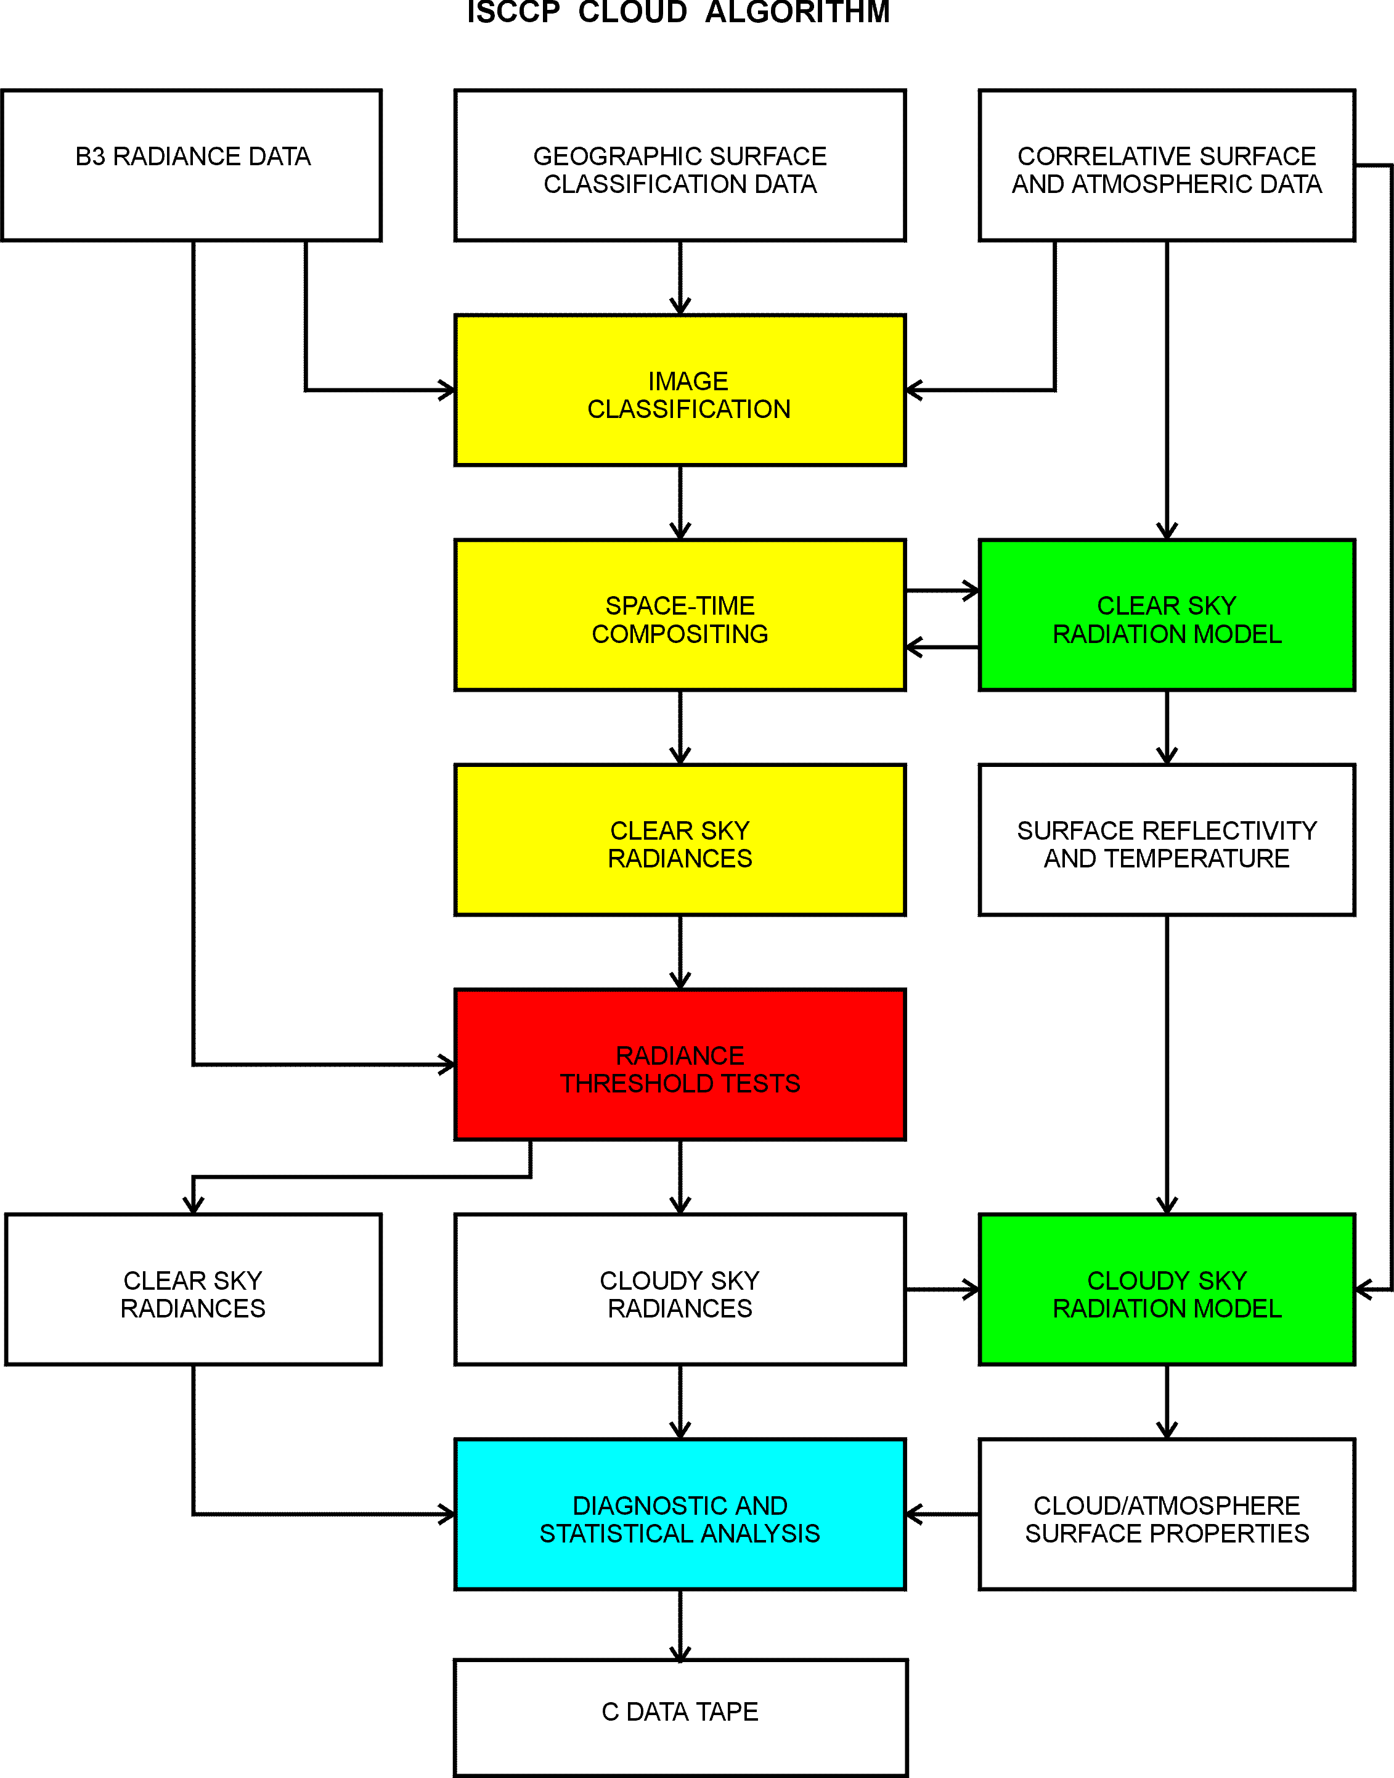
Description of Old Algorithm

Slide 30
Cloud Detection
The ISCCP cloud detection procedure is applied to each month of satellite data at eight times of day and consists of five steps:
space contrast test (applied to individual IR images)
time contrast test (three consecutive IR images at constant diurnal phase)
cummulation of space/time statistics (both IR and VIS images)
construction of “clear-sky composites” for both IR and VIS (once about every 5 days at each diurnal phase and location)
radiance threshold (both IR and VIS images)

Slide 31
The first test classifies as cloudy all pixels that are much colder (low IR radiance) than the warmest value in small spatial domains. It is a spatial contrast test because the warmest pixel is not classified as either clear or cloudy. The second test classifies as cloudy all pixels that have sharply lower IR radiances at the same location as compared with values one day earlier or later and classifies as clear all pixels that show little variation of IR radiance over one-day intervals. To avoid confusion with diurnal variations of surface temperatures, this test is done separately for each time of day. The results of these two tests are combined to label image pixels as clear only when they exhibit low variability in both space and time. The third step collects statistics on the variations of the IR and VIS radiances over larger spatial and temporal domains. These statistics are used in the fourth step, along with the results of the first two tests (number of clear pixels and average clear radiance), to estimate values of clear IR and VIS radiances for each location and diurnal phase, once every 5 days. In the final step, the original IR and VIS radiances in each pixel at each time are compared with the inferred clear values. If the observed radiances differ from the clear-sky values (lower IR or higher VIS) by more than the estimated uncertainty of the clear-sky values, they are classified as cloudy. A subset of these pixels, with radiance values close to the values dividing clear from cloudy, are referred to as marginally cloudy. All other pixels are classified as clear.

Slide 32
Radiative Analysis in ISCCP
Once each pixel is classified as clear or cloudy, the measured radiances can be compared to radiative transfer model calculations that include the effects of the atmosphere, surface and clouds. The attributes of the atmosphere, surface and clouds are represented in the model by a large number of physical properties; but the availability of correlative datasets and restriction of the satellite radiances to two wavelengths limit the number of parameters that can be determined from the observations. The analysis strategy used exploits the correlative data to isolate the cloud effects and attributes all remaining radiance variation to changes in two cloud properties; other parameters are assigned climatological average values.

Slide 33
For VIS (0.6 microns) and IR (11 microns) wavelengths, atmospheric effects are small and depend on ozone and water abundances, the temperature profile and aerosol optical thickness. Complete information on ozone, water, and temperature can be obtained from correlative data. Since little information is available concerning aerosol properties, their effects are neglected; however, since most aerosol occurs near the surface and affects the upwelling radiation from there, use of surface properties obtained from clear radiances with the same radiative model effectively incorporates the primary aerosol effects into these surface properties.

Slide 34
The two surface properties retrieved from clear radiance values are the "visible" reflectance and the "brightness" temperature. The visible reflectance represents the amount of sunlight reflected by the surface at 0.6 microns and at a particular sun and satellite geometry (the view/illumination geometry is recorded in the data). Since most surfaces reflect sunlight anisotropically, the reflectance varies with satellite position, time of day, and season.

Slide 35
The temperature values correctly describe the IR radiances at the surface but are not equal to the actual physical temperature since most surfaces have IR emissivities slightly less than one.
Little information exists concerning emmissivities for land and vegetated surfaces, so all temperatures are retrieved assuming an emissivity of one.

Slide 36
Clouds are represented in the model as a single, thin (i.e., isothermal) layer, uniformly covering the image pixel and composed of water droplets with a specified average size (10 microns) and size distribution. All variations of cloudy radiances are attributed to changes in "visible" optical thickness (defined at 0.6 microns) and a temperature.

Slide 37
The optical thickness parameter determines the amount and angular distribution of sunlight reflected by the cloud layer (the full effects of multiple scattering are included), and the temperature is a "brightness" temperature, like that for the surface, that is interpreted to represent the physical temperature at the top of an opaque cloud layer.

Slide 38
At night when only IR radiances are measured, no cloud optical thickness is reported and IR variations are associated with the cloud top "brightness" temperature.
During the day, the cloud optical thickness value is related to an IR optical thickness in the model to correct for cloud emissivities less than one; both the original (opaque cloud value) and corrected cloud top temperatures are reported.

Slide 39
Other cloud properties may vary, including particle size, phase (water or ice), and size distribution. Moreover, vertical (sub-pixel-sized) and horizontal inhomogeneities such as multiple layering or small scale "brokenness", can affect the radiances. If the role of these other cloud properties can be formulated and their value measured, then the retrieved optical thickness and temperature parameters in the ISCCP data set can be corrected by comparing the radiative model radiances calculated with and without the variation of these additional parameters to produce a transformation from one model to the other.

Slide 40
Statistics of ISCCP
The basic detection and radiative analysis is performed for each image pixel . However, the cloud climatology data need to be reduced to a more manageable volume. This reduction requires that the spatial distribution of the pixel values be summarized in the Stage C1 data. This is done by projecting the pixel data into a standard map grid (resolution about 280 km) and calculating the average values of cloud and surface properties, as well as their standard deviations.

Slide 41
To maintain approximately equal statistical significance, the map grid is an equal-area grid. In addition, the explicit distributions of cloud optical thicknesses and top pressures (obtained from the top temperature and the atmospheric temperature profile) are reported. All of these statistics are first collected for each satellite separately.

Slide 42
The final C1 data sets (one for each 3-h interval in a month) are assembled by "merging" the results from all the satellites. To preserve the statistical character and uniformity of the C1 results, "merging" is done by selection; i.e., only one result is reported for each map grid cell and any other results are discarded. The choice between satellites is made on the basis of two criteria: 1) a strong preference for time records produced from a single satellite and 2) limiting the satellite zenith angle (which also affects the number of pixels available). At low latitudes, the data reported generally come from the nearest geostationary satellite; if the primary data are missing then they are replaced by an adjacent geostationary satellite (if the zenith angle is not too large) or a polar-orbiter (if available at that time). In the polar regions, coverage is provided solely by the polar-orbiters, with the "afternoon" satellite preferred if two are available.
For a more detailed technical discussion, see:
Rossow, W.B., A.W. Walker, and L.C. Garder, 1993: Comparison of ISCCP and Other Cloud Amounts. J. Clim., 6, 2394-2418.

Slide 43
Updates on ISCCP
Radiance Calibrations
Revised VIS and IR calibrations to eliminate spurious changes between different reference polar orbiters (Brest et al. 1996)
Revised normalizations of geostationary satellite calibrations to eliminate occasional short-term deviations (Brest et al. 1996)
Cloud Detection
Improved cirrus detection over land by lowering IR threshold from 6 K to 4 K
Improved polar cloud detection over ice and snow surfaces by lowering VIS threshold from 0.12 to 0.06 and by using threshold test on 3.7 micron radiances
Improved detection of low clouds at high latitudes by changing to VIS reflectance threshold test.

Slide 44
Radiative Model used in ISCCP
Improved treatment of cold (top temperature < 260 K) clouds by using ice poly-crystal scattering phase function to retrieve optical thickness and top temperature.
Improved retrieval of cloud optical thicknesses over ice and snow surfaces using 3.7 micron radiances
Improved retrieval of cloud top temperatures by including effects of IR scattering
Improved retrieval of surface and cloud top temperatures by adopting new treatment of water vapor continuum absorption in IR.

Slide 45
Gridded Product Contents of ISCCP
Better resolved variations of optically thicker clouds by adding 6th optical thickness category
Added correct cloud water path parameter
Reported actual average values of cloud top temperature, pressure, optical thickness and water path for each of nine cloud types defined by cloud top pressure and optical thickness in the 3-hourly dataset
Reported separate cloud properties for liquid and ice forms of low and middle-level clouds
Provided conversion of cloud top pressures to cloud top heights above mean sea level based on atmospheric temperature profile
Added cloud amount frequency distribution to monthly dataset .

Slide 46
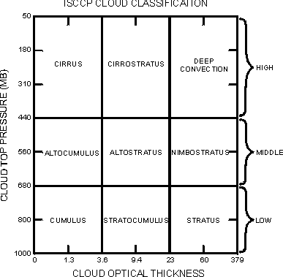
Added cloud amount frequency distribution to monthly dataset

Slide 47
In Summary:
The ISCCP algorithm uses a spatial contrast test on a single infrared image; a temporal contrast test on three consecutive infrared images at constant diurnal phase; the accumulation of space/time statistics for infrared and visible images; the construction of clear-sky composites for infrared and visible every 5 days at each diurnal phase and location; and the radiance threshold for infrared and visible for each pixel.
Only if no one of the tests indicates ‘no cloud’, the pixel is defined as cloud free. In addition two further tests are performed to determine whether a pixel is cloud-filled or only partially cloudy.
Current version is know as D1 (instead of C1). Version D2 gives only 3-hourly monthly mean values. Version DX is the original sampled data of a pixel each 30 km.

Slide 48
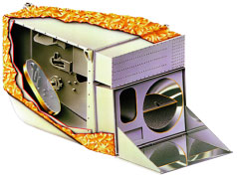
MODIS instrument highlights
NASA Terra, Aqua satellites
705 km polar orbits
Terra: launched 18 Dec 1999, descending (1030 local), Aqua: 18 April 2002, ascending (1330)
Sensor characteristics
Filter radiometer, 4 detector arrays, 36 spectral bands (0.41–14.385 µm)
Cross-track scan, 2330 km swath
Spatial resolution:
250 m (bands 1-2: VIS,NIR), 500 m (3-7: VIS-SWIR),
1000 m (8-36: MWIR-IR)
Onboard calibration:
Solar diffuser & Solar Diffuser Stability Monitor instrument, Spectral Radiometric Calibration Assembly instrument
(after S. Platnick)

Slide 49
MODIS operational cloud products
Pixel level products (Level-2)
Cloud mask,1 km, 250 m; U. Wisconsin (S. Ackerman, et al.)
Cloud top properties (pressure, temperature, effective emissivity), 5 km - U. Wisconsin (P. Menzel, et al.)
Cirrus reflectance (1.38 µm band) - Naval Res. Lab (B. C. Gao et al.)
Cloud optical & microphysical properties (optical thickness, effective particle size, water path, thermodynamic phase), 1 km - NASA GSFC
QA (quality assessment) included Gridded time-average products (Level-3)
Daily, 8 day, monthly composites containing all atmosphere products at 1˚ x 1˚ equal angle grid with various statistics and histograms, quick look imagery available at MODIS Atmosphere web site
After S. Platnick,
Notes:
QA some source of confusion - these are coded into a bit structure, e.g., thermo phase used in the tau, re retrieval are given in the first 3 bits of the 5th byte of the QA - not found in an “SDS”. Another ex.: tau confidence QA is bits 2,3 of the 3rd byte, and so on.

Slide 50
The 36 channel Moderate Resolution Imaging Spectroradiometer (MODIS) offers the opportunity
for multispectral approaches to cloud detection ; additionally, spatial uniformity measures add textural information that is useful in discriminating
cloudy from clear-sky conditions.
The ATBD document (provided to class) describes the approach and algorithms for detecting clouds (commonly called a “cloud mask”) using MODIS observations, developed in collaboration with members of the MODIS Science Teams (Ackerman et al., 1998).
The MODIS cloud screening approach includes new spectral techniques and incorporates many existing
techniques to detect obstructed fields of view.

Slide 51
DISCRIMINATING CLEAR-SKY FROM CLOUD WITH MODIS ALGORITHM THEORETICAL BASIS DOCUMENT (MOD35) MODIS Cloud Mask Team
Version 6.1
October 2010

Slide 52
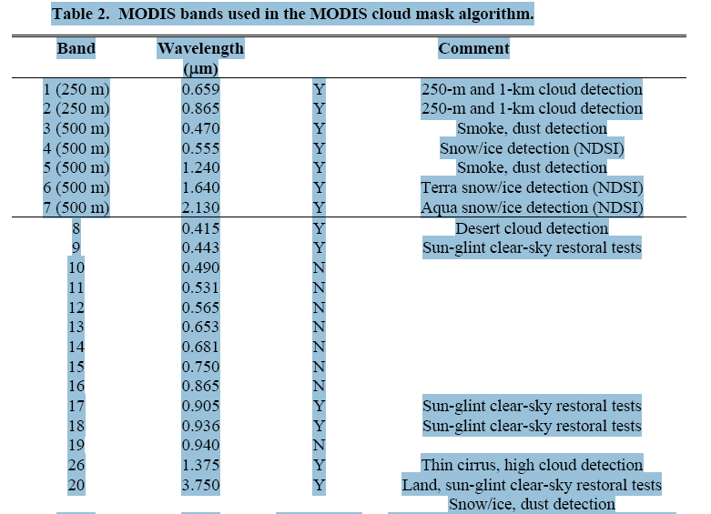

Slide 54
How much clouds ?
Global total cloud amount is about 0.68 (±0.03) when considering clouds with optical depth > 0.1.
This value increases to about 0.73 when including Sub-visible cirrus and decreases to about 0.56 for clouds with optical depth > 2. Oceans are covered by about 0.10–0.15 more cloudiness than land.

Slide 55
About 40%–50% of all clouds seen from above are high-level clouds, only about 15% (±5%) are midlevel clouds, and about 40% (±3%) are single-layer low-level clouds.
Global cloud amount and cloud temperature seem to be stable within the global mean interannual variability
(0.03 and 2 K, respectively).

