Slide 1
AOSC624
Class # 11: March 11, 2014
Microwave Remote Sensing
Note: Different units used for different
spectral regions:
Spectra | Energy expressed as a function of
Visible | Wavelength λ
Infrared | Wave number n = 1/λ
Microwave | Frequency ν=1/t, in GHz (since Hz is small)
Giga (G) denotes a factor of billion (10⁹)

Slide 2
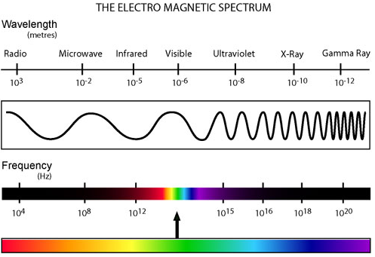

Slide 3
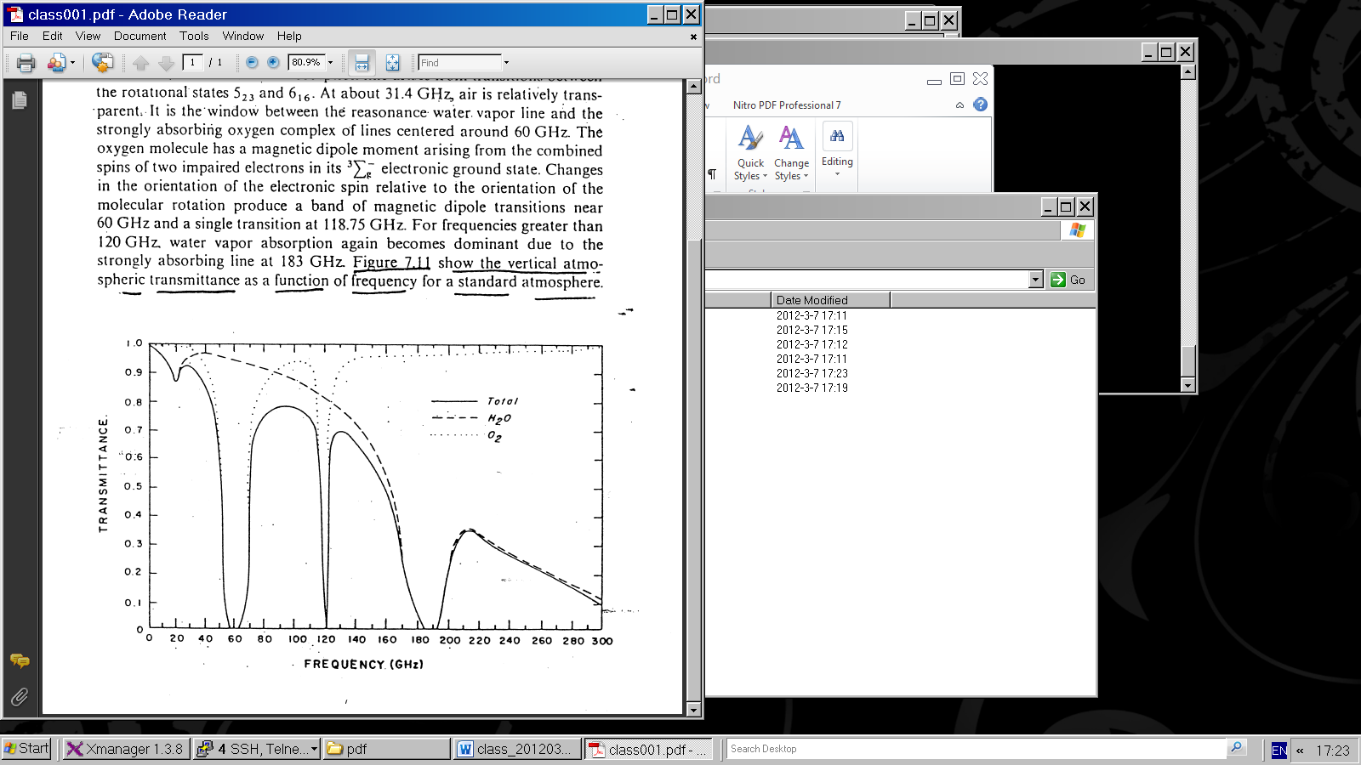
Absorption spectrum in microwave
Figure 1

Slide 4
Water vapor and molecular oxygen exhibit absorption lines in the microwave region.
Below 40 GHz (1 GHz = 10⁹ cycles/sec; note 1 cm = 30 GHz) only the weakly absorbing pressure broadened 22.235 GHz water vapor line is dominant.
At about 31.4 GHz, air is relatively transparent.
For frequencies greater than 120 GHz. water vapor absorption again becomes dominant due to the strongly absorbing line at 183 GHz. Figure 1 show the vertical atmospheric transmittance as a function of frequency for a standard atmosphere.

Slide 5
Special problem in the use of microwave from a satellite platform is the emissivity of the earth surface. In the microwave region of the spectrum, emissivity values of the earth surface range from 0.4 to 1.0. The emissivity of the sea surface typically ranges between 0.4 and 0.5, depending upon such variables as salinity, sea ice, surface roughness and sea foam. This complicates interpretation of terrestrial and atmospheric radiation with earth surface reflections.

Slide 6
In addition, there is a frequency dependence with higher frequencies displaying higher emissivity values. Over land, the emissivity depends on the moisture content of the soil. Wetting of a soil surface results in a rapid decrease in emissivity. The emissivity of dry soil is on the order of 0.95 to 0.97, while for wet bare soil it is about 0.80 to 0.90, depending on the frequency. The surface emissivity appearing in the first term has a significant effect on the brightness temperature value.

Slide 7
Spectral Intervals in (VIS, IR, MW) of interest in Remote Sensing
Several spectral regions are considered useful for remote sensing from satellites.
Windows to the atmosphere (regions of minimal atmospheric absorption) exist near
4 μm, 10 μm, 0.3 cm, and 1 cm.
Infrared windows are used for sensing the temperature of the earth surface and clouds, while microwave windows help to investigate the surface emissivity and the liquid water content of clouds.

Slide 8
The CO₂ and O₂ absorption bands at
4.3 μm, 15 μm, 0.25 cm, and
0.5 cm are used for temperature profile retrieval; because these gases are uniformly mixed in the atmosphere in known portions they lend themselves to this application. The water vapor absorption bands near 6.3 μm, beyond 18 μm, near 0.2 cm, and near 1.3 cm are sensitive to the water vapor concentration in the atmosphere.

Slide 9
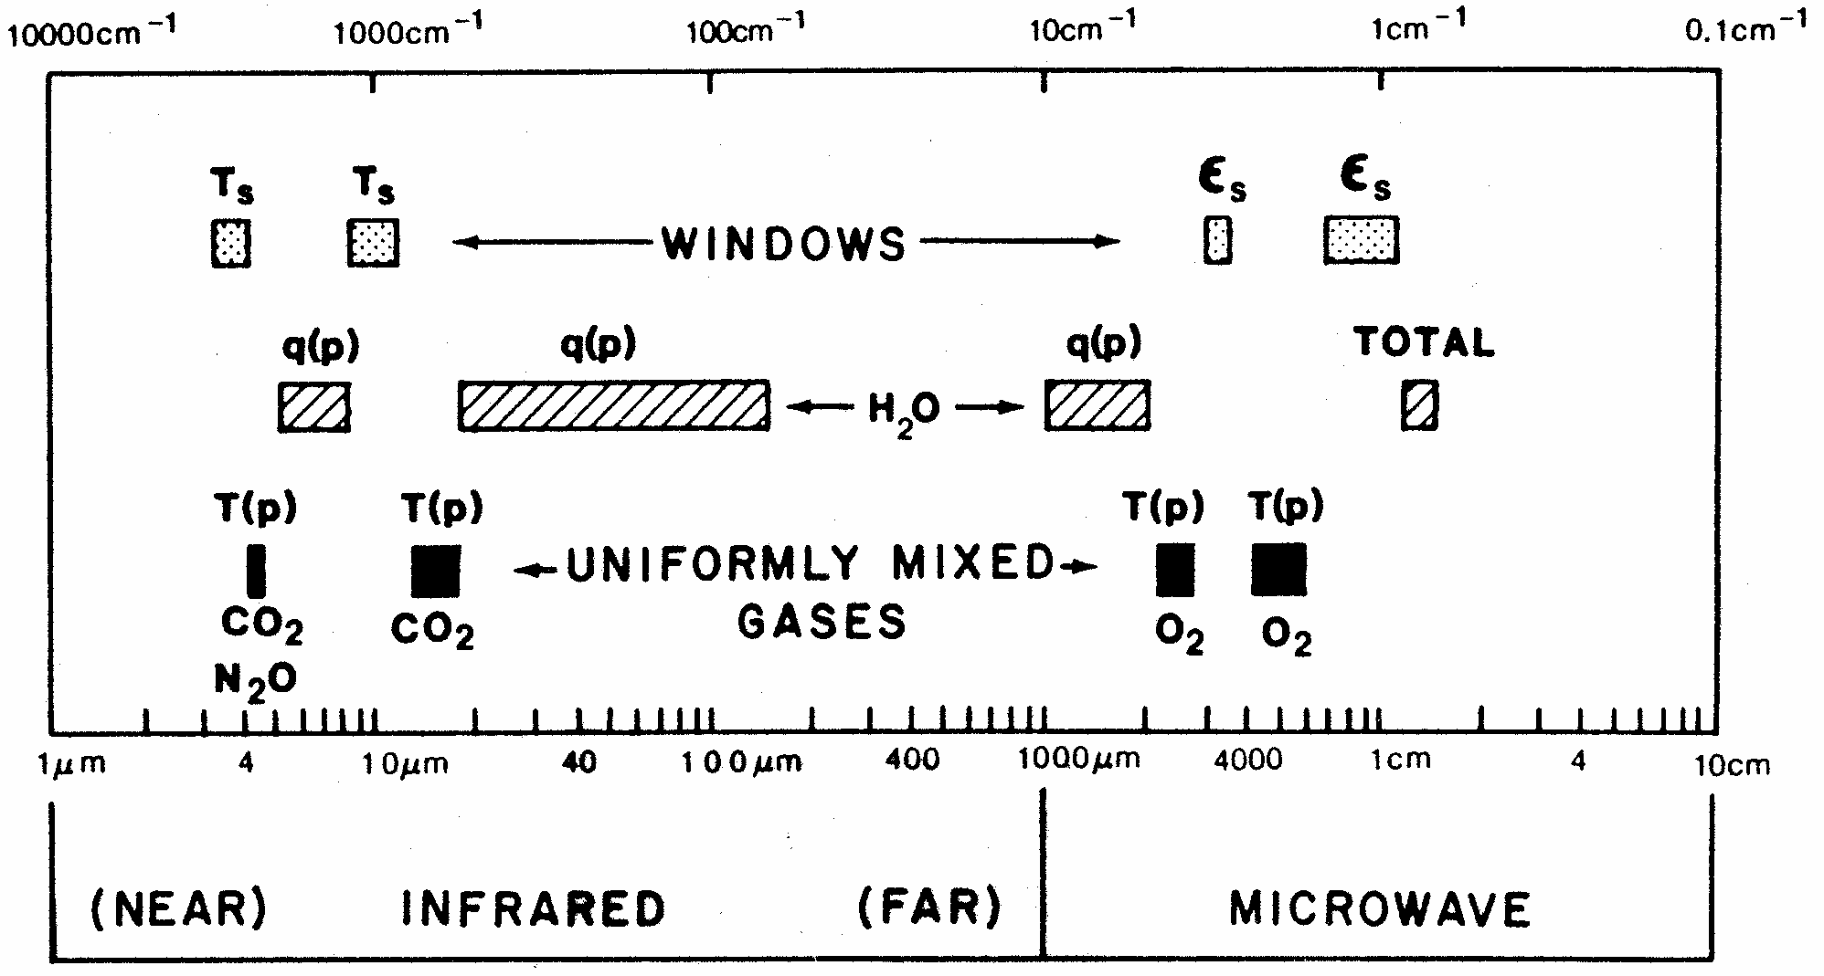
Spectral regions used for remote sensing of the earth atmosphere and surface from satellites. ε indicates emissivity, q denotes water vapor, and T represents temperature.

Slide 10
Microwave Instruments of focus
Passive = radiometers
Scanning Multichannel Microwave Radiometer, Special Sensor Microwave Imager, Sounder
SMMR, SSM/I, SSMIS, TMI, AMSU-A, B-true workhorses
Active = radar types
Scatterometers, SEASAT, ERS 1, 2, QuikSCAT; also workhorses—Currently Metop’ s ASCAT
Altimeters, TOPEX, Poseidon, Jason 1, 2, others.
Synthetic Aperture Radars, SARs RADARSAT 1, 2 , ENVISAT/ASAR , Tetra-SAR X
Precipitation /Cloud Radars, TRMM, CloudSat

Slide 11
Orbit considerations
Microwave emission is far out in the spectrum, wavelengths of mm to cm and longer, so detection requires large antennas (order of meters), therefore, we mount such instrument only on:
Polar orbiting satellites at 800 to 850 km height or in tropical orbits +/- 22 to 35 km. At the lower inclinations required for these orbits, the satellite cannot be in sun-synchronous orbit.
Active, i.e. radar type, MW instruments require much power, which also requires them to be in low earth orbit (800 km region).

Slide 12
Principles of MW radiometry
Radiometers are passive instruments, so they detect radiation emitted by Earth’s atmosphere or surface. The ocean is a weak emitter with emissivity of the order of 50%, so its black body temperature in most MW wavelengths is 150 K. It is therefore acting like a mirror for the atmosphere and clouds above. The atmosphere has a strong emission line around 22GHz, so that frequency is used to measure the TOTAL COLUMN OF WATER VAPOR in he air. 19 GHz and 37 GHz are sensitive to the “Mie scattering” by cloud droplets, so these frequencies are used for TOTAL LQUID WATER content, and 85 GHz receives SCATTERING FROM ICE PARTICLES at the top of clouds, indication of possible rain.
The solid Earth is a strong emitter, so atmospheric signals cannot be separated out over land

Slide 13
Variables obtained
Atmospheric Water Vapor and Cloud Liquid Water—first as total in the column, later as profiles of these quantities and interpreted in terms of different cloud particle sizes and precipitation size drops or even ice particles (through microwave scattering).
Multi-frequency instruments allow the various signals to be separated. The ocean which works as a background must be accounted for using special frequencies for effects of
Sea Surface Temperature, SST, and Wind.

Slide 14
Detection of MW radiation
Signals are received in so called “horns”, which have rectangular openings. The electro-magnetic radiation is received in horizontal or vertical planes, which means that the radiation is either horizontally or vertically polarized. The same is true for radiation sent out by a MW emitter that also can receive – a radar.

Slide 15
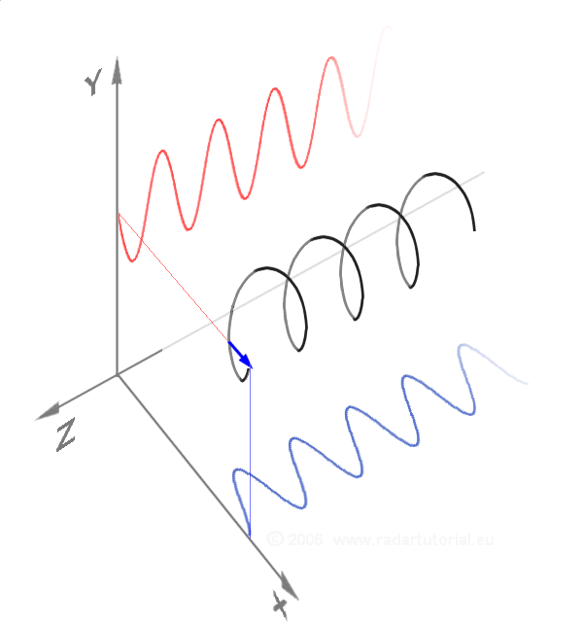
Vertically, horizontally and a circularly polarized wave as a sum of the two components

Slide 16
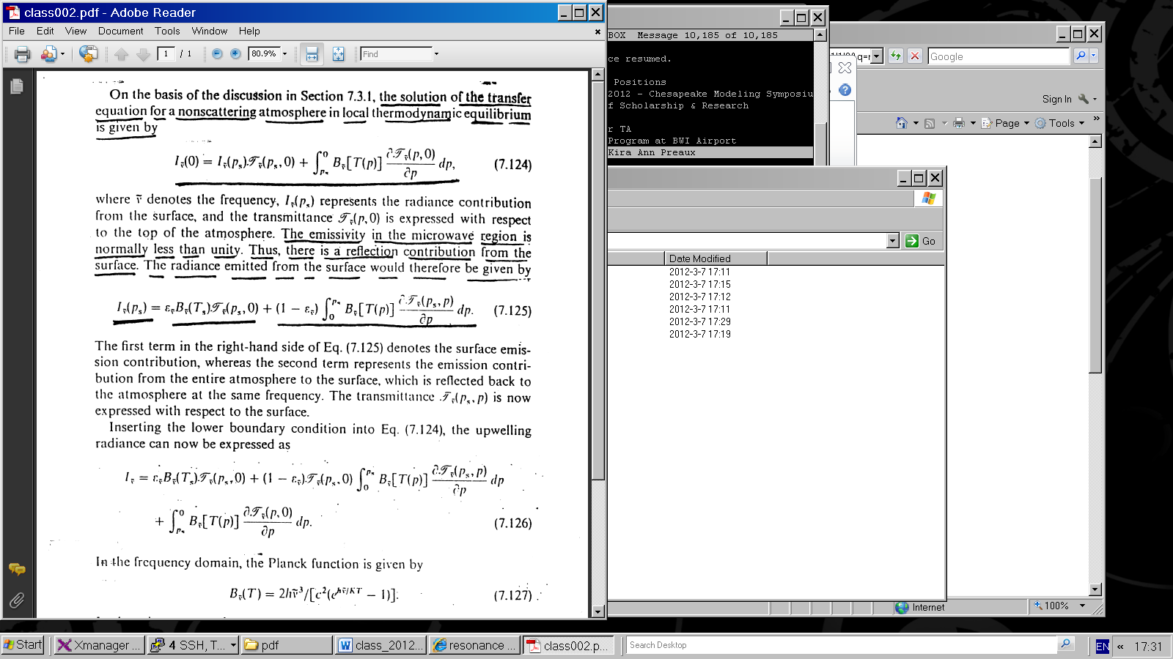
On the basis of previous discussion the solution of the transfer equation for a non-scattering atmosphere in local thermodynamic equilibrium is given by
(1)
Where denotes the frequency
I _{ṽ} (p_{s})
represents the radiance contribution from the surface and the transmittance is expressed with respect to the top of the atmosphere.

Slide 17
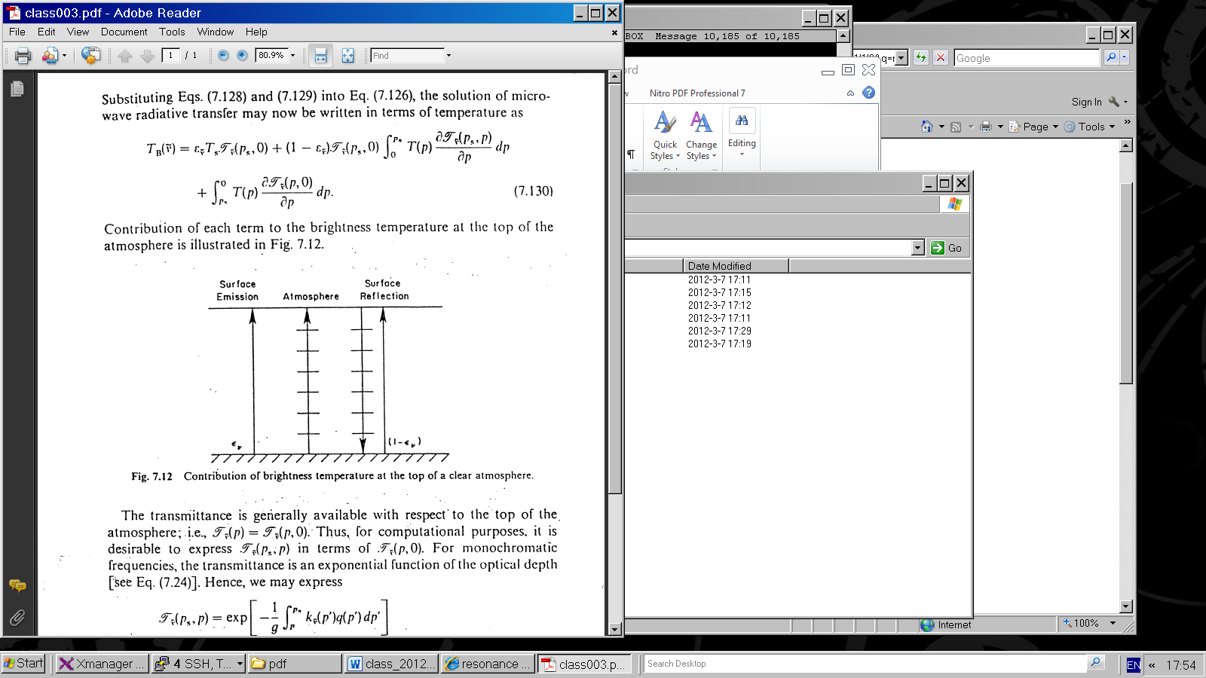
Since the emissivity in microwave is less than 1, there is a reflection contribution from the surface.
Contribution of each term to the brightness temperature at the top or the atmosphere

Slide 18
The radiance emitted from the surface is given as:
(2)
The first term in the right-hand side denotes the surface emission contribution, whereas the second term represents the emission contribution from the entire atmosphere to the surface, which is reflected back to the atmosphere at the same frequency.

Slide 19
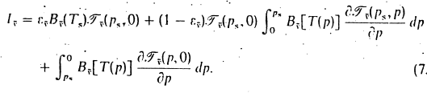
The transmittance is generally available with respect to the top of the atmosphere, namely, T _{ṽ} (p, 0).
For computational purposes it is desirable to express
T _{ṽ} (p_{s}, p) in terms of T _{ṽ} (p, 0) .
The transmittance T _{ṽ} (p_{s}, p) is now expressed with respect to the surface.
Inserting the lower boundary condition into Eq. (1) the upwelling radiance can now be expressed as:
(3)

Slide 20
Contribution of each term to the brightness temperature at the top of the atmosphere

Slide 21
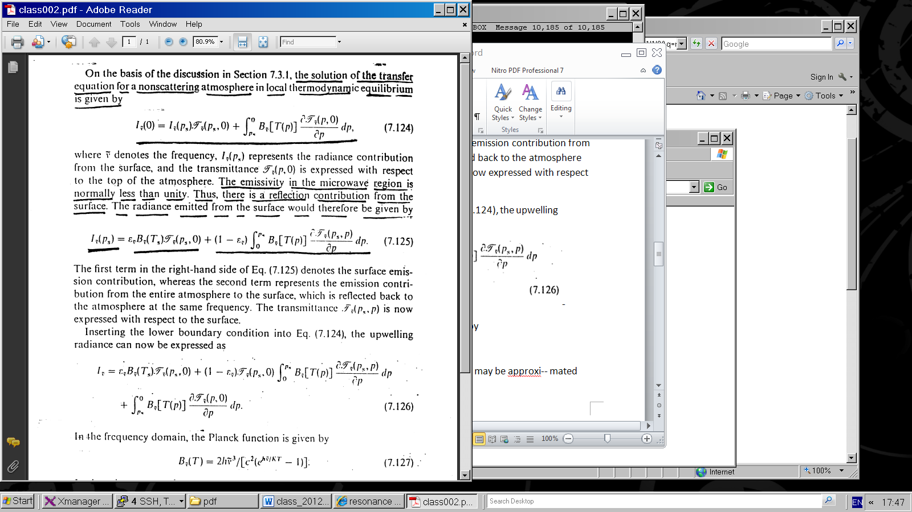
In the frequency domain, the Planck function is given by
(4)
In the microwave region h ṽ /K T« 1,
the Planck function may be approximated by
(5)
Thus, the Planck radiance is linearly proportional to the temperature, which is referred to as the Rayleigh-Jeans Law.
Analogous to the above approximation, we may define an equivalent brightness temperature T_{B} such that:
(6)

Slide 22
Substituting eqs. (5) and (6) into eq. (3), the solution of microwave radiative transfer
may now be written in terms of temperature as:
(7)

Slide 23
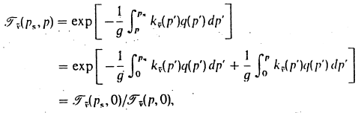
For monochromatic frequencies, the transmittance is an exponential function of the optical depth , hence, we may express
(8)
where T _{ṽ} (p, 0) is the the transmittance or the entire atmosphere, is a constant value, so:

Slide 24
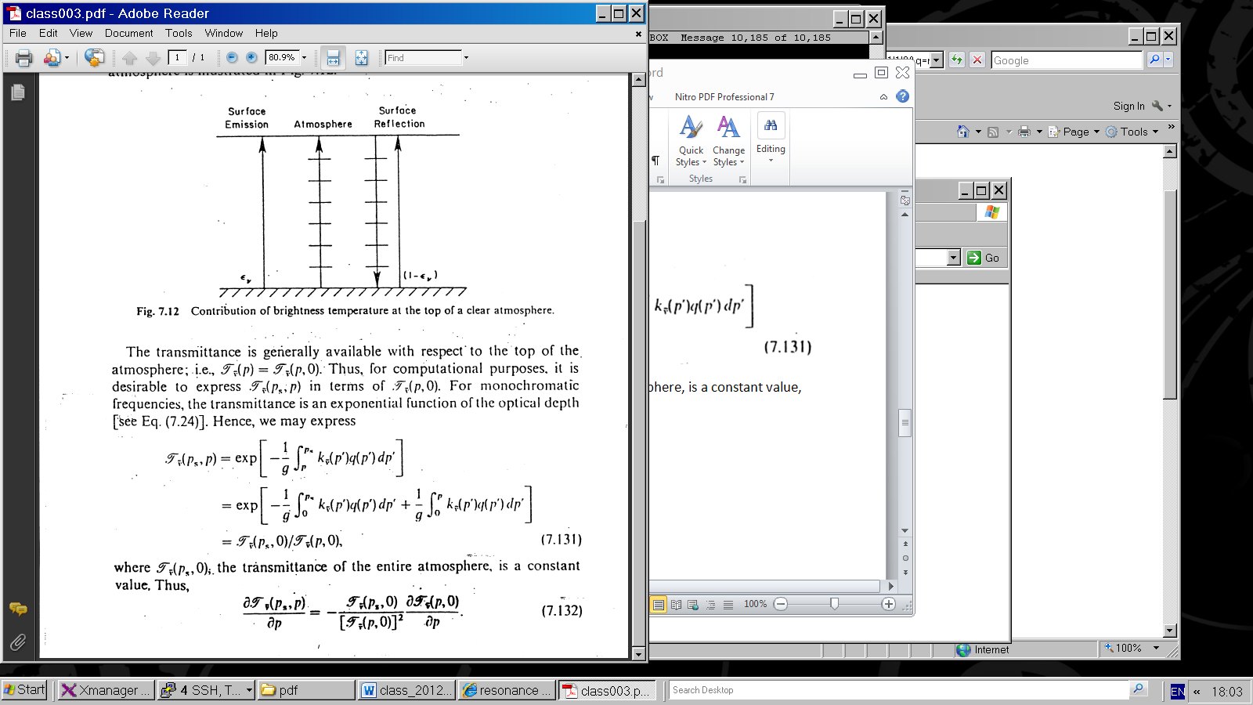
(9)
Substituting eq. 9 into eq. 7, rearranging terms and letting (p, 0) = (p)

Slide 25
Determination of Planetary Radiation Budget
Angular Distribution Models (ADM) Models
Global Radiation Budget
Climate Sensitivity to Clouds
Cloud Radiative Forcing
Results from Radiation Budget Missions (ERBE; CERES)
Special Programs to Better Understand Clouds (ARM)

Slide 26
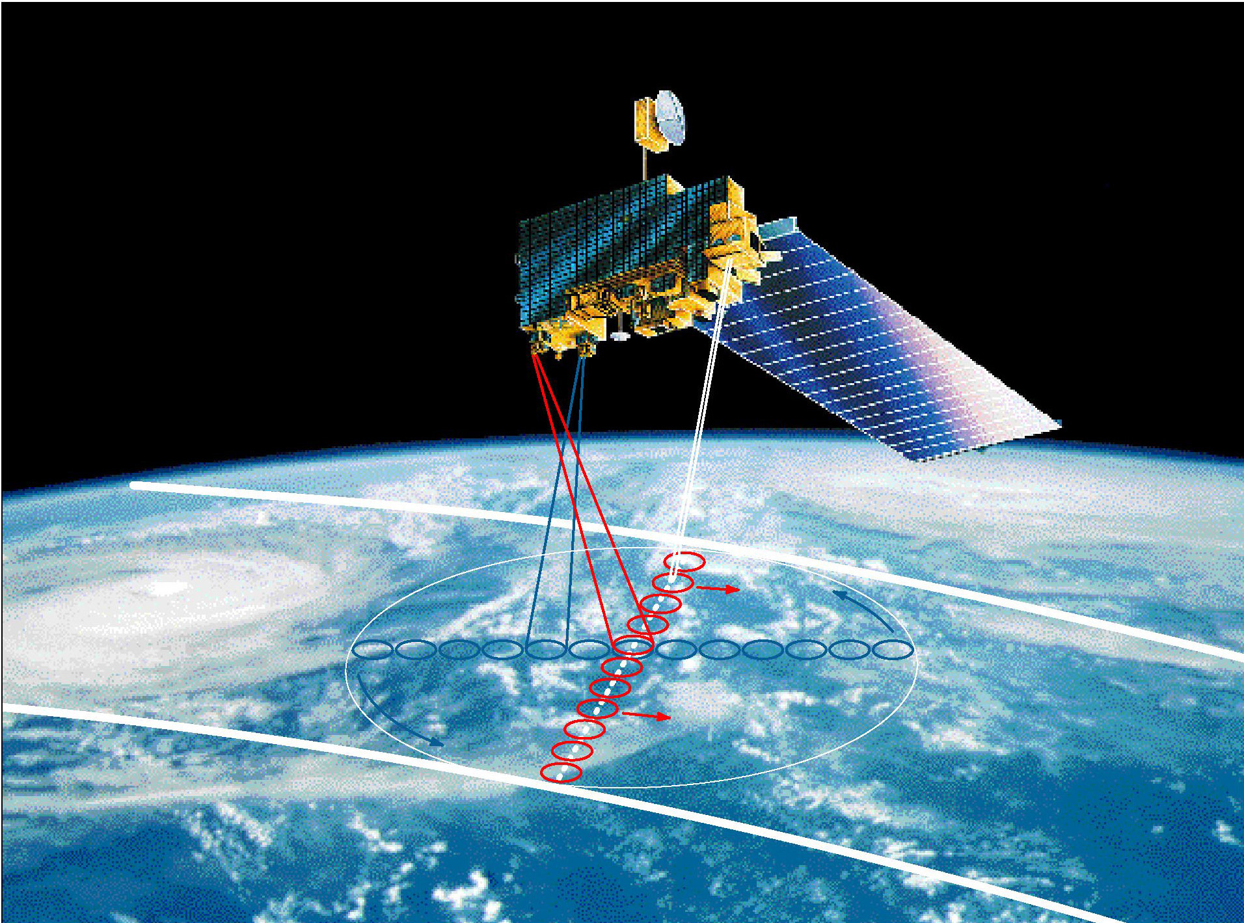
Clouds and the Earth’s Radiant Energy System
Is the global energy budget changing?
Effect of clouds on the radiation budget.

Slide 27
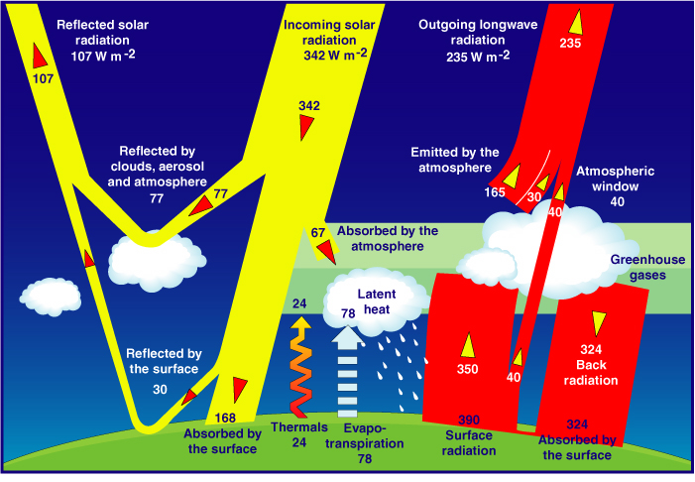
Satellites serve as source of information on the Global Energy Budget
As estimated from models (Kiehl and Trenberth, 1997)

Slide 28
Effect of Clouds
Clouds interact both with solar radiation, in the shortwave region of the spectrum, and with the radiation thermally emitted by the earth and atmosphere, in the longwave region.
Clouds reduce the net absorption of solar radiation by increasing the earth albedo, and they decrease the loss of terrestrial radiation to space by decreasing the effective radiative brightness temperature of the earth.

Slide 29
The effect of cloud cover on solar radiation depends primarily on the thickness of the cloud, but also it depends upon particle size and phase.
The longwave effect depends primarily upon cloud top temperature, which is a function of cloud height, and, for thin clouds, upon emissivity, which is related to optical thickness.

Slide 30
The solar radiation effect and the thermal emission effect are in opposite directions as far as net radiation at the top of the atmosphere is concerned.
Each effect, by itself, is large, but the combine effect is relatively small and will depend significantly on the cloud-free profile of atmospheric temperature, humidity, and aerosols, and upon surface temperature and optical properties.
The net effect is the difference of two large terms; led to a debate in the 70s on the role clouds play in the climate system.

Slide 31
Early studies of sensitivity to cloud amount
One of the early attempts to quantify the effect of clouds on the earth’s radiation budget is described in a technical report by London (1957), whose results were widely cited prior to satellite measurements. Using temperature and cloud cover observations for the Northern Hemisphere, he computed solar and infrared fluxes at the top of the atmosphere with and without clouds. He found that clouds have a net energy input primarily during the spring and summer seasons, with an annual average effect of ~35 W/m*2 a result not so different form modern satellite-based estimates to be discussed .

Slide 32
Later, Budyko (1969) used observations of the temperature (T_{s}) and cloud amount (A_{c}) compiled in Budyko (1963) to calculate outgoing infrared flux at the top of the atmosphere (F) and to derive a relationship based on regression:
  F = 223 + 2.2T_{s} - (48+1.6T_{s})Ac
where F is in W/m⁻² and T is in ⁰C. For a mean global surface temperature of 288 K, he finds the sensitivity of the infrared flux to clouds to be
δF/δA_{c} = -72 W/m⁻².

Slide 35

For the values adopted by Schneider (1989)
a_{c} = 0.5 and α₀ = 0.12
The solar radiation sensitivity coefficient is -130 W/m⁻²
(Here the results are normalized to the solar constant of
1368 W/m⁻²).
The net sensitivity to cloud amount is the difference between the
solar and infrared sensitivity coefficients:
which for Schneider’s model is -55 W/m⁻²

Slide 36
Climate Sensitivity
Radiative Effect at the Top of the Atmosphere
For a 50% Increase in Climate Parameter
Cloud
Height
High Cloud
Amount
Particle Size
(Low Clouds)
Stratospheric
Ozone
Carbon
Dioxide
Radiative
Effect
(W/m²)
Low Cloud
Amount
Cloud Optical
Depth
Indirect Aerosol
Forcing
Direct Anthropogenic
Aerosol Forcing
Land Albedo
Low clouds
COD

Slide 37
CLEAR-SKY AND CLOUD SENSITIVITY FROM 19 GCMS
Climate models are inconsistent in predicting the effects of clouds on climate
(Cess et al., 1990)

Slide 38
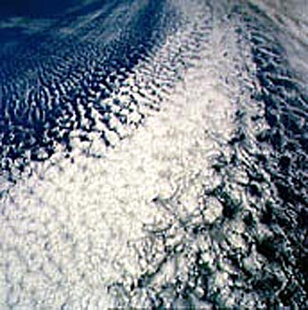
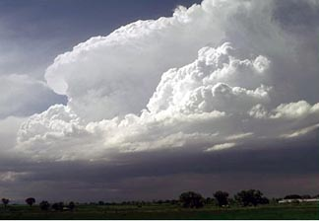
Due to their complexity, clouds are difficult to model
Satellites are useful for identifying clouds.

Slide 39
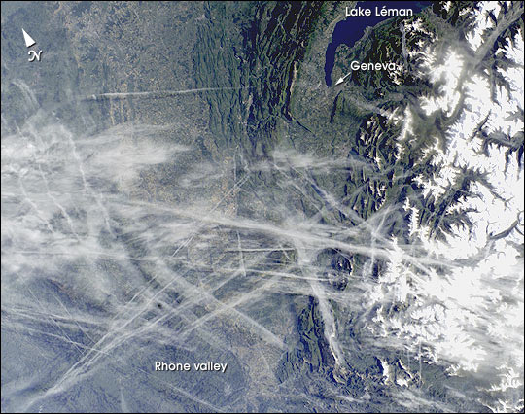
“Man made” clouds: Airplane Tracks

Slide 40
Over the last dozen years, NASA has launched a series of satellites – known collectively as the Earth Observing System (EOS) – that has provided critical insights into the dynamics of the entire Earth system: clouds, oceans, vegetation, ice, solid Earth and atmosphere (see next slide). Now NASA is helping to create a new generation of satellites to extend and improve upon the Earth system data records established by EOS.

Slide 41
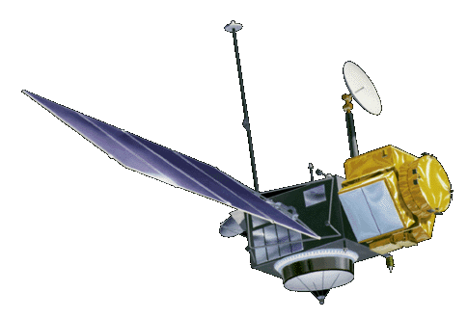


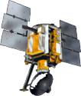
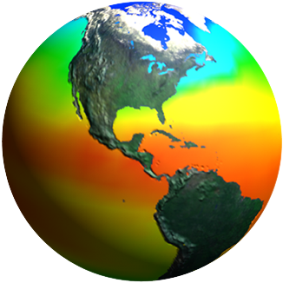
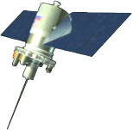
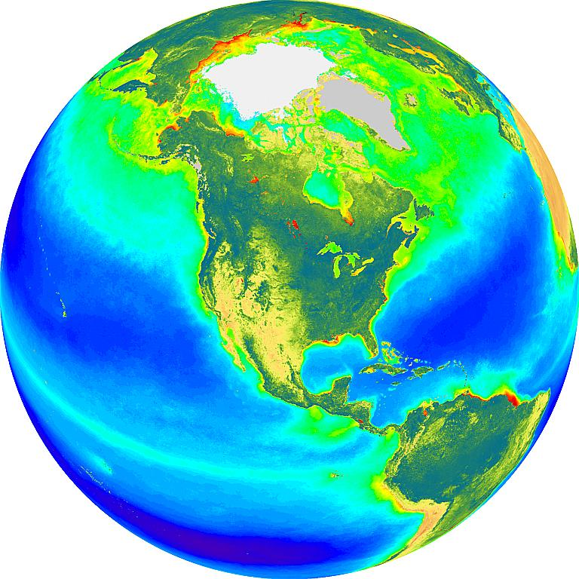
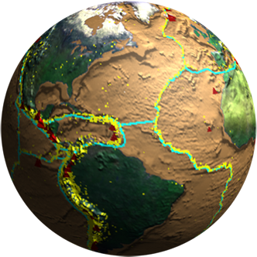
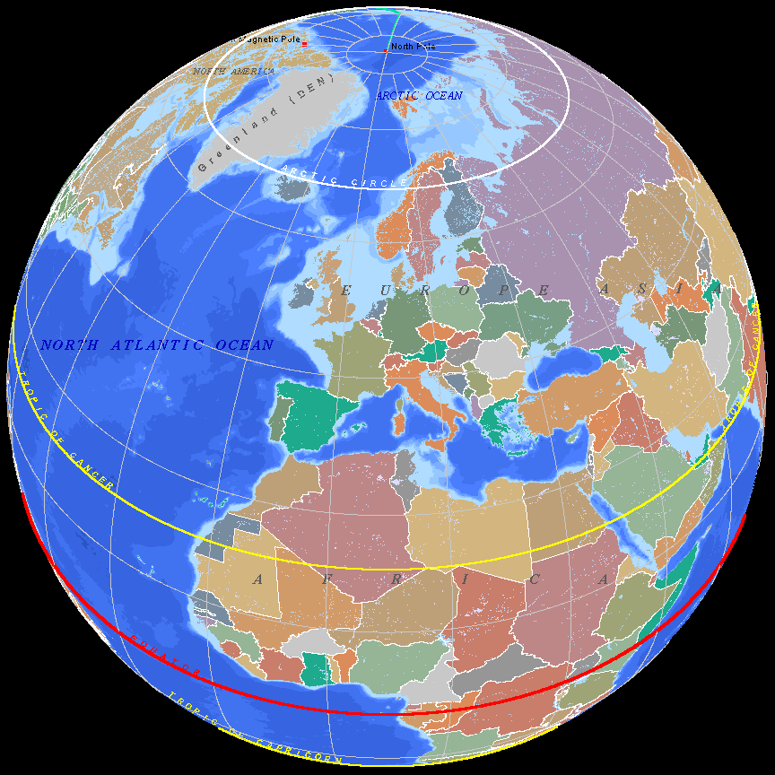
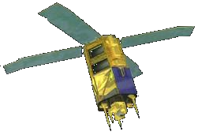
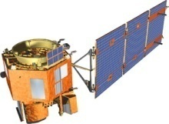
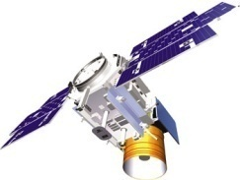
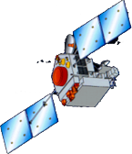
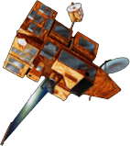
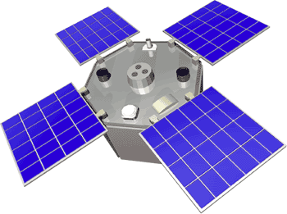
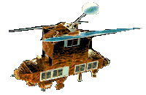
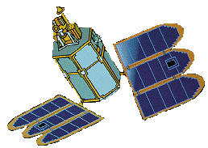
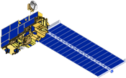
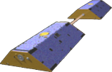
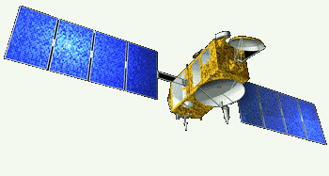
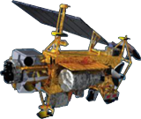
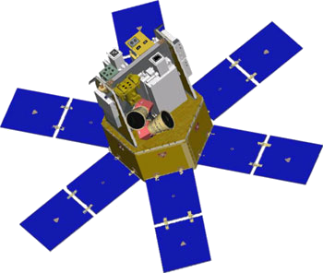
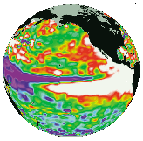
Spaceborne Earth Observation Systems
TOPEX/Poseidon
Landsat 7
SORCE
Aqua
QuikScat
Sage
EO-1
SeaWiFS
IceSat
TRMM
SeaWinds
ACRIMSAT
ERBS
Toms-EP
Grace
Jason
Terra
UARS

Slide 42
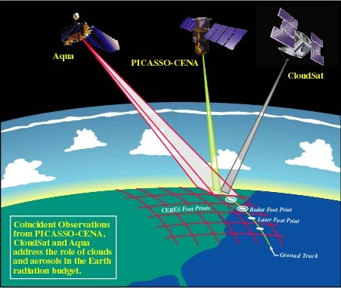
A configuration of several satellites with complimentary capabilities is considered as ideal for cloud research. In particular, the newer systems with active capabilities.
Aqua
CALIPSO
CloudSat

